Slide 1
BERD@NFDI Agile Software Engineering of Research Data Management Infrastructures
March 2024
Mahmoud Hassan (ZBW – Leibniz Information Centre for Economics)

Slide 2
Agenda
Introduction
Quick demo
Requirement gathering and development
Cloud infrastructure (IONOS)
BERD platform development
Deployment
Pros and Cons

Slide 3
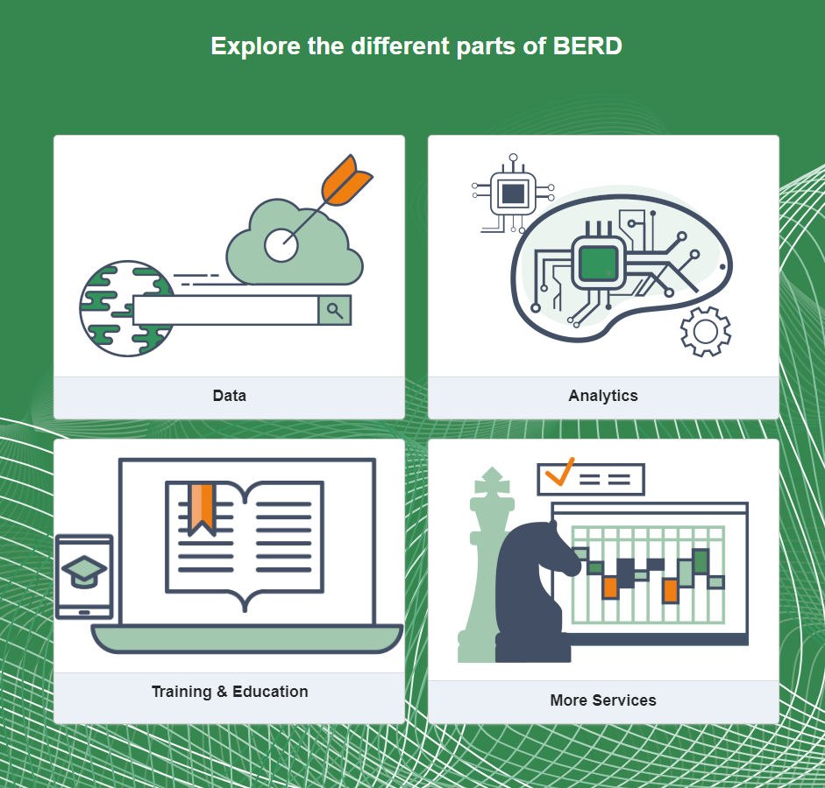
Business Economics and Related Data (BERD)
A National Research Data Infrastructure (NFDI) consortium which one of its goals is to build a powerful platform for collecting, processing, analyzing and preserving Business, Economic and Related Data all in one place.
BERD Cloud-based Platform
Data Portal as community service
Marketplace for data from companies
Connect publications and data
Facilitate learning and training (BERD Academy)
Services/Tools portal
Notes:
The BERD@NFDI consortium aims to establish a research data management platform for economics within the German National Research Data Infrastructure (NFDI).

Slide 4
Beta BERD Platform - Demo
Demo
Notes:
The BERD@NFDI consortium aims to establish a research data management platform for economics within the German National Research Data Infrastructure (NFDI).

Slide 5
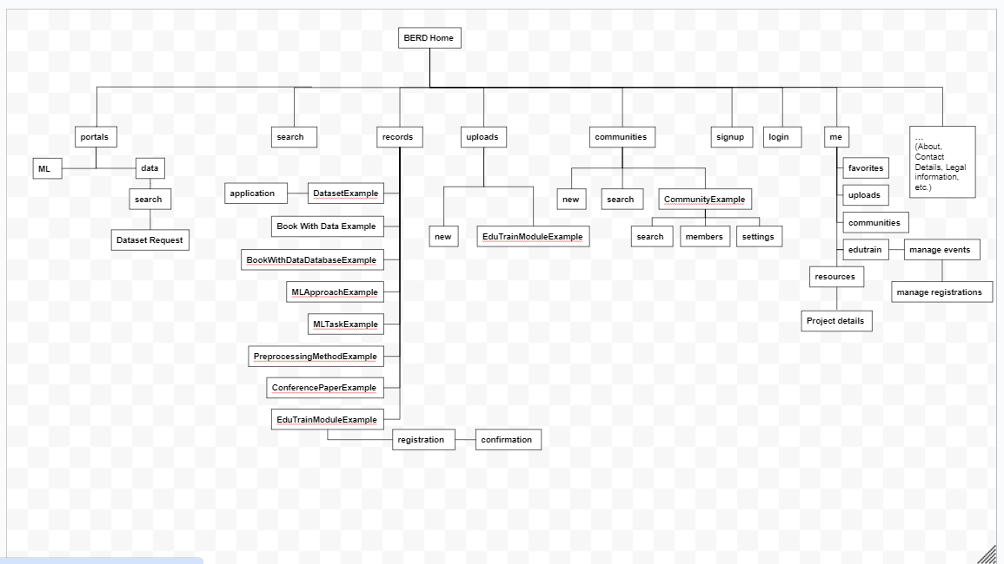
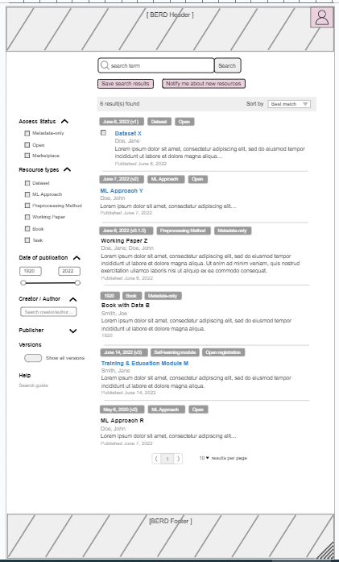
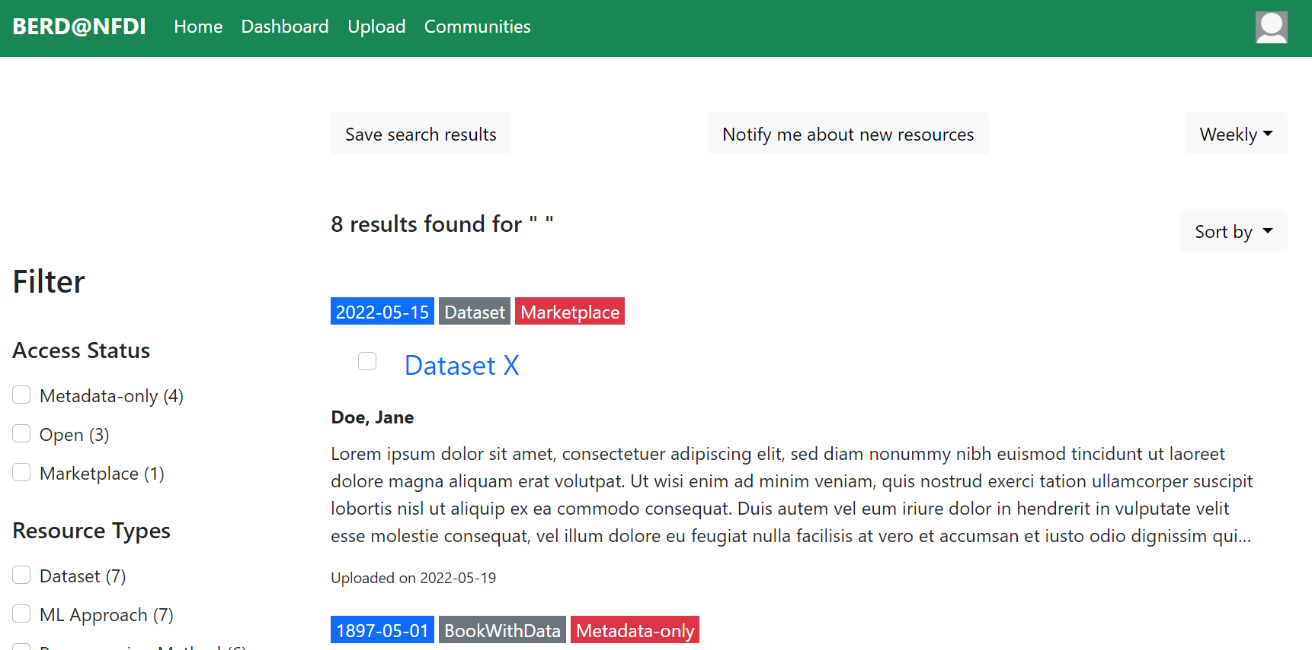
Requirement gathering and development
Gather requirements and discuss use cases
Creating wireframes via google drawings and mockups via interactive non functional interfaces
Development of the prototype via sprints in Jira
Notes:
This results in an agile, user-driven requirements engineering process.

Slide 6
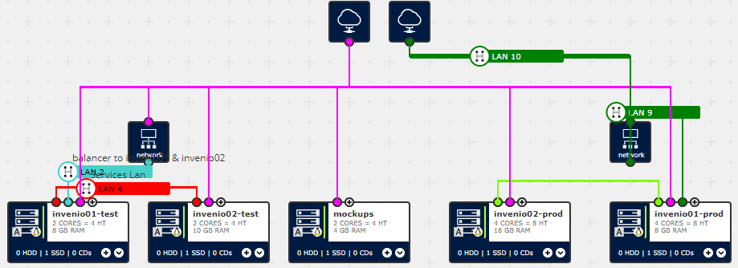
Cloud-based Research Data Management
Preference for Cloud Infrastructure provider compared to Hosting Model
Decision for Cloud Infrastructure Provider IONOS
Notes:
For scalability and maintainability while remaining relatively affordable and for legal reasons

Slide 7
BERD platform development
InvenioRDM (v12 beta) A research data management repository platform :-
Flexible data model (Extensible Data-cite based model)
OpenSearch as open source search engine
Modular and domain-driven architecture
Fine-grained search capabilities
Reuse of the concept of communities for BERD purposes (ex. quality checking ..etc)
Ex. Zenodo
Battle tested modules & delivers features required by our community (i.e user overview & removal..)
Notes:
Its modular and domain-driven architecture, characterized by distinct layers encompassing data access, service, and presentation
Communities is a collections of records/resources that share certain metadata/characteristics

Slide 8
BERD platform development
invenio-administration
invenio-accounts
invenio-user-profiles
invenio-records-resources
Invenio-app-rdm
BERD platform Extension
invenio-vocabularies
….
invenio-rdm-records
InvenioRDM
Notes:
adaptation and extension of this framework reflecting the specific needs of the BERD user community

Slide 9
BERD platform development
Postgres
OpenSearch
Search
Index
Login,
Sign up
InvenioRDM
BERD extension
Open Data Portal
Data
Upload
BERD data model
Administration
Business, Economic and Related Data
REST API
Crawlers(s)

Slide 10
Deployment
Via Gitlab :-
Merge requests are created per feature/bug/ticket.
Committing code triggers testing and build stages in the Gitlab pipeline.
Once approved, it is merged to the main branch which deploys automatically to a Staging server.
After testing on staging and confirming that everything is working
It is deployed to the (Beta) Production server via protected tags

Slide 11
Testing and deployment pipeline
Gitlab runner
Code base
merges
Main branch
triggers
Test
Build
Deployment
via
Protected tags
automatically
IONOS (beta prod server)
IONOS (Staging server)

Slide 12
Pros and Cons
Pros :-
Extensible data model for research data
Modular and highly customizable
Modules are battle tested for better security
Features well developed and reusable
Cons :-
Heavy modifications led to partially adapting modules
Certain level of complexity requires to be maintained
Documentation may not be up-to-date
Notes:
We discuss the advantages and drawbacks of this flexibility, including code complexity and technical debt, and how we address these issues through quality assurance measures like comprehensive testing and GitLab-based deployment.

Slide 13
Beta version is out :- https://berd-platform.de/
Comments/suggestions :- mhassan@zbw-workspace.eu
Thank you!

