Slide 1
WestAI Service Center
John Arnold – RWTH Aachen University
arnold@itc.rwth-aachen.de
contact@westai.de
westai.de

Slide 2
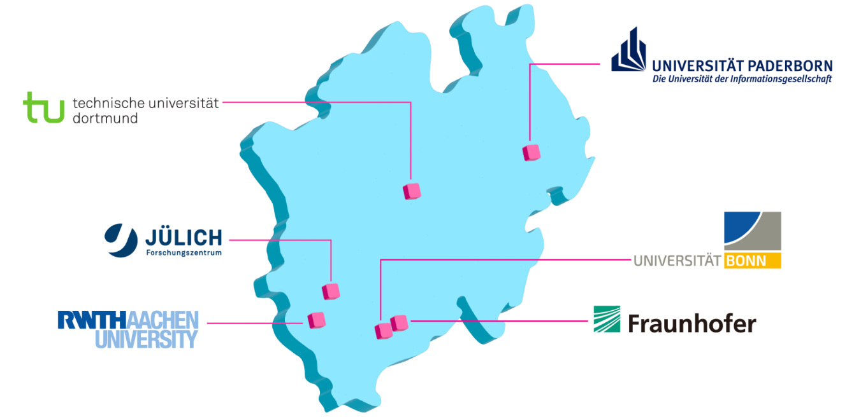
Goal and Partners of WestAI
Support researchers and industry partners in adapting AI/ML methods into their workflows by providing computing resources, AI models, and consulting services
10.000 GPU-h for free
Free AI Consultation
AI Trainings

Slide 3
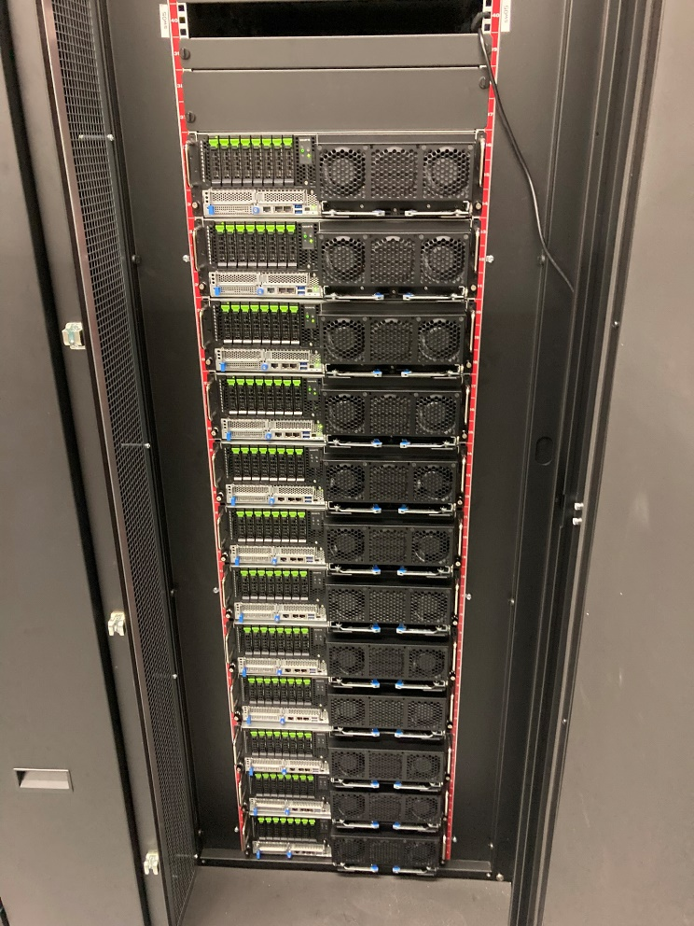
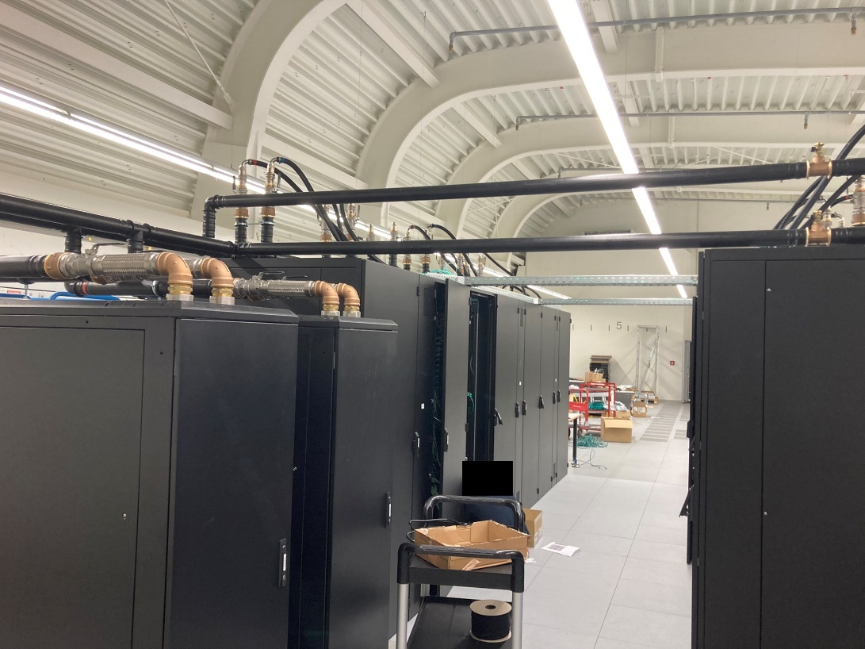
Claix-2023

Slide 4
Hardware
CLAIX-2023 – Start: Q1 2024
Start: Q1 2024
52 Compute Nodes†
2x 48 Cores, 512 GB DDR5
4x H100 GPUs*
16 Compute Nodes†
2x 48 Cores, 512 GB DDR5
4x H100 GPUs*
15 Nodes for WestAI
Isolated: Exclusive for WestAI
†Infiniband Network
*Full NVLINK, 94 GB HBM2e

Slide 5
Access and Software @ RWTH
Batch Mode
Login via SSH
SLURM
Apptainer (Singularity)
Module System
Interactive Mode
Jupyter Hub / Lab
Web Interface
Predefined Containers

Slide 6
Application Process
Academia or Businesses*
*with academic PI
Application
Description of project
Short technical overview
1 Page
JARDS
(Joint Application, Review and Dispatch Service)
Choose:
contact@westai.de
WestAI@RWTH
WestAI@FZJ
Resources: 10 000 GPU-h for 1 year
Access Governance Board
Formal review
Decision of approval

Slide 7
Consulting
For all experience levels
From initial feasibility talks to prototypes to finished solutions
You bring technical expertise and data, we provide AI expertise
Trainings

Slide 8
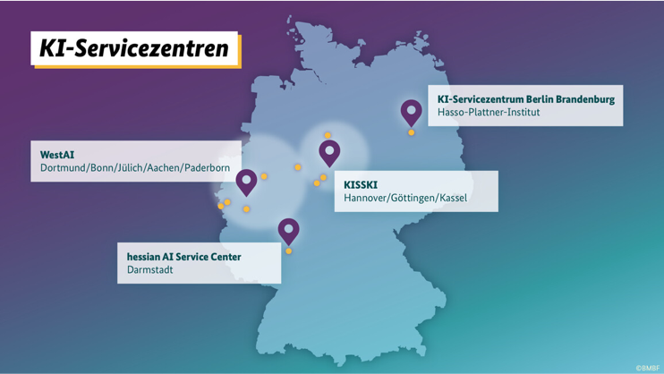
AI Service Centers

Slide 9
Thanks for listening! If you have any questions: arnold@itc.rwth-aachen.de contact@westai.de westai.de

