Slide 1
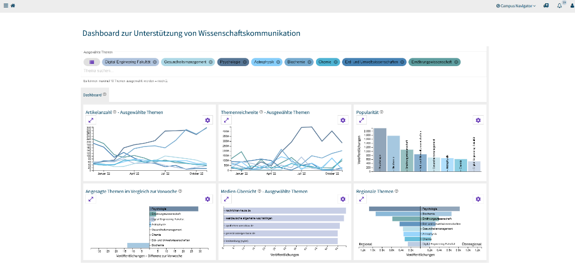
WiKoDa
A dashboard to enhance science communication
Jan Bernoth

Slide 2
Motivation

Slide 3
Areas of activity in academia
Education
Research
Academic Self-governance

Slide 4
Knowledge Transfer seems little
Academic Self-Governance
Elective duties in university bodies
Being part of university commission
Organizing in scientific association
Administrative services
Organizing institutes or faculties
Knowledge transfer and public engagement

Slide 5
Knowledge and Technology Transfer
Society
Research Results
LIE
present

Slide 6
Knowledge and Technology Transfer (modern approach)
Society
Research Results
Communicate about

Slide 7
Science Communication (definition)
„the use of appropriate skills, media, activities, and dialog to produce one or more of the following personal responses to science
Awareness
Enjoyment or other affective responses
Interest
Opinions
Understanding of science, its content, processes, and social factors.“
Source: Burns, T. W., O'Connor, D. J. y Stocklmayer, S. M. (2003). Science Communication: A Contemporary Definition. Public Understanding of Science, 12(2), 183–202. https://doi.org/10.1177/09636625030122004

Slide 8
How can an analytical dashboard support science communication?

Slide 9
Path to construct a user-centric application
User-centric Workshops/Interviews
Interaction-centric Evaluation

Slide 10
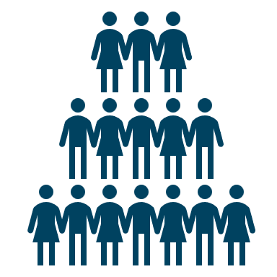
Data source for science communication: press review
To: Profs, Group Leader, Institute Administrations, Project Coordinators

Slide 11
Goal: Create a dashboard that provides everyone at the University of Potsdam with an overview of their research interests as discussed in the media.

Slide 12
Architecture
Topic A: Create analytics which are supportiv for Science Communication
Views Analytics
Dashboard
Calls data
DB
API (Python/Django)
Extractor
Stores and recalls data
Labels articles
Topic B: Solid Classification
Simulator
Classifying Algorithms

Slide 13
Characteristics of the simulator
Creates enough data to let scientists explore the functionalities
Build upon scenarios to analyze motivational aspects science communication, e.g. by a high public attention to a scientific topic
Test and recreate visualization

Slide 14
Data Simulation
Distribution in media
Distribution of topics
Title
Release date
Reach

Slide 15
WiKoDa

Slide 16
Evaluation of and in the simulation

Slide 17
Quantative Questionnaire Study
Assessment of Experience in Science Communication
Goals in Science Communication
Usage of Communication Channels
Task to full in the dashboard and rate how easy it was to fulfill
Rating User Experience, via Scales of UEQ+
Quality of Content
Trustworthiness of Content
Trust
Perspicuity (Easy to learn)
Usefulness
Clarity
Rating the dashboard in different given aspects
16 Participants

Slide 18
Next step: Analyze evaluation data

Slide 19
Thank you for your attentention!
Jan Bernoth
Jan.bernoth@uni-potsdam.de
ORCID: 0000-0002-4127-0053

Slide 20
How well is the simulation perceived?

Slide 21
Toolchain to create an analytical dashboard
Extract Text from Newspaper Articles
Store it in a backend database
Classify Text and label disciplines based on research at UP

Slide 22
Idea workshop for analytical components

