Slide 1
First Results on the Security Culture Survey
de-RSE’24, 05. – 07.03.2024, Universität Würzburg

Slide 2
About Me
German Aerospace Center (DLR)
Research in Aeronatuics, Space, Transportation, Energy, Security, and Digitalisation
50+ Institutes, 30+ Sites in Germany, 10 000+ Employees
Sustainable Software Engineering
Group within „Institute for Software Technology“
„Classical RSE work“
Guidelines: rse.dlr.de
Tools + Trainings
Support + Consulting
Michael Meinel
Research Software Engineer
Helping Developers since 2004
M.Sc. IT-Security (still) in progress

Slide 3
First, some History!

Slide 4
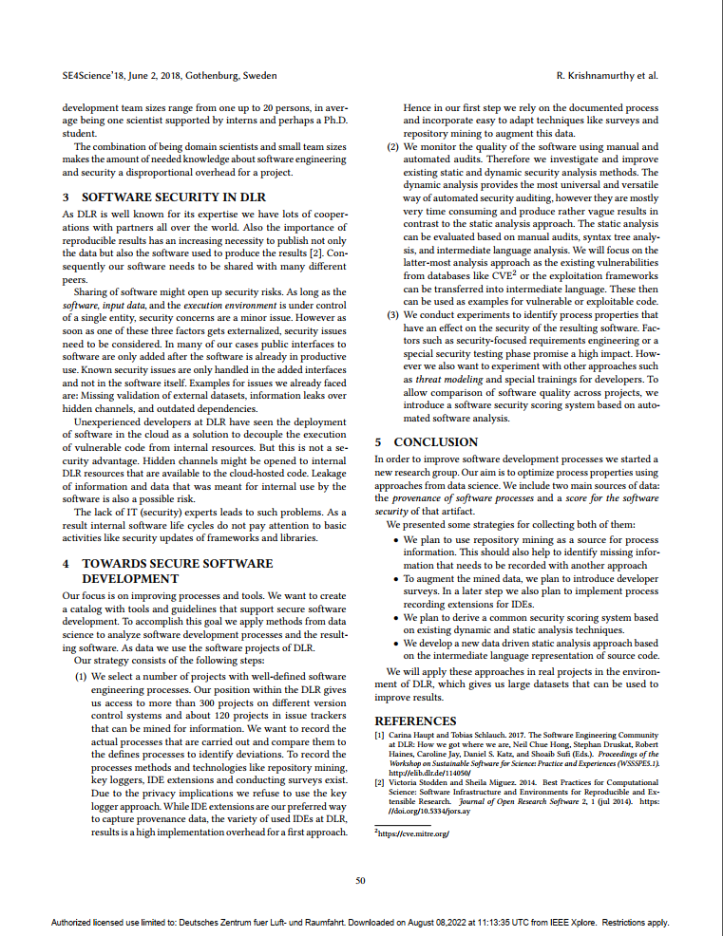
DLR Secure Software Engineering 2018 ACM/IEEE 1st International Workshop on Security Awareness from Design to Deployment
Position and Vision Paper
Published in 2018 at ICSE Workshop „SEAD’18“
Possible Collaboration ideas with newly founded Institute for Data Science (DW)
Data driven, automated security audition
Adoptation of Software Engineering methods and processes to increase security
DW is now operational
Full Paper:
https://doi.org/10.23919/SEAD.2018.8472854

Slide 5
Revisiting Secure Software Engineering For Research Software
RSECon UK 2022,
Michael Meinel, Martin Stoffers – German Aerospace Center (DLR)

Slide 6
Prof. Dr. Michael Felderer joins the DLR
New head of institute since beginning of 2023
Brings in new topics:
Explicit RSE Research
Security Topics
…
Comes with a broad network

Slide 7
Getting attention…
Subject: Secure Software Engineering for Research Software
Michael,
I just listened to your talk from the RSECon2022. I found it very interesting. I have interacted with a number of people from DLR in the past including Carina Haupt, Tobias Schlauch, and Stephan Druskat.
A brief introduction of me. I have been working with Software Engineering for Research Software for a long time. I have been one of the primary organizers of the SE4Science workshop series (https://se4science.org/workshops/). I am also on the Steering Committee for the US-RSE association. I have done a lot of research on adapting various software engineering practices for appropriate use in research software. I use empirical methods to conduct human-based research. I’ve also done some work on security and research software. I attach an editorial that will appear in the Computing in Science & Engineering magazine at some point in the future. This is definitely a topic of interest to me.
You can find more about my work on my webpage: http://carver.cs.ua.edu/
I thought I would contact you to see if there were any projects where my expertise might be useful or where we might collaborate in this area or others.
Look forward to hearing from you.
Best,
-- Jeff

Slide 8
So now, we‘re ready to go…
Some kind of expertise in security topics
A great new head of institute interested in Secure Software Engineering
An even greater team and network, that helps me do my research
Interesting and interested collaboration partners
A good starting point to begin research

Slide 9
Where to look at?
Jeff Carver, UA et. al.: „Let‘´s replicate this empirical study, but for RSEs“

Slide 10
Acknoledgements
Thanks to Jeff Carver et. al. for preparing this study and teaming up with us!
Demographic questions were developed by UA staff
Additional Vingettes were added by UA
We were allowed to add our own questions (about EU Cyber Resilience Act and legal restrictions)
Thanks to Michael Felderer for supporting the idea and the approach!
But most of all: Thank you for participating!
Survey ran from mid December to mid January (approx. 5 weeks)
Survey server was down for the whole first week in 2024
Yet, we got 66 full and 79 partial answers (i.e., those who at least filled in the first half)

Slide 11
Disclaimer
I‘m only allowed to show our (German) results… Well, I don‘t have the other data yet.
I just started in evaluating the data (using Jupyter). Numbers and diagrams are not yet cross-checked and hardly reproducible.
This slide deck was finished just about midnight… (... other stuff more important, like the HERMES and Reproducibility WS)
Nevertheless, lets see the results we have…

Slide 12
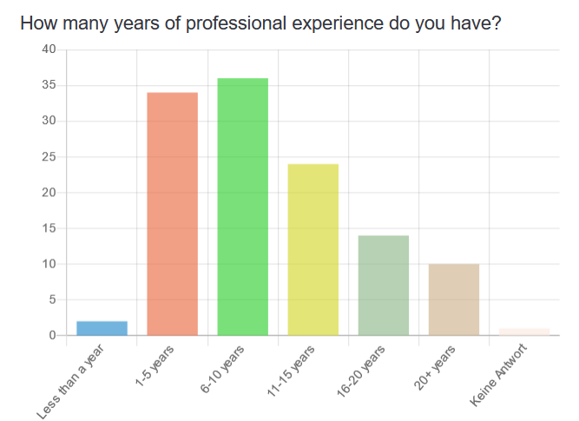
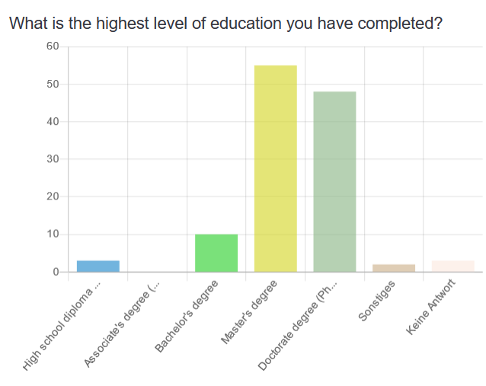
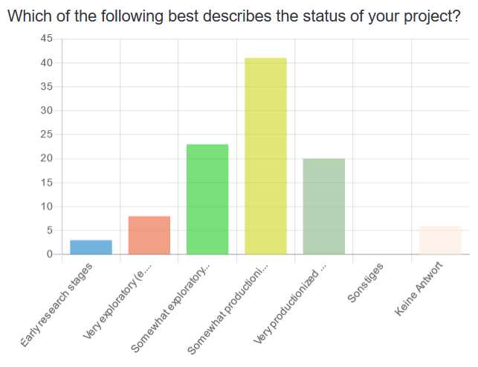
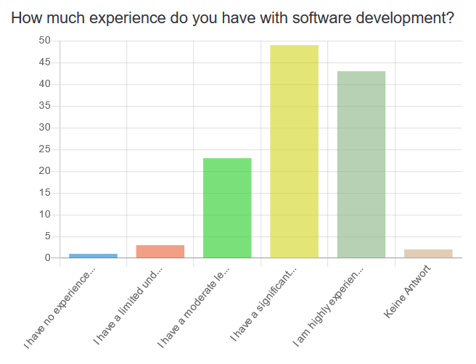
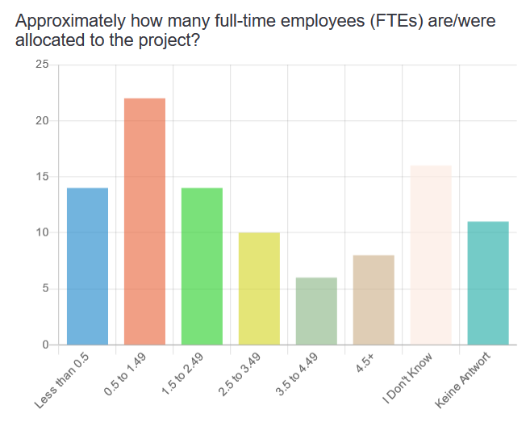
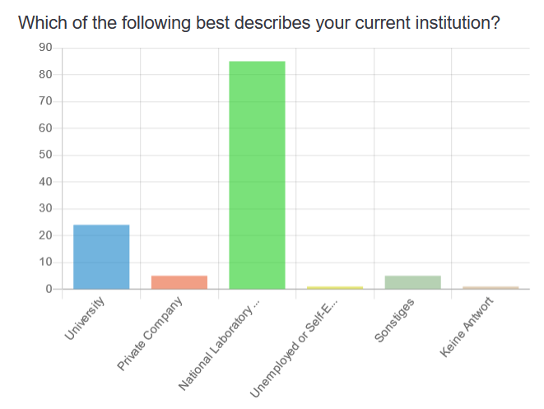
Who did participate?

Slide 13
Overall results, compared to original study
https://doi.org/10.1145/3341161.3343520

Slide 14
Attitude
 | Strongly disagree | Somewhat disagree | Neither agree nor disagree | Somewhat agree | Strongly agree
Value | 1% | 3% | 6% | 30% | 60%
 | 5% | 13% | 16% | 38% | 28%
Responsibility | 4% | 10% | 30% | 26% | 30%
 | 5% | 14% | 23% | 30% | 28%
Positivity | 5% | 9% | 20% | 26% | 40%
 | 3% | 15% | 30% | 34% | 18%

Slide 15
Behaviour
 | Strongly disagree | Somewhat disagree | Neither agree nor disagree | Somewhat agree | Strongly agree
Acts | 2% | 7% | 20% | 37% | 33%
 | 0% | 14% | 18% | 47% | 22%
Compliance | 2% | 7% | 17% | 38% | 36%
 | 3% | 14% | 28% | 42% | 14%
Risk-Taking | 2% | 10% | 26% | 31% | 30%
 | 10% | 23% | 16% | 32% | 19%

Slide 16
Competency
 | Strongly disagree | Somewhat disagree | Neither agree nor disagree | Somewhat agree | Strongly agree
Knowledge | 4% | 9% | 22% | 40% | 26%
 | 6% | 22% | 20% | 42% | 10%
Skills | 3% | 11% | 21% | 41% | 24%
 | 9% | 25% | 27% | 33% | 6%
Effectiveness | 5% | 10% | 19% | 43% | 23%
 | 6% | 27% | 22% | 35% | 10%

Slide 17
Subjective Norms
 | Strongly disagree | Somewhat disagree | Neither agree nor disagree | Somewhat agree | Strongly agree
Trust | 3% | 7% | 11% | 37% | 41%
 | 5% | 19% | 35% | 37% | 4%
Supportiveness | 6% | 9% | 20% | 33% | 32%
 | 9% | 23% | 24% | 20% | 4%
Expectation | 9% | 12% | 27% | 30% | 21%
 | 9% | 23% | 44% | 20% | 4%

Slide 18
Governance
 | Strongly disagree | Somewhat disagree | Neither agree nor disagree | Somewhat agree | Strongly agree
Expertise | 8% | 14% | 33% | 27% | 19%
 | 54% | 22% | 8% | 15% | 1%
Policies | 10% | 17% | 22% | 28% | 23%
 | 54% | 16% | 13% | 14% | 3%
Implementation | 8% | 19% | 22% | 26% | 25%
 | 24% | 10% | 23% | 30% | 13%

Slide 19
Communication
 | Strongly disagree | Somewhat disagree | Neither agree nor disagree | Somewhat agree | Strongly agree
Infrastructure | 13% | 26% | 20% | 22% | 19%
 | 35% | 22% | 15% | 23% | 5%
Codification | 11% | 27% | 27% | 21% | 14%
 | 23% | 28% | 30% | 17% | 3%
Personalization | 7% | 11% | 13% | 38% | 31%
 | 14% | 25% | 24% | 29% | 8%

Slide 20
Outlook
Evaluate the data (maybe even based on my notebook…)
I shared my data, waiting for the US data to come back
Compare results between the communities
Write and publish a high impact paper!
Maybe we‘ll see again at RSECon UK ;)
Kick off for our newly established Secure Software Engineering research group
Start more targeted research towards Secure Research Software Engieering
You are my guineapigs and I‘m very thankful for your collaboration
If you are interested and have ideas, don‘t hesitate to contact me
One important goal is to make our RSE guidelines more secure

Slide 21
Impressum
Thema: First Results on the Security Culture Survey de-RSE‘24 Conference, 05. – 07.03.2024, Uni Würzburg
Datum: 2024-03-05
Autor: Michael Meinel
Institut: DLR Institut für Softwaretechnologie
Bildquellen: Alle Bilder „DLR (CC BY-NC-ND 3.0)“, sofern nicht anders angegeben

