Slide 1
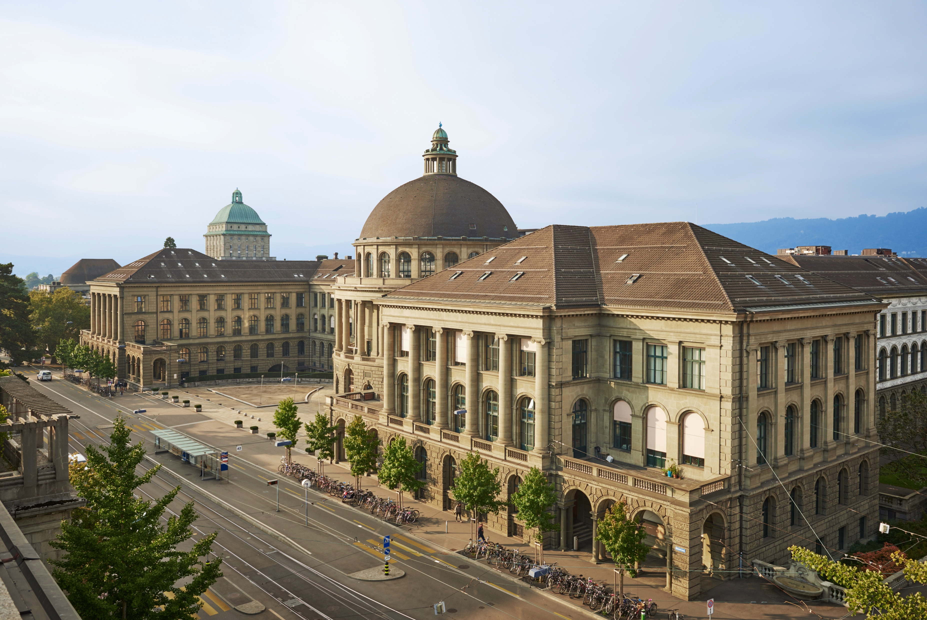

Building a community for Research Software Engineers @ ETH Zurich
Tarun Chadha, Franziska Oschmann, Uwe Schmitt
deRSE24, 7th of March 2024

Slide 2
Who are we?
https://sis.id.ethz.ch
Scientific IT Services of ETH Zurich, 10 years old
Research IT group (~50 people):
  RSE
  Data science
  HPC
  Trainings and Consultings
  Trusted Research Environments
  Part of central IT

Slide 3
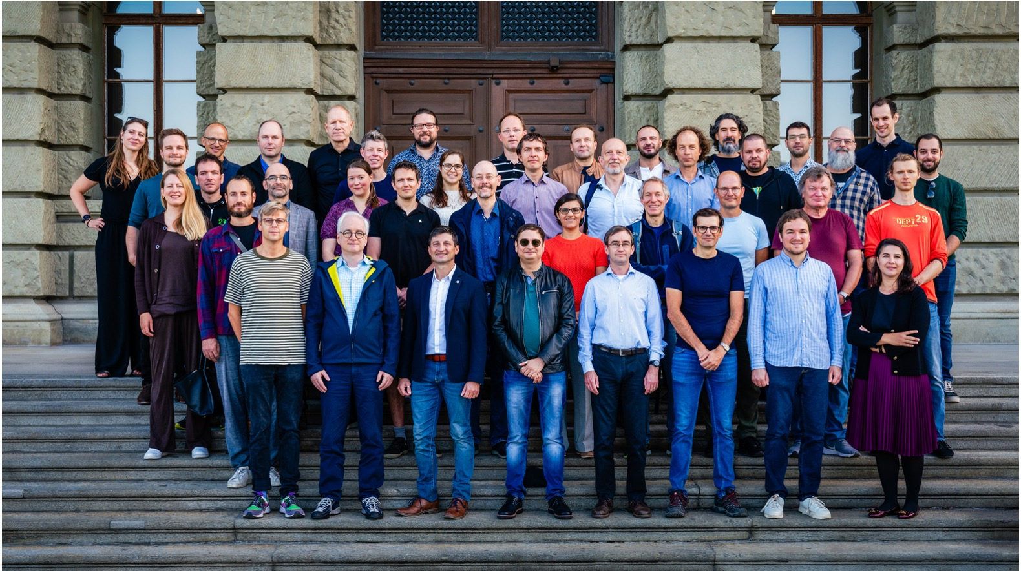

Slide 4
A bit of history
What happened ?

Slide 5

Source: https://rsecon2022.society-rse.org/ (CC BY 4.0 Deed)

Slide 6
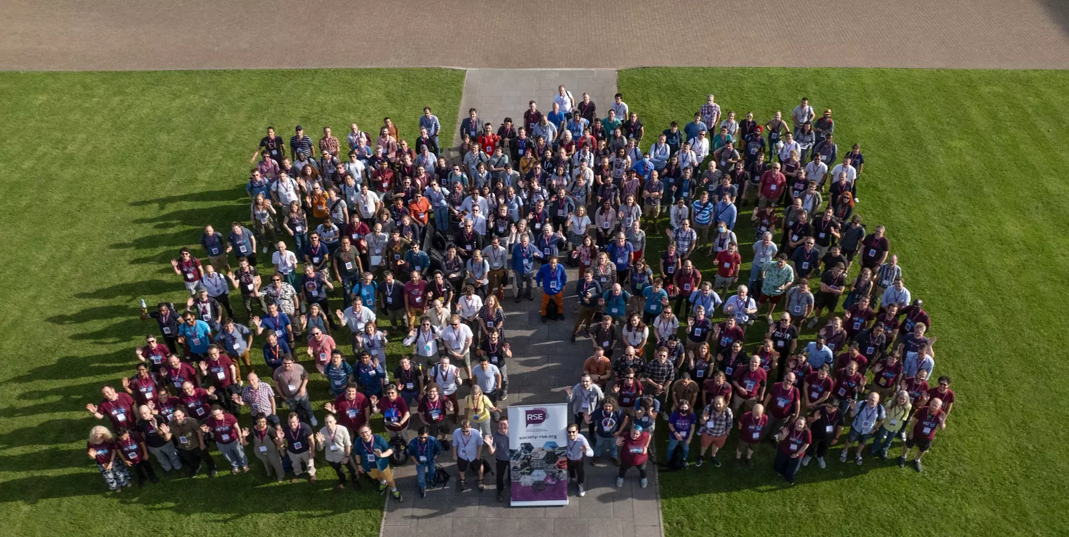
RSECon UK - 5-7 September 2023 - Swansea
Source: https://rsecon23.society-rse.org/ (CC BY 4.0 Deed)

Slide 7

Source: https://www.enhancer.ch/

Slide 8
2022 - RSE Con UK Newcastle - Why don’t we have this in Switzerland?
September 2023 - RSE Con UK Swansea - Why don’t we have this in Switzerland?
October 2023 - EnhanceR symposium – Why don’t we have this in Switzerland?
If no one else is doing it, then why not us?

Slide 9
RSE community @ ETH: first steps
Mail campaign (~7800 emails!) on 23rd of November
  First personal message at UK slack within one hour.
  Maybe we get 50 people together for regular meetups
Announced 1st online information event on 12th of December

Slide 10
1st online information event
Around 120 participants
2 parts:
  Talk by Prof. Simon Hettrick (Software Sustainability Institute UK)
  Information on community building @ ETH
    RSE community survey
    Q&A

Slide 11
Results of RSE community survey
13 out of 16 ETH Zurich departments represented!

Slide 12
First on-site event: 1st of February
Part 1: Lightning talks:
Part 2: Talk by Mr. Peter Schmidt
Part 3: Discussion rounds in small groups:
  What do you expect from the RSE community?
  What kind of role do you imagine for yourself in this community?
  How can we build the community?

Slide 13
Reactions:
EPFL Lausanne: we also want to do something!
KOF Swiss Economic Institute: We were just about to set up something of our own!
280 members on mailing list
~80 on matrix chat
~65 at first on-site event

Slide 14
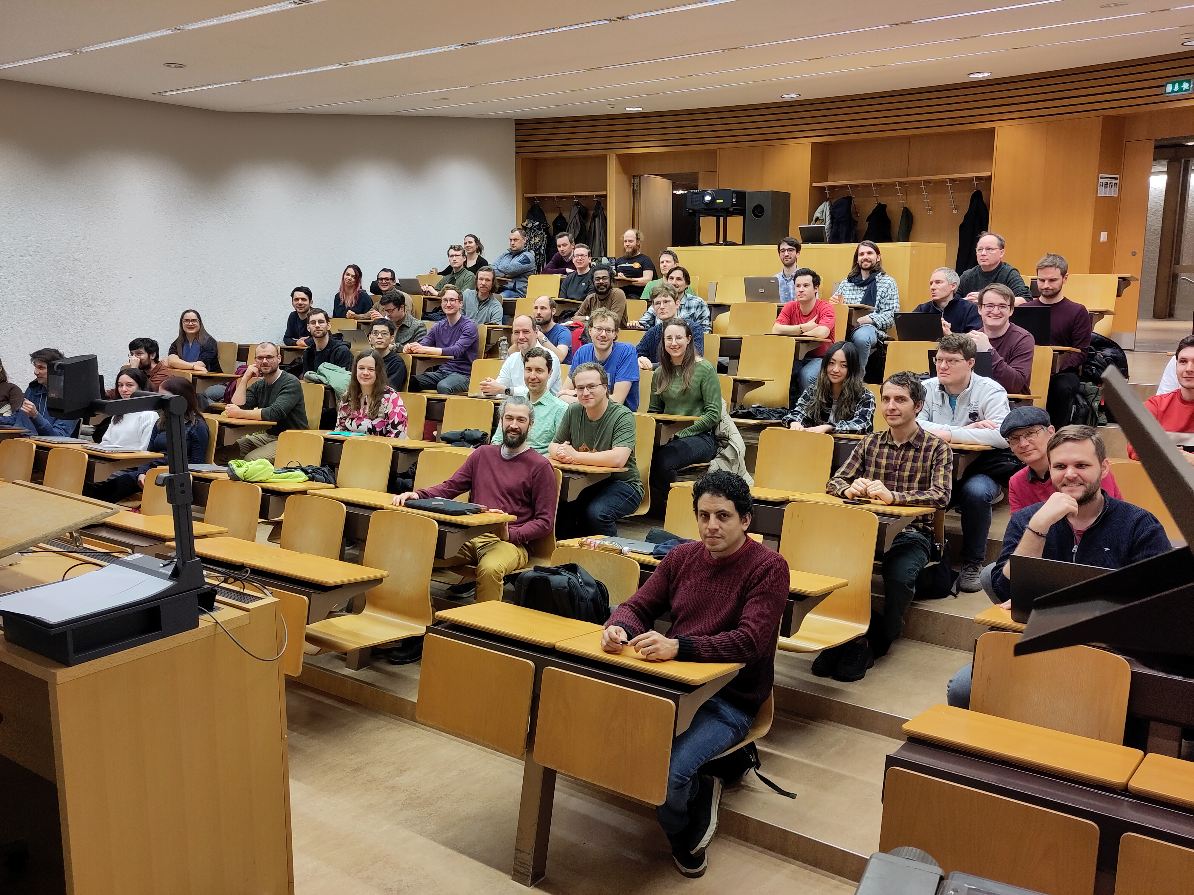

Slide 15
Ongoing / future activities

Slide 16
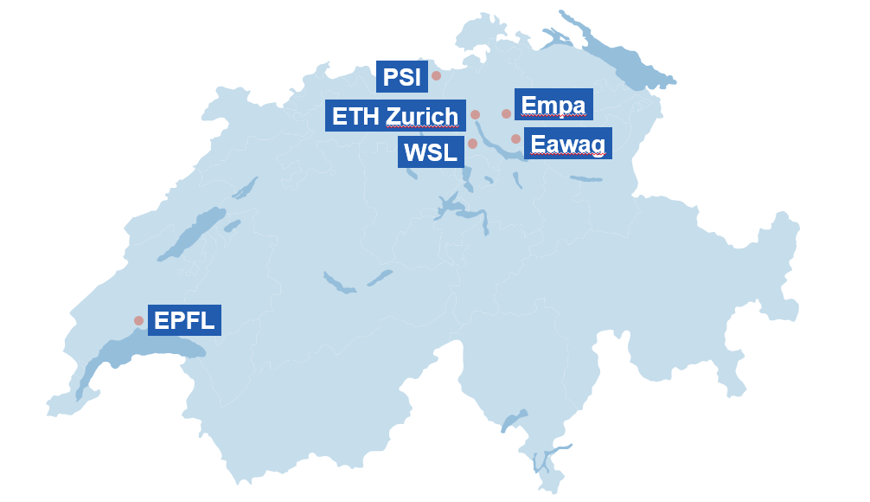
ETH Domain

Slide 17
Funding
We submitted a pre-proposal for funding by ORD-CH
  Setup network of RSE ambassadors in ETH Domain
  Work towards Swiss RSE association.

Slide 18
Next event: 12th of March, online
Overview of latest activities
Suggest working groups:
  Event planning
  Outreach, RSE ambassadors in institutes
  RSE education
Lightning talks + Technical presentation

Slide 19

Swiss RSESoc? When? How?
Source: Wikimedia.org (CC BY-SA 3.0 Deed)

Slide 20
Contact:
Uwe Schmitt, uwe.schmitt@id.ethz.ch
Franziska Oschmann, franziska.oschmann@id.ethz.ch,
Tarun Chadha, tarun.chadha@id.ethz.ch
License: CC BY-NC-SA 4.0 Deed

