Slide 1
RSE and the aspects of communication and education
Dr. Benjamin Fuchs, DLR Institut für Vernetzte Energiesysteme
06.03.2024

Slide 2
I am here today to report about my experiences with adapting SE methods
Special focus will be on communication and knowledge transfer
This talk will be about what worked and what didn‘t …

Slide 3
Multi task environment, RSE one of many
Developers lack experience and formal education
Staff fluctuation
Generating insight
New insights modify goals, priorities and applied methods

Slide 4
Notes:
Knowledge transfer is a continuous effort
Ever changing environment
Communication is a priority
RSE knowledge are: context sensitive tradeoff decisions

Slide 5
explicit knowledge
What to do
implicit knowledge
How to do
tacit knowledge
Why we do
Core challenge: transfer experience (implicit / tacit)

Slide 6
“The methods we apply”

Slide 7
Mentor mentee setup is very efficient (implicit/tacit knowledge transfer)
Time and effort intensive
Better efficiency in transfer is crucial
Next on our institutes agenda: communication and didactic trainings

Slide 8
Adapting SCRUM / Agile methods

Slide 9
SCRUM style sprints
Not feasible, needs adaption because:
RSE: one of many competing tasks
Lack of long uninterrupted timeframes
Different work schedules and rhythms in teams

Slide 10
Modified sprint: focus time and effort
reserve short timespans (days) in a regular intervalls (weekly to quarterly)
Focus benefits traction and transfering knowledge
Supplemented by development phases

Slide 12
Standup meetings
Work well
„What was?“ „What will be?“ and „What impedes us?“
Start of sprint days & regular meetings

Slide 13
Wrapups at the end of sprint days
Suplement standups
Focus on work athmosphere, what we enjoy and how we work
Tuning the knowledge transfer
Mentor learns what works for the mentee

Slide 14
Retrospectives
Work well when focus on improving work methods & group dynamics
Foster constructive feedback environment
encourages to take ownership as a team
We use the retromat to prepare https://retromat.org/

Slide 15
Scrum roles don‘t work and need modification:
User
Products & feedback
Lead RSE
Work process, requirements & every day decisions
RSE developer
Coding & work process
Product owner
budget & guidelines
Stakeholder
Scientific methods & feedback

Slide 16
Effort estimation
T-shirt sizing with non-linear scale works best
improves planning, prioritization & reality checks
regular training mandatory
evaluate estimates after the fact & identify causes for misestimates
Notes:
Our work reality is governed by change
The act of developing software is part of the scientific insight process
Requirements, goals and prioritization change frequently
Frequent exchanges and synchronization of operational and domain knowledge is key

Slide 17
„How does NVC fit into the picture?“

Slide 18
NVC works because:
supports building reciprocal understanding
shifts from focussing on solutions and strategies to needs
deescalates heated discussions

Slide 19
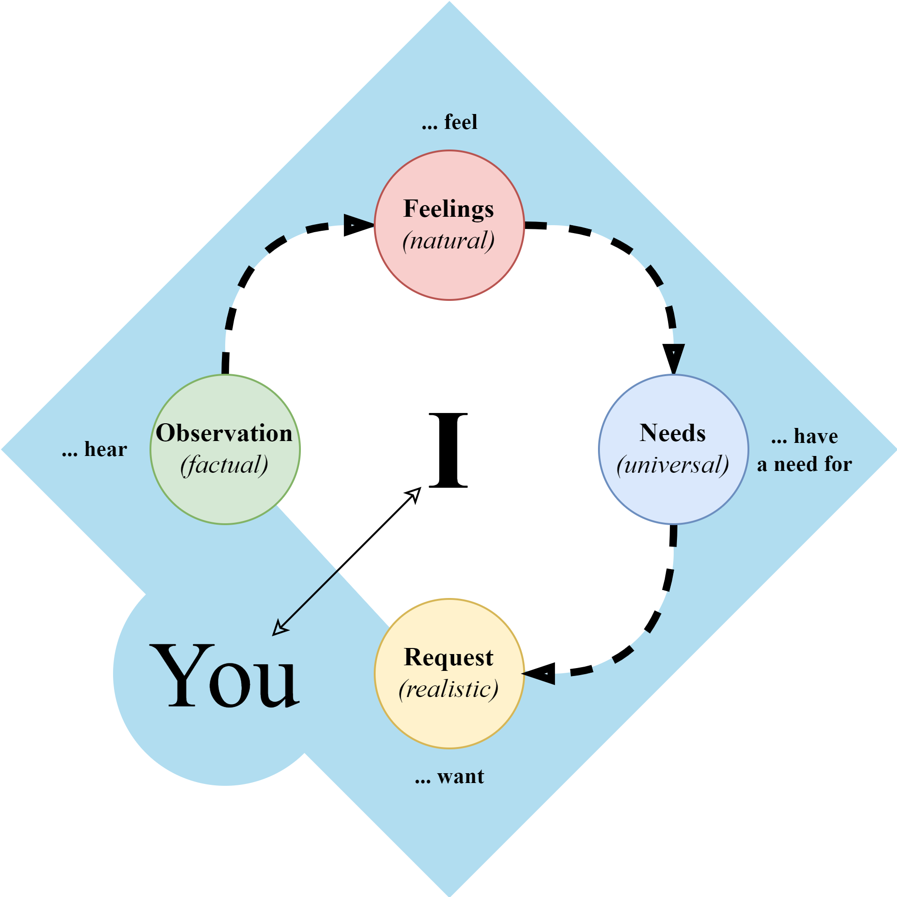
By Marshall Rosenberg

Slide 20
NVC works best with …
requirements engineering
retrospectives
educational settings
conflicts (priorities, goals, inter personal, …)
Very effective method for separating needs from solutions and goals
Notes:
Generally useful because
we cannot avoid conflicts so better come prepared
easy to understand and learn
provides a process which offers security also in challenging situations
can be applied even if others don‘t know the method

Slide 21
Challenges with NVC
method easy to understand but needs continuous training
most are unfamiliar with it
continuous training can be challenging

Slide 22
Summary

Slide 23
SCRUM principles work well
Some SCRUM concepts need adaption (sprints, roles)
Effort estimation helps in many ways
NVC is cross-sectional beneficial (e.g. requirements engineering)

Slide 24
Thank you all for your time!
and a big thank you to the organizers of the conference!
I look forward to your questions and individual discussions during the breaks

