Slide 1
Structured Experiment Metadata Acquisition Using Adamant: Current State and Concepts
deRSE24 Conference, Würzburg
Ihda Chaerony Siffa, Robert Wagner, and Markus M. Becker
7 March 2024
Department of Plasma Modelling & Data Science, Leibniz Institute for Plasma Science and Technology (INP)

Slide 2
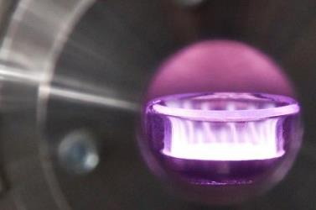
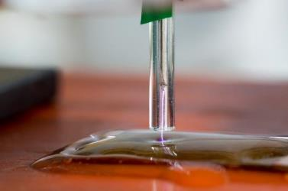
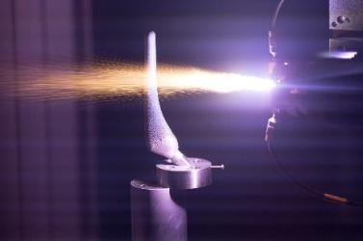
The Leibniz Institute for Plasma Science and Technology (INP) is one of the leading research institutes in the area of physical plasma, its basics and applications.
I. Chaerony Siffa, deRSE24, Würzburg, 07/03/2024
2

Slide 3
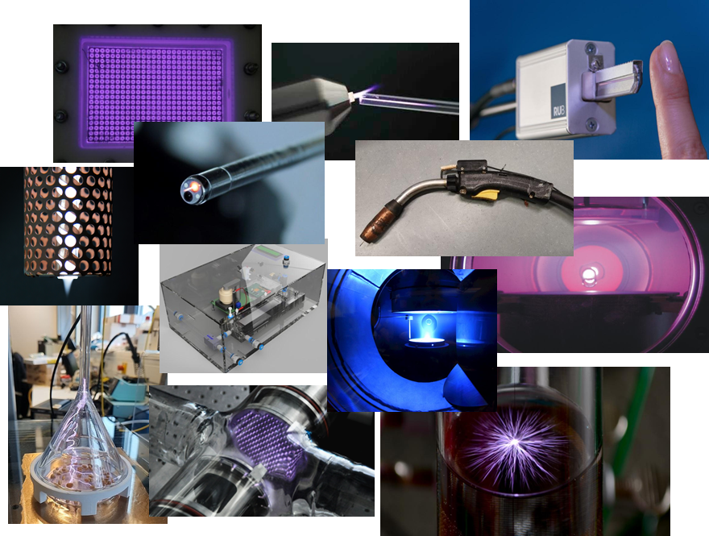
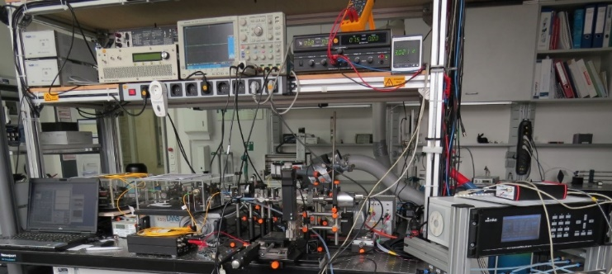
Challenges in plasma science and technology
Multidisciplinary research with unique experiment setups
Manifold interactions with gaseous, liquid and solid surroundings are important
Hard to compare and validate different experiments due to incomplete documentations
Many still use physical lab notebooks
I. Chaerony Siffa, deRSE24, Würzburg, 07/03/2024

Slide 4
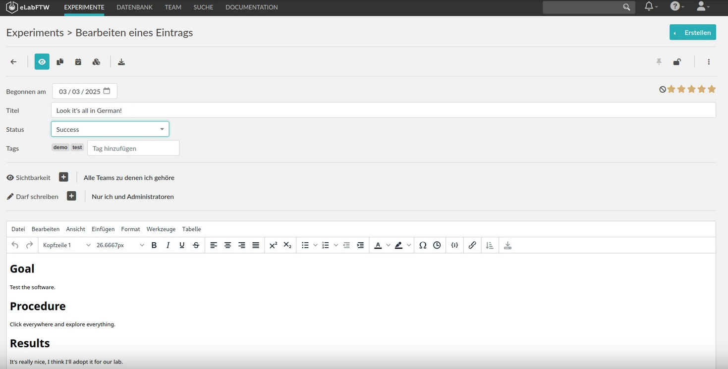
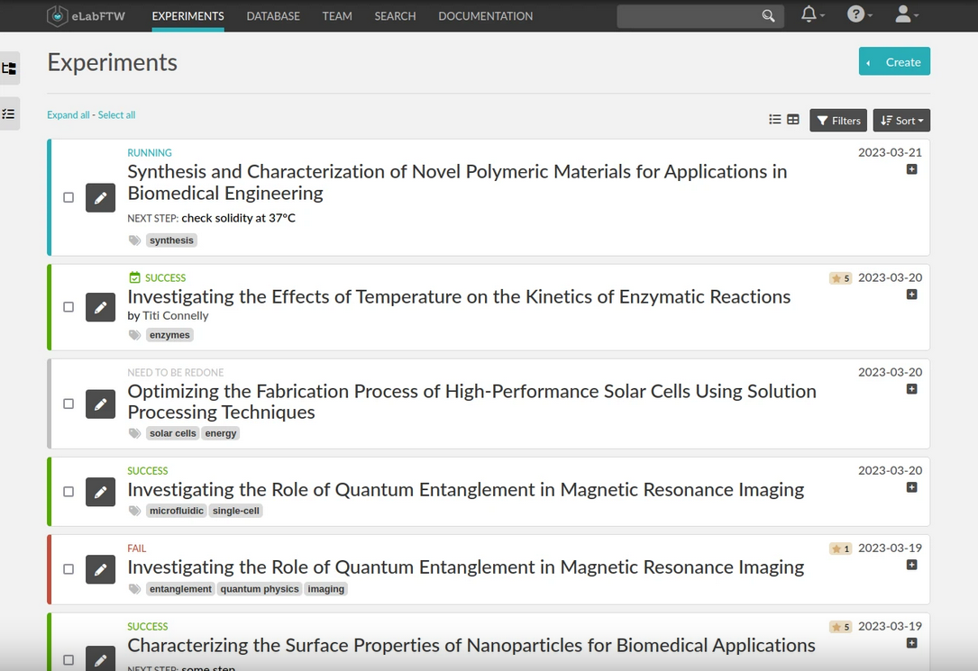
Our approach: eLabFTW + Adamant
Open source (AGPL-3.0 )
Can be self-hosted
Generic (mostly free text)
Limited in terms of the ability to describe your experiment metadata/documentation in a machine-readable way
https://www.elabftw.net/
I. Chaerony Siffa, deRSE24, Würzburg, 07/03/2024

Slide 5
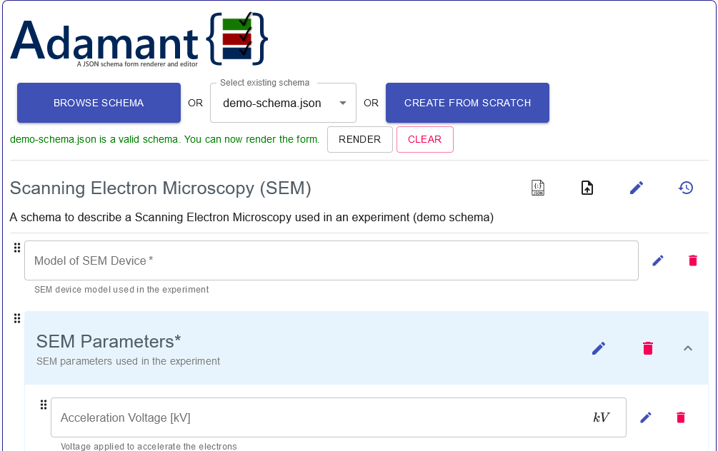
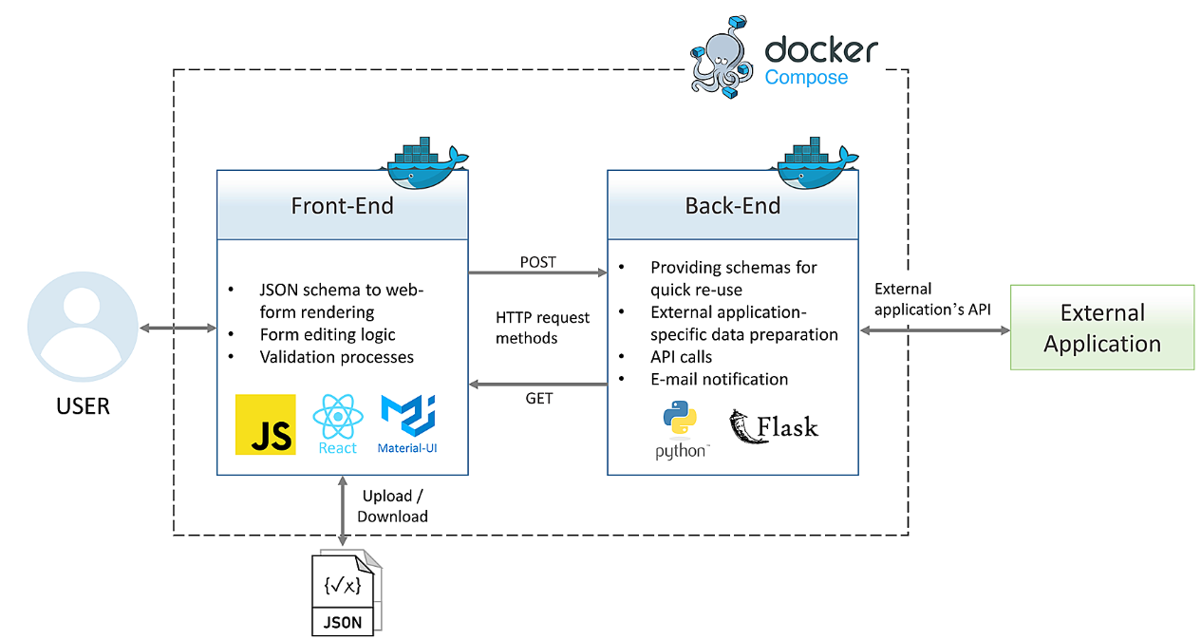
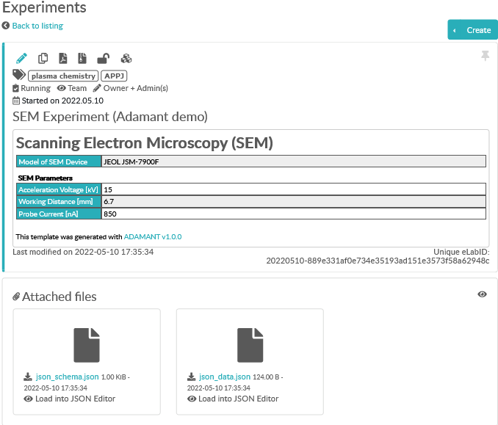
Our approach: eLabFTW + Adamant
RDM tool for schema based metadata acquisition
Try it on: https://plasma-mds.github.io/adamant/
User-friendly browser based RDM tool
Automatic generation of web-forms from JSON schemas
Ensure correctness of the inputted data (JSON schema validation feature)
Machine-readable output (because JSON)
Flask-based API to integrate with different RDM components
eLabFTW
https://doi.org/10.12688/f1000research.110875.1
I. Chaerony Siffa, deRSE24, Würzburg, 07/03/2024

Slide 6
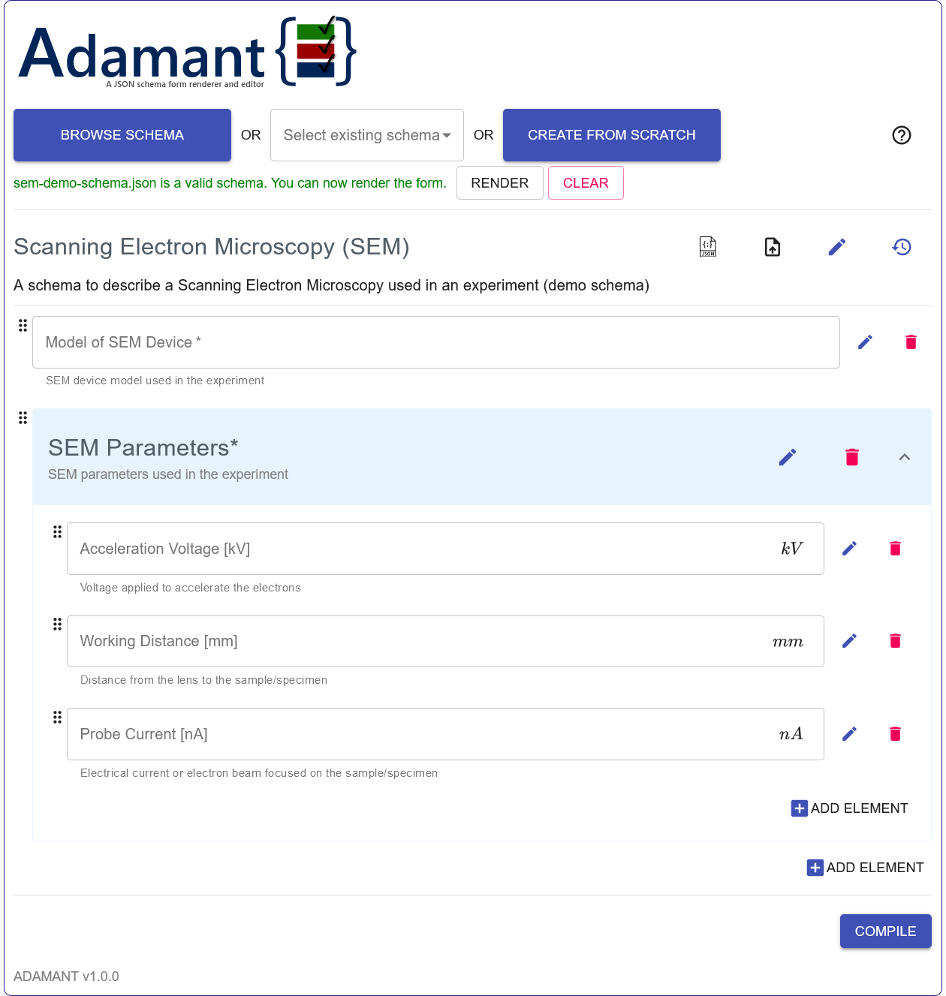
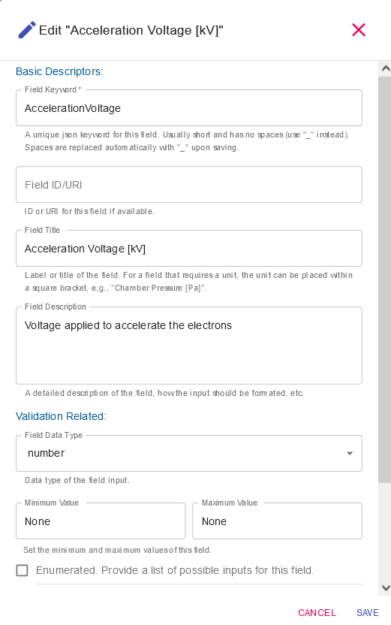
Adamant: general workflow
Browse or select
{
"$schema": "http://json-schema.org/draft-04/schema#",
"id": "http://scanning-electron-microscopy",
"title": "Scanning Electron Microscopy (SEM)",
"description": "A schema to describe a Scanning Electron Microscopy used in an
experiment (demo schema)",
"type": "object",
"required":["DeviceModel","SEMParameters"],
"properties": {
"DeviceModel":{
"title": "Model of SEM Device",
"description": "SEM device model used in the experiment",
"type":"string"
},
"SEMParameters":{
"title": "SEM Parameters",
"description": "SEM parameters used in the experiment",
"type":"object",
"properties": {
"AccelerationVoltage":{
"title": "Acceleration Voltage [kV]",
"description": "Voltage applied to accelerate the electrons",
"type": "number"
},
"WorkingDistance":{
"title": "Working Distance [mm]",
"description": "Distance from the lens to the sample/specimen",
"type": "number"
},
"ProbeCurrent":{
"title": "Probe Current [nA]",
"description": "Electrical current or electron beam focused on the
sample/specimen",
"type": "number"
}
}
}
}
}
{
"DeviceModel": “Jeol JSM-7500F",
"SEMParameters": {
"AccelerationVoltage": 15,
"WorkingDistance": 10,
"ProbeCurrent": 10
}
}
+
Scanning Electron Microscopy (SEM)
Model of SEM Device | Jeol JSM-7500F
SEM Parameters
Edit-field panel
Acceleration Voltage [kV] | 15
Working Distance [mm] | 10
Probe Current [nA] | 10
Metadata schema described in JSON
Dynamically rendered and editable web-form
Human- and machine-readable metadata
Edit-compile, ingest, and submit
I. Chaerony Siffa, deRSE24, Würzburg, 07/03/2024

Slide 7
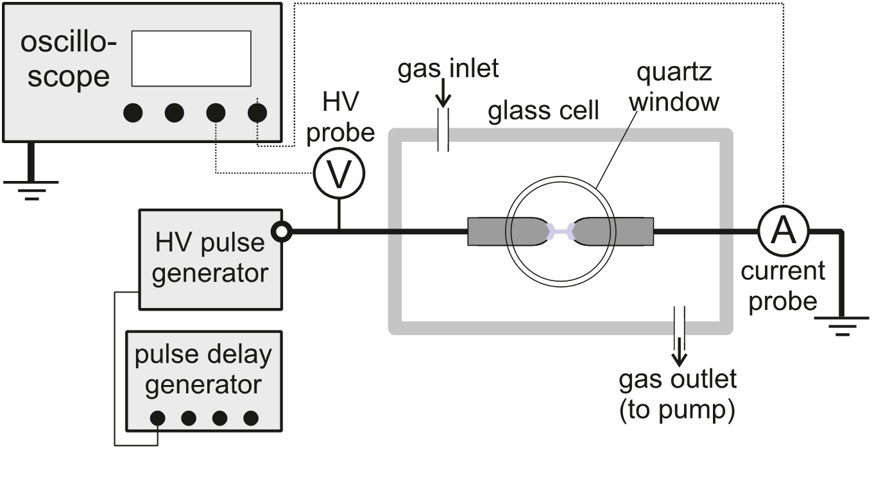
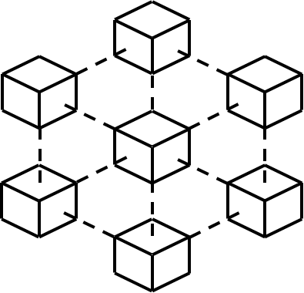
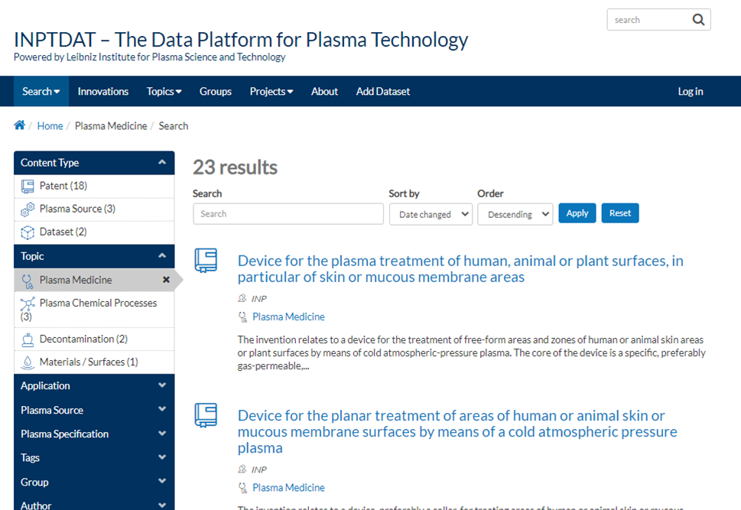
Production ready workflows at INP
Documentation of experiments leading to FAIR data
Publication of FAIR-assured dataset with records of ownership
W
Researcher
Researcher
ELN
Data
{✓x}
{✓x}
JSON
JSON
Adamant
Adamant
{✓x}
{✓x}
JSON
Experiment
JSON
Data
ELN
Blockchain / Smart Contracts
Research data repositories for plasma science and technology:
https://www.inptdat.de/
https://rdpcidat.rub.de/
Data
{✓x}
{✓x}
JSON
JSON
RD Repository
Well-described research data
I. Chaerony Siffa, deRSE24, Würzburg, 07/03/2024

Slide 8
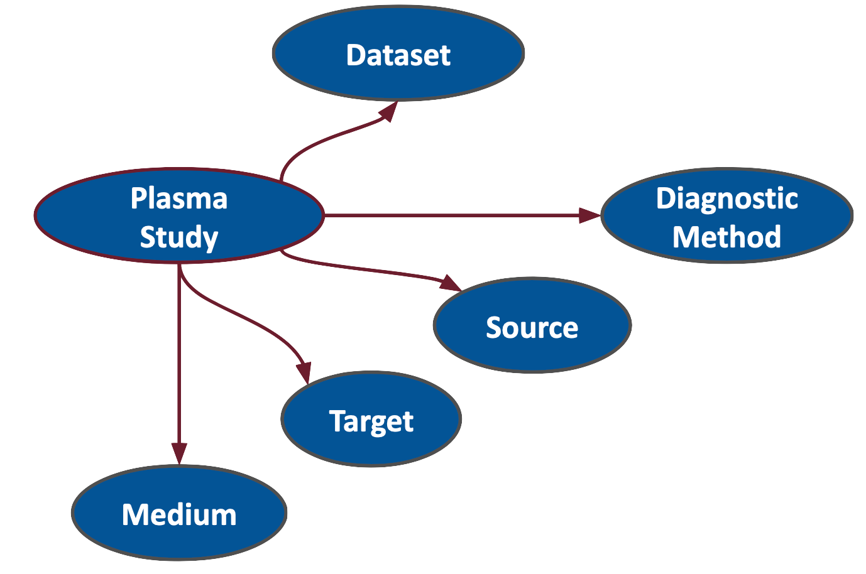
Concept: ontology and knowledge graph for standardized and assisted experiment design, and quick re-use of existing metadata
Standardized experiment documentation
Community approved (modular) schemas
Reuse of existing metadata
Auto. suggestions on experiment design
+
=
Ontology / Knowledge Graph
Adamant
I. Chaerony Siffa, deRSE24, Würzburg, 07/03/2024

Slide 9
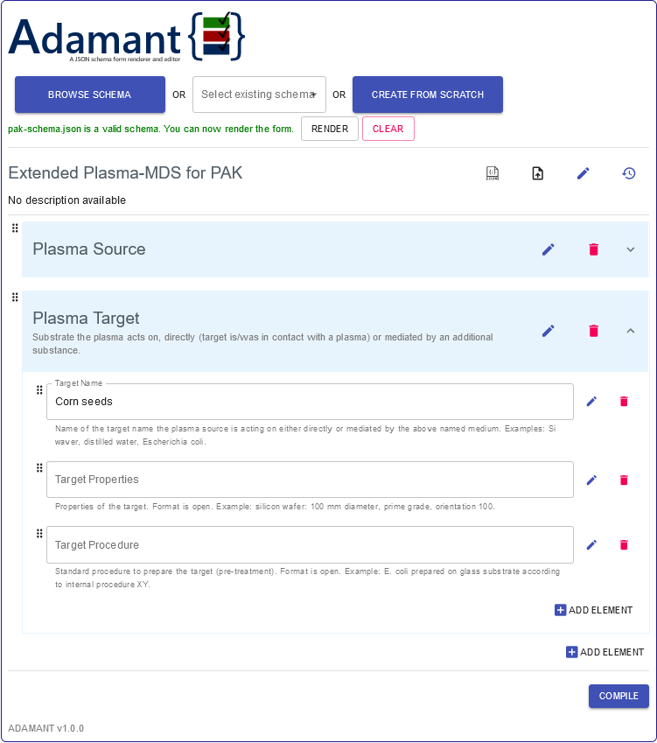
Concept: ontology and knowledge graph for standardized and assisted experiment design, and quick re-use of existing metadata
Because you have “Plasma Source” and “Plasma Target”. Click to read more
Suggested field elements
×
+
Diagnostics
?
+
?
Amount of seeds
+
?
Used seed accession(s)
Loading more suggestions
Please wait
Existing metadata
×
I. Chaerony Siffa, deRSE24, Würzburg, 07/03/2024

Slide 10
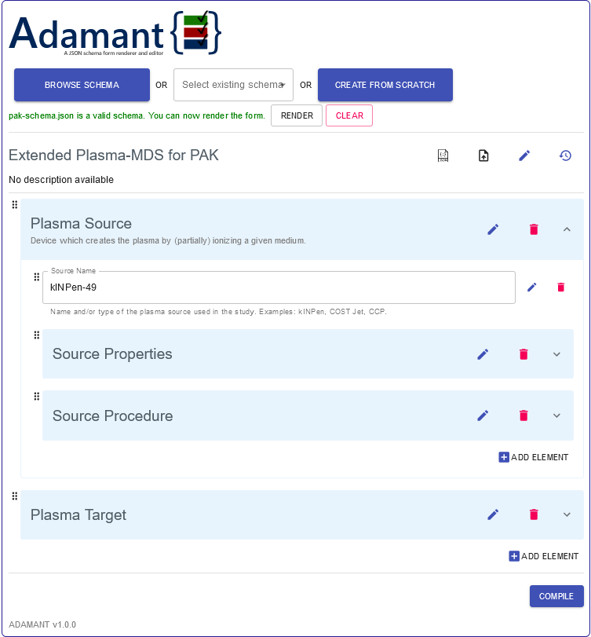
Concept: ontology and knowledge graph for standardized and assisted experiment design, and quick re-use of existing metadata
Suggested field elements
×
We found several existing metadata based on your input
×
◄
kINPen-495AD
?
◄
?
kINPen-496GCE
Use this metadata
◄
?
kINPen-49C
I. Chaerony Siffa, deRSE24, Würzburg, 07/03/2024

Slide 11
Concept: graph visualization for stored experiments
Resource (9)
hasDone
Researcher A
Experiment A
Experiment (4)
Researcher (4)
Researcher B
isUsedIn
Device (1)
Experiment D
hasDone
isUsedIn
hasDone
Device A
Researcher C
isUsedIn
isUsedIn
Graph created from the JSON data coming from Adamant
Made possible by machine-readable metadata
Experiment B
Experiment C
hasDone
Researcher C
I. Chaerony Siffa, deRSE24, Würzburg, 07/03/2024

Slide 12
Challenge and idea
Challenge: spaghetti code – hard to maintain and implement new features. Need massive refactoring!
Idea: using a long-context large language model to help with refactoring. Maybe?
Accept >30k lines of code
https://deepmind.google/technologies/gemini
Adamant‘s whole code base
(~20k lines of code)
Profit?!
Expert prompting

Slide 13
Summary
Using Adamant to collect human- and machine-readable experiment metadata
Based on the JSON Schema standard
User-friendly UI (edit and create JSON schemas without knowing JSON)
Flask API for seamless integration of RDM workflows and tools
Future work includes knowledge graph and ontology integrations as well as graph data visualization

Slide 14
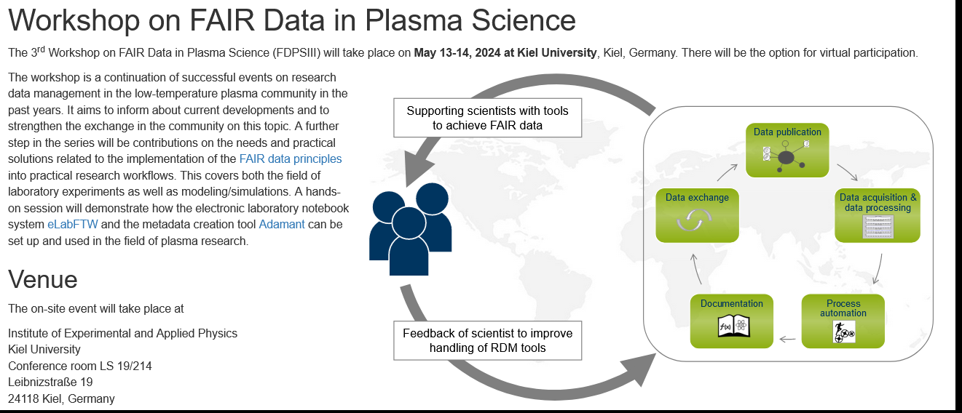
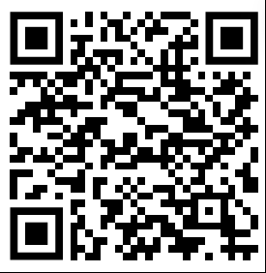
Advertisement
https://www.plasma-mds.org/ws-fair-data-plasma-science-3.html
When: May 13-14, 2024
Where: Institute of Experimental and Applied Physics, Kiel University (and ONLINE!)

Slide 15
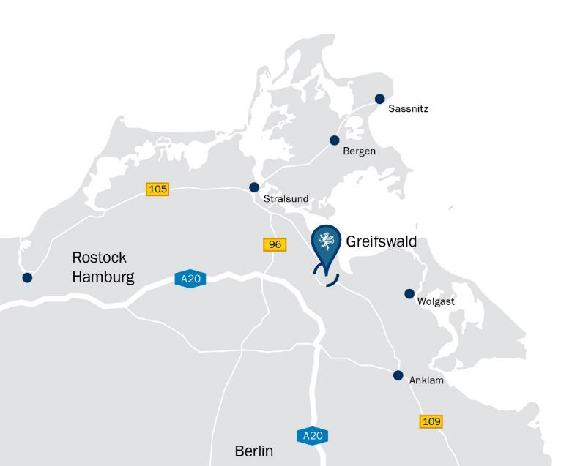
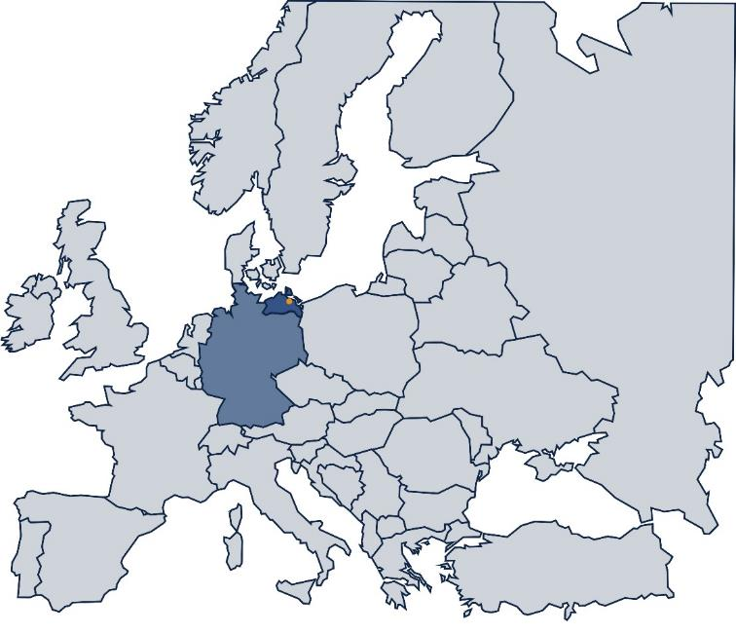
Contact
Leibniz Institute for Plasma Science and Technology (INP)
Address: Felix-Hausdorff-Str. 2, 17489 Greifswald
Phone: +49 - 3834 - 554 300, Fax: +49 - 3834 - 554 301
E-Mail: welcome@inp-greifswald.de, Web: www.leibniz-inp.de

