Slide 1
OCR(-D)4all An easy to use and highly adaptable open-source solution for automatic text recognition of historical printings and manuscripts
Maximilian Nöth, Herbert Baier, Christian Reul
Centre for Philology and Digitality (ZPD)
University of Würzburg
06.03.2024

Slide 2
Outline
OCR – Background
OCR-D
OCR4all
Future Work

Slide 3
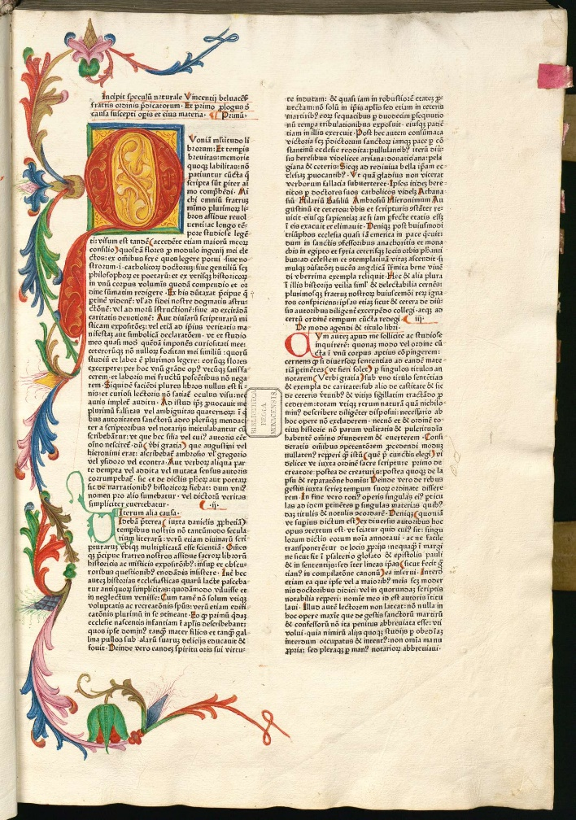
OCR – Motivation
Situation: Large amount of already scanned and publicly available prints and handwritten sources
Problem: Scans only offer very limited use
To-Do: Creating high-quality machine readable texts which are:
Searchable
Annotatable
Usable for quantitative analysis
Solution: Automatic Text Recognition (ATR)
Optical Character Recognition (OCR)
Handwritten Text Recognition (HTR)

Slide 4
OCR – Typical Workflow
Reul et al.: OCR4all—An Open-Source Tool Providing a (Semi-)Automatic OCR Workflow for Historical Printings. In: Appl. Sci. 2019, 9(22), 4853. P. 1. (https://doi.org/10.3390/app9224853)
Pre-processing: Binarization, Deskewing or Dewarping of the input image
Layout analysis: Dividing the page into smaller units like baselines, text lines and regions + recognizing different region types
OCR: Recognizing the text of a specific unit, usually using text lines
Post-correction: Using traditional statistical or LLM based methods to improve the OCR results

Slide 5
OCR-D – Motivation
Situation: Ever changing landscape of new processors for various steps of the OCR workflow
Problem: Processors often use nonuniform interfaces and custom output formats
Solution: OCR-D
Funded through a series of DFG projects with a focus on generating high-quality full text for all VD (Indices of German prints of the 16th, 17th and 18th century)
Provides a flexible yet standardized framework for a multitude of OCR processors
Focuses on mass digitization via the CLI
Fully open-source
But: Steep learning curve for less- and non-technical users

Slide 6
OCR-D OCR4all
Currently running DFG-funded project OCR4all-libraries
Main goals:
Comfortable application of OCR-D and standalone solutions via OCR4all
Maximizing usability and user experience
Full control without using the CLI
→ Applicable by non-technical users
Support optimizing the OCR result within OCR4all
Comparison, optimization, and exchange of workflow configurations
Generation of training data through LAREX (Layout and OCR)
Definition of sets, management of training data, as well as more comfortable training
→ Also helpful for more technical users
Keeping the user in control of all his data
Possibility to comfortably self-host OCR4all instance
In-tool data management (tagging, sharing, etc.)
Transcript of generation history for all results

Slide 7
OCR4all - Architecture
Backend:
API Gateway build with Spring Boot 3
Authorisation layer build with Spring Security
OCR(-D) processors implemeneted as microservices which communicate with the gateway through a REST API (general communication) and websockets (event messaging)
Frontend:
Vue.js based frontend which connects to a specified API Gateway
All advanced editors (LAREX, NodeFlow) are integrated as reusable components, allowing easy standalone usage
Certain backend configuration is possible through the admin panel (activating processors, storage limits, etc.)

Slide 8
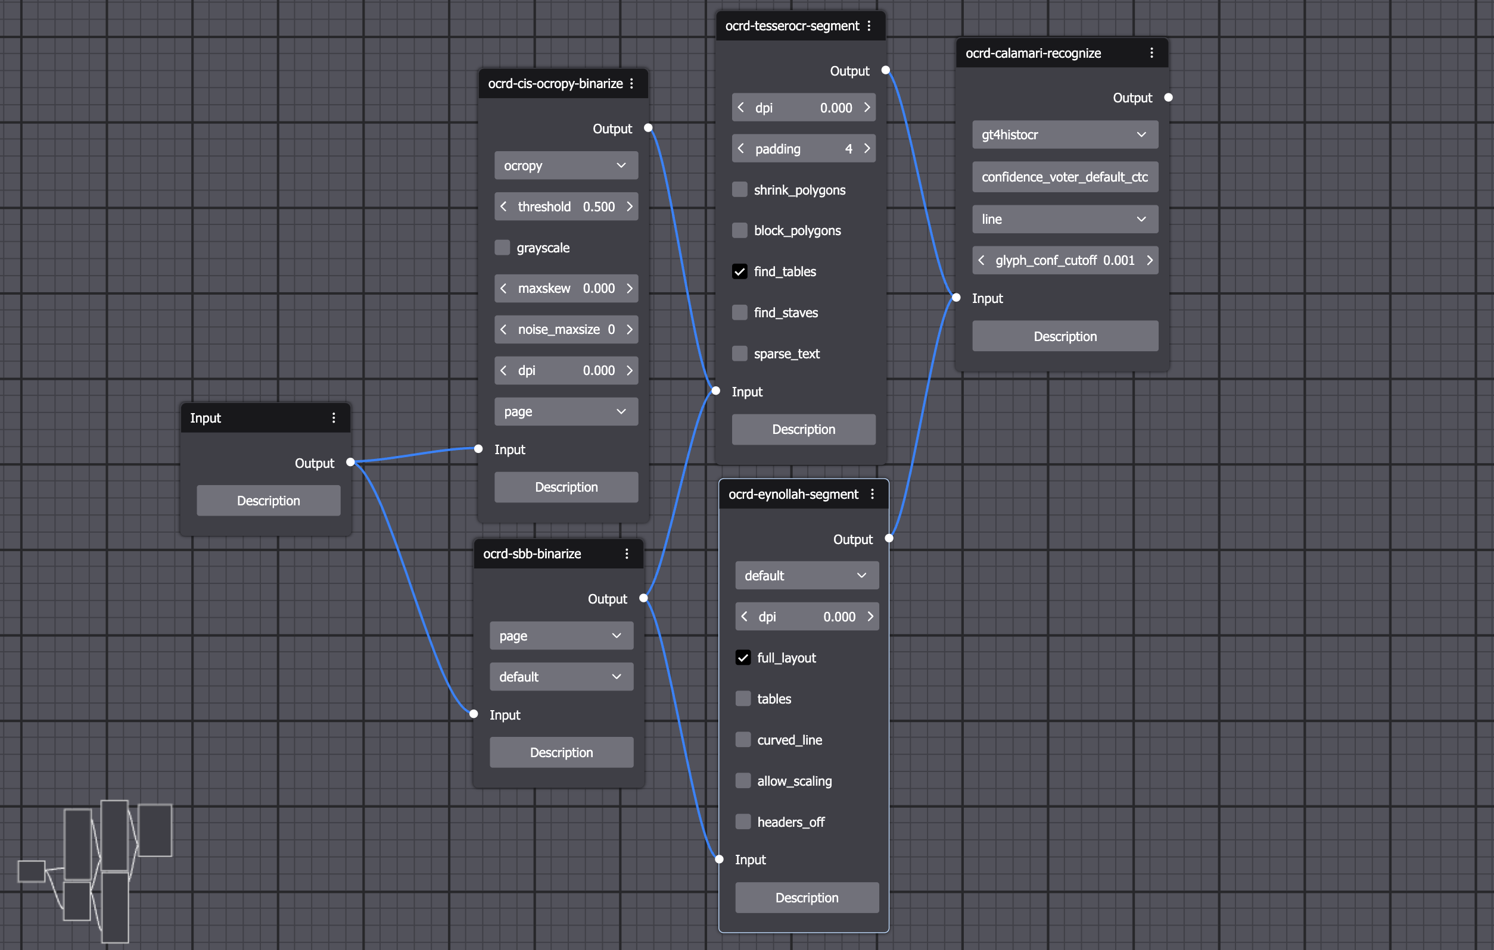
OCR4all – NodeFlow
NodeFlow is a visual node editor which allows the creation of simple and complex, branched workflows
Possibility to evaluate the quality of different branches on different datasets combined with tagsets
Full compatibility with native OCR-D usage through workflow and workspace exports

Slide 9
OCR4all – Future Work
OCR4all 1.0 stable release in Q2/24
Integration of additional deep learning training modules (Tesseract, Kraken, etc.)
Implementation of advanced resource management (GPU)
Allow connecting to existing security layers (OAuth, LDAP) for institutional usage
Continuous usability optimisation in collaboration with the Chair for Human Computer Interaction at the University of Würzburg

Slide 10
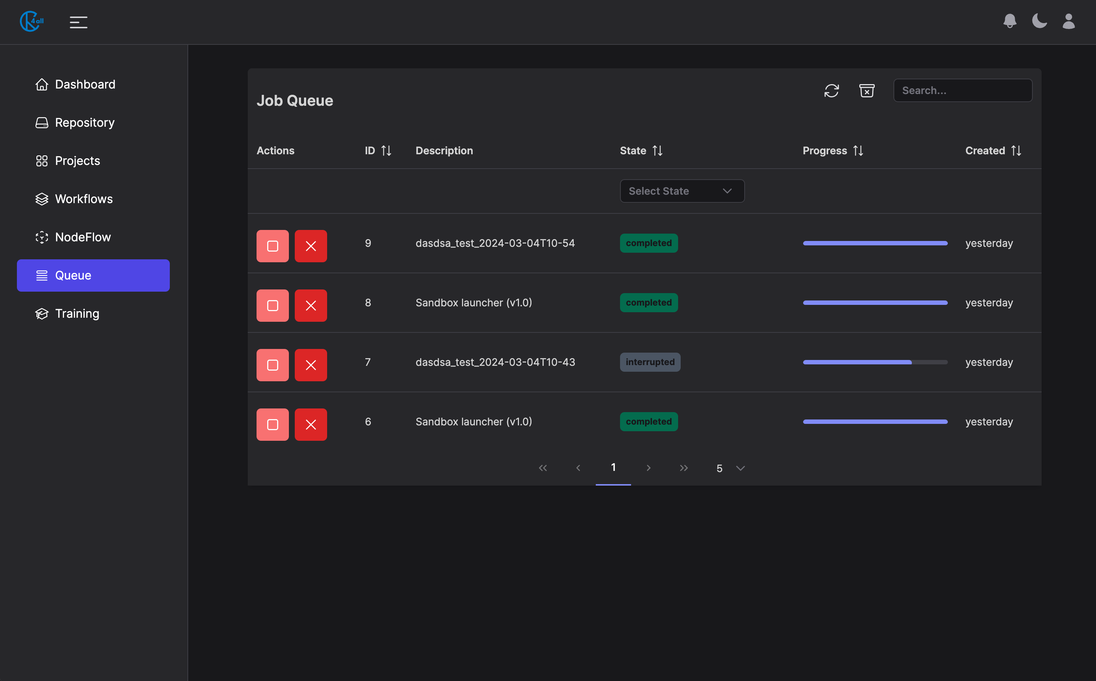
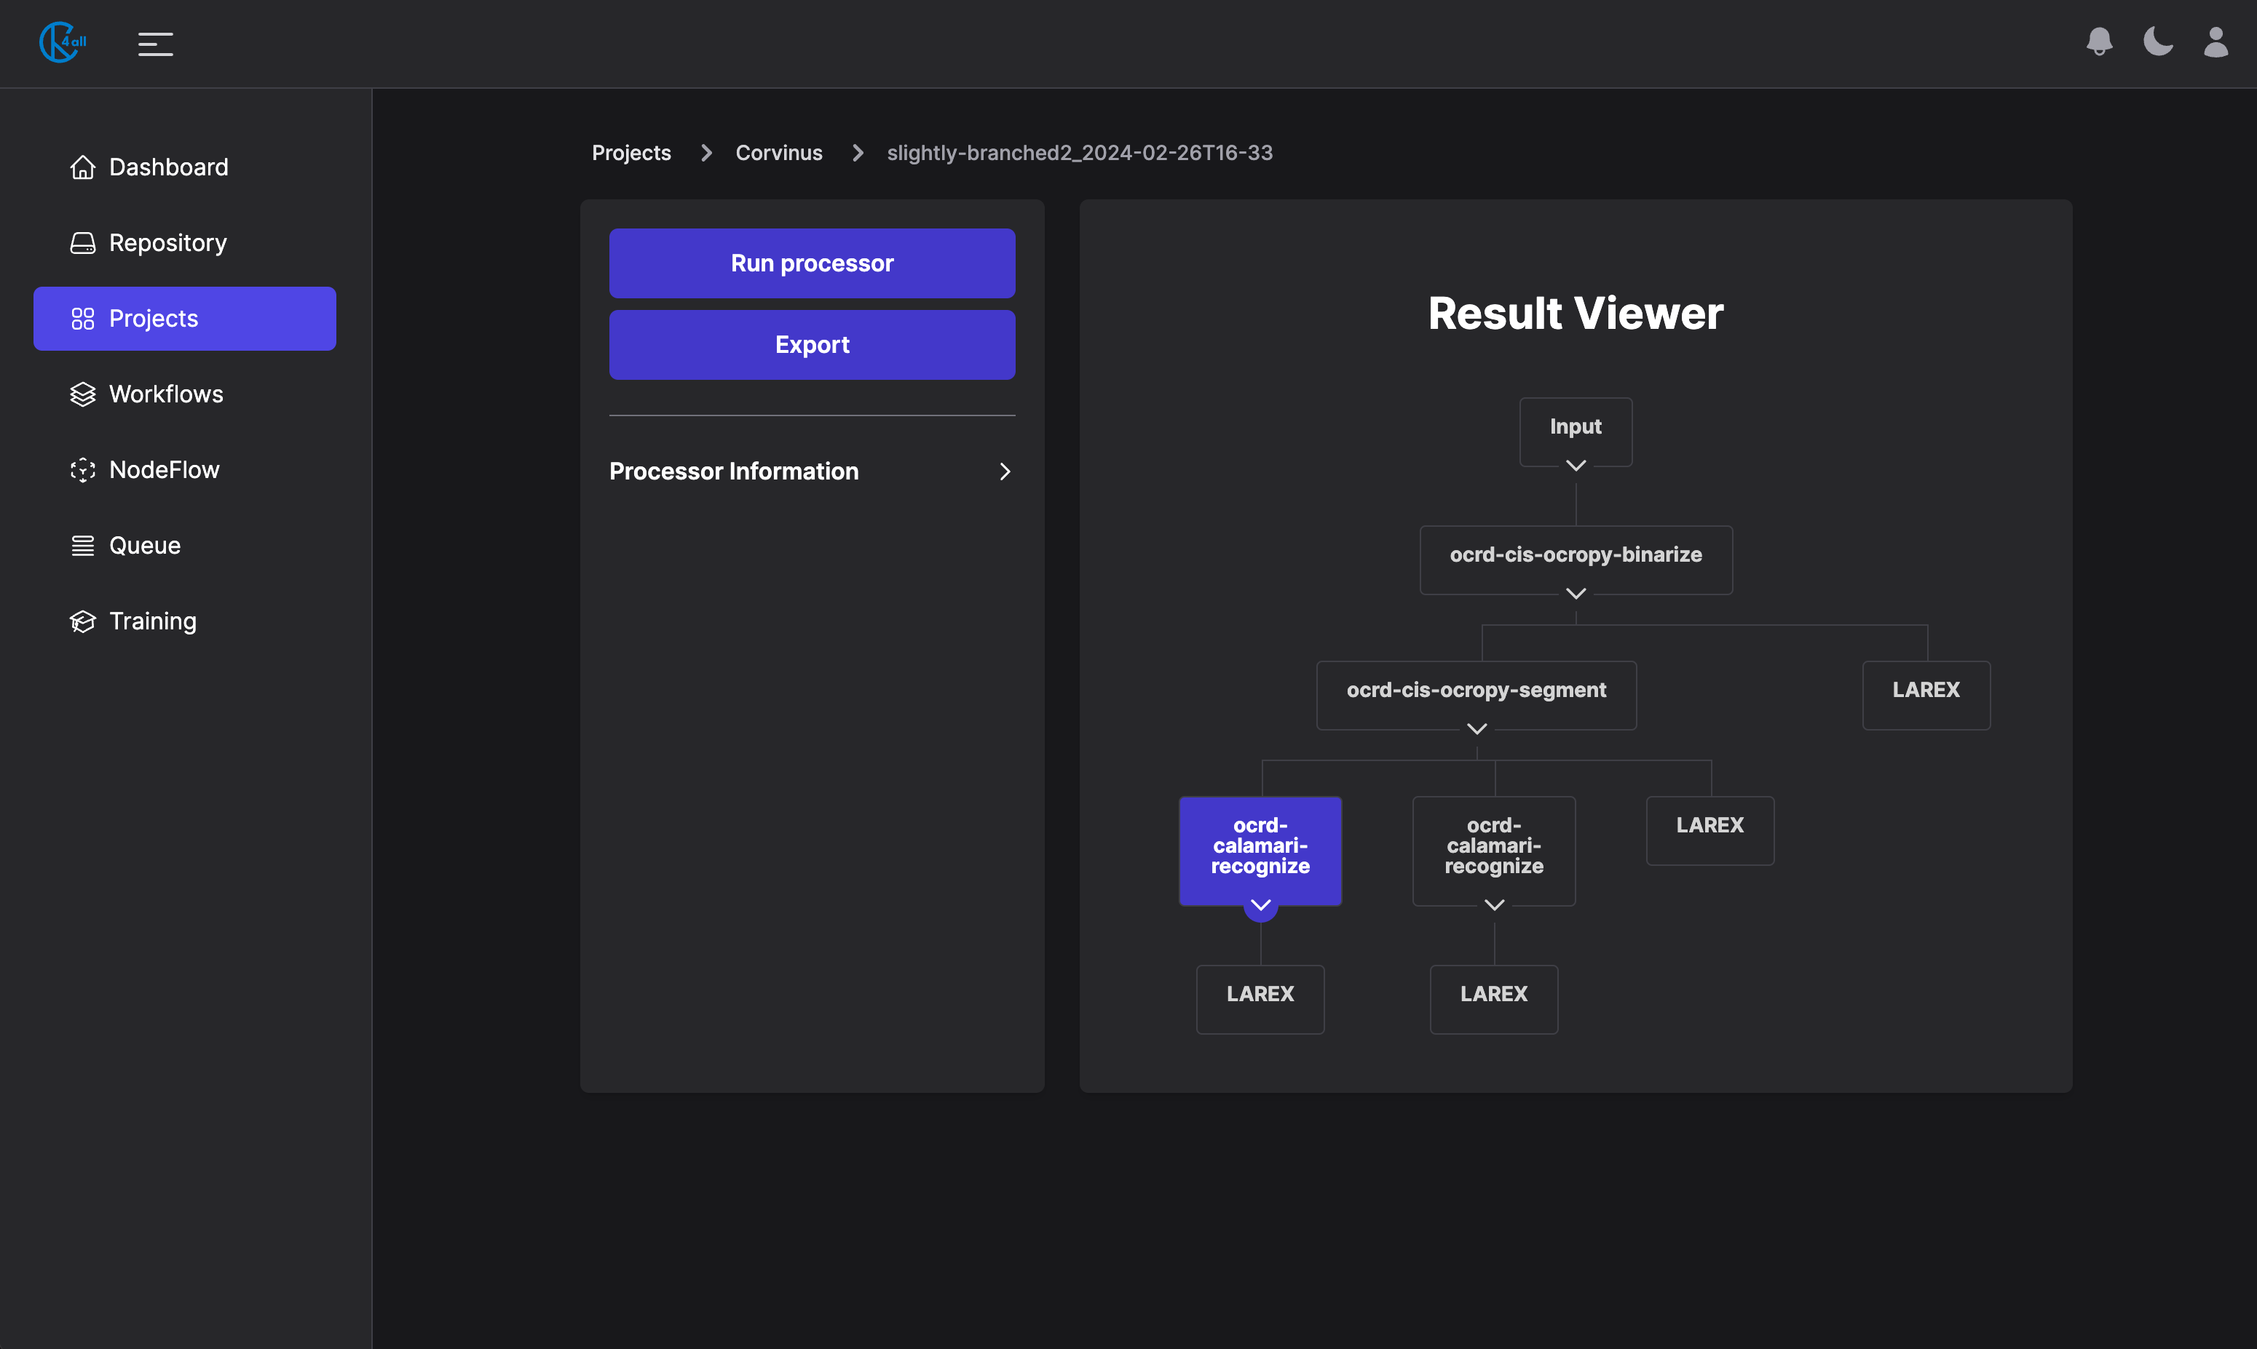
Addendum – OCR4all Interface

Slide 11
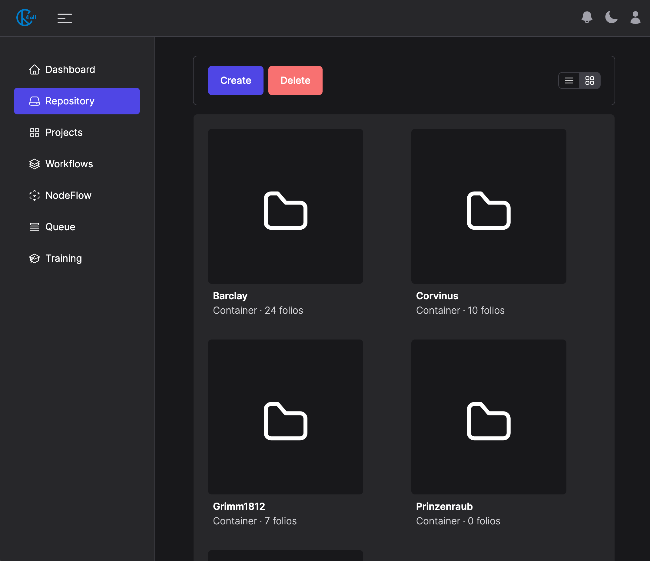
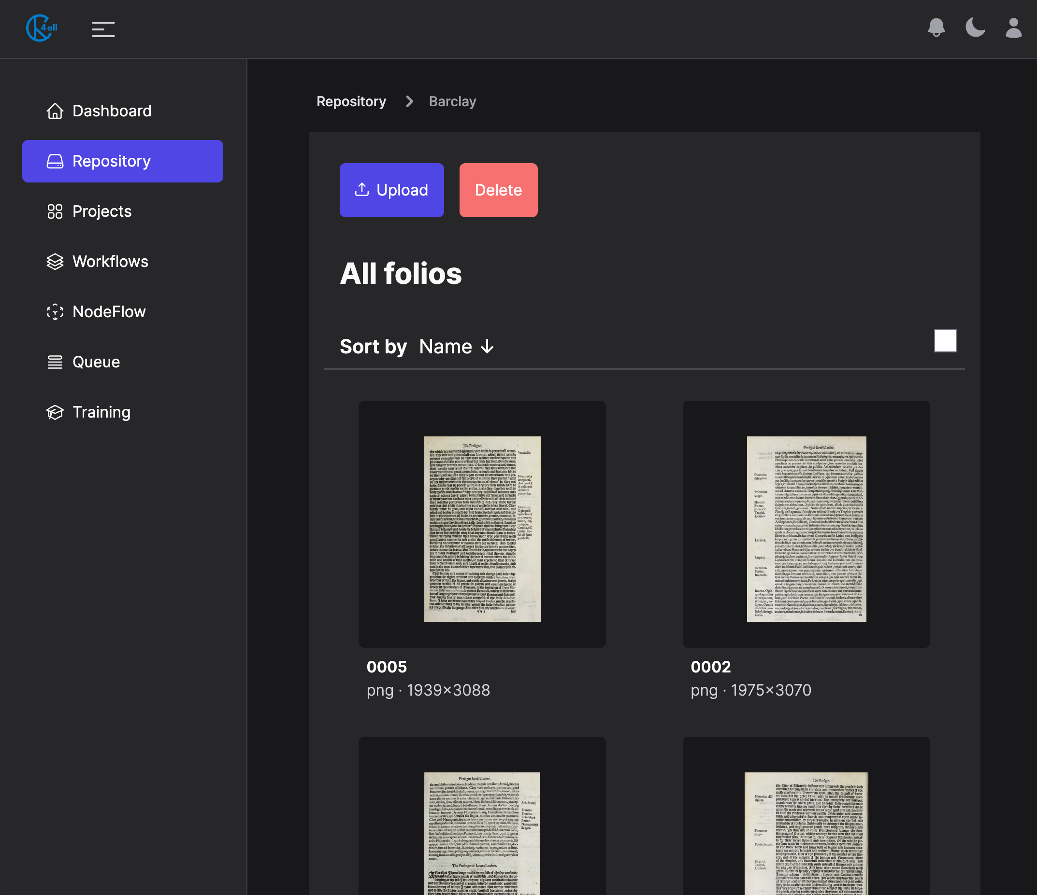
Addendum – OCR4all Interface

Slide 12
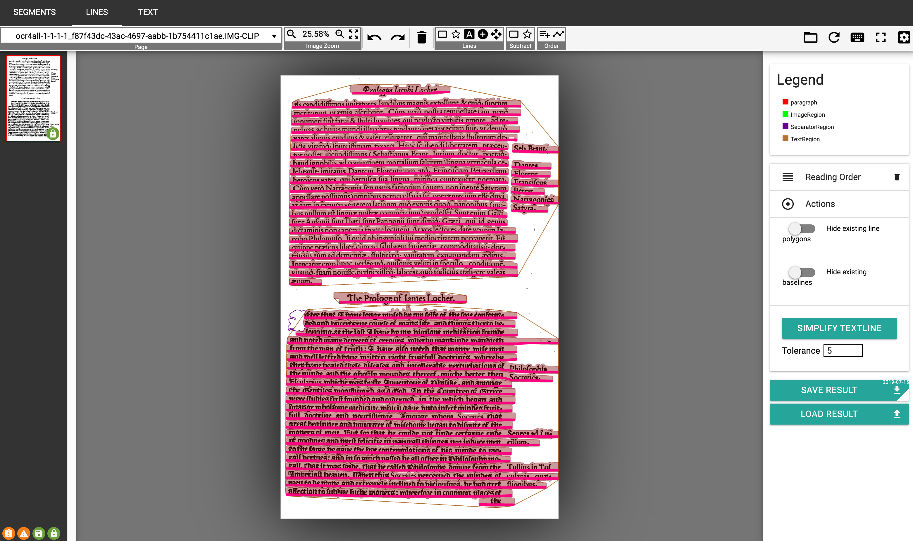
Addendum – LAREX

Slide 13
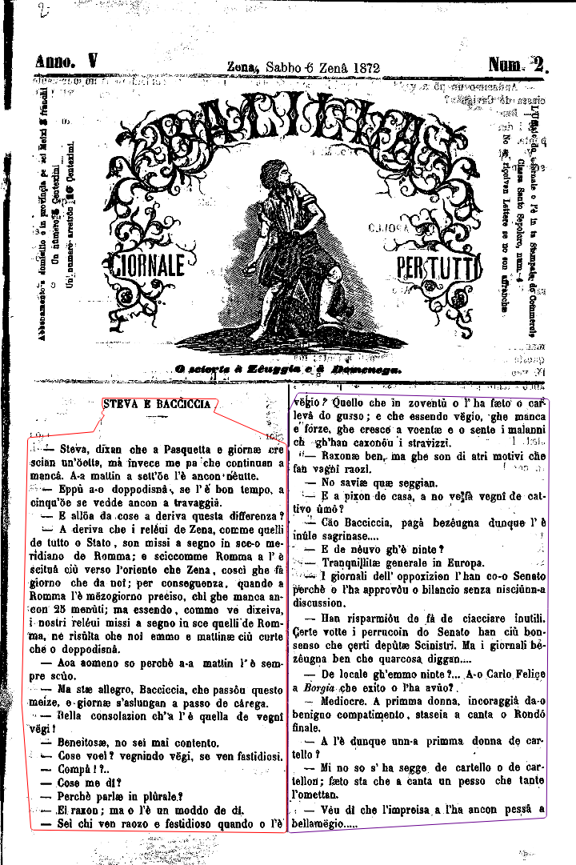
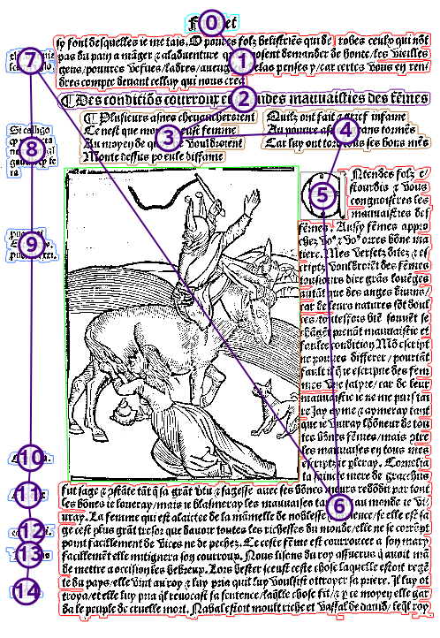
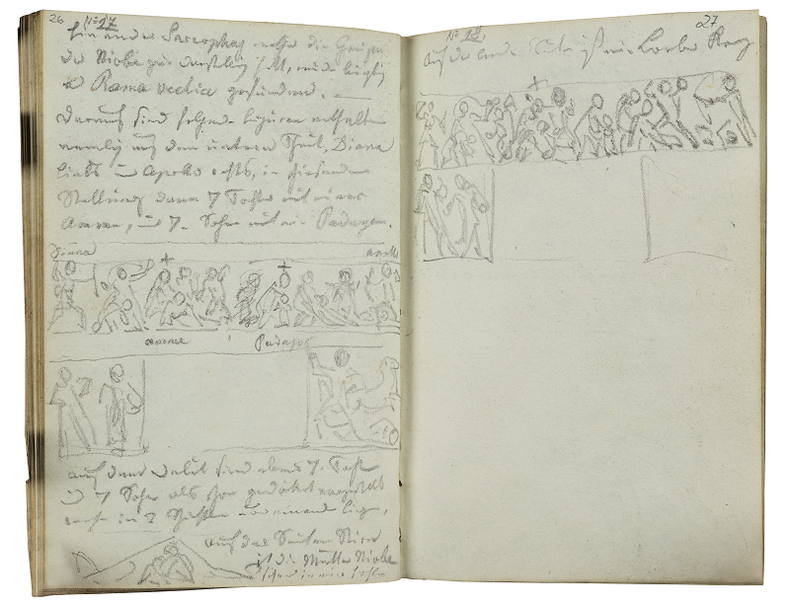
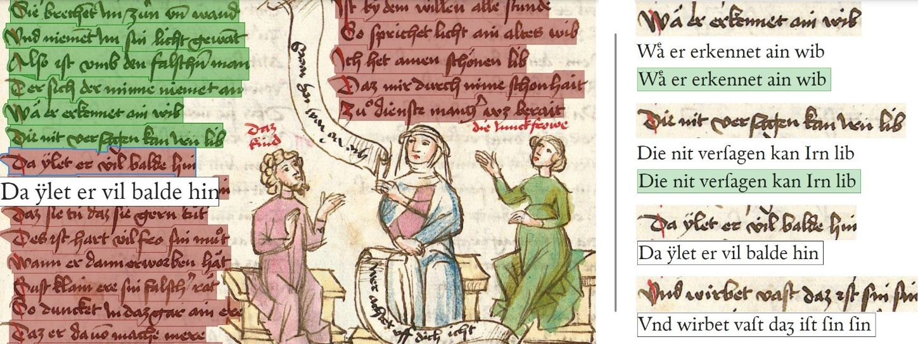
Addendum – Use cases

Slide 14
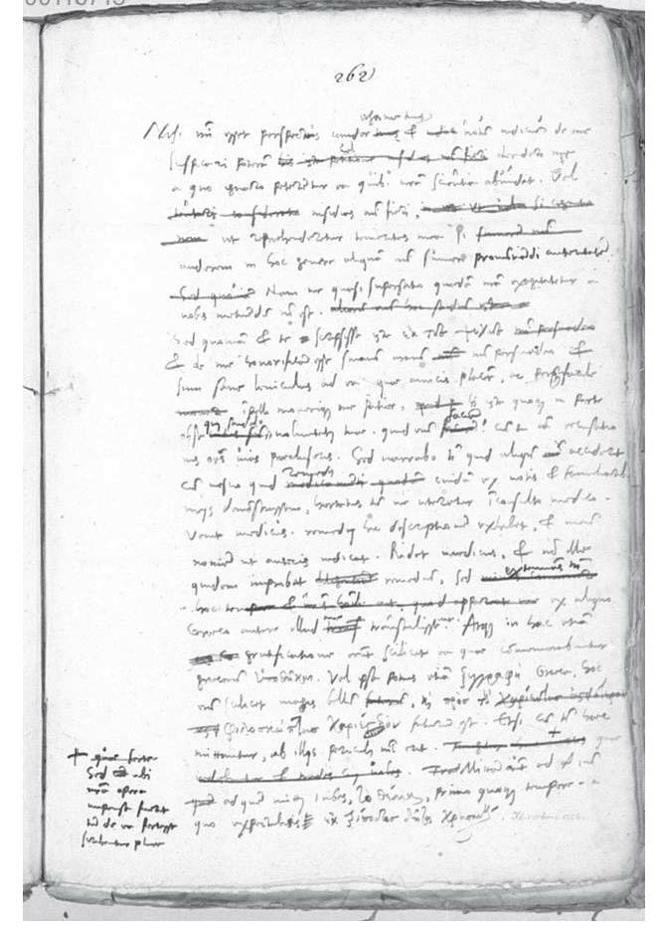
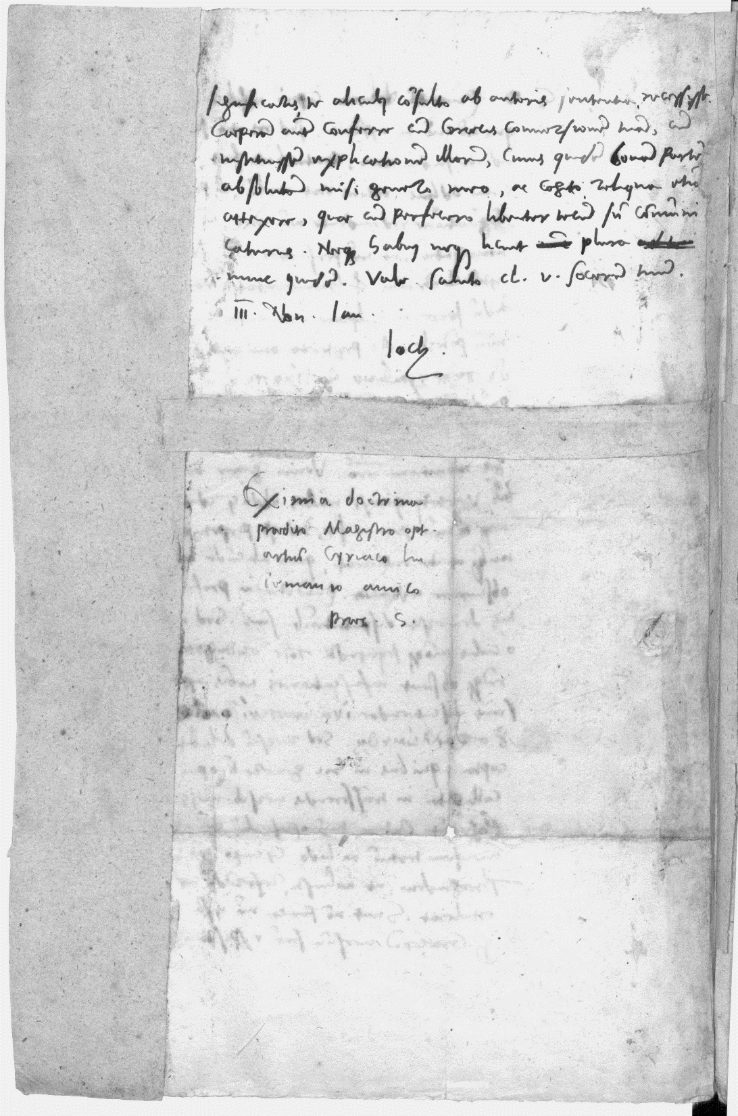
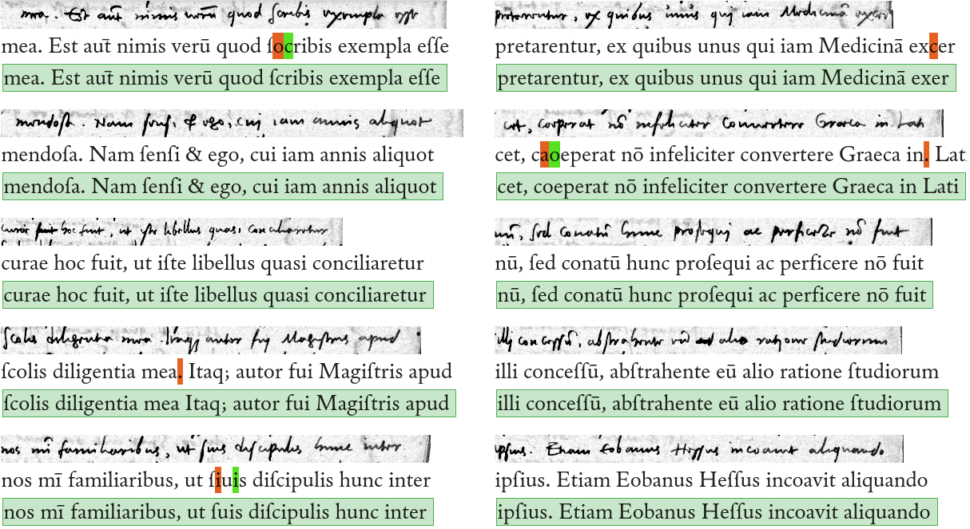
Addendum – Use cases
Camerarius himself: around 2% CER Correspondents: heavily fluctuating CERs depending on handwriting, scan quality, and amount of GT

