Slide 1
A web based tool for Import, Mapping and Harmonization of Tabular Data (applied to clinical data)
Lucas Kulla¹ ², Philipp Schader¹, Marco Nolden¹ ² and Klaus Maier-Hein¹ ²
1 Division of Medical Image Computing, German Cancer Research Center (DKFZ), Heidelberg, Germany
2 Helmholtz Metadata Collaboration (HMC), Hub Health

Slide 2
Motivation – the analysis pipeline
csv
API
xslx
json

Slide 3
Landing page

Slide 4
Upload data

Slide 5
Upload data – select reference schema

Slide 6
Upload data – preview reference schema

Slide 7
Upload data – file type not supported

Slide 8
Upload data – select sheet

Slide 9
Upload data – select header row

Slide 10
Data harmonization

Slide 11
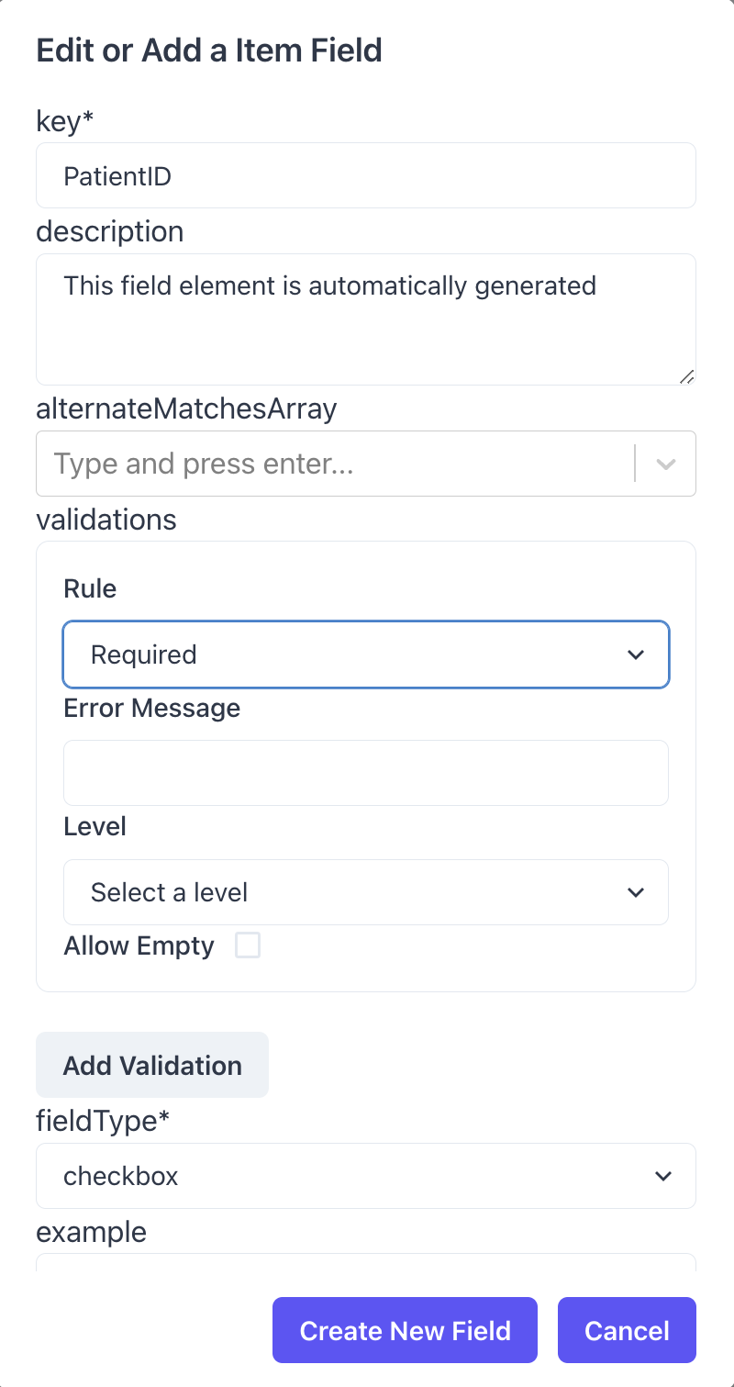
Data harmonization – add a Field

Slide 12
Validate harmonized dataset

Slide 13
Landing page

Slide 14
Data editor – complex harmonization

Slide 15
Schema editor

Slide 16
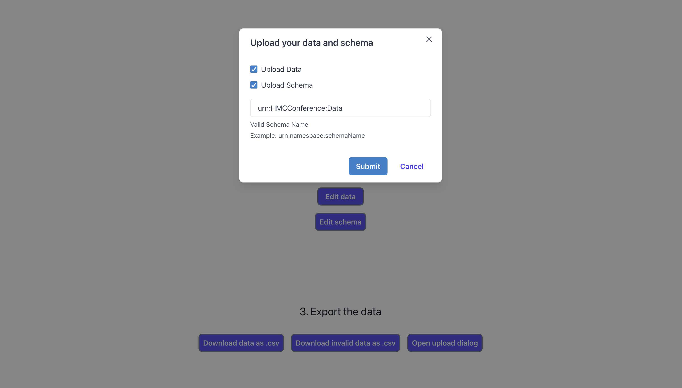
Upload data / schema to an API

Slide 17
A web based tool for Import, Mapping and Harmonization of Tabular Data (applied to clinical data)
Lucas Kulla¹ ², Philipp Schader¹, Marco Nolden¹ ² and Klaus Maier-Hein¹ ²
1 Division of Medical Image Computing, German Cancer Research Center (DKFZ), Heidelberg, Germany
2 Helmholtz Metadata Collaboration (HMC), Hub Health

