Slide 1

Python-Flask Shotsheet for ions and electrons teams
python-Flask-WTForms-MongoDB implementation of the current MicrosoftAccess ShotSheet
for keeping track of ions and electrons shots;
it is basically a fancy electronic lab notebook with enhanced queriability
HZDR · FWKT · Dr. Kristin Tippey · k.tippey@hzdr.de · www.hzdr.de

Slide 2

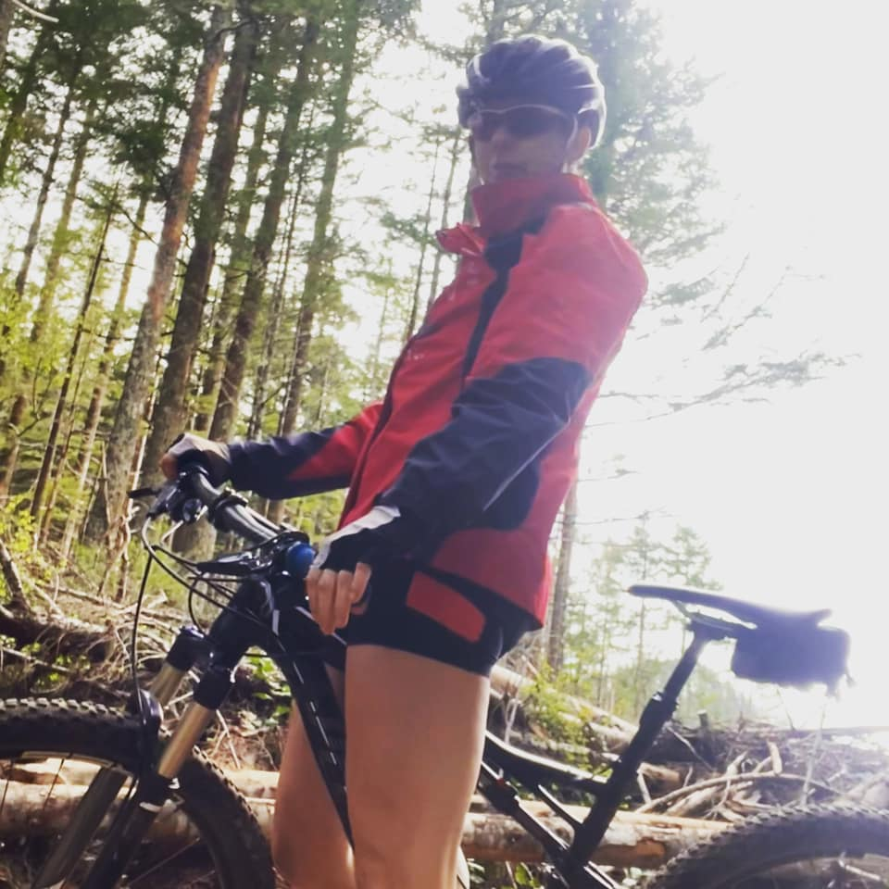

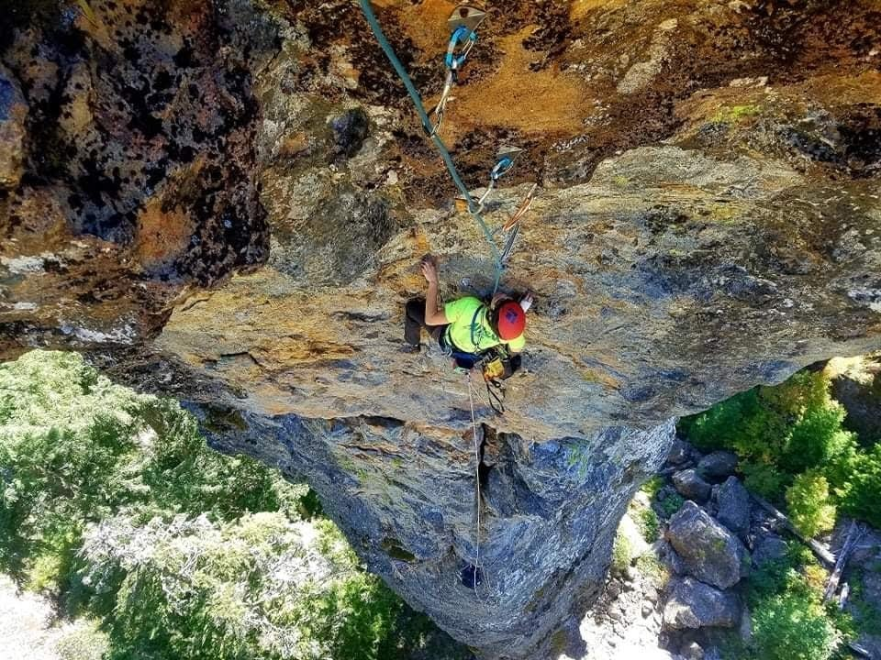
Who am I?
Kristin Tippey
PhD, Metallurgical & Materials Engineering, Colorado School of Mines
Some things I like: cycling, climbing, mountaineering.
As part of DAPHNE project, I‘m working on figuring out cleaning up metadata collection and storage
Figuring out nomenclatures for simulation codes and translating them to more curated text, sending to SciCat. Talking scientists into using the codes.
Building out some applications to make keeping track of data more streamlined

Slide 3
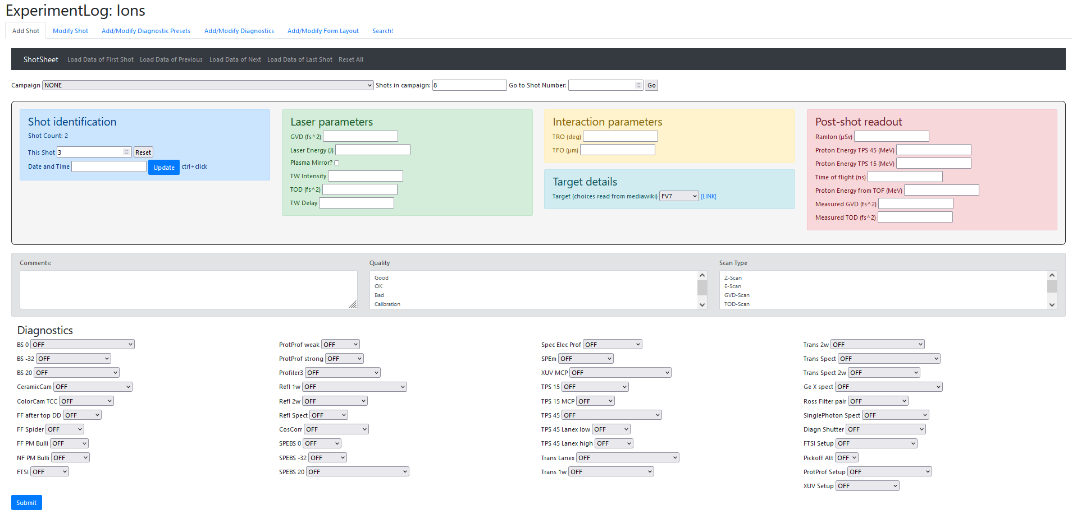
What is my Framework?
I‘m definitely more of a Materials Scientist who enjoys a coding hobby, mostly with Python + GitLab
Shotsheet is mostly Python with the necessary amounts of Jinja2, html, javascript, jquery. Installed via pyproject.toml, with some buildable documentation
waitress-serve --call shotsheet:create_app (http) OR
gunicorn -c SERVE.py SERVE:app (https)
ShotSheet is an attempt at a python-Flask-WTForms-MongoDB implementation of the current MicrosoftAccess ShotSheet for keeping track of ions and electrons shots; it is basically a fancy electronic lab notebook with enhanced queriability.
Data is input from a web browser and saved to a MongoDB database, where it can be queried either from ShotSheet or via other means, such as python script or Grafana.
The apps allow addition of information to the mongodb shots databases, as well as configuration of the input form, configuration of input form choices, ability to create and maintain layout templates with their own metadata, and search functionality.
2 implementations, one for Ions and one for Electrons
They are currently running on linux gateway fwklux9
Both still in the testing phase, although we are eager to begin capturing real data

Slide 4
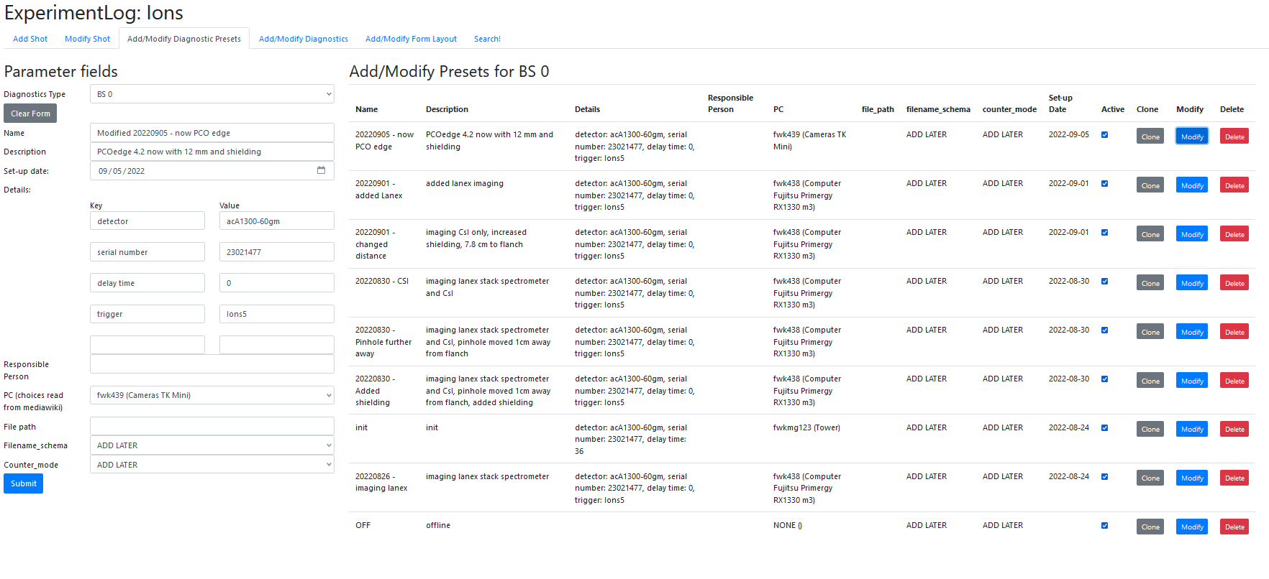
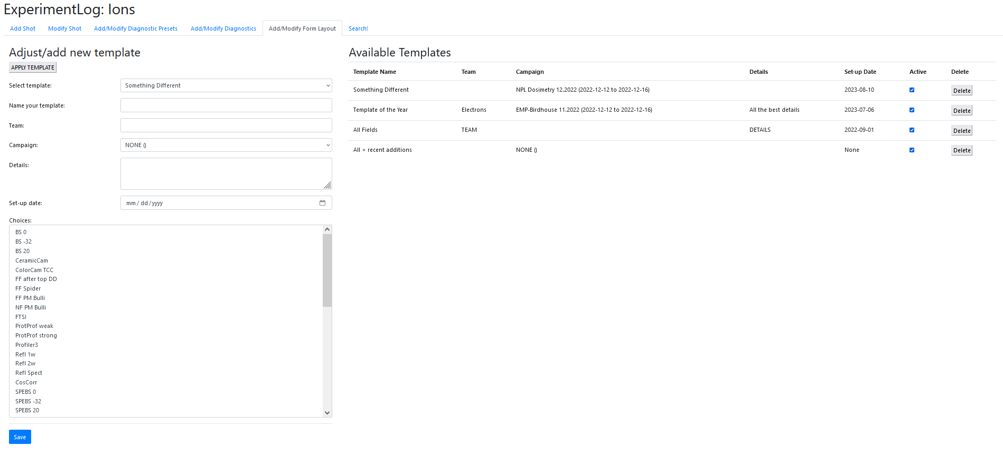
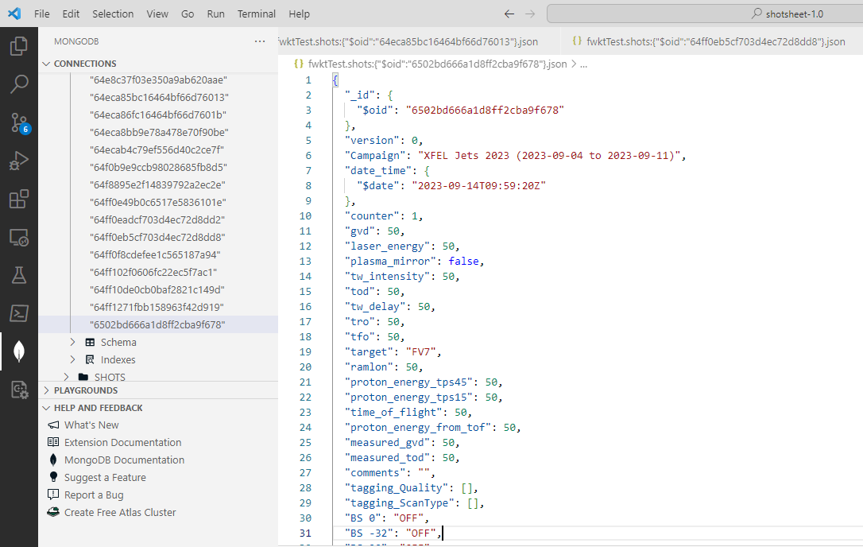
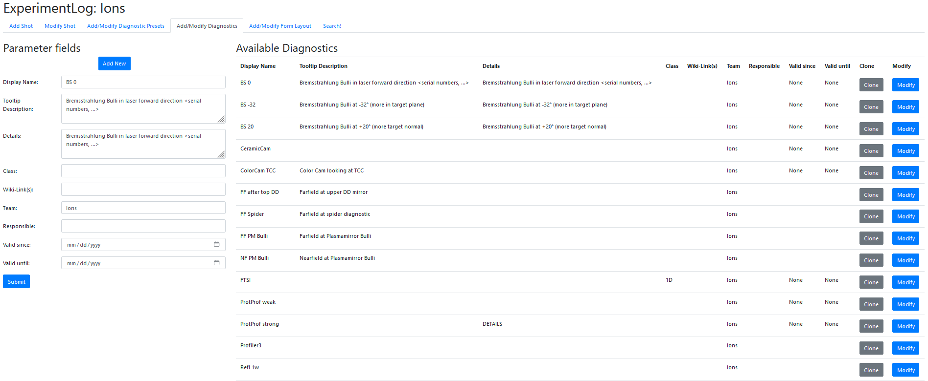
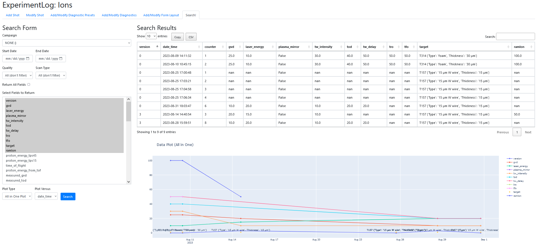
Configuring and Searching [ions]

Slide 5
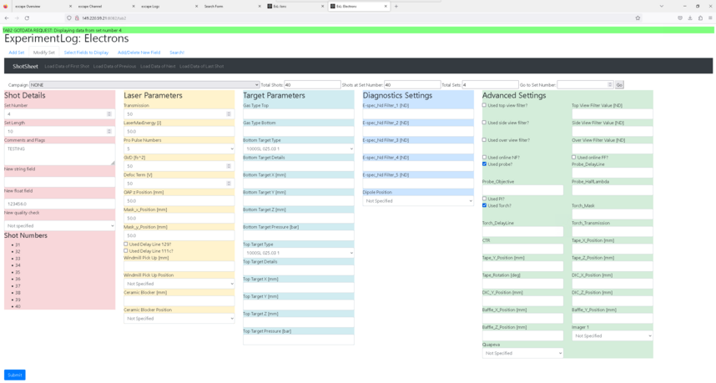
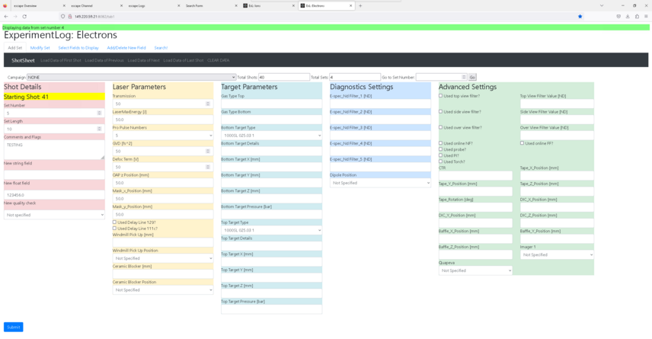
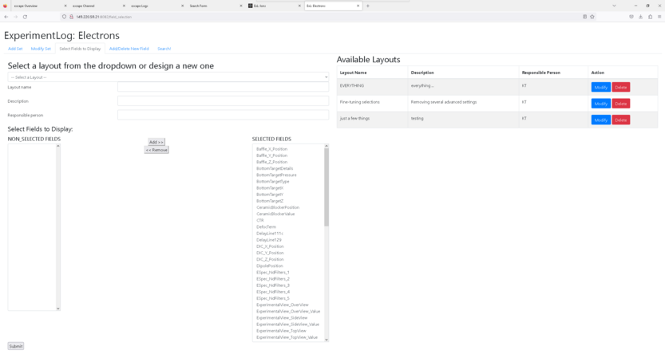
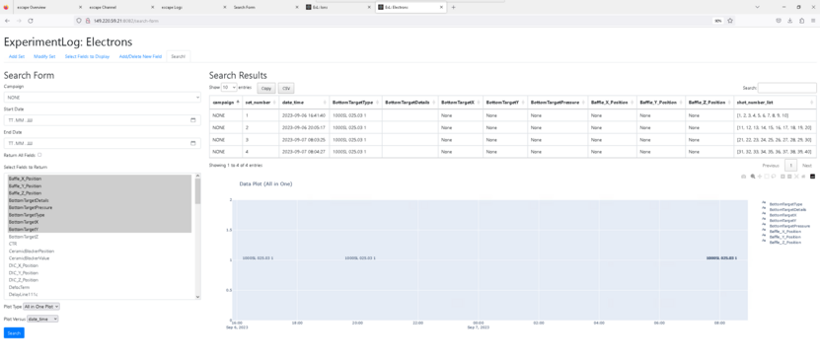
Shotsheet [electrons]

Slide 6
What are my Challenges?
How to handle multiple instances?
  Detect other open instances and can claim Master vs. Watcher or something like that.
  The closest I’ve come to identifying something workable is role-based access-control, with logins for the different roles
Prettying up the interface?
Allowing for an alias, some kind of easier name to remember than the IP address/port? Proxy?
How much to cache vs. clear?
Handling https
  Had an issue with cookies that rendered all csrf_tokens invalid on initial tryout. Removing safe cookies made it work again but I‘d rather keep security intact when possible. I think that means using https, but then I don‘t know how to make certificates that are trustworthy and don‘t need user to override non-safe site??
Demoing / Getting people to try it out?
  Made easier by other Shotsheet having issues accomodating increasing number of fields
  Discussing further requested/required features with users ... always leads to more requests

Slide 7
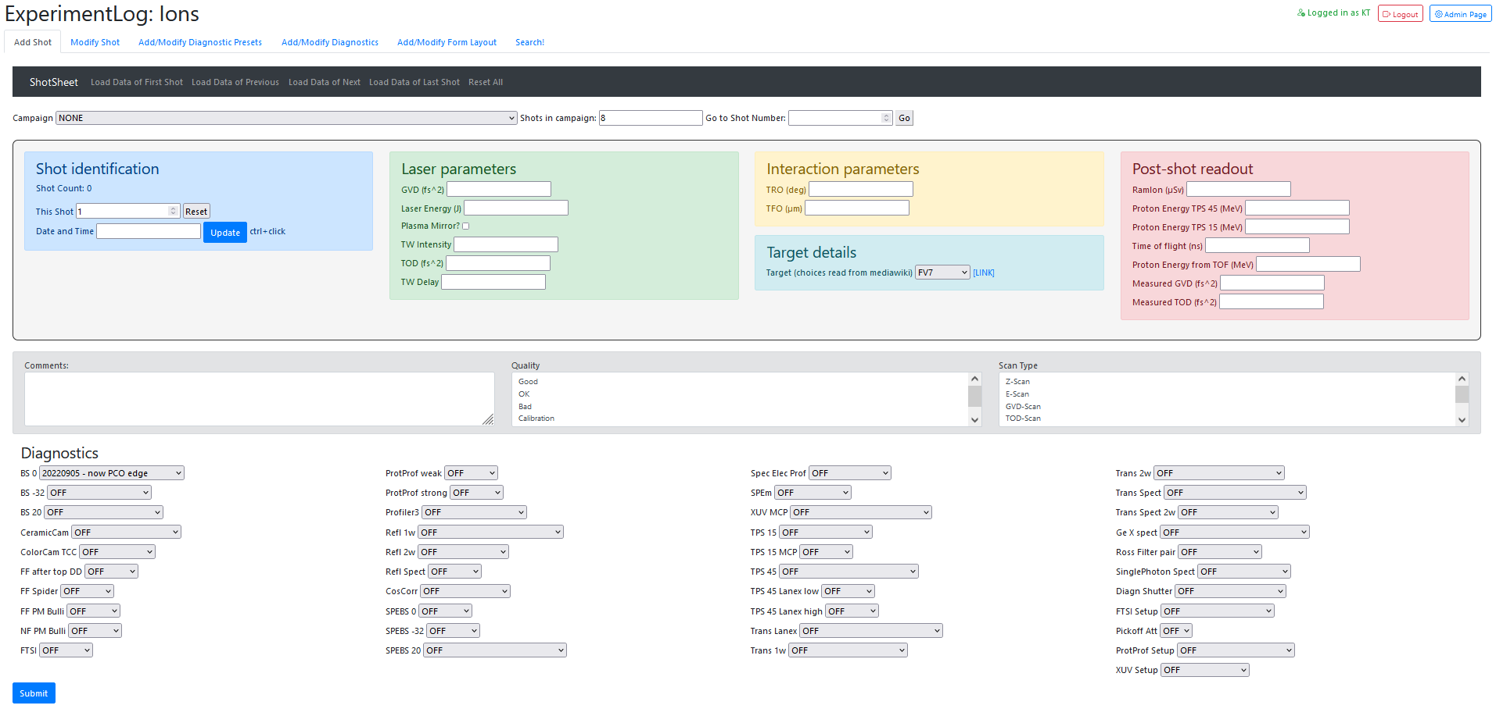
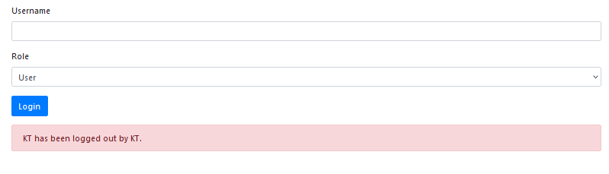
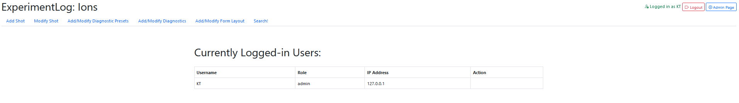
Access control ... Something like this ???
Login Page just to capture username and role
Admin-only view all logged in users and
remote user logout page

