Slide 1


HELPMI: defining MD standard for HIL
Helmholtz Laser-Plasma Metadata Initiative
A. Kessler¹, M. Kaluza¹, H.P. Schlenvoigt², F. Pöschel², A. Debus², V. Bagnoud³, U. Eisenbart³, J. Hornung³
¹ HI-Jena ² HZDR ³GSI
HELIPORT Final Meeting 14.06.2023

Slide 2
Outline
Missing Part in our HELIPORT Chain
  Some history
HELPMI Introduction
Meta Data for High Intensity Laser Systems
…. and Experiments
  First Draft
  Some advices from astronomy
Lessions learned
  How to involve Scientists and Technicians?
On the long way to free MD capable SW Stack
I have a dream…
???

Slide 3
Missing Part in HELIPORT Chain: MD for HIL
From NeXus Introduction (https://manual.nexusformat.org/introduction.html):
“A community of scientists and computer programmers working in neutron and synchrotron facilities around the world came to the conclusion that a common data format would fulfill a valuable function in the scattering community. As instrumentation becomes more complex and data visualization becomes more challenging, individual scientists, or even institutions, find it difficult to keep up with new developments. A common data format makes it easier, both to exchange experimental results and to exchange ideas about how to analyze them. It promotes greater cooperation in software development and stimulates the design of more sophisticated visualization tools.
…. and Simulation Codes!
The same is true for the HIL – Community! => so, let’s define one!
  But it turn out, not to be easy…

Slide 4
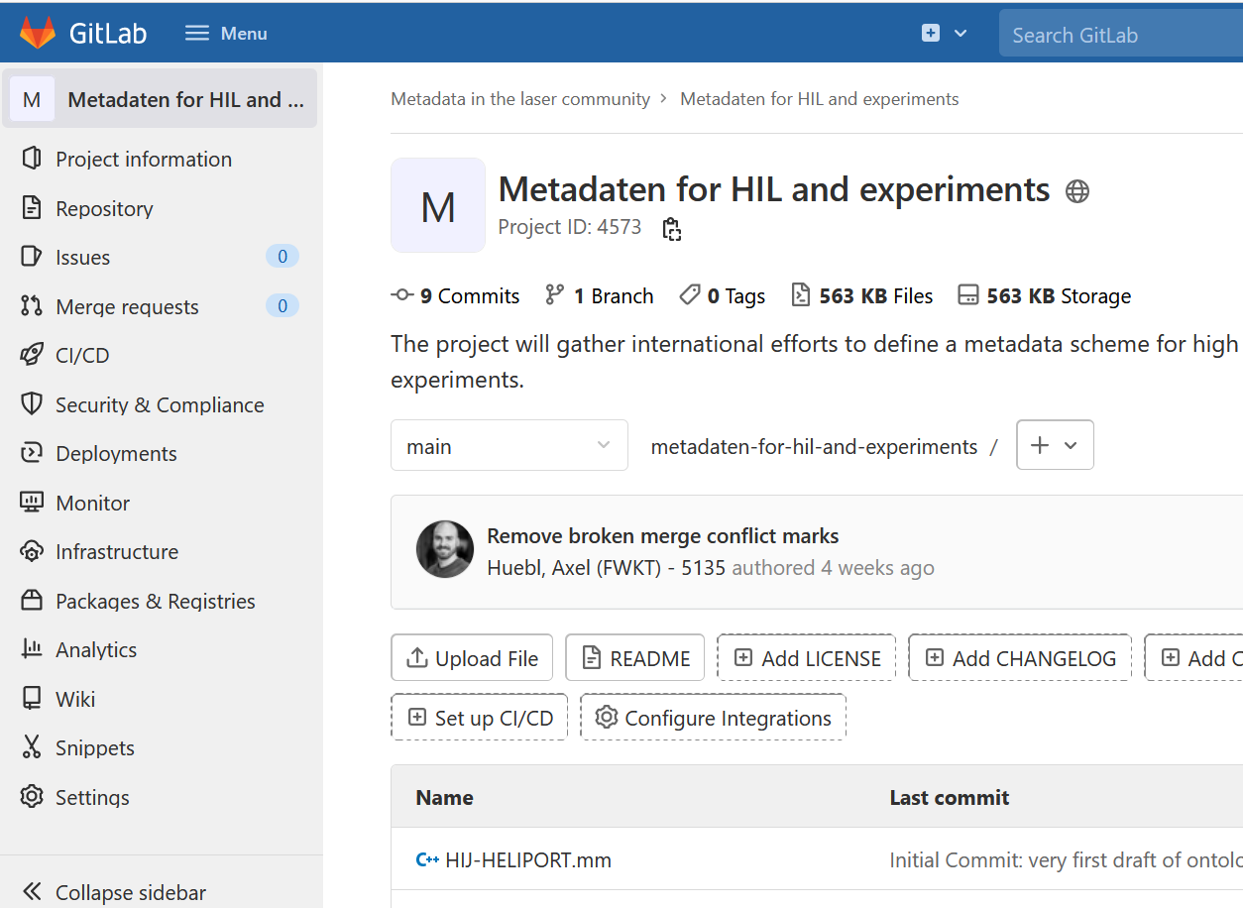
Trying to install collaboration for MD standard
In all workshops the need for MD standard is expressed
Ideas exist in many facilities
here is a lack of cooperation
=> lets bring different approaches together!
https://gitlab.hzdr.de/meta-laser/
Describe your work in wiki
Express wishes in Issues
Input is still limited...

Slide 5
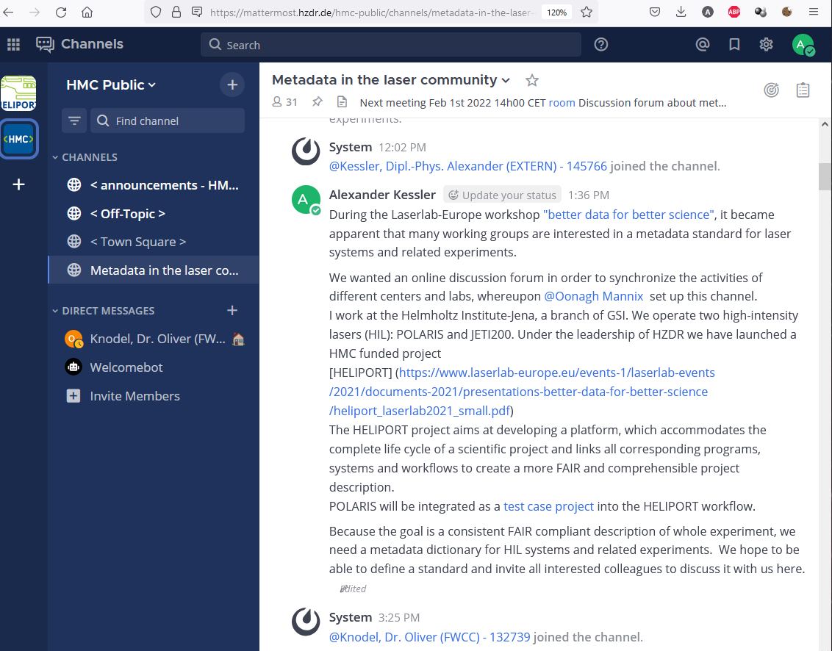
Trying to install collaboration for MD standard
Support from HMC
Oonagh Mannix (HZB), Witold Arndt (DLR)
Mattermost channel* -> Join us!
GitLab repository -> Contribute!
Technical advice on defining MD dictionary and ontology
Overview about existing MD Schemas
* https://mattermost.hzdr.de/hmc-public/channels/metadata-in-the-laser-community

Slide 6
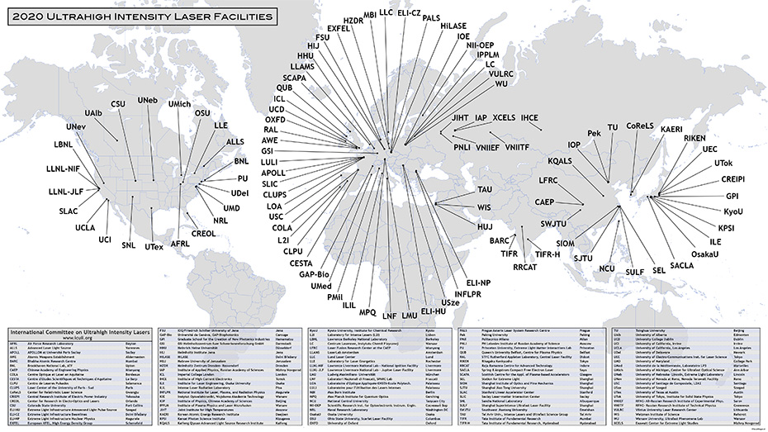
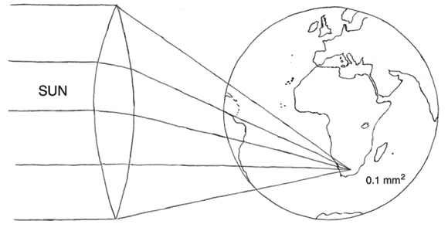
HELPMI: Who is our community
HELPMI: … Laser-Plasma …
Slide taken from H.P. Schlenvoigt: HELPMI @ HMC 2023 Kick Of Meeting
  Ultra-intense lasers can transform plasmas into particle-accelerating structures
    Ultra-fast (fs-ps), Joule-kJ laser facilties: ICUIL.org
    Chirped pulse amplification (invented 1985, Nobel prize awarded 2018)
Schwoerer H. (2008). Particle acceleration with lasers. S. Afr. J. Sci. 104, 299-304.
https://www.icuil.org/activities/laser-labs.html, Interactive map

Slide 7
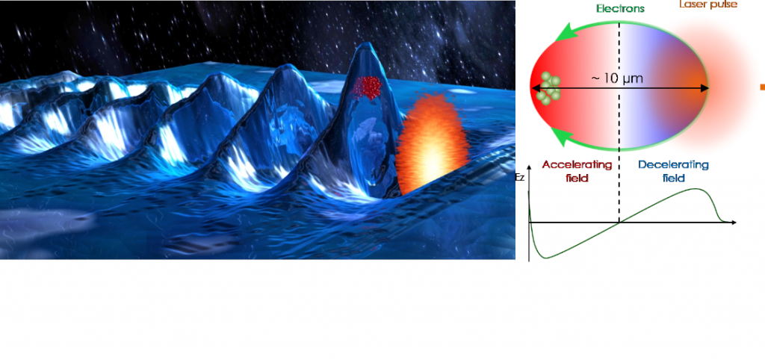
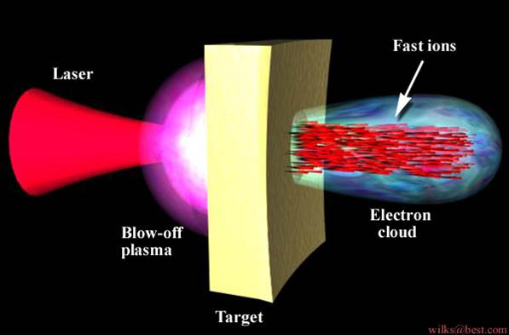
HELPMI: Who is our community
HELPMI: … Laser-Plasma …
Slide taken from H.P. Schlenvoigt: HELPMI @ HMC 2023 Kick Of Meeting
  Ultra-intense lasers can transform plasmas into particle-accelerating structures
    Electron acceleration and ion acceleration in high gradients, potentially reducing the accelerator‘s size
      Inherent ultra-short time structure and thus high peak currents
    Accelerating structures are optically generated and transient
      Fundamental research focusing onto scalings, specific regimes and adequate control
  Applications
    Small-scale accelerator substitute (Nuclear physics, Radiation physics, Medical research)
    Secondary radiation sources (X-rays, γ-rays, Neutrons, Free-electron lasers), fusion energy research
  Numerical modelling (digital twin) crucial for micro-physical understanding
    Expensive simulations up to exascale computing, GPU-accelerated
https://loa.ensta-paris.fr/research/upx-research-group/laser-wakefield-acceleration-lwfa/

Slide 8


HELPMI: Who are behind the project?
HELPMI: Helmholtz Laser-Plasma …
Slide taken from H.P. Schlenvoigt: HELPMI @ HMC 2023 Kick Of Meeting
  HZDR
    Collaborations with large labs, e.g. for FEL (Soleil, FR), proton acceleration (J-Karen-P, JP), Radiobiology
    Developer of PIConGPU and main contributor to openPMD
  GSI
    High-energy laser system PHELIX, coupled with ion beam facilities of GSI
    Expertise in warm dense matter, high-energy density physics and energy-loss measurements
  HI Jena
    Operation of two independent laser systems, to be synchronized in future
    Expertise in laser-particle acceleration, high-resolution probing, X-ray physics and spectroscopy
  In total: 6 laser systems (PHELIX, POLARIS, PEnELOPE, JETI, Draco, ReLaX, DiPOLE), 5 laser architectures (Nd:Glass, Yb:Glass, Yb:CaF₂, Yb:YAG, Ti:Sapphire), many in user operation

Slide 9
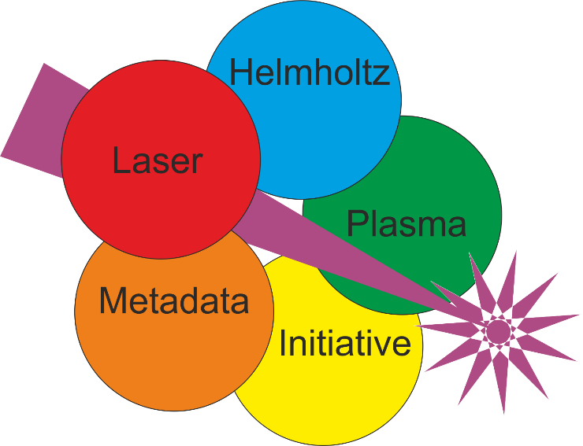


HELPMI main goals
HELPMI: … Metadata Initiative
Slide taken from H.P. Schlenvoigt: HELPMI @ HMC 2023 Kick Of Meeting
  Develop F.A.I.R data standard for LP community
    Develop vocabulary for laser-plasma experimental data
      Human- and Machine-readable implementation, extensible for future developments
      In close contact with laser-plasma community e.g. via workshops and project observers
    Extend existing openPMD standard and API towards experimental data
      Make openPMD extensible
      Adopt design of existing NeXus standard (from Photon-Neutron experimental community)
        E.g. experiment geometry data, incremental analysis
      Apply vocabulary and design features to openPMD
        Possibly interchangeable/-operable with NeXus
  Generalized and F.A.I.R. data standard for whole LP community
  (simulations and experiments)
  Connect with Photon and Neutron science community

Slide 10
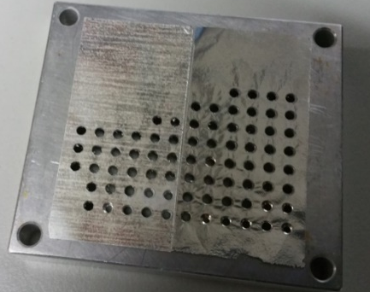
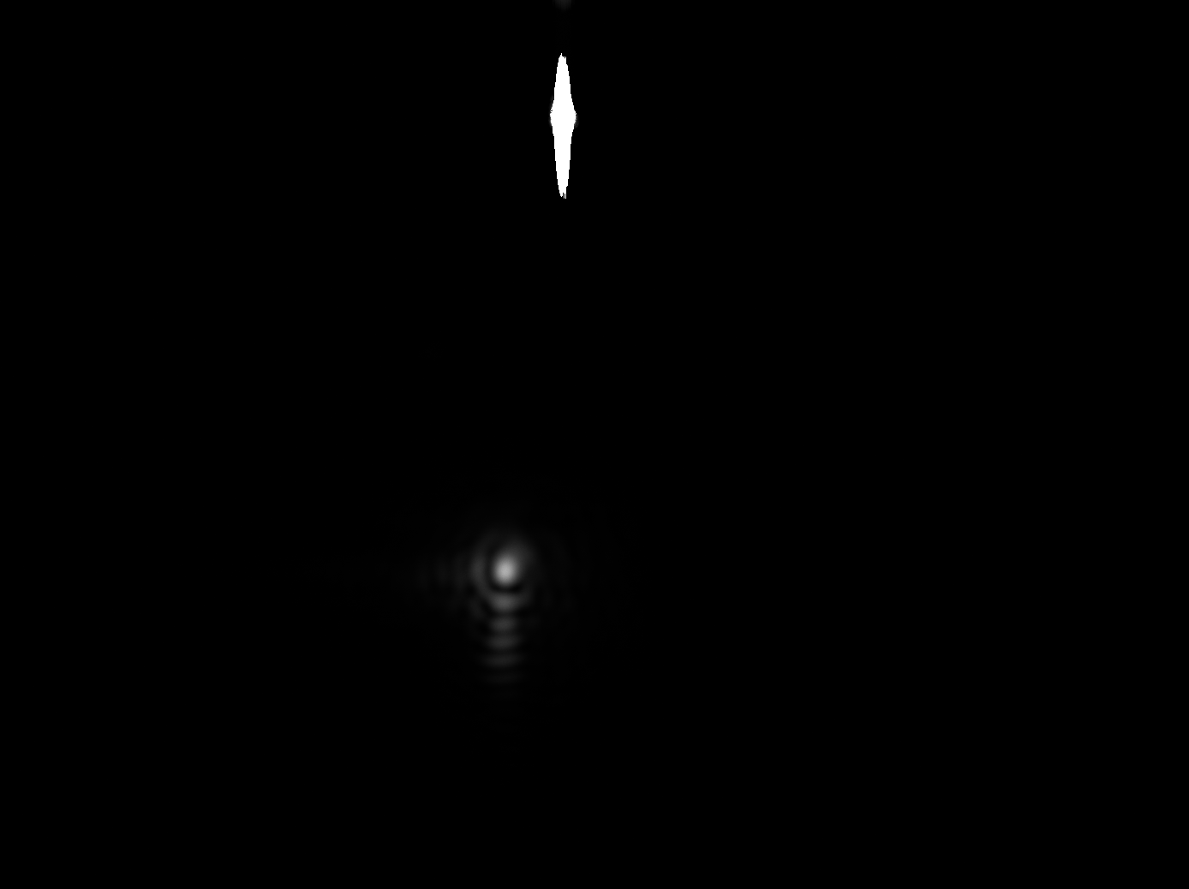
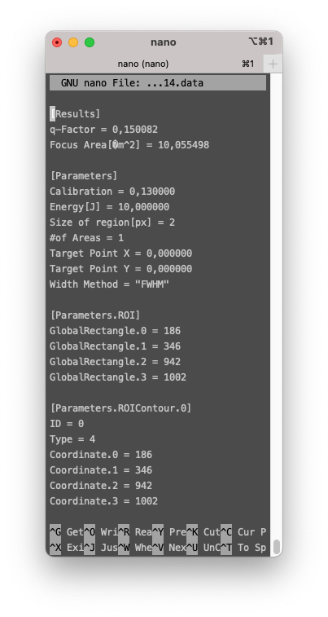

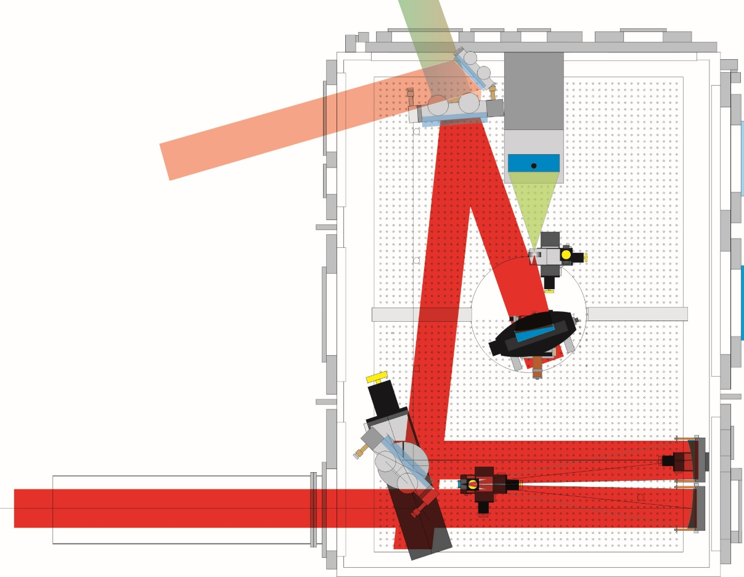


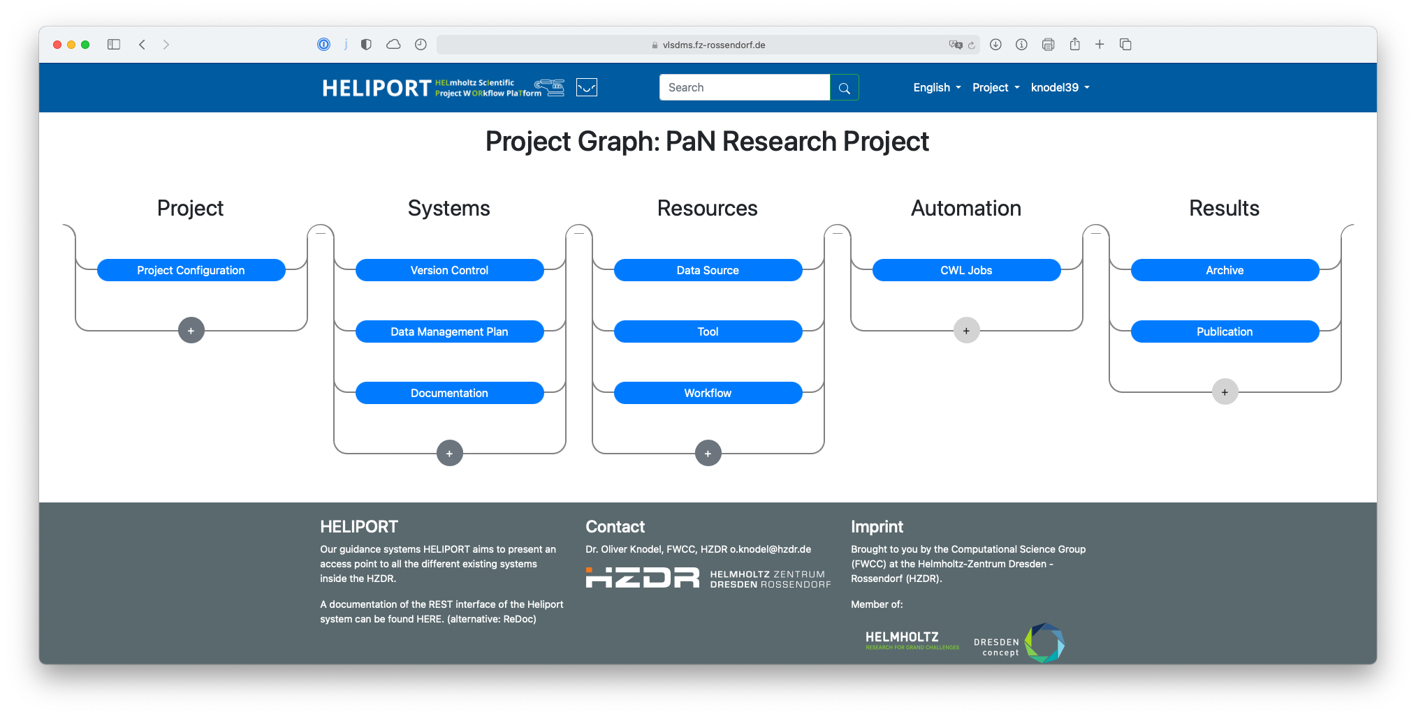
HIL typical experimental Setup
Back-reflection diagnostics
Online proton diagnostics
Laser pulse diagnostics
nearfield
farfield
laser energy
prepulse-contrast
(photo diode)
Experimental setup: 1…15 J, 120 fs, AOI = 0°
linear and circular polarization
targets: 5nm…500nm DLC-foils
  In the HELIPORT project, our goal is to bring all together: images, settings, target metadata and everything else.
l/4-
waveplate
Malte C. Kaluza, Contrast Dependence of Laser-Driven Proton Acceleration, 18th Advanced Accelerators Concepts Workshop, Breckenridge, US, (2018)
Notes:
Another view of a typical experimental setup is shown here: The Arrangements of the optics and the different diagnostics. Here is the beam … diagnostics. A foil after the experiment.
KLICK
Here the target, a typical resulting images, and the corresponding metadata. Data File and image have both the same filename, with endings .png and .data in the filesystem.
KLICK
With Heliport we can attach an individual unique identifier to ever digital object, link these objects together and keep track of them. Later we can use the Handle to import the Digital Object into a workflow and analyze the Associated Metadata or select an Object for an Data Publication — Author, Description and everything else comes from the Heliport project description.

Slide 11
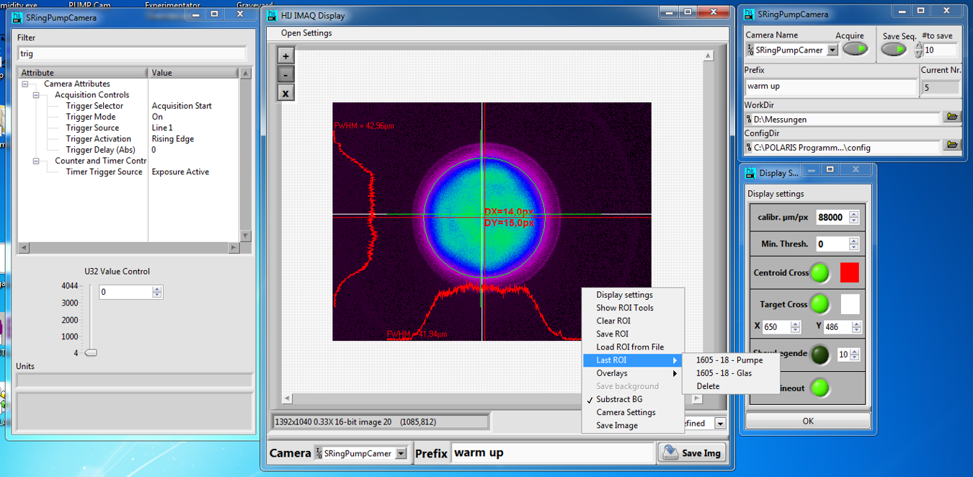
A naive Meta Data Ansatz
HIJ-Vision Lib https://git.gsi.de/HIJ_Vision/HIJ_Vision_Project
saves MD in naive ansatz
  Region Of Interest (ROI)
  Link to Background Image
  and so on, everything that is important for provenance!
BUT: It is not standardized!
  although it is possible to reproduce the results high manual and mental effort is required! (e.g. to understand how LabVIEW defines ROIs).

Slide 12
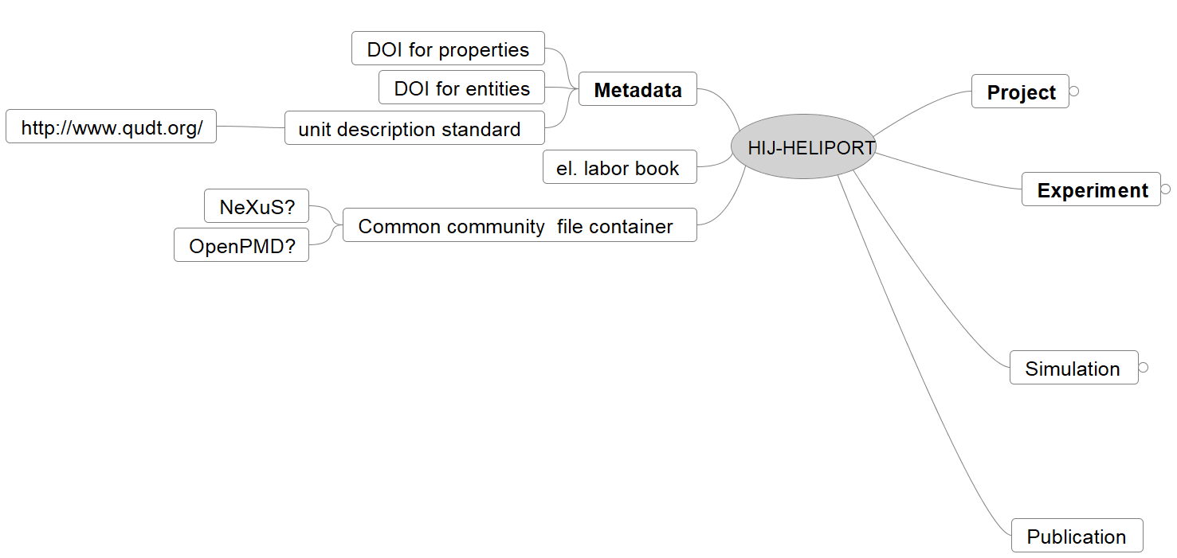
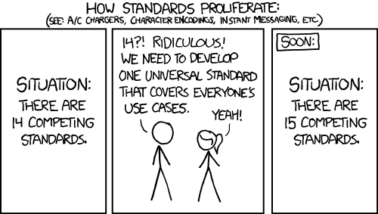
Topics to be described by Meta Data
A mind map in order to get overview about topics to be described
By Randall Munroe: https://xkcd.com/927

Slide 13
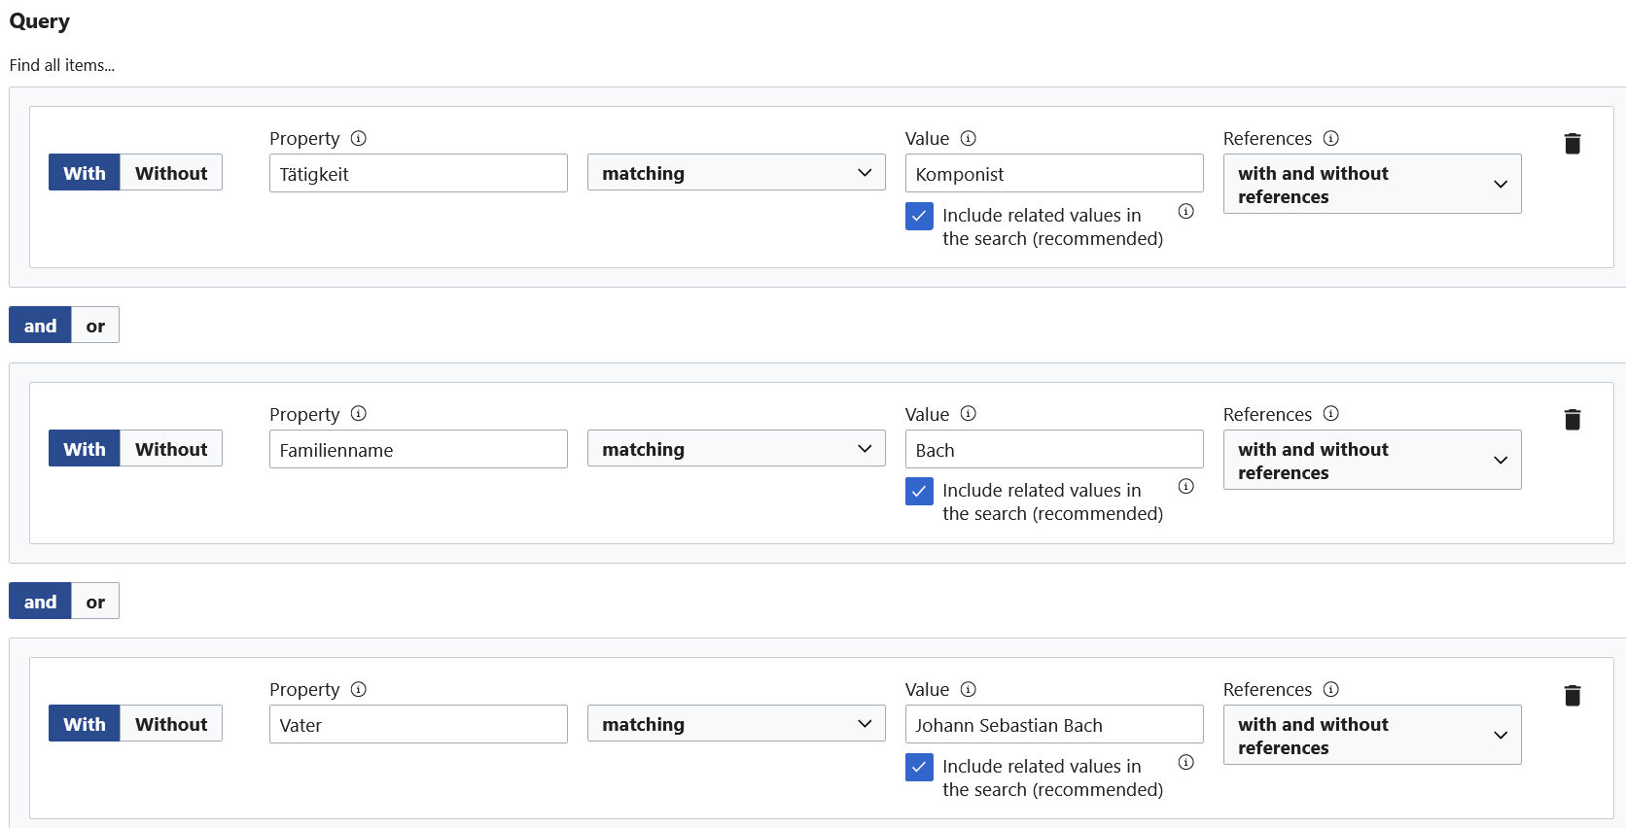
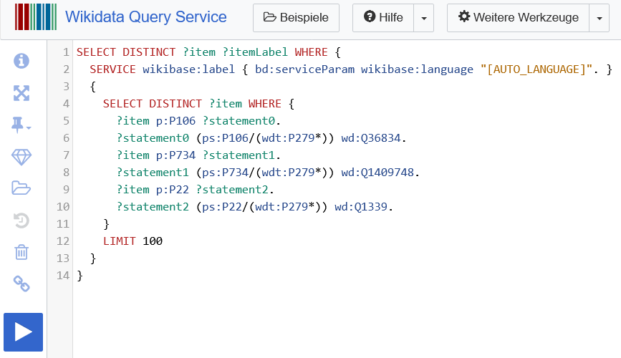
My imagination about dictionary

Slide 14
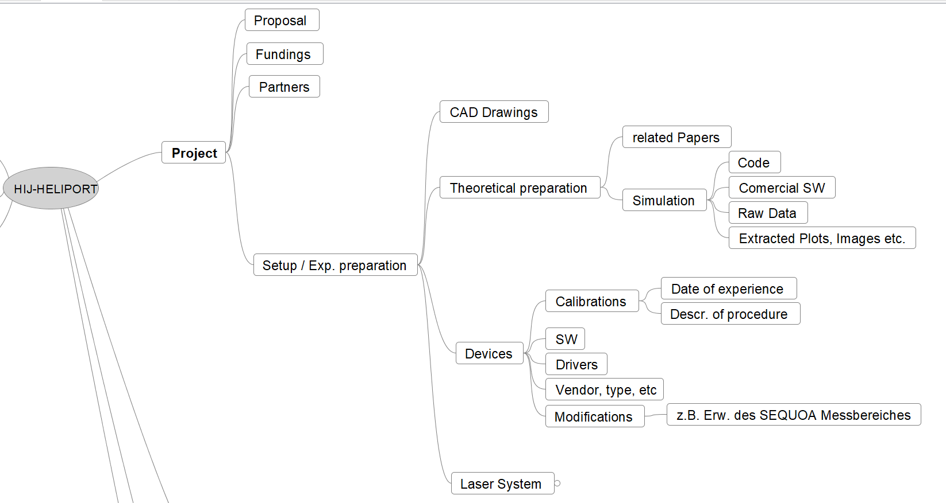
Topics to be described by Meta Data

Slide 15
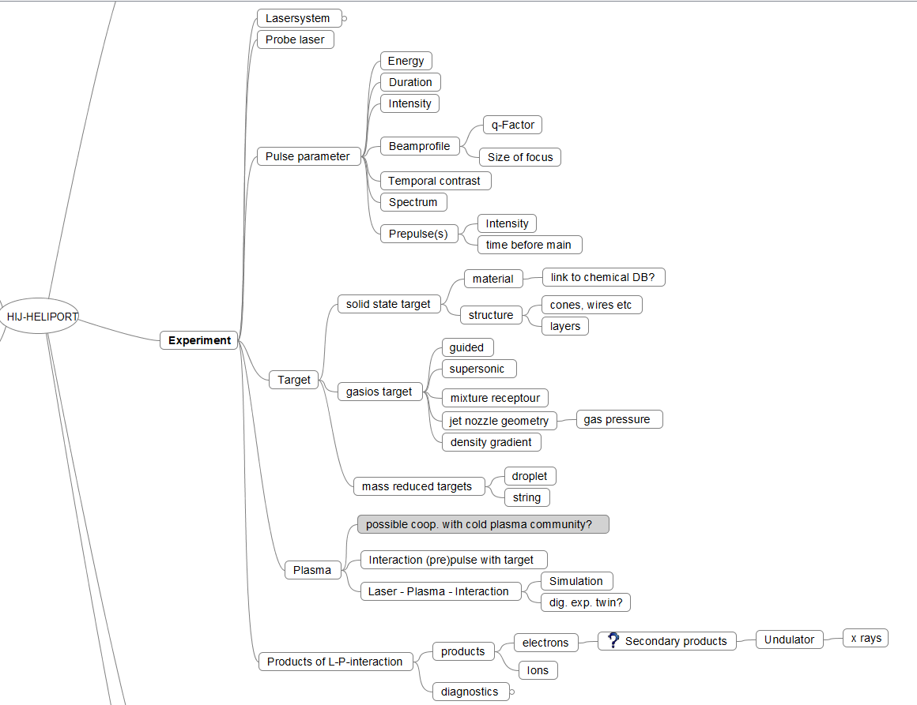
Topics to be described by Meta Data

Slide 16
some good advices from Astronomy
Advices from Jelle de Plaa (SRON). I asked him at thüringian RMD days to share experience about OGIP, FITS, ASDF and co.
  You need a strong organization behind (NASA)
  … a long breath
  … a lot of efforts to keep community together
From this point of view: The HMC approach to supporting short-term projects produces butterflies: beautiful, but short-lived!
(some music to this: Rajaton - Butterfy https://www.youtube.com/watch?v=st4zI_37JtU )

Slide 17
Lesions learned, or my experience with LabVIEW
In the long term: don't rely on a profit-oriented stock exchange-listed enterprise. That's it!

Slide 18
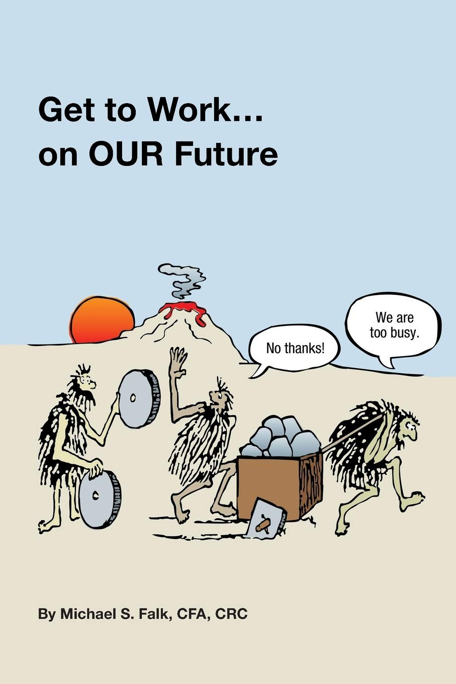
Lesions learned, or my experience with physicists
Youthfully confidence: we can do EVERYTHING!
  well, theoretically: Yes… But sometimes it is good to ask an expert
Never RTFMs!
  And misusage your SW!
What the farmer doesn't know, he doesn't eat!
  Prefer to use a reliable stone-age SW than to try to debug a new one
  Don’t accept an abstract layer without obvious benefit!
  Never schedule time for something except for experiment
Don’t care about building a system
  a lot of standalone 3th Apps for devices with vendor specific formats

Slide 19
Consequences
Barely one scientist will care about MD!
The MD Management must be so transparent as possible for the user!
SW tools must be user-friendly and provides immediate benefit!
We need a long-breath!
  … long support
  … dedicated experts cares about
we need a very solid SW stack as starting point!

Slide 20
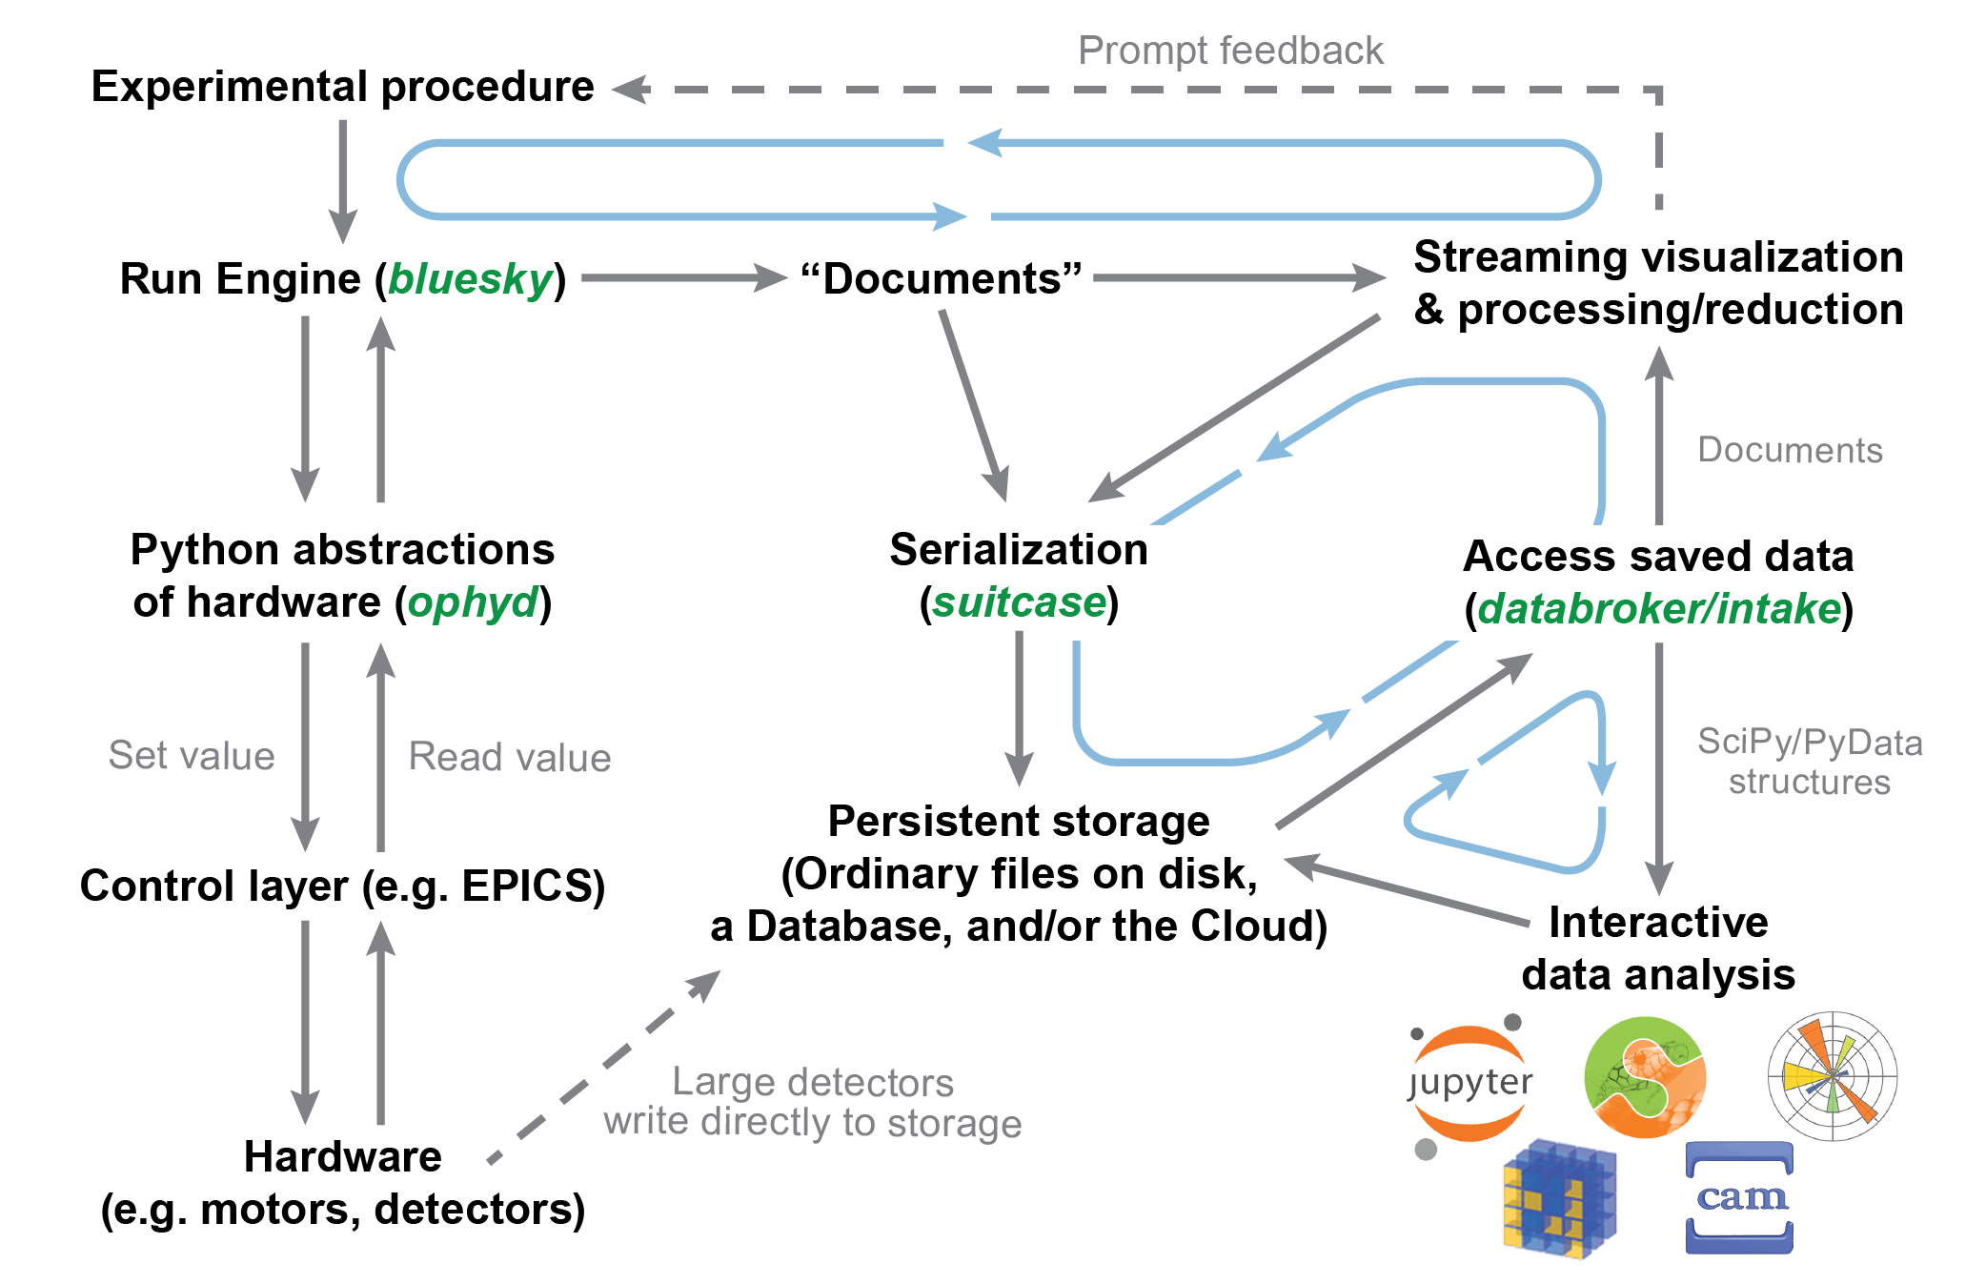
Possible SW Stack to continues produce MD
Promising candidates:
EPICS (may be TANGO) + BlueSky https://blueskyproject.io/
BlueSky closes the gap between Experiment and automatic MD Storage!
Experiment control via Jupyter Notebook
Offers automatically a lab book

Slide 21
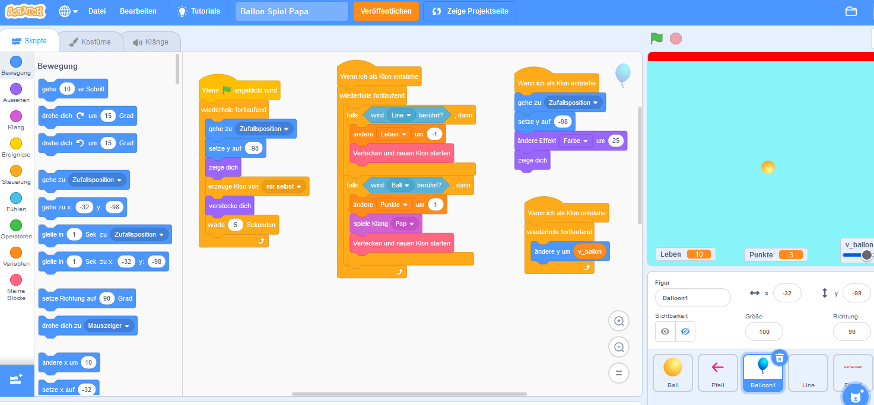
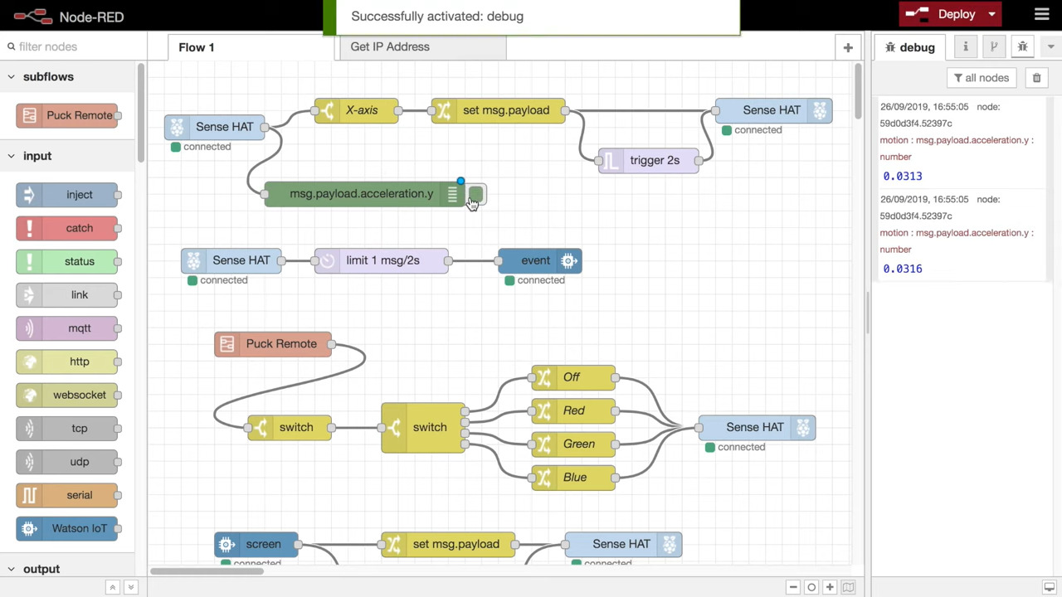
My dream: something like e.g. Scratch or Node-RED
Programming Language for Kids…
… well, I heard the same about LabVIEW ☺
E.g. HIJ-Vision: Image Analyze Classes are Blocks in Scratch or Blockly
The BIG ? : Do the benefits outweigh the effort?

