Slide 1
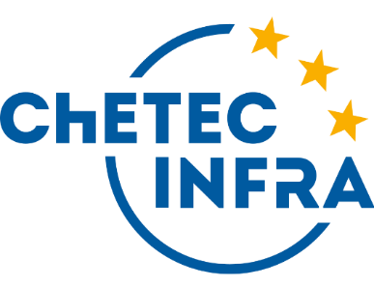
New Masterclasses For Nuclear Astrophysics
Hannes Nitsche (TU Dresden) Uta Bilow (TU Dresden), Daniel Bemmerer (HZDR)
This project has received funding from the European Union’s Horizon 2020 research and innovation programme under grant agreement No 101008324

Slide 2
What are we working on?
Development of two Nuclear Astrophysics Masterclasses
one-day outreach events for high school students, introducing them to modern research
First masterclass materials available @ mc.chetec-infra.eu/
Second masterclass currently in development
Languages
Finished: German, English, Italian, French, Czech, Bulgarian, Upper Sorbian
Not finished: Spanish, Romanian, Swedish, Hungarian, Lithuanian, Catalan, Hebrew, Welsh

Slide 3
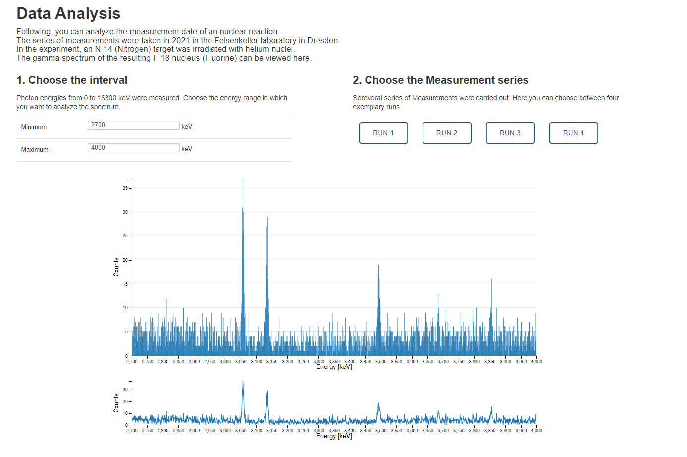
Content & Materials
Centerpiece of the masterclass: Analysis & evaluation of a nuclear physics experiment
Measurement carried out at the Felsenkeller underground ion accelerator lab
Tasks of the learners:
Gamma spectroscopy & peak measurements
Usage of a term diagram, consideration of background
Determination of the cross section & reaction rate
Goals:
Working as a nuclear physicist for one day
Gain an insight into the laboratory and the working methods of a nuclear physicist
Data Analysis Webtool

Slide 4
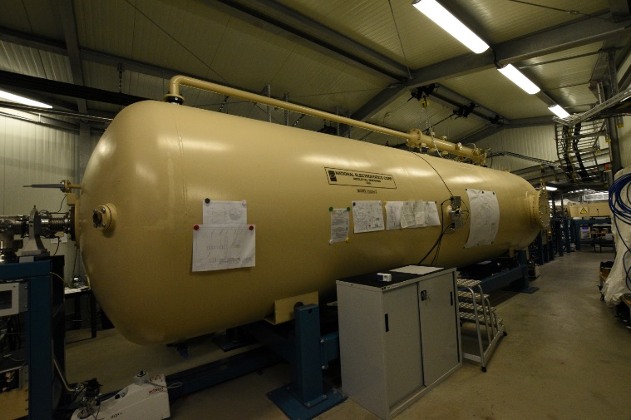
Content & Materials
Various Lectures linking the activities
Videos & Visualizations
Camera tour through the Felsenkeller underground laboratory
Astronuclear Nibbles – Video series
Interactive Nuclide Chart
Felsenkeller Laboratory
Astronuclear Nibbles:
https://youtu.be/L6NMurf64-4

Slide 5
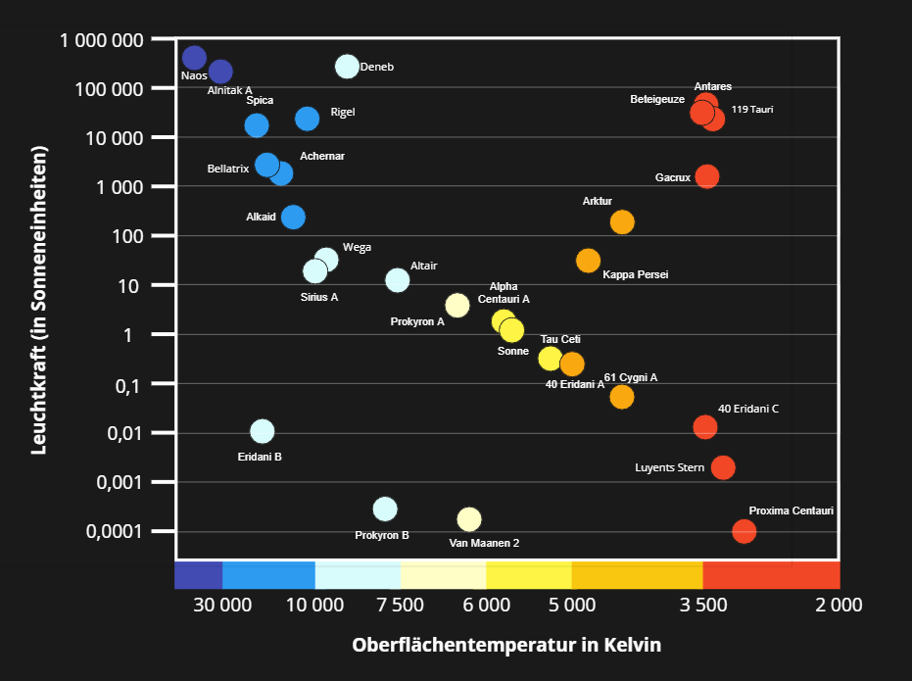
Content & Materials
Various Lectures linking the activities
Videos & Visualizations
Multiple Activities with gamification elements, e.g. …
Collaboratively create a Hertzsprung–Russell diagram together

Slide 6
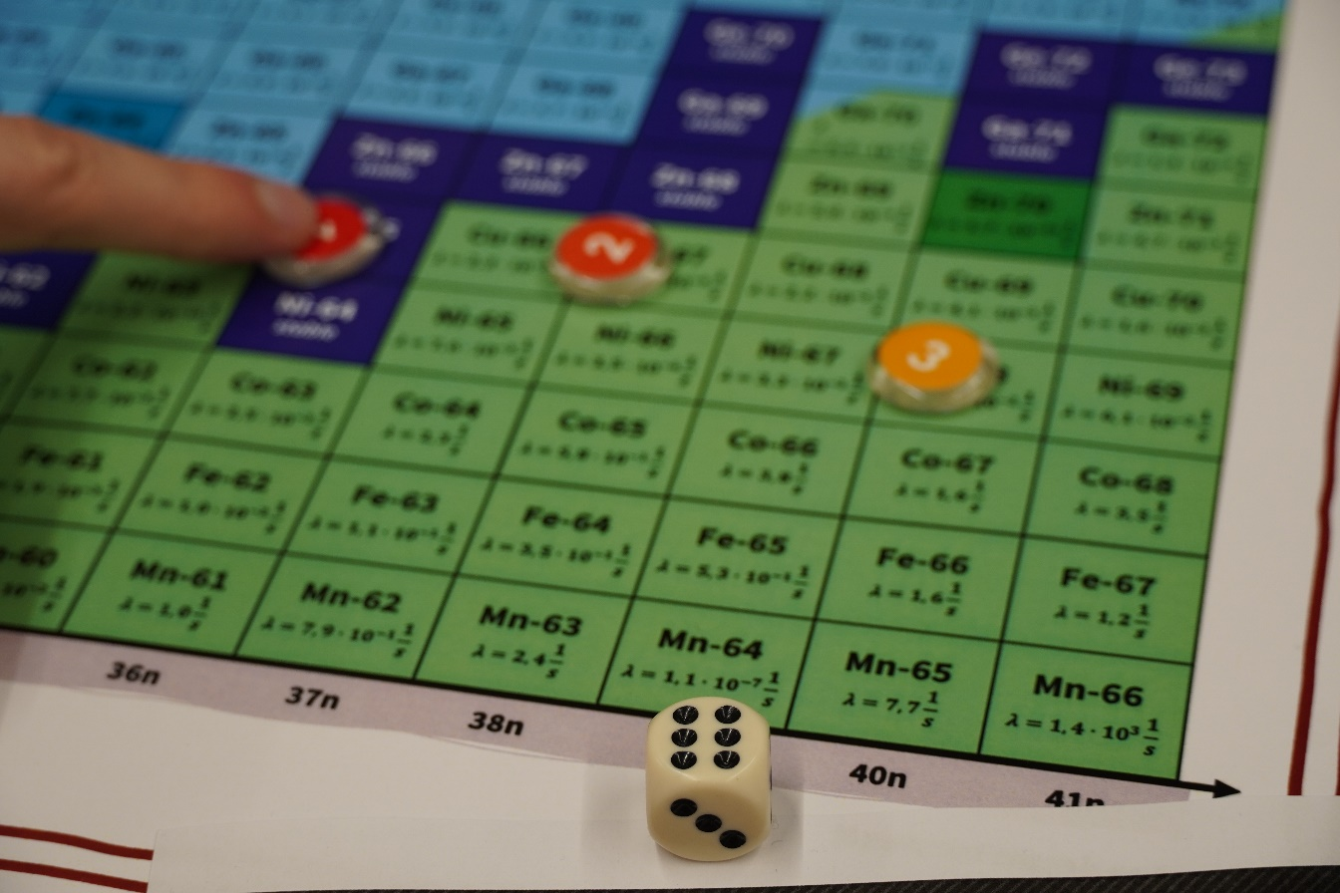
Content & Materials
Various Lectures linking the activities
Videos & Visualizations
Multiple Activities with gamification elements, e.g. …
Collaboratively create a Hertzsprung–Russell diagram together
The Nuclei Race: Recreating s- and r-processes in a board game

Slide 7
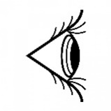
Content & Materials
Two different Masterclasses
Access to nuclear astrophysics from different points of view
No necessity to visit the first Masterclass to understand the second
Two independent Masterclasses
Each scientist can choose their preferred topic
1. Masterclass
Nuclear Physics Experiments
Nuclear Astrophysics
2. Masterclass
Astronomical Observations

Slide 8
Content & Materials
Second Masterclass
Currently under development
Stellar spectroscopy as the central data analysis Stellar Analysis Pipeline by Johannes Puschnig
Cosmological lithium problem & primordial nucleosynthesis as main themes
Focus on addressing cosmological problems with the help of nuclear astrophysics (big bang models via primordial Nucleosynthesis)
1. Masterclass
Nuclear Physics Experiments
Nuclear Astrophysics
2. Masterclass
Astronomical Observations

Slide 9
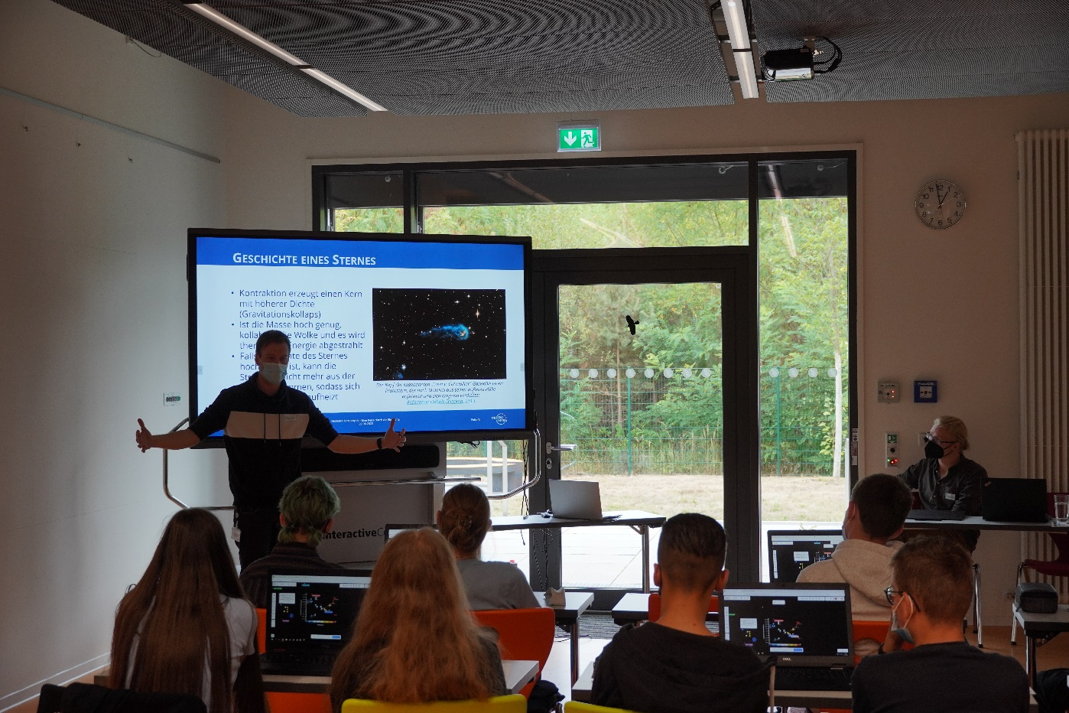
Masterclass Events
Masterclass Run Throughs
@ schools and school Labs in Germany
with high school students between the age of 14 and 18 Yrs

Slide 10
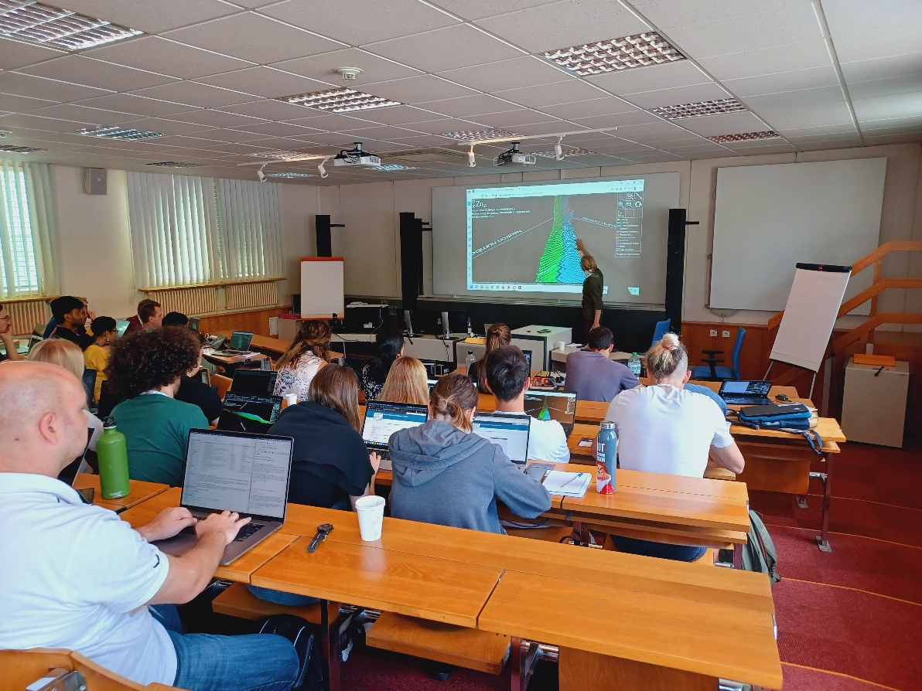
Masterclass Events
Masterclass Run Throughs
Masterclass Training Day
@ NPA-X Summer School
1 week PhD School on Nuclear Astrophysics @ CERN
1 day for outreach training
Introduction of PhD students to masterclass
Motivation for outreach
Discussion on science communication in nuclear astrophysics

Slide 11
Masterclass Events
Masterclass Run Throughs
Masterclass Training Day
Upcoming: ChINOS Summer School
ChETEC Observational School, 24.07. - 28.07. @ Ondrejov Observatory, Prague

Slide 12
Call To Action
We are looking for:
Scientists who want to give nuclear astrophysics masterclasses
Anyone who works in this field, can be an Facilitator
Open Access Teaching Materials including presentation & masterclass guide
Translations
Finishing of the translations of the first masterclass
Translators for the second masterclass
Why you should engage here:
Satisfy curiosity and spark interest
Inspire the next generation of scientists, gain new talents
Personal benefit: Self effectiveness as a scientist, active role in shaping society, communication training
WIN-WIN

Slide 13
Masterclass can be found online @
mc.chetec-infra.eu
Thank you for your attention.

