Slide 1
NA4 Mass Spectrometry Network
Maria Lugaro (Konkoly Observatory, HU)

Slide 2
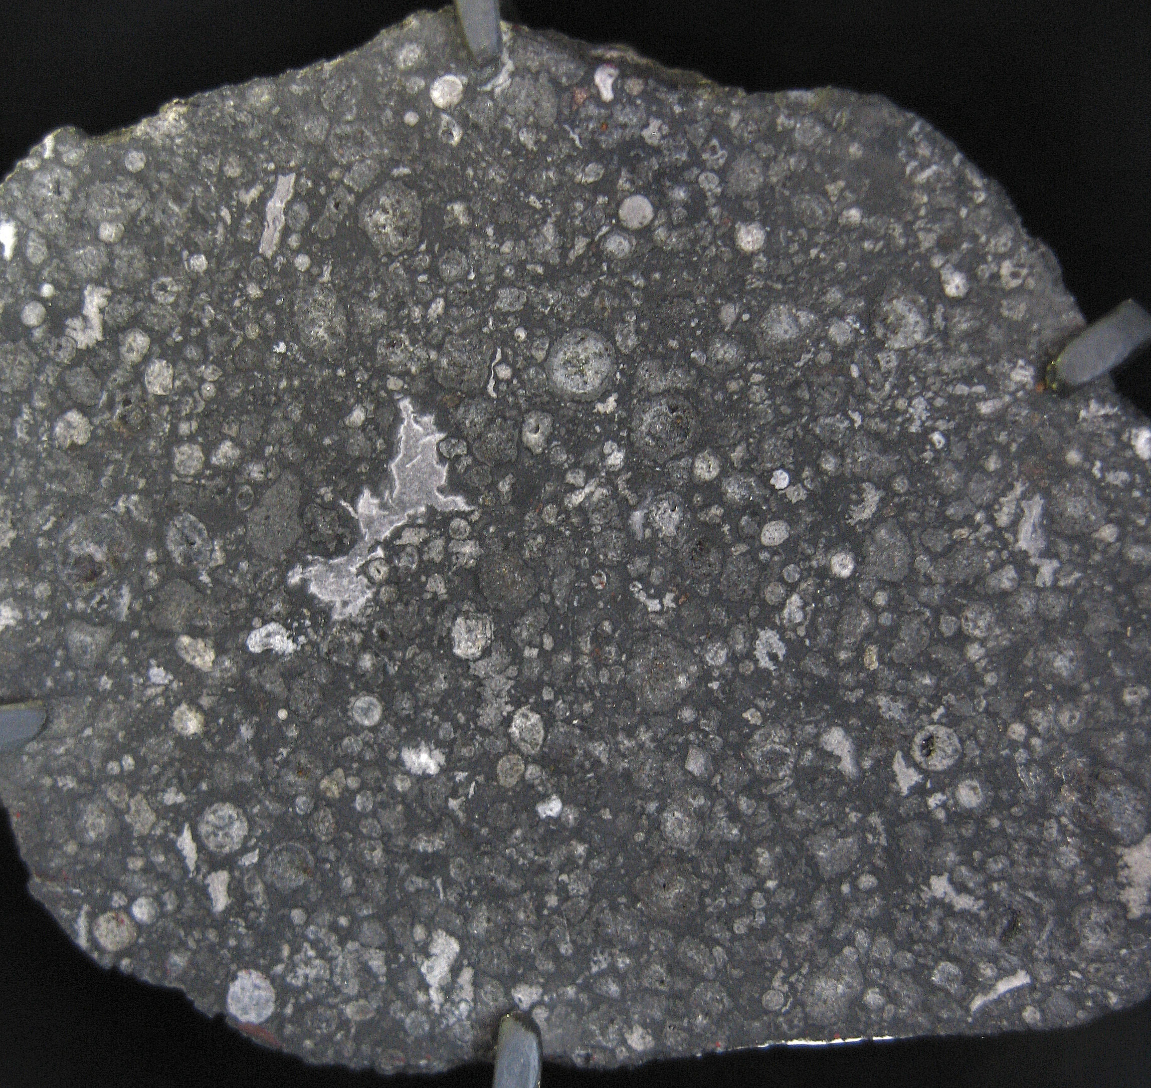
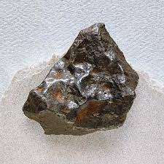
NA4 Mass Spectrometry Network: Introduction
Mass Spectrometry analysis of different types of meteorites has revealed isotopic variations due to the presence of material (e.g., stardust) that preserved the signature of nuclear reactions occurring in specific stars.
Chondritic meteorite
Iron meteorite

Slide 3
NA4 Mass Spectrometry Network: Introduction
Mass Spectrometry analysis of different types of meteorites has revealed isotopic variations due to the presence of material (e.g., stardust) that preserved the signature of nuclear reactions occurring in specific stars.
Chondritic meteorite
The interpretation of such variations provides evidence for
the environment of the birth of the Sun,
the accretion process,
the evolution of the proto-planetary disk, and
the formation of the planets.
Iron meteorite
Figure from Ek et al. 2020

Slide 4
NA4 Mass Spectrometry Network: Introduction
The comparison of the observed variations to predictions from models of nuclear burning in stars can help us to discover the physical origin of the isotopic variations.
However, this comparison has been limited to a handful of model predictions because:

Slide 5
NA4 Mass Spectrometry Network: Introduction
The comparison of the observed variations to predictions from models of nuclear burning in stars can help us to discover the physical origin of the isotopic variations.
However, this comparison has been limited to a handful of model predictions because:
(I) the predicted stellar abundances need to be transformed into a
representation that nuclear astrophysicists are unaccustomed to.

Slide 6
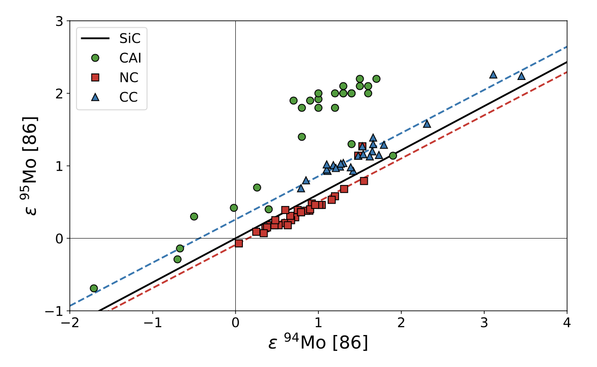
NA4 Mass Spectrometry Network: Introduction
The comparison of the observed variations to predictions from models of nuclear burning in stars can help us to discover the physical origin of the isotopic variations.
However, this comparison has been limited to a handful of model predictions because:
(I) the predicted stellar abundances need to be transformed into a
representation that nuclear astrophysicists are unaccustomed to.
Isotopic ratios are internally normalized, to avoid the problem of mass-depended fractionation
Variations are in parts per 10⁻⁴: stellar signatures are strongly diluted
Chemistry effects
See Mattias Ek’s talk

Slide 7
NA4 Mass Spectrometry Network: Introduction
The comparison of the observed variations to predictions from models of nuclear burning in stars can help us to discover the physical origin of the isotopic variations.
However, this comparison has been limited to a handful of model predictions because:
(I) the predicted stellar abundances need to be transformed into a
representation that nuclear astrophysicists are unaccustomed to.
(II) the stellar models are not fully available to/manageable by cosmochemists and planetary science researchers.

Slide 8
NA4 Mass Spectrometry Network: Introduction
The comparison of the observed variations to predictions from models of nuclear burning in stars can help us to discover the physical origin of the isotopic variations.
However, this comparison has been limited to a handful of model predictions because:
(I) the predicted stellar abundances need to be transformed into a
representation that nuclear astrophysicists are unaccustomed to.
(II) the stellar models are not fully available to/manageable by cosmochemists and planetary science researchers.
Abundances (not yields) are need – often these are not even published!
Radioactive contributions depends on time scale relative to dust formation and chemistry
Mixing of nearby layers?
Abundance profiles in the ejecta of a core-collapse supernova (Marco Pignatari)
Notes:
Here for Lyon add the other way around: no use of total yields, radioactive decay, different networks, no r process/no dust

Slide 9

NA4 Mass Spectrometry Network: Introduction
The comparison of the observed variations to predictions from models of nuclear burning in stars can help us to discover the physical origin of the isotopic variations.
However, this comparison has been limited to a handful of model predictions because:
(I) the predicted stellar abundances need to be transformed into a
representation that nuclear astrophysicists are unaccustomed to.
(II) the stellar models are not fully available to/manageable by cosmochemists and planetary science researchers.

Slide 10
NA4 Mass Spectrometry Network: Introduction
The comparison of the observed variations to predictions from models of nuclear burning in stars can help us to discover the physical origin of the isotopic variations.
However, this comparison has been limited to a handful of model predictions because:
(I) the predicted stellar abundances need to be transformed into a
representation that nuclear astrophysicists are unaccustomed to.
Provide Virtual Access to:
codes/algorithms for the nuclear astrophysicists
stellar models for the cosmochemists and planetary science researchers
(II) the stellar models are not fully available to/manageable by cosmochemists and planetary science researchers.
WP9/NA4

Slide 11
NA4 Mass Spectrometry Network: D9.1
Completed April 2022 based on Mattias Ek (ETHZ)’s python code
Focus on slow neutron-capture process in AGB stars
Code available via the ChETEC-INFRA.eu website; more AGB data to become available soon from CSFK
Dissemination via paper (Lugaro et al. 2023, EPJA, 59, 53) and talk (Lugaro et al.) at OMEG2022 conference (October 2022)
See Mattias Ek’s talk

Slide 12
NA4 Mass Spectrometry Network: D9.2
Completed: June 2023 based on Marco Pignatari (CSFK)’s python code
Validation of the code completed using Ni isotopes, more development ongoing
Code available via the online platform: https://astrohub.uvic.ca/chetec/
ApJS paper (Pignatari et al., in prep) and talk (Lugaro et al.) at the Goldschmidt conference in Lyon (14th July 2023)
Six (seven) sets of core-collapse supernovae of masses 15, 20, 25 solar masses available to be processed (for a total of 18 models, to become 21)

Slide 13
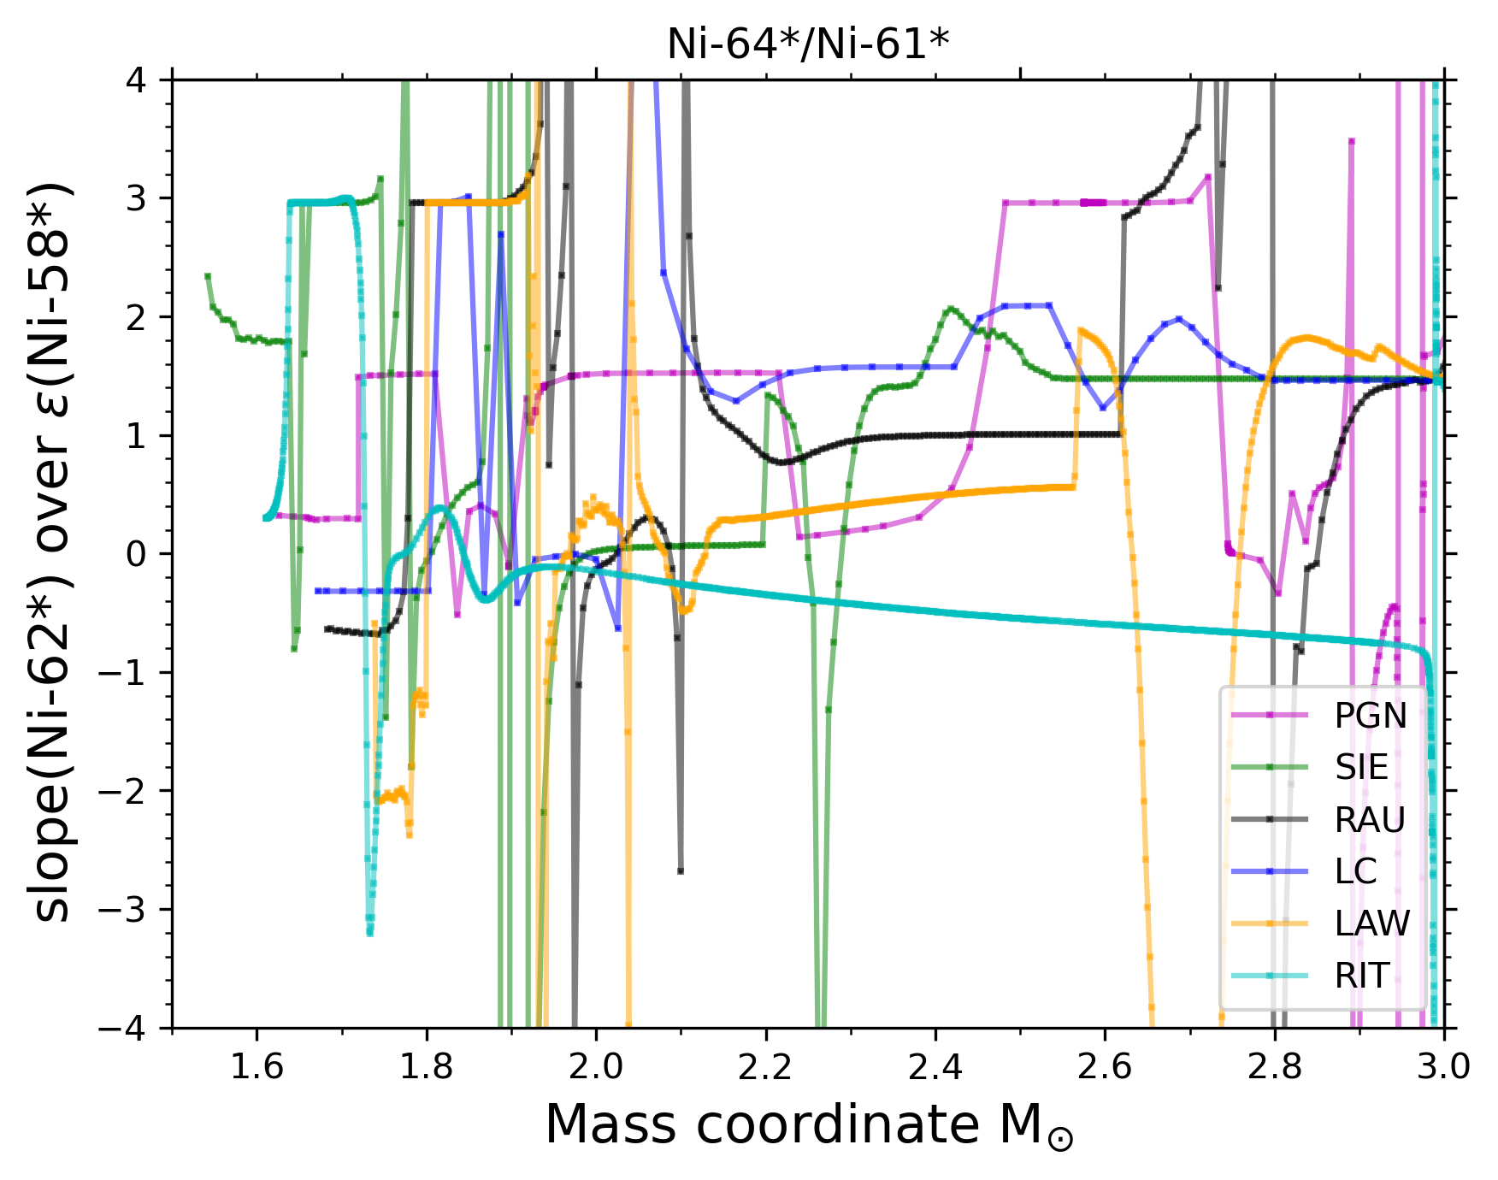
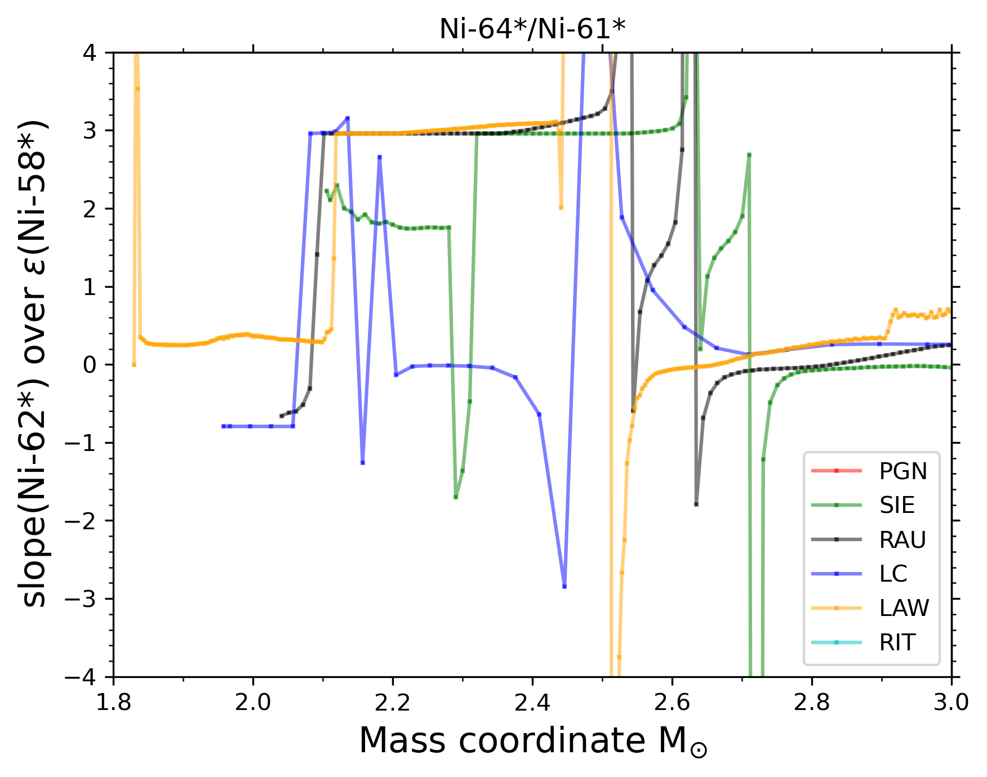
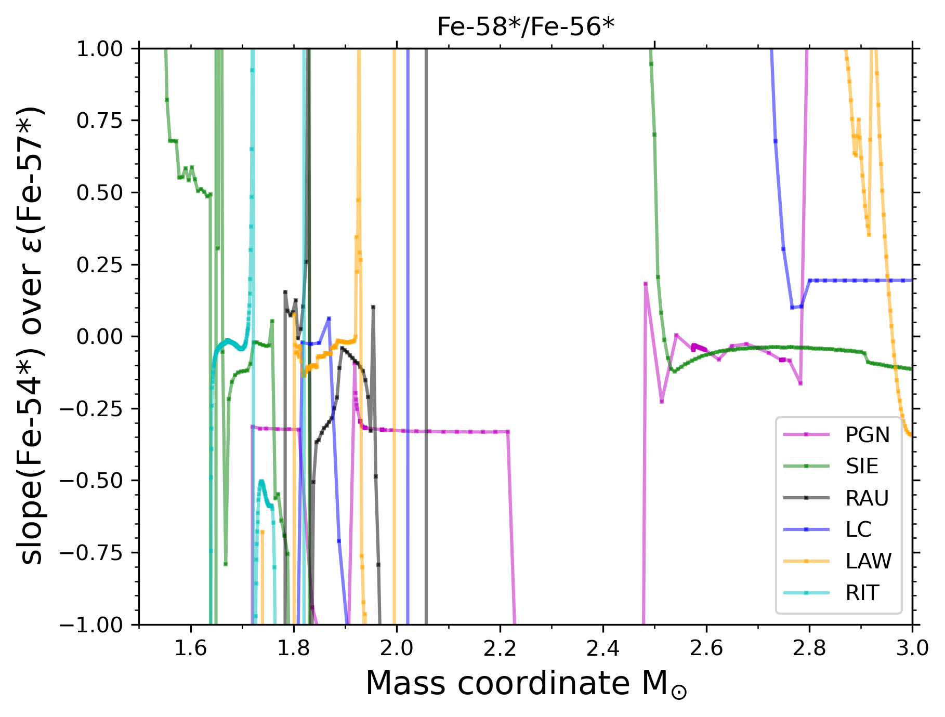
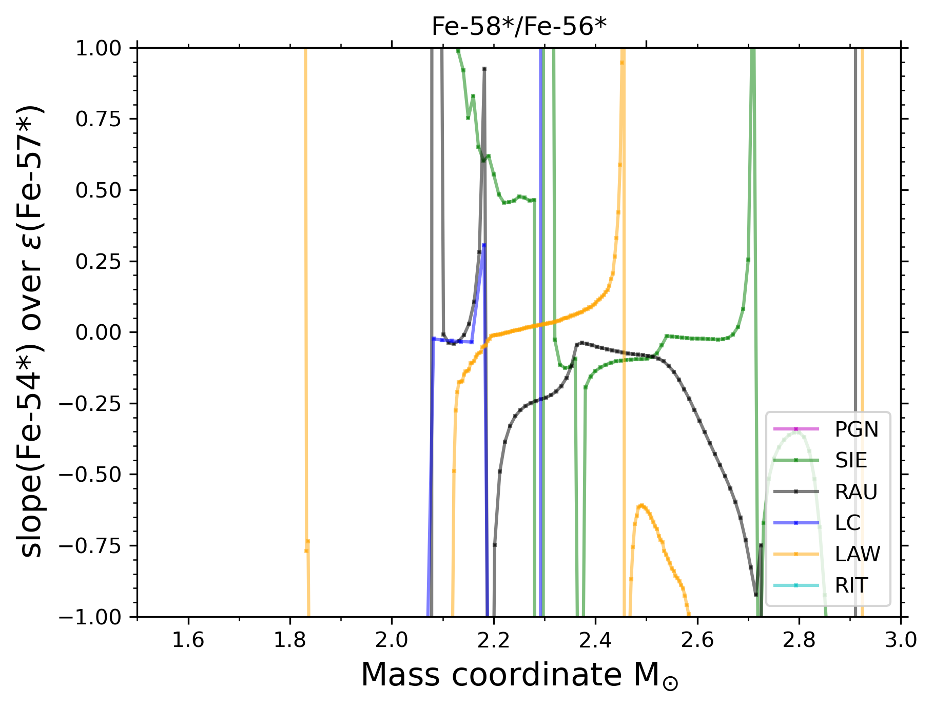
NA4 Mass Spectrometry Network
DATA
e.g., Steele et al. 2012
Nanne et al. 2019
Makhatadze et al. 2023
15 M⦿
25 M⦿
DATA
e.g., Hopp al. 2022
Figures by Gábor Balázs

Slide 14
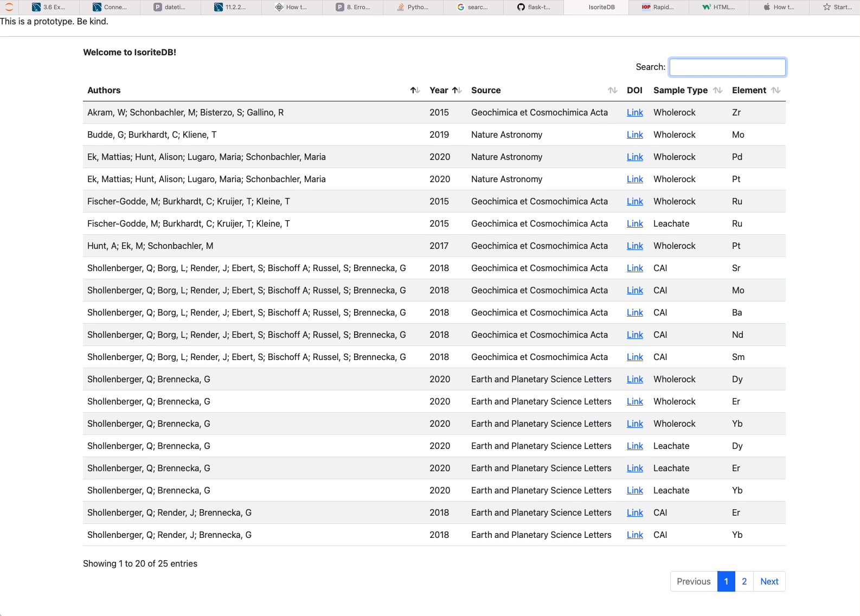
NA4 Mass Spectrometry Network: D9.3
In Progress: October 2023 prototype from Mattias Ek (ETHZ)

Slide 15
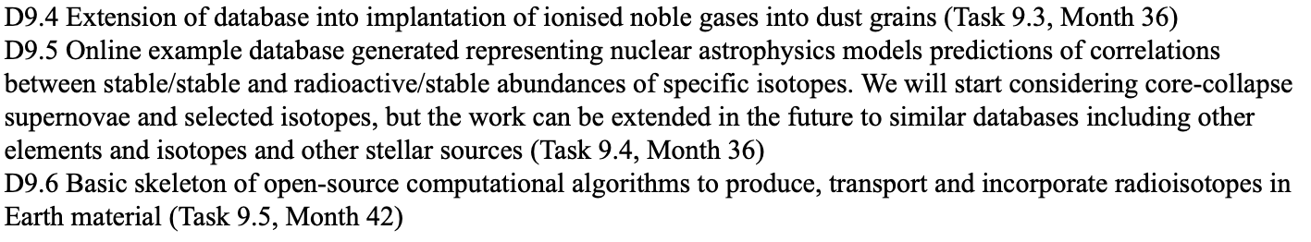
NA4 Mass Spectrometry Network: Future D9.4, D9.5, D9.6
April 2024
April 2024
October 2024
See Benjiamin Wehmeyer’s talk

Slide 16
NA4 Mass Spectrometry Network
  Bridge the gaps between nuclear astrophysics and cosmochemistry and planetary science
  Combine expertise on mass spectrometry laboratory investigations and the theoretical modelling that can help to interpret the data
  Train a new generation of scientists who can understand both languages
  Provide the first comprehensive framework of Virtual Access to tools (D9.1, D9.2, D9.4, D9.6), data (D9.2), and resources (D9.3, D9.5) to the different communities

