Slide 1
WP6/NA1 “Comprehensive Nuclear Astrophysics”
ChETEC-INFRA General Assembly 2023

Slide 2
WP6/NA1 “Comprehensive Nuclear Astrophysics”
Aims
Link three types of nuclear astrophysics infrastructures to one model science case: the astrophysical s-process: AGB stars observed by means of ChETEC-INFRA telescopes are then modeled by ChETEC-INFRA HPC, and selected uncertain nuclear reactions be studied at ChETEC-INFRA nuclear labs
Plan of action through textbook examples of cross-collaboration between astronomers, astrophysicists, nuclear physicists and cosmochemists
State-of-the-art yields from all astrophysical sites that contribute to galactic nucleosynthesis will be merged into a brand-new, user-friendly galactic chemical evolution (GCE) platform

Slide 3
WP6/NA1 “Comprehensive Nuclear Astrophysics”
Structure
WP6 Coordination: Jordi José, UPC Barcelona
Task 6.1 Binary Star Database to support observations (PIs: Camilla J. Hansen, UFrankfurt, & Richard Stancliffe, UHull; other participants: VU Vilnius)
Task 6.2 Cross-Collaboration Textbook Examples
(PI: Jordi José, UPC Barcelona; other participants: HUJI Jerusalem, ULB Brussels, HZDR Dresden, U Hull,
MPIA Heidelberg, VU Vilnius)
Task 6.3 Galactic Chemical Evolution (PI: Brad K. Gibson, UHull; other participants: CSFK Budapest, INAF)

Slide 4
WP6/NA1 “Comprehensive Nuclear Astrophysics”
Task 6.1 – Report on main activities
Binary Star Database to support observations
SPECIFIC GOALS
-Training students in all astro-nuclear-disciplines: Observations, theory, experiments – the plan is to hire a student at MPIA, starting out with observations, and following train the student in theory (Hull), and experiments (Oslo / Frankfurt)
-Observe AGB & CEMP-s stars, derive RV + 1D, LTE abundances → apply corrections (in collaboration with WP5)
-Run stellar evolution models & post processing (AGB + s-process)
-Experiments relevant for the s-process (rates for Kr & Rb, cross sections for Bi & Pb)

Slide 5
WP6/NA1 “Comprehensive Nuclear Astrophysics”
Task 6.1 – Report on main activities
Binary Star Database to support observations
MAIN ACTIVITIES PERFORMED AND ACHIEVEMENTS
To understand binary systems, their mass transfer, AGB stars – and the s-process that they host, we carried out binary monitoring through repeated radial velocity (RV) observations. The s-process nucleosynthesis is being explored via chemical abundance analyses of AGB and binary stars.
The current state of the RV part by number is:
(i) Total observing nights awarded: 46 at TNA telescopes: Moletai, Ondrejov, and Rozhen
(ii) Total number of stars observed: 202
(iii) Total number of RVs measured: 271
Approximate average RV_{rms}: ~ 4 km/s (best ≤ 0.8 km/s) at TNA telescopes which is comparable to literature RV_{rms} which typically cover a similar range ~ 0.05 – 3 km/s

Slide 6
WP6/NA1 “Comprehensive Nuclear Astrophysics”
Task 6.1 – Report on main activities
Binary Star Database to support observations
MAIN ACTIVITIES PERFORMED AND ACHIEVEMENTS
The current state of the abundance part by number is:
(i) Total number of stars with estimated atmospheric parameters: 78
(ii) Total number of stellar abundances/patterns computed: 4
Target stars are observed at TNA facilities, with high- resolution echelle spectrographs at a moderate signal-to-noise (S/N) for RVs and high S/N for abundances.
Raw spectra are reduced using observatory pipelines and our own codes. Targets without RVs in literature are prioritized for follow up to build the RV database. Stellar parameters are estimated using the ATHOS and Xiru programs. These parameters are compared to the photometric and spectral results from Gaia DR3, and are in good agreement. Photospheric abundances are computed using the PyMOOGi program. Clean lines of the desired s-process elements are fitted using Gaussian profiles, and the abundances are computed. Abundances from blended lines are computed using spectral synthesis.

Slide 7
WP6/NA1 “Comprehensive Nuclear Astrophysics”
Task 6.1 – Report on main activities
Binary Star Database to support observations
OUTCOMES
Outreach activities: We have participated in several local and virtual events (e.g., SNAQs)
Deliverables (Task 6.1, Month 12): D6.1 was completed after 6 months, where we set up an online data base. We uploaded new abundances and RV results after 12 months as well.
Publications: 1 (+3 in progress)
Talks in Conferences/Workshops/Schools: 2

Slide 8
WP6/NA1 “Comprehensive Nuclear Astrophysics”
Task 6.2 – Report on main activities
Cross-Collaboration Textbook Examples
SPECIFIC GOALS
Provide the ChETEC-INFRA community with textbook examples of cross-collaboration between astronomers, astrophysicists, nuclear physicists, and cosmochemists.
(i) Identification of suitable science cases (i.e., nuclear reactions of astrophysical interest affected by large nuclear uncertainties) through sensitivity studies
(ii) Feasibility studies of the nuclear physics experiments planned to reduce their associated uncertainties
(iii) Preparation of a proposal for the experiment
(iv) Measurement and data analysis
(v) Evaluation of the astrophysical/cosmochemical impact for a specific stellar site

Slide 9
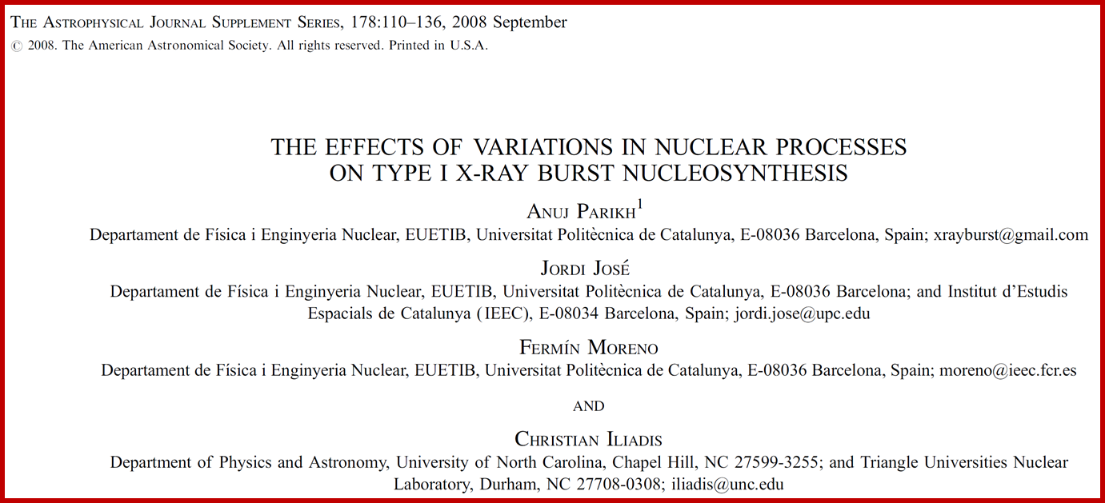
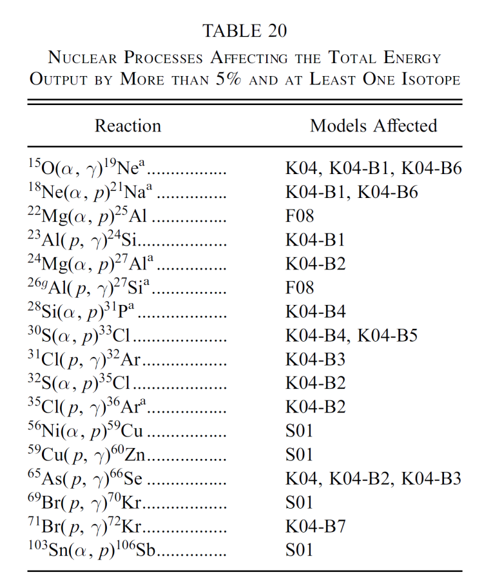
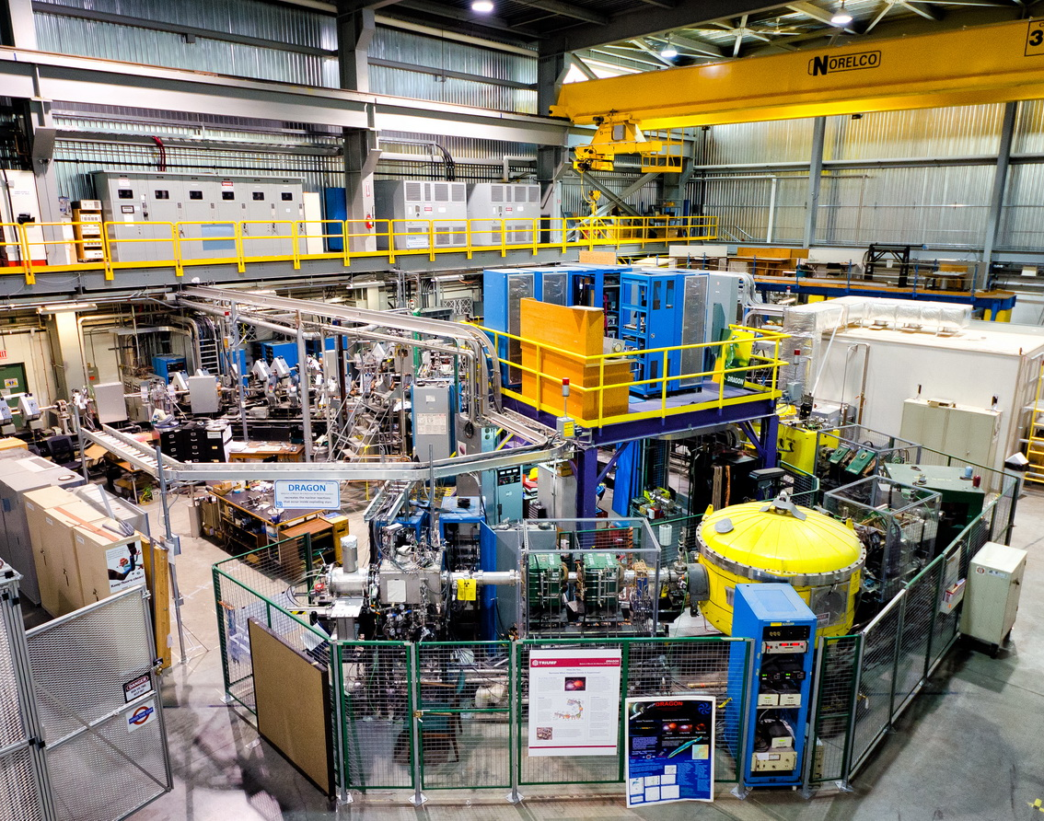
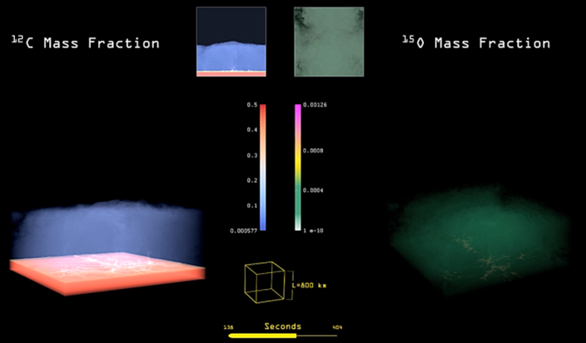
WP6/NA1 “Comprehensive Nuclear Astrophysics”
Sensitivity studies
Identification of key reactions
of astrophysical interest
Experiments
Astrophysical impact of new reaction rates

Slide 10
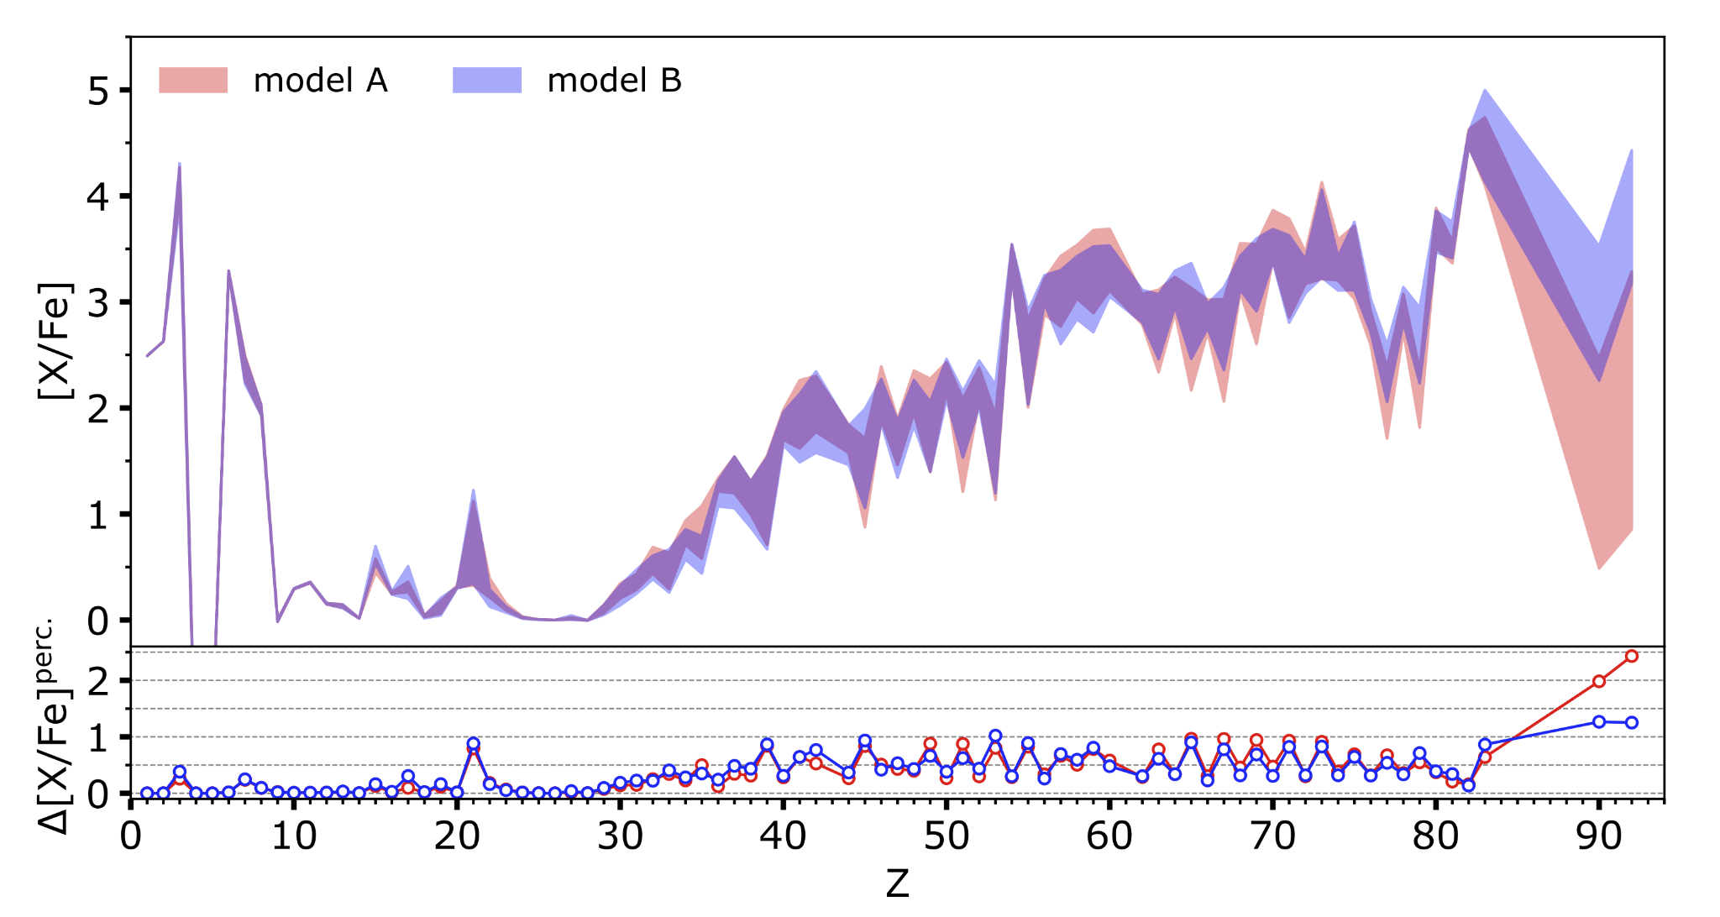
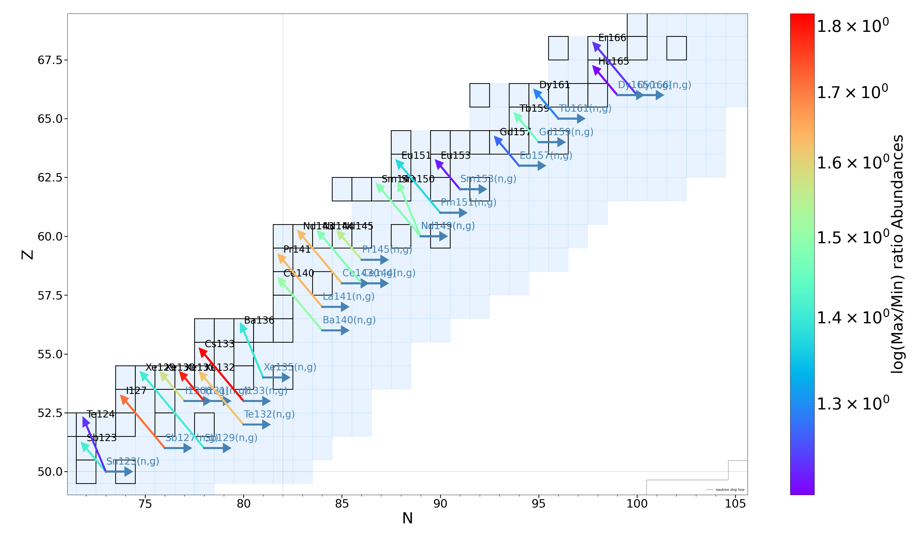
WP6/NA1 “Comprehensive Nuclear Astrophysics”
Sensitivity studies
Identification of key reactions
of astrophysical interest
Experiments
log(Maximum surface abundance / Minimum Surface Abundance)
Correlated models uncertainties and Non-correlated parameters uncertainties​ in early AGB stars
Identification of key (n,g) reactions for the i-process nucleosynthesis
S. Martinet’s Talk → Impact of the systematic and statistical nuclear uncertainties on the i-process nucleosynthesis

Slide 11
WP6/NA1 “Comprehensive Nuclear Astrophysics”
Task 6.2 – Report on main activities
Cross-Collaboration Textbook Examples
MAIN ACTIVITIES PERFORMED AND ACHIEVEMENTS
We have selected a small set of key reactions previously identified in existing sensitivity studies:
³⁰P(p,γ), relevant for classical novae
¹⁵O(α,γ), relevant for type I X-ray bursts
²⁶Al(n,p) and ²⁶Al(n,α), relevant for core-collapse supernovae.
The impact of the new reaction rates has been evaluated with state-of-the-art stellar codes developed and maintained in WP6. PhD Students and young Postdocs have actively participated in all the different stages mentioned above, getting in turn training in computational astrophysics, observational astronomy, experimental nuclear physics, and cosmochemistry.

Slide 12
WP6/NA1 “Comprehensive Nuclear Astrophysics”
Task 6.2 – Report on main activities
Cross-Collaboration Textbook Examples
OUTCOMES
Outreach activities: multiple outreach activities have been conducted in the last 18 months by participants of Task 6.3, including “Seminar at SNAQs”, “Public Talk at INPC22, Cape Town”.
Deliverables (Task 6.2, Month 12): D6.2. We published on ChETEC-INFRA webpage a first version of the multidisciplinary guide to astronuclear science cases. It includes a discussion on the role of sensitivity studies in the identification of key reactions (and in the evaluation of the impact of their uncertainties), and a number of specific astrophysical scenarios in explosive nucleosynthesis for which such sensitivity studies have been conducted (e.g., novae and supernovae, X-ray bursts...).
Publications: 6 (+ 2 in progress)
Talks in Conferences/Workshops/Schools: 3

Slide 13
WP6/NA1 “Comprehensive Nuclear Astrophysics”
Task 6.3 – Report on main activities
Galactic Chemical Evolution
SPECIFIC GOALS
- Development of the next generation of the OMEGA/OMEGA+ software pipeline, linking GCE expertise at Hull, with those at CSFK and INAF. These subtasks include:
*Multi-zone extension to the existing single-zone versions of both codes
*Stellar population synthesis post-processing tool
*Radial gas flows, churning, and 2D resonances
- Maintenance of (i) stellar yields databases, and (ii) stellar observational abundances databases; integration with OMEGA/OMEGA+

Slide 14
WP6/NA1 “Comprehensive Nuclear Astrophysics”
Task 6.3 – Report on main activities
Galactic Chemical Evolution
MAIN ACTIVITIES PERFORMED AND ACHIEVEMENTS
The primary goal has been the development of the next generation of the OMEGA/OMEGA+ software pipeline, linking Galactic Chemical Evolution expertise at UHull, with those at CSFK and INAF. Among the achievements obtained so far:
- A framework for the multi-zone extension to the existing version of OMEGA/OMEGA+ has been
designed and developments are ongoing.
- The multi-zone framework includes a prescription for radial gas flows.
- Working on a preliminary version of a stellar population synthesis and post-processing tool.
- PhD student attached to 6.3 has published a first-author paper using the OMEGA tools
(Womack et al. 2023)

Slide 15
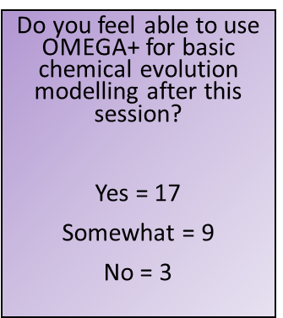
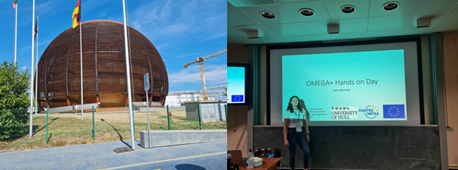
WP6/NA1 “Comprehensive Nuclear Astrophysics”
K. Womack’s Talk → Course on Galactic Chemical Evolution: Developments and Uptake

Slide 16
WP6/NA1 “Comprehensive Nuclear Astrophysics”
Task 6.3 – Report on main activities
Galactic Chemical Evolution
OUTCOMES
Outreach activities: 211 outreach events between May 2021 and Oct 2022 have been conducted by participants of Task 6.3, including “Pint of Science”, “Engineering UTC careers talk”, “Nova studios promotional film”, “Hull collegiate breakfast”, “Notre Dame”, “HERAS”, “Mexbrough and Swinton”, “York Astro”, “Guildford astro”, “Wakefield astro”, “Binding blocks x2” (GCSE and A-level versions), and “Wyke careers talk”
Deliverables (Task 6.3, Month 12): D6.3. We have launched an online and in-person OMEGA/Python training school (the latter was delivered as part of the NPA-X School).
Publications: 20
Talks in Conferences/Workshops/Schools: 5

Slide 17
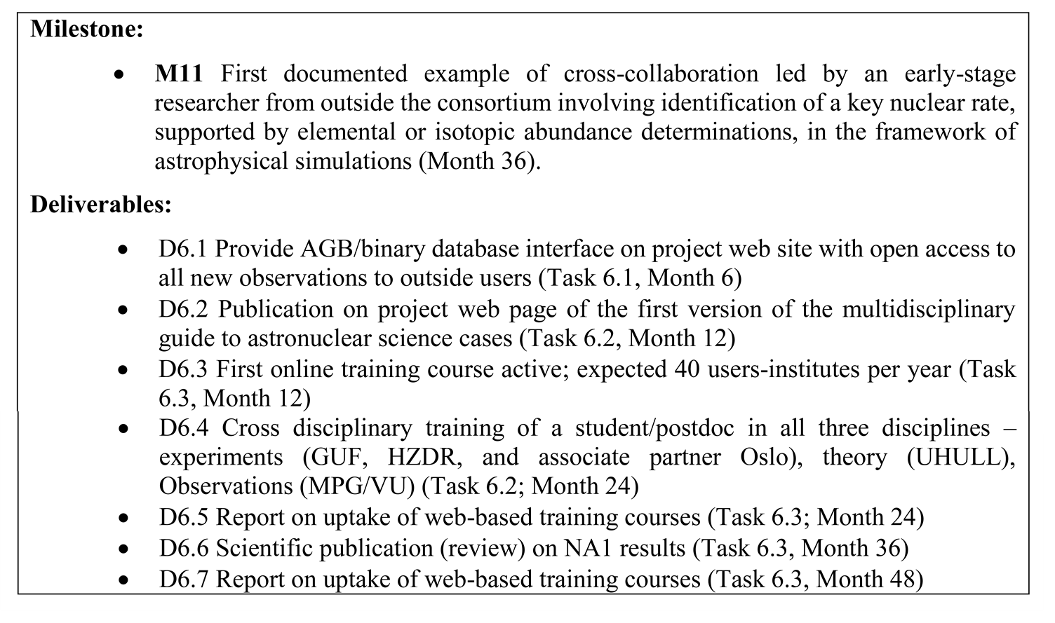
WP6/NA1 “Comprehensive Nuclear Astrophysics”
TBD
TBD

Slide 18
WP6/NA1 “Comprehensive Nuclear Astrophysics”
ChETEC-INFRA General Assembly 2023

