Slide 1
Astronuclear Laboratory improvements (JRA1)
Marco La Cognata
WP3 coordinator

Slide 2
Overview
JRA1 –WP3 tackles four key challenges faced by the ChETEC-INFRA astronuclear laboratories that limit progress:
solid targets (task 3.1, PI R. Spartà/INFN, participants: IFIN-HH, ATOMKI, UKE, UoC, CNRS, UNIPD, about 43 person-months)
gas targets (task 3.2, PI T. Szücs/ATOMKI, participants: HZDR, CNRS, TUD, UMIL, UNIPD, about 17 person-months)
neutron detection (task 3.3, PI L. Swiderski/NCBJ, participants: INFN, PTB, ISMA*, UNIPD, about 32 person-months)
accelerator mass spectrometry: production of nuclear charge separated beams (task 3.4, PI Robin Golser/UNIVIE, participants: HZDR, about 12 person-months)
*External collaboration – no person-months GUF IS INVOLVED IN ALL THE ACTIVITIES CONCERNING THE WEBSITE

Slide 3
Deliverables
D3.1 | Report on the experimental techniques used for solid target production on the project web site
D3.2 | Report on the development of a gas-jet target with in-beam target thickness diagnostic, on the project web site and in a scientific journal
D3.3 | Provide to the community, upon request, one sample each of three possible scintillator materials for neutron detector in cooperation with industry
D3.4 | Report on testing by radioactive sources and beam bombardment of the solid targets produced
D3.5 | Report, on ChETEC-INFRA web site, on community-accepted methods to measure two non-routine AMS isotopes of astrophysical relevance
D3.6 | Scientific publication on isobar suppression by ion-gas or ion-laser-interaction
D3.7 | Publication on ChETEC-INFRA web site and in a scientific journal of target production protocols, characterization procedures, and results
D3.8 | Report on the development of a gas cell target to be used for angular distribution measurements, on the project web site and in a scientific journal
D3.9 | Report on the ChETEC-INFRA web site on different materials studied for neutron detection and position sensitive neutron detectors

Slide 4
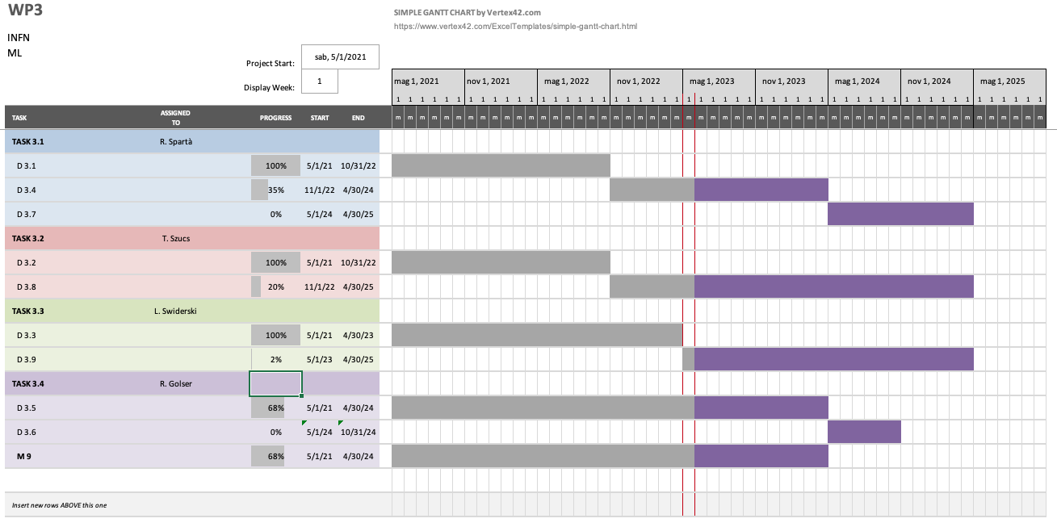
Gantt chart

Slide 5
Task 3.1 General overview
Solid
Targets for
Astrophysics
Research
Task 3.1
ultra-pure material targets for low reaction yields to be studied
noble gases targets implanted into a host material
Characterization of targets using sources and in-beam approaches (thickness, contaminants, long-term stability…)
Also (proposal to be implemented):
thin self-supporting rotating target systems (1000 rpm)
R. Spartà, T. Szücs, M. Heine, M. Moukaddam, S. Courtin, L. Trache, M. La Cognata, A. Caciolli, D. Mengoni, A. Tumino, G. Lanzalone, A. Zilges, A. Blazhev, S. Prill, S. Wilden, F. Heim, …

Slide 6
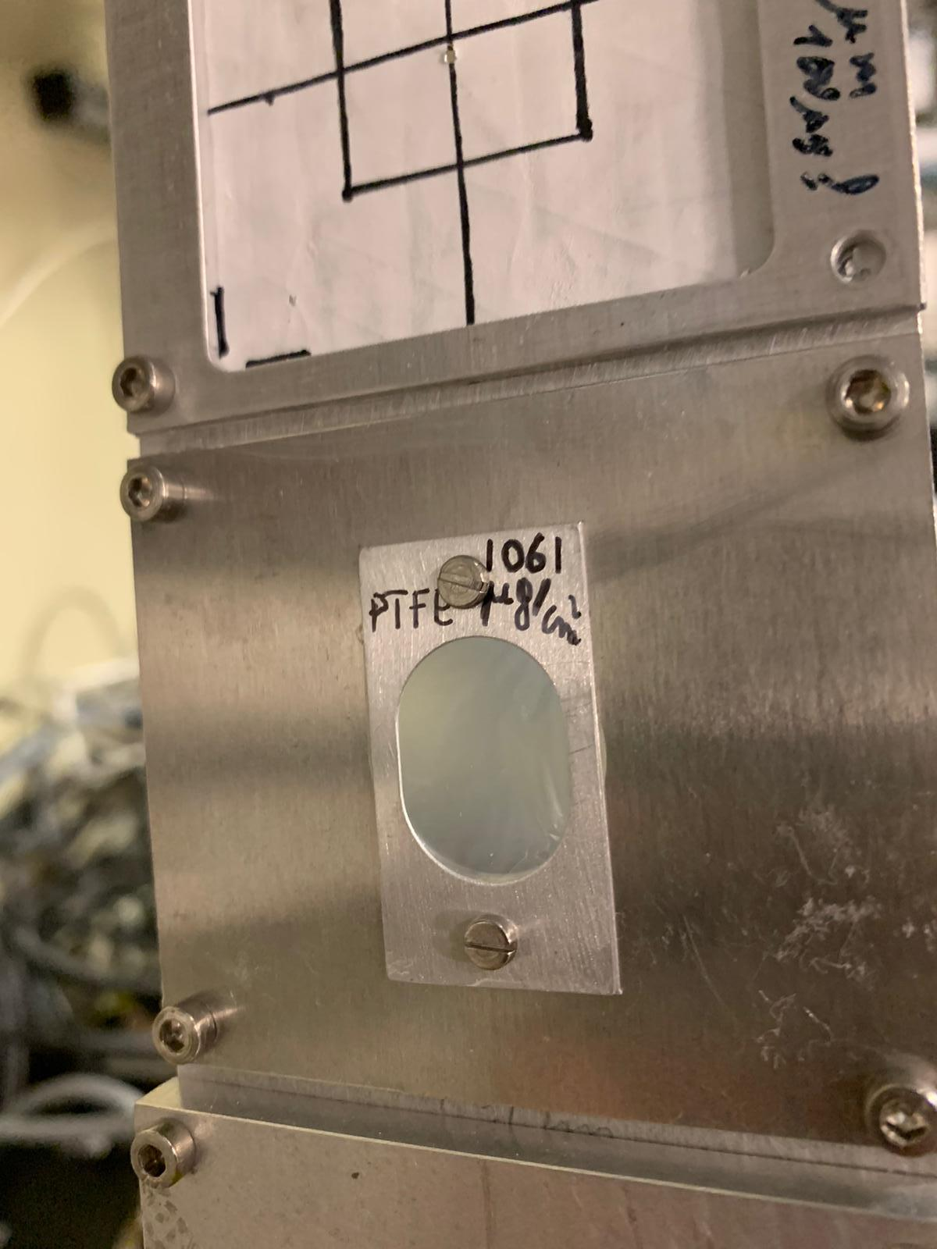
Deliverable 3.1
Report on the experimental techniques used for solid target production on the project web site successfully delivered (https://www.chetec-infra.eu/jra/star/)
Example: teflon target produced with an innovative rolling technique at INFN-LNS and successfully tested during an experimental run at UJF–Rez (Czech Republic) under 200 nA of beam current.
This technique allowed the target to be self-supporting, which helped overcome the need of a backing material (reducing spurious beam-target reactions), and improved the observable experimental yield over fluorine targets produced with other techniques.
Other features
Thickness not lower than 1000ug/cm^2
Disomogeneity 20%
OK up to about 200 nA beam current, then quick deterioration

Slide 7
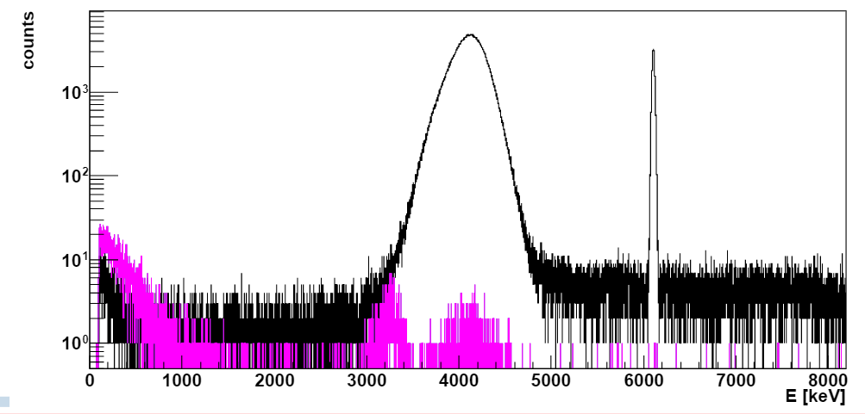
Other successful implementations
Updates from IFIN - HH
Updates from UniMi - INFN LNL
TiD₂ target
Grafite target
2 targets of Ta₂O₅ prepared in collaboration with Laboratori Nazionali del Gran Sasso (Assergi L’Aquila, Italy) by anodization of tantalum backings in ultrapure water. [Caciolli et al, EPJA (2012)] to study the reaction ¹²C + ¹⁶O with the activation method). Better than CeO₂ previously used, but still completely deteriorated in the beam spot area → work still in progress
In the first tests, H contamination level was assessed using Nuclear Reaction Analysis, with the ²H(³He,p)⁴He reaction.
So far, we have reached a factor of ~3 reduction in H contamination, more tests will be performed in the future.

Slide 8
Task 3.2 General overview
Windowless targets
Thin-window gas-cell targets
Diagnostics
effective gas thickness
Composition
Long term stability
Nuclear Resonance, off-beam XRF and in-beam PIXE, RBS setups. Cyclotron/tandetron accelerator for target analysis.
T. Szücs, M. Heine, M. Moukaddam, S. Courtin, D. Bemmerer, U. Bilow, K. Zuber, A. Guglielmetti, A. Caciolli, D. Mengoni, R. Depalo, …

Slide 9
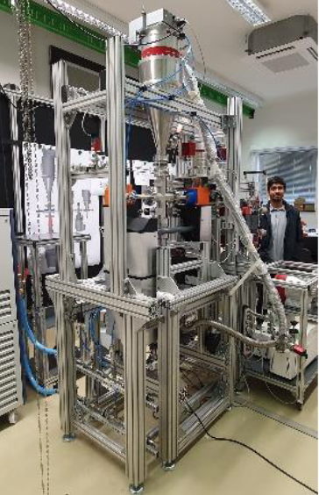
Gas-Jet Target
The gas-jet target with laser interferometer jet density monitoring was built in HZDR
D3.2 Deliverable is fulfilled: Publication is published as a proceedings contribution of the Nuclear Physics in Astrophysics - X conference (NPA-X) EPJ Web of Conferences 279, 13002 (2023) and the paper is also available on arXiv: https://doi.org/10.48550/arXiv.2210.15218
Vacuum test were done. A new roots-blower pump shall be installed, but awaits for delivery.
Further work on the nozzles is ongoing in collaboration with Lithuanian partners
Absolute jet thickness determination is under way via alpha energy loss. (A Bachelor student is hired for this task)
A Master student is hired to work on the interferometric jet characterization.
A calorimeter is developed for beam intensity measurement.
The setup will be installed in the Felsenkeller underground accelerator facility

Slide 10
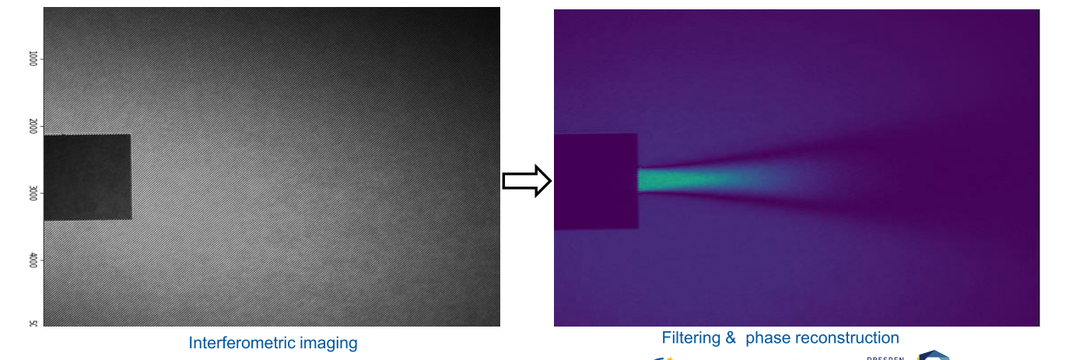
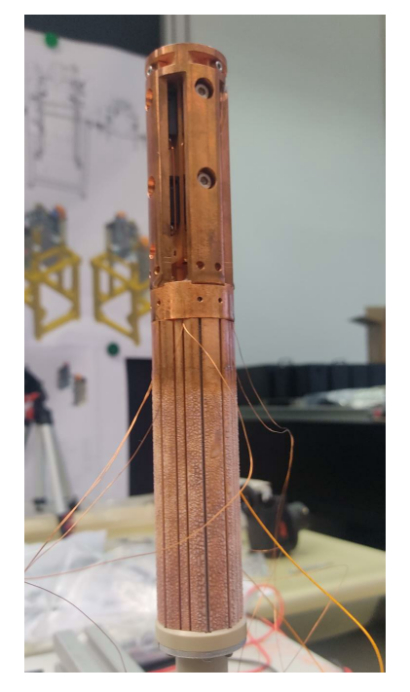
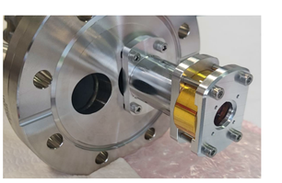
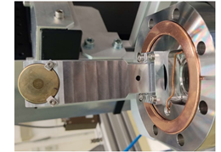
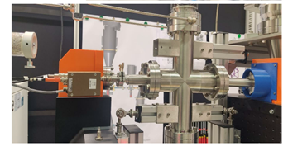
Gas-Jet Target
Calorimeter prototype, for the beam current measurement
Measured jet density distribution (on similar setup)
Absolute target thickness determination via alpha energy loss
source
detector
Complete assembly

Slide 11
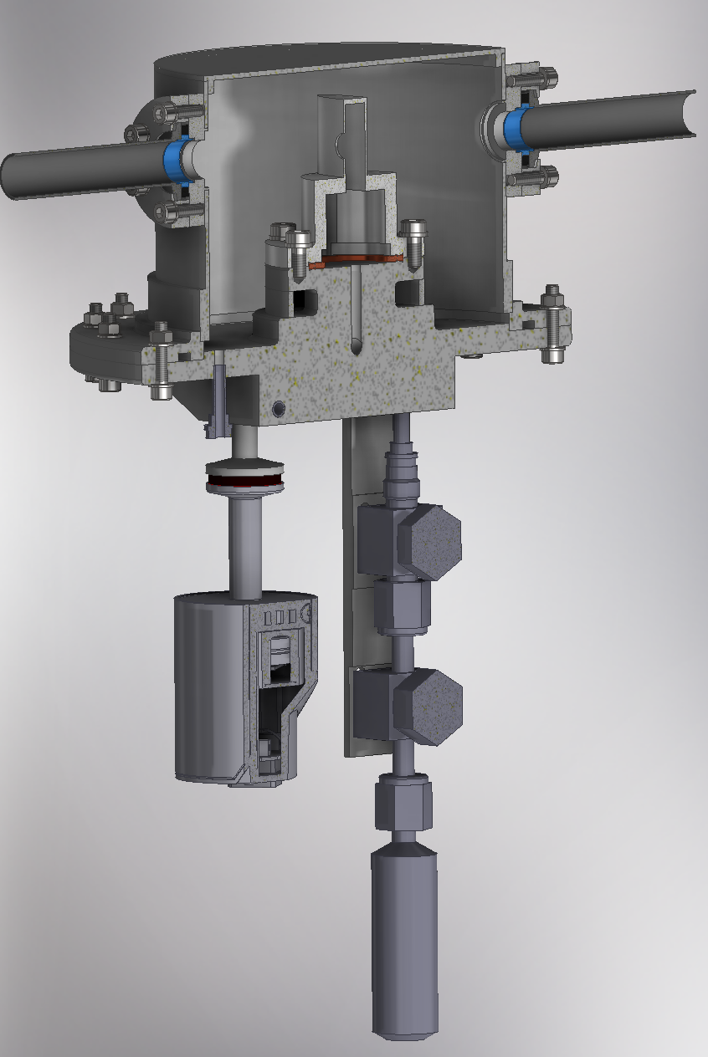
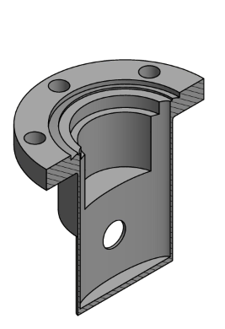
Thin windowed gas target
The first prototype have been built
First test in the Felsenkeller were done with 1um nickel foil, without gas.
We are short of vacuum tight foils.
Different window options are under investigation
At higher beam energies, thicker (thus vacuum tight) entrance foils can be used
Exchangeable cell
1 cm thickness
Optional exit foil

Slide 12
Task 3.3 General overview
Develop and test new neutron detector materials, such as composite scintillators, new plastics, etc. especially with low afterglow
neutron-gamma discrimination capabilities
new methodologies and algorithms for neutron/gamma discrimination
Develop a read-out system based on SiPM or Photomultipliers that will allow to obtain a spatial resolution and to be used in environments with intense gamma flash
L. Swiderski, J.J. Valiente Dobon, R. Nolte, E. Pirovano, M. Dietz, A. Caciolli, D. Mengoni, R. Depalo, A. Gottardo, M. Grodzicka-Kobylka, J. Iwanowska-Hanke…

Slide 13
T3.3 – Neutron Detector Development
Characterization of scintillation properties and pulse shape discrimination (PSD) performance of new organic glass scintillator (OGS) in comparison to other standard materials.
The laboratory tests covered measurements of:
scintillation emission spectra,
photoelectron yield and light output,
neutron/gamma discrimination,
analysis of the light pulse shapes originating from events induced by gamma-rays and fast neutrons.

Slide 14
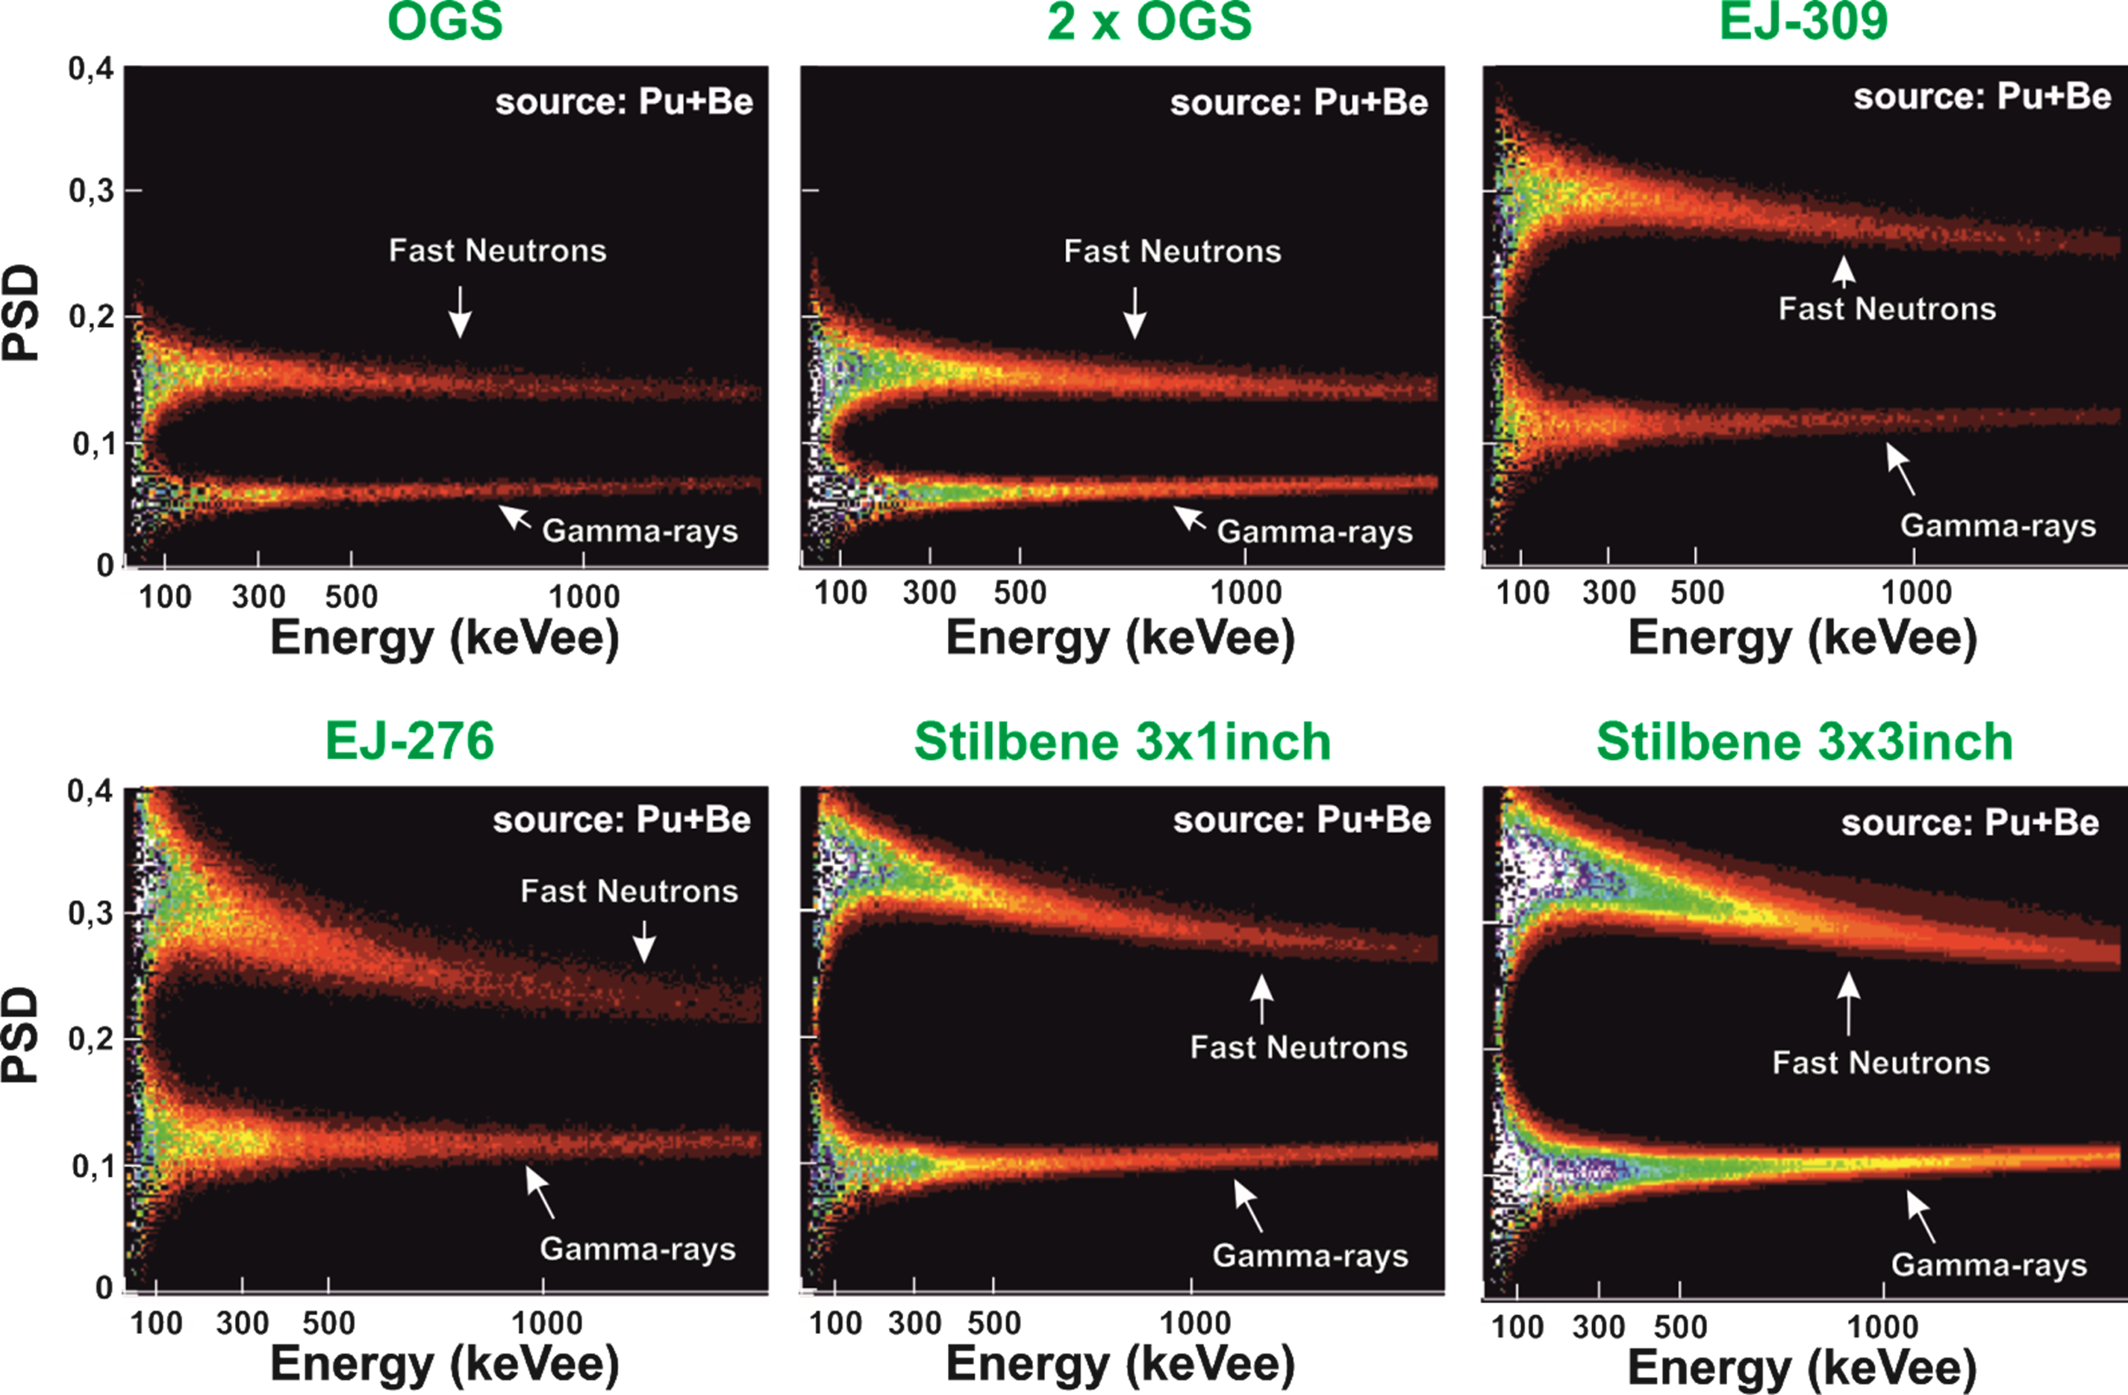
T3.3 – Neutron Detector Development
2D plots of PSD vs energy recorded with PuBe sources for OGS, EJ-309, EJ-276 and Stilbene samples.
OGS is characterized with/as:
good PSD discrimination: better than for EJ-276 plastic scintillator, almost as good as for the EJ-309 liquid,
high light output ~20 000ph/MeV,
emission spectrum with maximum at ~430nm, well-matching most of the available photodetectors
fast decay of the scintillation pulse
nontoxic, nonflammable material

Slide 15
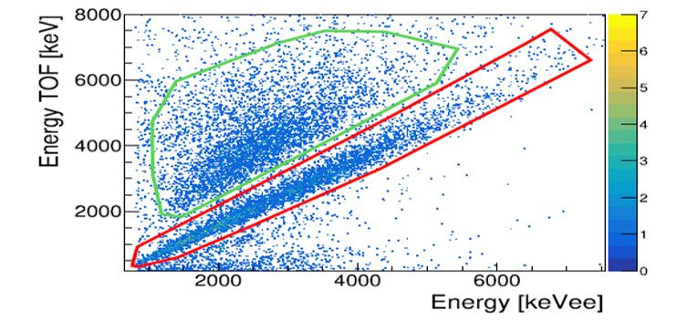
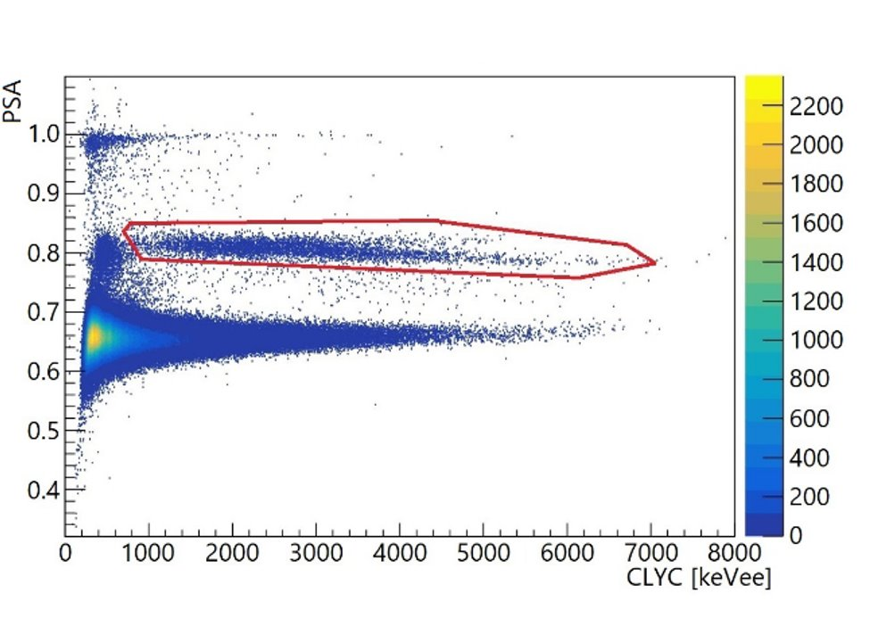
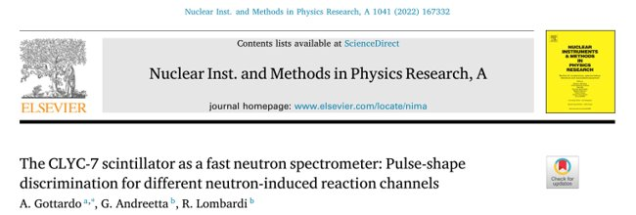
T3.3 – Neutron Detector Development
CLYC scintillators for fast neutron spectroscopy
Neutron spectroscopy via the ³⁵Cl(n,p)³⁵S reaction, but «parasitic» ³⁵Cl(n,α)³²P channel.
Matrix TOF vs Energy deposited in CLYC​
with ²⁵²Cf source
Time of Flight distinguish between (n,α) and (n,p) reactions​
Energy deposited in CLYC does not distinguish between (n,α) or (n,p)​
Excellent neutron/gamma discrimination with a ²⁵²Cf source down to few hundred keV neutrons

Slide 16
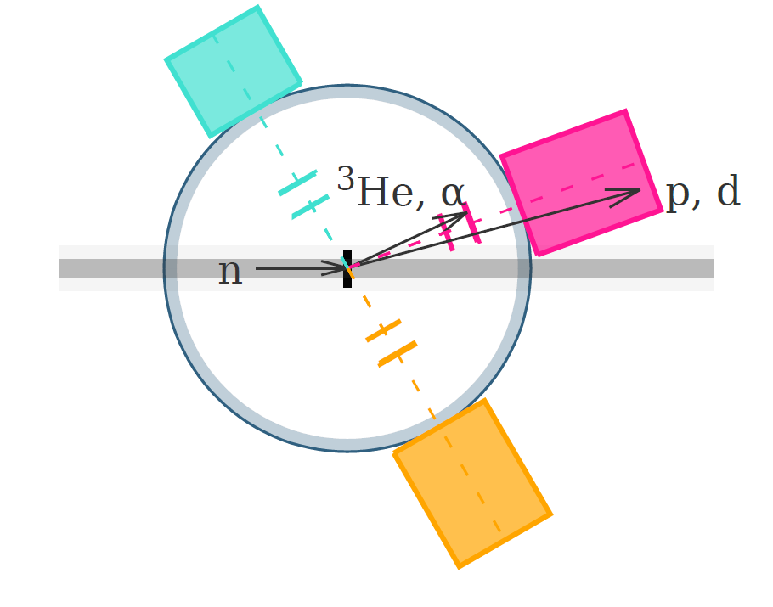
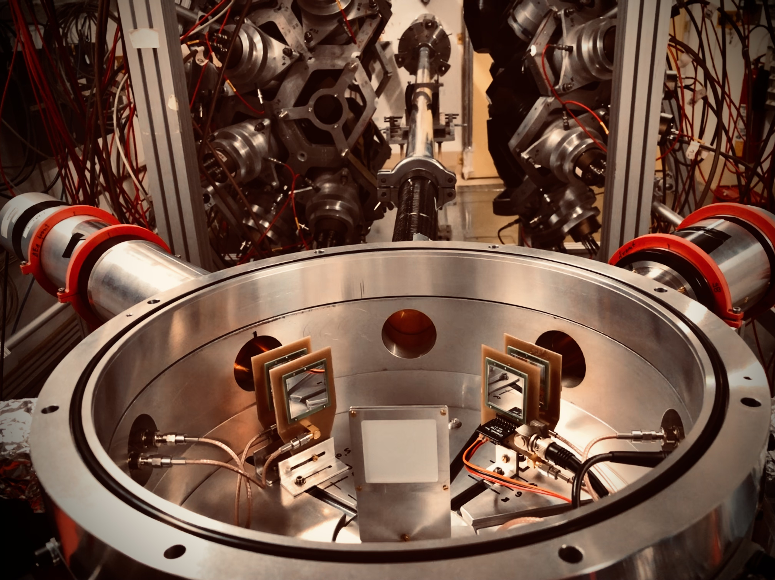
T3.3 – Neutron Detector Development
Neutron Detector Development at Pulsed Ultra-Strong Neutron Sources
Development of instrumentation to be used at CERN, at the neutron spallation source n_TOF
Detection of the neutron-induced emission of light charged particles, for high-energy incident neutrons (E_{n} > 100 MeV)
Main challenge:
E.m. interferences induced by the gamma flash (RF noise)
Silicon semiconductor detectors are especially sensitive to it
Scintillators
Si detectors
Target (CH₂)
Neutron beam direction

Slide 17
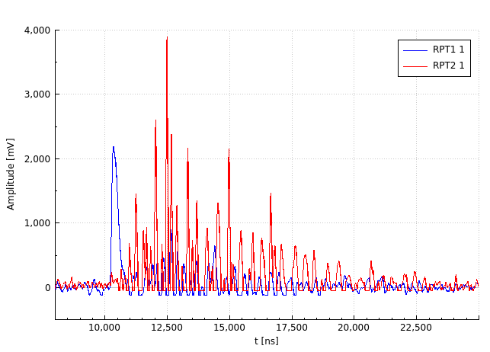
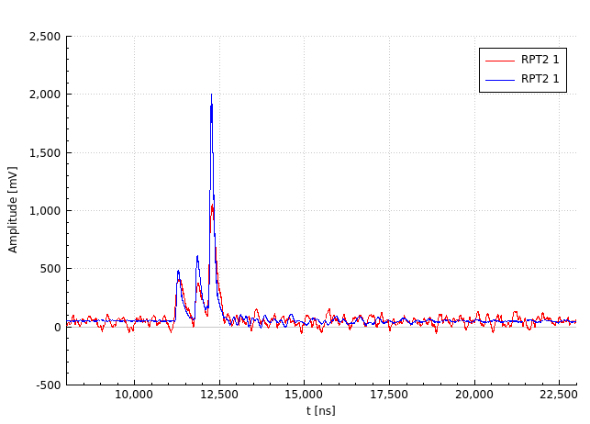
T3.3 – Neutron Detector Development
Neutron Detector Development at Pulsed Ultra-Strong Neutron Sources
Improved design:
Shielded preamplifier, improved grounding, short cables
Preamp inside the vacuum chamber, directly under on the Si diodes
RF tight vacuum chamber (windows included)
Initial design: RF noise
With RF-tight design: clean particle-induced signals
Si-diodes signals
Si-diodes signals

Slide 18
Status of deliverable 3.3
D3.3 | Provide to the community, upon request, one sample each of three possible scintillator materials for neutron detector in cooperation with industry
Deliverable deadline: April 30th 2023
As a result of the deliverable, 3 sets of neutron detection apparatus are offered for use to the community during laboratory tests or physics experiments. Upon request, the equipment will be leased for a period of at least 12 weeks to the requesting side. Task 3.3 participants declare to provide support during installation, maintenance, data acquisition and analysis . First start-up of eased setup should be supervised by the equipment provider (upon the provider decision).
Available sample scintillation materials:
CLYC
OGS
Stilbene
And related readout. The availability of materials will announced through the website and the mailing list

Slide 19
Task 3.4 General overview
Develop techniques to access the nuclear charge of the isotope to be provided for accelerator mass spectrometry, e.g. by ion-gas or ion-laser-interaction
Develop high performance community-accepted methods to measure non-routine AMS isotopes of astrophysical relevance
R. Golser, P. Steier, M. Martschini, D. Bemmerer, A. Wallner, J. Lachner, …

Slide 20
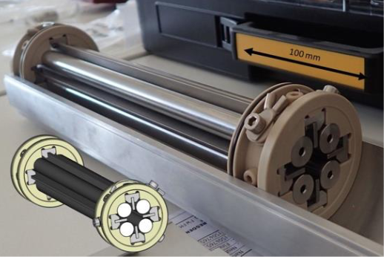
Improvements in tools and techniques
At the Vienna Environmental Research Accelerator (VERA) together with HZDR we develop an enhanced version for ion-laser interaction mass spectrometry (ILIAMS 2.0) to suppress challenging medium-mass isobars. It uses a radio-frequency quadrupole ion-guide filled with buffer-gas (He and O₂), where an intense laser beam overlaps with the ion beam. Less-strongly bound isobaric species (¹⁸²WF₅⁻) are removed, while wanted species (¹⁸²HfF₅⁻) remain unaffected.
ILIAMS 2.0 will accept large emittance ion beams and will feature a UV-laser to destroy and/or neutralize WF₅⁻. Additional challenges for ¹⁸²Hf detection are (a) the chemical preparation of HfF₄ AMS targets from deep-sea MnFe crusts and (b) fabrication of reliable low-level (¹⁸²Hf/Hf ≃ 10⁻¹³) reference materials.
Currently, ILIAMS 2.0 is prepared for commissioning. The protocol for the chemical preparation of HfF₄ targets needs further refinement, as the Hf is buried in still too large amounts of matrix elements.

Slide 21
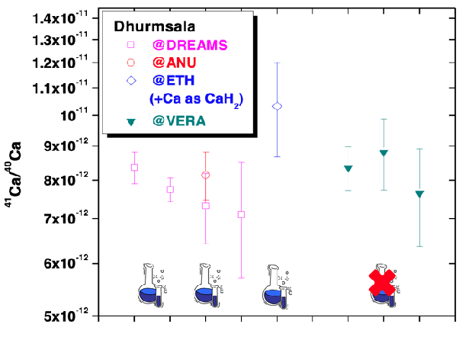
AMS for Calcium Samples
Impressive progress has been demonstrated in measuring ⁴¹Ca/⁴⁰Ca in stony meteorites (e.g., Dhurmsala, Kindberg and Knyahinya).
Time-consuming, labour intensive and cumbersome chemical preparation can be entirely omitted, thus establishing instrumental AMS (IAMS).
The new IAMS results are fully comparable to earlier data from larger AMS facilities using sophisticated chemical preparation of CaF2 and CaH2, respectively
Comparison of ⁴¹Ca/⁴⁰Ca of the stony meteorite Dhurmsala measured by classical AMS at the 6 MV accelerator facilities at Dresden (DREAMS) and Zurich (ETH), the 14 MV one at Canberra (ANU), and without chemically-processing at the 3 MV Vienna Environmental Research Accelerator (VERA) using ILIAMS.

Slide 22
THANKS FOR YOUR ATTENTION

