Slide 1
DOI and User Upload
Alexander Kemp - Software Engineer - DSEG
Notes:
Intro, me and broken shoulder

Slide 2
DOI Work to Date
Rough proof of concept demo ’ed in Feb (thanks to a broken collarbone!)
Working with Diamond to refine requirements through Use Cases
Speaking to ISIS and ESRF to understand how they do it
Broken down into two main areas of functionality
Automatic minting based on the investigation end date
User-defined minting of DOIs
Plan on releasing a final POC end of June and Starting Upload Dev
Notes:
Running through the MPV
Why have this meeting
A lot to go through, wont go through the mappings

Slide 3
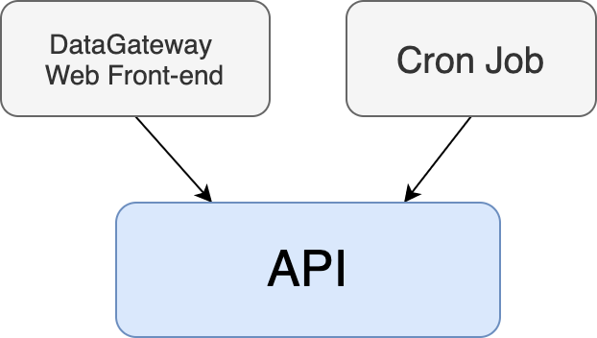
How?
Two main cases:
That a script will need to automatically create Data Publications based on information provided in an Investigation.
That user (PI) will want to create a Data Publication based on a set of Visits / Datasets / Datafiles with information or metadata that they provide.
- Fast API
Microservice
Containerised

Slide 4
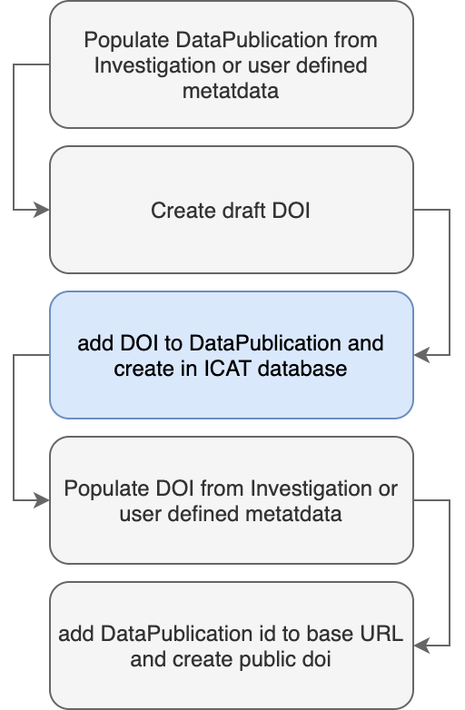
What?
Creating a DataPublication touches:
Dataset
DataCollectionDataset
DataPublicationUser
Investigation
Affiliation
Datafile
Facility
User
DataCollectionDatafile:
InvestigationUser
DataCollection
DataPublicationType
DataPublicationDate
DataCollectionInvestigation
DP needs a DOI, but a DOI needs a DP for the landing page URL

Slide 5
Difference in Facility Approach
Diamond: Difference in Reqs
Publish at a later date
Create from Investigations / Datasets / Datafiles
We do more of the ETL on our side
ISIS:
Only automatic minting of whole investigations, based on when a data file is entered into ICAT.
No User-defined DOIs, but they will hopefully be moving over to this new DOI tool.
Notes:
Running through the MPV
Why have this meeting
A lot to go through, wont go through the mappings

Slide 6
Difference in Facility Approach..cont
ESRF:
They only produce DOIs for datasets
An email is also sent to the participants of the investigation.
Deltas documented here if anyone wants more details
Notes:
Running through the MPV
Why have this meeting
A lot to go through, wont go through the mappings

Slide 7
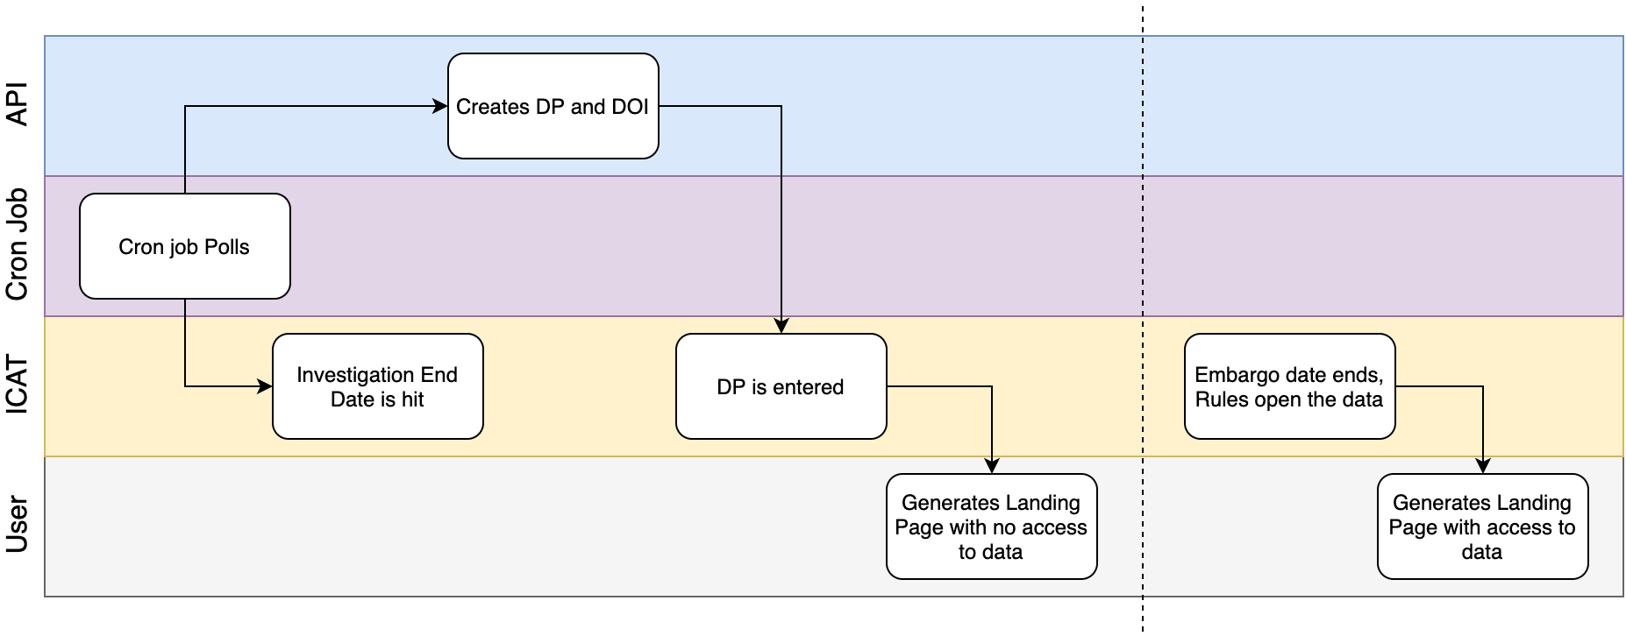
Event Flow for Automatic Process

Slide 8
UI Flow for Manual Process
In Figma

Slide 9
Changes to Schema?
Need to maintain landing pages for removed DataPublications.
So need to track deleted DPs that are created erroneously
Can’t remove DOIs so they’ll still need to point to a landing page where the user will be informed that the Publication has been removed.
Need a flag to denote proprietary data
Not implemented yet
Will add issues in github
Notes:
Running through the MPV
Why have this meeting
A lot to go through, wont go through the mappings

Slide 10
Upload work to Date
Provide the functionality to allow Diamond user to supplement their data online
Using this as part of my CS MSc
Currently looking at underlying protocols and frameworks
Met with Zenodo SRE, who pointed us towards www.tus.io
Current Challenges include:
Choosing right protocol
Imposing limits
Making sure it’s not abused
Notes:
Running through the MPV
Why have this meeting
A lot to go through, wont go through the mappings

Slide 11
Upload work to Date…cont
DOI: Users shouldn’t be able to supplement their data once a DP has been created.
Given an investigation with a DOI and DP, a user shouldn’t be able to add to a Publication
Solution probably to create a new DP for all uploaded data and relate it to other DP/DOIs
Notes:
Running through the MPV
Why have this meeting
A lot to go through, wont go through the mappings

Slide 12
Questions

