Slide 1

Travel Grants For Dummies
How to apply?
How to fill in the forms?
And then?

Slide 2
What can I apply for?
At the AWI there are 3 types of Travel Grants
for PhD students:
1. Conference Funds
2. POLMAR Qualification Grant
3. POLMAR short-term Research Grant

Slide 3
Who is applicable for grants from POLMAR Conference Funds?
All PhD students who are registered with the POLMAR graduate school and
employed by the AWI or
scholarship holders or
guests for doctoral studies
to a sum of max. 5000 Euros over their entire PhD-project period of 3 - 4 years.

Slide 4
The POLMAR Conference Funds consist of
a sum of max. 5000 Euros over the applicant´s entire PhD-project period of 3 - 4 years
for the communication of doctoral thesis results and scientific networking for travel to (inter)national conferences.

Slide 5
2. Who is applicable for a POLMAR Qualification Grant?
The POLMAR Qualification Grant is available to
all PhD students who are registered with the POLMAR graduate school
and
who supplied to POLMAR protocols of their Thesis Advisory Committee meetings within the last 6 months.

Slide 6
The POLMAR Qualification grant consists of
a budget of 500 Euro per year and PhD candidate (max. 1500 Euro in total)
for external training measures in addition to the POLMAR program, e.g. Summer/ Winter Schools, scientific methods trainings, language courses.
(Mandatory courses that are necessary for expedition participation or laboratory use, e.g. safety training, shooting courses, are excluded.)

Slide 7
3. POLMAR short-term Research Grant
Please check individually with POLMAR (info.polmar@awi.de)
For first information, see https://intranet.awi.de/forschung/phd-office/travel-support/polmar-short-term-research-grant.html

Slide 8

How to conquer the red tape
Check:
Am I applicable for finance?
Does my superior support my
participation in the conference /
training course?

Slide 9
Which requirements do you have to fulfill?
You must be registered with AWI PhD office POLMAR. (https://intranet.awi.de/forschung/phd-office/phd-registration.html)
You must have submitted protocols of your regular TAC meetings to POLMAR (info.polmar@awi.de) within the previous 6 months.

Slide 10
If your PhD project is financed by a scholarship or a grant, you first must use up the travel funds raised by your project. If in doubt, ask your section head / project management.
Your paper or poster must have been accepted at the conference.
For more detailed information, check here:
https://intranet.awi.de/forschung/phd-office/travel-support.html

Slide 11
The paperwork
Complete the questionnaire „Application for POLMAR Travel Support“
(see next slide for an example)
You find it here: https://intranet.awi.de/forschung/phd-office/travel-support/conference-funds.html
Send the questionnaire to info.polmar@awi.de for approval.

Slide 12
After preliminary approval by POLMAR, there are different ways to proceed, depending on whether
you are employed by the AWI
or
hold a grant from another organization / are a guest at the AWI.
Example

Slide 13
You are an AWI employee
Fill in the form „Awi Travel application and travel expenses report“
It is available from your section´s assistant or from the „Reisekosten
-abteilung“.
Have the completed form approved by your supervisor.
Scan and email it to info.polmar@awi.de for check and approval.

Slide 14
Complete all boxes marked „before you travel“.
Scan and email the form to info.polmar@awi.de.
Send the original by „Hauspost“ to POLMAR.
The POLMAR team will check, sign in the box „approval“ and revert the form to you.
Example

Slide 15
After your journey
complete all boxes marked „after your journey“;
Add all receipts (originals);
Send the completed form with all receipts by „Hauspost“ to the „Reisekosten-abteilung“ for check and reimbursement.

Slide 16
You are at AWI on a scholarship or grant
After preliminary approval of your application, the POLMAR Team will
fill in the form „AWI Assumption of Travel Cost“;
send the form to you by „Hauspost“.

Slide 17
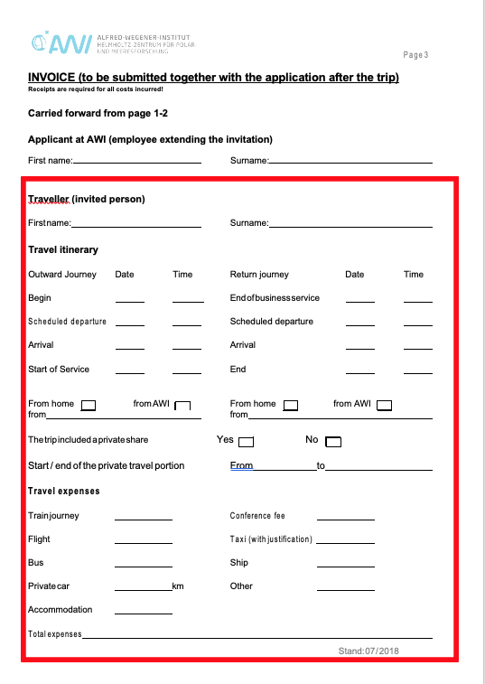
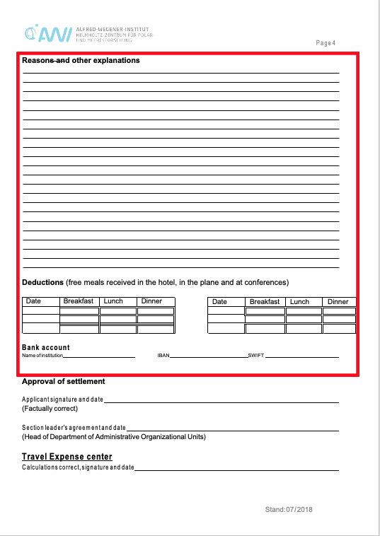
After your journey,
you
complete the boxes marked in red on pages 3 and 4;
Scan and send all 4 pages of the form to info.polmar@awi.de for approval of settlement.
Example
Example

Slide 18
POLMAR will check, sign the approval of settlement
and email the form back to you.
Thereafter you add all receipts,
send the completed and approved form
by „Hauspost“ to the „Reisekostenabteilung“ for reimbursement.

Slide 19

YOU
DID IT!!
CONGRATS!

