Slide 1

Lifetime measurement of the dominant ²²Na (p,γ) ²³Mg resonance in novae
Louis Wagner
Postdoc at TRIUMF
for the DSL2 collaboration
September 20th, 2024
Dresden, Germany
Notes:
6 minutes radiative capture
12 minutes for recoil separators
12 minutes for science highlights

Slide 2
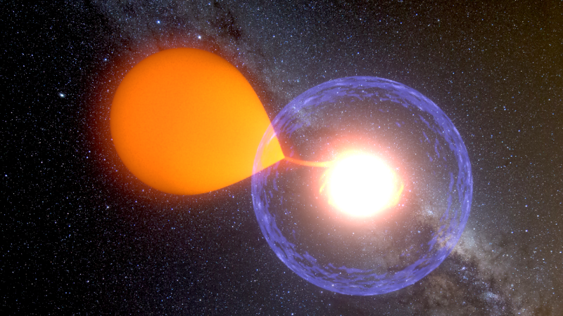
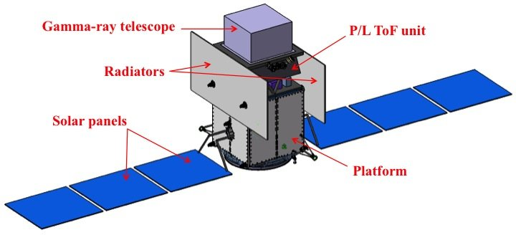
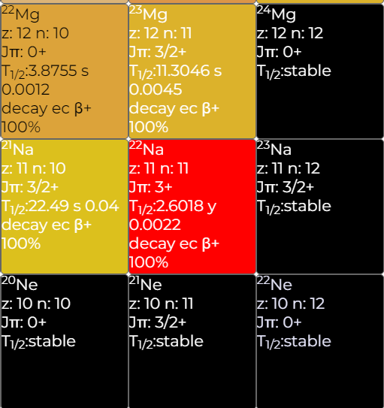
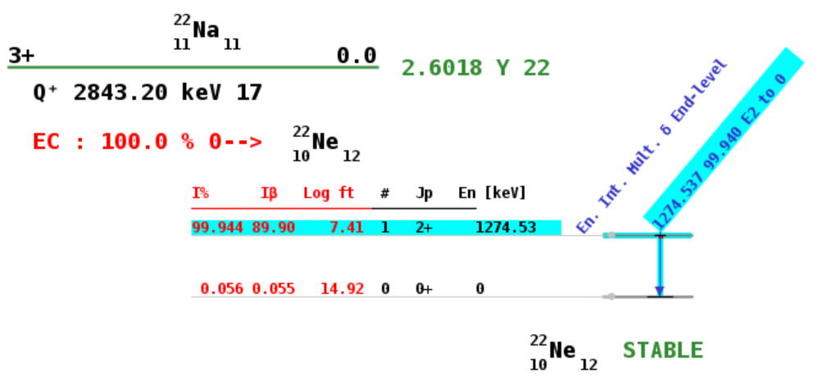
The ²²Na (p,γ) ²³Mg reaction
²²Na is of high interest for space-based γ-ray astronomy
direct observation could constrain classical nova models
characteristic 1275 keV β-delayed γ decay radiation could be observed with future γ-ray telescopes
Low ²⁰Ne / ²²Ne ratios found in presolar grains hint on novae origins since ²²Na decay only viable source of ²²Ne (noble gas)
For linking observations with nova model predictions nuclear data are needed because:
  ²²Na(p,γ)²³Mg reaction destroys ²²Na produced during a nova
classical nova
Artist's portrayal of a classical nova explosion. Credit: K. Ulaczyk / Warsaw University Observatory
p
“Future γ-ray telescope”
Tatischeff, V. et al. (2018). The e-ASTROGAM gamma-ray space observatory for the multimessenger astronomy of the 2030s. 10.48550/arXiv.1805.06435.
ec
²²Na decay scheme and chart from www-nds.iaea.org

Slide 3
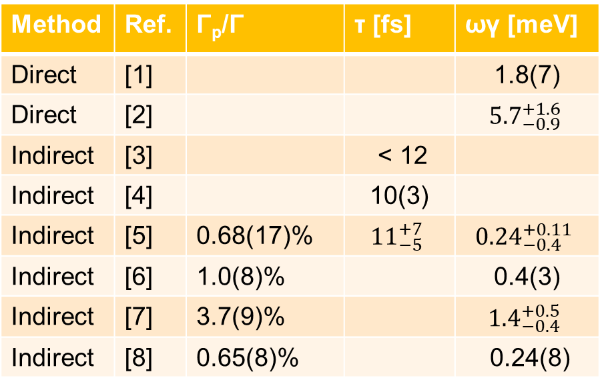
The 204 keV resonance in ²²Na (p,γ) ²³Mg
order of magnitude discrepancies in the experimentally determined strength of the 204 keV resonance
important at nova T window [0.05 - 0.5] GK
affects predictions of the ejected yield substantially.
resonance strength can be determined by measuring the proton branching ratio and the lifetime of the corresponding E_{x}=7.785 MeV excited state in ²³Mg.
But only if spin and parity assignment is decided between (5/2)⁺ or (7/2)⁺
New measurement of the lifetime could shed light on discrepancies
Method | Ref. | Γ_{p}/Γ | τ [fs] | ωγ [meV]
Direct | [1] |  |  | 1.8(7)
Direct | [2] |  |  | $${5.7}_{−0.9}^{+1.6}$$
Indirect | [3] |  | < 12
Indirect | [4] |  | 10(3)
Indirect | [5] | 0.68(17)% | $${11}_{−5}^{+7}$$ | $${0.24}_{−0.4}^{+0.11}$$
Indirect | [6] | 1.0(8)% |  | 0.4(3)
Indirect | [7] | 3.7(9)% |  | $${1.4}_{−0.4}^{+0.5}$$
Indirect | [8] | 0.65(8)% |  | 0.24(8)
References:
[1] F. Stegmüller, et al., Nucl. Phys. A 601, 168 (1996).
[2] A. L. Sallaska et al., Phys. Rev. C 83, 034611 (2011).
[3] O. S. Kirsebom et al., Phys. Rev, C 93, 025802 (2016)
[4] D. G. Jenkins et al., Phys. Rev. Lett. 92, 031101 (2004).
[5] C. Fougères et al., Nat Commun 14, 4536 (2023)
[6] K. Peräjärvi et al., Phys. Lett. B 492, 1 (2000).
[7] A. Saastamoinen et al., Phys. Rev. C 83, 045808 (2011).
[8] M. Friedman et al., Phys. Rev. C 101, 052802 (2020).
Poster #138

Slide 4

TRIUMF
UBC
TRIUMF

Slide 5
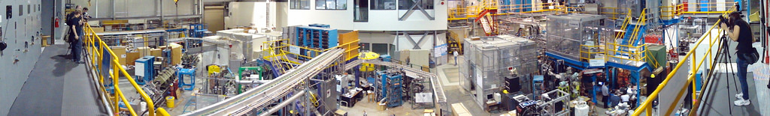
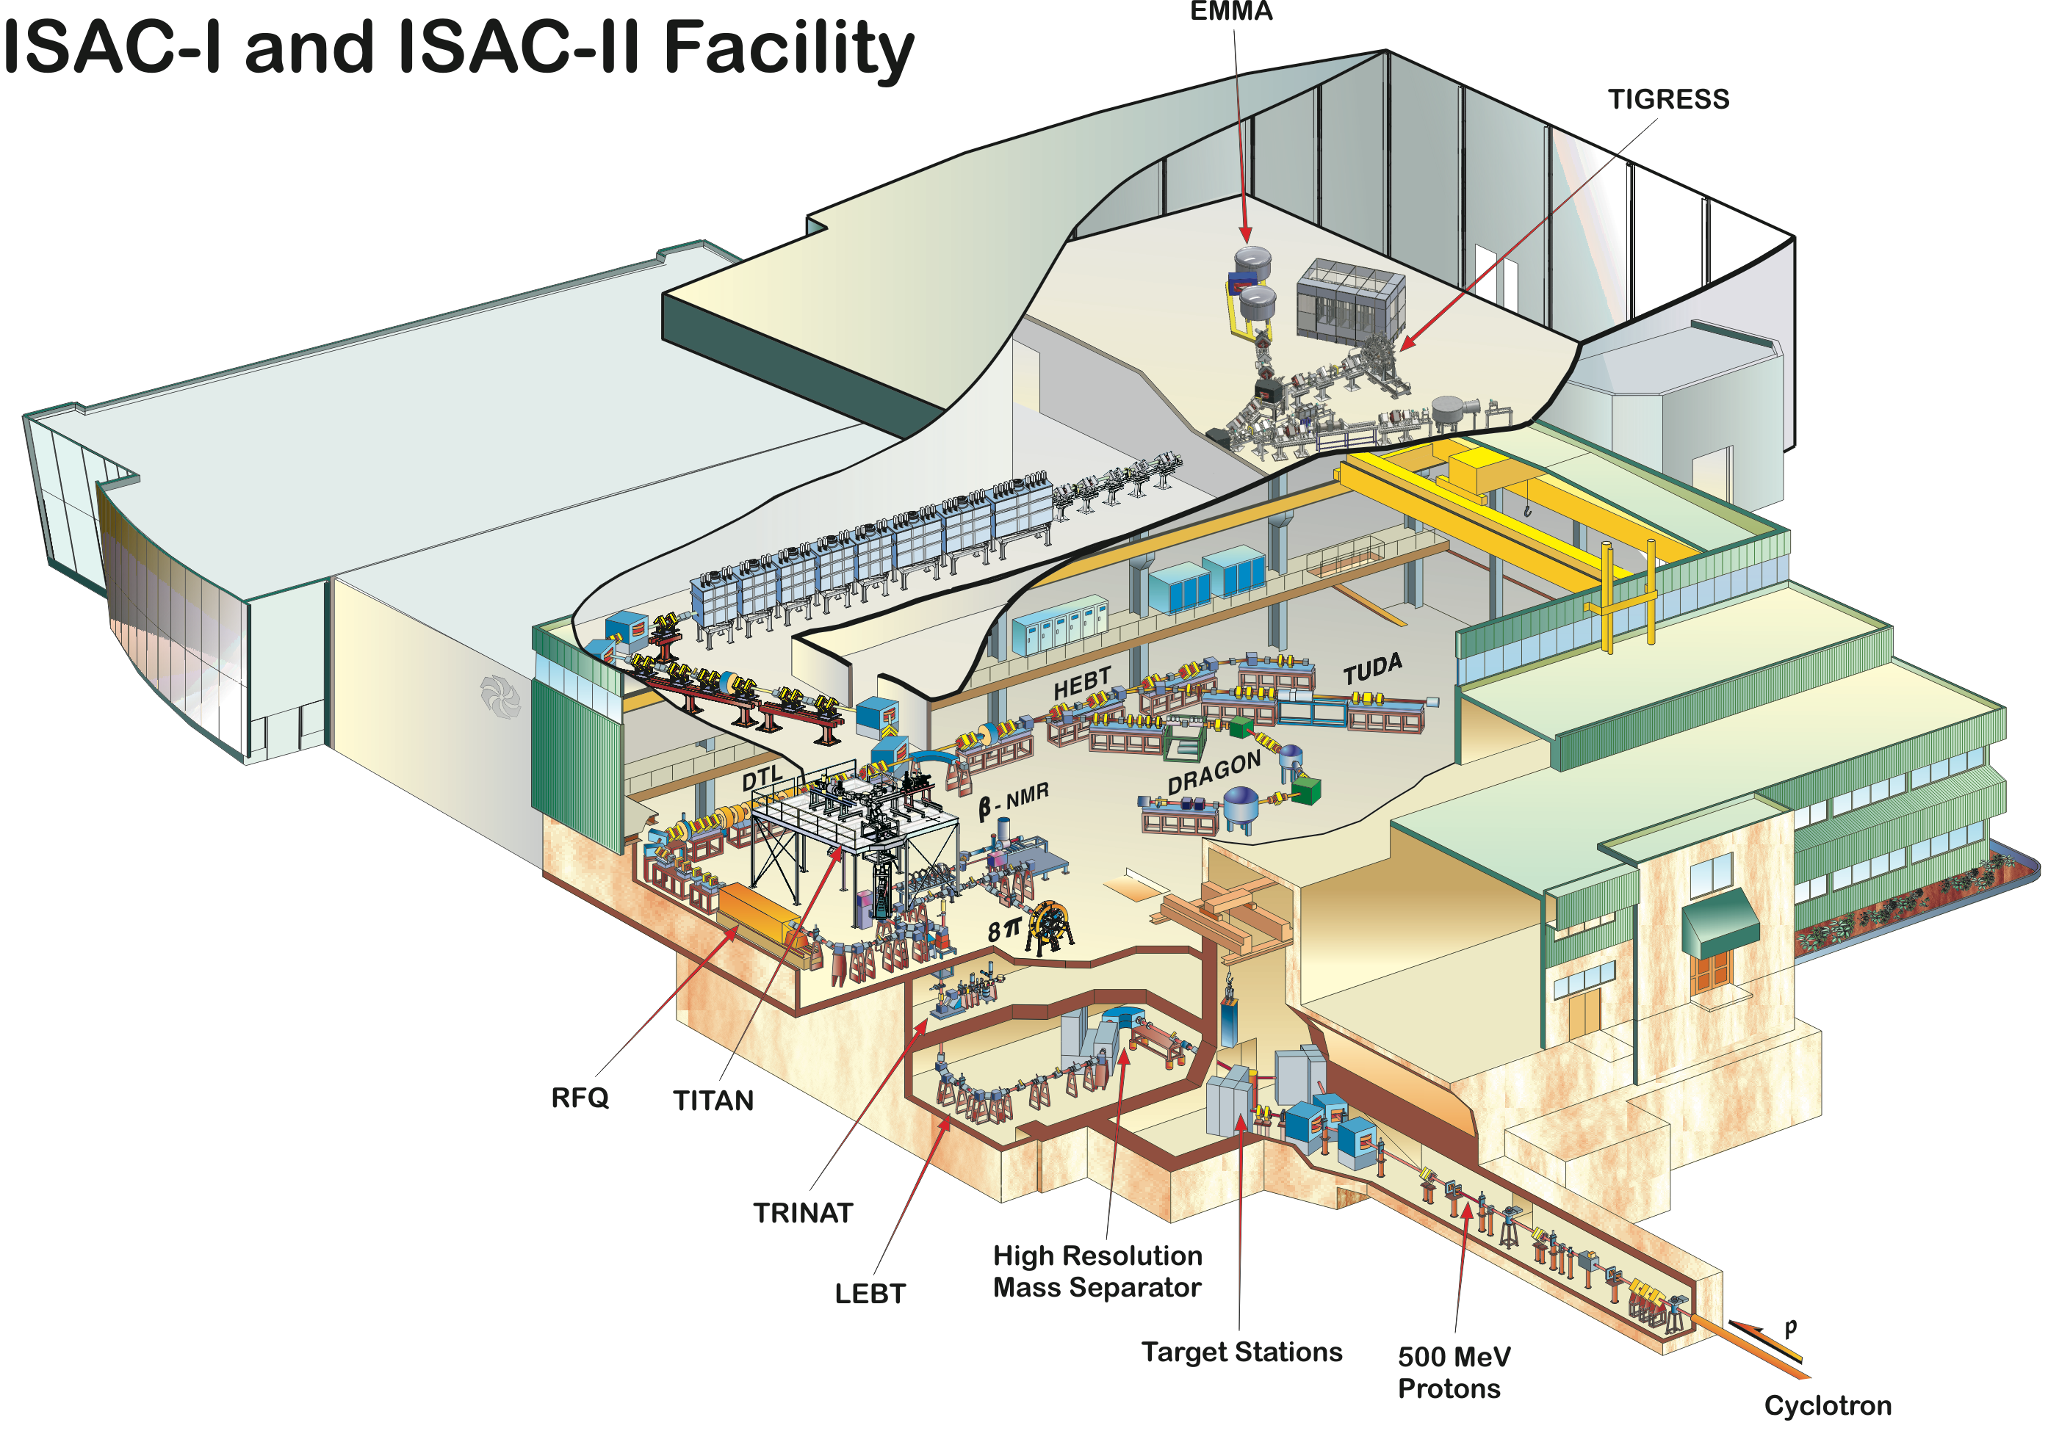
TRIUMF ISAC Facility
The Isotope Separator and
Accelerator (ISAC) facility at TRIUMF provides a wide variety of intense beams of exotic nuclei produced using the ISOL method and stable beams from ion source OLIS
Beams reaccelerated through 35 MHz RFQ with A/q<30
105 MHz variable energy DTL (3 ≤ A/q ≤ 6)
Energies between 0.15 MeV/u & 1.8 MeV/u
Low-energy regime well suited for reaction studies for novae & X-ray bursts
ISAC-II SC-LINAC max. beam energies 6.5 – 16.5 MeV/u suited for transfer reactions on heavy ions
DSL2

Slide 6
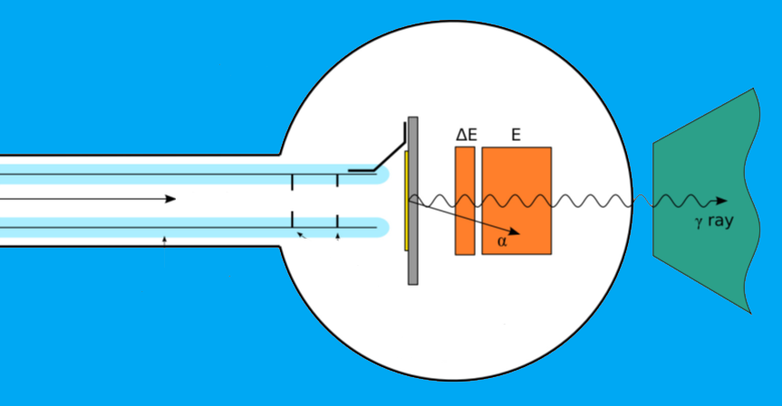
DSL2 at ISAC-II

Slide 7
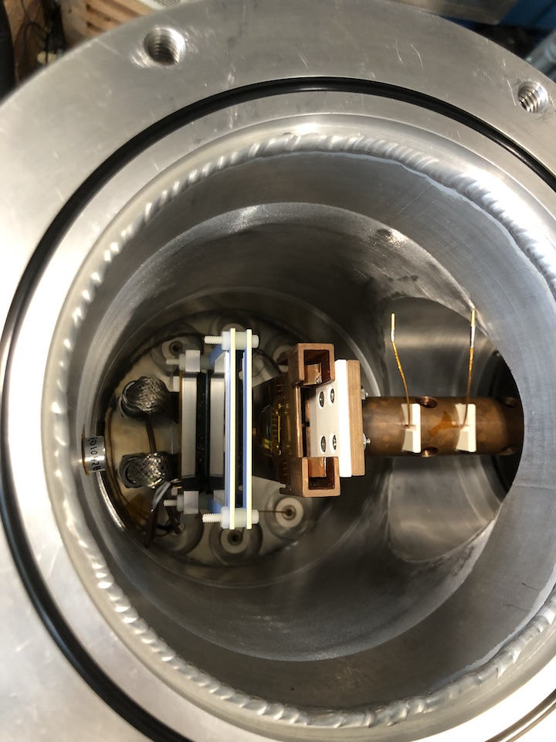
Doppler-Shift Lifetime setup 2 (DSL2)
designed, fabricated and tested at MSU / FRIB
funded by the U.S. National Science Foundation "NSF"
installed at TRIUMF-ISAC-II beamline
improved version of the DSL setup used to get an upper limit of 12 fs on the lifetime of the same exited state [3]
new DSSSD ΔE detector with pixilated (16 x 16) particle detection for angular sensitivity and improved solid angle coverage
[3] O. S. Kirsebom et al., Phys. Rev, C 93, 025802 (2016)

Slide 8
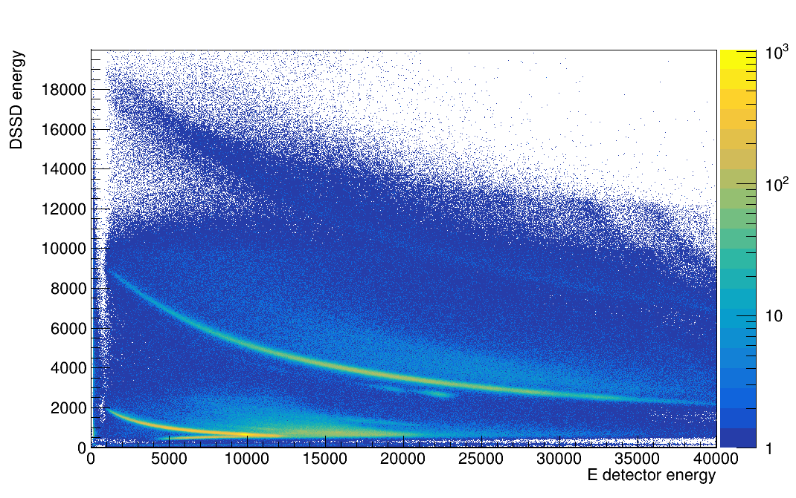
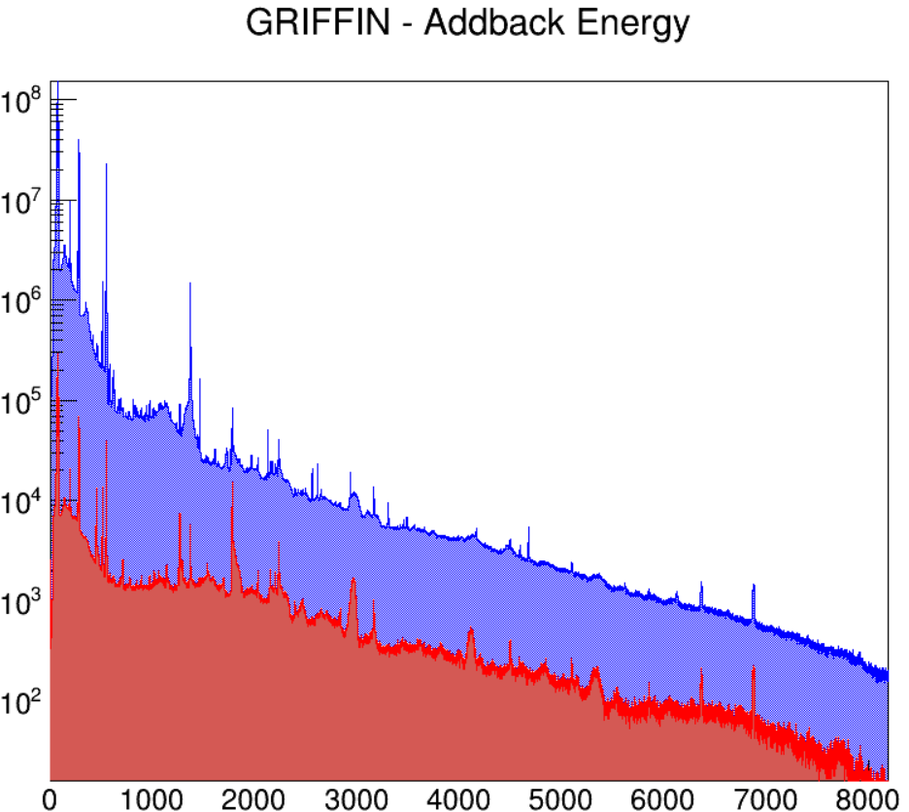
PID and gamma ray detection
Excited states in ²³Mg are populated by ²⁴Mg (³He,α) ²³Mg reaction
using a 75 MeV ²⁴Mg beam of > 6×10⁹ pps for 70 h for Doppler-Shift Attenuation Method (DSAM)
Si detector array used for PID to gate HPGe detector γ spectra on α energy
¹⁹⁷Au (279 → g.s.)
²⁸Si (6879 → g.s.)
²³Mg (2771 → g.s.)
α
SE
³He
ungated
p
Gated on α
HPGe energy [keV]
PID from Si detector telescope; calibrated energy in [keV]
Illustration of α gate effect on γ spectrum (online data)

Slide 9
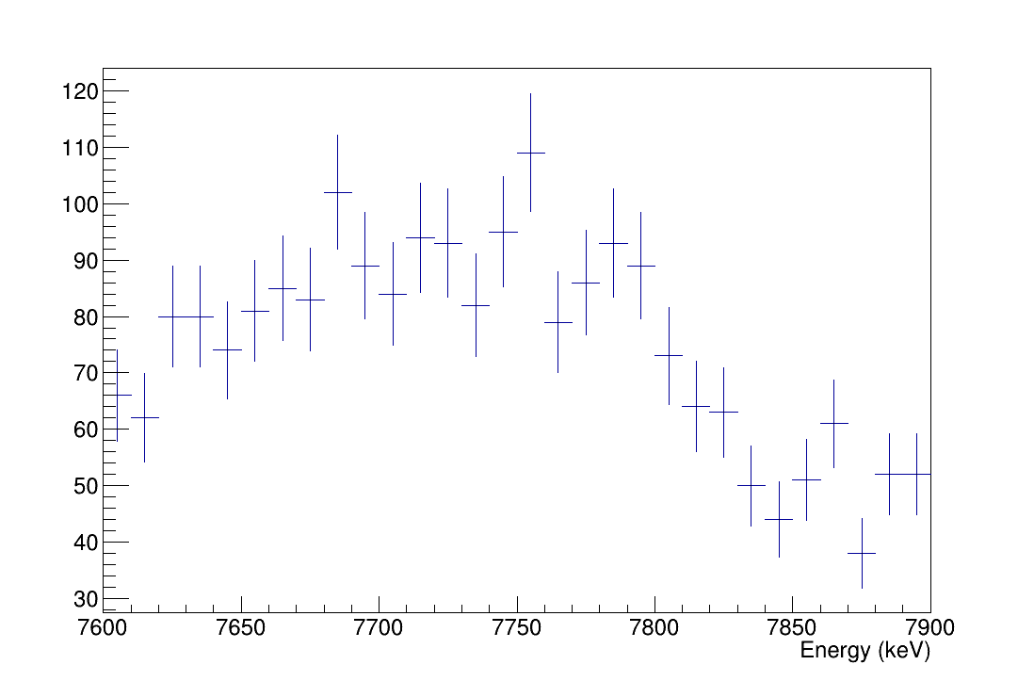
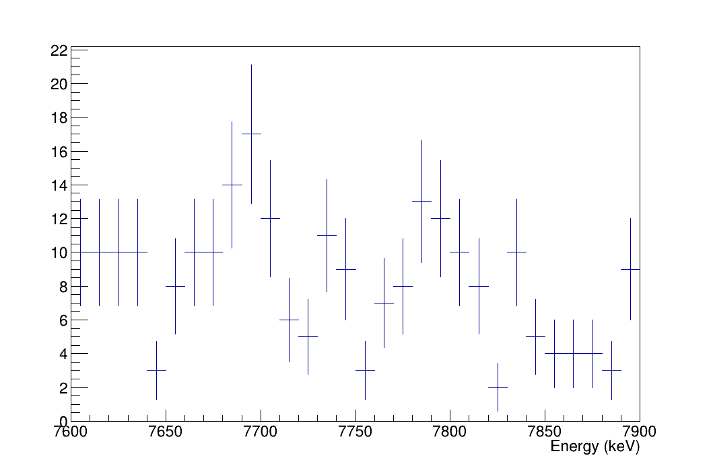
PID and gamma ray detection
Excited states in ²³Mg are populated by ²⁴Mg (³He,α) ²³Mg reaction
using a 75 MeV ²⁴Mg beam of > 6×10⁹ pps for 70 h for Doppler-Shift Attenuation Method (DSAM)
Si detector array used for PID to gate HPGe detector γ spectra on α energy
deexcitation γ-rays are detected to perform line-shape analysis and infer the lifetime
First run encountered issues due to target contaminations (C, O) and low beam rate
LLNL made target
TRIUMF made target
preliminary
preliminary
Gated γ spectra for ROI @ 7785 keV deexcitation to g.s. by Lexanne Weghorn (MSU/ FRIB)

Slide 10
Line shape analysis for DSAM
Markov chain Monte Carlo-based Bayesian statistical techniques will be applied to a simulation of the DSAM [9] using the following model parameter:
Lifetime
γ-ray energy
Background
Stopping power of Au foil (SRIM)
Angular correlation between γ and α emission
HPGe detector response function
Fitting the model to the γ-ray spectrum determines the likelihood, quantifying how well the model reproduces the data. Then MCMC algorithms generate a random walk through the parameter space.
Each step is accepted or rejected according to the product of the prior and the likelihood to reproduce the measured observables.
In the end the lifetime and its uncertainty are extracted from the posterior probability distribution.
Workflow of the MCMC based Bayesian DSAM data analysis framework from [9]
[9] L. J. Sun et al., Phys. Lett. B 839, 137801 (2023)

Slide 11
Summary / Outlook
Summary
First experiment with the new setup DSL2
Successful demonstration of improved setup => angular resolution and ~ x10 higher statistics per incident beam particles
Lifetime measurement of E_{x}=7.785 MeV excited state in ²³Mg to infer the resonance strength of the 204 keV resonance in ²²Na (p,γ) ²³Mg relevant for classical novae
issues due to contaminations in LLNL target but mainly insufficient statistics from low beam intensity
Outlook
Analysis under way:
  Improve α particle gates in the PID to get cleaner peaks from deexcited ²³Mg in HPGe γ spectrum
  Feed the peak shapes to MCMC DSAM simulation as proof of principle
Run experiment with intended intensity of 3 pnA ²⁴Mg beam in fall to get sufficient statistics
Measure lifetime with fs precision to distinguish shell-model prediction (0.6 ... 1.7 fs) from existing experimental values (6 ... 18 fs) in literature

Slide 12










Thank you
Merci
My thanks to the DSL2 collaboration:
A. Adams^{b}, C. Angusª, B. Davidsª, J. Dopfer^{b}, N. Esker^{c}, M. Friedman^{f}, A. Garnsworthyª, G. Hackmanª,
K. Hudsonª, J. Jeongª , V. Karayonchevª, L. Le^{c},
M. Oliver^{c}, C. Ricker^{b}, R. Russell^{e}, L. J. Sun^{b}, V. Vediaª, L. Wagnerª, L. Weghorn^{b}, C. Wrede^{b}, J. Williamsª,
J. Wilkinson^{d}, D. Yatesª
ªTRIUMF, ^{b}MSU/FRIB, ^{c}SJSU, ^{d}LLNL,
^{e}Uni Surrey, ^{f}Hebrew Uni
www.triumf.ca
Follow us @TRIUMFLab

Slide 13
Backup
Slides

