Slide 1

Study of the α-nucleus optical potential in the mass range relevant to the γ-process nucleosynthesis
György Gyürky
Institute for Nuclear Research (Atomki)
Debrecen, Hungary

Slide 2
γ-process: synthesis of p-nuclei
See the talk of Lorenzo Roberti!
p-isotopes, p-process
Huge reaction network
High importance of (γ,α) reactions

Slide 3
(γ,α) reaction rates
W. Rapp et al., 2006
Important especially in the heavy mass range
Calculated in the HF statistical model
Very sensitive to the α-nucleus Optical Model Potential (αOMP)
Various OMPs
¹⁴⁴Sm(α,γ)¹⁴⁸Gd
(kind of)
local fit
E. Somorjai et al., 1998

Slide 4
(How to remedy) the αOMP problem?
Very old McF potential used in astrophysics
Simple, but for higher energies (and not good even there)
Elastic α-scattering at low energies
Systematic study on many heavy isotopes
⁶⁴Zn
⁸⁹Y
⁹²Mo
¹⁰⁶Cd
¹¹⁰Cd
¹¹⁶Cd
¹¹²Sn
¹²⁴Sn
¹⁴⁴Sm
...

Slide 5

A new αOMP for astro purposes:
The ATOMKI potential
Based on scattering
Good reproduction of experiments
Few parameters
Real part: double folding
Immaginary part: surface Woods-Saxon
Project driven by
Peter Mohr

Slide 6
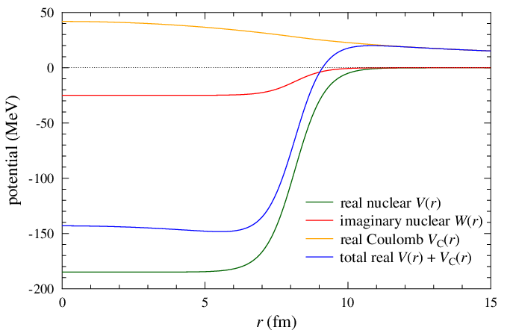
Problem with the WS potential
V_{C}(r)
W(r)
V(r)+V_{C}(r)
V(r)
Coulomb barrier

Slide 7
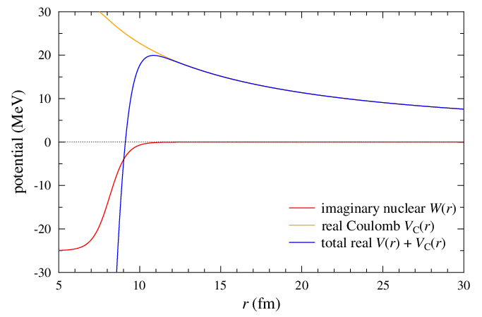
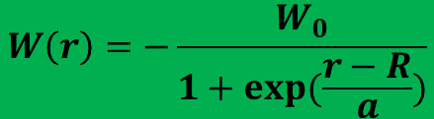
Problem with the WS potential
E ≈ 10 MeV (far below barrier)
( ≈ Gamow window!)
V(r)+V_{C}(r)
W(r)
Alpha capture
$$W\left(r\right)=−\frac{W_{0}}{1+exp⁡(\frac{r−R}{a})}$$

Slide 8
Atomki-V2 optical potential
Motivated by α-induced reaction studies
Pure Barrier Transmission model
Real part: double folding
Imaginary part: narrow and deep Woods-Saxon
Good behavior, but further experiments needed
Implemented in TALYS
Reaction rates provided
Systematic work continued with (α,n) reactions

Slide 9
Two recent experiments:
- ¹⁴⁴Sm(α,n)¹⁴⁷Gd and
- ^{120,122,124,130}Te(α,n)^{123,125,127,133}Xe
Sensitive to the αOMP close above the (α,n) threshold
No (good quality) experimental data
Measurable with activation

Slide 10
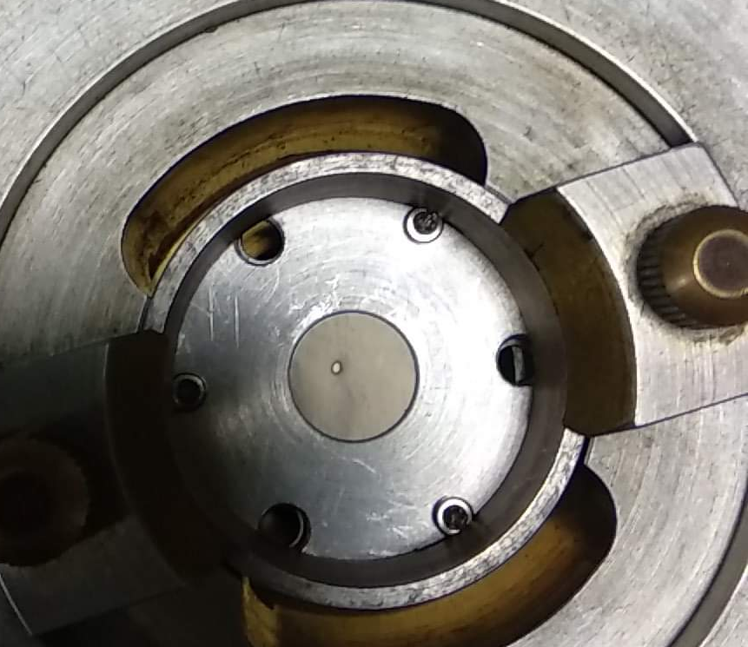
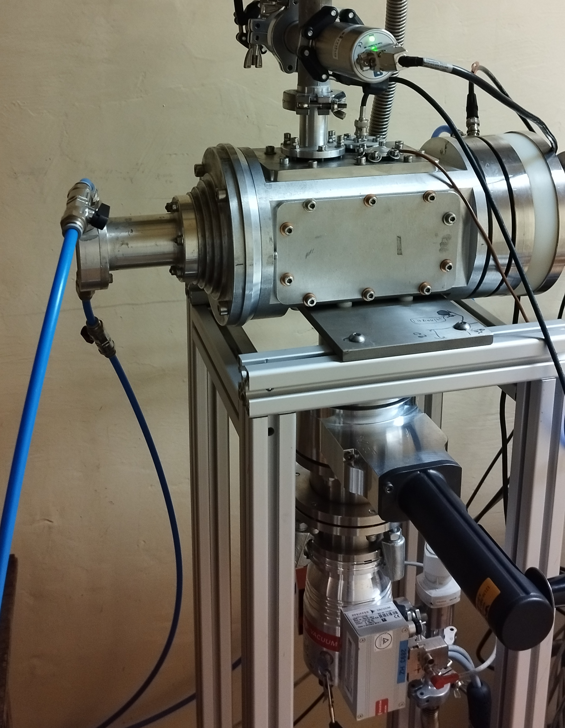
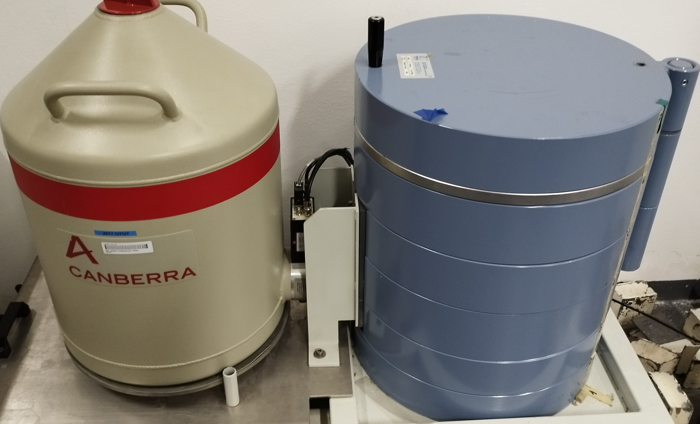
Experiments
Evaporated (natural) Sm and Te targets
Cyclotron accelerator of Atomki
(~10 - ~20 MeV)
HPGe detectors for decay counting

Slide 11
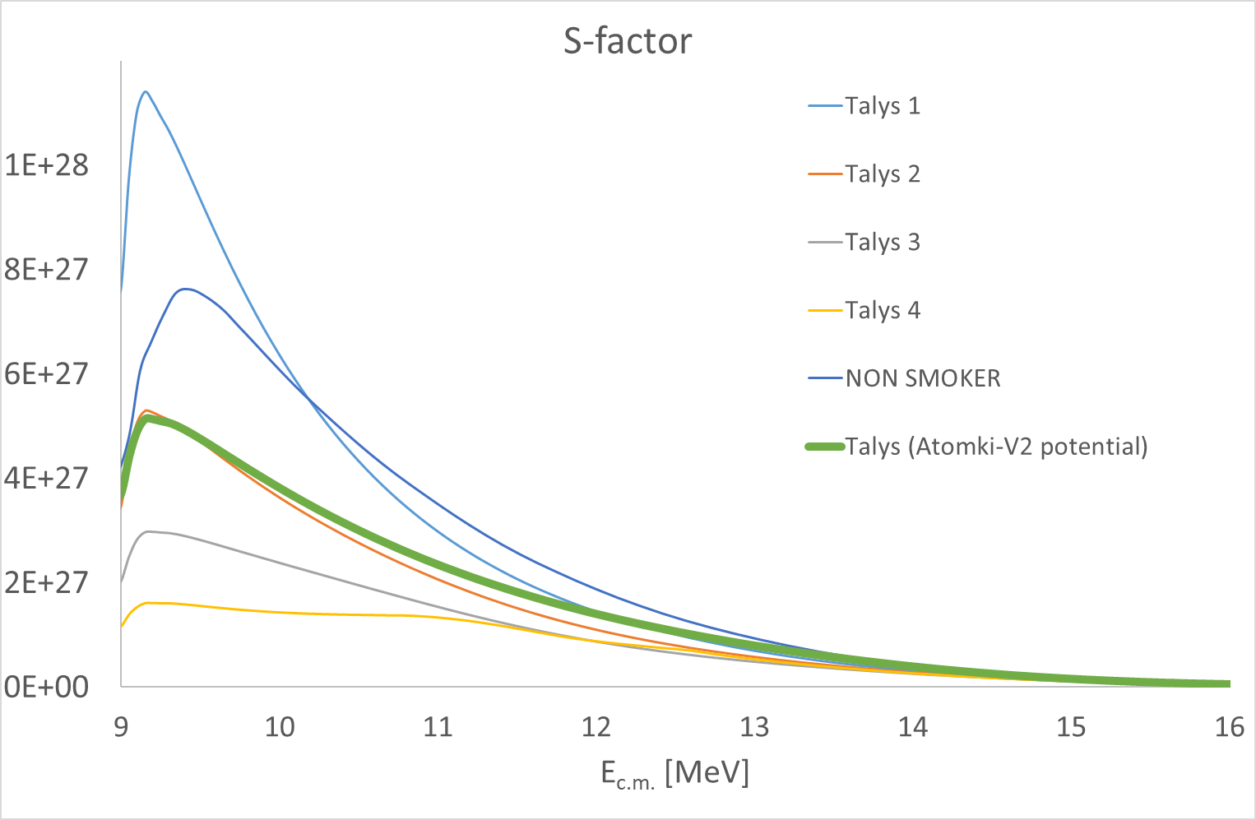
Results ¹²²Te(α,n)¹²⁵Xe
¹²²Te + α system
Gamow window
(α,n) threshold

Slide 12
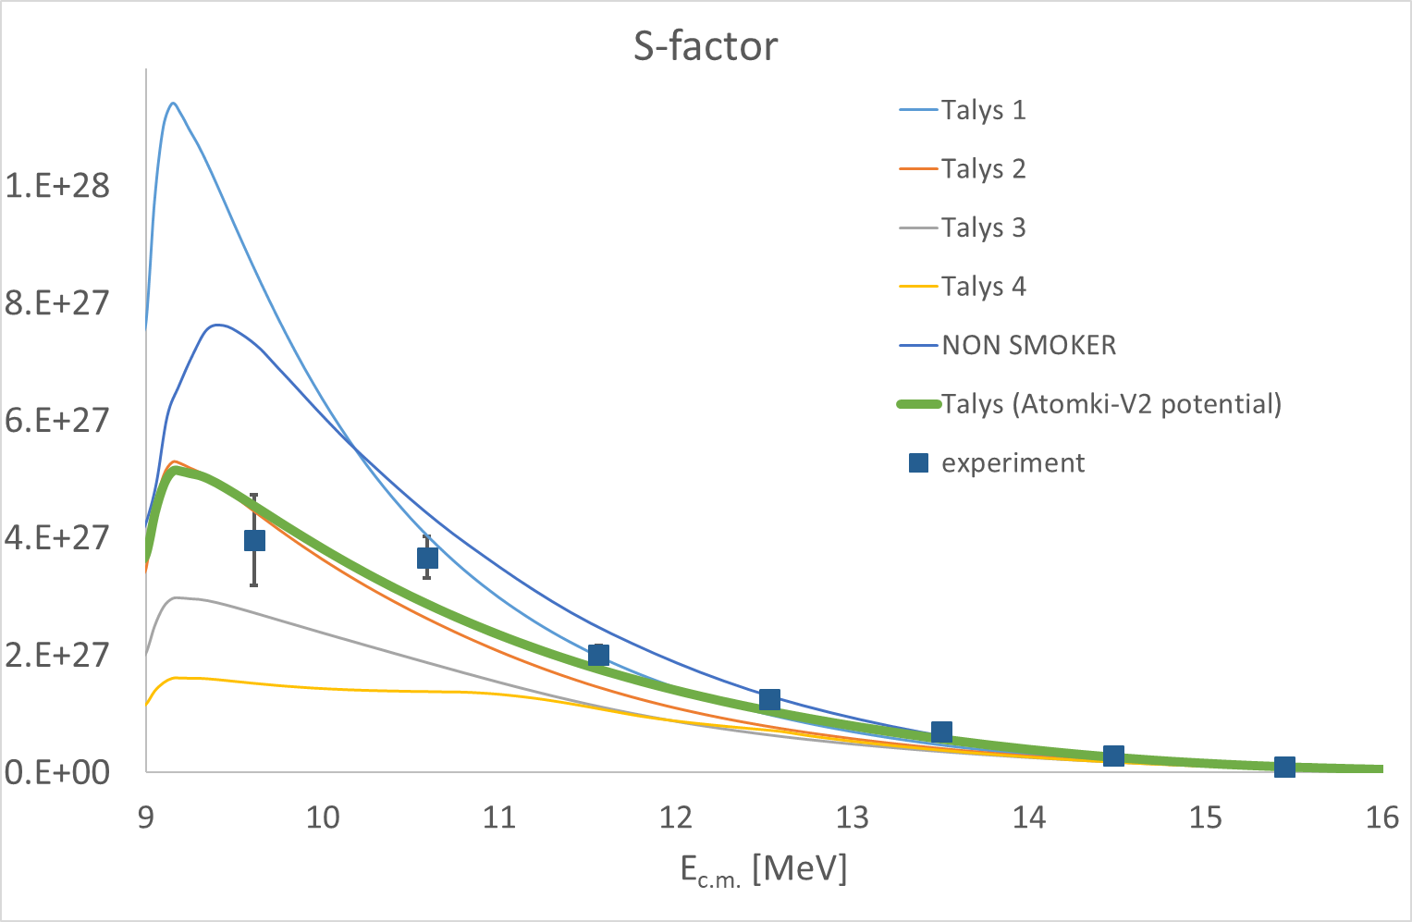
Results ¹²²Te(α,n)¹²⁵Xe

Slide 13
Other studied reactions
¹²⁰Te(α,n)¹²³Xe
¹³⁰Te(α,n)¹³³Xe
¹⁴⁴Sm(α,n)¹⁴⁷Gd
¹²⁴Te(α,n)¹²⁷Xe
Nuclear Level Density
problem (most likely)
Gy. Gyürky et al., PRC 107, 025803 (2023)
Zs. Mátyus et al., PRC 109, 065806 (2024)

Slide 14
On the neutron-rich side: weak r-process
¹⁰⁰Mo(α,n)¹⁰³Ru
⁹⁶Zr(α,n)⁹⁹Mo
T.N. Szegedi et al., PRC 109, 035804 (2021)
G.G. Kiss et al., ApJ 908, 202 (2021)
See also the talk of Almudena Arcones and Poster #46 by Sándor Kovács

Slide 15
Summary
Heavy element nucleosynthesis is still not fully understood (e.g. γ-process)
Nuclear physics uncertainties play a role
αOMP is often a key parameter
New αOMP has been created, tailored for low energies
Its testing with further experiments is necessary and going on

Slide 16
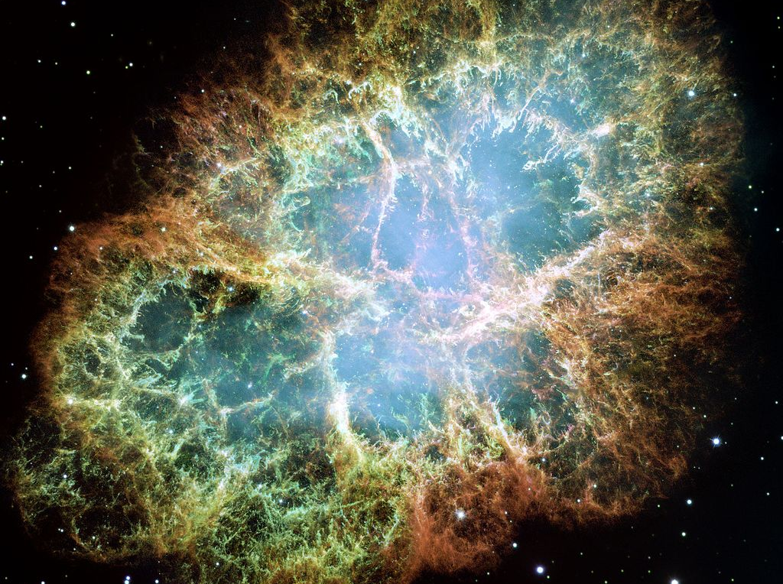
Thank you for
your attention!
Atomki nuclear astrophysics group:
  Mátyus, Zsolt
  Mohr, Peter
  Csedreki, László
  Elekes, Zoltán
  Fülöp, Zsolt
  Gyürky, György
  Halász, Zoltán
  Kiss, Gábor
  Kovács, Sándor
  Szegedi, Norbert
  Szücs, Tamás

Slide 17
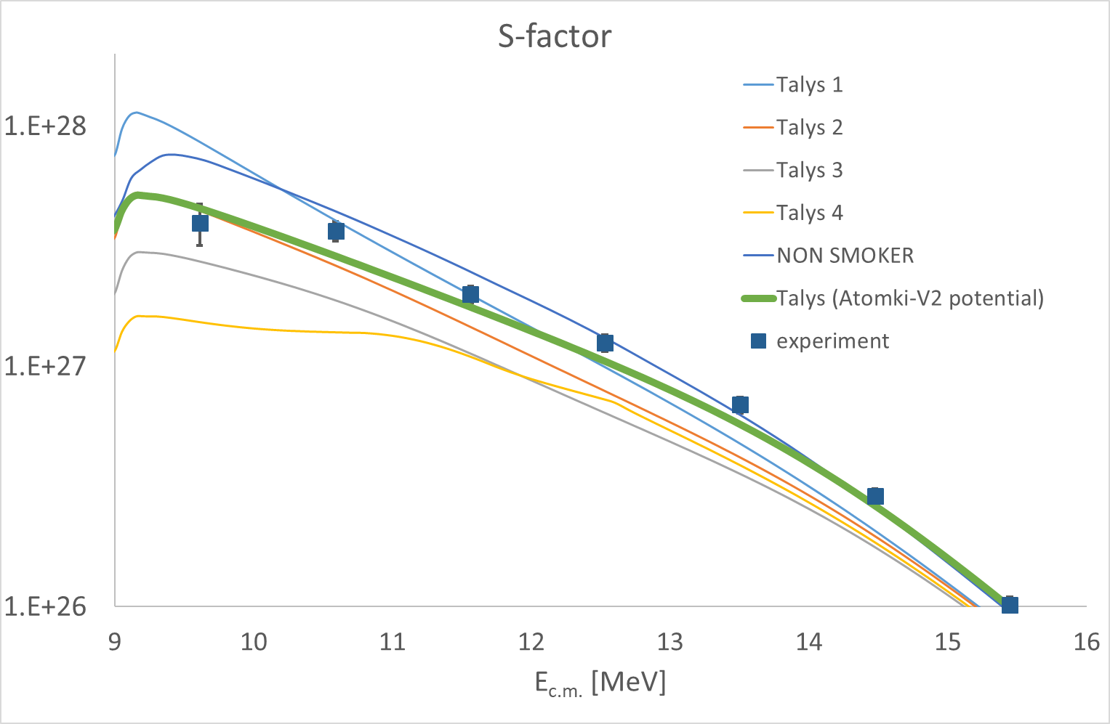
Results ¹²²Te(α,n)¹²⁵Xe

