Slide 1




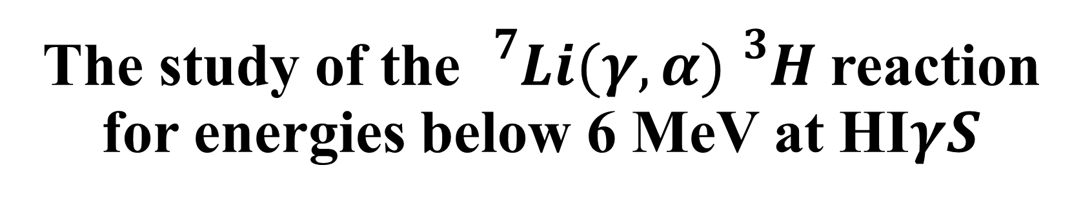
The study of the ${}_{}^{7}{Li(γ,α)}{}_{}^{3}H$reaction for energies below 6 MeV at HI$γS$
Ioana KUNCSER
ELI-NP (Romania)
Nuclear Physics in Astrophysics IX
17.09.2024

Slide 2
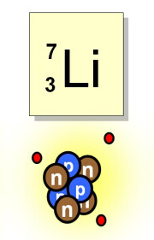
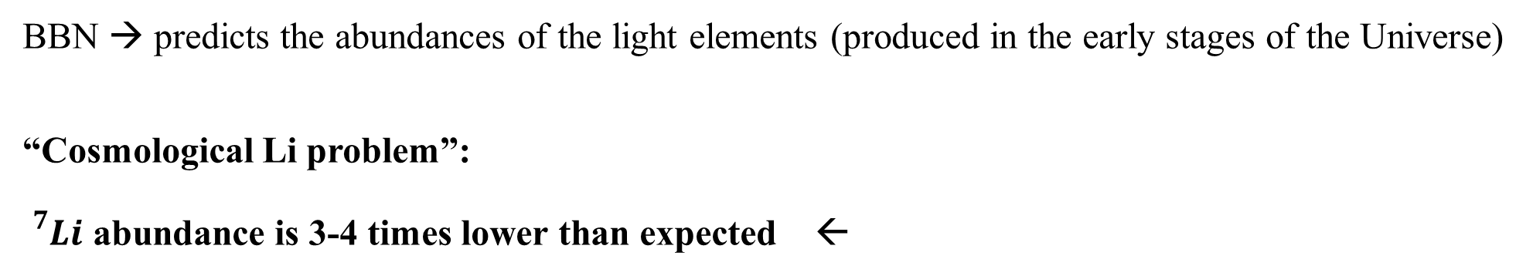
Motivation of the experiment
BBN → predicts the abundances of the light elements (produced in the early stages of the Universe)
“Cosmological Li problem”:
${}_{}^{7}{Li}$ abundance is 3-4 times lower than expected ←
Observations on the low-metallicity stars
1

Slide 3
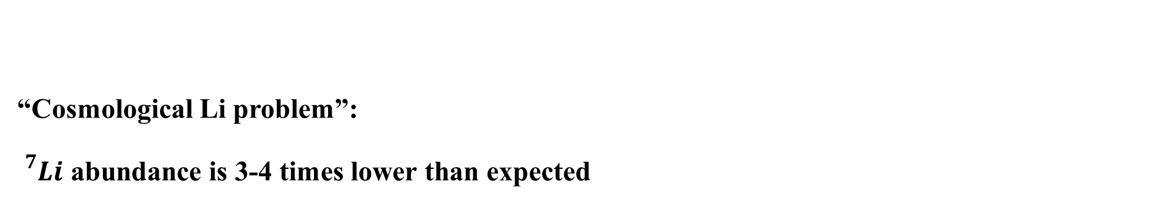
Motivation of the experiment
“Cosmological Li problem”:
${}_{}^{7}{Li}$ abundance is 3-4 times lower than expected
The stellar measurements are leading to anomalous results
OR
An error is present in the nuclear theoretical models
1

Slide 4
Motivation of the experiment
“Cosmological Li problem”:
${}_{}^{7}{Li}$ abundance is 3-4 times lower than expected
The stellar measurements are leading to anomalous results
OR
An error is present in the nuclear theoretical models
The error can be related to the WMAP baryonic density
Lower value → higher effect of the ${}_{}^{3}{H(α,γ){}_{}^{7}{Li}}$ reaction
1

Slide 5


Two main reactions are responsible for the production of mass 7 elements
$${}_{}^{3}{He(α,γ){}_{}^{7}{Be}}$$
$${}_{}^{3}{H(α,γ){}_{}^{7}{Li}}$$
from Neff et al, PRL 106, 042502 (2011)
The theoretical models doesn’t fit the experimental data for ${}_{}^{3}{H(α,γ){}_{}^{7}{Li}}$
2

Slide 6

Two main reactions are responsible for the production of mass 7 elements
$${}_{}^{3}{He(α,γ){}_{}^{7}{Be}}$$
$${}_{}^{3}{H(α,γ){}_{}^{7}{Li}}$$
from Neff et al, PRL 106, 042502 (2011)
Only a few experiments were performed
Due to restricted use & health/safety, an experiment with a tritium target cannot be performed anymore
However, the ${}_{}^{3}{H(α,γ){}_{}^{7}{Li}}$ reaction can still be studied by its INVERSE REACTION
2

Slide 7

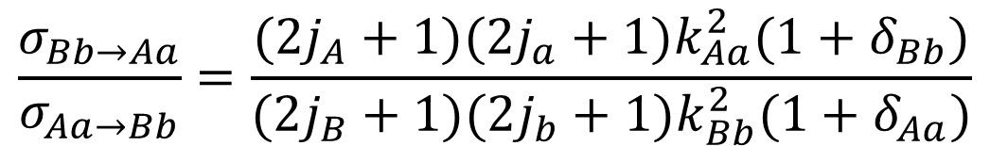

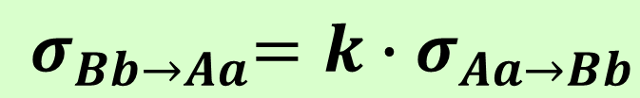
Reciprocity Theorem:
Inverse reaction
$$\frac{σ_{Bb→Aa}}{σ_{Aa→Bb}}=\frac{(2j_{A}+1)(2j_{a}+1)k_{Aa}^{2}(1+δ_{Bb})}{(2j_{B}+1)(2j_{b}+1)k_{Bb}^{2}(1+δ_{Aa})}$$
$$⇒$$
$${ σ}_{Bb→Aa}{=k∙σ}_{Aa→Bb}$$
Direct reaction
*Photons: $2j_{γ}+1=2$
3

Slide 8



Reciprocity Theorem:
Inverse reaction
$$\frac{σ_{Bb→Aa}}{σ_{Aa→Bb}}=\frac{(2j_{A}+1)(2j_{a}+1)k_{Aa}^{2}(1+δ_{Bb})}{(2j_{B}+1)(2j_{b}+1)k_{Bb}^{2}(1+δ_{Aa})}$$
$$⇒$$
$${ σ}_{Bb→Aa}{=k∙σ}_{Aa→Bb}$$
Direct reaction
*Photons: $2j_{γ}+1=2$
α
$${}_{}^{3}{H(α,γ){}_{}^{7}{Li}}$$
Direct reaction
$$E_{γ}$$
7Li
$${}_{}^{7}{Li(γ,t){}_{}^{4}{He}}$$
Inverse reaction
Back-to-back
Lithium photodisintegration: k >100
t
3

Slide 9
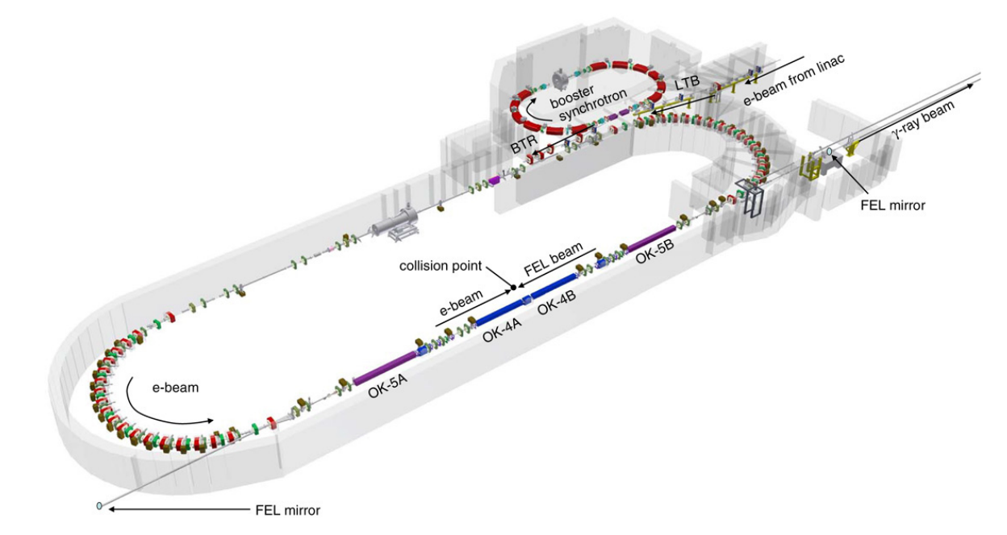
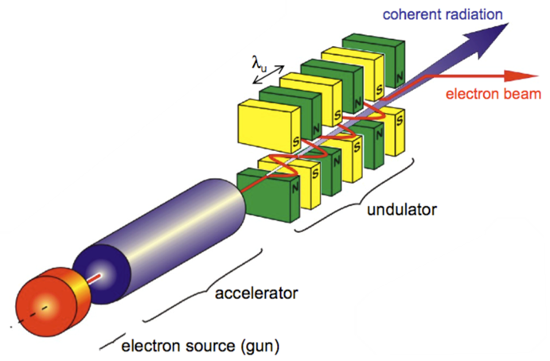
Set-up at HIγS
High Intensity
γ Source
Energy:
1 MeV -100 MeV
4

Slide 10
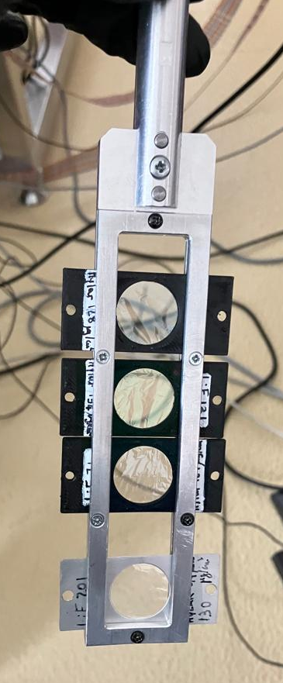
Set-up at HIγS
High Intensity
γ Source
LiF/Mylar
4

Slide 11
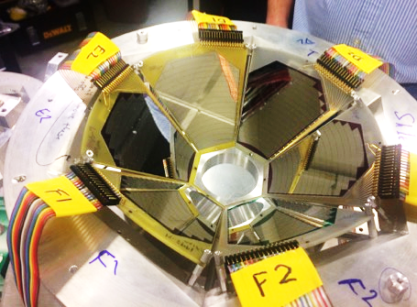
Set-up at HIγS
High Intensity
γ Source
Silicon Detector Array
LiF/Mylar
4

Slide 12
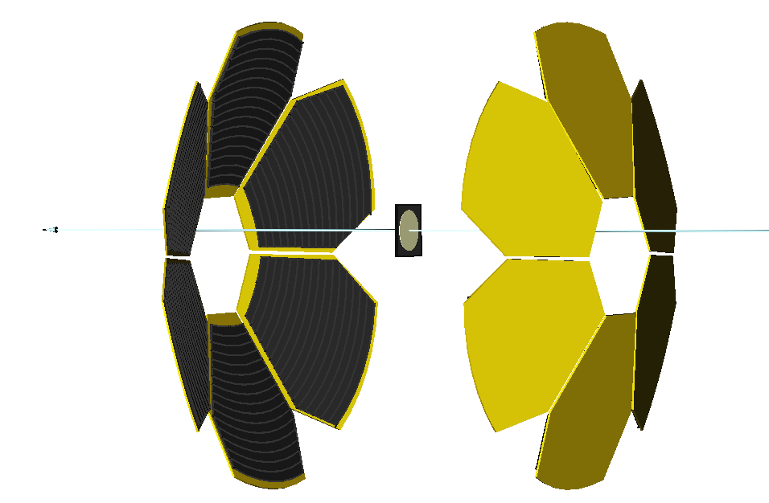
SIDAR
α
Silicon
Detector
Array
γ - beam
7Li
2 x 6 YY1
(16 strips)
t
192 channels
5

Slide 13
Efficiency ~ 38.66%
SIDAR
covers a wide angular range
covers a wide angular range
α
Silicon
Detector
Array
γ - beam
7Li
2 x 6 YY1
(16 strips)
t
192 channels
Downstream
coincidences
Upstream
coincidences
5

Slide 14
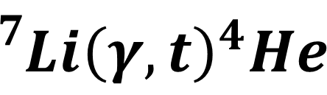
The old experiment:
2017
4.4 MeV - 10 MeV
The new experiment:
6th April 2023-12th April 2023
3.7 MeV - 6 MeV
$${}_{}^{7}{Li}{\left(γ,t\right)}^{4}He$$
6

Slide 15
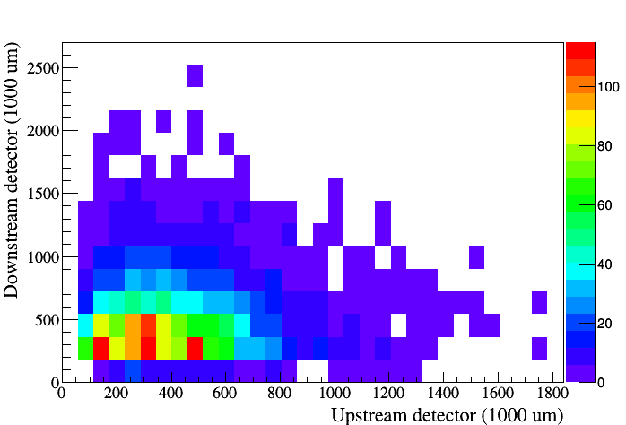
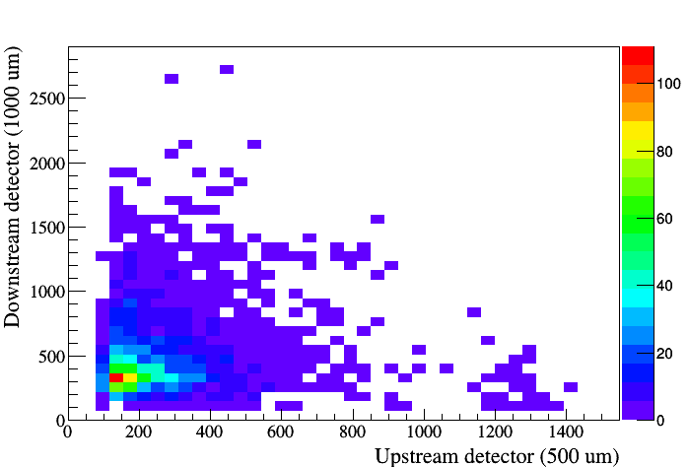
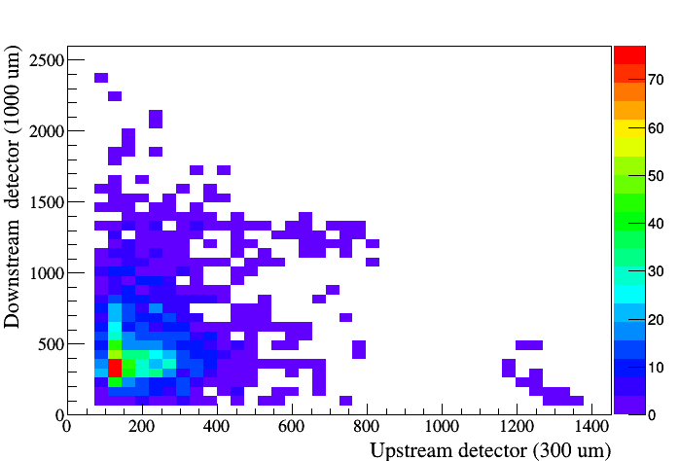
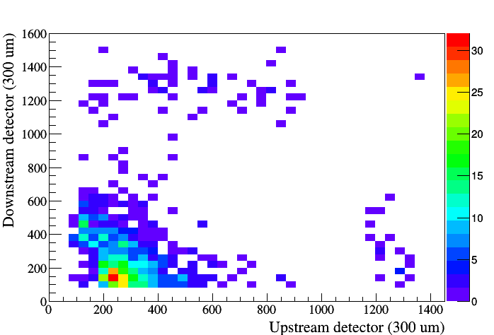
The old experiment:
2017
4.4 MeV - 10 MeV
The new experiment:
6th April 2023-12th April 2023
3.7 MeV - 6 MeV
$${}_{}^{7}{Li}{\left(γ,t\right)}^{4}He$$
Downstream (300 μm)
Downstream (1000 μm)
Upstream (1000 μm)
Upstream (500 μm)
Coincidences corresponding to 4.4 MeV gamma beam were observed only in the thinner detectors
Downstream (1000 μm)
Downstream (300 μm)
Upstream (300 μm)
Upstream (300 μm)
6

Slide 16
The old experiment:
2017
4.4 MeV - 10 MeV
The new experiment:
6th April 2023-12th April 2023
3.7 MeV - 6 MeV
$${}_{}^{7}{Li}{\left(γ,t\right)}^{4}He$$
6

Slide 17
The old experiment:
2017
4.4 MeV - 10 MeV
The new experiment:
6th April 2023-12th April 2023
3.7 MeV - 6 MeV
$${}_{}^{7}{Li}{\left(γ,t\right)}^{4}He$$
IMPROVEMENTS
1. Array of thinner Si detectors: 100 (d) &65 (u) µm
2. Thinner entry flange
Reduced electron density in the flange
(Al instead of stainless steel)
4. Longer vacuum pipe (in front of the chamber)
6

Slide 18
The old experiment:
2017
4.4 MeV - 10 MeV
The new experiment:
6th April 2023-12th April 2023
3.7 MeV - 6 MeV
$${}_{}^{7}{Li}{\left(γ,t\right)}^{4}He$$
IMPROVEMENTS
1. Array of thinner Si detectors: 100 (d) &65 (u) µm
2. Thinner entry flange
Reduced electron density in the flange
(Al instead of stainless steel)
4. Longer vacuum pipe (in front of the chamber)
The coincidences have been
clearly separated even for the lowest energy
The background has been highly reduced
6

Slide 19
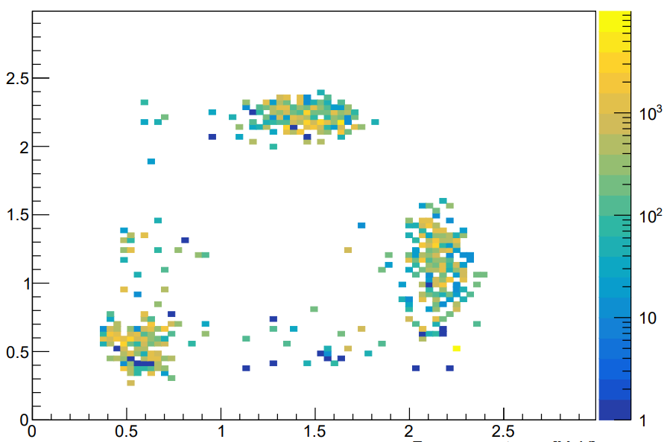
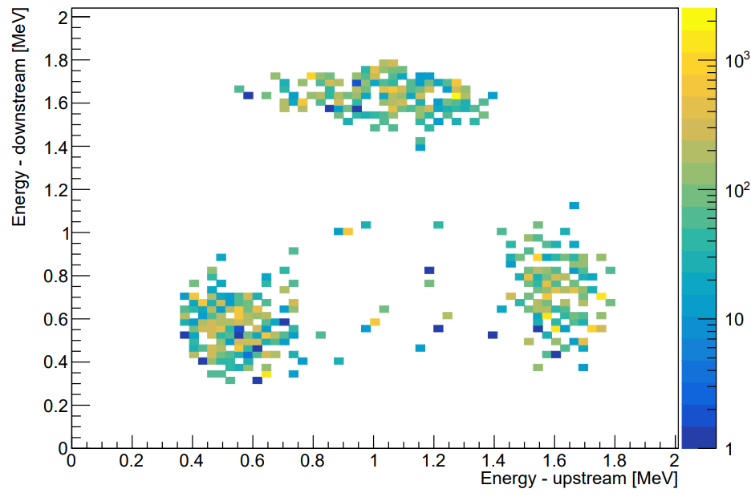
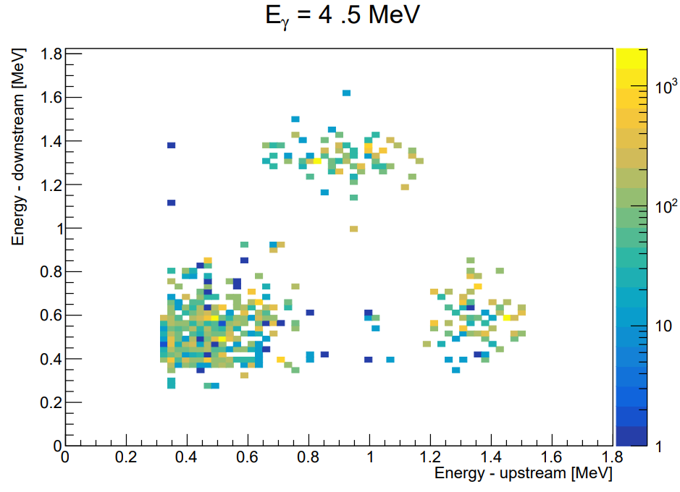
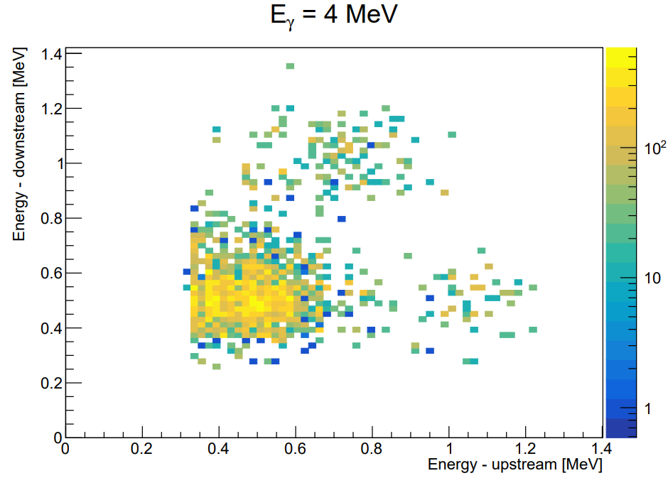




$$E_{γ}=6 MeV$$
$$E_{γ}=5 MeV$$
Energy – Downstream [MeV]
Energy – Downstream [MeV]
Energy – Downstream [MeV]
Energy – Downstream [MeV]
Energy – Upstream [MeV]
PRELIMINARY
RESULTS
Energy – Upstream [MeV]
$$E_{γ}=4.5 MeV$$
$$E_{γ}=4 MeV$$
Energy – Downstream [MeV]
Energy – Downstream [MeV]
Energy – Upstream [MeV]
Energy – Upstream [MeV]
7

Slide 20
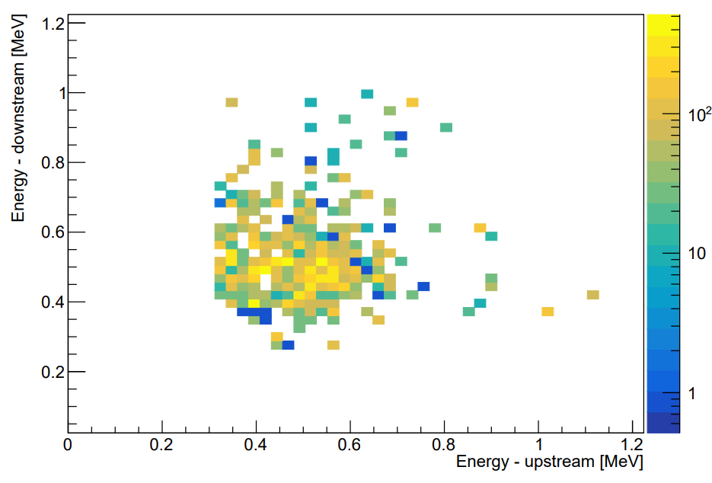

PRELIMINARY RESULTS
$$E_{γ}=3.7 MeV$$
Energy – Downstream [MeV]
Energy – Upstream [MeV]
8

Slide 21
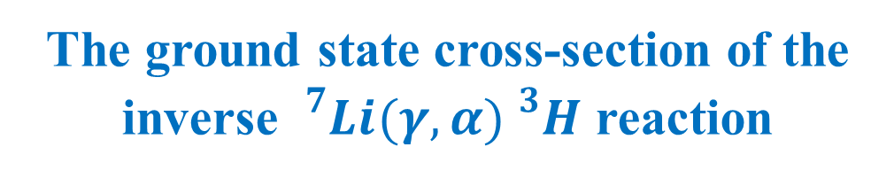
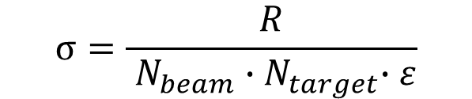



Number of coincidences
The ground state cross-section of the
inverse ${}_{}^{7}{Li(γ,α){}_{}^{3}H}$ reaction
$$σ=\frac{R}{{ N}_{beam}{ ∙N}_{target}∙ε}$$
$${ N}_{b}=I∙t$$
$${ N}_{t}\sim {10}^{18}$$
$$where I\sim {10}^{7} s^{−1}$$
Quantity | Uncertainty
Events no | ~ 5-18 %
Intensity | ~ 10%
Li-7 atoms no | ~ 1%
Efficiency | ~ 1%
9

Slide 22
Number of coincidences
The ground state cross-section of the
inverse ${}_{}^{7}{Li(γ,α){}_{}^{3}H}$ reaction
$$σ=\frac{R}{{ N}_{beam}{ ∙N}_{target}∙ε}$$
PRELIMINARY RESULTS
$${ N}_{b}=I∙t$$
$${ N}_{t}\sim {10}^{18}$$
$$where I\sim {10}^{7} s^{−1}$$
Quantity | Uncertainty
Events no | ~ 5-18 %
Intensity | ~ 10%
Li-7 atoms no | ~ 1%
Efficiency | ~ 1%
9

Slide 23
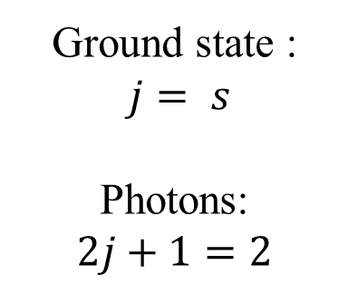
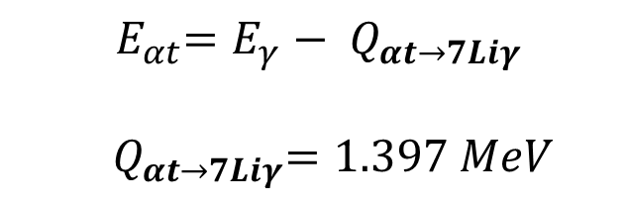
The ground state cross-section of the direct ${}_{}^{3}{H(α,γ){}_{}^{7}{Li}}$ reaction
PRELIMINARY
RESULTS
PRELIMINARY
RESULTS
Ground state :
$j= s$
Photons:
$$2j+1=2$$
$${ E}_{αt}=E_{γ}− Q_{αt→7Liγ}$$
${ Q}_{αt→7Liγ}=1.397 MeV$
$$\frac{{σ }_{7Liγ→αt}}{σ_{αt→7Liγ}}=\frac{(2j_{α}+1)(2j_{t}+1) }{2∙(2j_{Li}+1) }∙\frac{{2∙m}_{αt}∙E_{αt}∙c^{2}}{E_{γ}^{2}}∙\frac{1}{1+δ_{αt}}=\frac{1}{4}∙\frac{{2∙m}_{αt}∙E_{αt}∙c^{2}}{E_{γ}^{2}}$$
10

Slide 24

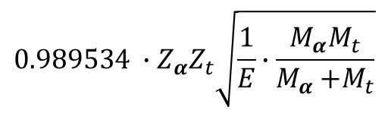
Astrophysical$S−factor$
$S_{αt→7Liγ}\left(E\right)=e^{2πη}∙E$ $∙σ_{αt→7Liγ} \left(E\right)$
$$0.989534 ∙Z_{α}Z_{t}\sqrt{\frac{1}{E}∙\frac{M_{α}M_{t}}{M_{α}{+M}_{t}}}$$
11

Slide 25
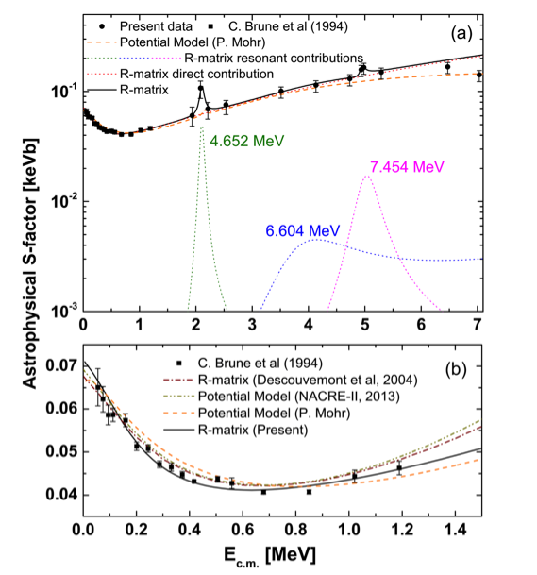
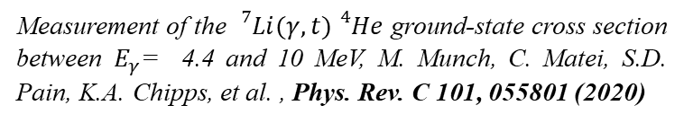
Astrophysical$S−factor$
$S_{αt→7Liγ}\left(E\right)=e^{2πη}∙E$ $∙σ_{αt→7Liγ} \left(E\right)$
$$0.989534 ∙Z_{α}Z_{t}\sqrt{\frac{1}{E}∙\frac{M_{α}M_{t}}{M_{α}{+M}_{t}}}$$
Measurement of the ${}_{}^{7}{Li(γ,t){}_{}^{4}{He}}$ ground-state cross section between $E_{γ}$ = 4.4 and 10 MeV, M. Munch, C. Matei, S.D. Pain, K.A. Chipps, et al. , Phys. Rev. C 101, 055801 (2020)
11

Slide 26
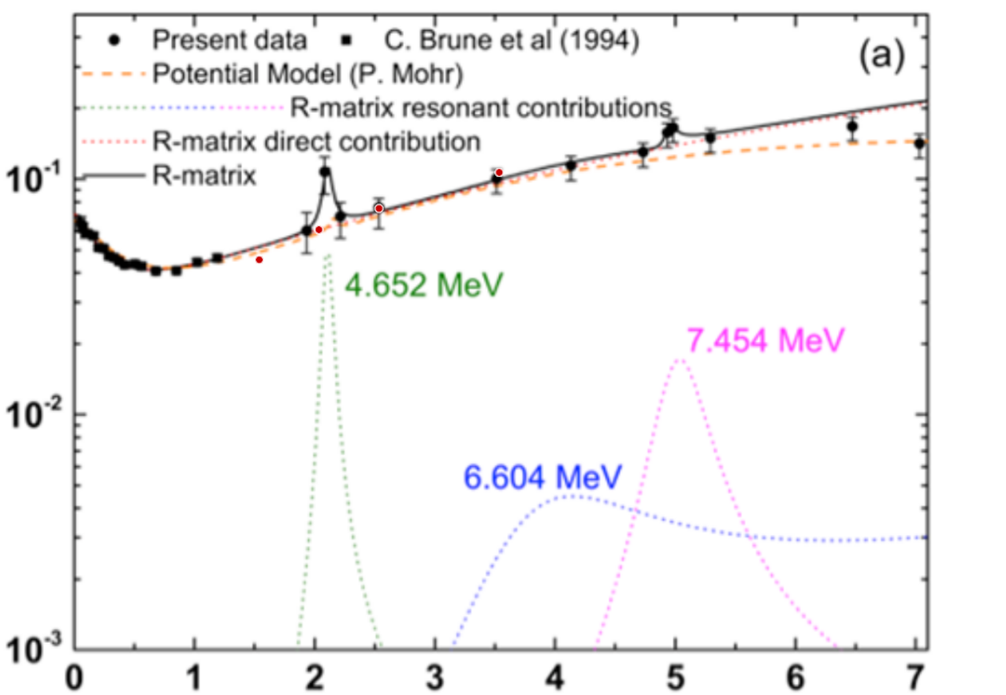
Astrophysical$S−factor$
$S_{αt→7Liγ}\left(E\right)=e^{2πη}∙E$ $∙σ_{αt→7Liγ} \left(E\right)$
Preliminary results
$$0.989534 ∙Z_{α}Z_{t}\sqrt{\frac{1}{E}∙\frac{M_{α}M_{t}}{M_{α}{+M}_{t}}}$$
Measurement of the ${}_{}^{7}{Li(γ,t){}_{}^{4}{He}}$ ground-state cross section between $E_{γ}$ = 4.4 and 10 MeV, M. Munch, C. Matei, S.D. Pain, K.A. Chipps, et al. , Phys. Rev. C 101, 055801 (2020)
11

Slide 27

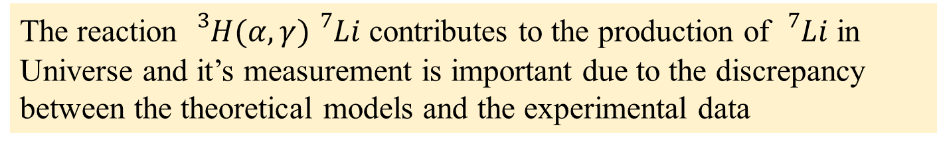
CONCLUSIONS…
The reaction ${}_{}^{3}{H(α,γ){}_{}^{7}{Li}}$ contributes to the production of ${}_{}^{7}{Li}$ in Universe and it’s measurement is important due to the discrepancy between the theoretical models and the experimental data
The inverse reaction has been studied in 2017 by our team at HIγS for gamma beam energies between 4.4 and 10 MeV using a Silicon Detector Array. Below 6 MeV the coincidences were clearly observed only in the thinner detectors
A new experiment with an improved set-up was performed in April 2023 to cover the gap between 3.7 and 6 MeV
In 2023 the coincidences have been clearly separated and the background has been highly reduced, affecting only the lowest energy. Data analysis underway. The preliminary ground state cross-section and the s-factor have been successfully extracted
12

Slide 28
Thank you for attention!
Catalin Matei, D. Balabanski, Ioana Kuncser, T. Petruse, A. Pappalardo, H. Pai, Yi Xu (ELI-NP, Bucharest-Magurele, Romania)
Steve Pain, Kelly Chipps, T. King, M Febbraro (ORNL – Oak Ridge, Tennessee, USA)
M. Grinder, S. Balakrishnan, Heather Garland, Jolie Cizewski (Rutger University - New Brunswick, New Jersey, USA)
H. Karwowski, R.V. Janssens, T. Psaltis, C. Marshall (University of Nord Carolina - Chapel Hill, Nord Carolina USA)
C.R. Brune, A. Voinov (Ohio University, Athens, Ohio, USA)
O. Tindle, C. Haverson, R. Smith (Shefield Hallam University, UK)
M. La Cognata, G.L. Guardo, S. Palmerini, L. Sergi, D. Lattuada, R.G. Pizzone, G. Rapisarda, A. Tumino (INFN-Laboratori Nazionali del Sud, Catania, Italy)
K.Y. Chae, Gyoungmo GU (Sungkyunkwan University, Suwon, Korea)
Nuclear Physics in Astrophysics IX
17.09.2024

Slide 29
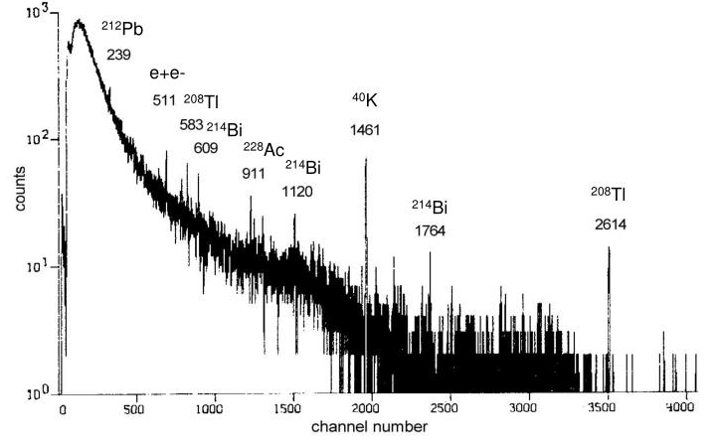

Gamma beam energy measurement
Ge DETECTOR + ATTENUATORS
Calibrated using background
Known energy loss
$$E_{γ}=E_{det}+E_{loss}$$
39.35 cm
of
copper

Slide 30
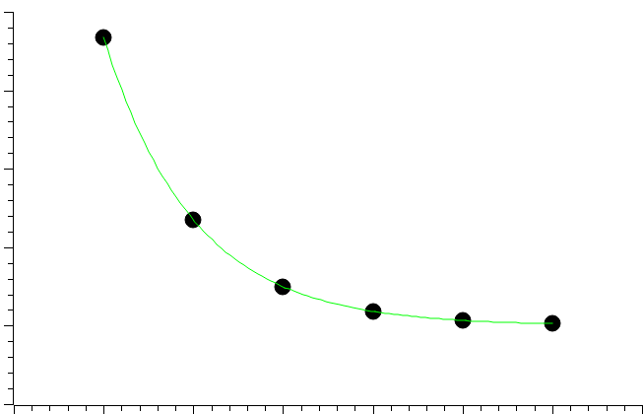
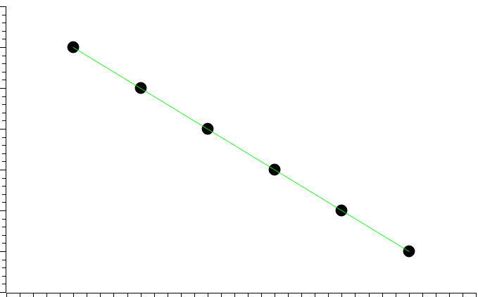




Gamma beam intensity measurement
Measuring
continuously
Pb glass
NaI Detector
gamma beam
1
2
3
4
5
6
100%
efficiency
Attenuators
No
Attenuation
Value
Coefficient related to the energy of the beam
$$A_{1}$$
$$I=I_{0}∙e^{−μx}$$
Pb glass intensity calibration
Log(Intensity)
Intensity
$$A_{1}+A_{2}$$
$$A_{1}+…+A_{3}$$
Intensity measurement during the run
Thickness
Thickness

Slide 31
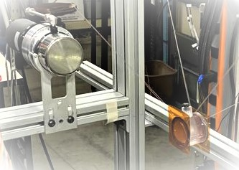


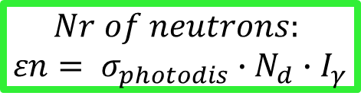
Gamma beam intensity measurement
deuterium photodisintegration
d
$$d+γ=n+p+2.2 MeV$$
n
p
p
p
gamma beam
n
d
p
p
n
d
Liquid scintillator → n detector
$$E_{n}=\frac{E_{gamma}−2.2 MeV}{2}$$
$$Nr of neutrons:$$
$$εn= σ_{photodis}∙N_{d}∙I_{γ}$$

Slide 32
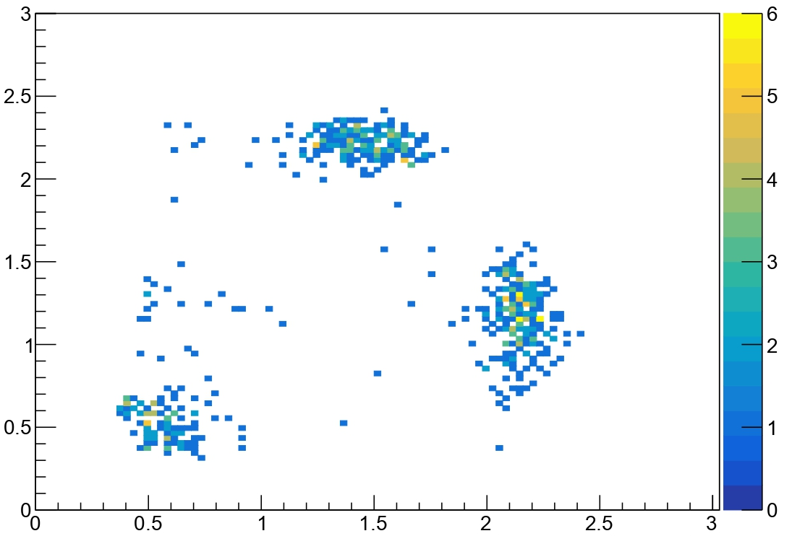
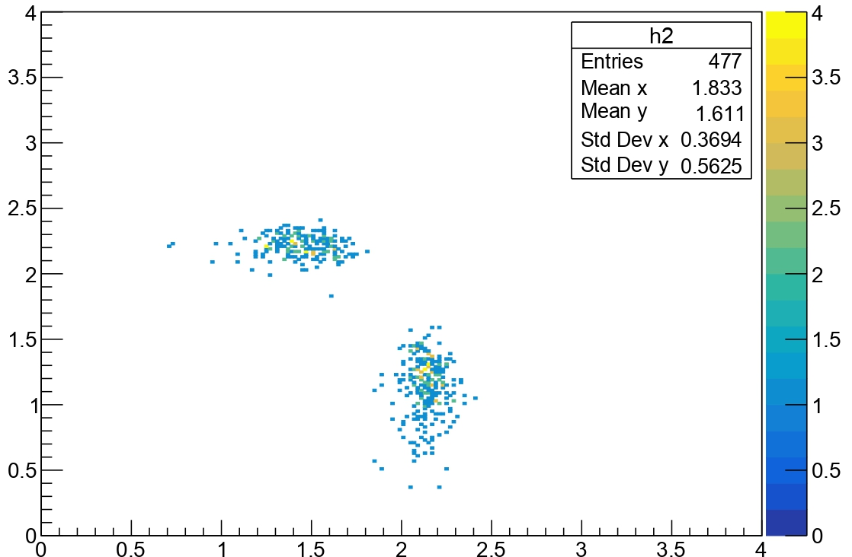
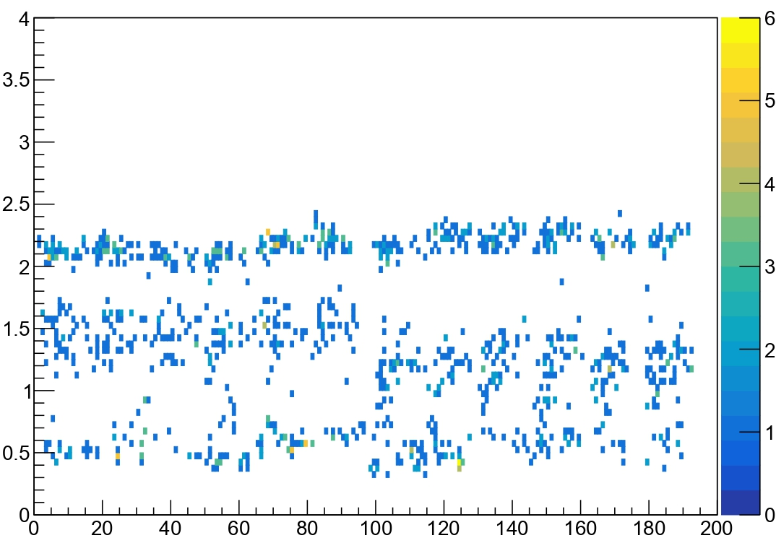
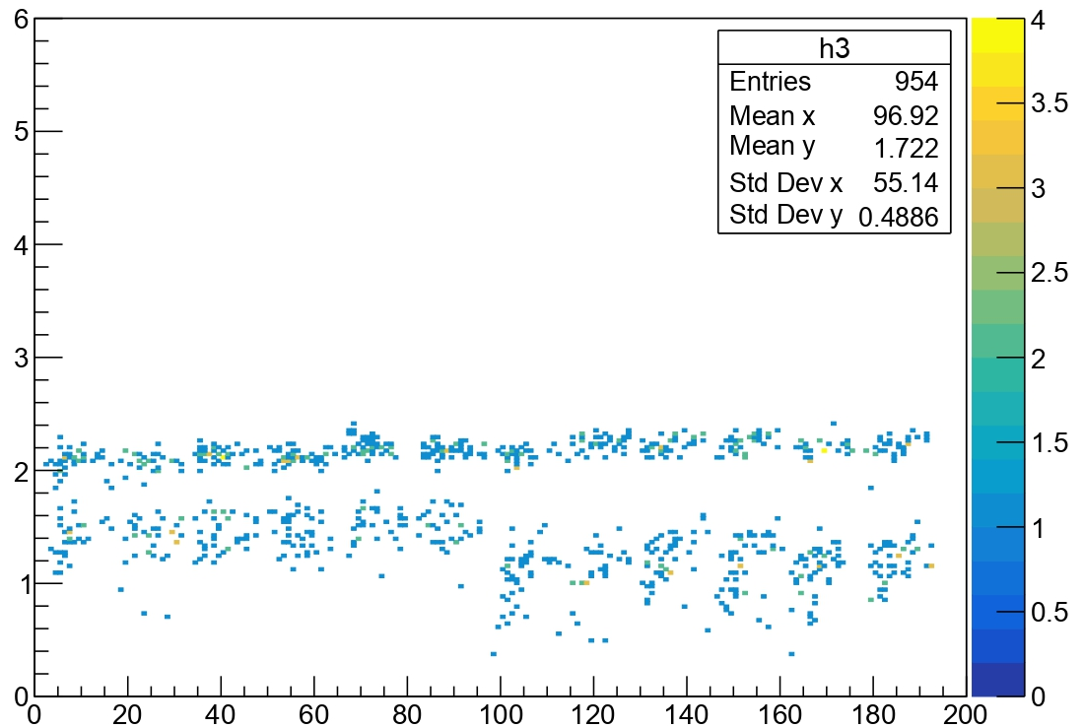
Downstream Energy [MeV]
Downstream Energy [MeV]
Background can be easily subtracted
for
6 MeV
Upstream Energy [MeV]
Upstream Energy [MeV]
Upstream
Downstream
Coincidence Energy [MeV]
Coincidence Energy [MeV]
Upstream
Downstream
Strip
Strip

Slide 33
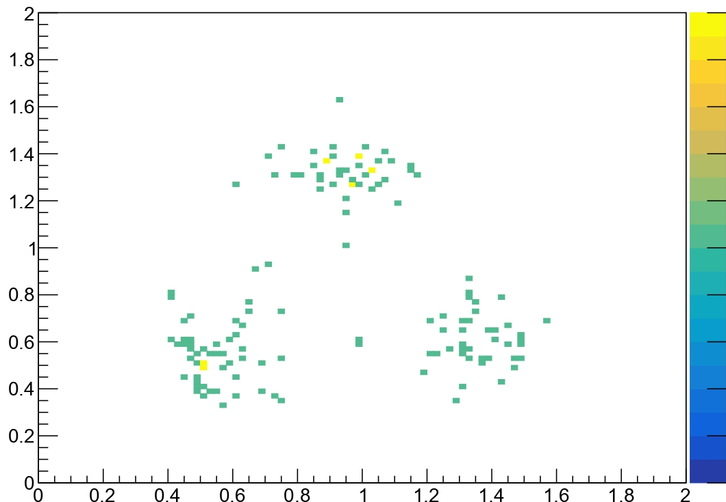
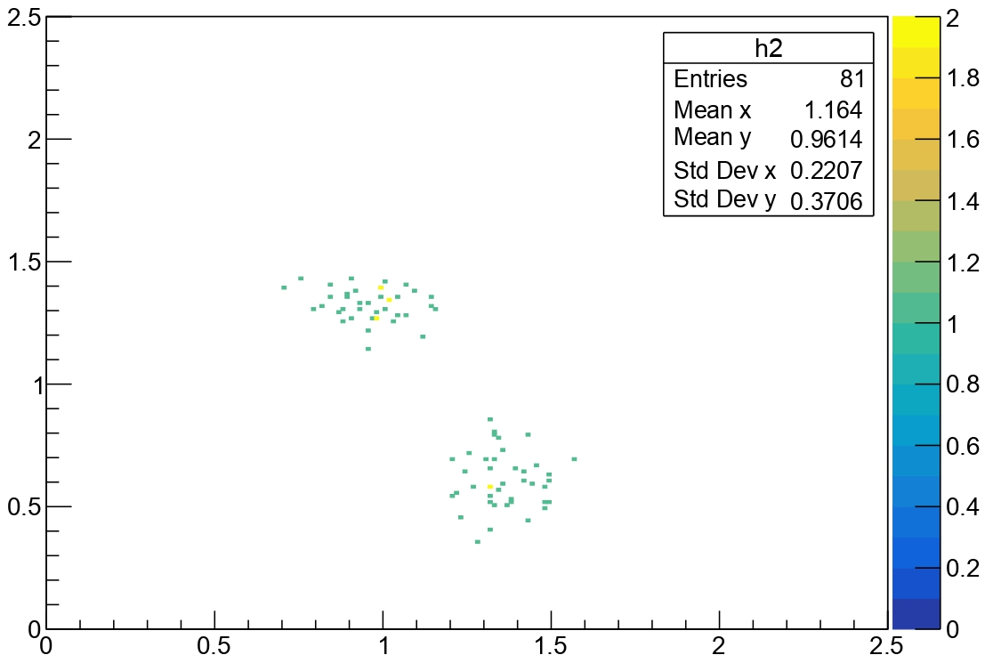
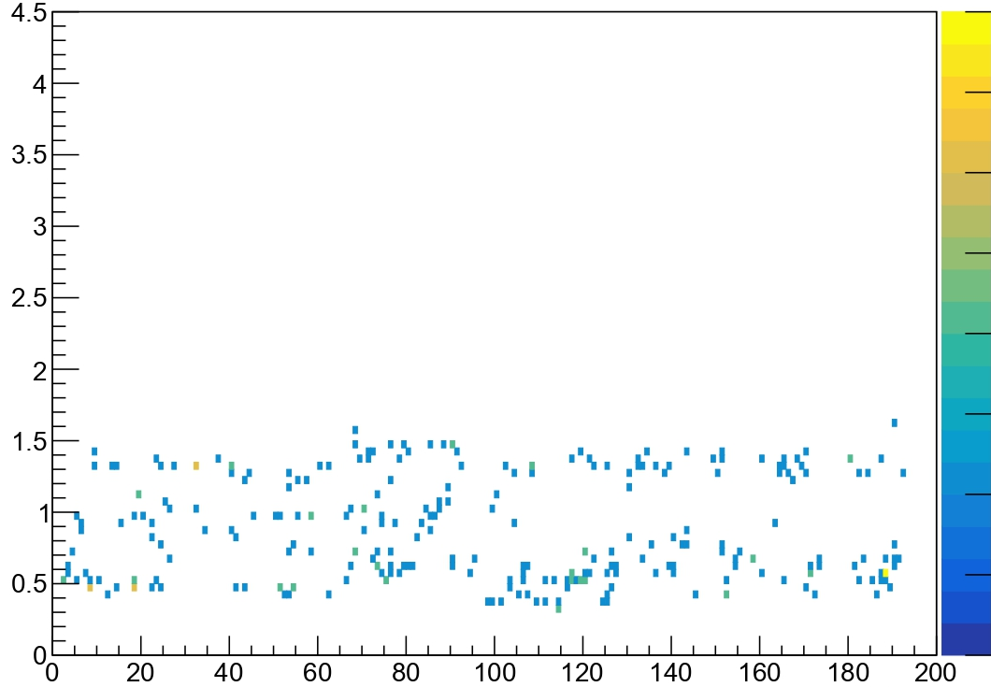
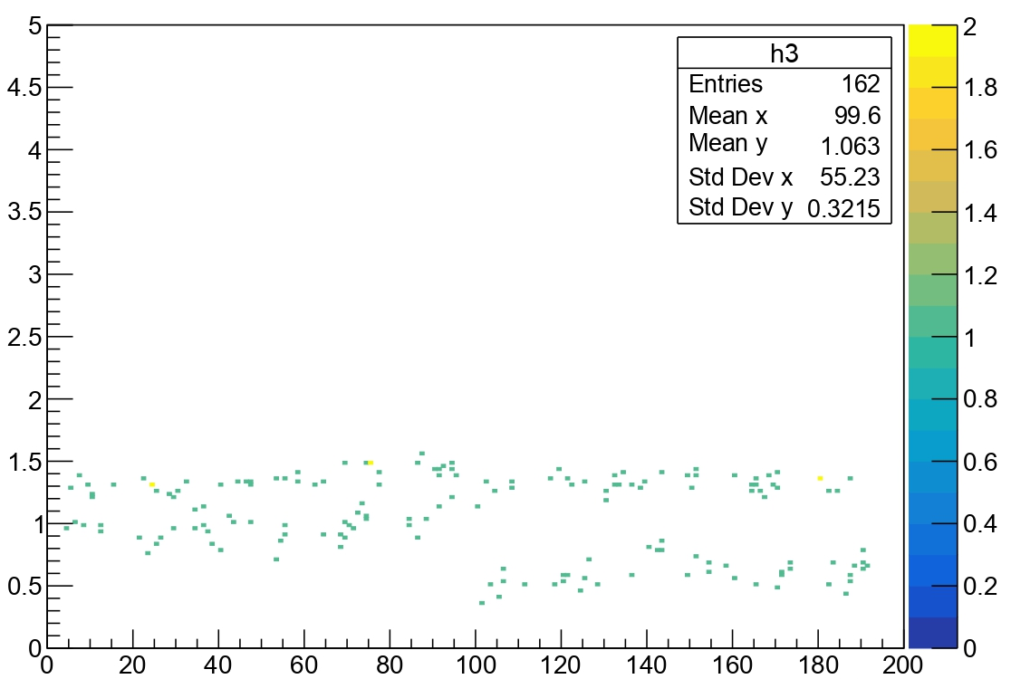
Downstream Energy [MeV]
Downstream Energy [MeV]
And
even
for
4.5 MeV
Upstream Energy [MeV]
Upstream Energy [MeV]
Upstream
Downstream
Coincidence Energy [MeV]
Coincidence Energy [MeV]
Upstream
Downstream
Strip
Strip

Slide 34
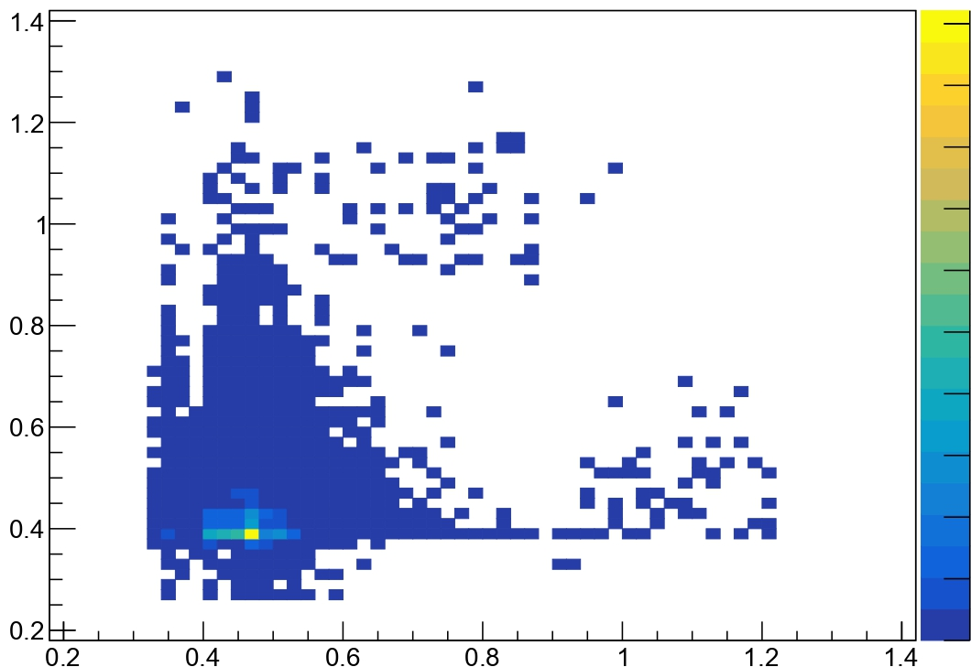
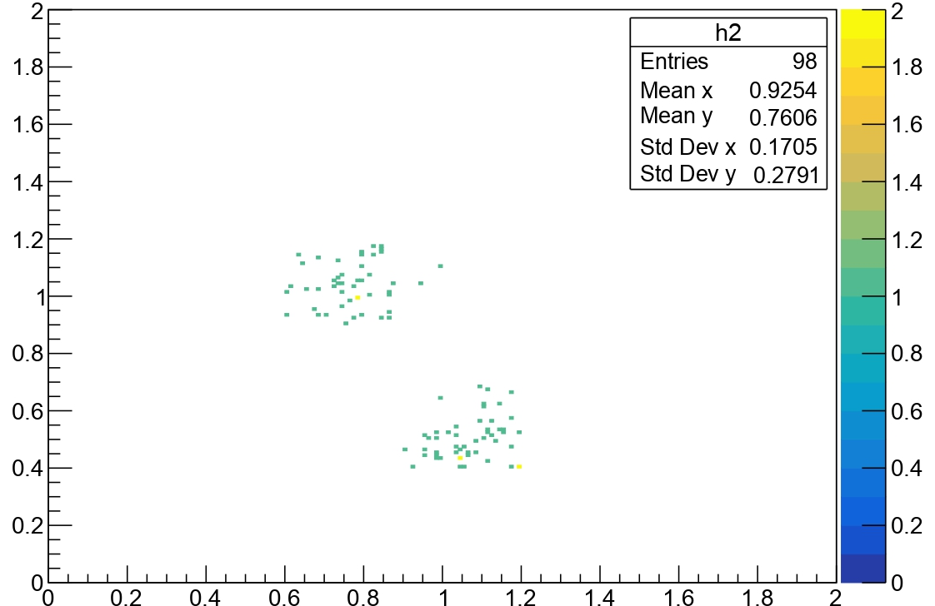
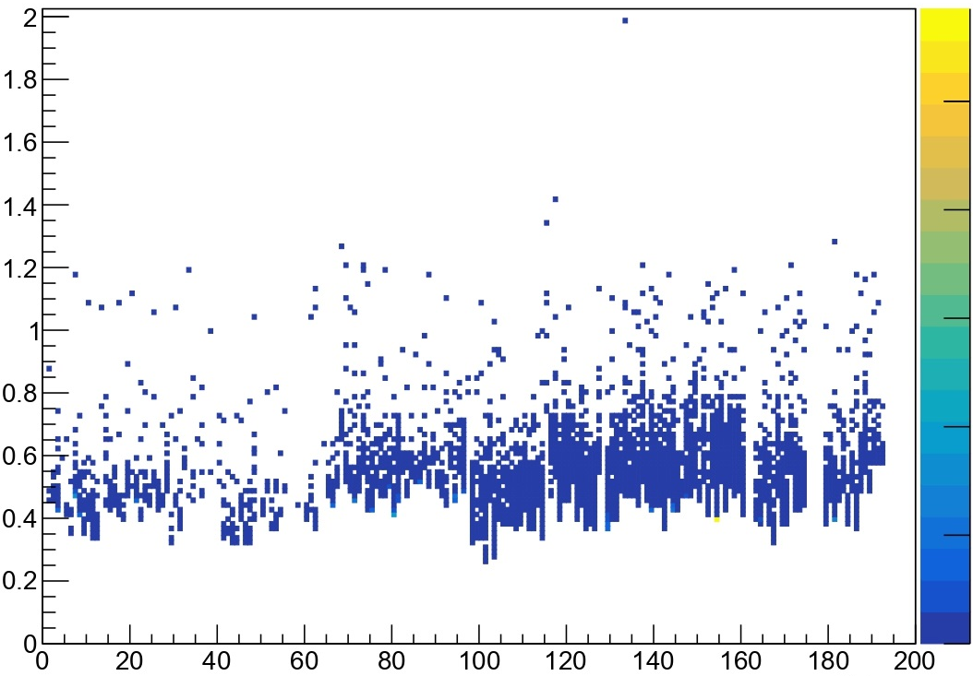
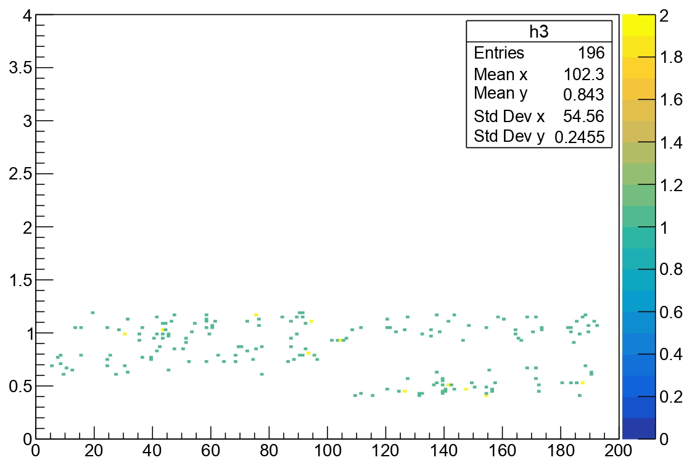
Downstream Energy [MeV]
Downstream Energy [MeV]
Still
possible
for
4 MeV
Upstream Energy [MeV]
Upstream Energy [MeV]
Upstream
Downstream
Coincidence Energy [MeV]
Coincidence Energy [MeV]
Upstream
Downstream
Strip
Strip

Slide 35
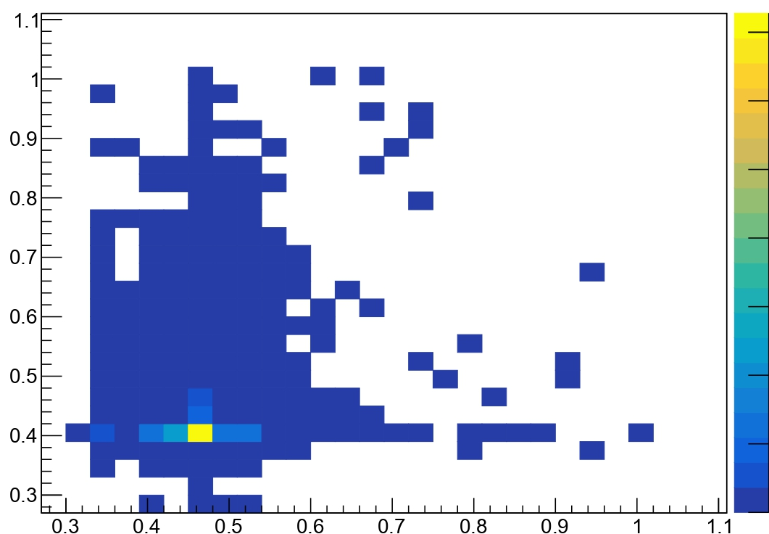
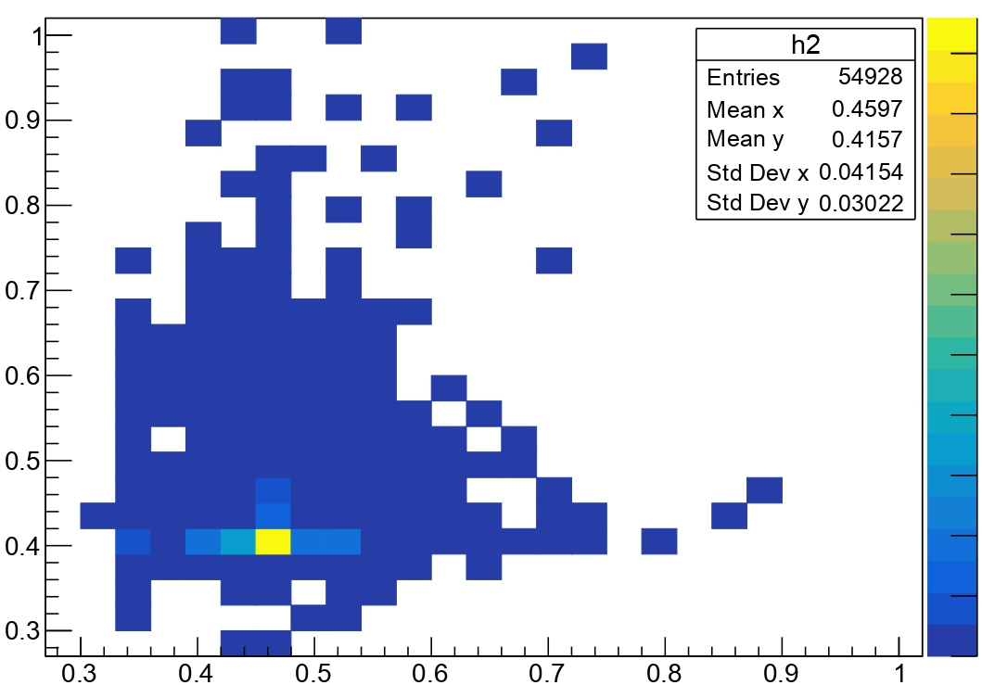




Downstream Energy [MeV]
Downstream Energy [MeV]
Difficult to distinguish for
3.7 MeV
Upstream Energy [MeV]
Upstream Energy [MeV]
Upstream
Downstream
Coincidence Energy [MeV]
Coincidence Energy [MeV]
Upstream
Downstream
Strip
Strip

Slide 36




p – process
$${}_{}^{102}{Pd(γ,p){}_{}^{101}{Rh}}$$
$${}_{}^{102}{Pd(γ,α){}_{}^{98}{Ru}}$$
ΔE [MeV]
$${}_{}^{112}{Sn\left(γ,p\right){}_{}^{111}{In} }$$
$${}_{}^{112}{Sn(γ,α){}_{}^{108}{Cd}}$$
Total Energy [MeV]

Slide 37

Monte-Carlo Simulation Code
for reactions with
charged particles detection
Beam
Target
Detectors
VIKAR (FORTRAN)
Charged
or
neutral
Mono/Multi-layer foil
or
Gas jet
Resistive
or
non-resistive
Si detectors
(telescopes)
3.7 MeV
Common geometries
and
real-word arrays
Effects:
beam spot size and energy spread, energy loss and straggling in targets and detectors, detector segmentation, resolution effects

Slide 38

Monte-Carlo Simulation Code
for reactions with
charged particles detection
Beam
Target
Detectors
VIKAR (FORTRAN)
Charged
or
neutral
Mono/Multi-layer foil
or
Gas jet
Resistive
or
non-resistive
Si detectors
(telescopes)
4.0 MeV
Common geometries
and
real-word arrays
Effects:
beam spot size and energy spread, energy loss and straggling in targets and detectors, detector segmentation, resolution effects

Slide 39

Monte-Carlo Simulation Code
for reactions with
charged particles detection
Beam
Target
Detectors
VIKAR (FORTRAN)
Charged
or
neutral
Mono/Multi-layer foil
or
Gas jet
Resistive
or
non-resistive
Si detectors
(telescopes)
4.5 MeV
Common geometries
and
real-word arrays
Effects:
beam spot size and energy spread, energy loss and straggling in targets and detectors, detector segmentation, resolution effects

Slide 40

Monte-Carlo Simulation Code
for reactions with
charged particles detection
Beam
Target
Detectors
VIKAR (FORTRAN)
Charged
or
neutral
Mono/Multi-layer foil
or
Gas jet
Resistive
or
non-resistive
Si detectors
(telescopes)
5.0 MeV
Common geometries
and
real-word arrays
Effects:
beam spot size and energy spread, energy loss and straggling in targets and detectors, detector segmentation, resolution effects

Slide 41

Monte-Carlo Simulation Code
for reactions with
charged particles detection
Beam
Target
Detectors
VIKAR (FORTRAN)
Charged
or
neutral
Mono/Multi-layer foil
or
Gas jet
Resistive
or
non-resistive
Si detectors
(telescopes)
6.0 MeV
Common geometries
and
real-word arrays
Effects:
beam spot size and energy spread, energy loss and straggling in targets and detectors, detector segmentation, resolution effects

