Slide 1
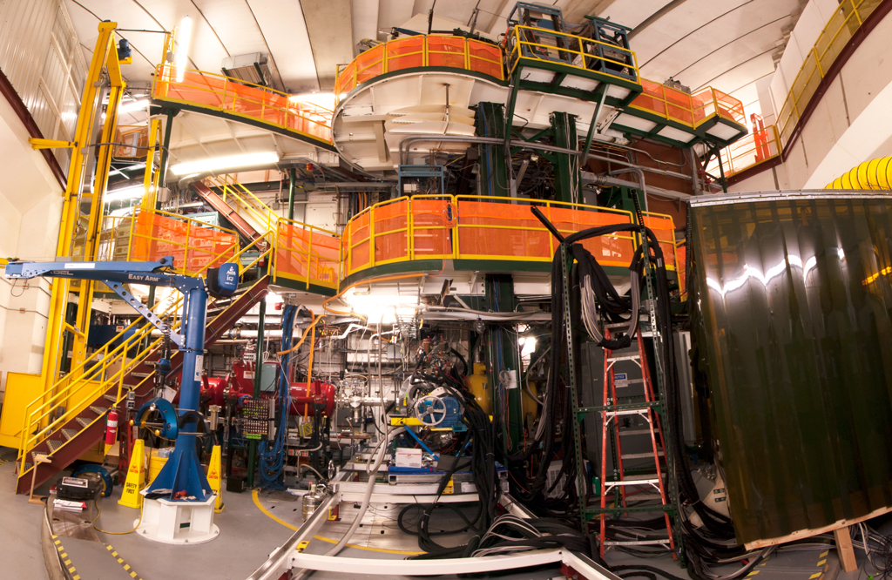
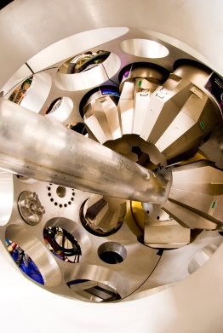
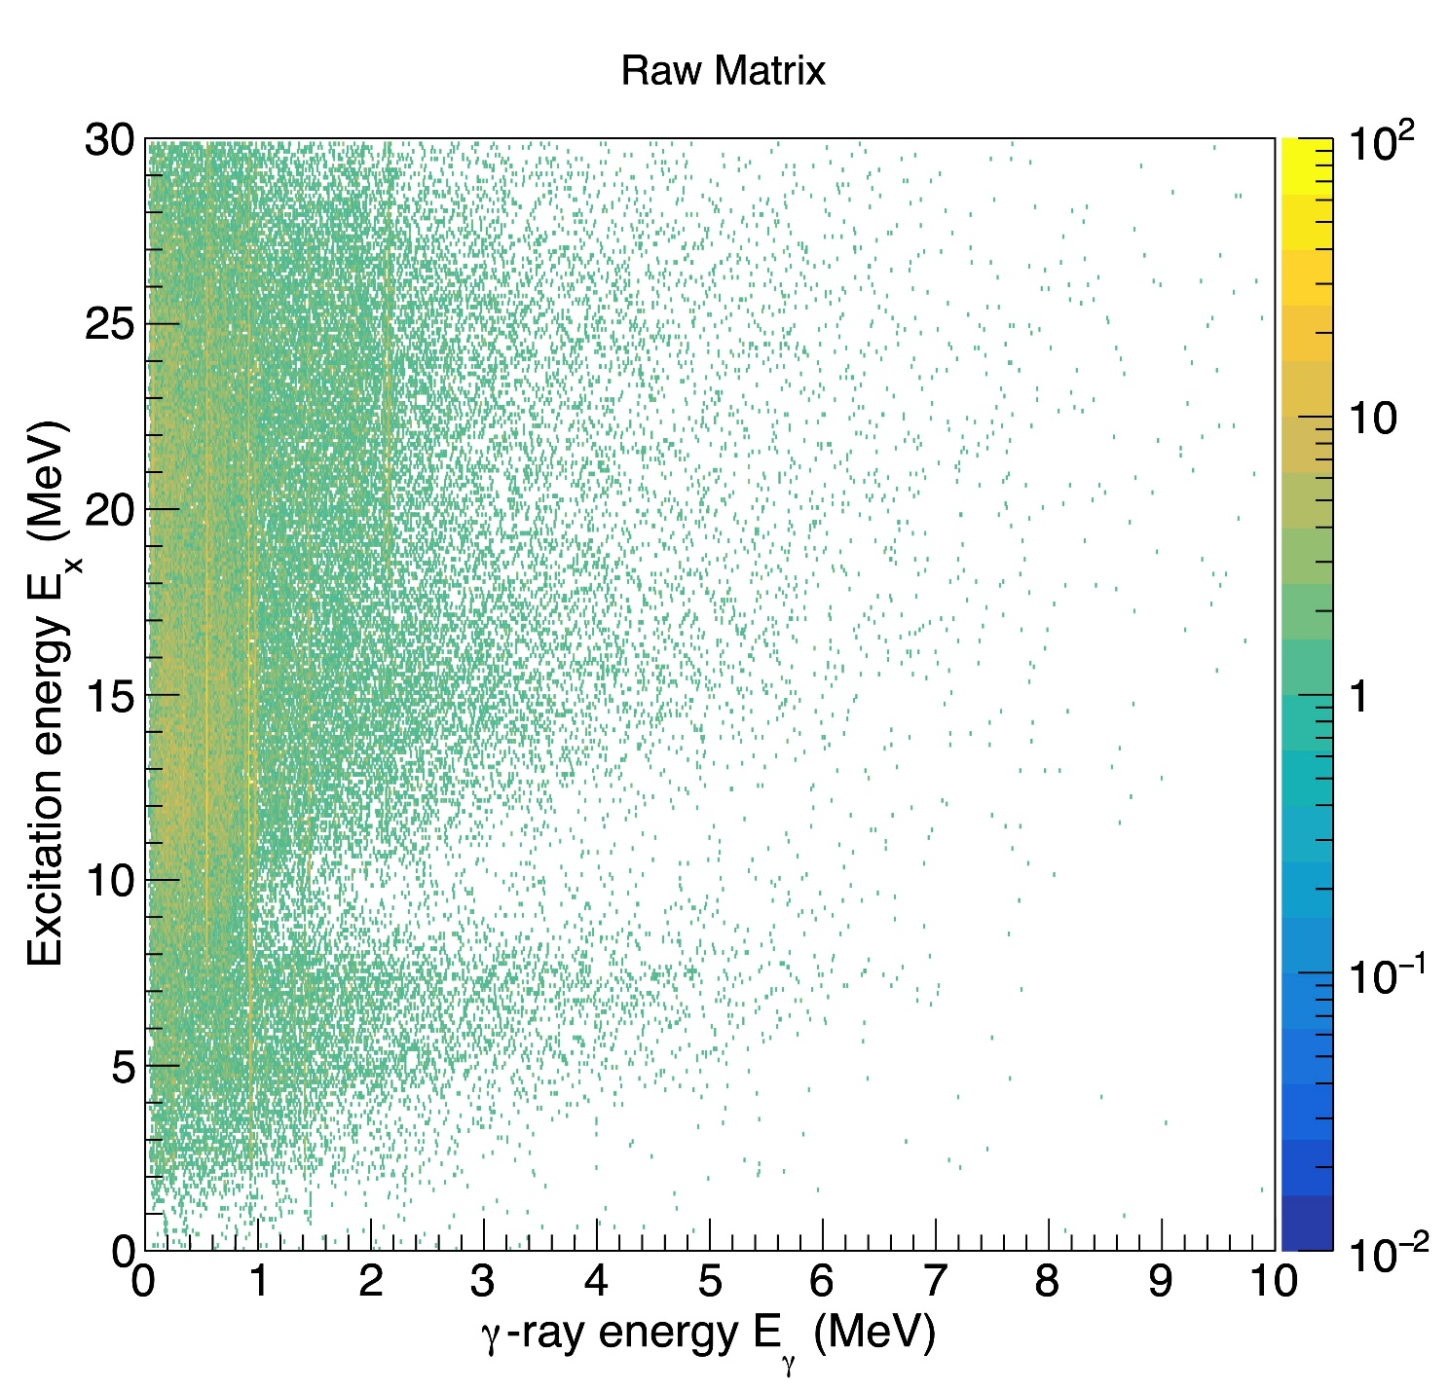
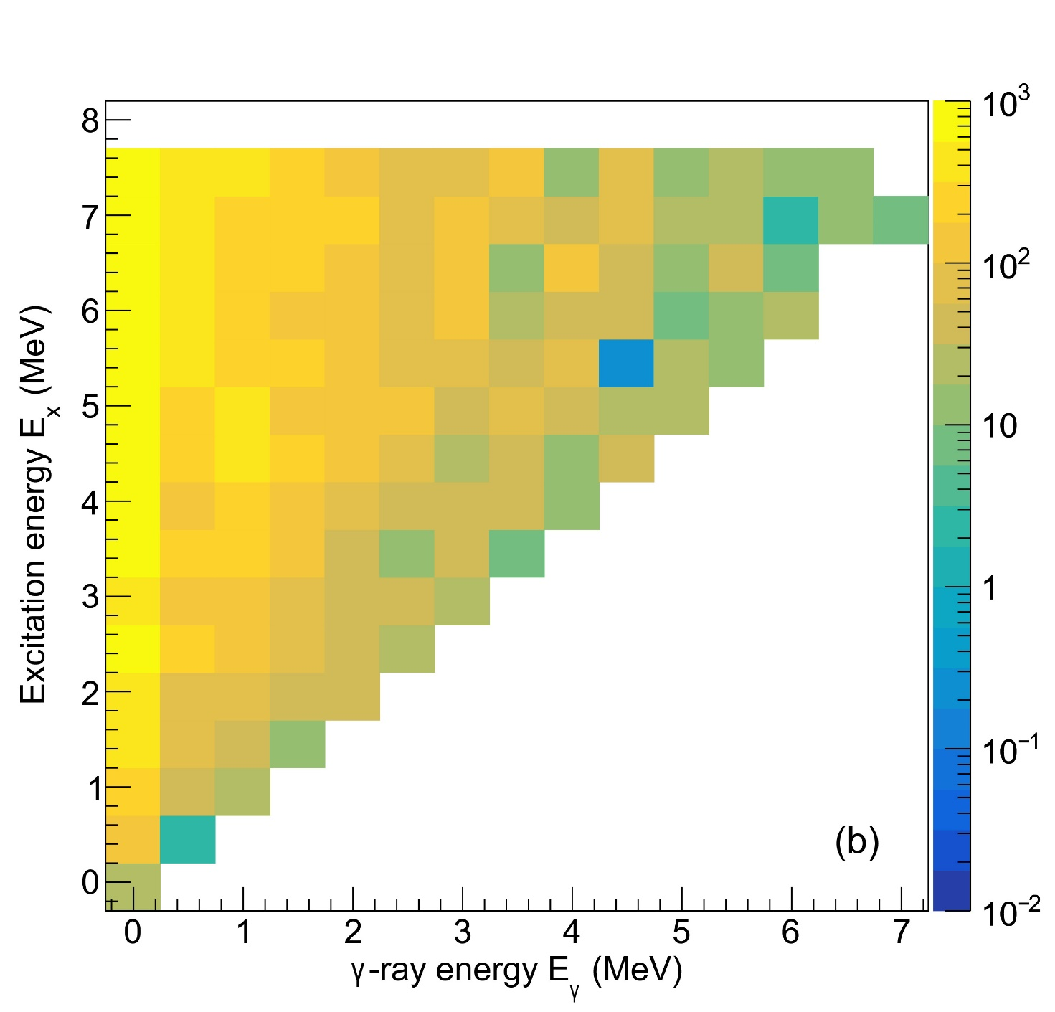
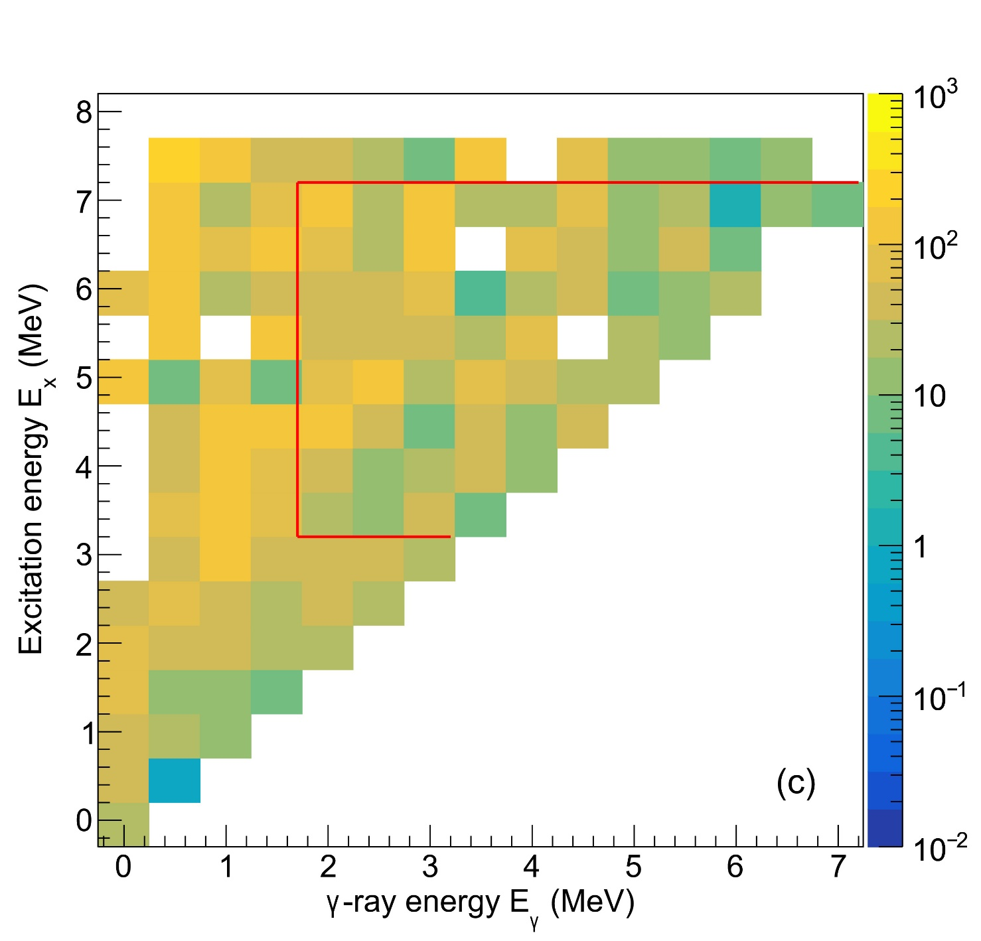
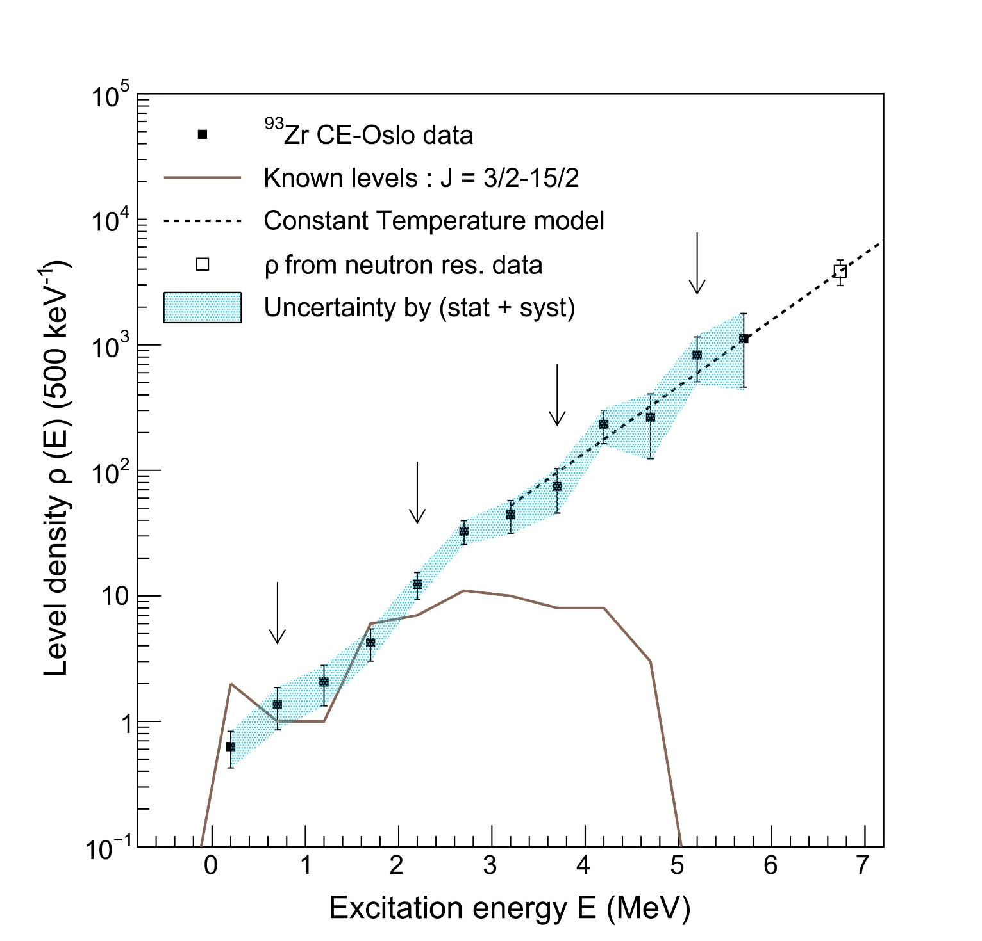
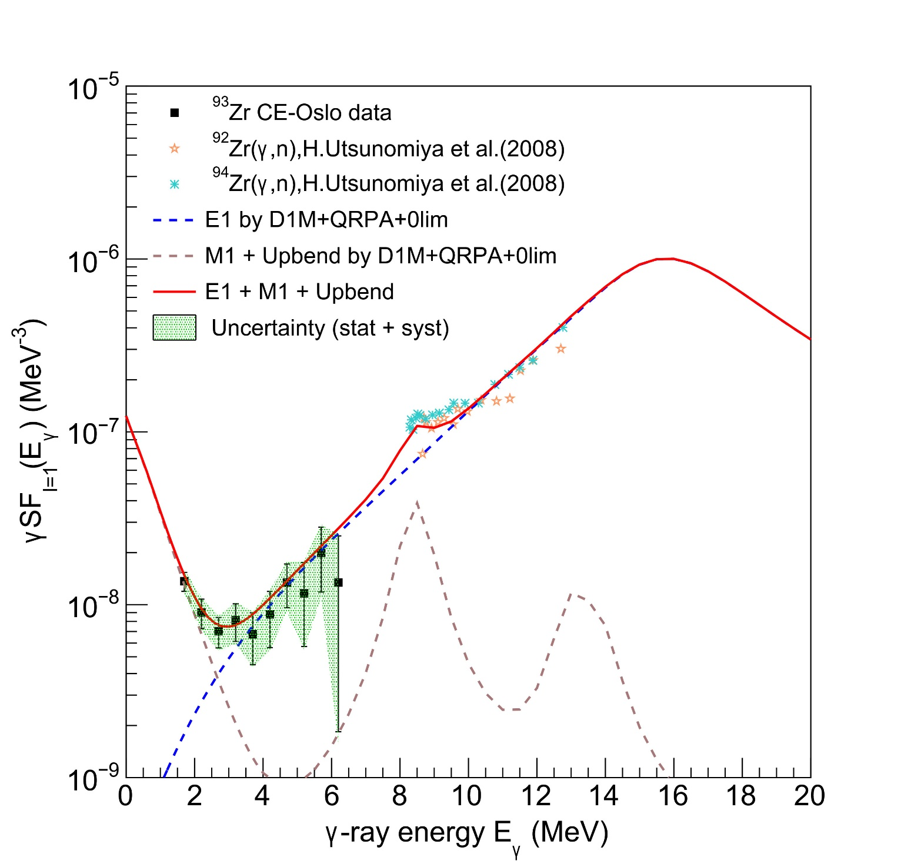
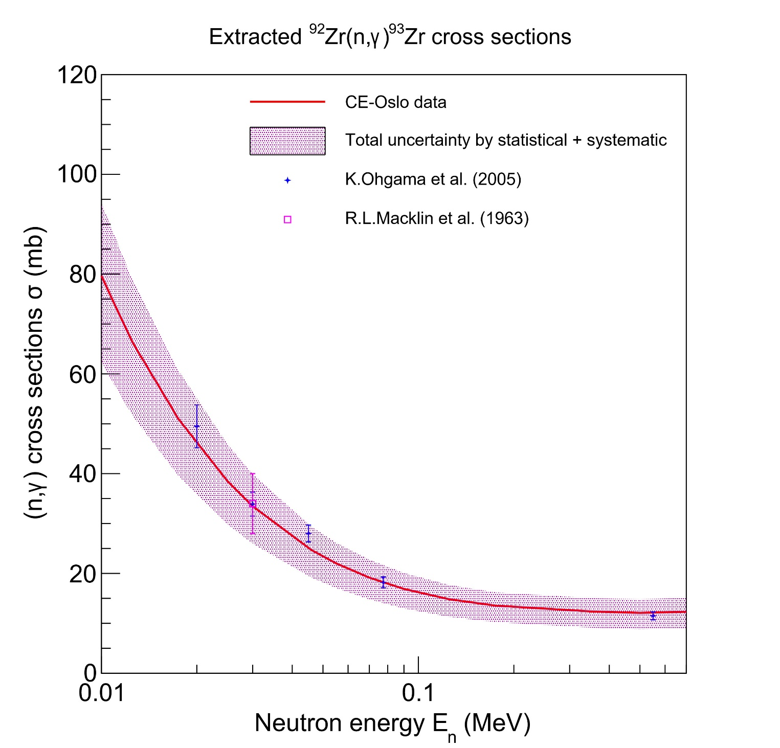
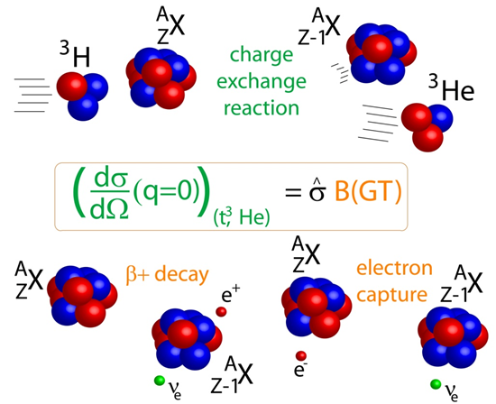
First Application of the Charge-Exchange Oslo Method to Constrain (n,$γ$) Cross Sections
N.D. Pathirana^{1,2}, H. Berg^{1,2}, B. Gao³, M. Guttormsen⁴, A.C. Larsen⁴, C. Maher^{1,2}, S. Noji¹, A. Riley⁵, A. Schiller⁴, A. Spyrou^{1,2}, S. Uthayakumaar¹, R.G.T. Zegers^{1,2},
and members of the e15112 experiment collaboration
¹Facility for Rare Isotope Beams, ²Michigan State University, ³Institute of Modern Physics, ⁴University of Oslo, ⁵Ursinus College
Introduction
Experimental Details
The development of the Charge-Exchange Oslo (CE-Oslo) method is important for constraining multiple inputs for nucleosynthesis simultaneously;
Nuclear level density (NLD)
γ-ray strength function (γSF)
Gamow-Teller strengths
$β$-delayed neutron decay probabilities
The long-term goal is to pursue (p,n+γ) experiments in inverse kinematics to extract such constraints for unstable nuclei.
The CE-Oslo method is first tested on stable nuclei in forward kinematics.
To test the CE-Oslo method, data from a previous CE experiment ⁹³Nb(t,³He+$γ$)⁹³Zr is taken, which has been run at 115 MeV/u in coincidence with S800 and GRETINA at NSCL.³
Using the particle-$γ$coincidence data, the NLD of ⁹³Zr, $γ$SF of ⁹³Zr, and (n,γ) cross sections of ⁹²Zr are extracted with the Oslo method package and the TALYS reaction code.^{1,4,5,6,7}
GRETINA
(γ-detection)
³He ejectiles at S800
(E_{x} measurement)
³H (115 MeV/u)
~3M pps
target (~34 mg/cm²)
(t,³He+γ) beam with S800 Spectrograph +GRETINA
Photo from S. Noji
Gamma-Ray Energy Tracking In-beam Nuclear Array
Fig. 2 ⁹³Nb(t,³He+$γ$)⁹³Zr experimental setup
Results for ⁹³Nb(t,³He+γ)⁹³Zr
Raw Matrix
Unfolded Matrix (Compressed to 500 keV/bin)
Primary Matrix (Compressed to 500 keV/bin)
Motivation
Charge-Exchange (CE) Reactions
CE reactions are characterized by the exchange of a proton and a neutron between the target nucleus and the projectile nucleus.
CE experiments of 100 MeV/u or above are used to extract Gamow-Teller strengths B(GT) (∆L = 0, ∆S = 1, ∆T = 1).
In β-decay experiments, states can only be measured up to the Q-value, but CE reactions are not limited by the reaction Q-value window.
CE-Oslo Method
The Oslo Method for extracting first-generation γ-rays and, subsequently, Nuclear Level Density (NLD) and γ-ray Strength Function (γSF), has been established decades ago.¹
More recently, this technique has been successfully applied to extract NLD & γSF from γ-ray spectra obtained after $β$-decay, the so-called $β$-Oslo Method.²
Similarly, we now develop the CE-Oslo Method for CE reactions.
(a)
(b)
(c)
Fig. 3 The (a) raw matrix (b) unfolded matrix and, (c) primary matrix
Extracted Nuclear Level Density of ⁹³Zr
Extracted$\text{γ}\text{−}$strength function of ⁹³Zr
Extracted ⁹²Zr(n, $\text{γ}$)⁹³Zr cross sections
Ex
CE reaction
(t,³He)
$${}_{Z−1}^{A}Y$$
(a)
(b)
(c)
Q-value
β-decay
Fig. 4 The (a) NLD of ⁹³Zr (b) $γ$SF of ⁹³Zr and, (c) ⁹²Zr(n, $γ$) ⁹³Zr cross sections
$${}_{Z}^{A}X$$
Fig. 1 Charge-Exchange reactions and comparison with EC and $β$-decay
Conclusion
Acknowledgements
The extracted ⁹²Zr(n,γ)⁹³Zr cross sections from the CE-Oslo method are consistent with the known experimentally measured cross sections.
This is the first time that:
⁹²Zr(n,γ)⁹³Zr cross sections are measured using the Oslo Method.
The CE-Oslo method is applied to constrain the (n,γ) cross sections.
The Oslo method is applied to constrain (n,γ) cross sections using the GRETINA γ-coincidence data with S800.
I would like to thank my Ph.D. advisor Prof. Remco Zegers for his guidance and our Charge-Exchange group for their support, Prof. Artemis Spyrou and her SuN group for providing details and the NSF for providing funding to make this possible. This work is supported by the National Science Foundation PHY-2209429, “Windows on the Universe: Nuclear Astrophysics at the FRIB”.
References
[1] M.Guttormsen, Nucl. Instrum. Methods Phys. Res.A 255 (1987)
[2] A. Spyrou et al., Phys. Rev. Lett. 113, 232502 (2014)
[3] B.Gao et al., PhysRevC.101.014308 (2020)
[4] M.Guttormsen, Nucl. Instrum. Methods Phys. Res. A 374 (1996)
[5] A Schiller et al., Instrum. Methods Phys. Res.A 447 (2000)
[6] A. C. Larsen et al., Phys. Rev. C 83, 034315 (2018)
[7] Arjan Koning et al., Eur. Phys. J. A (2023) 59:131

