Slide 1



The Astrophysical ¹⁴⁰Ce(n,γ)¹⁴¹Ce Reaction: Present and Future
Moshe Friedman
The Hebrew University of Jerusalem
Nuclear Physics in Astrophysics XI
09/17/2024, Dresden, Germany

Slide 2
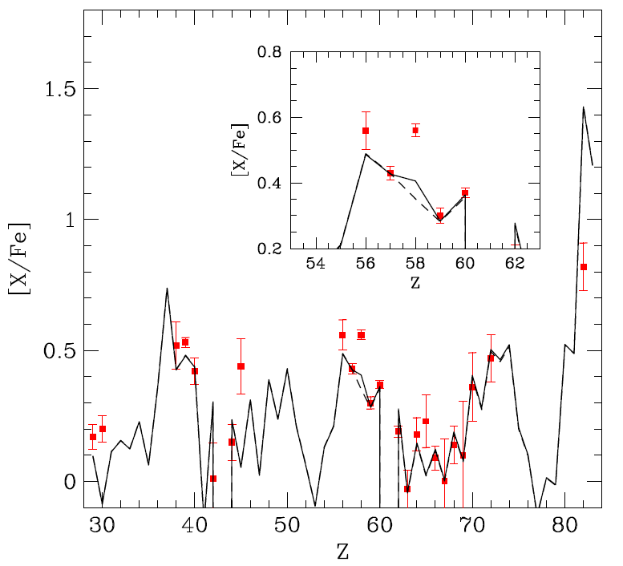
Motivation
Talk by C. D. Pardo (yesterday)
Poster #113 by R. N. Sahoo
S. Amaducci et al., PRL 132 (2024)

Slide 3
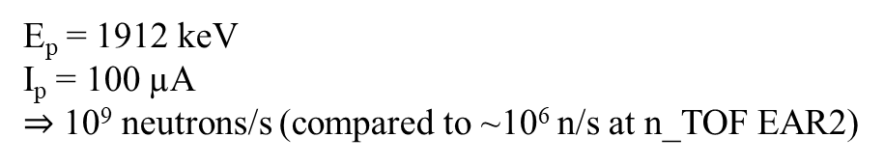
The ⁷Li(p,n) Reaction as a Quasi-Stellar Neutron Source
E_{p} = 1912 keV
I_{p} = 100 µA
$⇒$ 10⁹ neutrons/s (compared to ~10⁶ n/s at n_TOF EAR2)
W. Ratynski, F. Käppeler, PRC 37 (1988)
M. Heil et al., PRC 77 (2008)

Slide 4
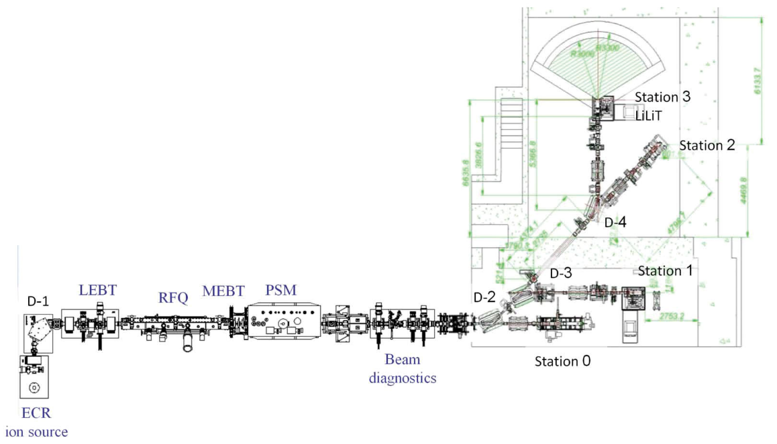

The Liquid-Lithium Target (LiLiT)
SARAF Phase I
I_{p} = 1-2 mA
$⇒$ 10¹⁰ neutrons/s
S. Halfon et al., RSI 85 (2014)

Slide 5
The Liquid-Lithium Target (LiLiT)

Slide 6
^{nat}Ce(n,γ) measurement at SARAF
R. N. Sahoo et al., PRC 109 (2024)

Slide 7
Results
Two new measurements recently reported
n_TOF (Amaducci et al. PRL 2024)
  High energy resolution
  Resonances extracted between 1-65 keV
  JENDL and reasonable assumptions were used with the experimental data to calculate MACS values.
Activation (R. N. Sahoo et al., PRC 2024)
  Integral measurement at kT ≈ 35 keV
  Extrapolation to other energies using xs libraries.
Relevant temperature range kT ≈ 8-35 keV
Could unknown systematics in either (or both) neutron Time-of-Flight or activation techniques be the reason for this discrepancy?
Measured MACS (mb)
 | kT = 10 keV | kT = 30 keV
KADoNiS0.3 | 19.5 | 11.0(4) [1]
Amaducci | 25.26(0.25) | 13.15(0.39)
Sahoo | 14.8 | 9.7(5)
[1] F. Käppeler et al. PRC 53 (1996)

Slide 8
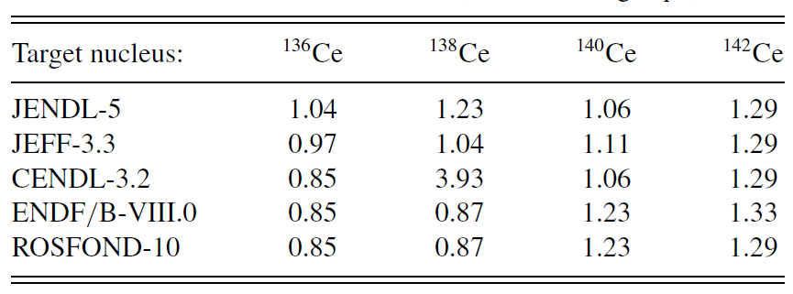
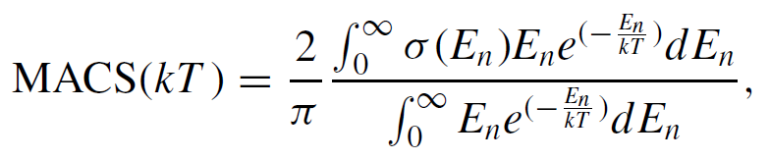

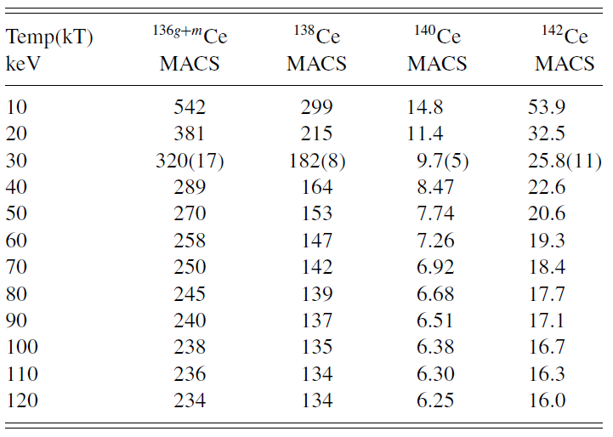
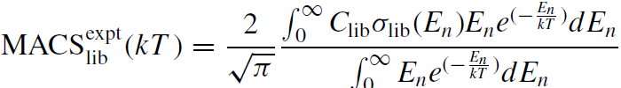
How the extrapolation is done?

Slide 9
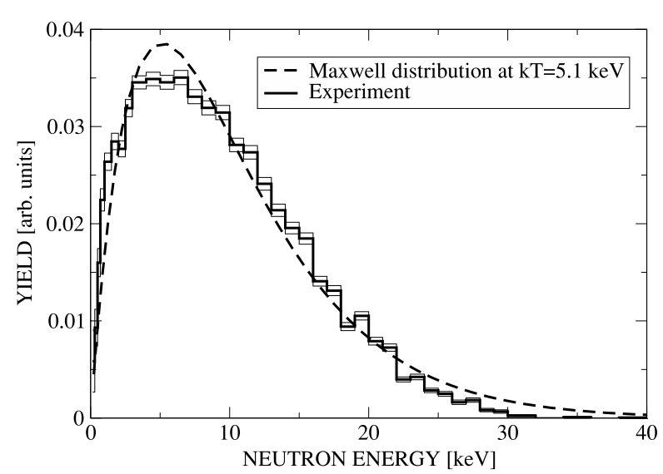
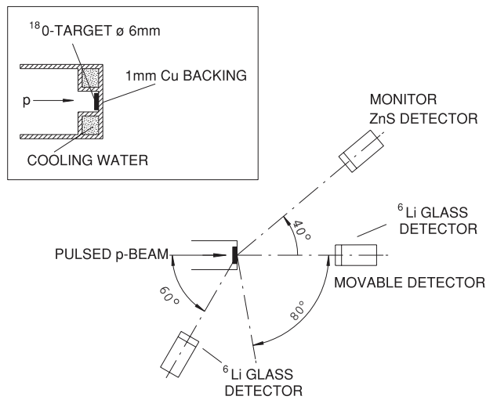
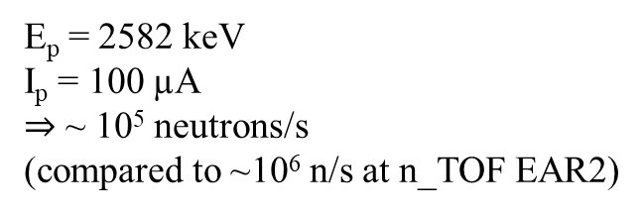
The ¹⁸O(p,n) Reaction as a Quasi-Stellar Neutron Source
E_{p} = 2582 keV
I_{p} = 100 µA
$⇒$ ~ 10⁵ neutrons/s
(compared to ~10⁶ n/s at n_TOF EAR2)
M. Heil et al., PRC 71 (2005)

Slide 10
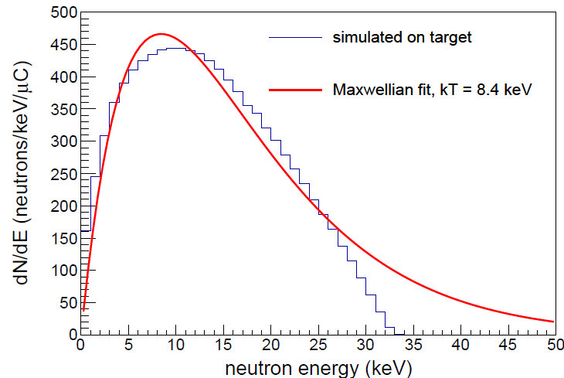
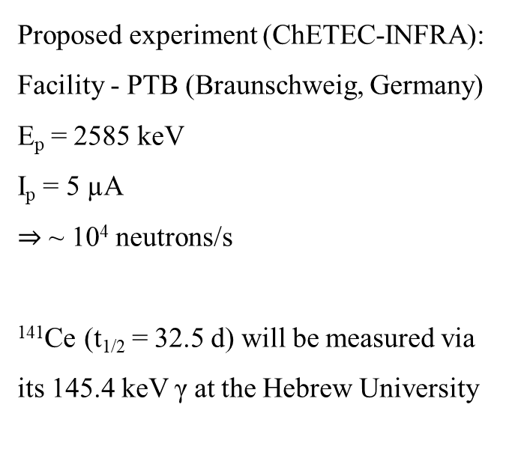
Measuring the ¹⁴⁰Ce(n,γ)¹⁴¹Ce Cross Section at kT = 8 keV
Proposed experiment (ChETEC-INFRA):
Facility - PTB (Braunschweig, Germany)
E_{p} = 2585 keV
I_{p} = 5 µA
$⇒$ ~ 10⁴ neutrons/s
¹⁴¹Ce (t_{1/2} = 32.5 d) will be measured via its 145.4 keV γ at the Hebrew University
0.75 mm
Ce
Ta₂¹⁸O₅
Proton beam E_{p} = 2585 keV
50 mm
⁶Li-glass
Ta Target backing
Au
neutrons
20 mm

Slide 11
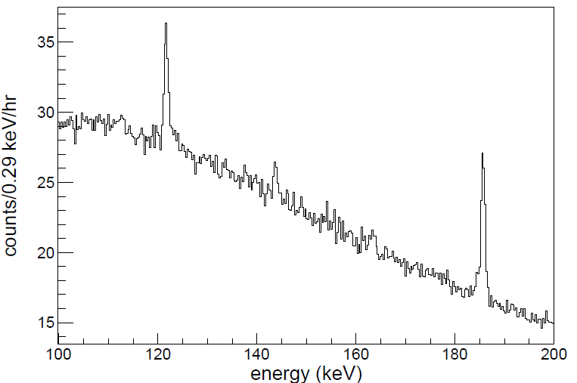
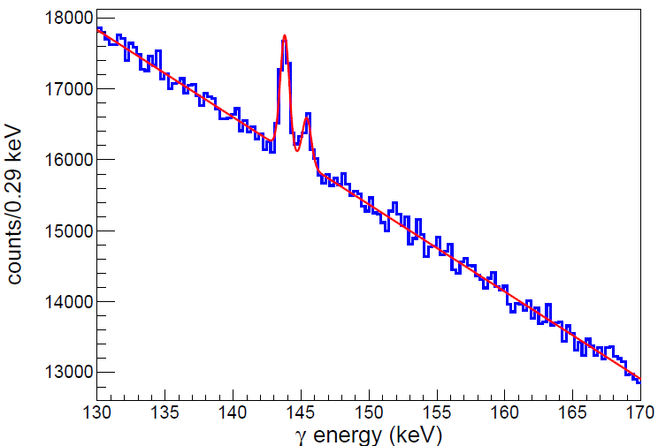

Measuring the 145.4 keV γ from ¹⁴¹Ce
Background spectrum – HPGe @ HUJI
Expected signal
(4 weeks of decay measurement)
²³⁵U (143.8 keV)
$$\frac{ΔN}{N}=0.14$$
Estimation based on ENDF8 (low limit)

Slide 12
Summary
¹⁴⁰Ce s-process abundances are underestimated by calculations.
We have contradicting measurements of the ¹⁴⁰Ce(n,γ)¹⁴¹Ce cross sections at the temperature range of 8-35 keV.
Extrapolation procedures of n-TOF and activation measurements may be the origin of part of this discrepancy.
A new measurement is planned at PTB to measure this cross section at 8 keV by means of activation, allowing a direct comparison between the different experimental methods.

Slide 13
Thanks for listening!

