Slide 1
Jet and Extended Gas Target System for the Felsenkeller Underground Laboratory
NPA-XI 2024, Dresden
September 20, 2024
Anup Yadav
Institute of Radiation Physics · Division of Nuclear Physics · a.yadav@hzdr.de · www.hzdr.de

Slide 2
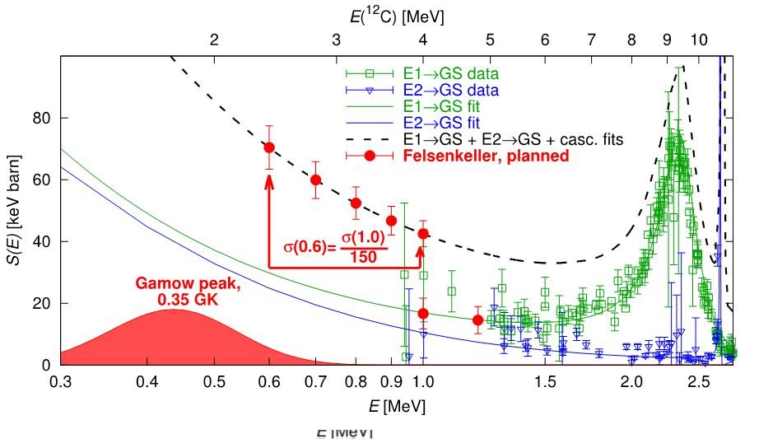
Scientific Motivation: Gas Target
Why jet gas target?
High Density: Concentrates target nuclei in a thin region
Pure: Chemically pure target
High Intensity: Meets demands for higher beam intensities
Localized: Ideal for precise angular measurements
¹²C (α,γ)¹⁶O reaction
¹²C (α,γ)¹⁶O reaction controls the C/O abundance ratio.
Planned energy range: 0.6 – 2.0 MeV
High-energy data with the jet, low-energy data with the extended gas target.

Slide 3
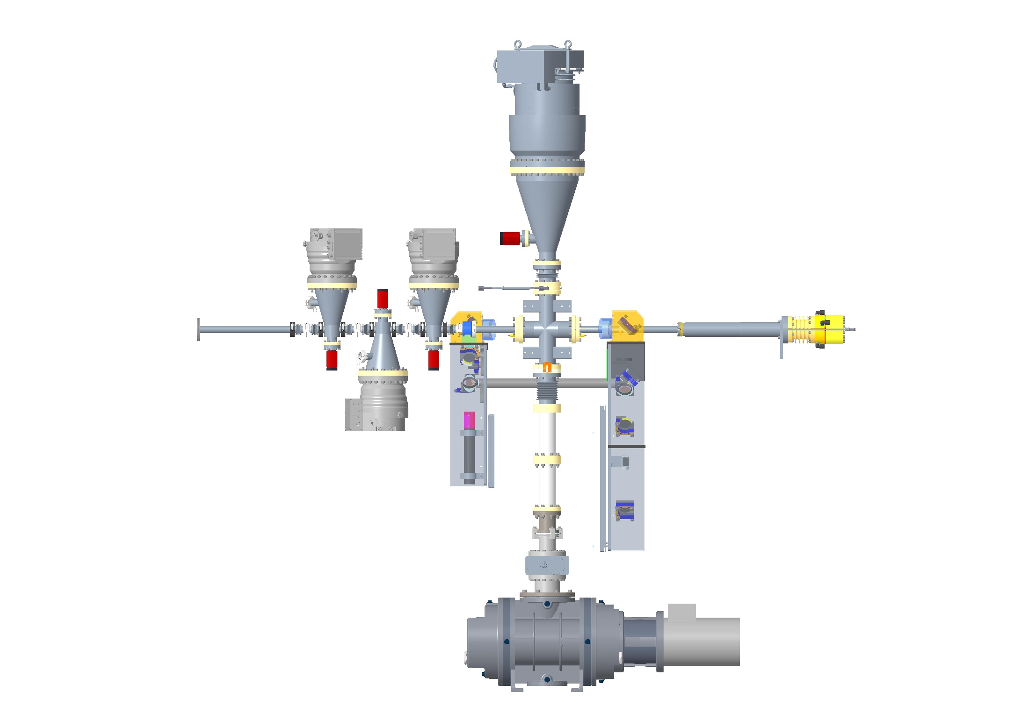
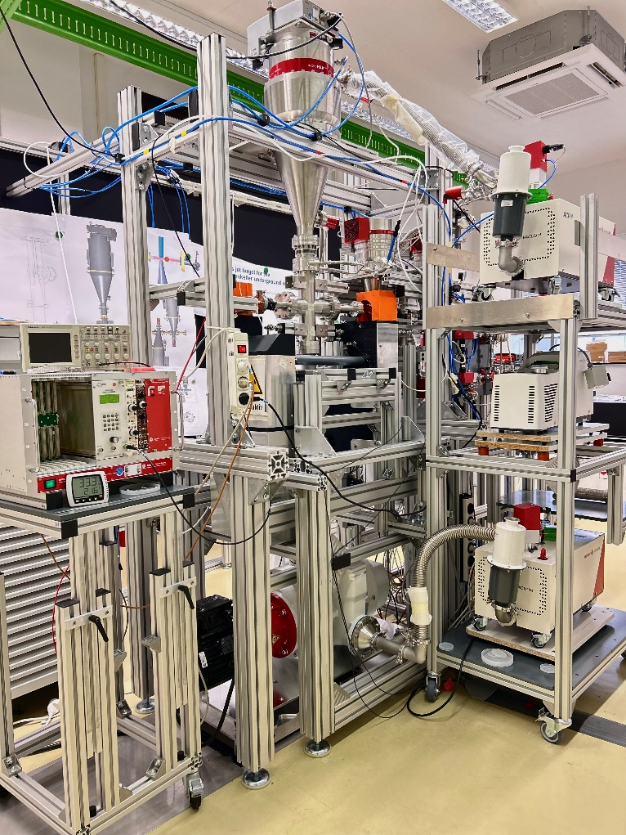
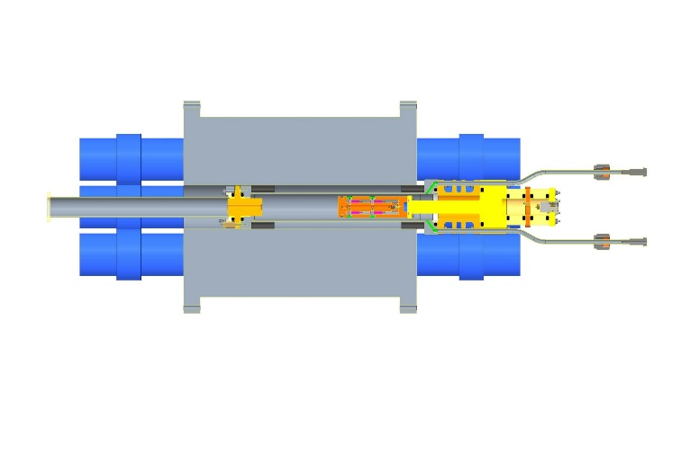
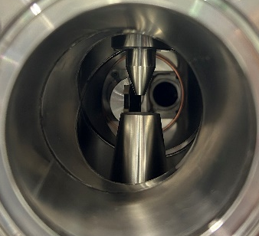
Felsenkeller Gas Target Setup: “Jet
and Extended”
stage 3
stage 1
chamber
ion beam
direction
catcher
extended, static
gas target with
beam calorimeter
stage 2

Slide 4
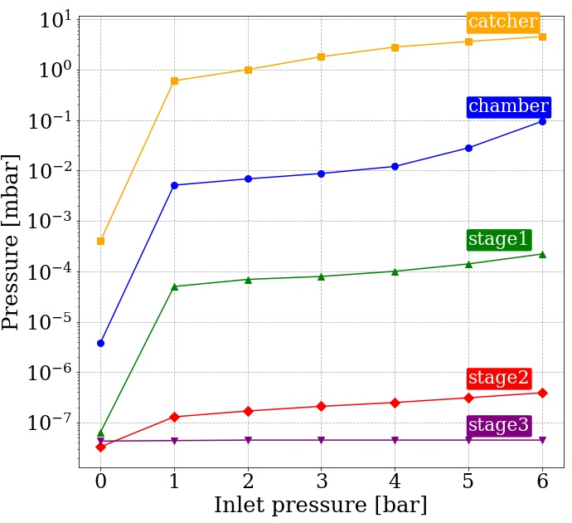
Pressure Profile in Jet Gas Target Setup
stage 3
stage 1
chamber
ion beam
direction
catcher
stage 2

Slide 5

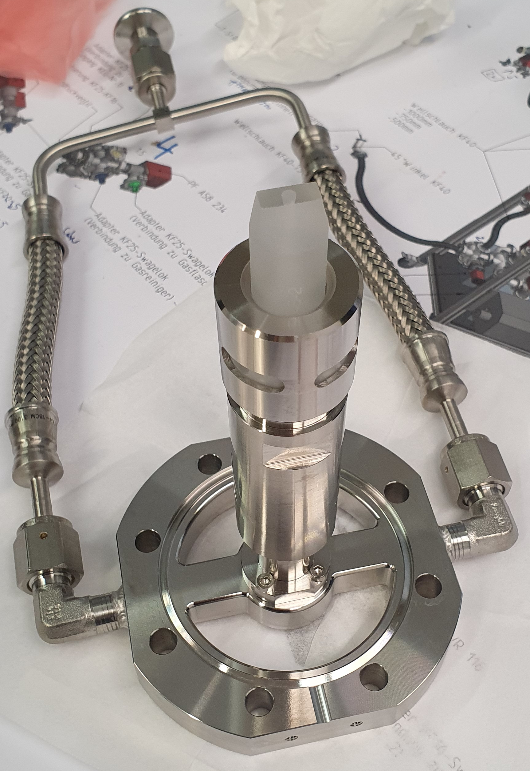
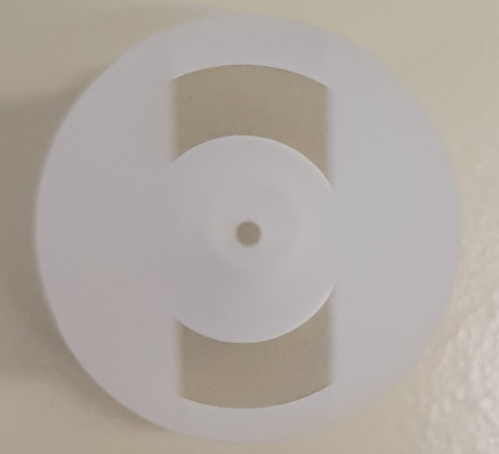

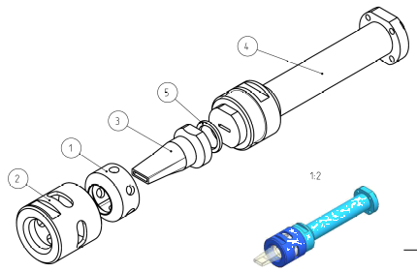

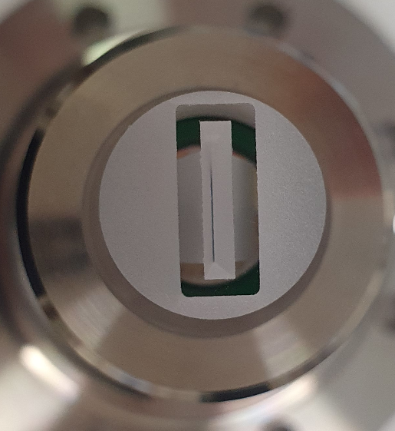

Gas Nozzles: FTMC, Glass
Type | Throat (mm) | Converging
slit | 0.1 × 8 | rapidly
cylindrical | 1.0 Ø | rapidly
slit | 0.1 × 8 | slowly
cylindrical | 1.0 Ø | slowly
slit | 0.08 × 10 | rapidly
by Vidmantas Tomkus, FMTC, Lithuania
Notes:
Collabaration with a science institute in Lithuania who can produce a non-axial symmetric nozzles

Slide 6
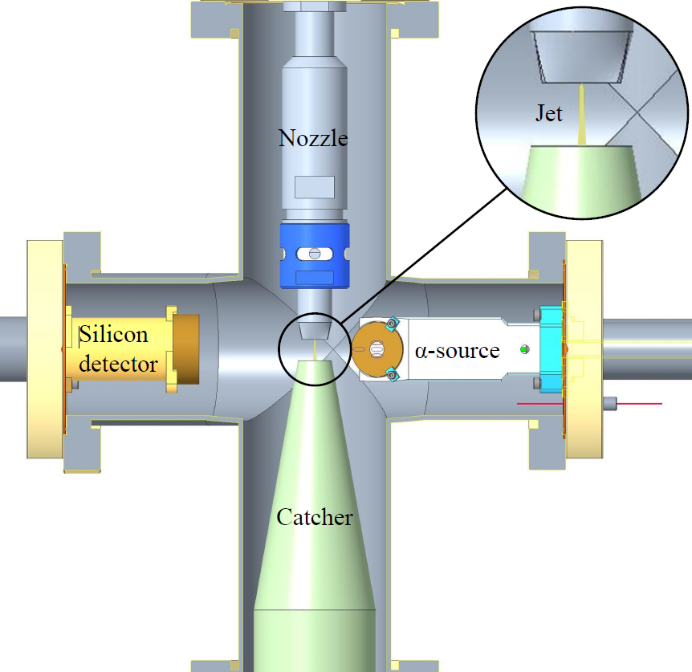
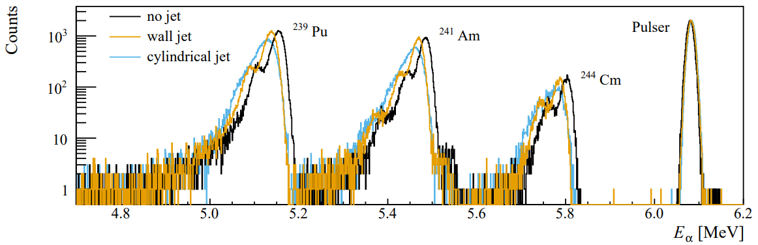
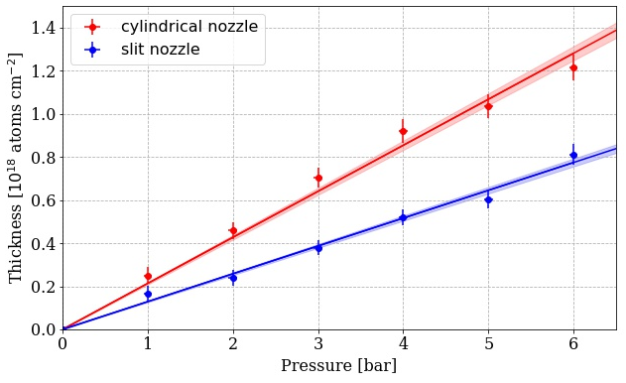
Total Jet Thickness “Energy loss measurements with α particles’’
Jet thickness increases linearly with nozzle inlet pressure
Thickness up to 10¹⁸ cm⁻² achievable with realistic pressures
Notes:
N₂ gas used for absolute thickness measurements via energy loss technique
Jet thickness increases linearly with nozzle inlet pressure
Thickness up to 10¹⁸ cm⁻² achievable with realistic pressures

Slide 7
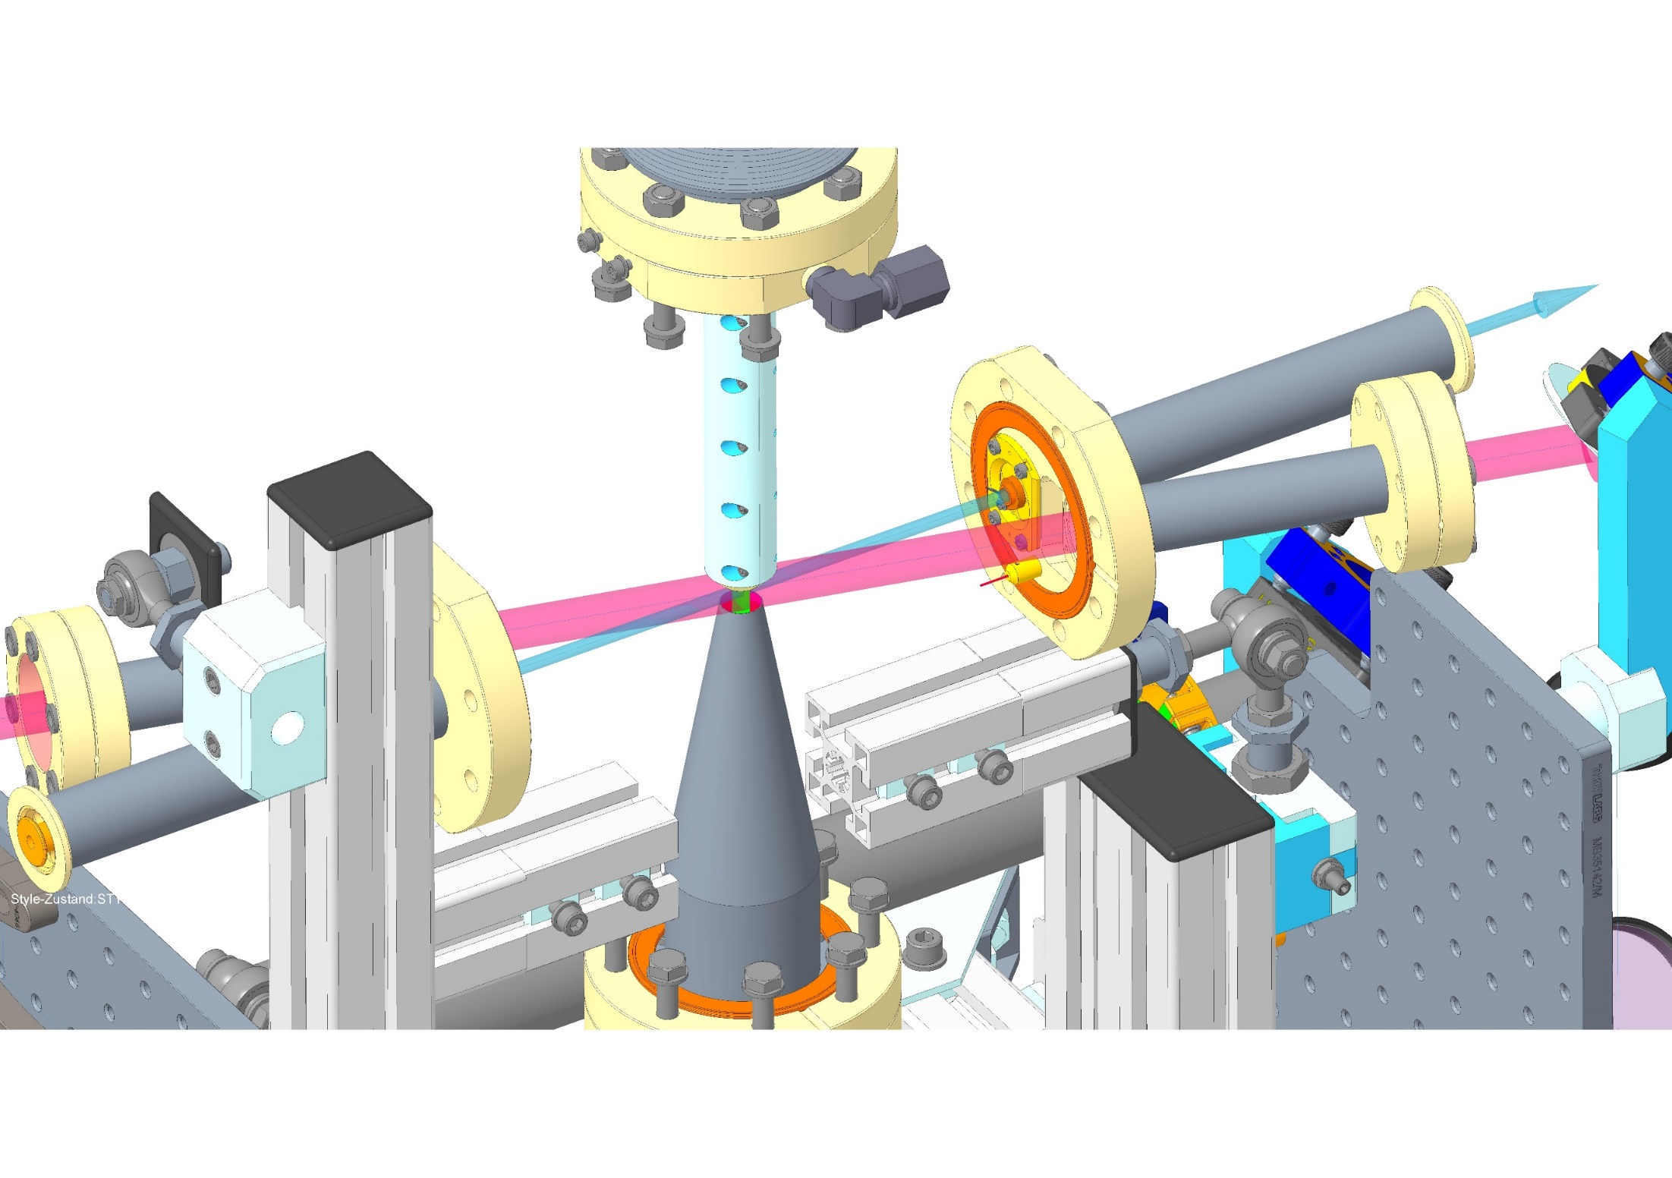
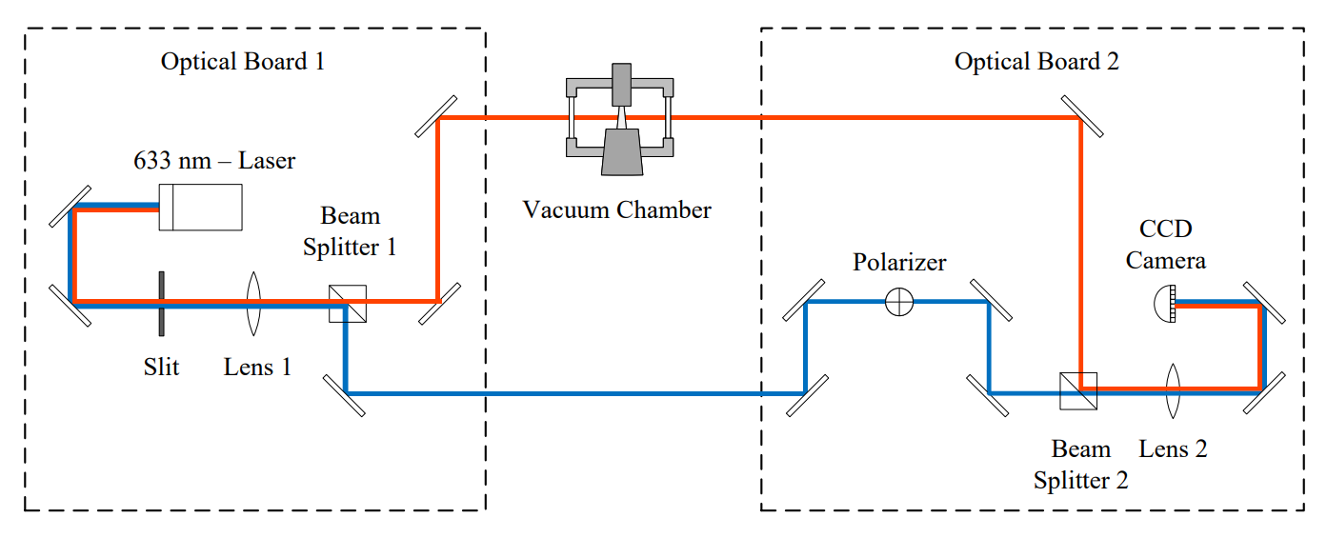
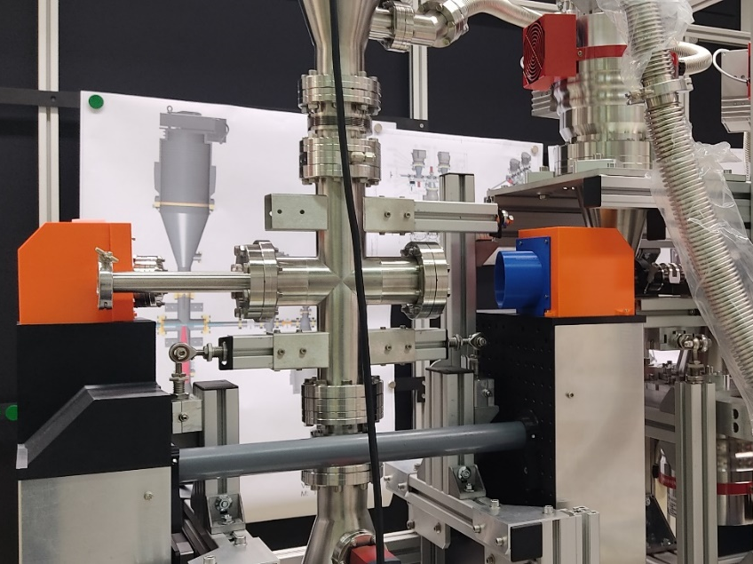
Mapping the Jet by “Laser interferometry”
Couperus, Irman et al. NIM A 830, 504 (2016)
Optical path length difference depends on:
  Gas refractive index (for N₂: 1.0002985)
  Density distribution
Path length shift for N₂ (0.11 μm)
Setup
Notes:
Laser interferometry technique for continuous monitoring density and shape

Slide 8
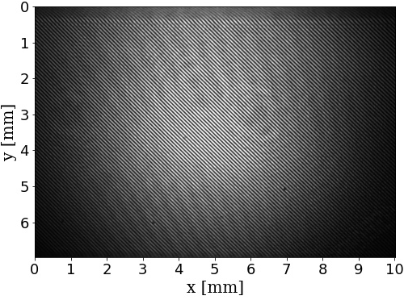
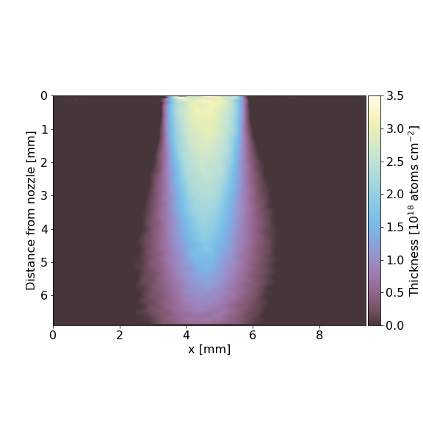
Mapping the Jet by “Laser interferometry”
Mach-Zehnder Interferometer
Fourier-transform technique used for image processing
Phase
retrieval
Jet thickness reconstruction
Filtering &
phase reconstruction

Slide 9
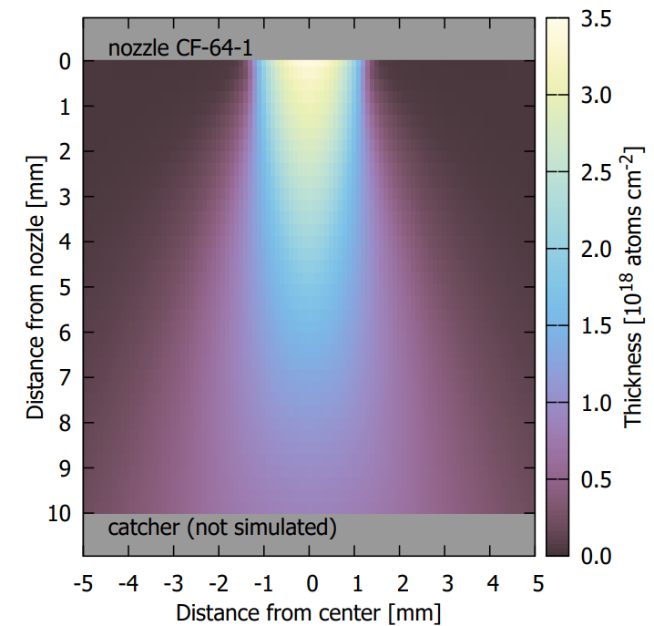
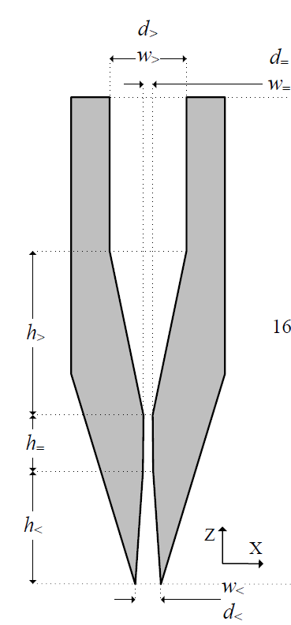
Computation Fluid Dynamic Simulations
Simulated jet inside nozzle and its expansion in the jet chamber
2D axisymmetric, density-based solver with SST k-omega viscous model under ideal gas conditions
Notes:
Examined effects of varying geometry parameters
Studied pressure, density, velocity, and more

Slide 10
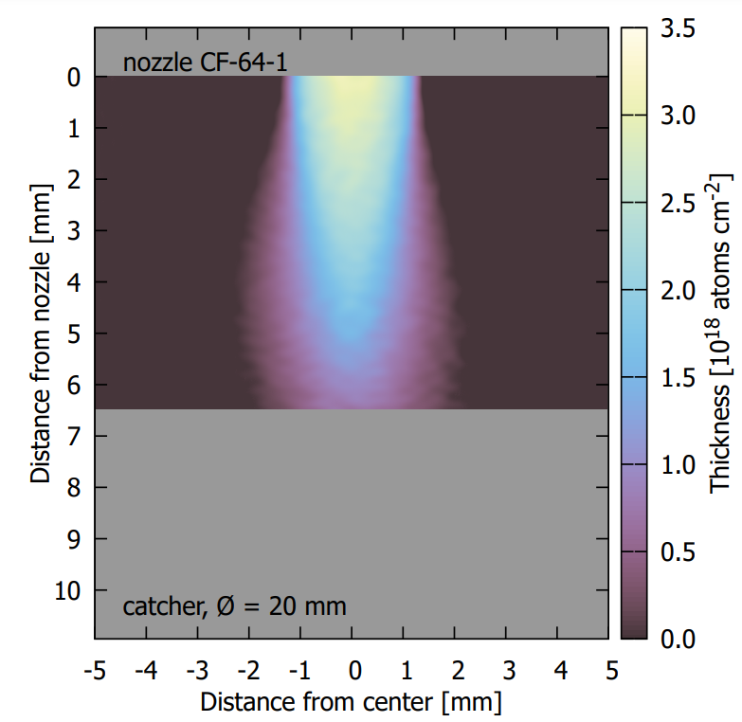
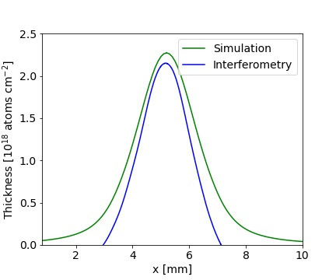
Laser interferometry and Simulations
Measurement
Simulation
Catcher is not considered in the simulations
Thickness profile is 1 mm wide strip at 3 mm after the nozzle exhaust

Slide 11
Outlook: Next steps
idea
design
construction
move to Felsenkeller
nitrogen and other gases
completed
completed
completed
completed
tests
completed
ongoing
✓
✓
✓
✓
✓

Slide 12
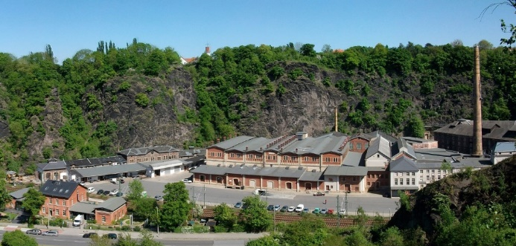
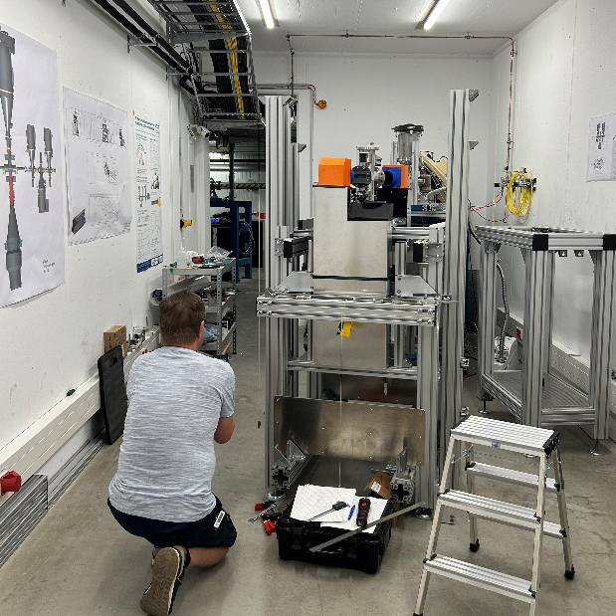
The new gas-target system for Felsenkeller

Slide 13
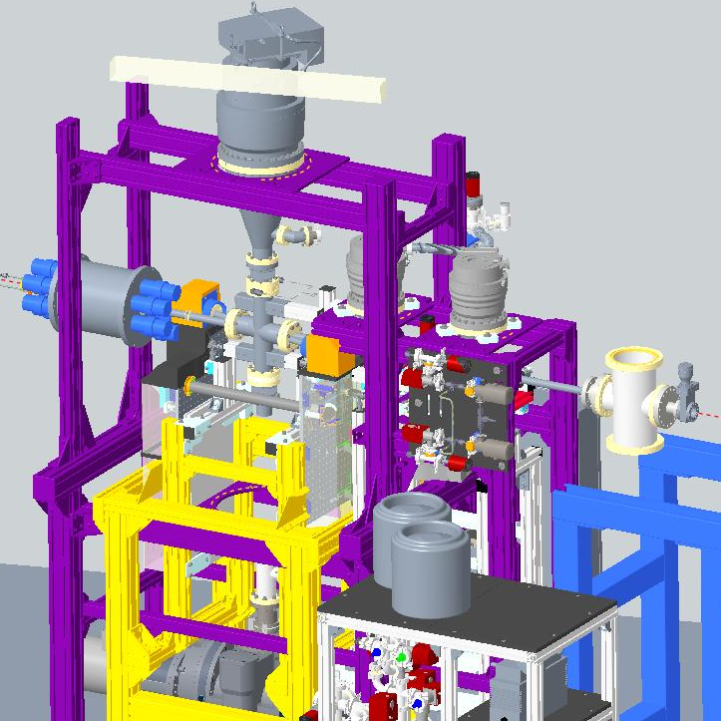
Summary
Gas targets allow experiments with unlimited beam intensity
Various experiments can be studied, as ^{14,15}N(α,γ), ³He(α,γ), ¹²C(α,γ), and more
Felsenkeller target system combines jet and static extended gas target
Density distribution is continuously monitored by laser interferometry

Slide 14
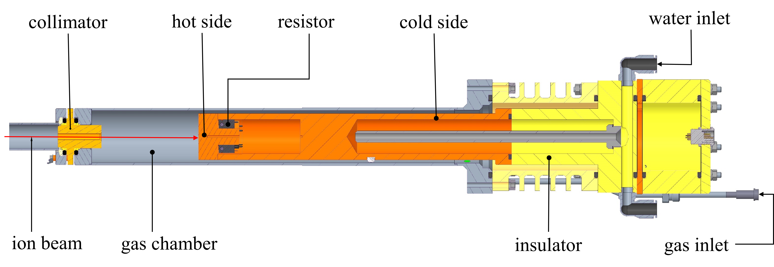
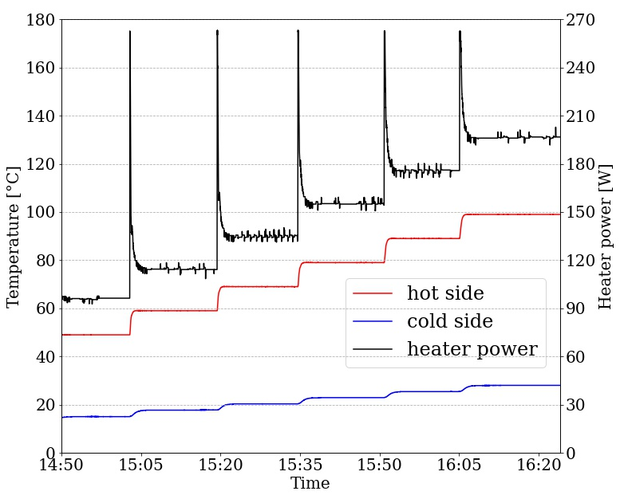
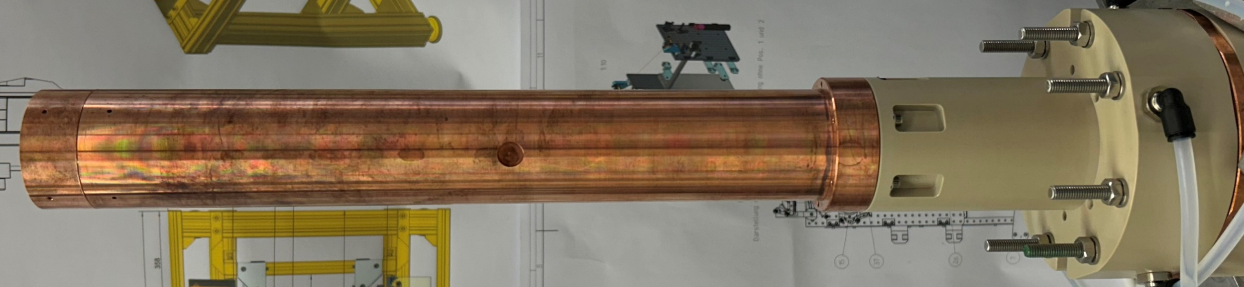
Calorimeter for beam intensity determination idea based on LUNA calorimeter
Initial tests with the calorimeter

