Slide 1
Structure of neutron-rich light nuclei and its implications on nucleosynthesis of heavy elements
Margareta Sigmund, PhD Candidate at Ruđer Bošković Institute
Zagreb, Croatia
18th Russbach School on Nuclear Astrophysics,
March 2023

Slide 2
Introduction
Study of nuclear structure in light nuclei
Implications in nucleosynthesis
Small number of degrees of freedom → “ab initio” models
Single-particle dynamics and nucleon correlations - both pronounced
Wide variety of nuclear structures
Hoyle state
¹²C(𝛼,𝛾)¹⁶O - subthreshold resonance
¹³C(𝛼, n)¹⁶O - source of neutrons in low mass AGB stars
²²Ne(𝛼, n)²⁵Mg - source of neutrons in large mass AGB stars
1p_{1/2}
1p_{1/2}
1p
1p
1p_{3/2}
1p_{3/2}
1s
1s_{1/2}
1s
1s_{1/2}
2

Slide 3
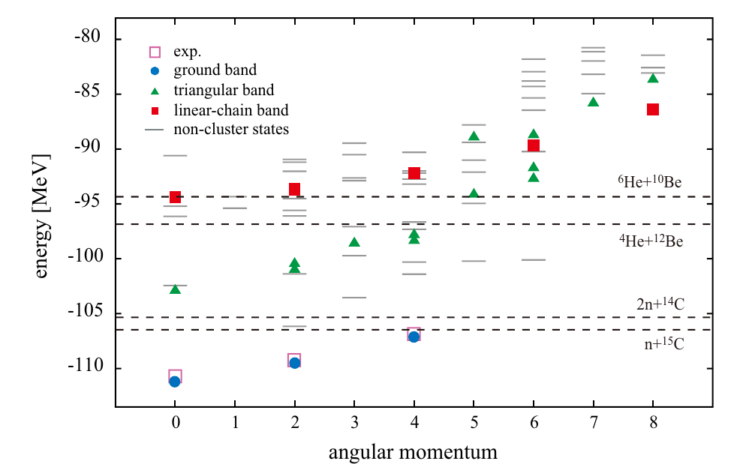
Motivation and implications - ¹⁶C
List of states predicted by AMD theory
[T. Baba and M. Kimura, Phys. Rev. C 97 (2018) 054315.]
<number>
Notes:
Klasterska struktura

Slide 4
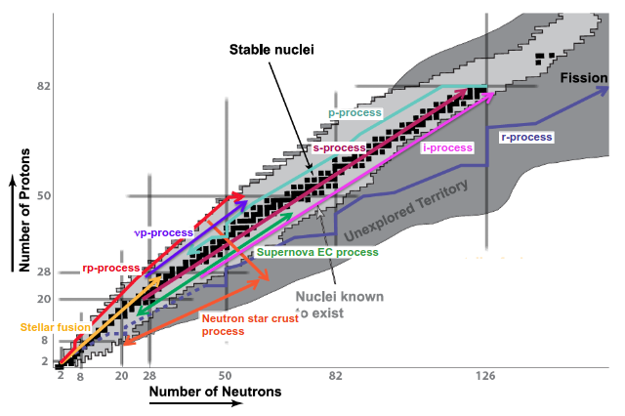
Motivation and implications
[Figure from Frank Timmes]
<number>

Slide 5
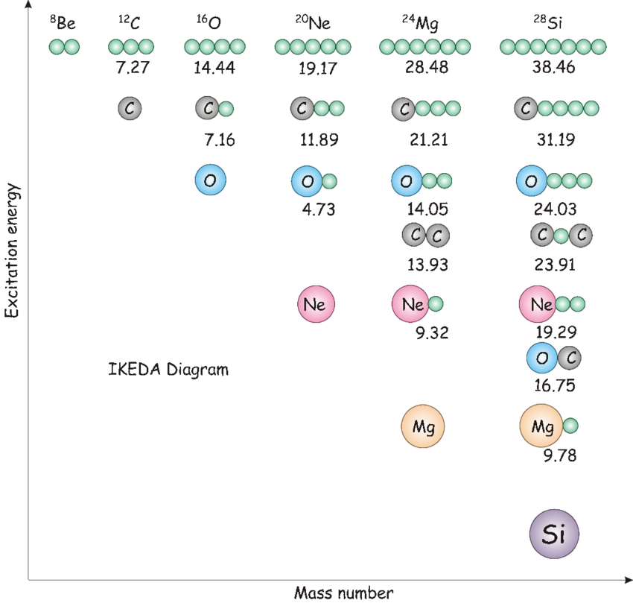
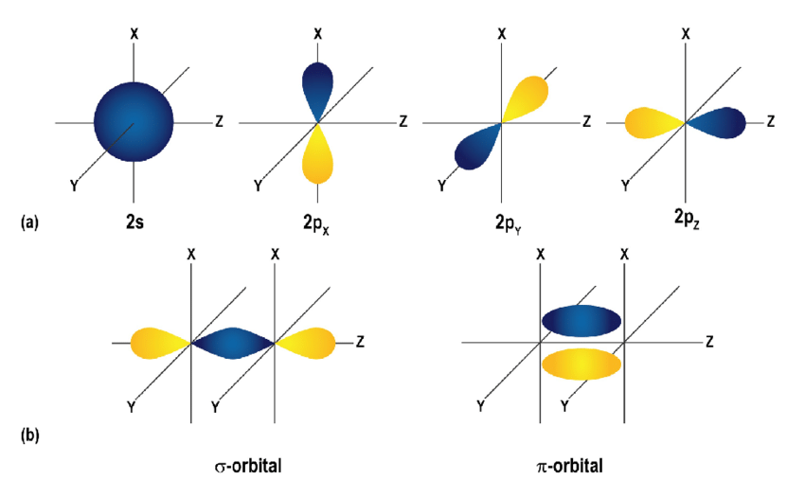
Studying the structure of ¹⁶C - Clustering & Nuclear molecules
[Adapted from K. Ikeda, N. Tagikawa, H. Horiuchi, Prog. Theor. Phys. 464 (Suppl.) (1968).]
[Wijeratne, Kosala. (2018). Conducting Polymer Electrodes for Thermogalvanic Cells. 10.3384/diss.diva-152888.]
<number>
Notes:
Alfa čestica je klaster - 20 MeV

Slide 6
Studying the structure of ¹⁶C - Transfer reactions
¹¹B
n+n+T
+
𝛼
⁹Li
¹⁶C
𝛼
¹¹B
𝛼
𝛼+ T
¹⁶C
¹¹B
+
𝛼
⁹Li
<number>
Notes:
Alfa čestica je klaster - 20 MeV

Slide 7
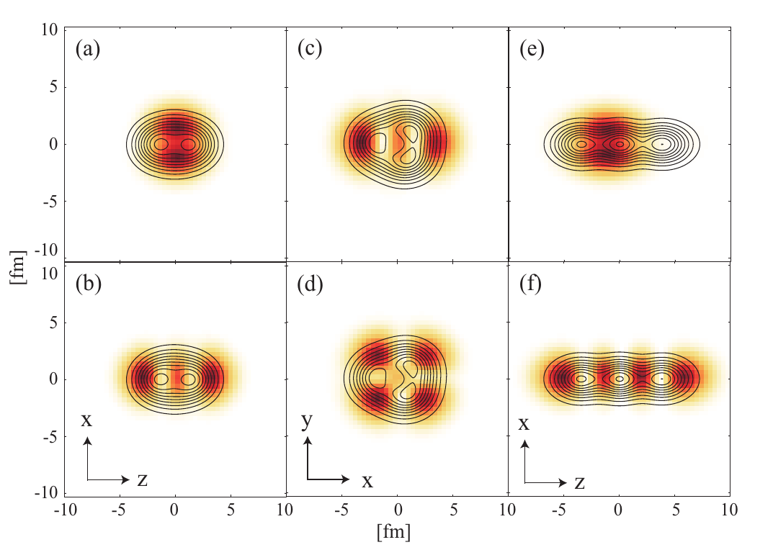
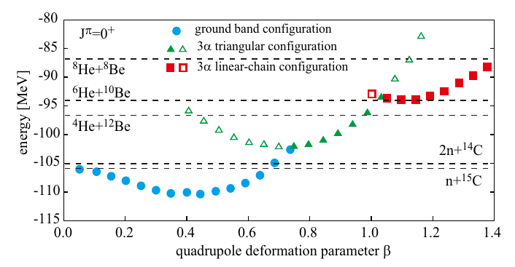
¹⁶C - What theory predicts? - AMD
[T. Baba, Y. Chiba, and M. Kimura, Phys. Rev. C 90 (2014) 064319.]
<number>

Slide 8
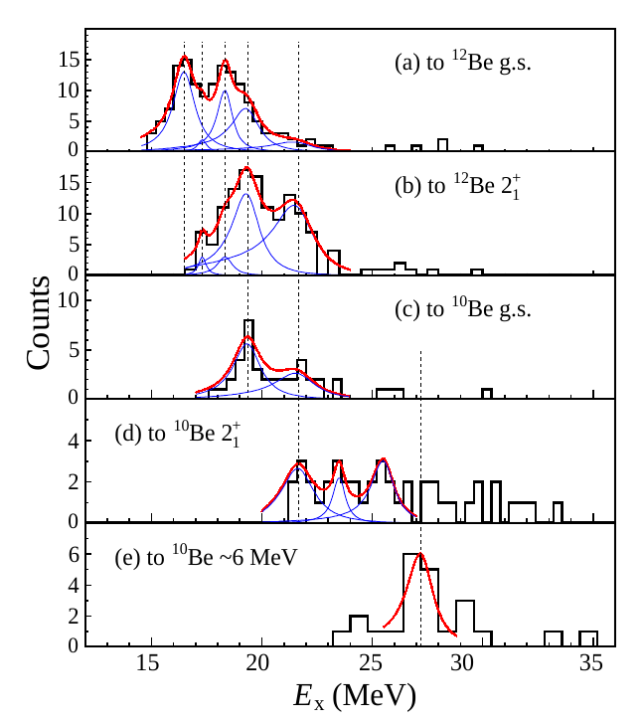
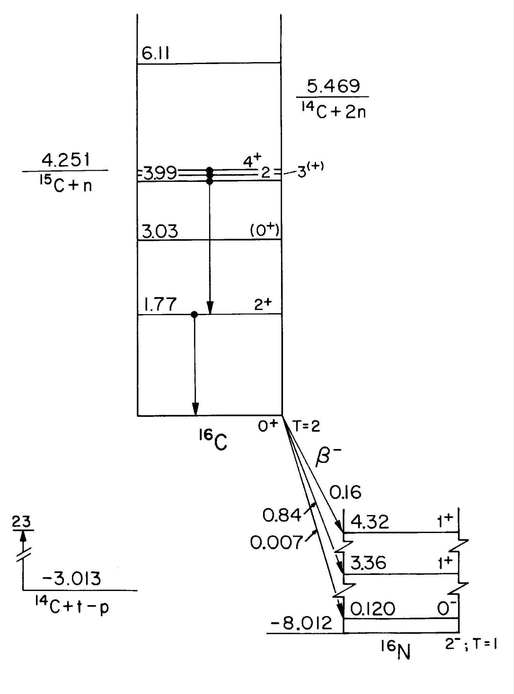
¹⁶C - What we already know?
[https://nucldata.tunl.duke.edu/nucldata/figures/16figs/16_06_1993.gif]
[J. X. Han et al, Phys. Rev. C 105, 044302 (2022)]
<number>

Slide 9
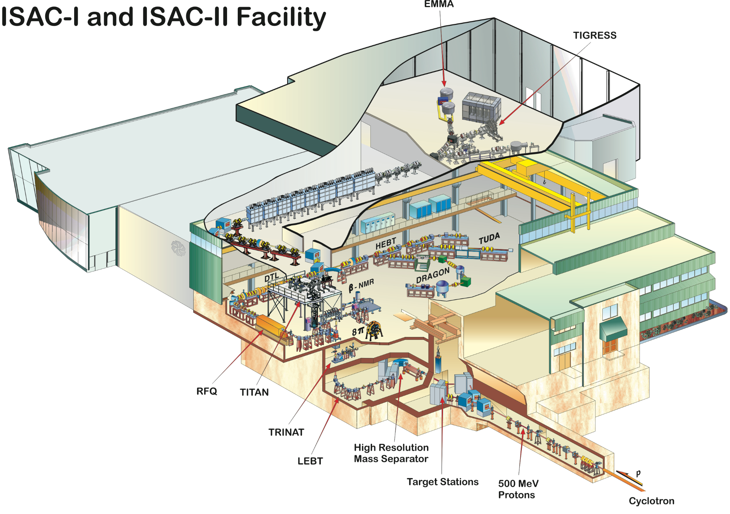
Experimental proposal
By the end of the year 2023
TRIUMF Isotope Separator and Accelerator (ISAC) facility, Vancouver, Canada
TUDA Chamber
Rare isotope beam 9Li (70 MeV, 5x10⁶ pps)
¹¹B target (isotopically enriched >95%, 600 𝜇g/cm²)
<number>

Slide 10
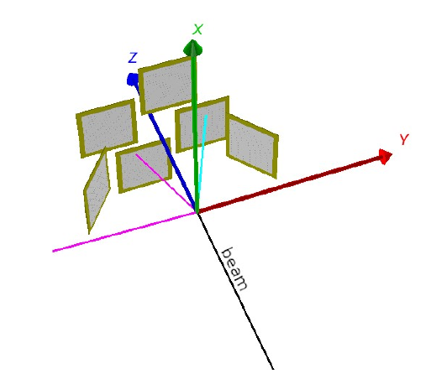
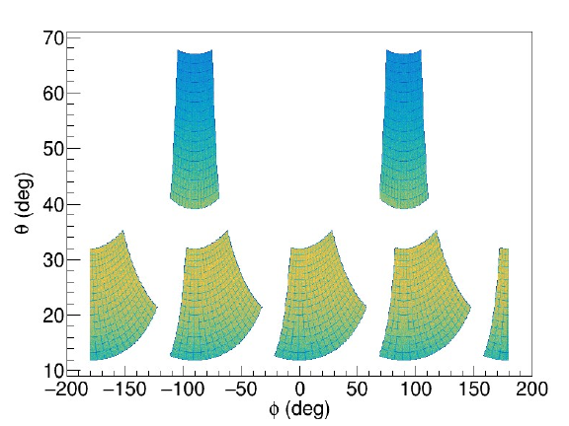
Experimental setup
Silicon detector telescope (DSSSD (1000 𝝁m), SSSSD (20 𝝁m)) → particle identification
Coincident detection (2 or 3 coincident particles)
Rutherford scattering below 50 Hz, efficiently detect desired products
<number>

Slide 11
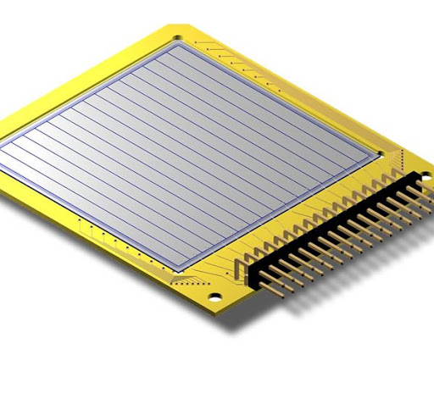
Experimental setup - telescope detectors
SSSSD - 20 𝝁m
DSSSD - 1000 𝝁m
<number>

Slide 12
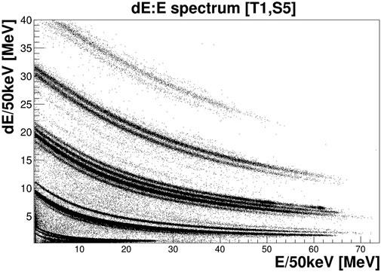
𝚫E-E spectra - identification of nuclei
[Vukman N, Soić N et al., (2022) Cluster decays of ¹²Be excited states. Front. Phys. 10:1009421. doi: 10.3389/fphy.2022.1009421]
<number>

Slide 13
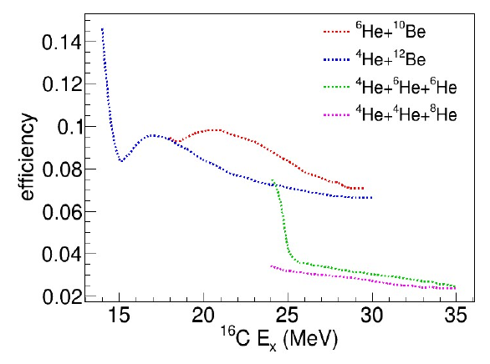
What are we planning to measure?
Production of ¹⁶C
Decay channels of interest
<number>
Notes:
Coincidence of two or three products of reaction

Slide 14
Fi nding out what have we measured
On wide range of different states
Measure excitation energy
Determine state width
Relative decay partial widths
Benchmark theoretical models with our experimental results
Improved nuclear potential advances models for heavy nuclei nucleosynthesis
<number>

Slide 15
Thank You!
Spokespersons: D. Dell’Aquila⁴, A. Di Pietro³, M. Freer², N. Soić¹
Group: ⁴D. Dell’Aquila, ³A. Di Pietro, ²M. Freer, ¹N. Soić, ⁵M. Alcorta, ⁶T. Davison, ¹J. Diklić, ³P. Figuera, ¹I. Gašparić, ¹A. Horvat, ¹D. Jelavić Malenica, ²T. Kokalova, ⁷M. La Cognata, ¹I. Lihtar, ¹T. Mijatović, ⁸M. Milin, ¹L. Palda, ³R. G. Pizzone, ^{3,9}R. Sparta, ¹S. Szilner, ¹I. Tišma, ³A. Tumino, ¹M. Uroić, ¹N. Vukman, ²C. Wheldon
¹Ruder Boskovic Institute, Zagreb, Croatia
²University of Birmingham, UK
³INFN-LNS, Catania, Italy
⁴Universita degli Studi di Sassari, Italy
⁵TRIUMF, Vancouver, Canada
⁶University of Edinburgh, UK
⁷INFN, Italy
⁸University of Zagreb, Croatia
⁹University of Catania, Italy
¹⁰KORE University, Italy
<number>

Slide 16
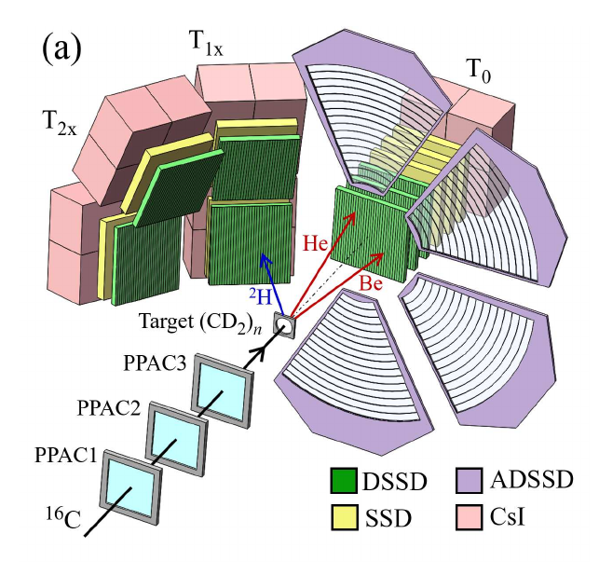
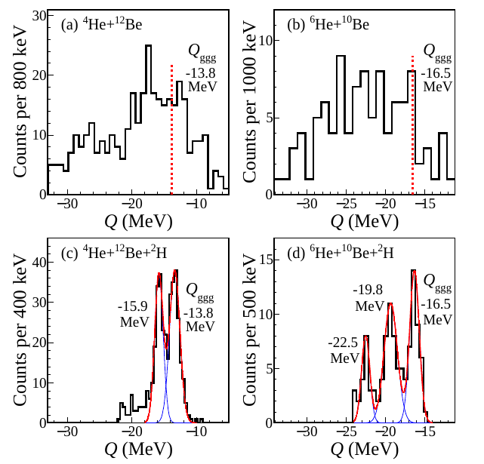
Experimental details (PRC 105, 044302 (2022))
¹⁸O - 59.6 MeV/nucleon → ¹⁶C ~ 23.5 MeV/nucleon (purity ~90%, intensity ~1.5x10⁴ pps)
<number>

