Slide 1
The PANDORA project : an experimental setup for measuring in-plasma β − decays in nuclei of astrophysical interest
18th Russbach School on Nuclear Astrophysics – Russbach, 13/03/2023

Slide 2
Introduction
Nucleosynthesis proceeds by nuclear fusion in massive stars until iron, where it stops because the fusion of still heavier nuclei needs energy instead of providing it.
Heavier nuclei are created by an interplay between neutron capture and beta-decay.
A major difference exists between terrestrial and stellar conditions: stellar nucleosynthesis proceeds in a hot and dense environment which affects the degree of ionization of the atoms involved in the stellar nucleosynthesis.
This raises the question “whether or not” the high degree of ionization could induce any significant differences of the beta-decay properties with respect to neutral atoms.

Slide 3
β-decay investigation in matter: from early experiments to storage rings
Long standing question: How constant really are nuclear decay constant ?
One of the paradigms of nuclear science since the very early days has been the general understanding that the decay constant is independent of extranuclear considerations
What happens to β-radioisotopes under extreme conditions of Temperature (2500 K), Pressure (2000 atm) or Magnetic fields (80000 G) ? → almost nothing… < 0.05 % decay constant variation
In 1947 Segrè and Daudel pointed out that the possibility to alter the decay rate of ⁷Be by changing the electron density, at least for low Z nuclei, an effect due to different chemical environment
How does the surrounding chemical environment (lattice structure and electron affinity) affect the host atoms decay? (e.g. ⁷Be →⁷Li) → A variation of E.C. lifetime of around 3.5%
G. T. Emery, Perturbation of Nuclear Decay Rates, Annual Review of Nuclear Science 22, 1972
H. Mazaki et al., Effect of Pressure on the Decay Constant of ^{99m}Tc, Phyc. Rev. C 5, 1972
E. Segrè , Possibility of altering the decay rate of a radioactive substance Phys. Rev. 71, (274) 1947
G. T. Emery, Perturbation of Nuclear Decay Rates, Annual Review of Nuclear Science 22, 1972
What happens when atoms are highly ionized? → ….the answer came from Storage Rings experiments ….

Slide 4
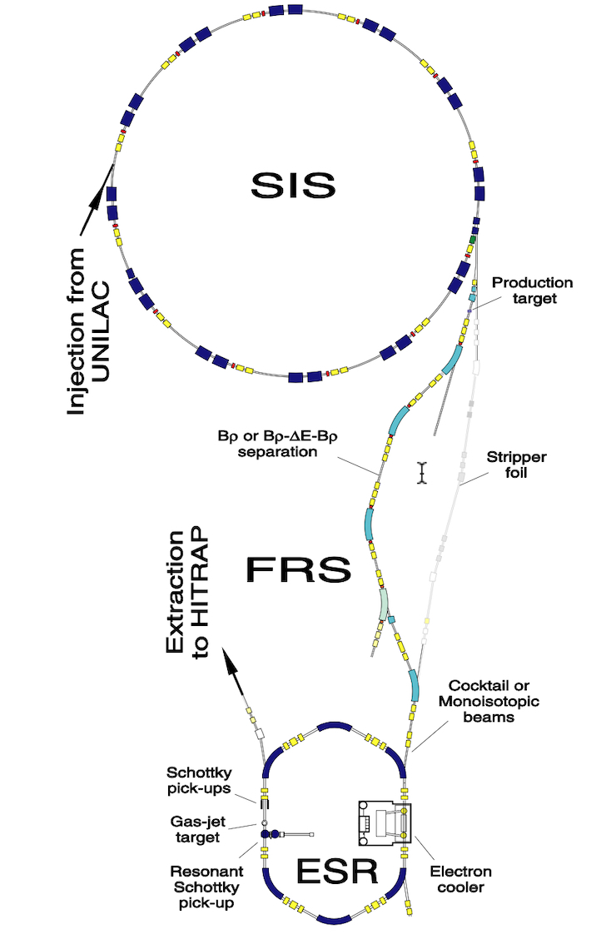
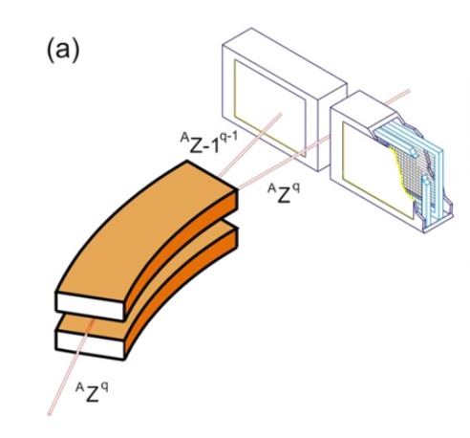
Storage Ring experiments
Experiments performed at ESR (Experimental Storage Ring - GSI)
Method:
β-unstable nuclei produced at high atomic charge state (projectile fragmentation or fission)
Separation of reaction products ( fragment separator)
Injection in storage ring operating at ultra vacuum
Decay of ions in ring is expressed by the decay constant: λ = ln(2) / T_{1/2} where λ = λ_{nuclear} + λ_{loss}
Depending on nuclear charge and the m/q acceptance of the ring up to three charge state can be stored in the ring
For cases in which the decay induces a change in m/q larger than the acceptance the decay products can be measured by in-ring particle detectors (multiwire proportional chambers or Si detector telescopes)
When the decay induces a change inside the acceptance the variation of revolving frequency in the ring is used to detect the decay

Slide 5
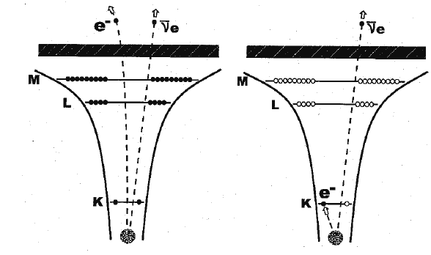
Storage Ring experiments
Important findings:
The beta decay in highly ionized atoms shows important variations compared to neutral species
Electron Capture becomes impossible in fully ionized atoms.
Bound state beta decay typically marginal can become important.
  Bare ¹⁶³Dy⁶⁶⁺ nuclei, being stable as neutral atoms, become radioactive,
  thus allowing the s process, with a half-life of 33 days.
  Bare ¹⁸⁷Re⁷⁵⁺ ions decay, due to the bound-state beta decay, becomes 9 orders
  of magnitude faster than neutral ¹⁸⁷Re atoms with a half-life of 42 Gyr.
  ¹⁴⁰Pr⁵⁸⁺ ions half-life T_{1/2} = 3.04 min ( with a single orbital electron) due to EC
  decay is shorter than the one of ¹⁴⁰Pr⁰⁺ neutral ions with 59 electrons T_{1/2} = 3.39
  min
free β-decay
bound β-decay
M. Jung at al., First observation of bound-state β⁻ decay, Phys. Rev. Lett. 69, 1992
Y. Litvinov and F. Bosh: Rep. Prog. Phys. 74, 016301 (2011)
F. Bosch at al., Observation of Bound-State β⁻ Decay of Fully Ionized ¹⁸⁷Re: ¹⁸⁷Re−¹⁸⁷Os Cosmochronometry,
Phys. Rev. Lett. 77, 1996
Y. Litvinov et al., Measurement of the β+ and orbital electron capture decay rates in fully ionized, hydrogen-like and helium-like ¹⁴⁰Pr Ions Phys. Rev. Lett. 99, 2007, 262501
Storage ring experiments are incapable of exploring the rate modifications due to a CSD

Slide 6
Beta – decay theory
The comprehension of beta decay theory is central to understand the effect of stellar conditions on β-decay lifetimes
Terrestrial environment
Stellar environment
(continuum state β⁻ decay)
(continuum state β⁺ decay)
(bound state β decay)
(electron capture)
(free electron capture)
Decay become possible when reaction Q value > 0
for neutral atomic species – nuclear transition between ground states:
where m(^{A}_{Z}X) is the atomic mass and B_{x} is the atomic binding energy.

Slide 7
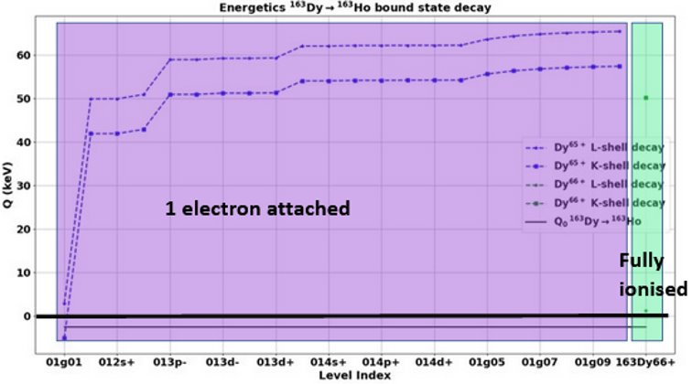




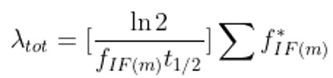
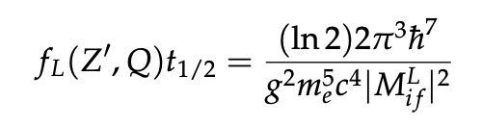
Beta – decay theory
A more general form the Q value for:
continuum state β⁻ decay
bound state β⁻ decay
orbital EC
¹⁶³Dy →¹⁶³Ho bound state β decay
i i+1
i,j
i+1,j’
E*_{X} : excited nuclear state energy
B*_{x} : ionisation energies to obtain a charge state
e*_{X} : level excitation energies of state j of a nucleus with charge
state i
i,j
For continuum state β⁺ decay:
For free EC:
The ft of the decay is given, from the theory, by the relation:
Decay rate in stellar environment
CSD and level population of ions​
EEDF of electrons
Terrestrial and stellar decays can have widely different f_{L} and therefore different T_{1/2}

Slide 8
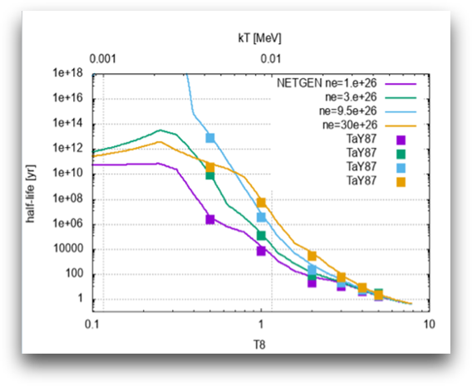
Beta decay in stellar environment
In a stellar plasma, ions are embedded in a cloud of charges, both positive and negative.
These charges create EM fields which act as perturbation to the atomic/ionic levels.
The net effect of these perturbations on the internal states of the ions leads to corrections of Q values
which affects the decay rates.
Original predictions of modifications in beta decay rates in plasma due to the effect of temperature were performed by Takahashi and Yokoi
Takahashi et al. 1987, Phys Rev C36 (1987) 1522
Takahashi and Yokoi, Nucl. Phys. A404 (1983) 578​

Slide 9
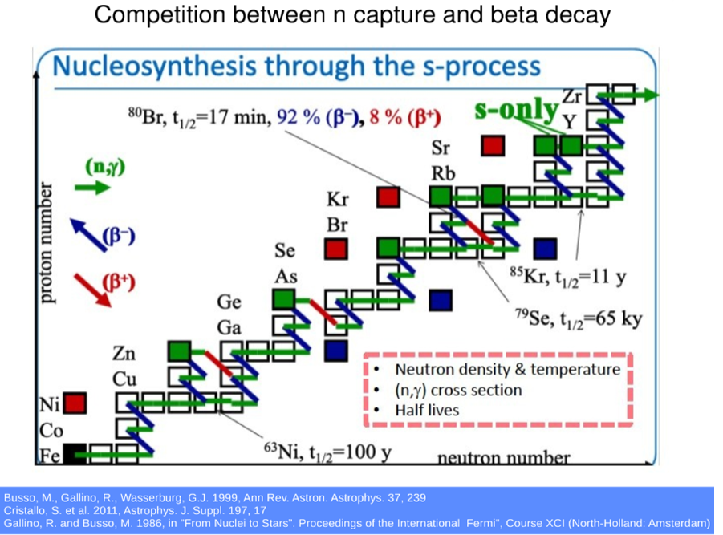
S- process branching points
Important branching points in s-processes in the nucleosynthesis chain depend on the “competitive” rates of neutron capture vs. β-decays.

Slide 10

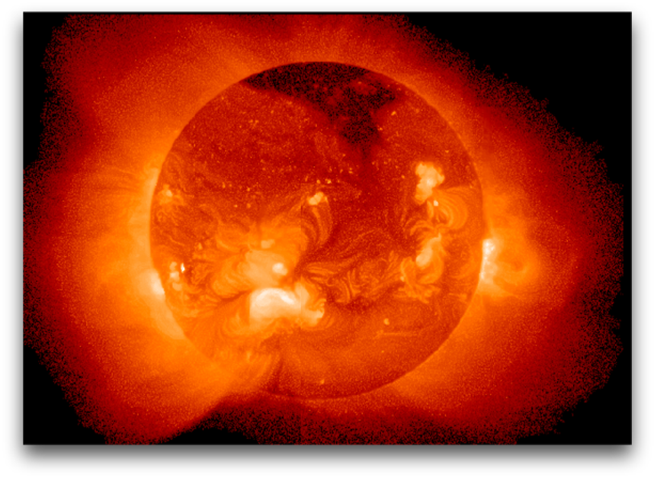
PANDORA
A NEW CHALLENGE: Reproduce in laboratory some stellar-like conditions and measure the expected variations of nuclear lifetime in β – decaying nuclei
We need to create and confine a plasma to be able to study the β decay in such evironment
Plasma: 4th state of matter

Slide 11
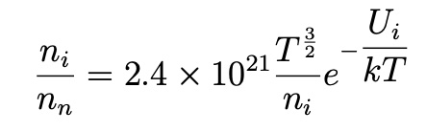
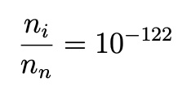
What is a plasma ?
Main Plasma Constituents
Saha equation → ratio of ionized over neutral atoms
Positively charged ions
Electrons
Neutrals
On Earth
PLASMA : a quasi-neutral gas made of charged particles exhibiting a collective behaviour
Key plasma properties
Quasi neutrality
Strength and range of the electric force and the good conductivity of plasma ensures
that densities of positive and negative charges in any sizeable region are ’’equal’’.
Directly connected to Debye lenght
Display collective behaviour
particle motion in a defined region will depend on the general status of the system
The plasma, while being negligible on the earth represents represents about the 99% of the known matter of the Universe

Slide 12

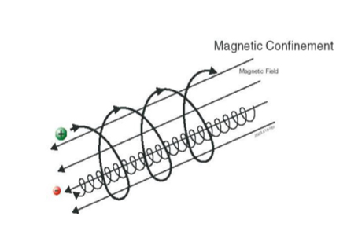
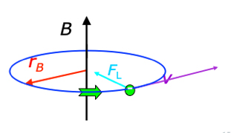
How can plasmas be confined ?
The Lorentz force F_{L} exerted by a static magnetic field B on particles of mass m having an elementary charge e causes a circular motion
The radius (Cyclotron radius) r_{B} of the circular trajectory is given by r_{B} = mv/eB
The corresponding cyclotron frequency ω_{B} doesn’t depend on particle velocity and is given by
ω_{B} = eB/m
Ion sources are typically based on magnetic confinement
F_{L} = qv x B

Slide 13
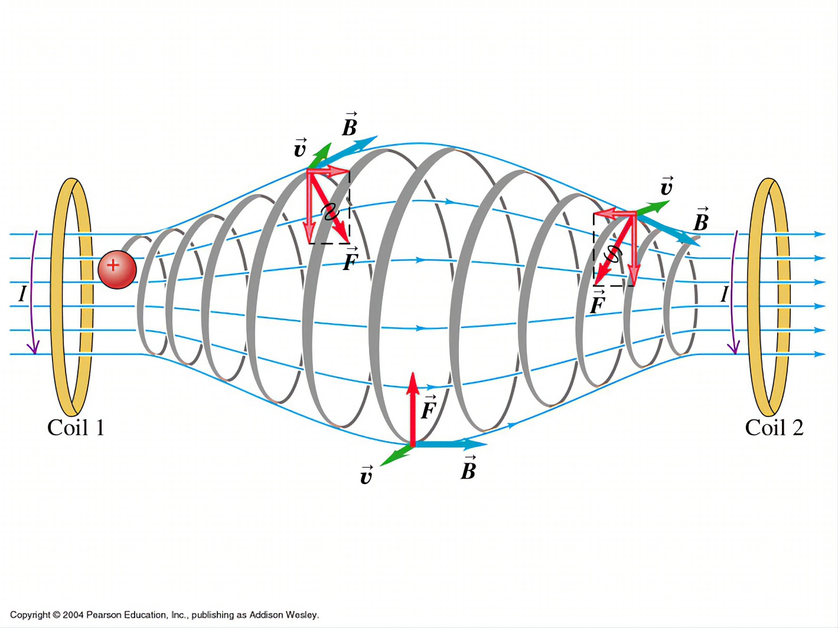
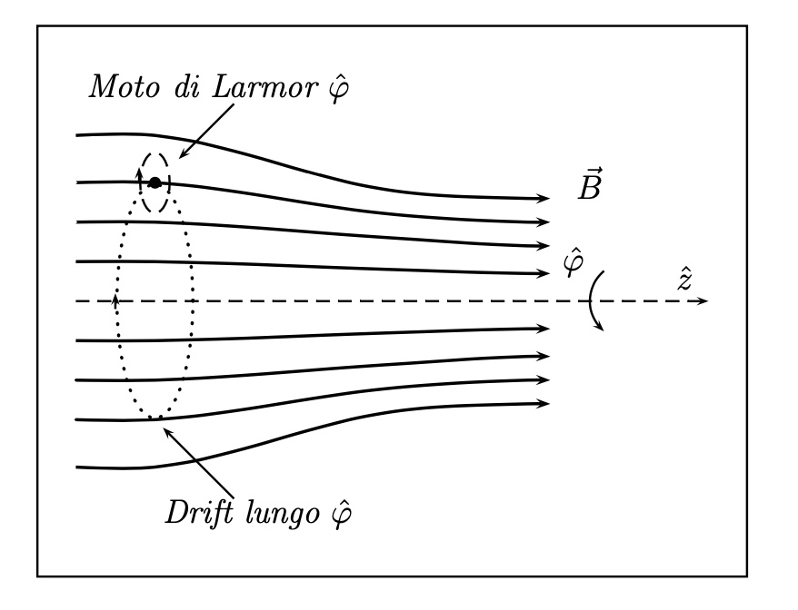
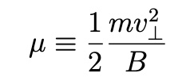
Magnetic confinement
Magnetic fields force charged particles to reduce freedom degrees: electrons spiralyze around the field lines and can be trapped for several milliseconds in mirror machines or toroidal structures
Mirror structures have axial symmetry and can be produced using SC coils. Commonly used in ion source field.
To produce trapping:
Magnetic field should display a gradient in a direction parallel to the field lines
In a simple mirror the field has a radial component
Magnetic moment :
Mirror effect
Loss cone

Slide 14
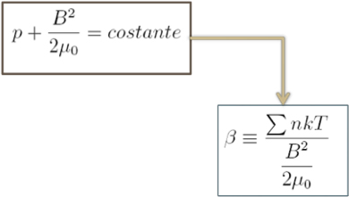
Magnetic confinement
The ideal confinement requires some stringent conditions on plasma equilibrium and stability
Plasma can also be viewed as a fluid. Therefore the confinement and its equilibrium and stability can be investigated by looking to the equilibrium between the plasma kinetic pressure and the magnetic confining field pressure
The stability of the confinement can be studied as a function of the β parameter which is the ratio between kinetic and magnetic pressure
The condition for a magnetically stable plasma is β << 1

Slide 15
Plasma heating via Electron Cyclotron Resonance
A plasma in a magnetostatic field behaves as an electrically anisotropic medium
EM wave propagation plays a fundamental role since the plasmas are typically generated and heated mainly through the interaction of the electrons with EM waves
Optimum condition for the energy transfer is achieved in the so-called resonance region for EM frequencies values equal to the cyclotron frequency ω_{B}
High charge state ions are primarily produced by sequential impact ionization: the ions must remain in the plasma long enough (tens of ms) to reach high charge states.
Notes:
When electromagnetic waves of appropriate frequency are beamed into the plasma, the plasma particles absorb energy from the field of the wave and transfer it to the other particles through collisions.

Slide 16
Plasma temperatures in a magnetic trap
Weakly ionised plasma is a mixture of different gases: neutral gas, ion gas and electron gas.
Electrons and ions can have different distribution functions (close to a Maxwellian) and therefore different temperatures.
Under the action of EM field electron gain more energy than ions. Their mean energy will exceed the mean energy of the ions and neutrals T_{e} >> T_{i} , T_{n}
In plasma temperatures are measured in eV kT = 1 eV corresponds to T = 11600 ºK
Typical values are:
kT_{e} = 1…..10⁴ eV for electrons ( i. e. 10⁴ – 10⁸ Kelvin )
kT_{i} = 0.03 …. 1 eV for ions ( i. e. about 10⁴ Kelvin )
Ions can be considered ’’cold’’

Slide 17
PANDORA PROJECT
The PANDORA project: a new multidisciplinary study
supported by the National Scientific Committee 3 (CSN3) of INFN
Build a new dedicated setup to perform in-plasma studies
for the first time, β-decay measurements in plasmas;
plasma opacity measurements in conditions similar to kilonovae ejecta;
an unprecedented setup for applications: it will be the biggest B-minimum magnetic trap with potentiality as ion source; as testbench for magnetic fusion; as radiation source for Archeometry.
Huge impact on nuclear physics and stellar nucleosynthesis
Heavy elements production in n-star merging
New ion and radiation sources for science and technology

Slide 18
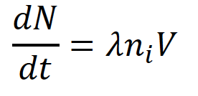
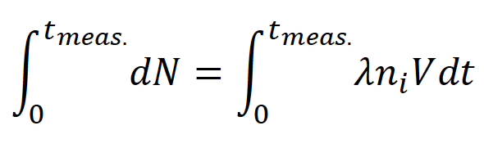
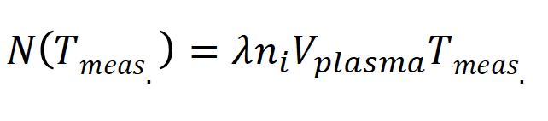
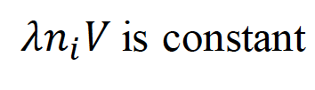
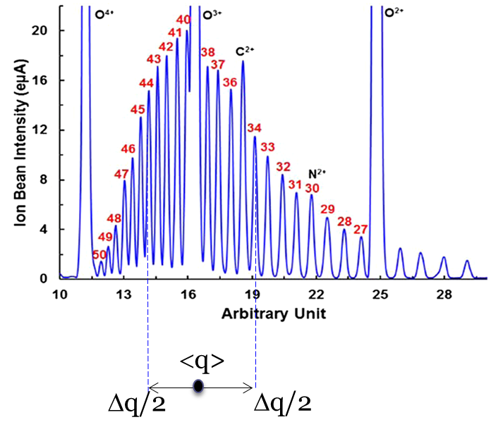
PANDORA concept
Build a plasma trap where ion species are confined in a magnetic field and a plasma is created with:
Electron Density: 10¹² – 10¹⁴ cm⁻³
Electron Temperature: 0.01 – 100 keV
Ion Density: 10¹¹ cm⁻³ (this density values relies on the radiactive isotope concentration in plasma)
Ion Temperature: ~ 1 eV
D. Mascali et al., EPJ web of conference 227, 2020, 01013
D. Mascali et al., EPJ-A , 53, 2017, 7
Gamma-rays emitted by the daughter nuclei after the beta decay will be detected by an array of HPGE
Charge State Distribution f (ρ_{plasma}, T_{plasma})
Plasma volume (const.)
Isotope decay
constant
Density of the isotope in the plasma (const.)
N
τ=1/λ
Plasma parameters to be measured using multiple diagnostic tools
<q>
t
<q>
Remind that q = q(r) in the plasma

Slide 19
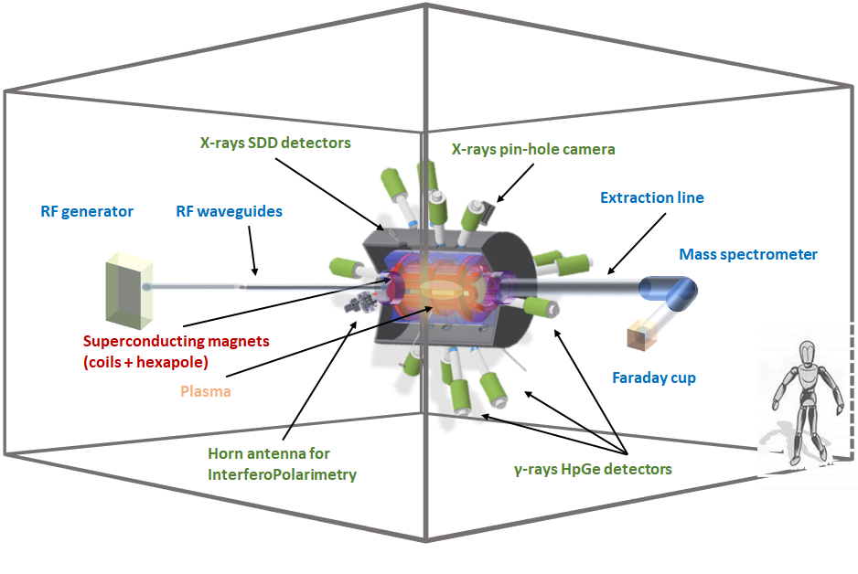
PANDORA design
PANDORA Experimental Setup:
Trap
Detector array
Plasma Diagnostics
Trap

Slide 20
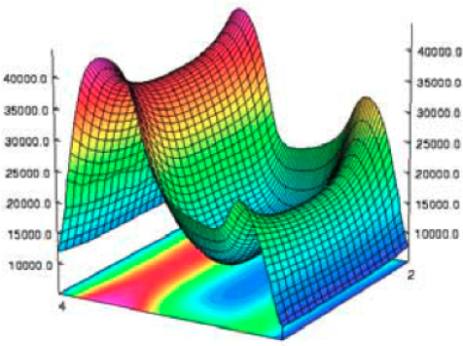

PANDORA design: the magnetic trap
The PANDORA magnetic trap is composed by:
3 superconducting coils for axial confinement
a superconducting hexapole for radial confinement
B_{minimum} Magnetic Field
The so-called minimum-B magnetic configuration produces an axial magnetic field (from the axial coils) and a radial magnetic field (from the hexapole coils) that grows in every direction starting from the plasma chamber center.
Plasma traps design needs to take into account two critical points:
plasma confinement time
magnetic system feasibility
$τ_{i}^{q}$ ~ B_{max}/B_{min}
High charge state ions production: ions must remain in the plasma long enough (tens of ms) to reach high
charge states ( n_{e} x τ_{i} )
since n_{e} $∝$ (ω_{RF})² high operating frequencies are needed

Slide 21
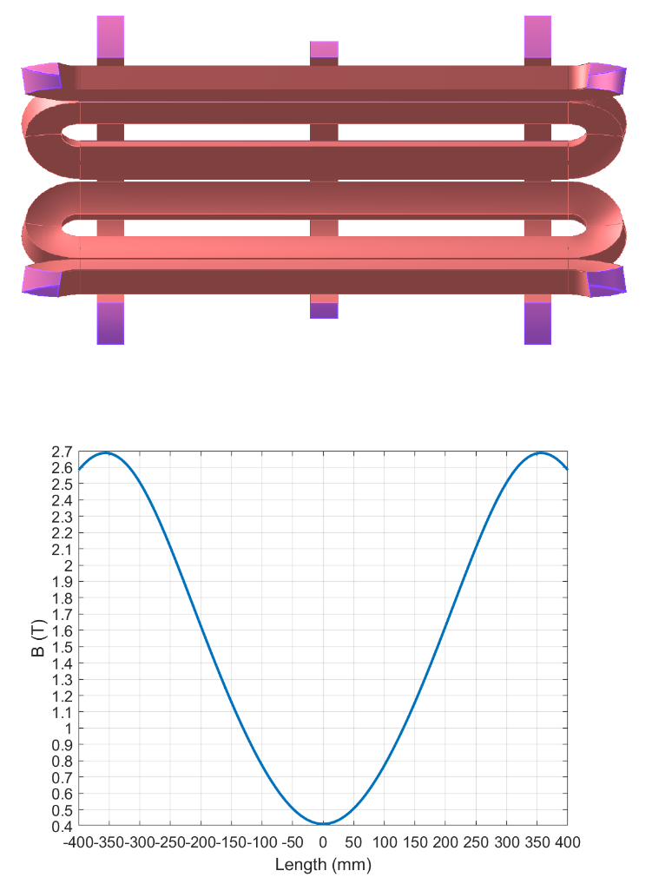
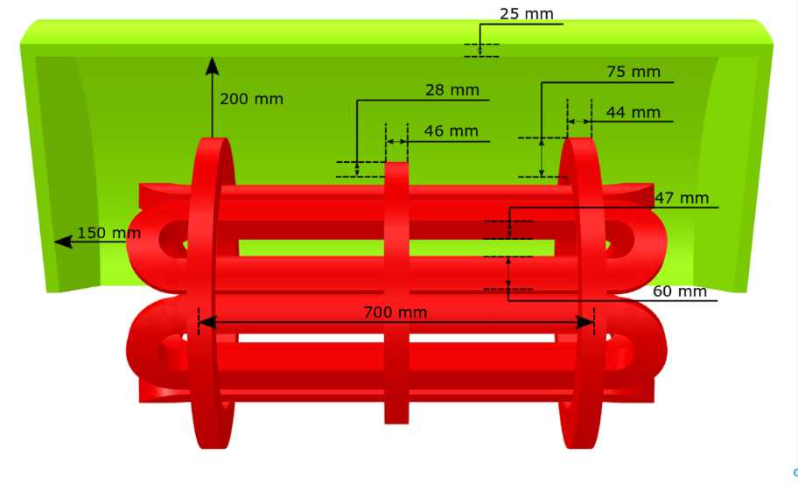
PANDORA design: the magnetic system
The PANDORA’s trap has been designed to operate at 18 + 21 GHz.
The magnetic system will have a length L = 700 mm and a radius R = 300 mm
It will enclose a plasma chamber with inner radius R_{CH_IN} = 140 mm and length L = 700 mm.
The SC coils and hexapole will be made of Niobium-Titanium alloy (NbTi), whose upper critical field is about 10 T at 4.2 K.
MAGNETIC SYSTEM FIELD REQUIREMENTS
B_{inj} max @ z = -350 mm | 3 T
B_{inj} operative range | 1.7 T – 3 T
B_{ext} max @ z = 350 mm | 3 T
B_{ext} operative range | 1.7 T – 3 T
B_{min} @ z = 0 mm | 0.4 T
B_{hex} @ R_{CH_IN} = 140 mm | 1.6 T
LHe | Free
Warm Bore radius | 150.5 mm
The magnetic trap is surrounded by an iron yoke
Coils and hexapole in red with yoke in green

Slide 22
PANDORA design: the magnetic system
Problem: detection array placement around the trap
HPGe detector should be able to ‘’look’’ into the plasma to detect the γ-rays emitted after the beta decay :
minimize the thickness of the material to be crossed by γ-rays
Gamma absorption → detection threshold
Compton scattering → rate on detectors
High Magnetic field region
Detectors cannot stay in a high magnetic field due resolution losses or damage
Critical detector placement
Trap magnetic field shape creates regions of electron focalization where a high background is expected due to electron bremmstrahlung → to be avoided

Slide 23
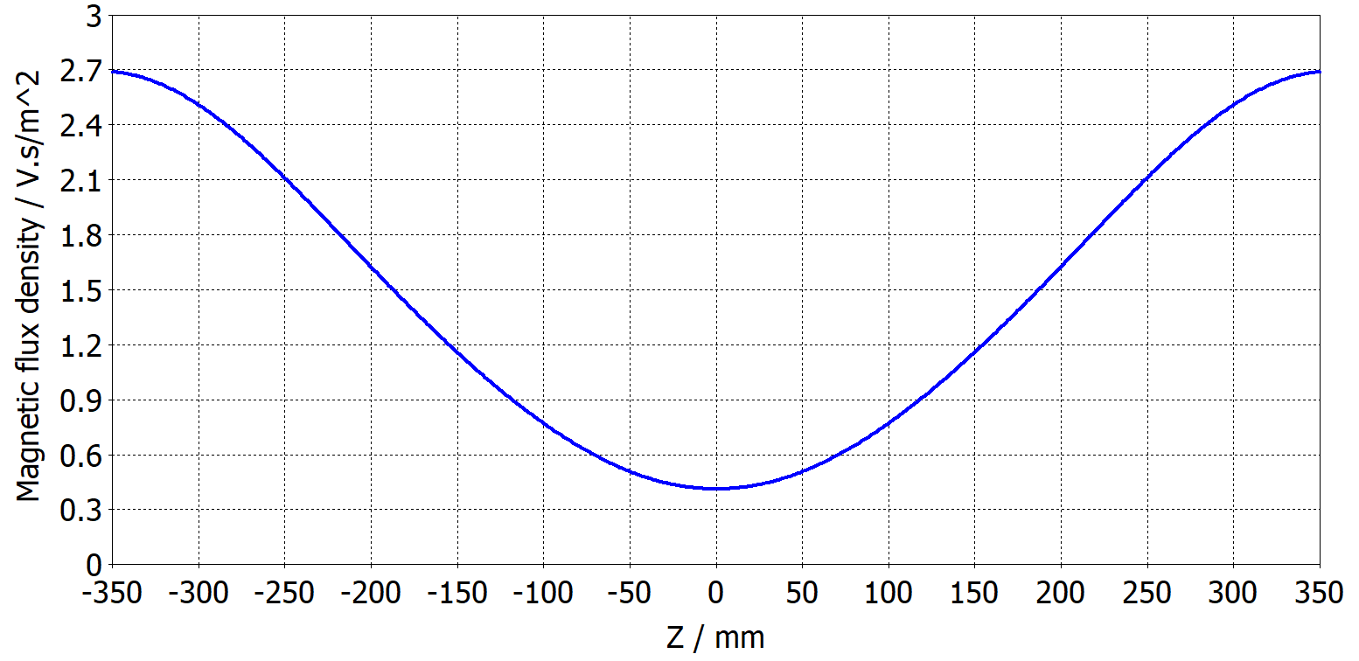
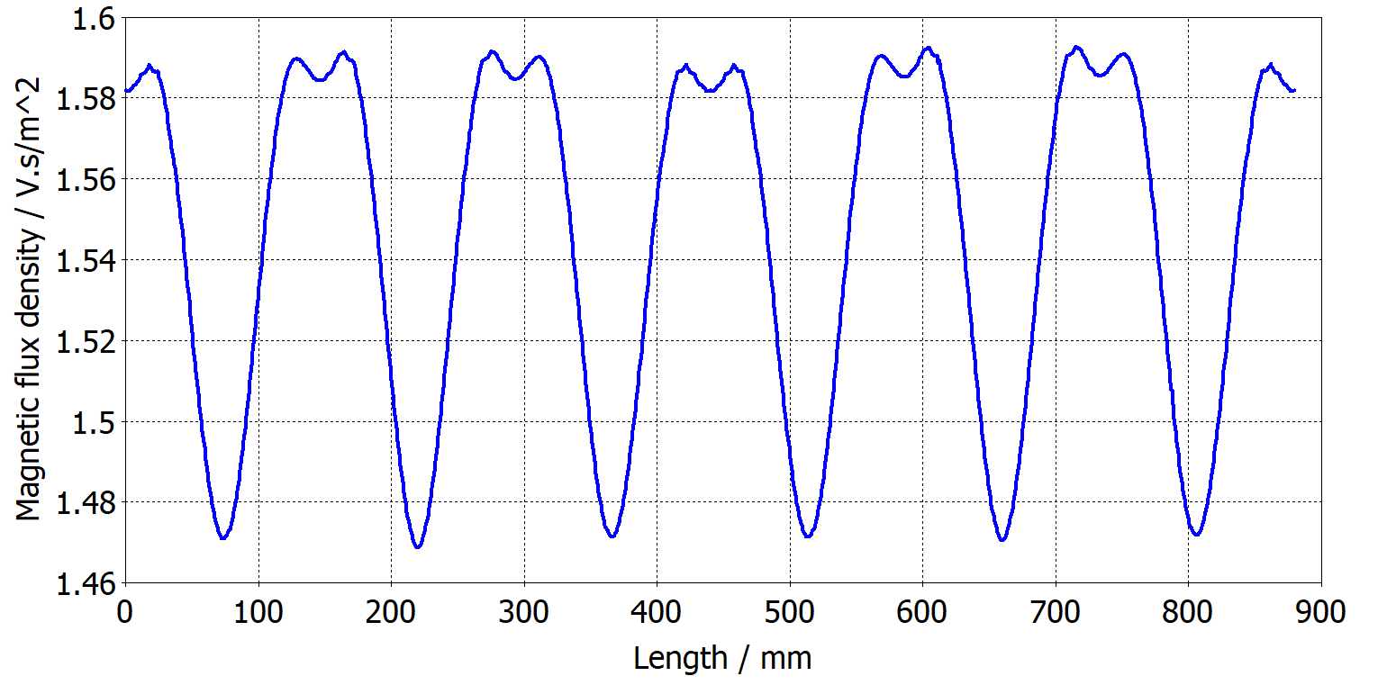
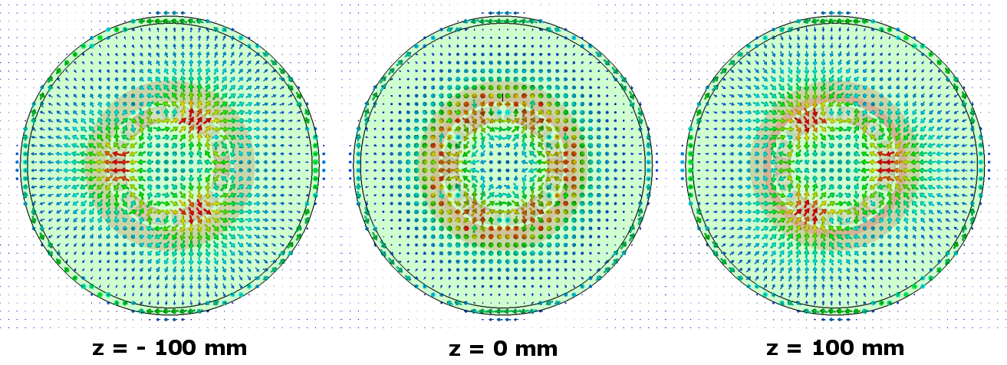
PANDORA design: the magnetic field profile
Axial magnetic field profile
Radial magnetic field profile
Magnetic field profile at different axial positions
In red are shown the regions of high B intensity

Slide 24
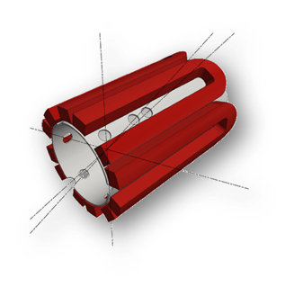
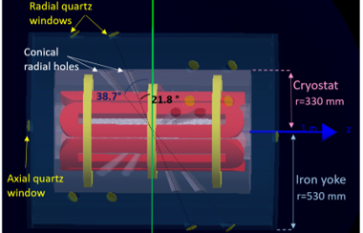
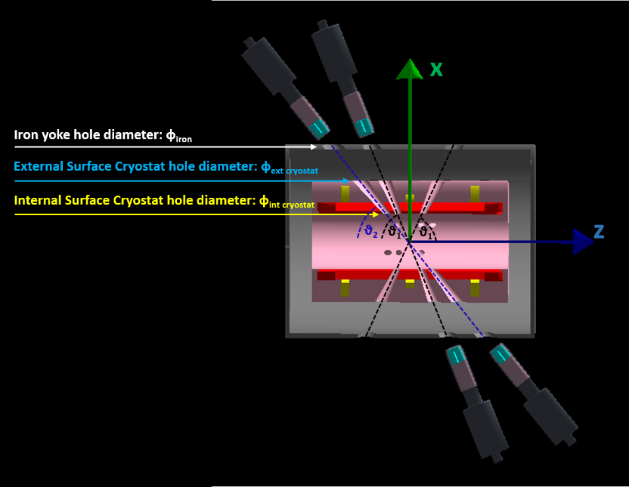
PANDORA design: the magnetic trap
For detector placement and diagnostics purposes, it is needed to keep up to 18 lines of sight between the warm bore radius and the external iron yoke, through the cryostat and the inner cold mass
Reference solution: placing the holes along the axis of each hexapole conductor without intercepting magnetic branches
Each line of sight shall pass through the center of the magnetic system (z=0)
The magnetic trap will employ a single, bulk cryostat that will enclose both the three axial coils and the hexapole.
The cryostat plays also the role of multi-collimator for the HPGe array, suppressing the sources of background arising from photons coming from the walls and not directly from the plasma core, thus improving the signal-to-noise ratio.
Notes:
implies design or innovative solutions and given the impossibility of defining the technical specifications with sufficient precision

Slide 25
PANDORA concept and design
PANDORA Experimental Setup:
Trap
Detector array
Plasma Diagnostics
Trap
Detector array

Slide 26
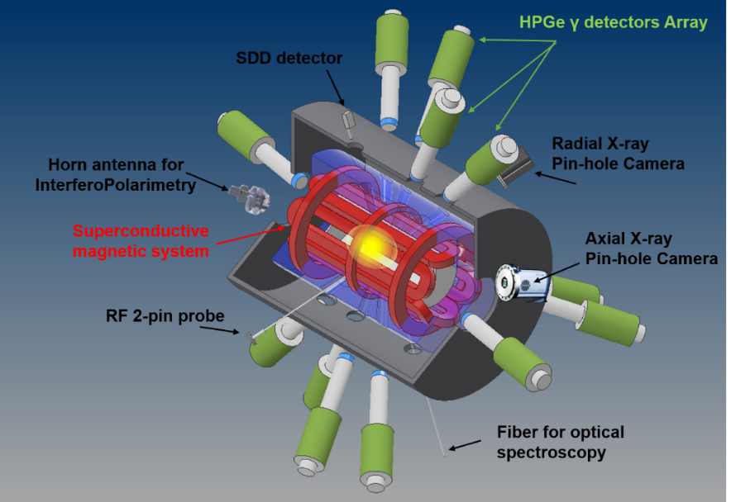
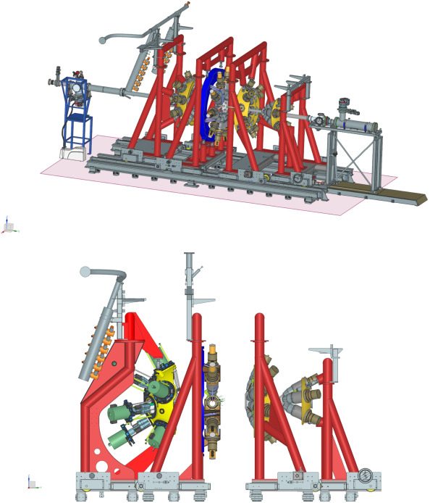
PANDORA design: the HPGE array
Array of 14 HPGe detectors placed around the trap in correspondence to the holes in the magnetic system
Formalized a Collaboration Agreement with GAMMA to use 16 HPGe coaxial detectors of GALILEO for the first experimental campaign
GASP detector specifications:
Average relative efficiency of about 70-80% (size)
Average Energy resolution of 2 keV at 1332 keV (⁶⁰Co)
Relat. eff (%) = K D^{α} L^{β} where K = 2.432
α = 2.815
β = 0.778
Important quantities :
Photopeak detection efficiency
P/T (peak to total)
P/C (peak to Compton)
(P/T)^{n} where n is the fold of the event
The ratio is higher when total absorption is maximized
Can be improved using Anti-Compton Shields
Fundamental role in experiments with high fold coincidences
Peak/Compton
Example: GALILEO array in LNL has a total photopeak efficiency of 4.5% at 1332 keV and a P/T ~ 50%
Notes:
implies design or innovative solutions and given the impossibility of defining the technical specifications with sufficient precision

Slide 27
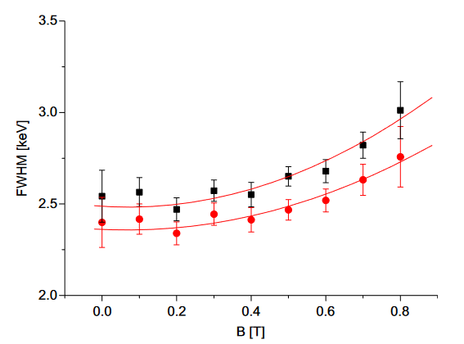
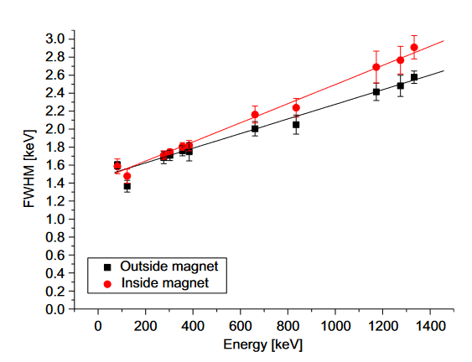
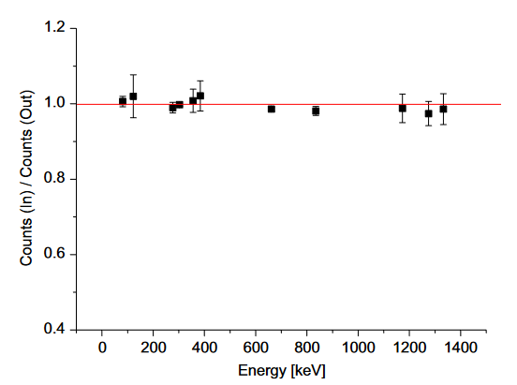
HPGE detectors and magnetic fields
The PANDORA setup will use high intensity magnetic fields (up to 3 T) → need of locating the gamma-ray detectors in areas where the magnetic field is present
Due to the magnetic field effects on the charge carrier trajectories the performances of the Ge crystals could be modified as well as the electronic circuits affected.
Worsening in energy resolution
Possible losses in counting rate
n-type HPGE detector
From K. Szymanska et al. NIMA592 (2008) 486
B = 0.8T
B = 0.8T
1173 keV
1332 keV

Slide 28
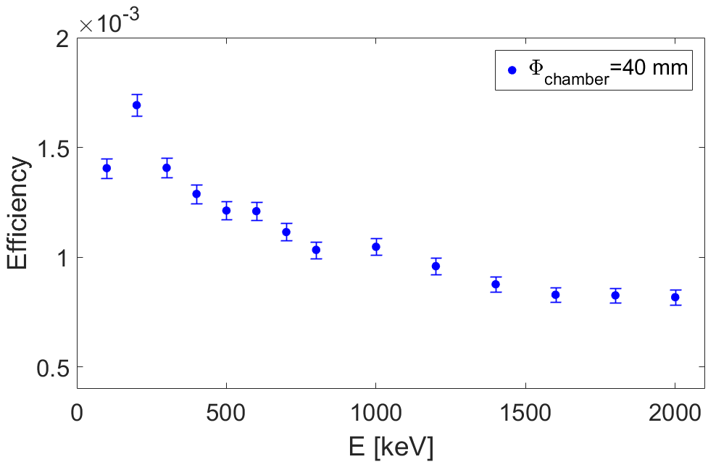
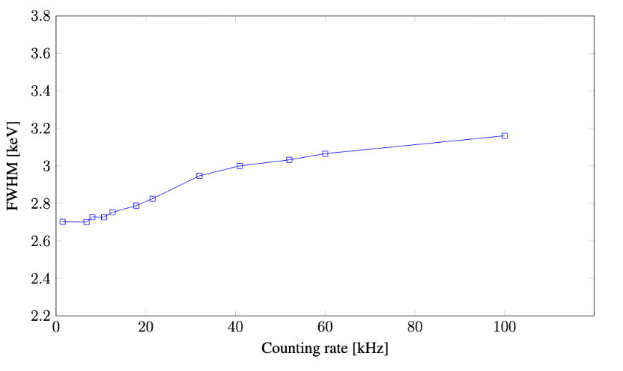
PANDORA design: the HPGE array
Pandora detection efficiency is limited by mechanical constraints
HPGe use is mandatory due to their energy resolution
Total photopeak detection efficiency simulated assuming an extended source (plasma volume of 1500 cm³) ~ 10⁻³
Value of the order of 10⁻³ compensated by the large number of atoms in the plasma makes the measurements feasible
No Anti-Compton Shields around HPGe
No high fold events (run in F = 1 mode)
Detectors will work in harsh experimental conditions (up 50 kHz on each detector) dedicated electronics able to run at high rate will be used
No magnetic field effects on HPGe charge collection (detectors in a region B ~ 200 Gauss
Array detection efficiency
D. Mascali et al. . Universe 2022, 8, 80
HPGe signals are long (rise time ∼ 100-300 ns, decay ∼ 45 μs)
Standard parameters at low rate (≤ 15 kHz) are based on an integration time around 6 μs. Energy resolution of 2 to 2.3 keV at 1332 keV
Dedicated pre-amplifier tested show little worsening of the resolution vs rate
A. Goasduff et al. in print on Front. Nucl. Phys.

Slide 29
PANDORA concept and design
PANDORA Experimental Setup:
Trap
Detector array
Plasma Diagnostics
Trap
Detector array
Plasma Diagnostics

Slide 30
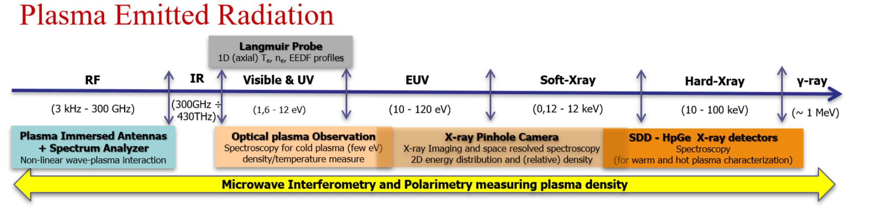
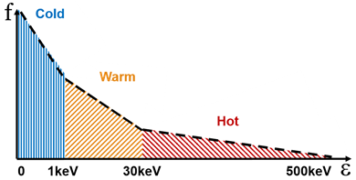
PANDORA design: multi-diagnostics setup
Since the ionization states and charge state distributions are determined by the plasma temperature, at a given density and assuming a certain confinement time, plasma diagnostics plays a relevant role in order to relate the plasma environment properties to the measured lifetimes
on-line monitoring of all plasma parameters (ρ, T, CSD)
investigation of the plasma properties in all energetic domains
performing high-resolution spatial and time resolved analysis

Slide 31
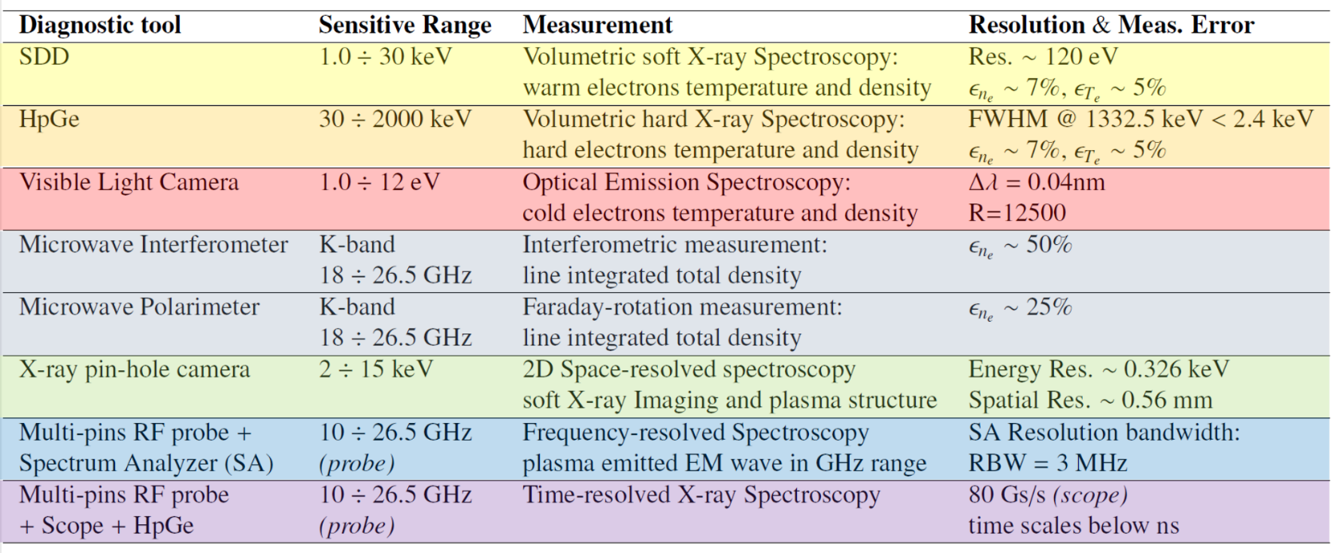
PANDORA design: multi-diagnostics setup
SDD for “warm electrons”: probing volumetric soft X-radiation (2 – 20 keV)
HPGe for "hot electrons”: probing volumetric hard X-radiation (30 - 2000 keV)
OES for “cold electrons”: probing volumetric optical radiation (1 – 12 eV)
Microwave Interferometry and Polarimetry to measure the line-integrated total density
Pinhole camera for high resolution spatially-resolved soft X-ray spectroscopy to investigate plasma structure and confinement dynamics in the range 2 - 20 keV
RF probe + Spectrum Analyzer and/or Scope for time-resolved Spectroscopy
E. Naselli et al., Il Nuovo Cimento 44 C, 2021, 64
S. Biri et al., JINST 16, 2021, P03003
R. Racz et al., Plasma Sources Science and Technology 26, 2017, 7
D. Mascali et al., Review of Scientific Instruments 87, 2016, 02A510

Slide 32
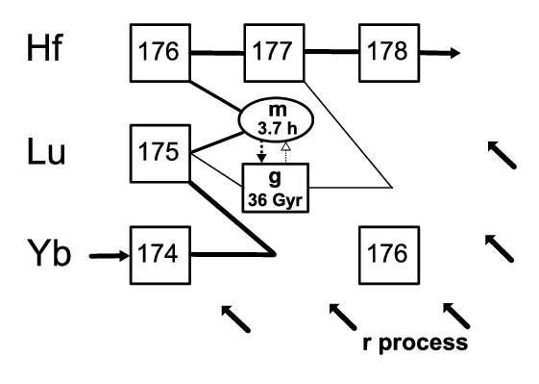
Physics cases
The collaboration with theoreticians allowed to identify of a long list of isotopes (more than 100) of potential interest for stellar nucleosynthesis
¹⁷⁶Lu: lifetime vs. T – theoretical predictions
Three cases were selected for the first campaign of measurements
Isotope | T_{1/2} [ yr ] | E_{γ} [ keV ]
¹⁷⁶Lu | 3.78 · 10¹⁰ | 202.88 & 306.78
¹³⁴Cs | 2.06 | 795.86
⁹⁴Nb | 2.03 · 10⁴ | 871.09
Courtesy of A. Mengoni
Takahashi et al. 1987, Phys Rev C 36, 1522
¹⁷⁶Lu: This nucleus is very long-lived in laboratory conditions and in principle might act as a cosmo-chronometer;
the s-process branching point at ¹⁷⁶Lu is among the most important ones for the understanding of slow neutron captures in the AGB phases of low and intermediate mass stars;
it determines the abundance of ¹⁷⁶Hf, an “s-only” nucleus;

Slide 33
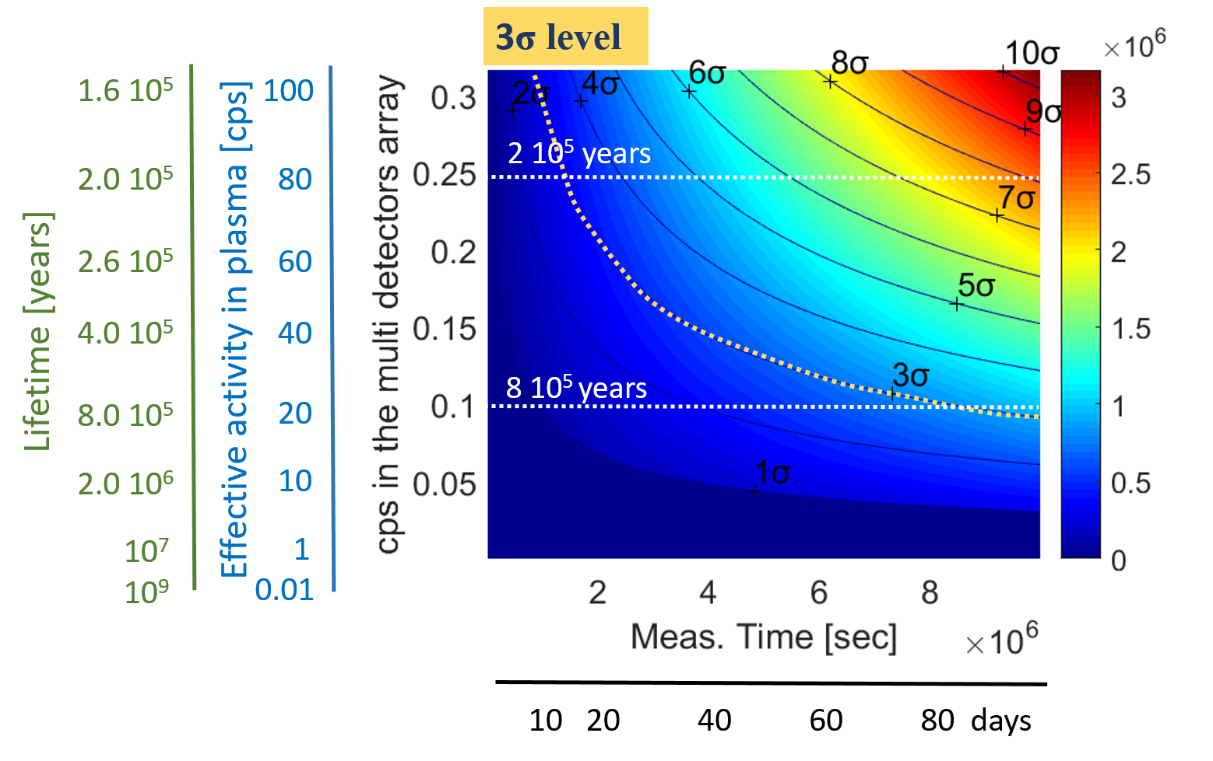
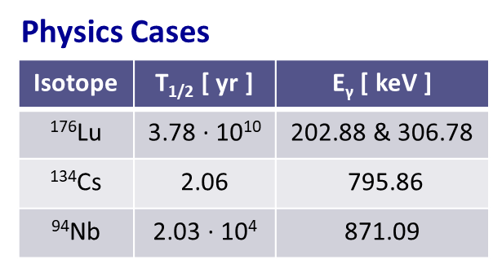
Evaluation of ¹⁷⁶Lu lifetime measurability
“Measurability” of ¹⁷⁶Lu lifetime was evaluated using GEANT4 simulations assuming an array of 14 HPGe-detectors
until 6 order of magnitudes
1% Lu of 10¹³ cm⁻³ (Vp=1500 cm³)
Expected ¹⁷⁶Lu lifetime in the PANDORA plasma
Neutral ¹⁷⁶Lu
3.78 10¹⁰
E. Naselli et al., EPJ web of conferences 227, 2020, 02006
D. Mascali et al., EPJ web of conferences 227, 2020, 01013

Slide 34
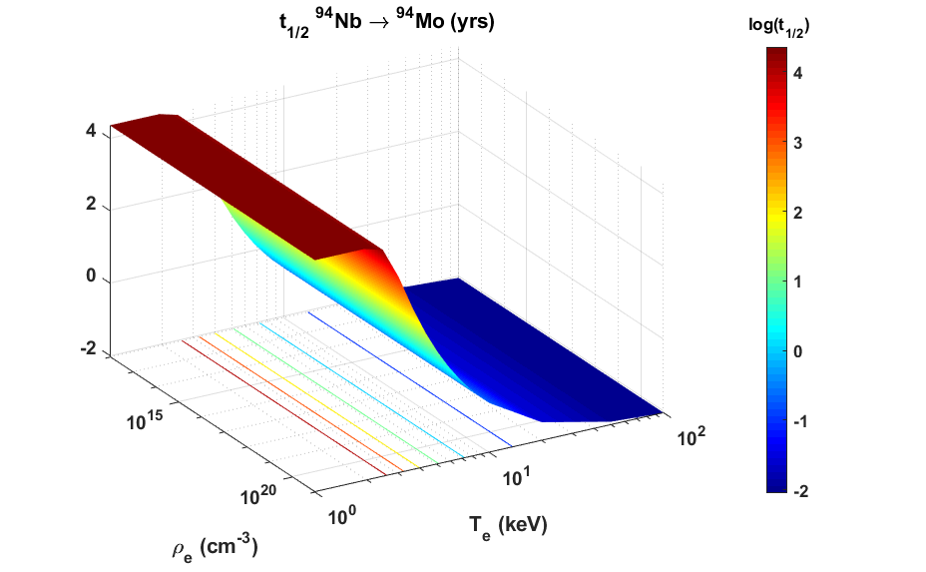
Comparison with theory
Once measured the variation, it can be compared to Takahashi-Yokoi theory (without LTE hypothesis)
Benchmark Takahashi-Yokoi theory
Adapt to stellar atmosphere assuming n_{e} and T_{e} leading to ions in LTE population
T_{e} = 0.1-100 keV in a lab. Magnetoplasma
Variation with T_{e} stronger than with ρ_{e} so “stellar effect” can be modelled in ECR plasmas

Slide 35
PANDORA collaboration
¹ INFN – Laboratori Nazionali del Sud, I-95125 Catania, Italy
² INFN – Sez. di Perugia, I-06123 Perugia, Italy
³ INFN – Sez. di Bologna, I-40127 Bologna, Italy
⁴ INFN – TIFPA, I- 38123 Povo TN, Italy
⁵ INFN – Laboratori Nazionali di Legnaro, I-35020 Legnaro PD, Italy
⁶ Department of Physics, University of Perugia, I-06123 Perugia, Italy
⁷ INAF – Istituto Nazionale di Astrofisica – Osservatorio Astrofisico di Catania, I-95123 Catania, Italy
⁸ Institute of Nuclear Science, ATOMKI, HU-4026 Debrecen, Hungary
⁹ Max Planck Institute – Institute of Plasma Physics, D-85748, Garching
¹⁰ INAF – Osservatorio Astrofisico d’Abruzzo, I-64100 Teramo – Italy
¹¹ Department of Engineering, University of Brescia, I-25123 Brescia,
¹² Department of Physics, University of Padova, I-35131 Padova, Italy
¹³ Department of Electrical, Electronics and Computer Engin., University of Catania, I-95126 Catania, Italy
¹⁴ GANIL, F-14000 Caen, France
¹⁵ Department of Engineering, Mediterranean University of Reggio Calabria, I-89124 Reggio Calabria, Italy
¹⁶ Department of Physics, Jyvaskyla University, FI-40014 Jyväskylä, Finland
¹⁷ Johannes Gutenberg University Mainz, D-55122 Mainz, Germany
¹⁸ Department of Physics, University of Milano, I-20133 Milano, Italy
¹⁹ INFN- Sez. di Milano, I-20133 Milano, Italy
²⁰ Politecnico di Milano, I-20133 Milano, Italy
²¹ GSI – D- 64291 Darmstadt, Germany
²² Department of Physics, University di Camerino, I-62032 Camerino MC, Italy
²³ Agenzia Nazionale per le Nuove Tecnologie (ENEA), I-40129 Bologna, Italy
²⁴ Department of Physics, University of Catania, I-95125 Catania, Italy
²⁵ INFN – Sez. dell’Aquila, I-67100 L’Aquila,
²⁶ Department of Physics, Università di Trento, 38123 Povo TN, Italy
²⁷ CNAO, I-27100 Pavia, Italy
²⁸ Department of Engineering and Architecture, Università di Parma, Modena e Reggio Emilia, Italy
²⁹ Department of Physics, University di Messina, I-98122 Messina, Italy
³⁰ Department of Engineering and Architecture, Universitá degli Studi di Enna “Kore”, I-94100 Enna, Italy
³¹ Università degli Studi di Modena e Reggio Emilia Dipartimento di Ingegneria Enzo Ferrari: Modena, IT
PANDORA in ITALY
INFN – LNS
18 Researchers + 11 Tecnologists
INFN – LNL
4 Researchers + 3 Tecnologists
TIFPA
5 Researchers
INFN – BO
4 Researchers
INFN-PG
4 Researchers
First Experiment Foreseen in 2025

Slide 36
Thanks for your attention

Slide 37
Issues to consider ….
Sources of background:
Radioactive atoms are confined in the plasmoid for a short time (t_{c} < 1 sec) and then will move
away ending their diffusion path on the walls of the trap
Evaluation on the HPGe counting rate due to isotope deposition on the walls of trap
The total amount deposited increases linearly during the experiment
Diffusion path different for neutral anche charged particles
Ions become neutral once deposited on the walls therefore sizeable effect (if any) can be foreseen only for short living nuclei
Preliminary simulations suggests that the effect is small
Evaluation of the effects of the variation of plasma volume on the HPGe counting rate
Optimization of counting rate vs background noise and vs isotope deposition
Evaluate implications on axial detectors which ‘’see’’ a thicker volume
Detailed study of absorber materials to reduce the background rate on HPGe

