Slide 1
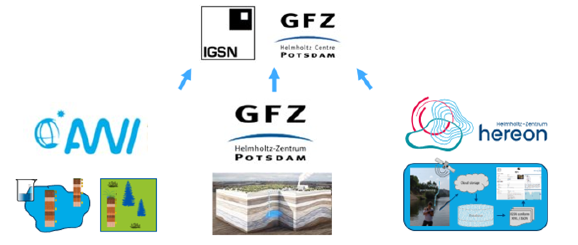
FAIR WISH project – Developing templates to register IGSNs for various sample types in E&E
Mareike Wieczorek*, Birgit Heim, Linda Baldewein, Alexander Brauser, Simone Frenzel, Ulrike Kleeberg, Kirsten Elger
*mareike.wieczorek@awi.de; Alfred-Wegener-Institut Helmholtz-Zentrum für Polar- und Meeresforschung; https://www.awi.de/
Aim
Facilitate sample IGSN registration with a standardized, user-centric template
Introduction
IGSN – International Generic Sample Number
https://www.igsn.org/
https://dataservices.gfz-potsdam.de/igsn-new/
Persistent and citable identifier
Connects sample and online description
Upcoming merge with DataCite
Lists based on recommendations developed in “List of identified linked open data vocabularies to be included in IGSN metadata” (https://doi.org/10.5281/zenodo.6787200)
Dynamic, may be expanded if required
Focus on usability over complexity
HowTo:
Explanations on template use and the “Guide“
Parent, 1.-3. Child:
User generated template for “Parent“ samples and their “(great-grand)-children“ samples (Level 2 to 4)
Sample Type/ Material […]:
Lists with controlled vocabularies
Guide:
Explanations on the variables and possibility to select the variables needed to describe a sample at four hierarchy levels
parent IGSN:
Lake
1. child IGSN:
Sediment core
Status
Customisable, standardised templates for IGSN metadata registration at four hierarchy levels are ready
Only few mandatory metadata fields
Works in Excel and LibreOffice
2. child IGSN:
Core sections
3. child IGSN:
Core samples
Next Steps
Researchers (E&E communities) will test the template
Video-Tutorial + Questionnaire (in prep.)
One on one evaluation with users
‘Is everything understandable?’
‘Is anything missing?’
Want to test the template?
Please contact us:
mwieczor@awi.de
bheim@awi.de

