Slide 1



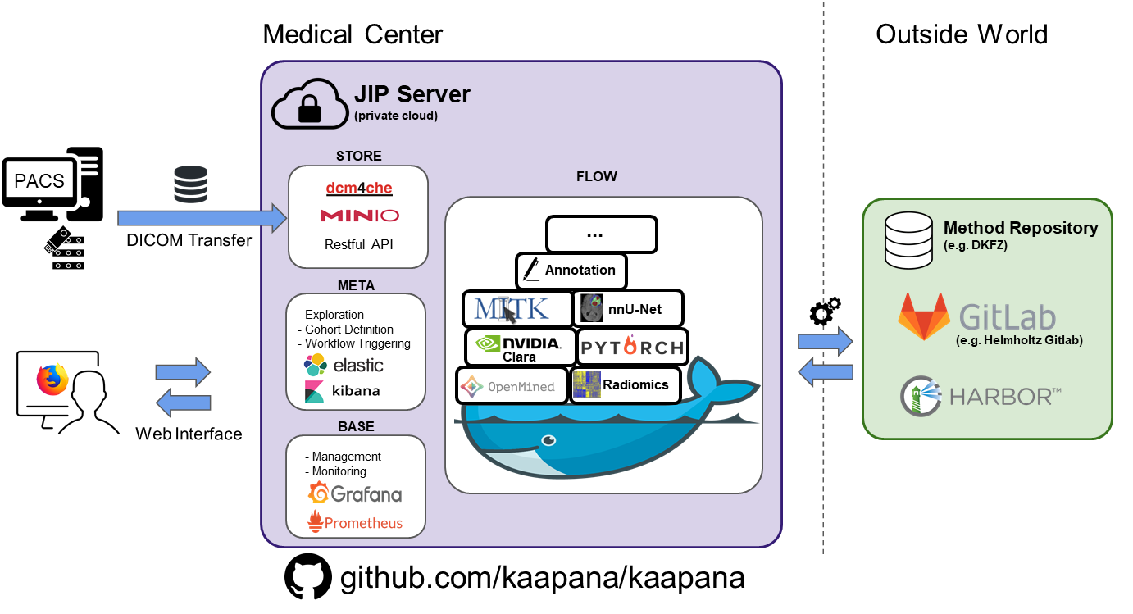
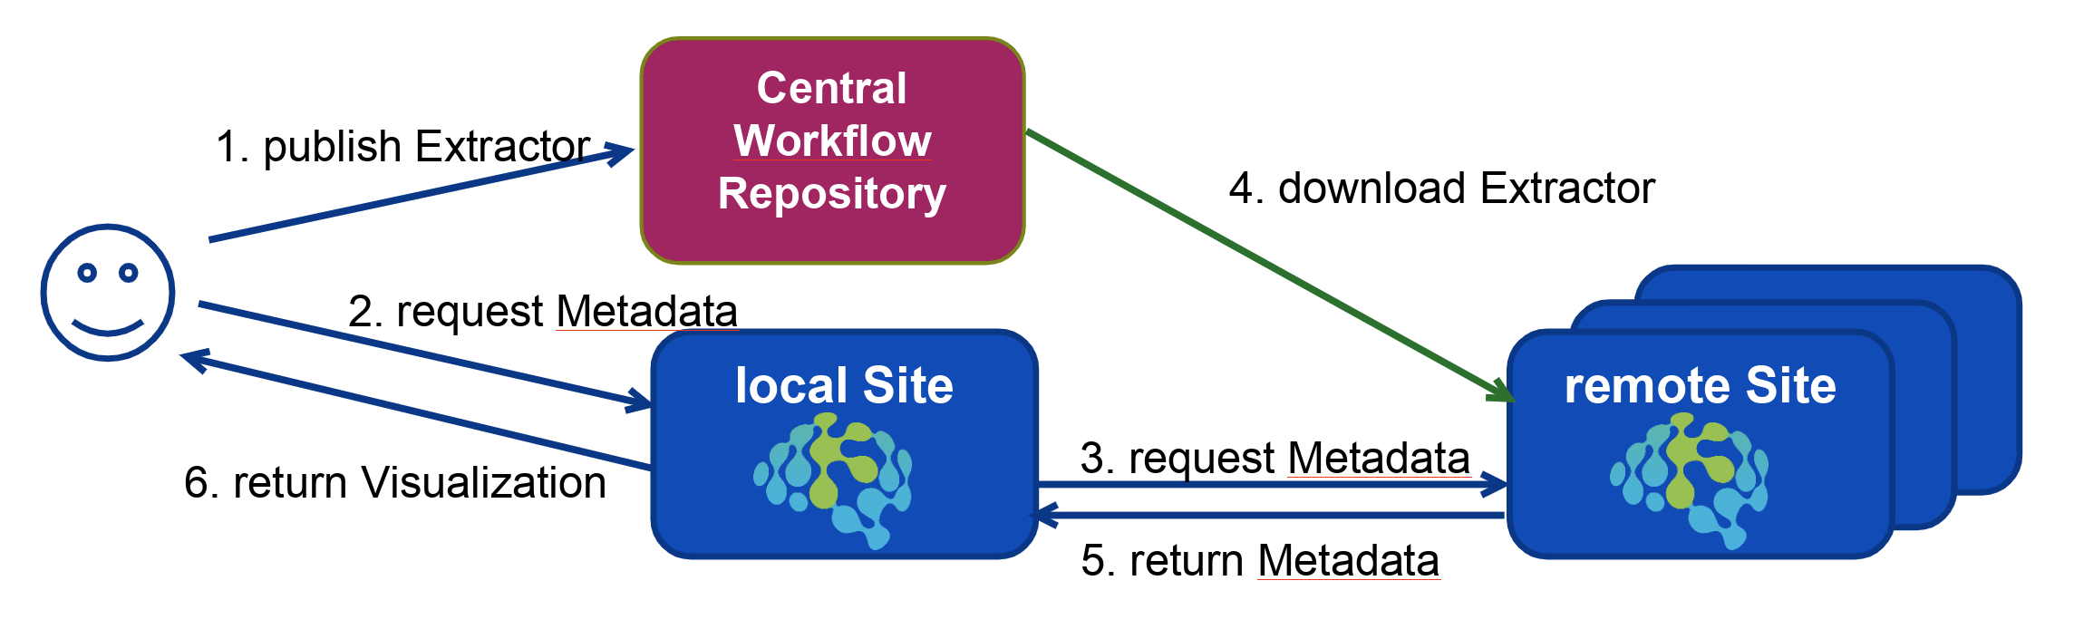

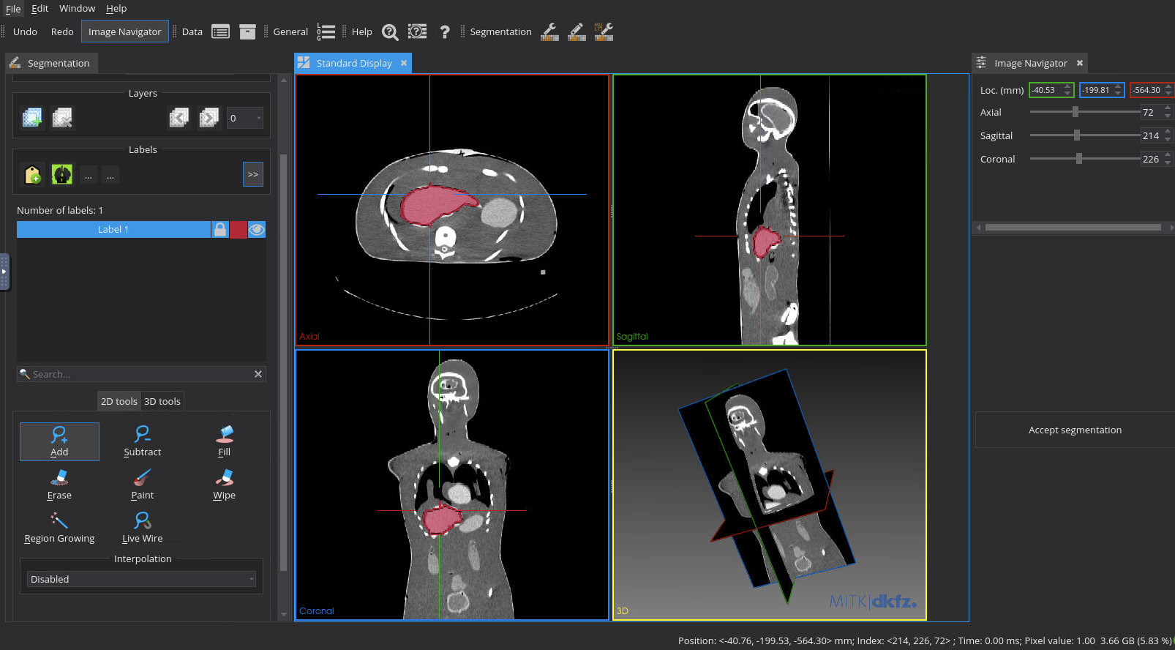
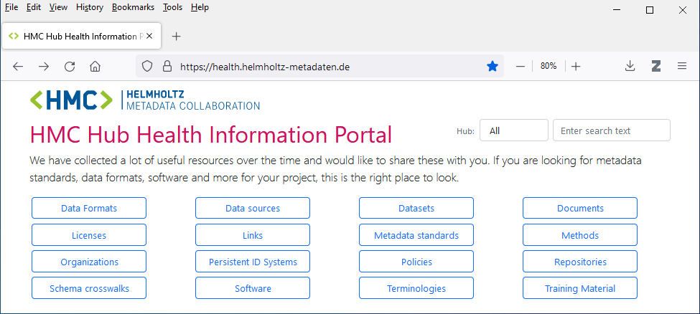
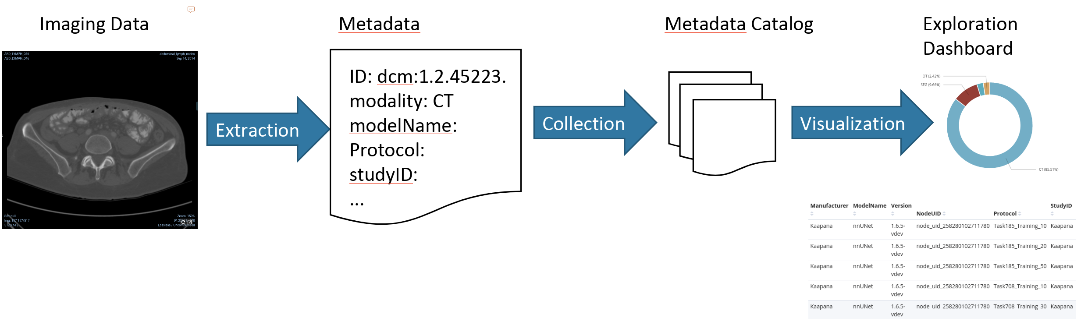
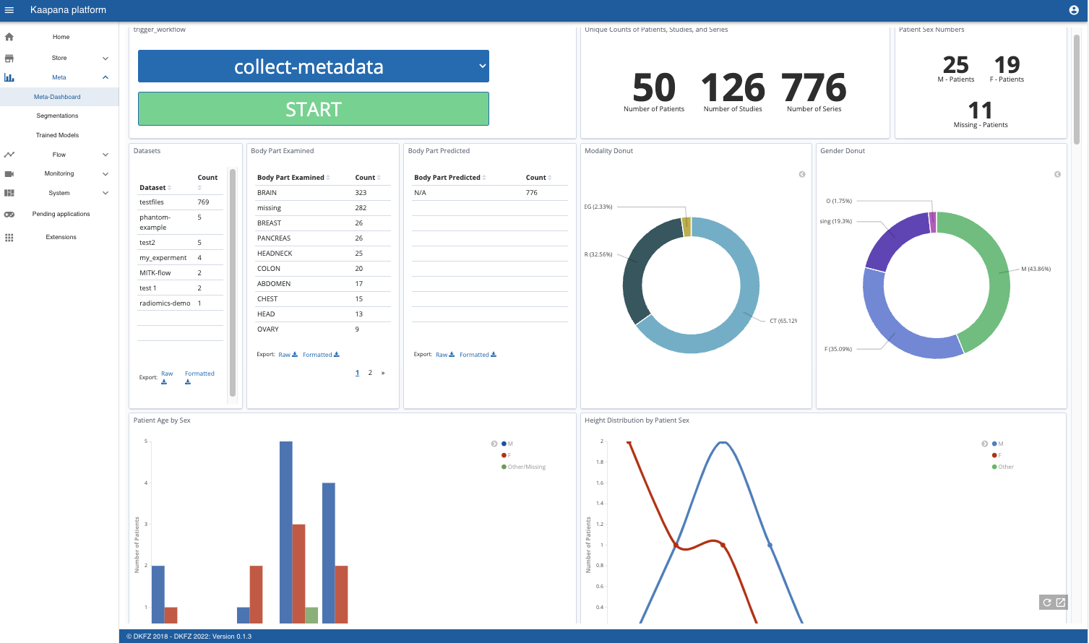
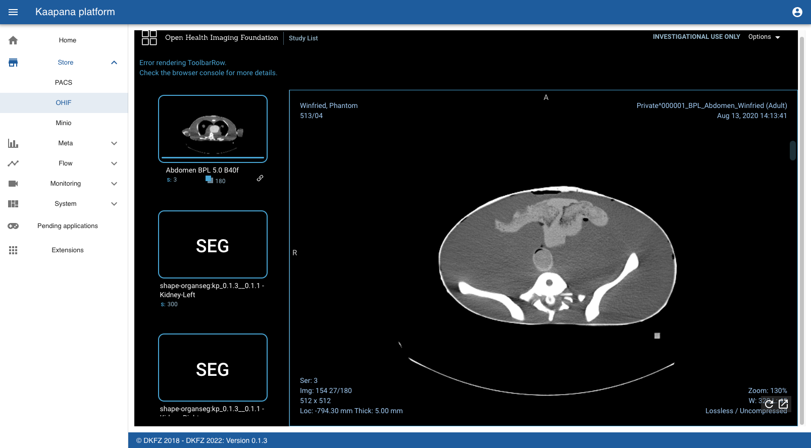
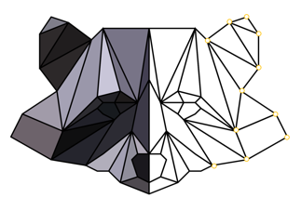

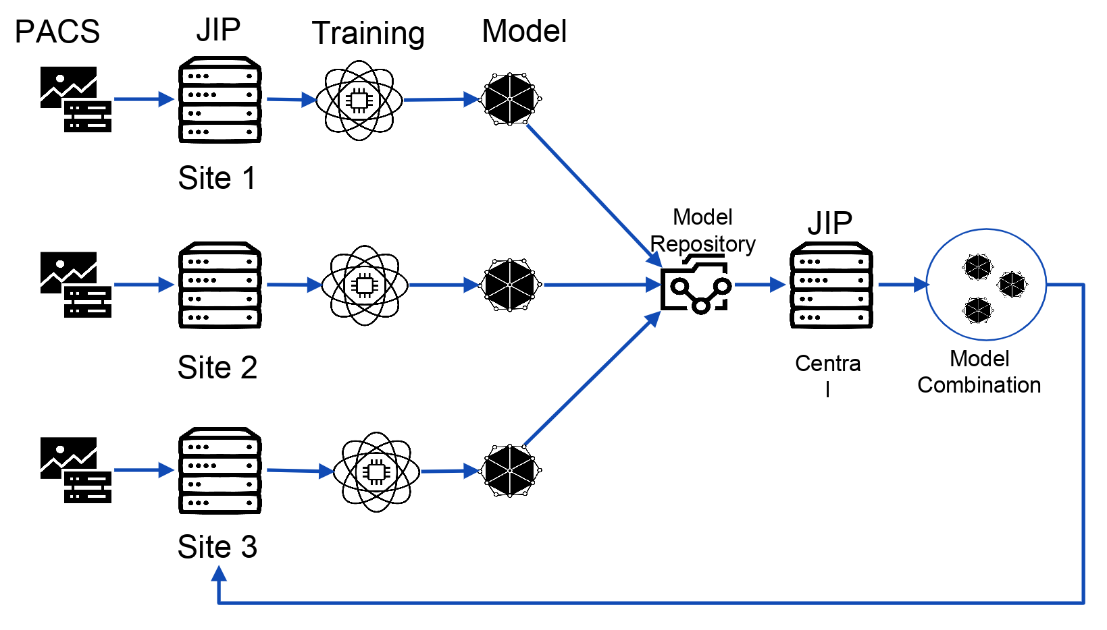


Medical Imaging as a Case Study of the Use of Metadata in Health Research Data Management
Jos Lehmann^{1,2} // Philipp Schader² // Lucas Kulla^{1,2} // Klaus Maier-Hein^{1,2} // Marco Nolden^{1,2}
¹ Hub Health
Helmholtz Metadata Collaboration //
² Division of Medical Image Computing
German Cancer Research Center
(Deutsches Krebsforschungszentrum, DKFZ)
Background
Framework for metadata use cases in health data analysis
Application in Projects
Metadata-enabled functionalities identified in HMC ^{1., 2.}
Data and Metadata Workflow ^{b.}
Architectural base: Kaapana ^{4.}
Discovery
Acquisition
Integration /
Harmonization
Exploration
Integration /
Harmonization
Curation
Analysis
Publishing
Multi-, Inter-, Trans-disciplinary Indexing and Retrieval
Versioning
Provenance tracking
Data Contextualization
Workflow Reproduction
Compliance Assessment
Publication
Machine Learning Trainability and Explainability ^{a.}
Example: segmentation workflow
Medical
Imaging Device
PACS
Picture
Archiving and Communication System
DICOM
Digital Imaging and Communications in Medicine
Manual
Segmentation
Patient
Cohort Selection
Semi-automatic Segmentation
FAIR data sharing
Practitioner
EHR
Electronic Health Record
FHIR
Fast Interoperability Healthcare Resources
Remote Metadata Extraction (e.g. via Hub Health Information Portal and/or BioPortal)
Automatic Segmentation
Discovery
Acquisition
Integration /
Harmonization
Exploration
Curation
Analysis
Publishing
Metadata characterization ^{5.}
Benchmarking the use of health metadata for segmentation in Kaapana ^{4.}
Intrinsic Metadata
e.g. Column Properties, Cardinalities, Patterns, Correlations, Data Rules. Semantics etc.
Extrinsic Metadata
e.g. Provenance, Privileges, Location, Completeness, etc.
References & Literature
Federated Learning
^{3.}
HMC Cross-cutting topic 1 - Mapping, "HMC Community Survey 2021“ 2022.
HMC Cross-cutting topic 3 - FAIR concepts and implementation, "An interpretation of the FAIR principles to guide implementations in the HMC digital ecosystem" 2022.
M. Ligero et al. "A CT-based Radiomics Signature Is Associated with Response to Immune Checkpoint Inhibitors in Advanced Solid Tumors“, Radiology 2021; 00:1–11
J. Scherer et al. "Joint Imaging Platform for Federated Clinical Data Analytics “, JCO Clin Cancer Inform 2020 Nov;4:1027-1038.
F. Schomm-von Auenmüller, "Profiling Data and Beyond: Gaining Insights from Metadata," 05 2018. (Doctoral Dissertation) https://d-nb.info/1213805287/34
RACOON
A. Flynn, C. et al. "The Knowledge Object Reference Ontology (KORO): A formalism to support management and sharing of computable biomedical knowledge for learning health systems" Eur Radiol Exp, vol. 6, no. 29, 2022
H. Kondylakis, E. Ciarrocchi, L. Cerda-Alberich, I. Chouvarda, L. A. Fromont, J. M. Garcia-Aznar, V. Kalokyri, A. Kosvyra, D. Walker, G. Yang and E. Neri, "Position of the AI for Health Imaging (AI4HI) network on metadata models for imaging biobanks," Learning Health System, vol. 2, no. 2, 2018
Acquisition
Integration /
Harmonization
Exploration
Curation
Analysis
https://helmholtz-metadaten.de/en/health/overview
https://helmholtz-metadaten.de/en/health/hub-health-contact
hmc-health@dkfz-heidelberg.de

