Slide 1


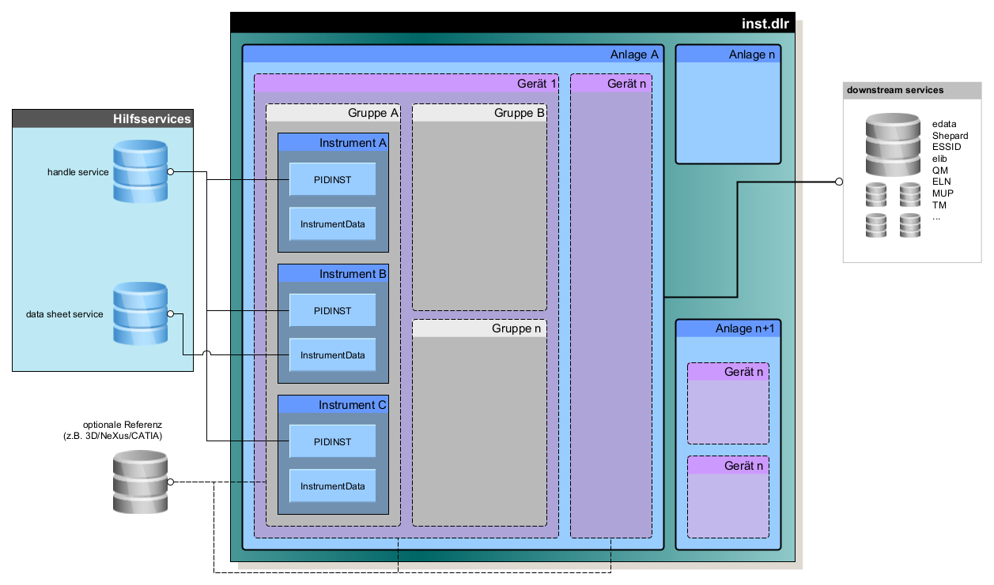




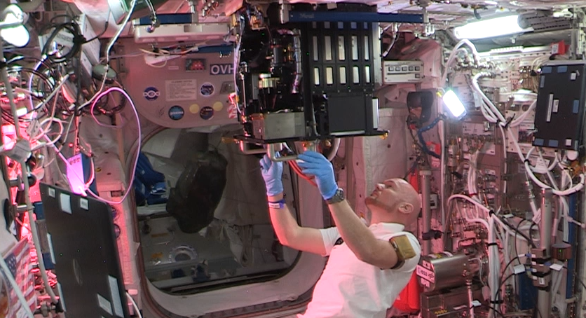
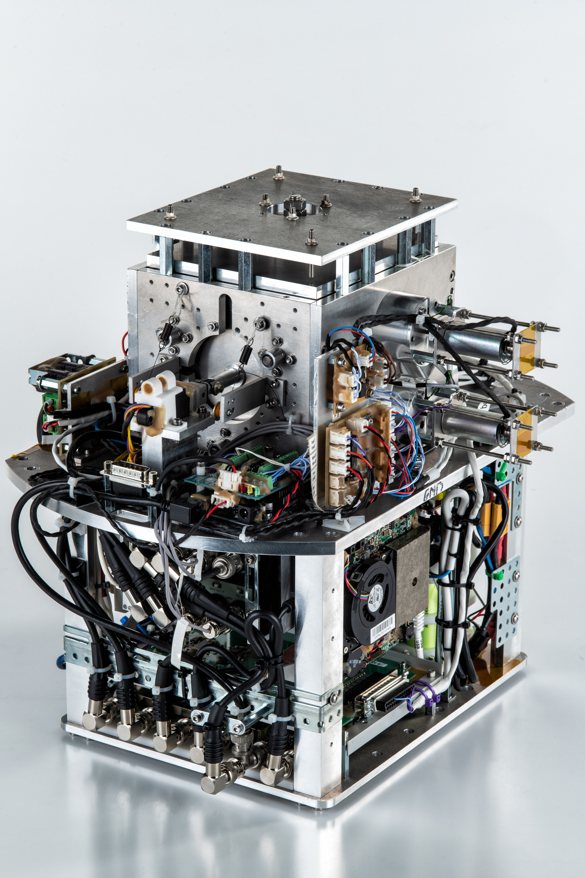
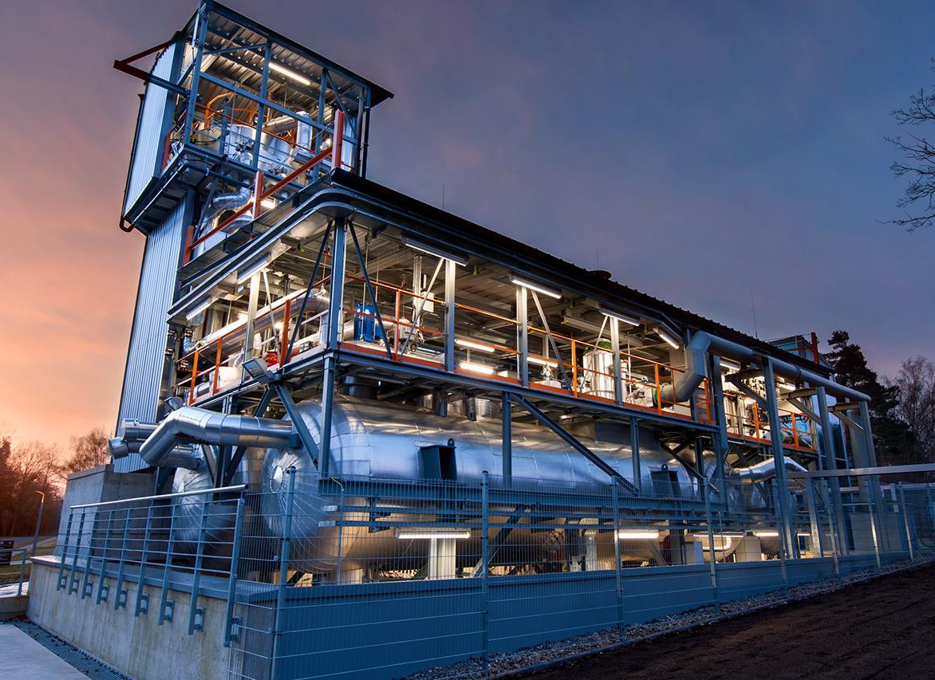
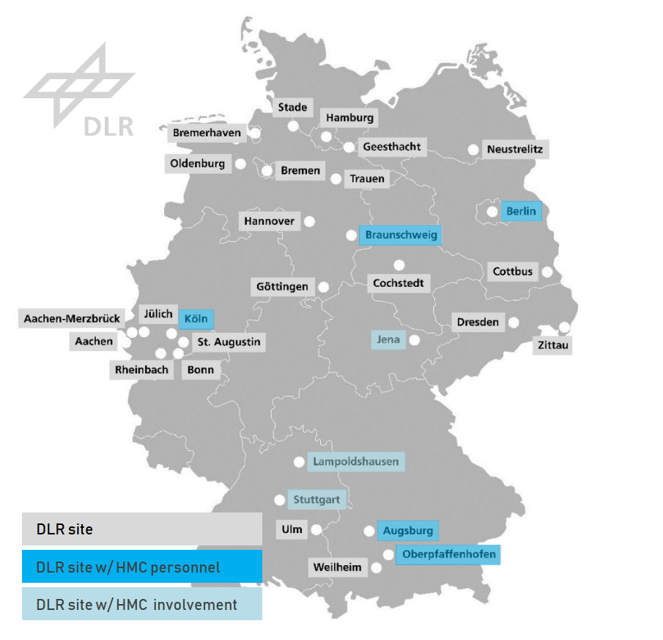
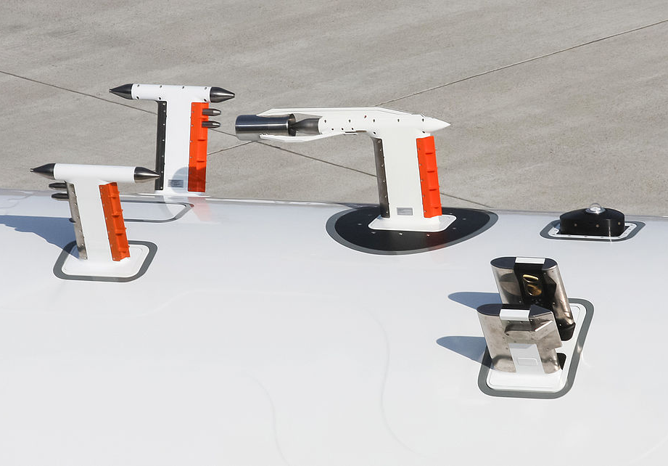
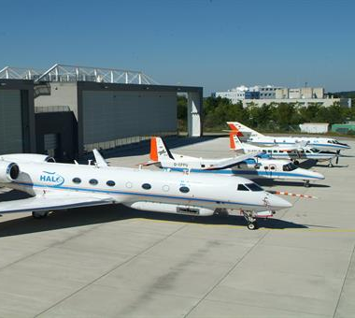
inst.dlr: a semantic instrument database for scientific large-scale facilities
Witold Arndt¹ // Christian Langenbach¹
¹ DLR German Aerospace Center – Research Data Management
Motivation for inst.dlr
Main Technical Challenges
System Structure
Foundation
High-quality metadata is the key to sustainable use and an essential prerequisite for the efficient and reproducible re-use of research data - whether by third parties after publication, by colleagues in the same department or, not least, by the researchers themselves a few years later.
The most efficient solution is to link the creation of data directly with the description and semantically precise linking of machine-readable and schema-compliant metadata.
  Compared to commercial systems:
  Almost always individual items / configurations
  High complexity through modular design
  Iterative changes in set-up and operation
  Long-term usage of components and different life cycles for sub-assemblies
  Components and instruments built by different suppliers and again not off-the-shelf
  Very heterogeneous documentation of components, their maintenance and interactions
  inst.dlr builds upon preliminary work:
  RDO PIDNINST standard
  HZB/HMC RDMinfoPool
  NFDI4Ing OntoHuman
Key points
Pilot Infrastructures
Duration: 2023 – 2025 (36 mo)
Budget:~1 MEUR
Personnel: 3 FTE
Scope: Internal metadata reuse and 3rd party reuse, e.g. technology transfer, marketing, accounting, potentially other research orgs
Implementation: 3 pilot institutes, central IT services
Funding: 100% DLR internal digitalisation programme (PK-D)
Main Organisational Challenges
The instrument as the central element in the data model is referenced via PIDINST and provides further metadata as InstrumentData. The two help services for handle and data sheet are connected.
Via an API, metadata of the system, devices, groups or instruments can be passed on to internal or external services with controlled granularity.
  Unclear and heterogenous processes for data retention and data exchange
  Concerns regarding data protection and secrecy, NDAs, embargoes
  Limited resources for data annotation, scientists’ training
MEGraMa (Magnetically Excited Granular Matter)
Main Organisational Challenges
DLR locations and mission
  Unclear and heterogenous processes for data retention and data exchange
  Concerns regarding data protection and secrecy, NDAs, embargoes
  Limited resources for data annotation, scientists’ training
Increasing complexity, # of interfaces
DLR is the Federal Republic of Germany's research centre for aeronautics and space.
We conduct research and development activities in the fields of aeronautics, space, energy, transport, security and digitalisation. The German Space Agency at DLR plans and implements the national space programme on behalf of the federal government. Two DLR project management agencies oversee funding programmes and support knowledge transfer.
DLR operates 150+ large-scale research facilities, national and international missions and projects at 50+ sites and offices. This is operated and established by 11k employees (5.8k scientists) on a yearly budget of ~1350 MEUR.
Test Fa­cil­i­ty for Ther­mal En­er­gy Stor­age in Molten Salt (TESIS:com)
DLR, inst.dlr and HMC
inst.dlr is a contribution to develop and deploy tools, processes and training in metadata generation, data publication and data re-use for large-scale facilities with a link between industry and research.
HMC / DLR Contact:
Witold Arndt <witold.arndt@dlr.de>
DLR Flight Experiments

