Slide 1

On Using Drilling Data to Interpret Rock Mass Conditions
Marlène Villeneuve
Montanuniversität Leoben, Austria

Slide 2
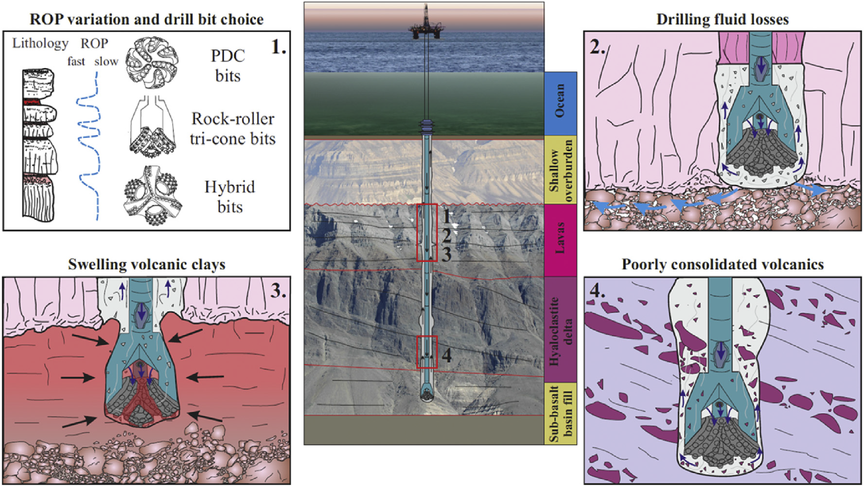
What happens at the well bottom
Millett et al., 2016

Slide 3
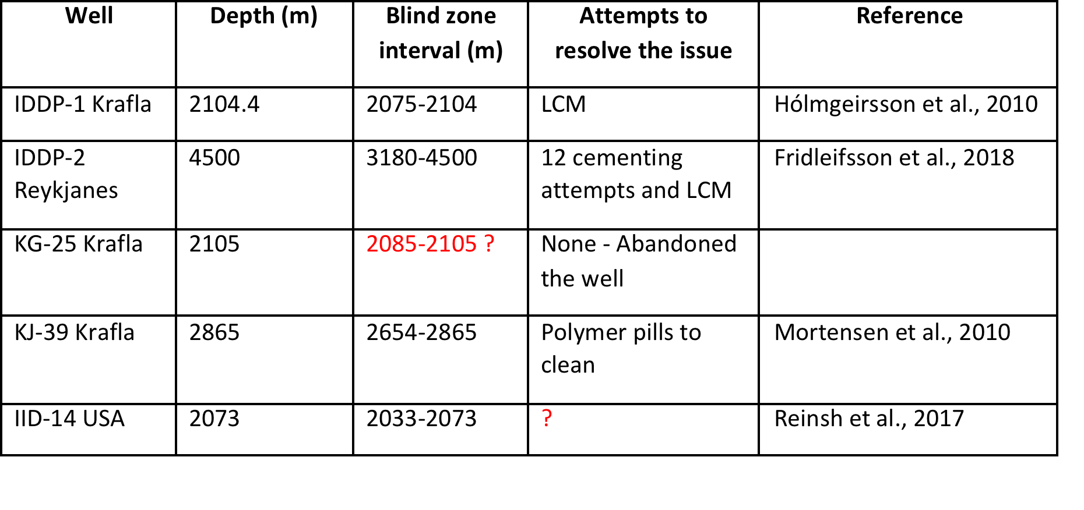
Blind Zones
Millett et al., 2016

Slide 4
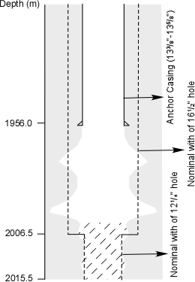
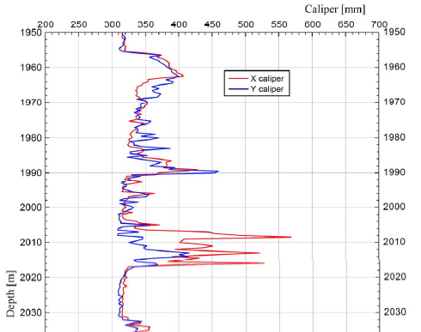
Borehole washout
Millett et al., 2016

Slide 5
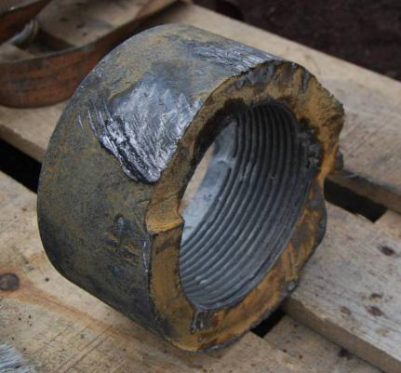
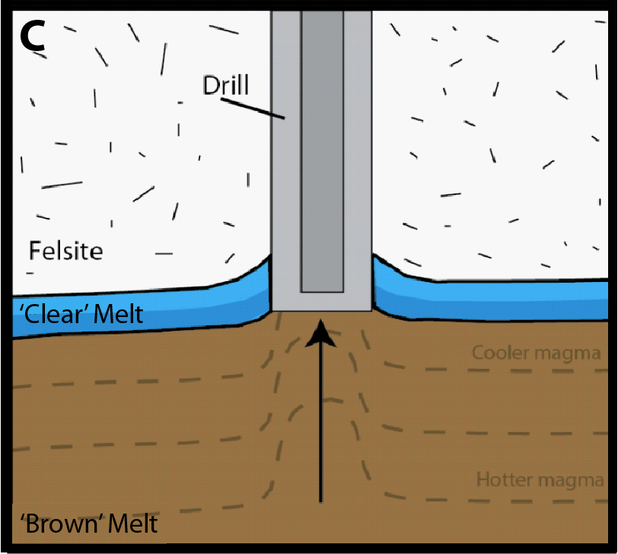
Drilling into partially cooled, extremely viscous magma
High Torque
broken box from 2101 m depth (magma interception)
Millett et al., 2016

Slide 6
Signal Processing - Key Parameters
Rock Mass Rating:
Characterisation of rock mass quality (strength and fracturing)
Feed Pressure (thrust)
Damper Pressure
Rotation Pressure (torque)
Penetration Rate
Water Pressure
Hammer Pressure
Water Flow
Rotation Speed

Slide 7
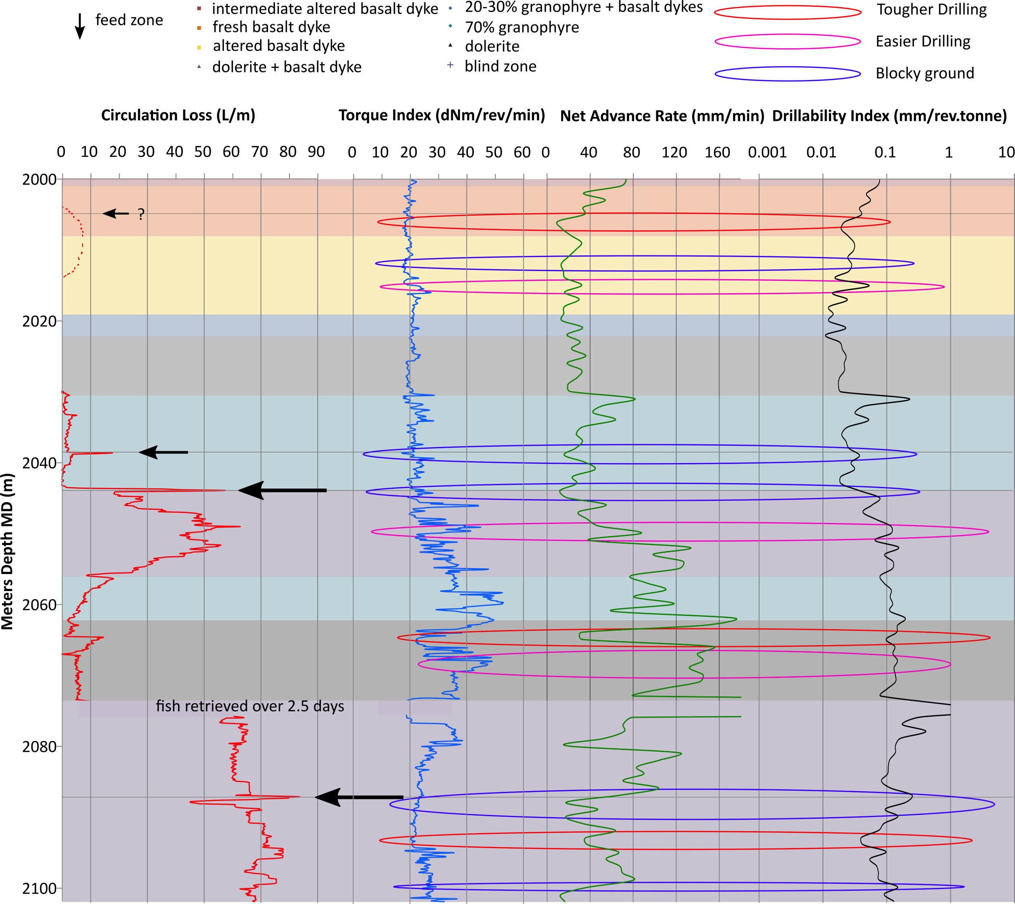
Using drilling parameters to characterise changing drilling conditions

Slide 8
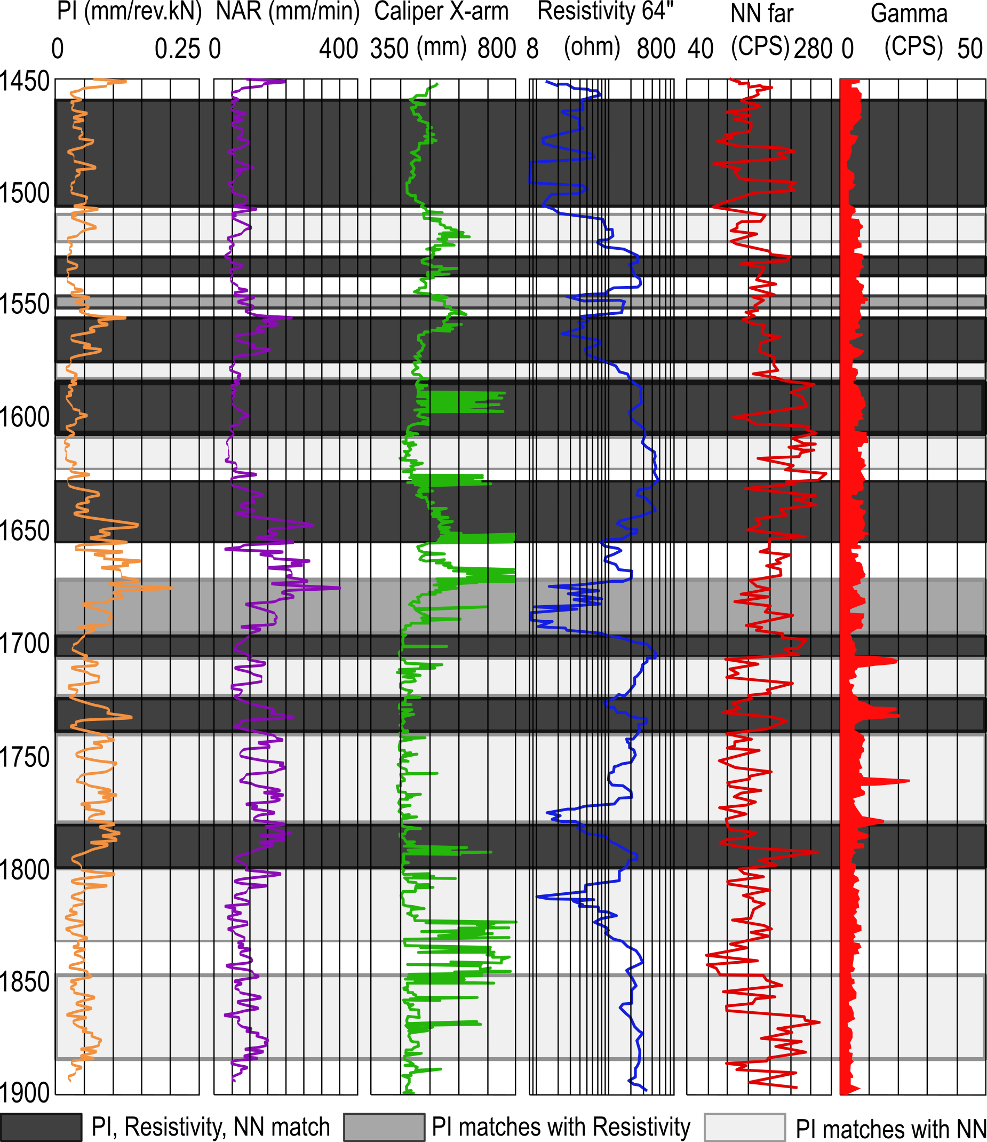
Using drilling parameters and wireline to characterise changing drilling conditions

Slide 9
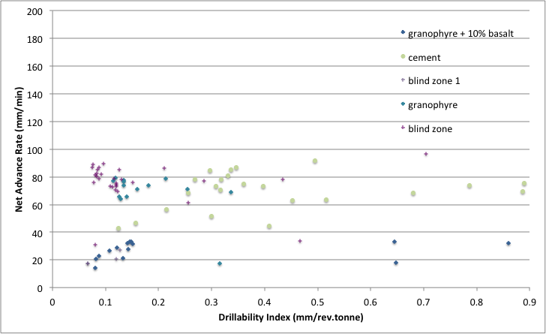
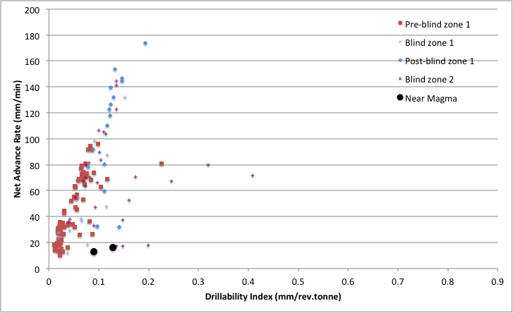
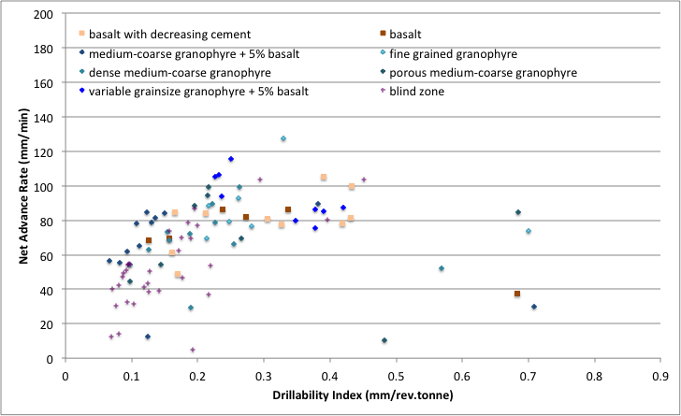
Using drilling parameters to characterise changing drilling conditions
Sidetrack 1
IDDP1
First Leg
Sidetrack 2

Slide 10
Data Processing – Indices and event detection
"normal" drilling range
Lab experiments: Artificial fractures in pre-cast concrete blocks
Artificial fracture

Slide 11
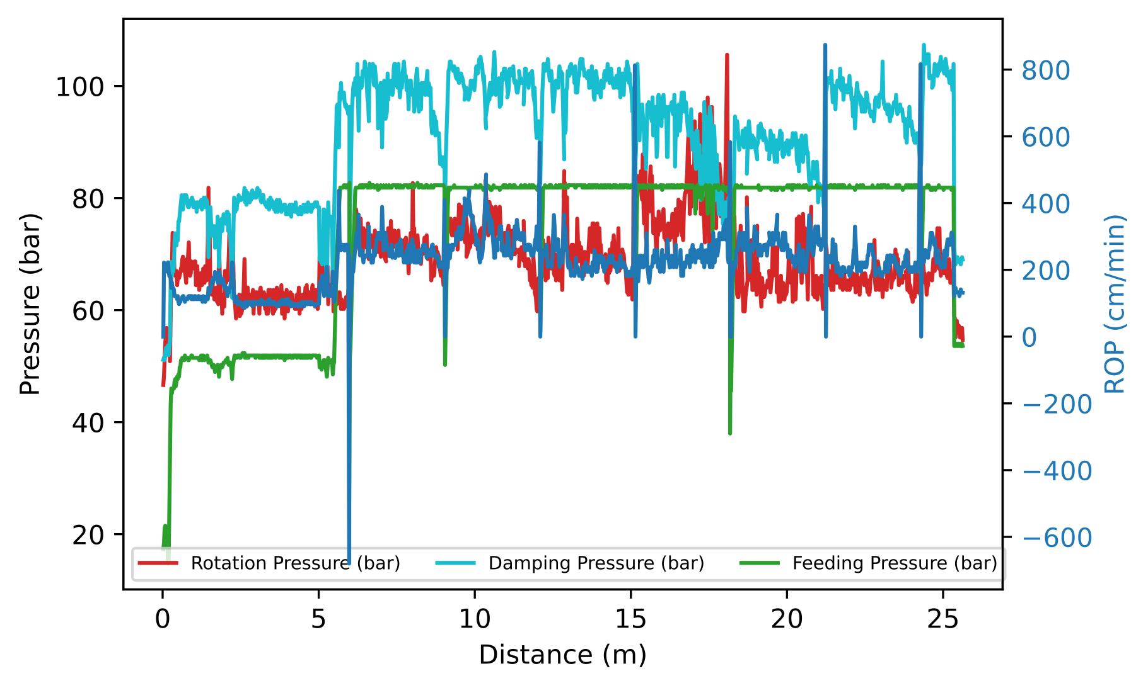
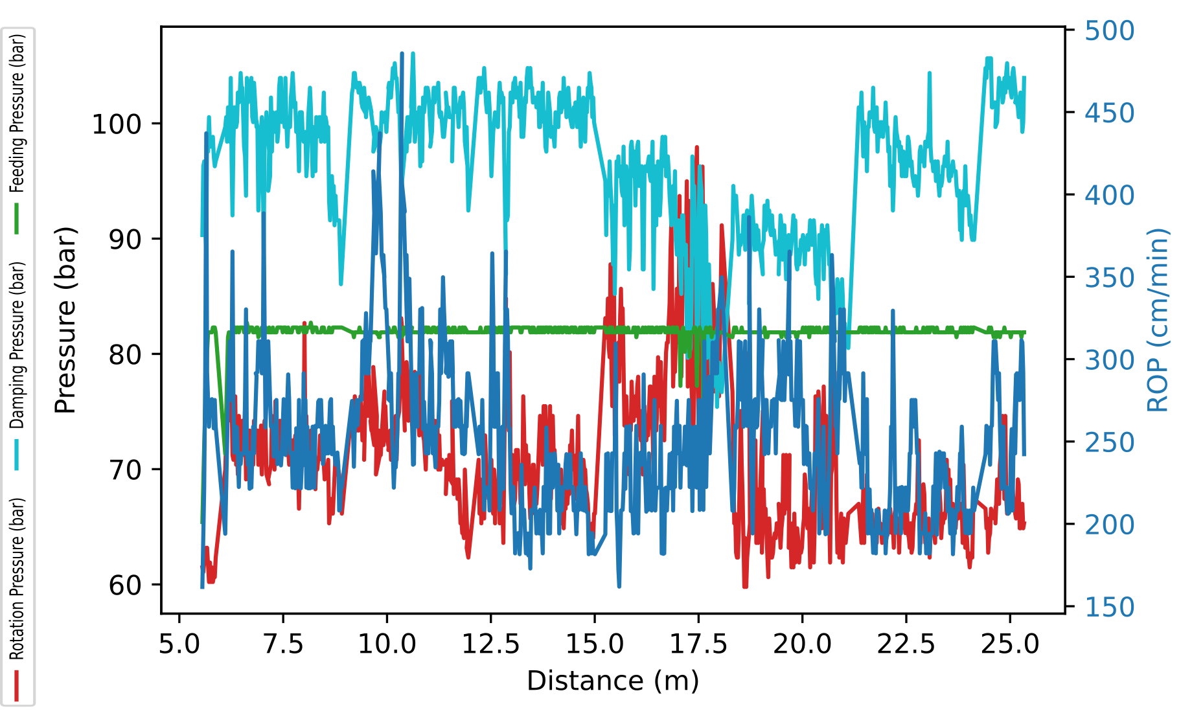
Signal Processing - Filtering
Events?
Event
collaring
Rod change

Slide 12
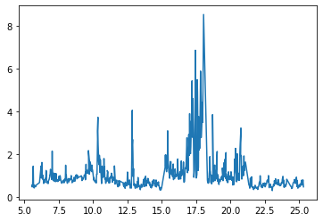

Signal Processing - Indices
Objective is to emphasize the “events”
Modified Drillability Index:
Events
Rotation Pressure (torque)
Penetration Rate (ROP)
$$\frac{{Rotation Pressure}^{4}∙ROP}{{Damping Pressure}^{4}∙Feed Pressure}$$
Damping Pressure
Feed Pressure (thrust)
Liu et al. 2017 method
1. Videos
2.a. Stand der Technik
2.c. Modelisierung
2.b. Verarbeitung

Slide 13
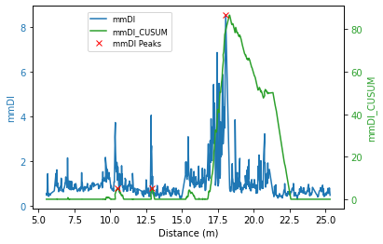
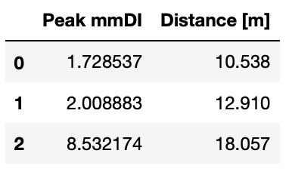
Peak Detection Algorithms
Peak detection using cumulative sums and peak-finding algorithms

Slide 14
Summary
Drilling response has been shown to correlate to changing ground conditions
Several methods exist to compute indices based on drilling parameters
Ongoing development of algorithms to automate event detection
Manual relation of events to observed conditions: cuttings, wireline, fluid losses: requires complete datasets for several wells to develop correlations
Eventual potential to use AI to help identify events, maybe even in real time

Slide 15
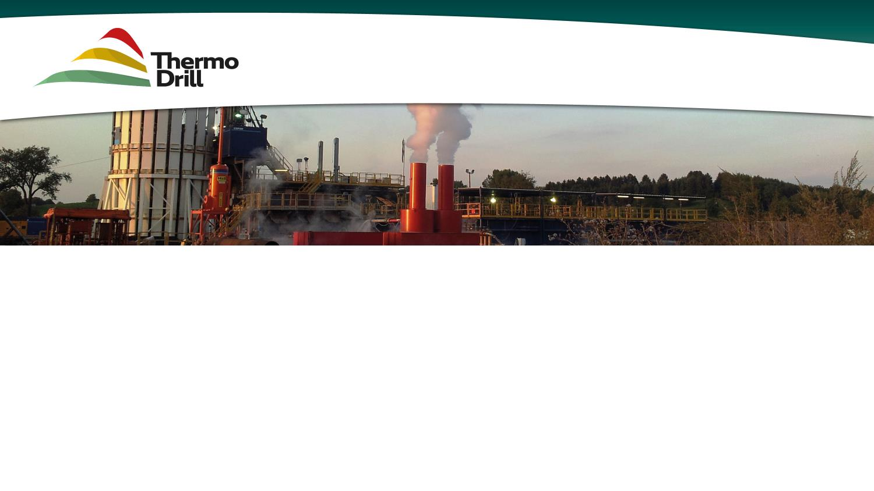










Fast track innovative drilling system for deep geothermal challenges in Europe

Slide 16
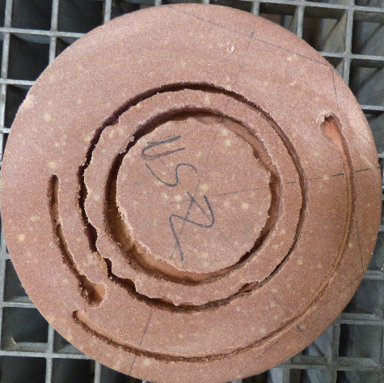
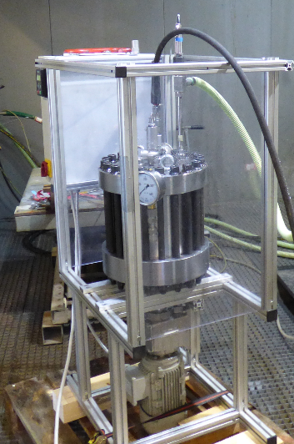
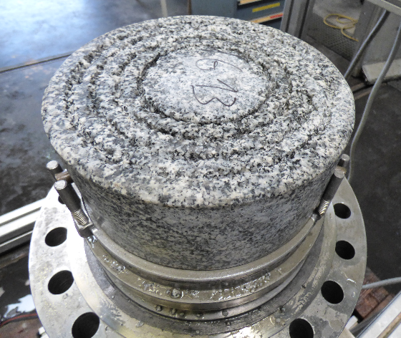
High Pressure Fluid Jetting
Sandstone
Granite

Slide 17
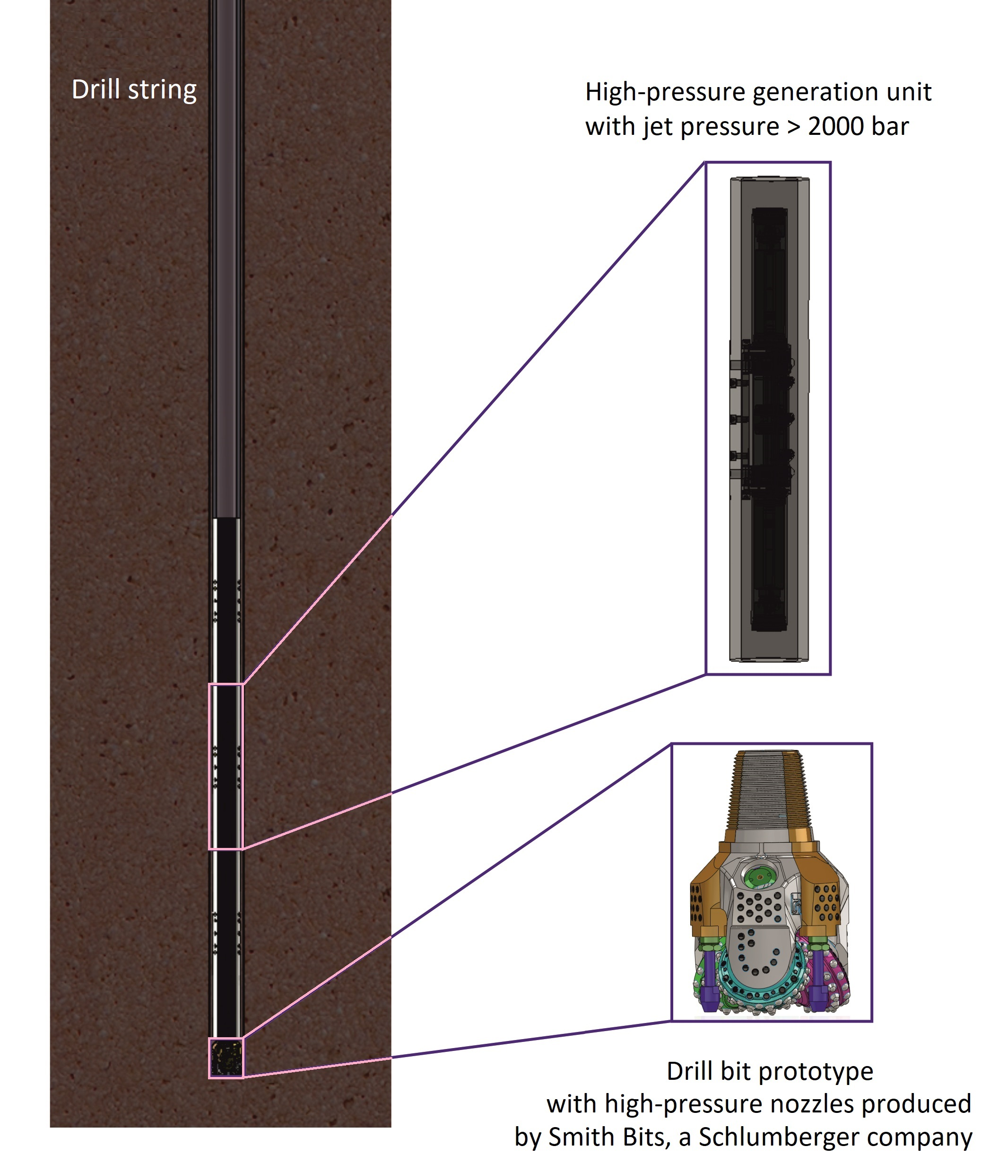
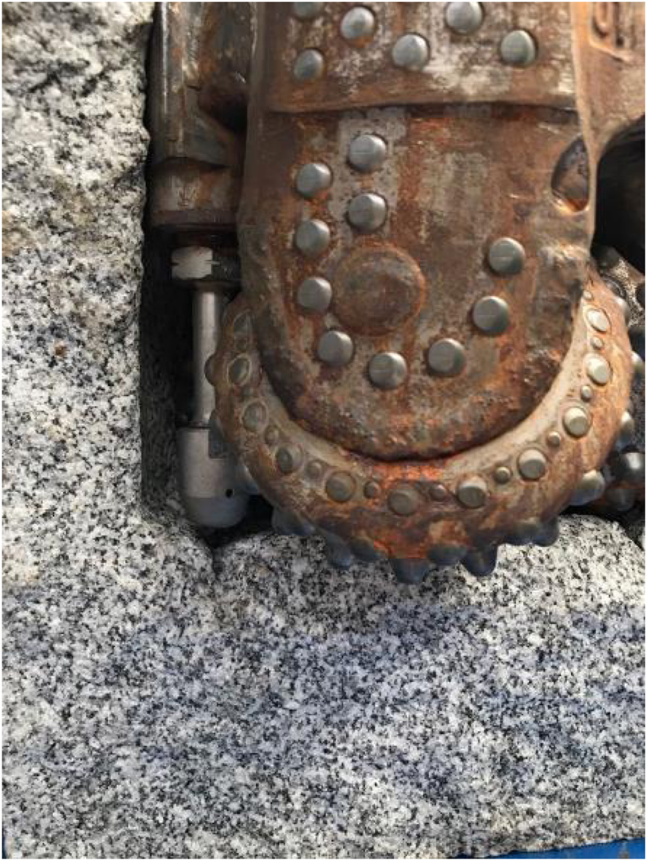
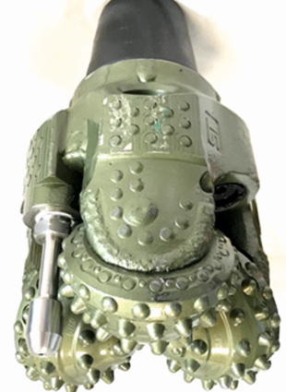
Drilling System Prototype

Slide 18
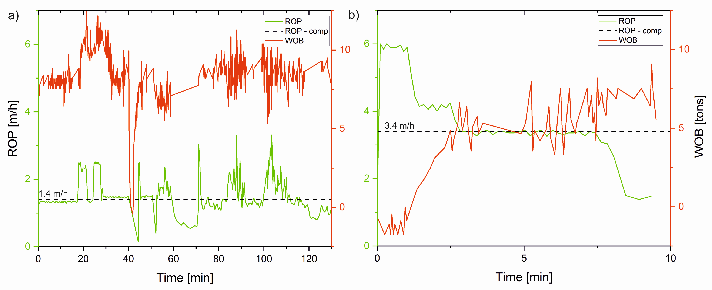
Field Validation
Standard Roller Cone Baseline
ThermoDrill Roller Cone
Notes:
8.5 inch inclined hole
Roller cone bits
Baseline drilling included changing parameters to optimise ROP
With WOB held constant, ROP relatively constant
ThermoDrill drilling included high ROP with WOB=0 at start up, similar to baseline drilling
Constant drilling at 3.4 m/h with constant WOB is the ThermoDrill rate in this rock
Decrease in ROP at end due to some malfunction

Slide 19
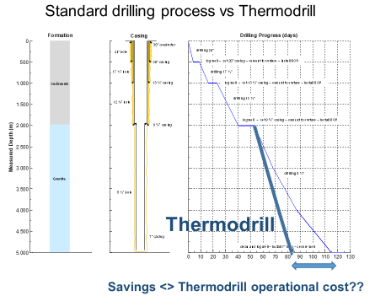
Indicative Improved Efficiency
Notes:
- Based on lab tests

Slide 20
Benefits
Increase in ROP
Preconditioning of the rock by the jetting reduces bit wear, allowing an increase on the running time of each bit
Reduction of the number of bits
Reduction of the overall tripping time

Slide 21
Visit us under http://www.thermodrill-h2020.org/
Financial & Administrative Coordinator: Karin Rehatschek (karin.rehatschek@unileoben.ac.at)
Scientific & Technical Coordinator : Thomas Stoxreiter (thomas.stoxreiter@unileoben.ac.at)
This project has received funding from the European Union's Horizon 2020 research and innovation programme under grant agreement No. 641202.

