Slide 1
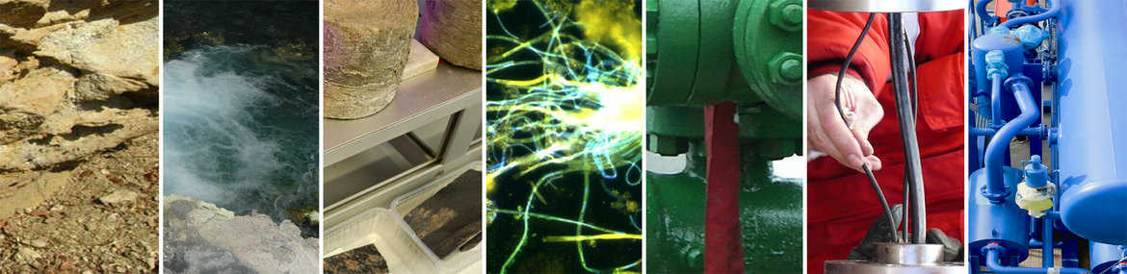
KMT @ GFZ
Geothermal activities of Section 4.8 Geoenergy
Katrin Kieling, Project manager Section 4.8

Slide 2
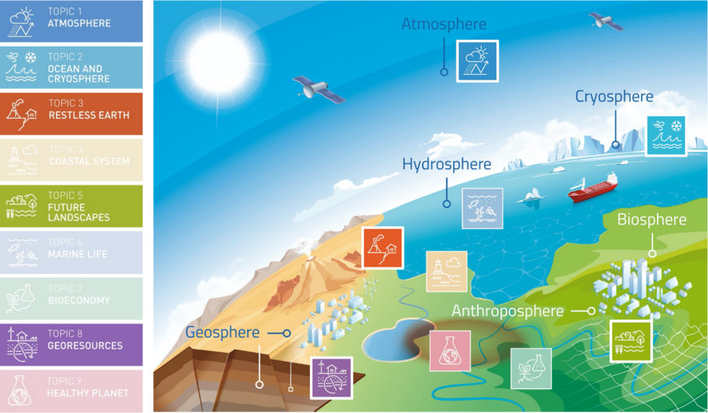
GFZ Section Geoenergy

Slide 3
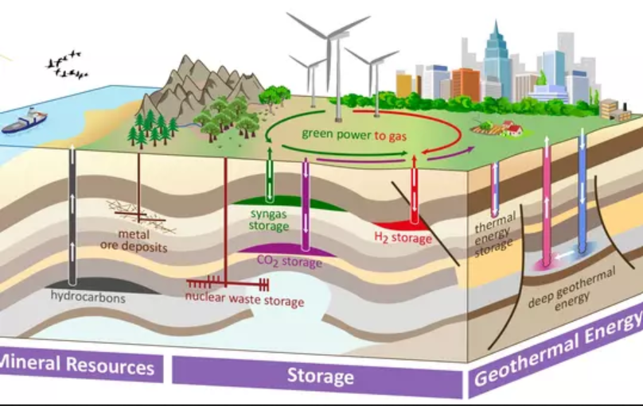
GFZ Section Geoenergy

Slide 4
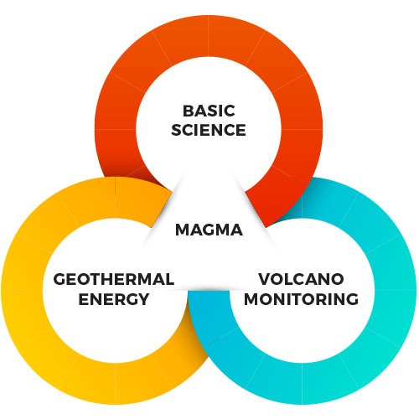
GFZ Section Geoenergy

Slide 5
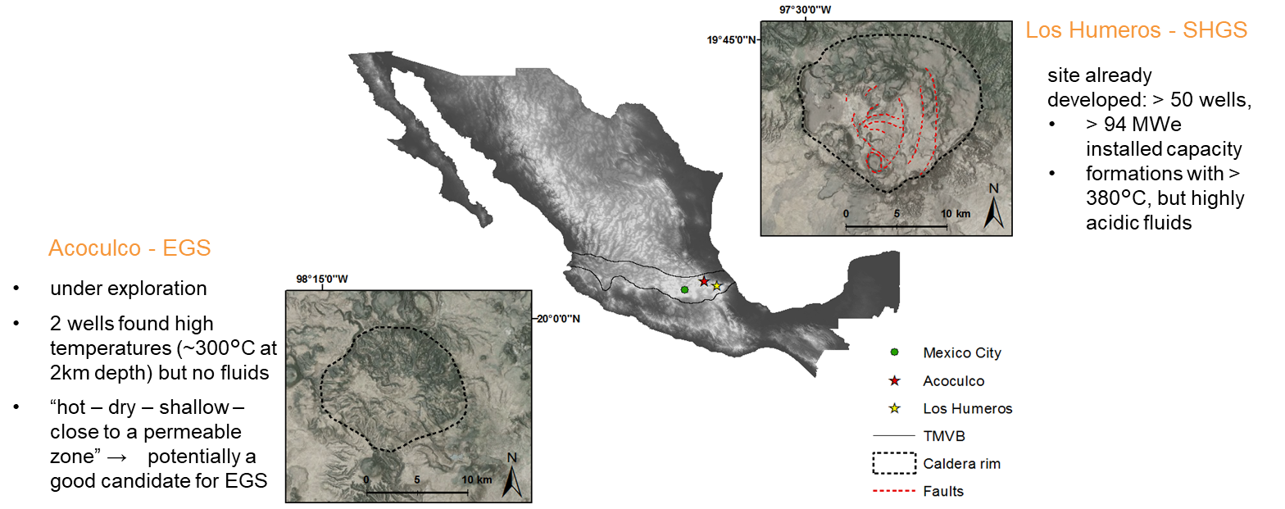
Geoenergy research at high-temperature systems – GEMex project
Cooperation in Geothermal energy research Europe-Mexico for development of Enhanced Geothermal Systems (EGS) and Superhot Geothermal Systems (SHGS)

Slide 6
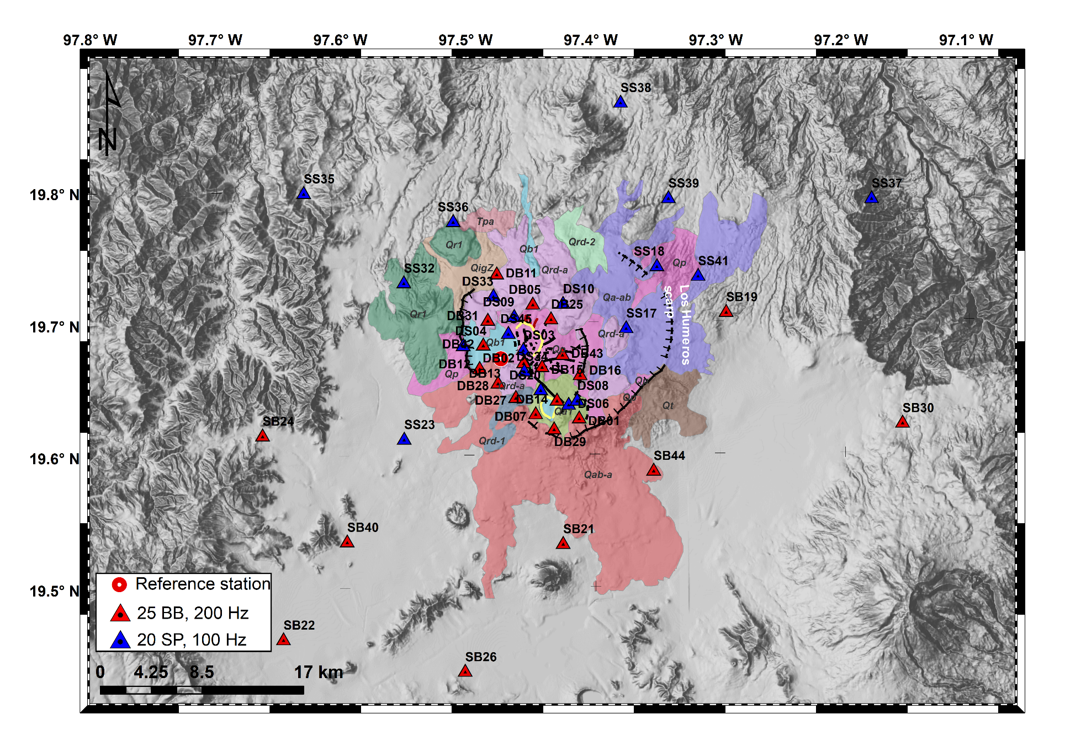
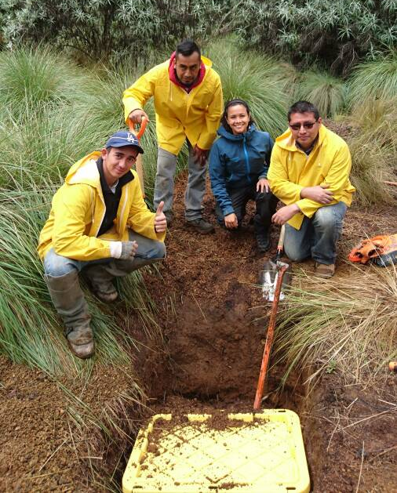
Passive seismic monitoring- The 6G Seismic Network
45 seismic stations installed at Los Humeros from Sept 2017 to Sept 2018
Joint work with KIT, UMSNH, UNAM, HBO
Data publication available
Toledo, T., Gaucher, E., Metz, M., Calò, M., Figueroa, A., Angulo, J.; Jousset, P.; Kieling, K.; Saenger, E. (2019): Dataset of the 6G seismic network at Los Humeros, 2017-2018. GFZ Data Services. Other/Seismic Network. doi:10.14470/1T7562235078

Slide 7
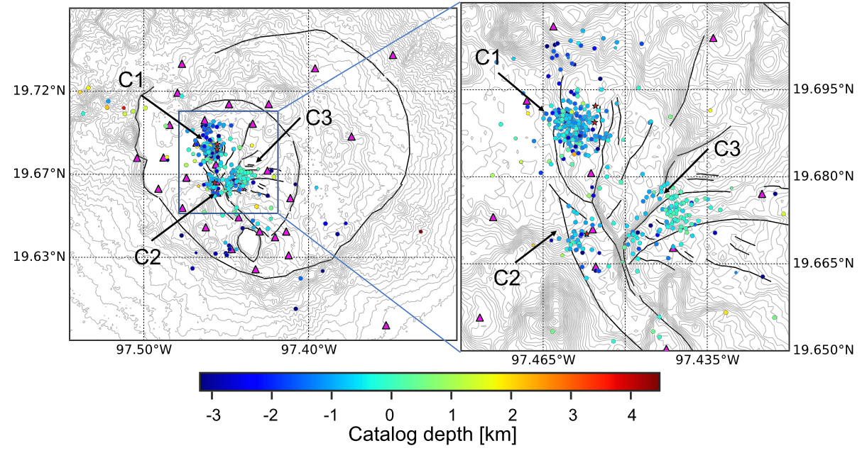
Passive seismic monitoring- seismic catalogue
488 local events identified
3 clusters – C1 and C2 associated to injection wells
C3 not associated to any geothermal well, but could hint to an increased permeability of E-W trending Las Papas and Las Viboras faults at depth
Toledo et al. (JGR, 2020)

Slide 8
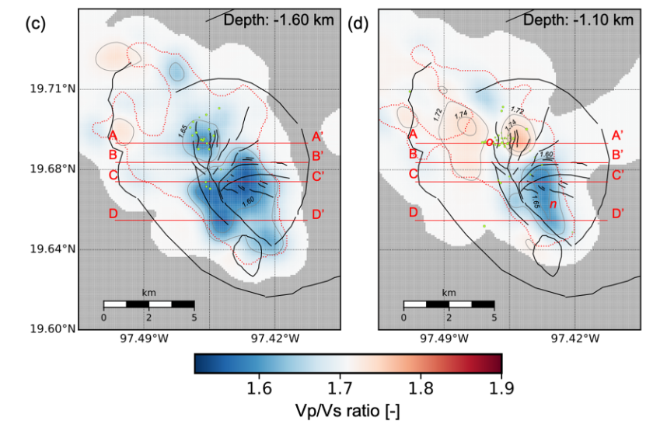
Passive seismic monitoring- seismic catalogue
Earthquake tomography using body wave tomography
Regions of high Vp/Vs could hint at regions with increased liquid content e.g. left and right of Los Humeros fault in the north of the caldera
Toledo et al. (JGR, 2020)

Slide 9
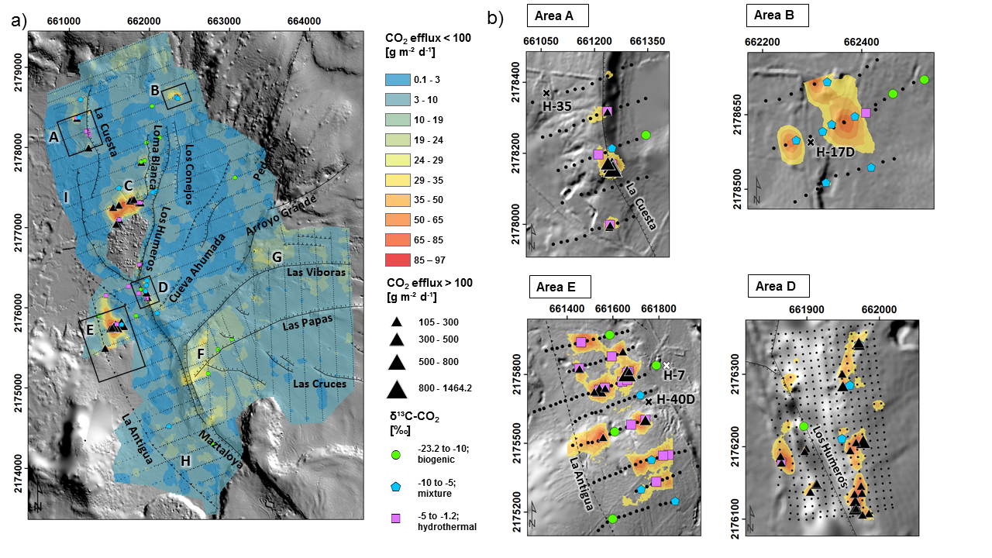
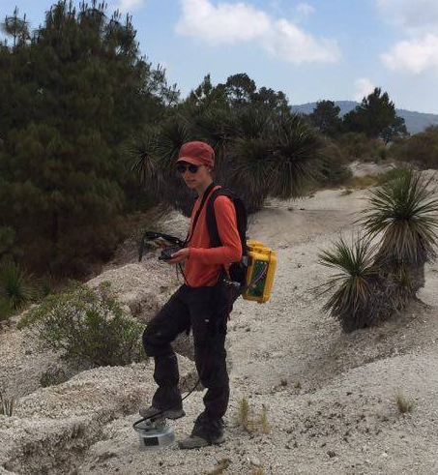
Exploration and monitoring using magmatic volatiles
CO2-efflux measurements along a regular grid
Additional gas and gas isoptop analysis in zones with high efflux
Jentsch et al. (JVGR, 2020)
<Foliennummer>

Slide 10
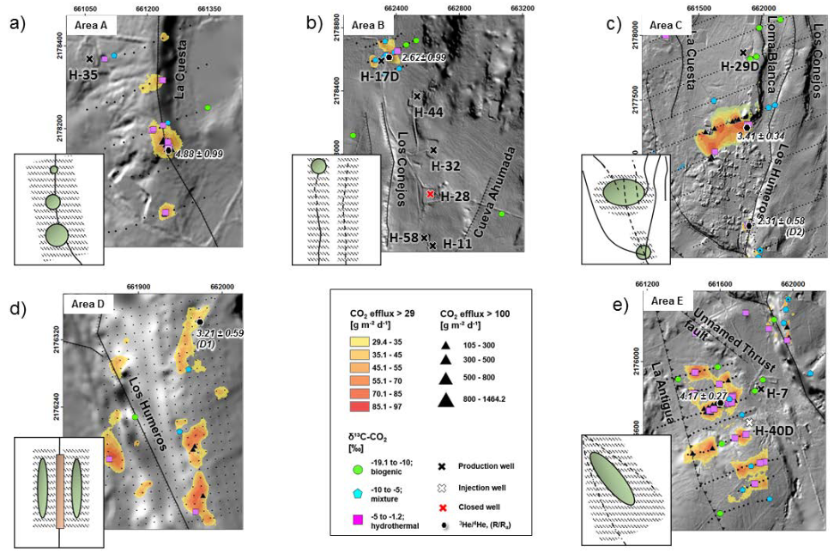
Exploration and monitoring using magmatic volatiles
typical major normal fault with highest gas emissions at the fault bend.
Hidden fault or fault continuation of Los Conejos fault
horsetail fault termination starting in the south of Humeros village with faults forming the horse tail.
Permeable fault damage zone and a less permeable fault core along Los Humeros fault
Fault intersection or linkage of two fault damage zones favoring increased degassing
Jentsch et al. (JVGR, 2020)
<Foliennummer>

Slide 11
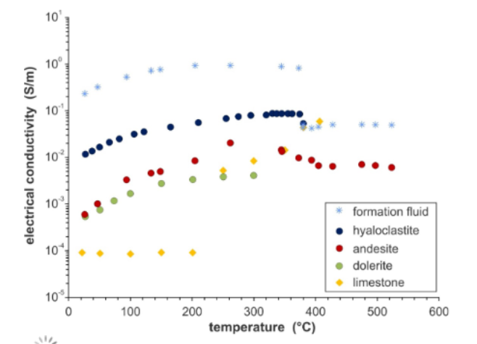
Electrical and hydraulic rock properties
Electrical conductivity of various rock
samples representing the basement and
reservoir units of the target area
electrical properties are sensitive to temperature, porosity, alteration of the rock, fluid content and the nature of formation fluids
→ Resistivity survey data interpretation is extremely complex
In GEMex, we have studied both the electrical resistivities of relevant pore fluids and the electrical and hydraulic properties of rock samples during fluid percolation up to 530 °C at maximum
Database publication: Weydt et.al. (ESSD, 2021)
Kummerow et al. (2020, GEMex final conference)
<Foliennummer>

Slide 12


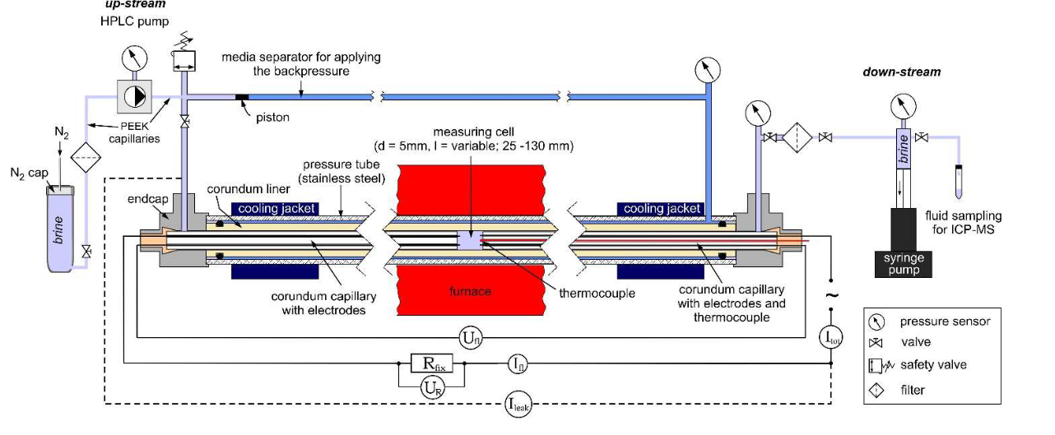
Monitoring mineral solubility/precipitation by impedance spectroscopy
Set-up for measurements of electrical fluid conductivity and reactive flow experiments
Solubility rates of quartz in high temperature solutions (Tmax= 500°C)
Redefining fluid properties at extreme conditions to optimise geothermal energy extraction
Objective: Accurate predictions by thorough knowledge of the physical & chemical properties of geothermal fluids
Data collection
Process understanding
Predictive modelling
Kummerow et al. (JVGR, 2020)
<Foliennummer>

Slide 13
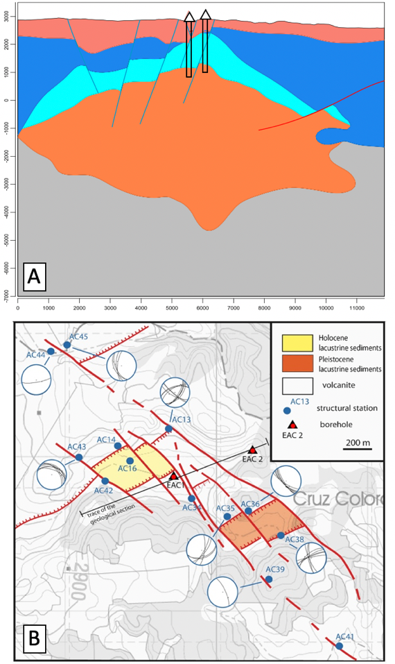
Stimulation Design for Acoculco
Stimulation Design for Acoculco by Hannes Hofmann (GFZ), Francesco Parsio, Lies Peters (TNO), Michal Kruszewski (IEG), Baptiste Lepillier (TUD)
Taking into account:
Structural Geology + faults
<Foliennummer>

Slide 14
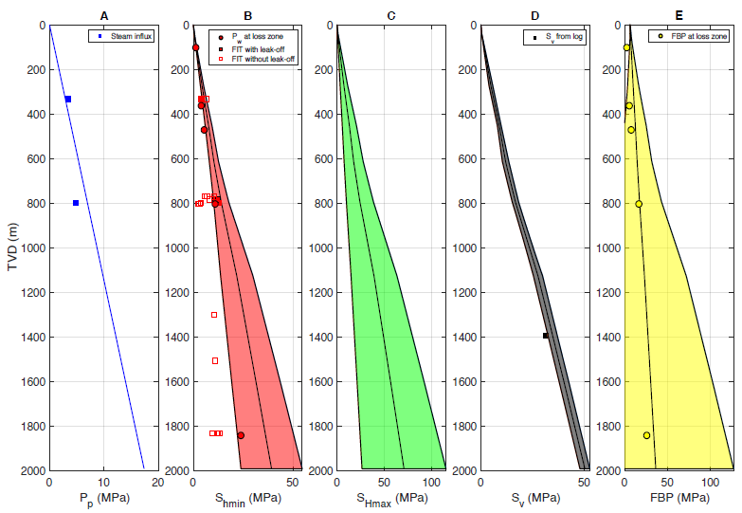
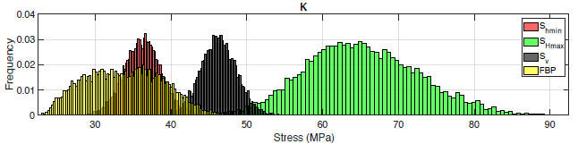
Stimulation Design for Acoculco
Stimulation Design for Acoculco by Hannes Hofmann (GFZ), Francesco Parsio, Lies Peters (TNO), Michal Kruszewski (IEG), Baptiste Lepillier (TUD)
Taking into account:
Structural Geology + faults
Stress field (including high uncertainites)
Kruszewski et al., Geothermics, 2021
<Foliennummer>

Slide 15
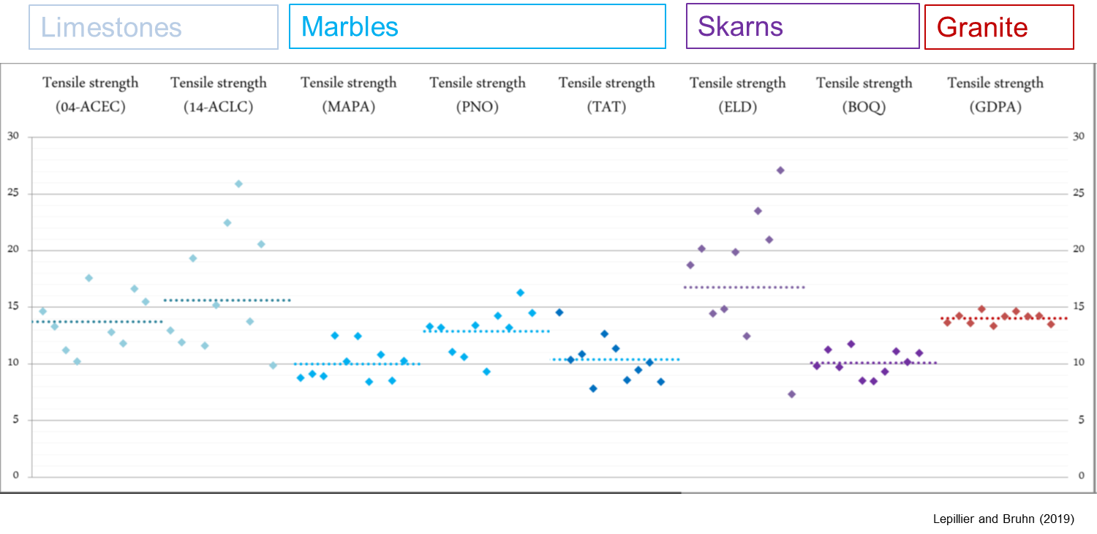
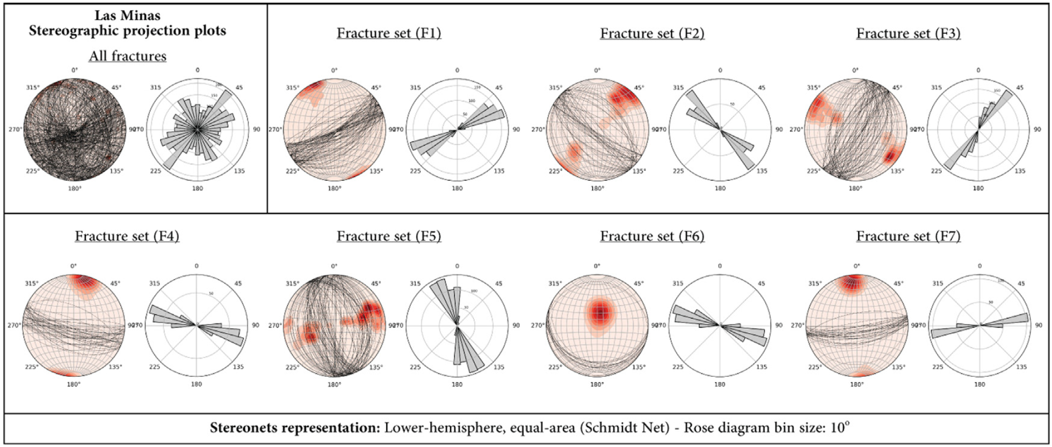
Stimulation Design for Acoculco
Stimulation Design for Acoculco by Hannes Hofmann (GFZ), Francesco Parsio, Lies Peters (TNO), Michal Kruszewski (IEG), Baptiste Lepillier (TUD)
Taking into account:
Structural Geology + faults
Stress field (including high uncertainites)
Rock Properties and fracture distributions
Lepillier et al. (2020)
<Foliennummer>

Slide 16
Stimulation Design for Acoculco
EAC-1
Stimulation Design for Acoculco by Hannes Hofmann (GFZ), Francesco Parsio, Lies Peters (TNO), Michal Kruszewski (IEG), Baptiste Lepillier (TUD)
Taking into account:
Structural Geology + faults
Stress field (including high uncertainites)
Rock Properties and fracture distributions
Wells, temperatures, fluid loss information,
Hofmann et al., GEMex Deliverable 7.2
<Foliennummer>

Slide 17
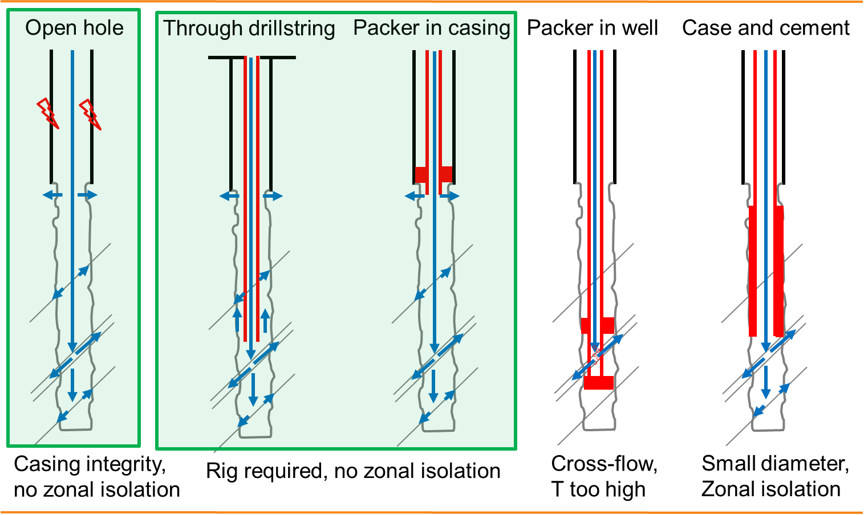
Stimulation Design for Acoculco
Stimulation Design for Acoculco by Hannes Hofmann (GFZ), Francesco Parsio, Lies Peters (TNO), Michal Kruszewski (IEG), Baptiste Lepillier (TUD)
Taking into account:
Structural Geology + faults
Stress field (including high uncertainites)
Rock Properties and fracture distributions
Wells, temperatures, fluid loss information
Stimulation options
Hofmann et al., GEMex Deliverable 7.2
<Foliennummer>

Slide 18
Stimulation Design for Acoculco
EAC-1
Check casing integrity and effect of temperature on casing integrity
Open hole thermal stimulation of EAC-1 with low pressures to improve permeability of existing inflow zone at ~1650 m close to the well
Stepwise pressure increase once the stimulation efficiency drops to stimulate fracture network away from well
Microseismic monitoring and temperature monitoring to detect stimulated reservoir volume and inflow zones
If target zone cannot be stimulated zonal isolation is required
Primary goal: stimulate existing fractures and connect permeable fault damage zones/intersections
Secondary goal: hydraulic connection between EAC-1 and EAC-2; drilling a third well may be required
<Foliennummer>

Slide 19
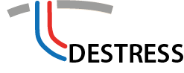
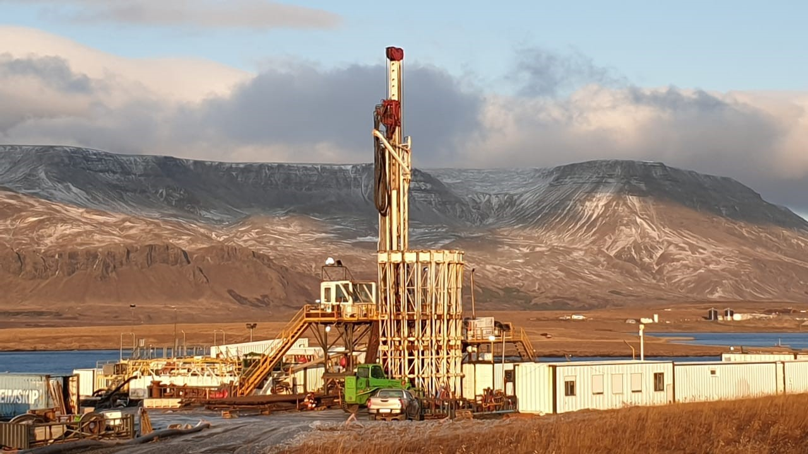
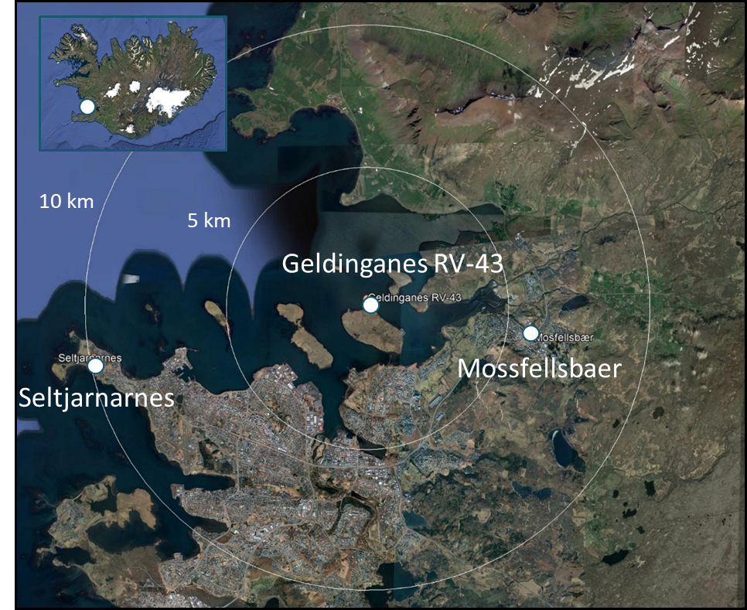
Soft stimulation treatment of geothermal well RV-43 - Geldinganes
Well RV-43:
  Azimuth: 16°, KOP 250 m
  1832 m MD, 1550 m TVD, 702 m MD casing
  8 1/2“ open hole with breakouts
  Well previously stimulated
Stress field:
  Potential SHmax azimuth: 315° - 37°
  Normal faulting (?)
  Low horizontal stresses
Faults:
  Potential azimuth 25° - 45°
  Likely vertical
No historic seismicity
Hofmann et al., Geothermics, 2021
<Foliennummer>

Slide 20
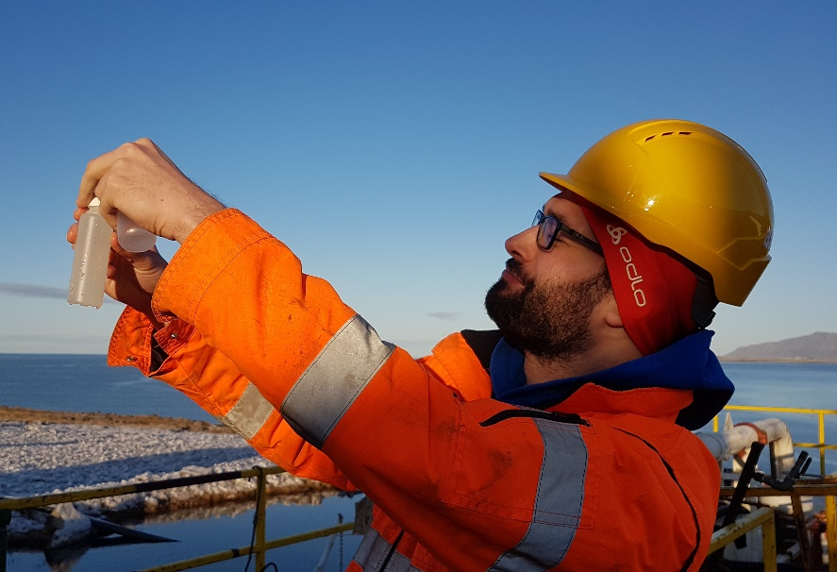
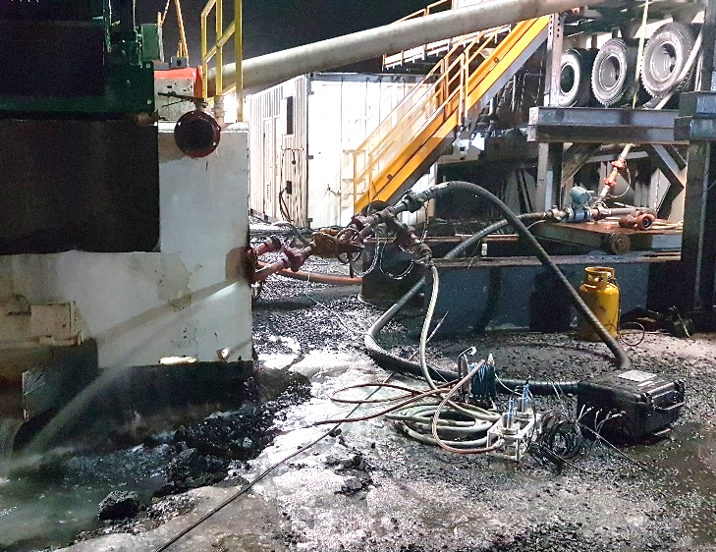
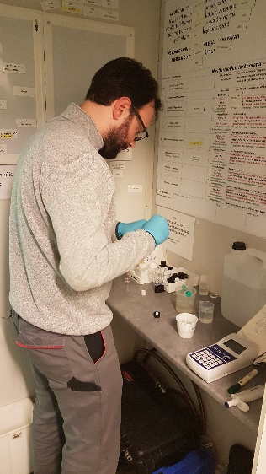
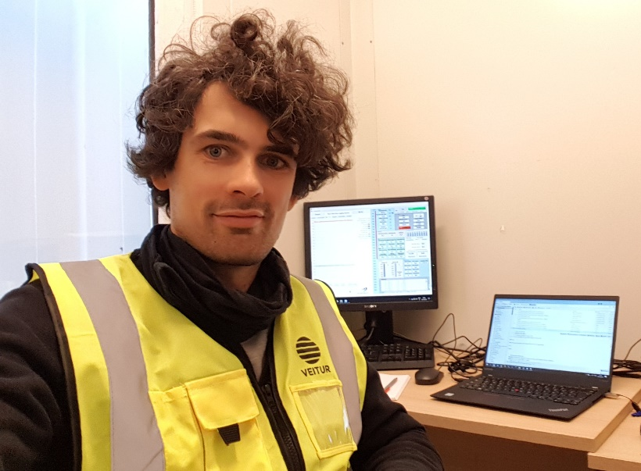
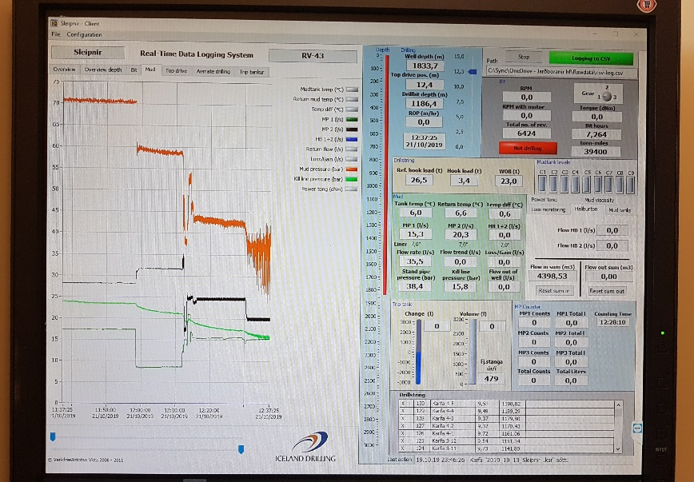
Soft stimulation treatment of geothermal well RV-43 - Geldinganes
Real-time geochemical analysis (flowback water continuously monitored + discrete water samples (H₂S, silica, bicarbonat))
Real-time hydraulic monitoring and data analysis
<Foliennummer>

Slide 21
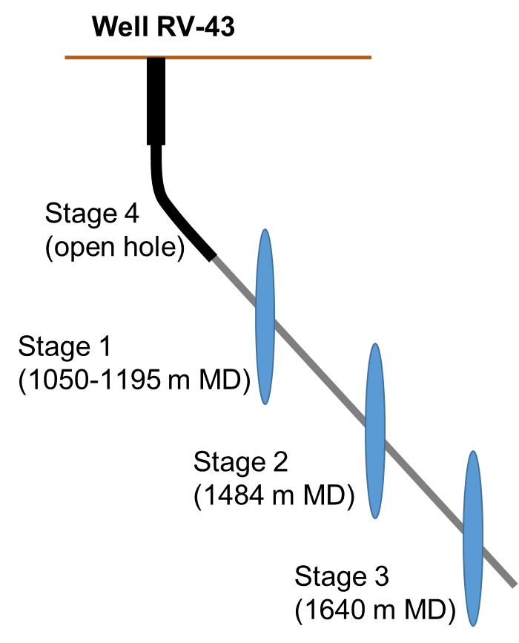
Soft stimulation treatment of geothermal well RV-43 - Geldinganes
Multi-stage stimulation
Soft stimulation treatment procedures were successfully applied at field scale in a densely populated area.
Hydraulic performance of well RV-43 was increased by hydraulic stimulation.
Moment magnitudes of induced seismic events were below 0
results indicate that short cycles of high rate/pressure injection are significantly more efficient than long constant rate injection phases with similar injection rate and pressure
Zonal isolation with open hole packers and borehole integrity problems is challenging
2018
After
Drilling
2001
After 1st
stimulation
in 2001
Hofmann et al., Geothermics, 2021

Slide 22
GFZ @ KMT
Geothermal activities of Section 4.8 Geoenergy
Thank you for your attention!

