Slide 1
Recent progress on the development of the fast orbit feedback for PETRA IV
Conceptual design layout and challenges
Sajjad H. Mirza on the behalf of Feedbacks team at PETRA IV
Berlin, 08.06.2022

Slide 2
Outline
Introduction: FOFB for PETRA IV
Proposed topology
Identifying subsystems (modeling and designing phase)
Special features for PETRA IV
Integration of beam lines into FOFB system
Summary and Outlook

Slide 3
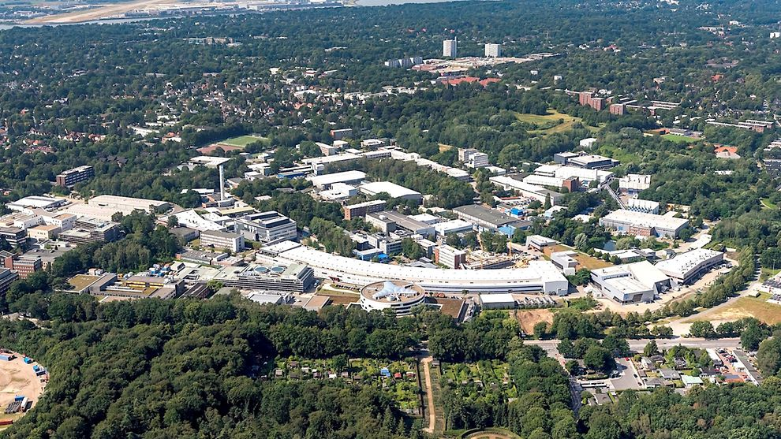
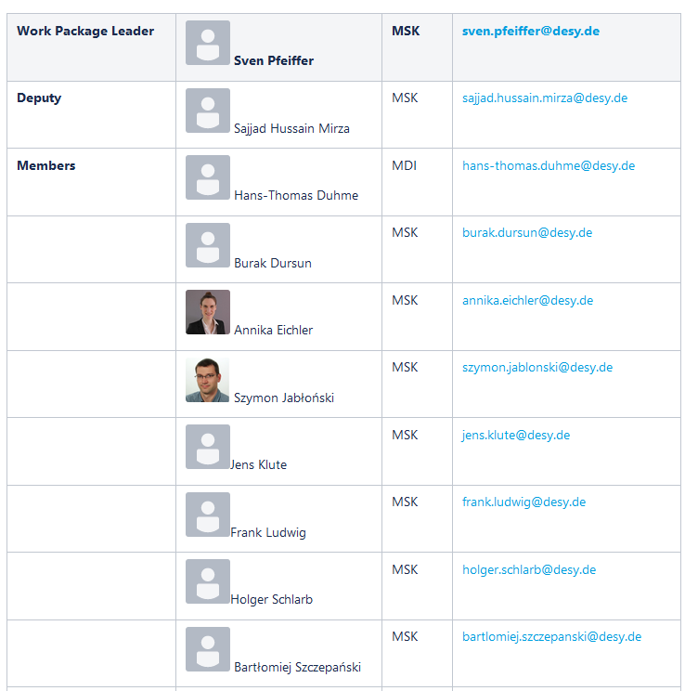
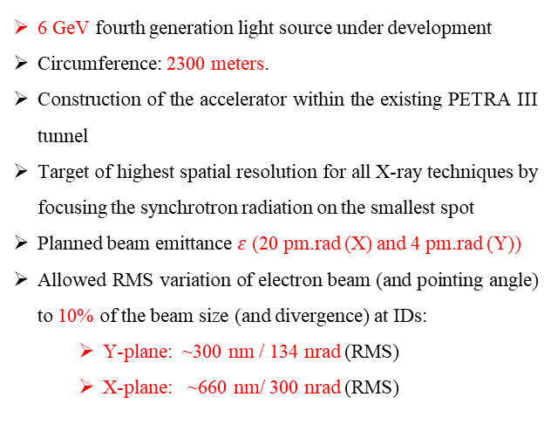
Introduction
PETRA IV and Fast orbit feedback system
6 GeV fourth generation light source under development
Circumference: 2300 meters.
Construction of the accelerator within the existing PETRA III tunnel
Target of highest spatial resolution for all X-ray techniques by focusing the synchrotron radiation on the smallest spot
Planned beam emittance $ε$ (20 pm.rad (X) and 4 pm.rad (Y))
Allowed RMS variation of electron beam (and pointing angle) to 10% of the beam size (and divergence) at IDs:
  Y-plane: ~300 nm / 134 nrad (RMS)
  X-plane: ~660 nm/ 300 nrad (RMS)
https://www.hamburg.de/bwfgb/14855792/foederung-petra-iv-tdr/
The exact requirements for the RMS stability of the orbit are not finalized yet! But we prepare for the orbit stability from beginning!
Feedback team
For designing the
Transverse Multi-bunch feedback
Fast orbit feedback system
Stability Task Force
For understanding and affecting the stability requirements for the FOFB system during the design phase of the ring.
Coordination between mechanics, feedback, beam dynamics, girder and magnet design, electromagnetic compatibility, infrastructure.

Slide 4
FOFB conceptional design

Slide 5
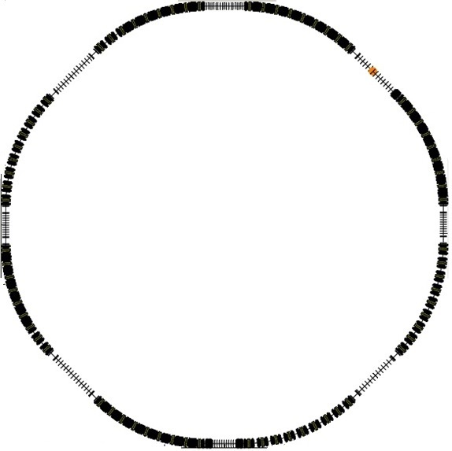
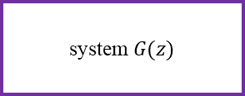
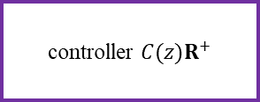
Conceptual schematic for FOFB sytem
FOFB system on top of SOFB system
controller $C(z)R^{+}$
system $G(z)$
-
FOFB loop
M BPM values
N fast corrector values
BPM sampling @ 130 kHz
PETRA IV ring
M BPM values
Planned parameters/features
1 kHz frequency for disturbance rejection
Bandwidth starting from quasi-DC
Minimum latency: data rate of 130 kHz (turn by turn rate)
µ-TCA based hardware (controller)
Combined magnets for slow and fast action at overlapped locations.
Ref.
K slow corrector values
-
Slow controller
Larger misalignment errors → slow magnets.
Slow correction system → reference for the FOFB system.
FOFB system → fast as well as ‘very slow’ shifts relative to the residual of slow system.
DC relaxation of fast magnets might be needed (depends on arrangement correctors).
Inclusion of XBPMs into FOFB system.
Local bumps around Insertion devices.

Slide 6
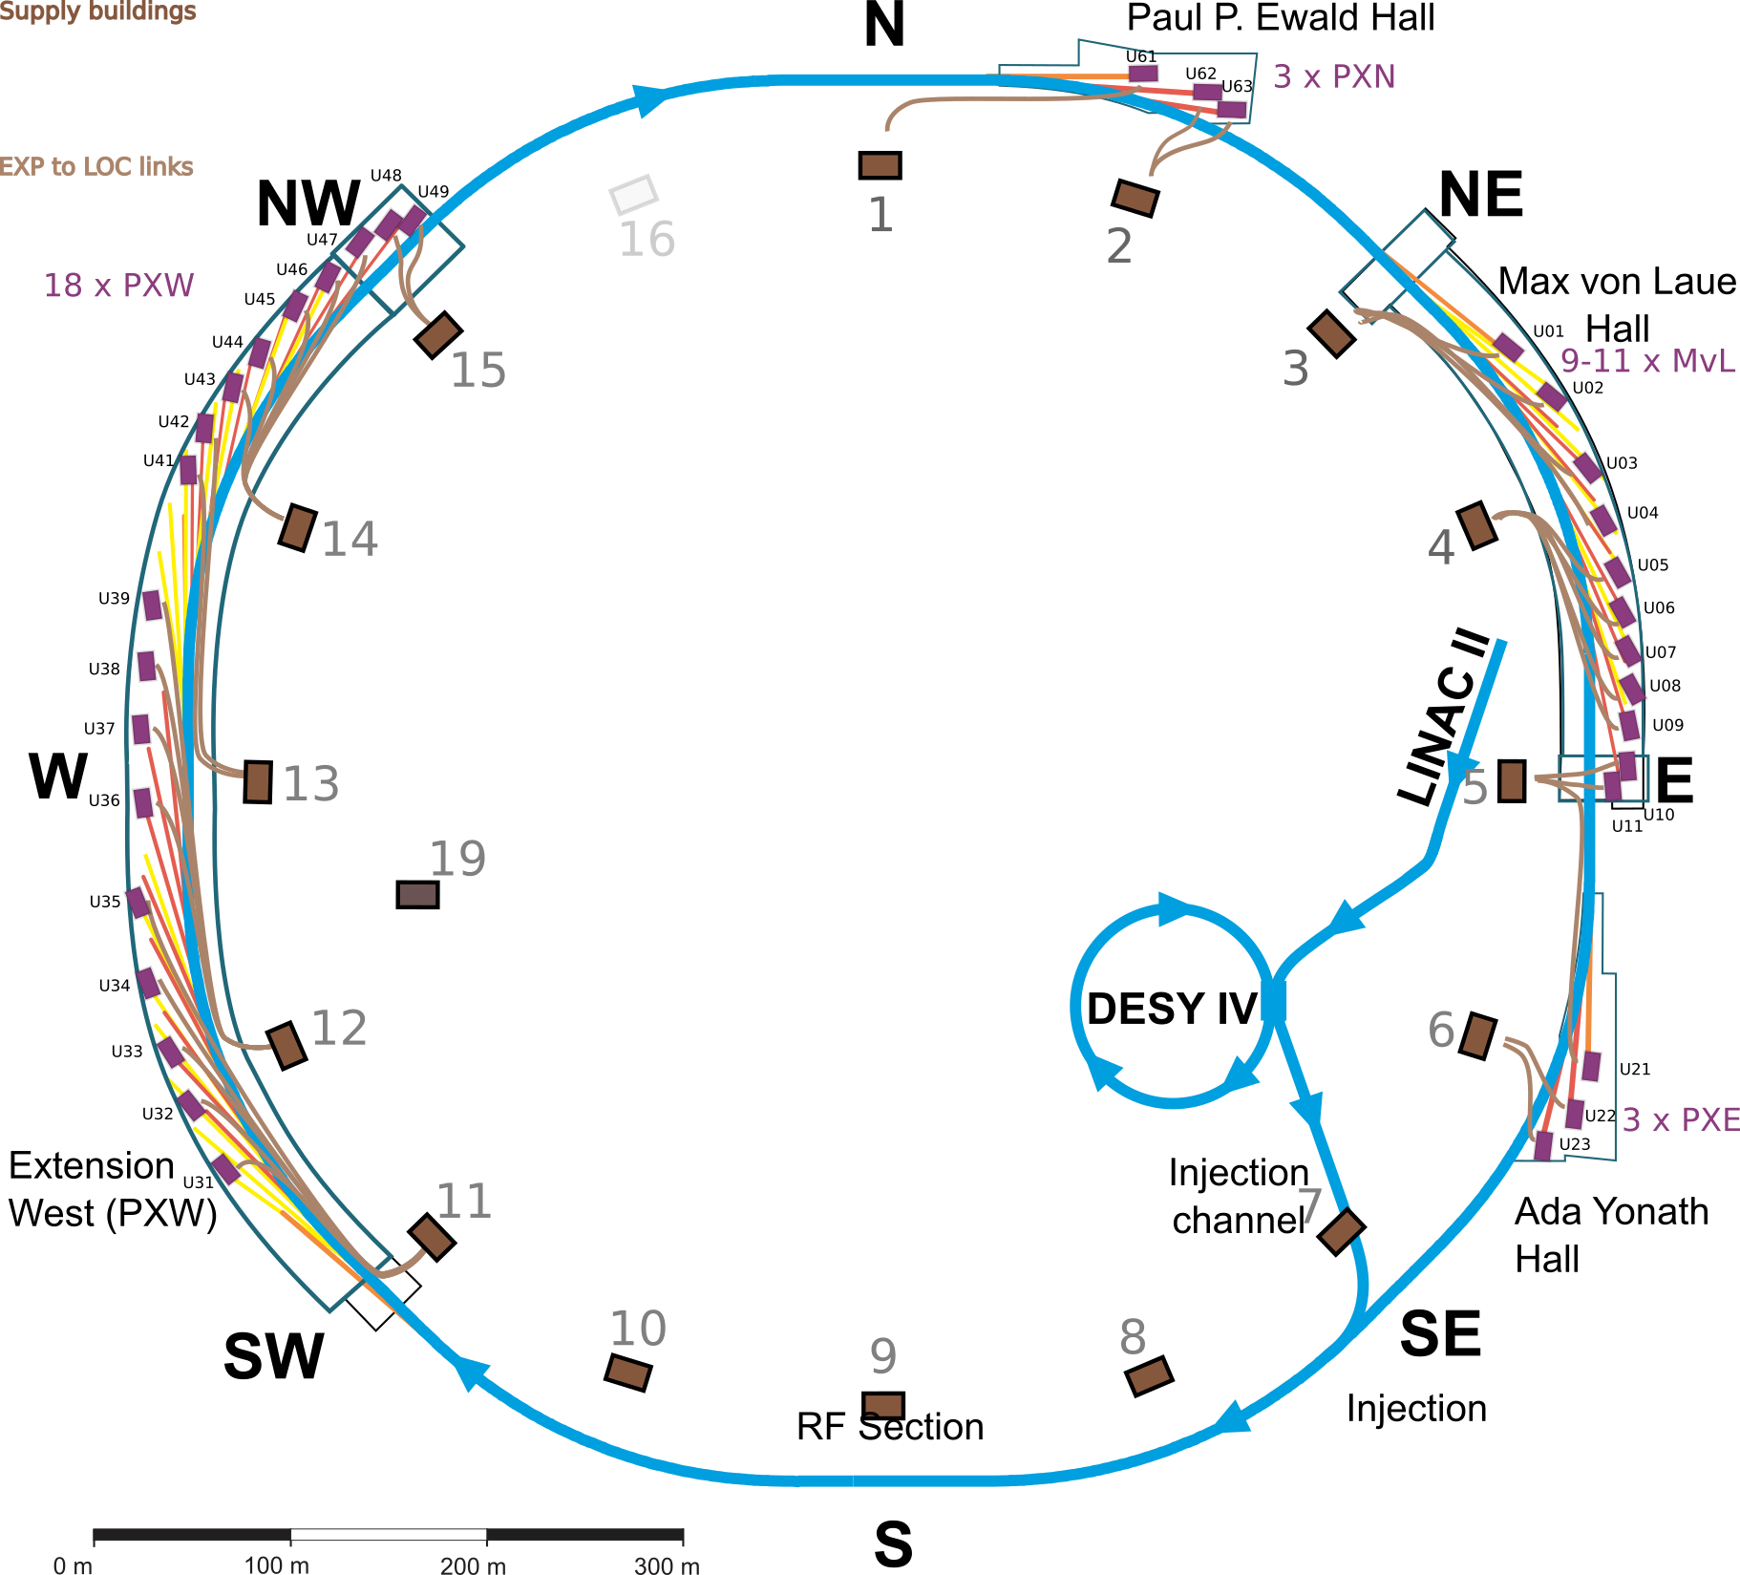
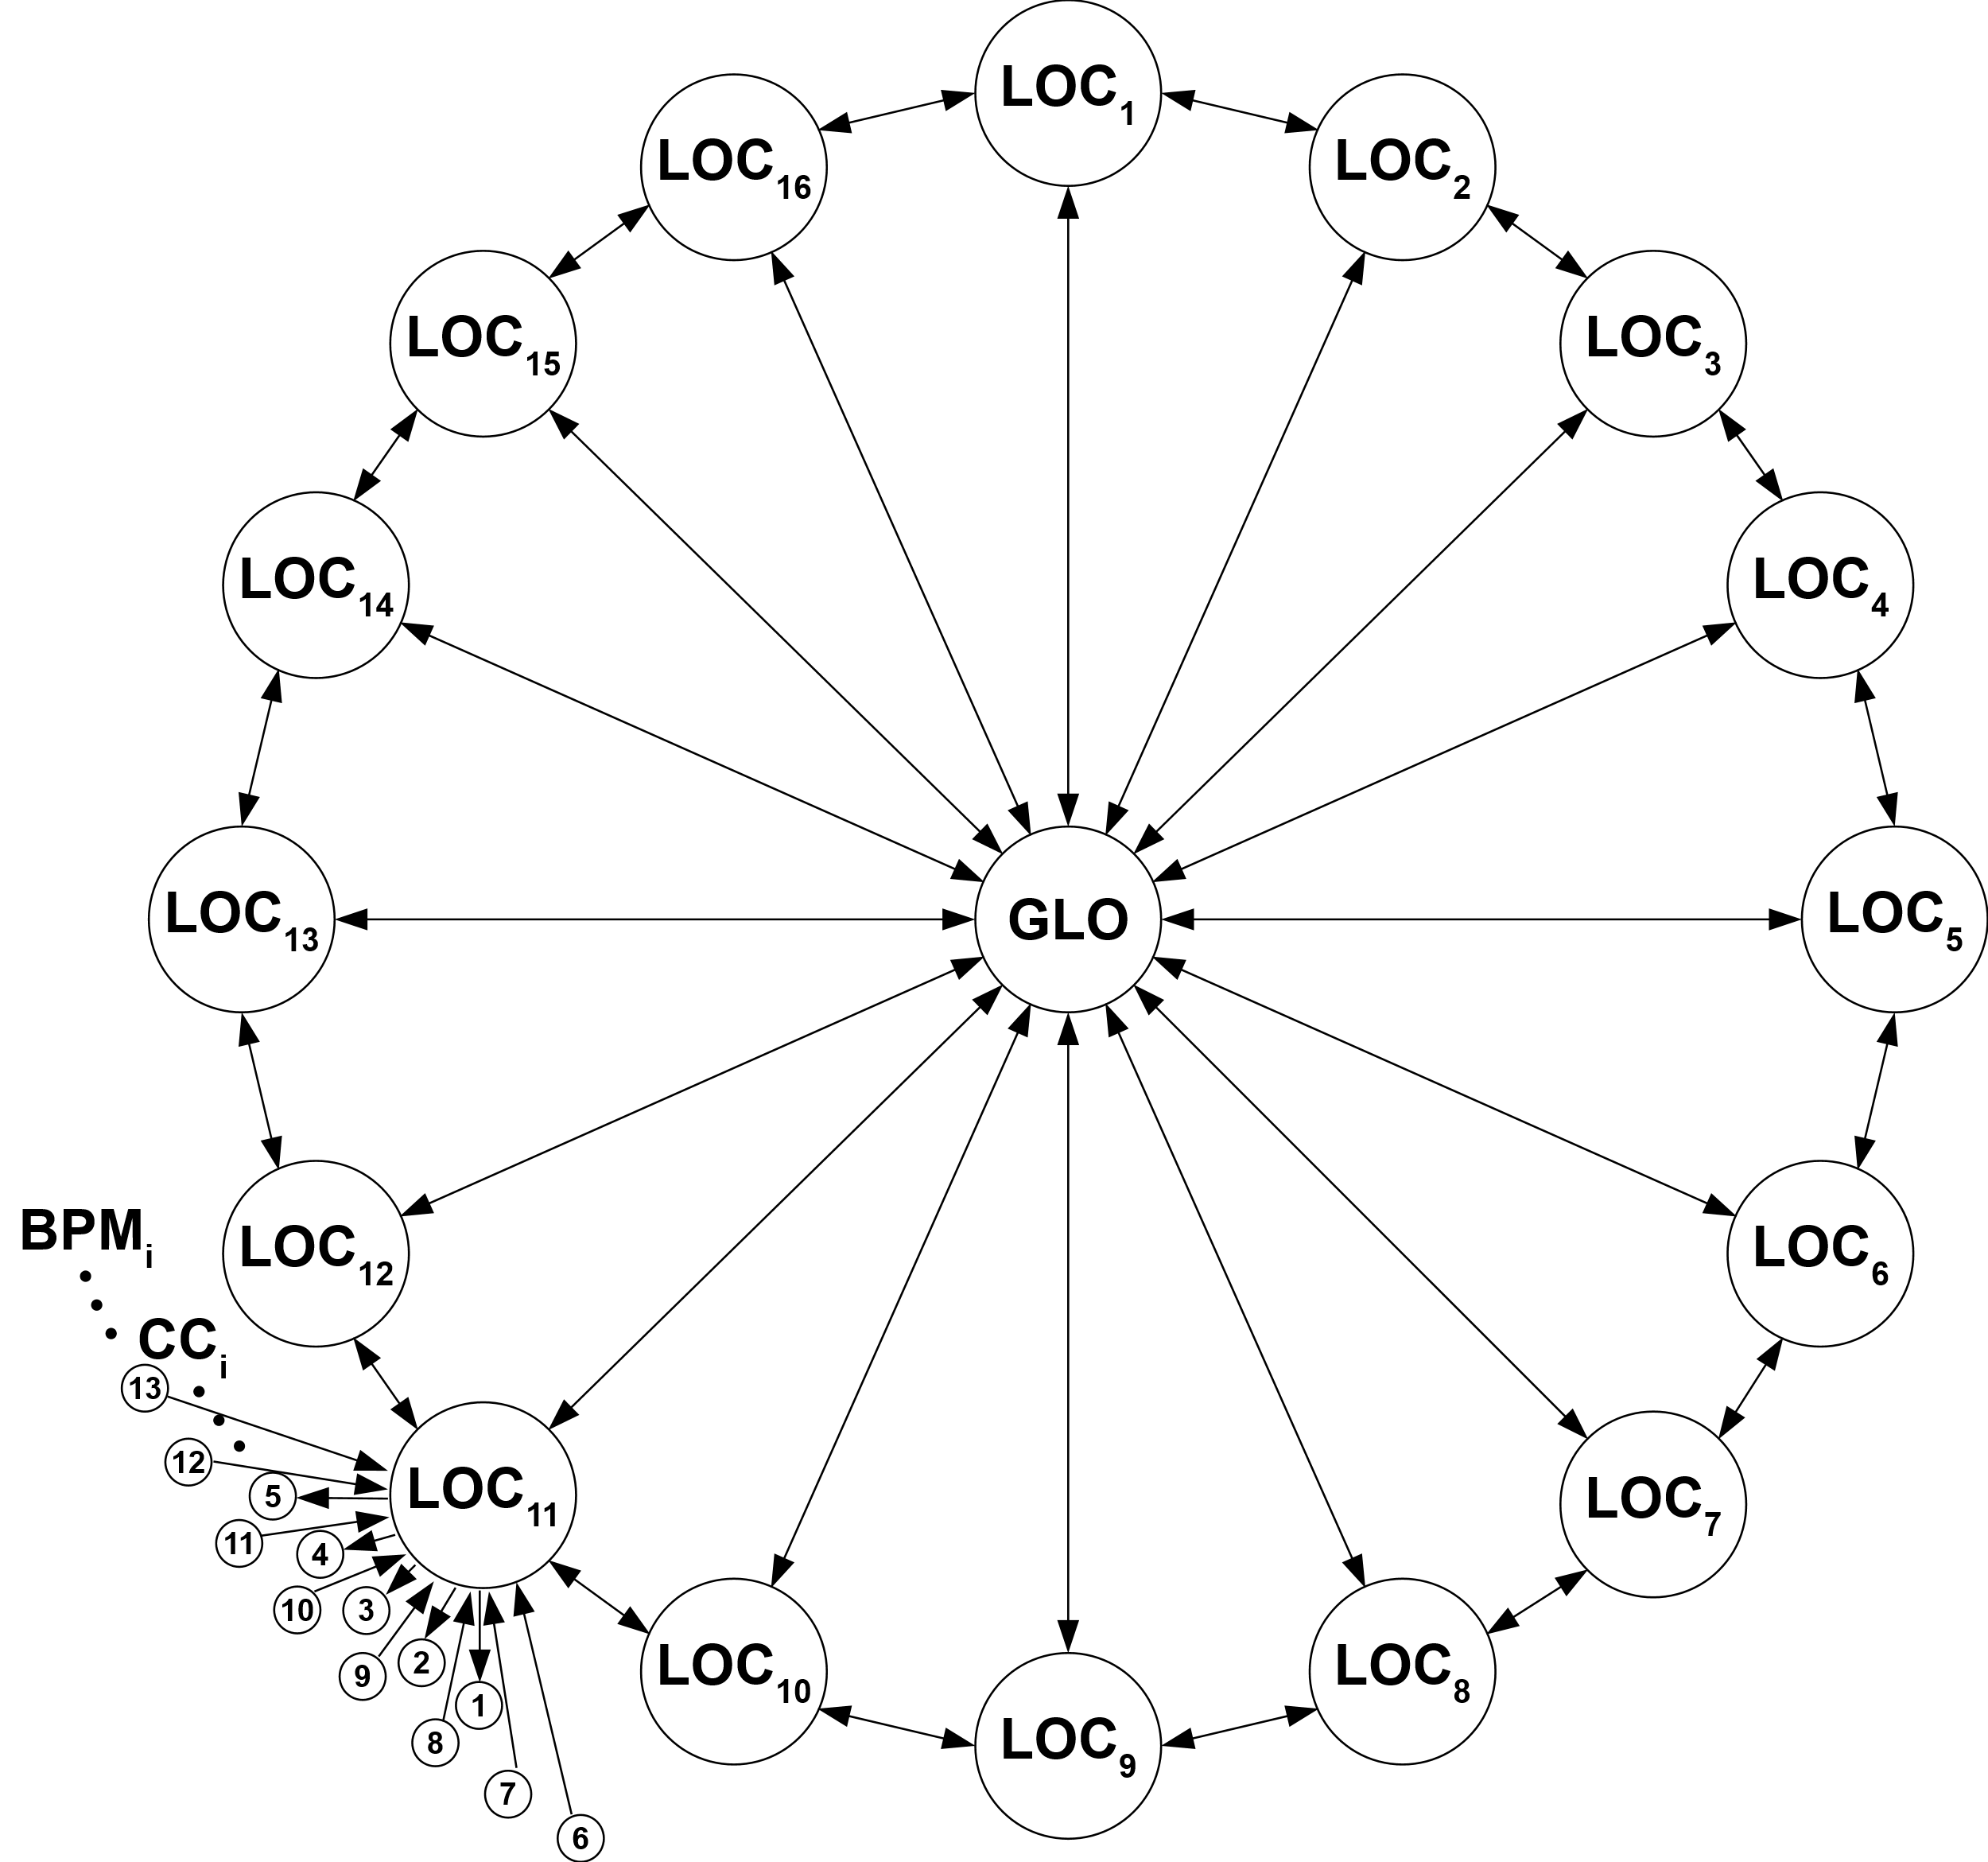
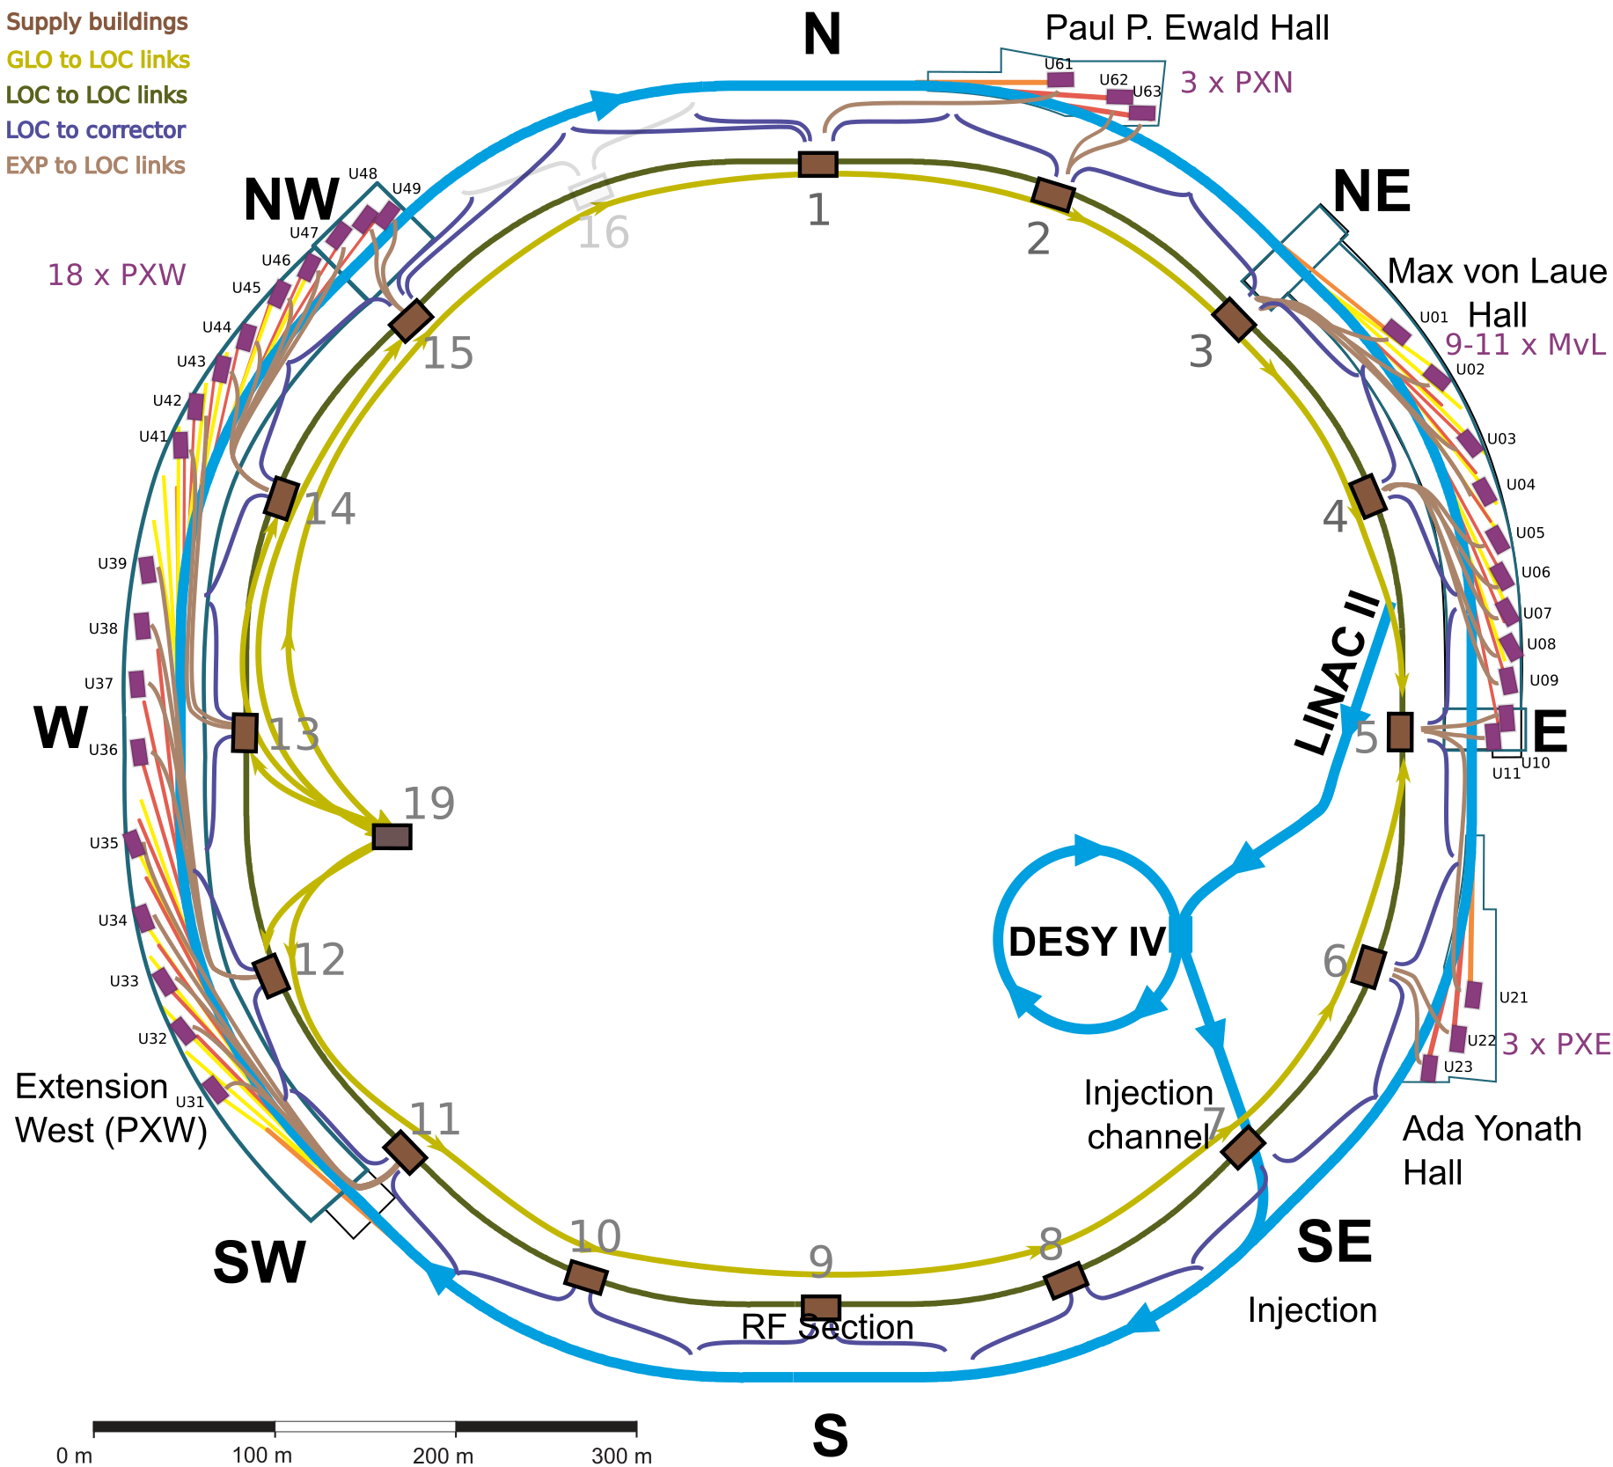
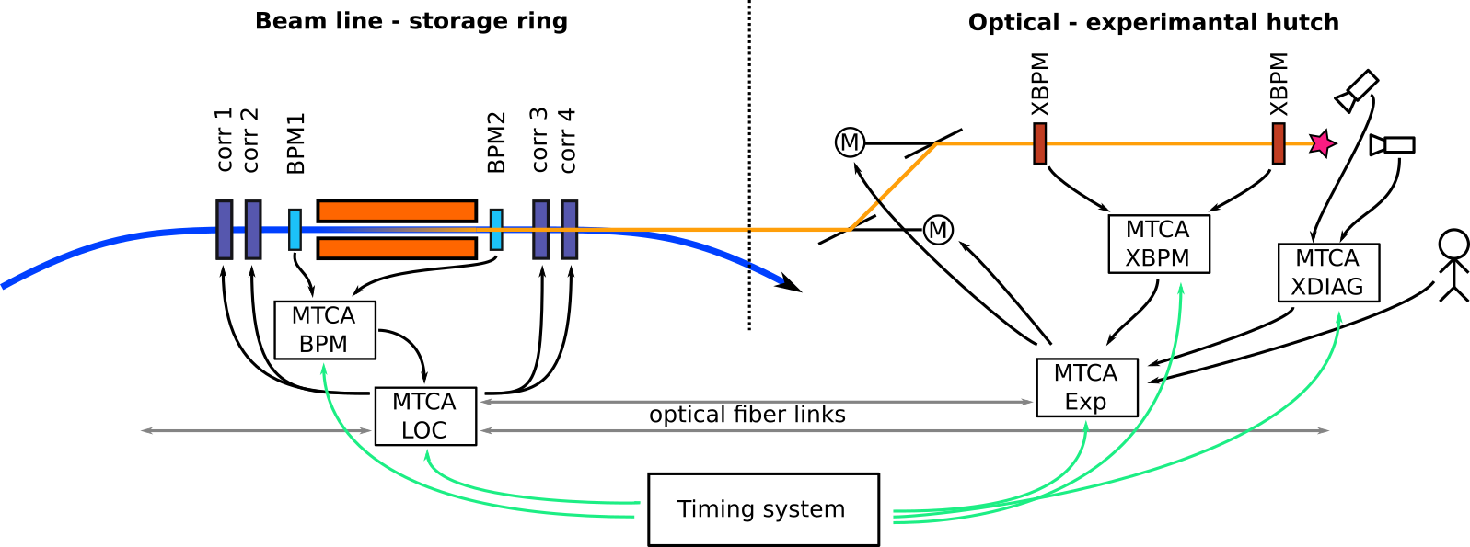
FOFB system topology
Distribution of hardware resources over the ring for latency optimization
15 Supply building considered to be the local stations
Each supply building shall host:
  A set of BPMs hardware
  A set of current controllers
Global to local links through the tunnel (1.5 km) (adds latency)
Long cables from current controller to the corrector magnets (300 m)
Experiments to local stations links:
  Shortest link to loc N
  Longer link to loc N-1
Ideal scenario
For local bump controllers: The BPMs and correctors around IDs should be accessible to one PS building (Collaboration with Diagnostic group )
Important points:
130 KHz sampling frequency for FOFB system
Reducing latency
One turn closed orbit (special to PETRA IV)
The relative location of BPMs and correctos. The correctors before and after a BPM may have a one turn delay uncertainty for global FOFB system?
Selection of beam position calculation algorithm (I/Q pair, frequency domain, time domain).
Local fast orbit feedback systems?

Slide 7
Analytical modeling of FOFB subsystem

Slide 8
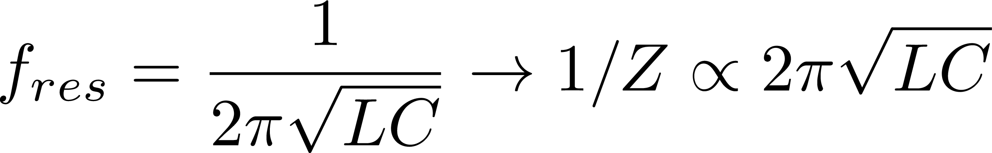
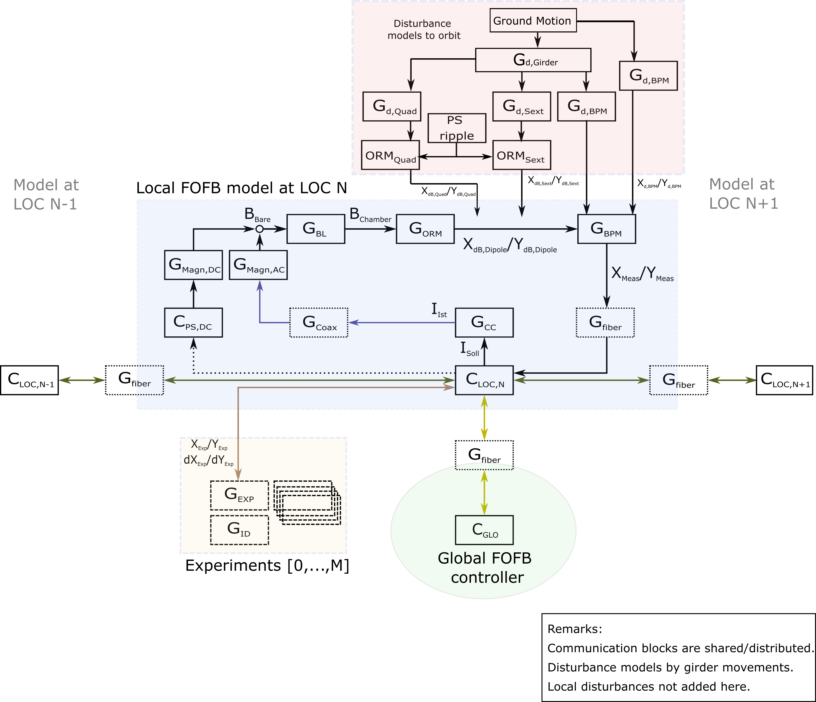
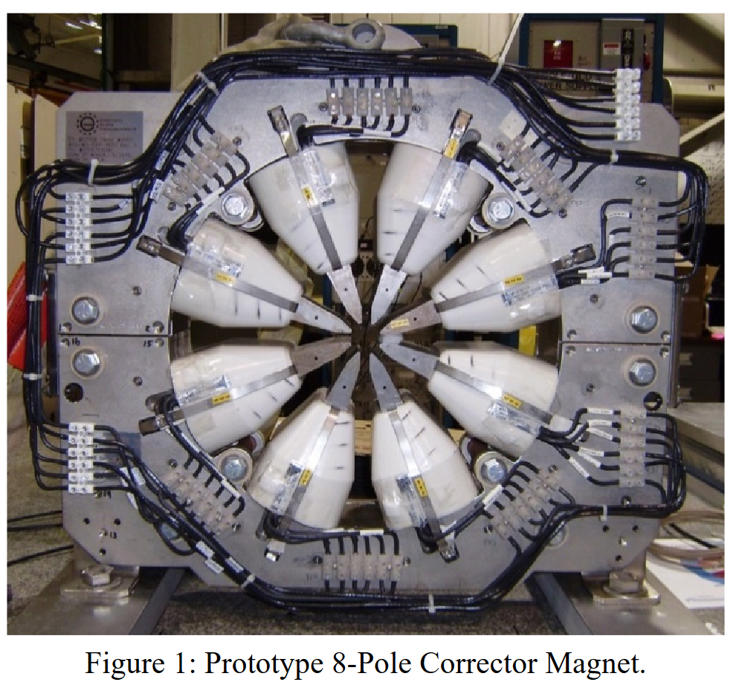
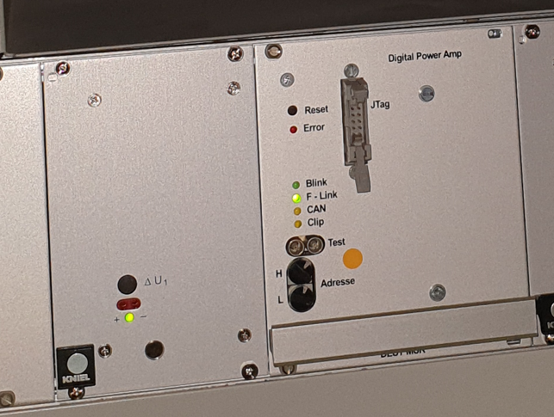
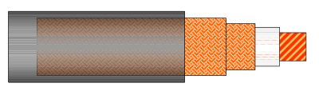
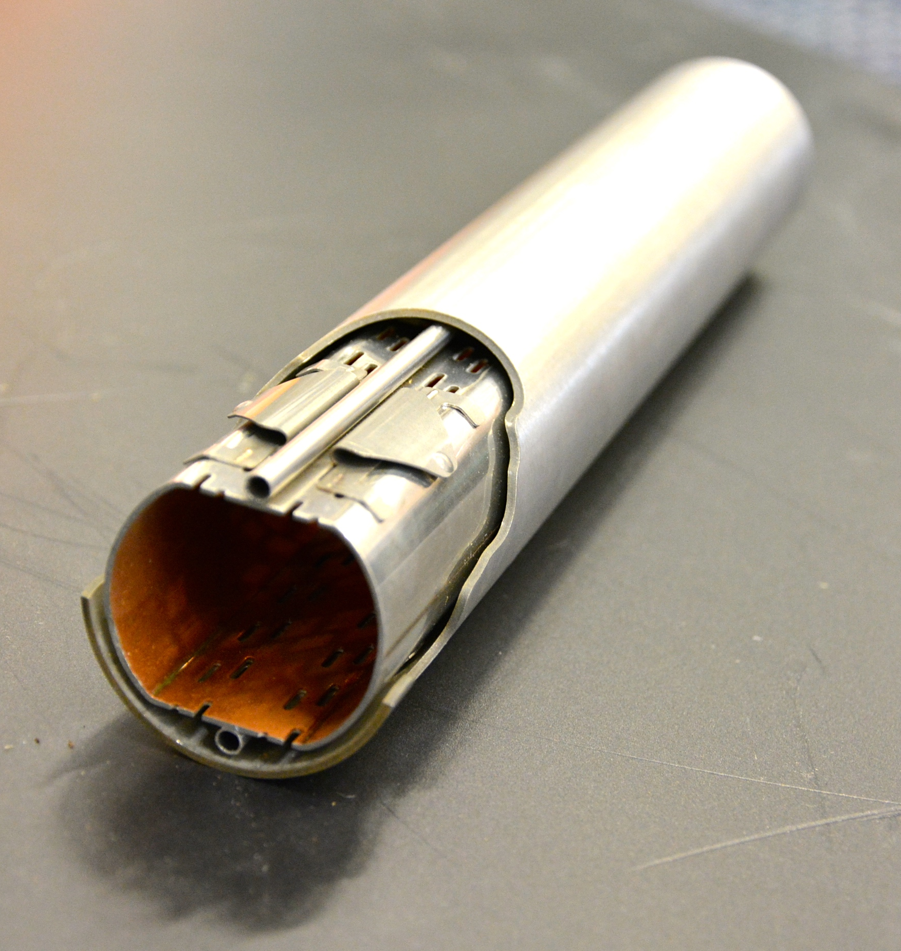
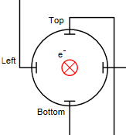
Analytical modeling for FOFB subsystems
Identifying the subsystems
Magnetic field
Magnetic length
Inductance L
Current, Voltage
Update frequency
Resolution/Precision
With stability task force
Power
Supply
Magnet
@APS
Length, diameter, …
Insulation Material
C’, L’, R’
Cable
Beampipe
Material
Dimensions
Inner coating
@LHC
Controller
Processing mode
(delay, noise)
Data rate
BPM

Slide 9
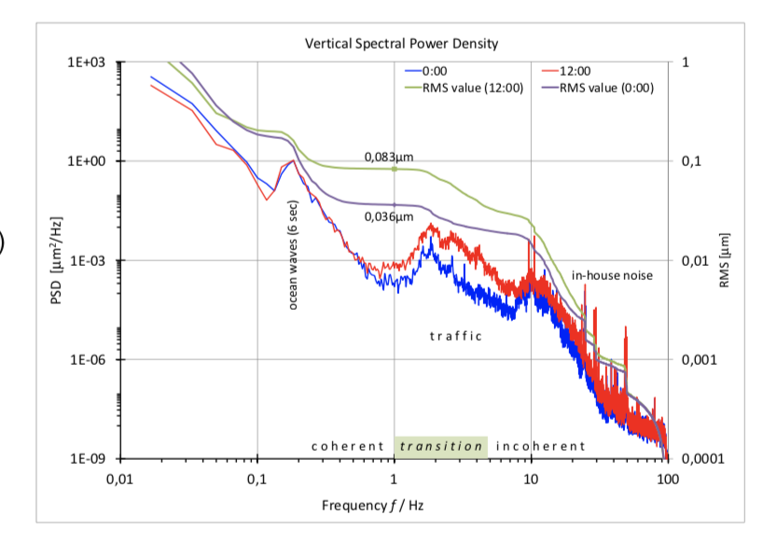
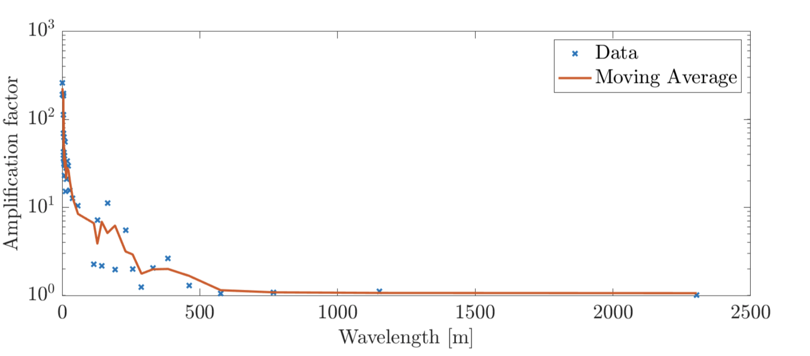
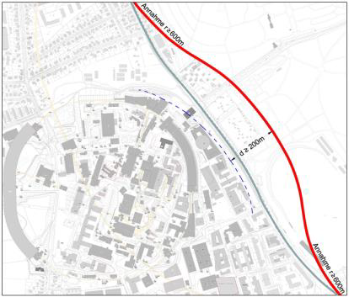
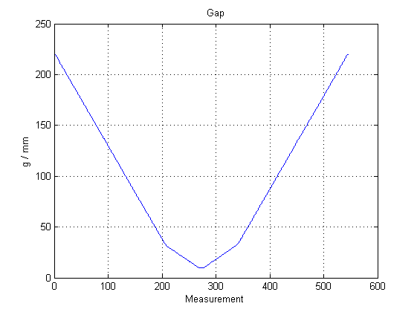
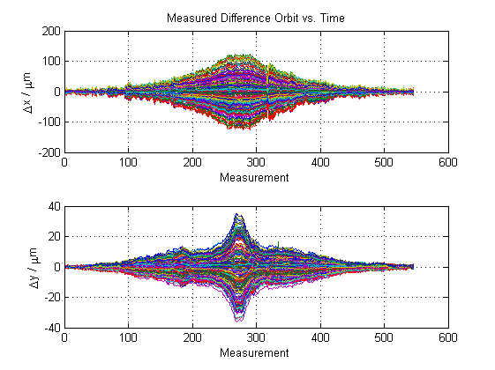
Expected disturbances
Findings of STF, based upon exiting ring PETRA III
A brief summary
Ground motion
Quadrupole transfer function measurement for PETRA III
Source | Freq. range
In house noise | 25 Hz / 10...100Hz
Road traffic | 1…10Hz
Harmonics of DESY II | ~30Hz
Asynchronous motors | Just below 50 Hz
Controlled motors/pumps | 1500U/min→25 Hz
PIII Quad supports (transfer function) | 7-10Hz (sharp) 20-70 Hz
Power supply output ripple | 12.5 Hz (DESY white circuit), 25, 50, 100, 150, 200, 1000 Hz
ID Gap movements | Hz—depends on speed of ID movement
Girder | 30 Hz <desired eigenfreq. <48 Hz
Incl. excitation bursts
Ground motion wavelength vs amplification (simulation for PIV)
Ration of max. orbit vs max magnet offset
Orbit perturbation due to gap movements at PETRA III
Upcoming train nearby DESY
: Δx= ±120 µm
An improvement is expected in PETRA IV
Δy= ±35 µm

Slide 10
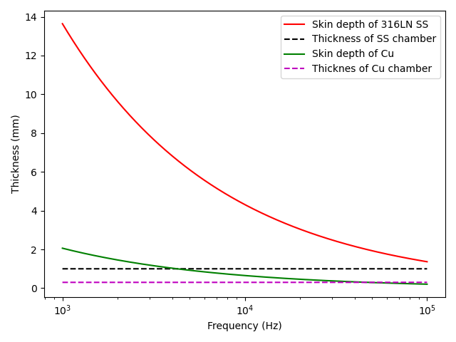
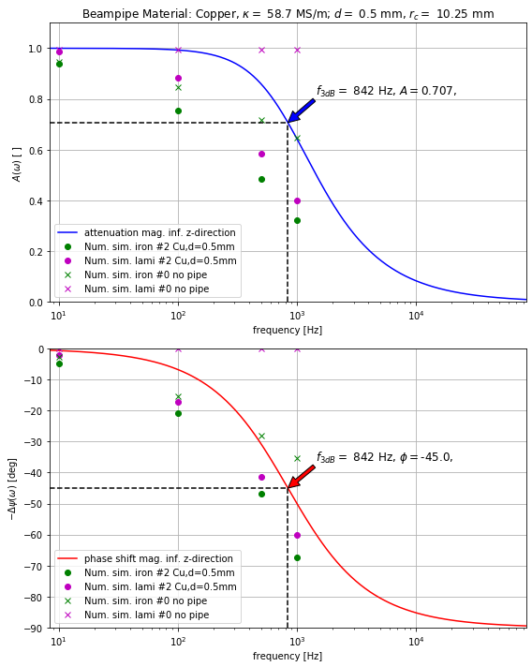













Vacuum chamber
Eddy currents in the vacuum pipe
Reminder: The 3D effects will come on top! Plot by M. Marx and H. Schlarb
$$a=10 mm$$
$$d=1 mm$$
$$D_{out}=23 mm$$
A thin pipe approximation can be used to model the transfer function of vacuum pipe’s eddy current effects
$$G_{vac}=\frac{ω_{0}}{(s+ω_{0})}$$
$$ω_{0}=\frac{1}{τ}$$
$$τ=\frac{1}{2}μ_{0}σad$$
$$μ_{0}=4π×{10}^{−7} H/m$$
$$σ_{Cu}=59{×10}^{6}{(Ohm.m)}^{−1}$$
$$a_{Cu}=10{×10}^{−3}m$$
$$d_{Cu}=0.5{×10}^{−3}m$$
$$f_{−3dB}(Cu)=850 Hz$$
$$σ_{SS}=1.35{×10}^{6}{(Ohm.m)}^{−1}$$
$$a_{SS}=10{×10}^{−3}m$$
$$d_{SS}=1{×10}^{−3}m$$
$$f_{−3dB}(SS)=18 kHz$$
Vacuum pipe was decided to change from Cu (0.5 mm) to SS (1 mm) under fast correctors

Slide 11
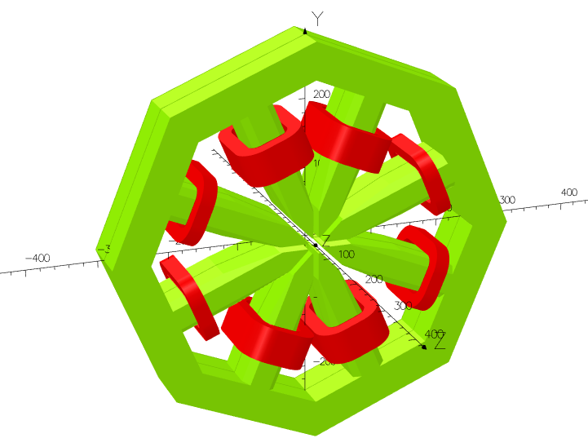
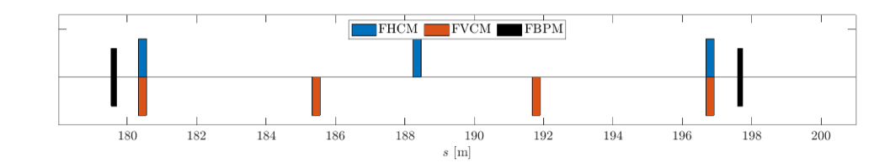
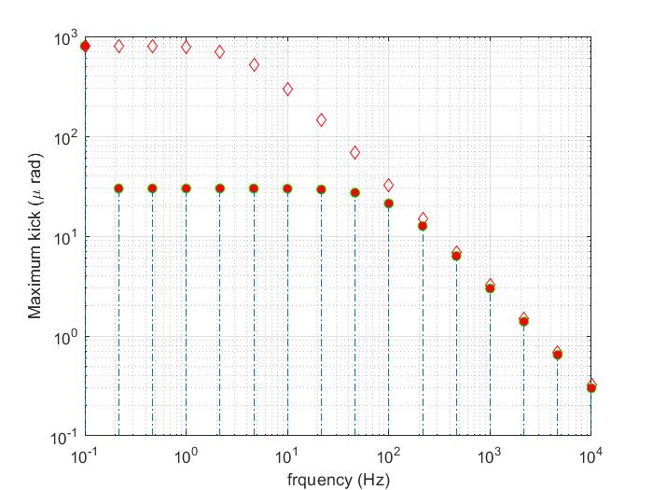
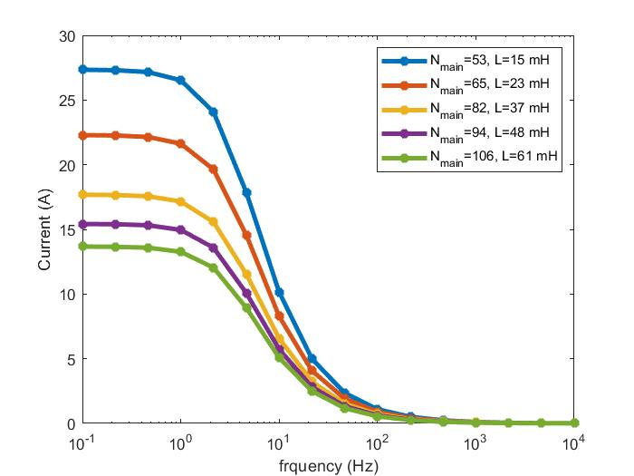
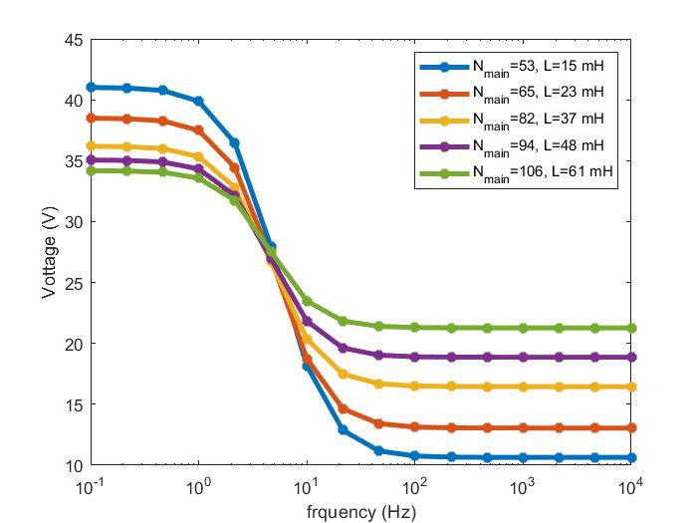
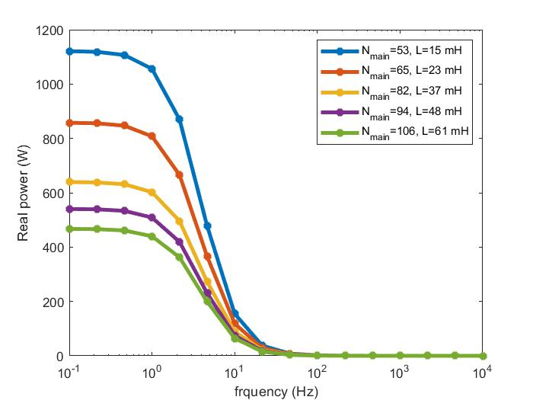





Corrector magnets
Fundamental design and specs. of power supply
Machine Physics requirement:
Fast magnet max. kick = $30μrad$
Slow magnet max. kick = $800μrad$
FOFB system requirement:
Same transfer function for each corrector magnet
Design provided by
Alexander Aloev.
Transition between slow
and fast kick requirement
Number of turns in one main coil | Number of turns in one auxiliary coil
200 | 83
147 | 61
53 | 22
106 | 44
159 | 66
94 | 39
188 | 78
135 | 56
171 | 71
176 | 73
118 | 49
183 | 76
41 | 17
82 | 34
123 | 51
164 | 68
65 | 27
130 | 54
195 | 81
193 | 80
Slow magnet
max. kick
$$θ_{max}(f)$$
Available correctors:
~ 650 slow correctors per plane
200/322 fast corrector per H/V plane
Combined function magnets
$$I_{max}(f)$$
Fast magnet
max. kick
What matters? The design of P.S. (µ-TCA to Giant P.S.)
Required max. current and voltage of P.S for DC as well as high frequency action
Power to be dumped as heat
Physical size of the magnet
$$V_{max}(f)$$
$$P_{max}(f)$$

Slide 12
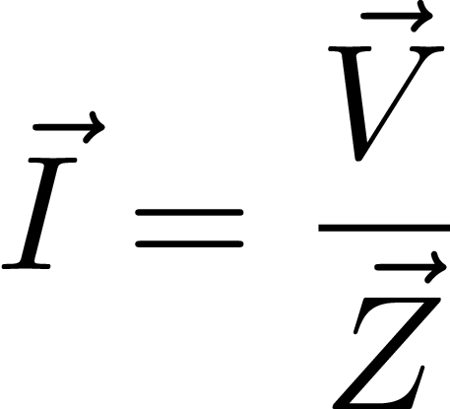
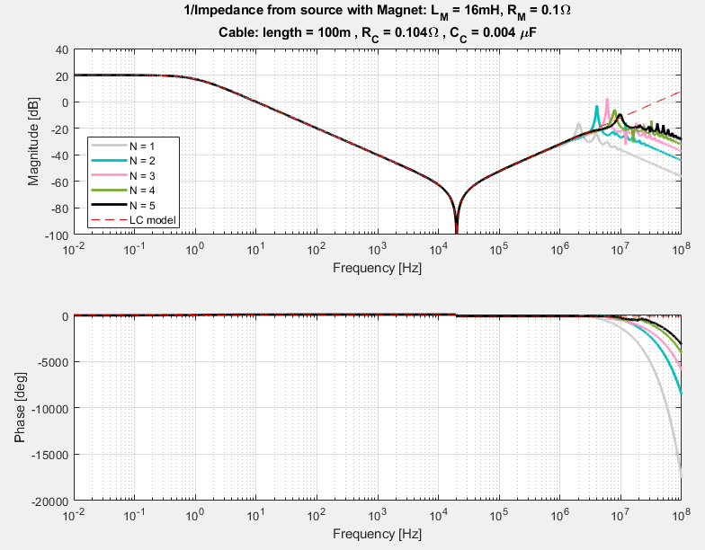
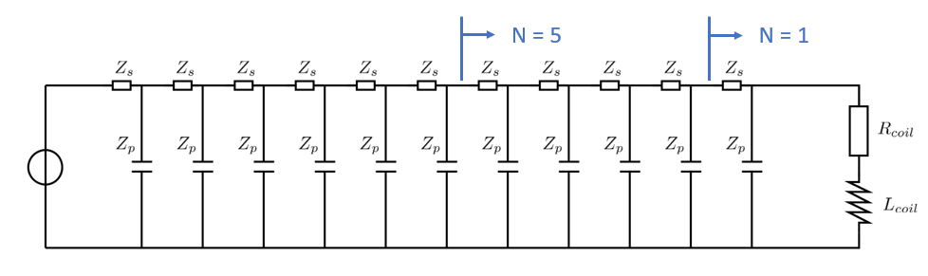
Magnet – cable characteristic
Long cables required from P.S. buildings to magnets
Current at source as given by impedance
Complex impedance computed by piecewise staging of cables with propagation time of 2/3 c
High frequency > f_{notch} dominated by cable
Low frequency < f_{notch} dominated by magnet
300m cable
length

Slide 13
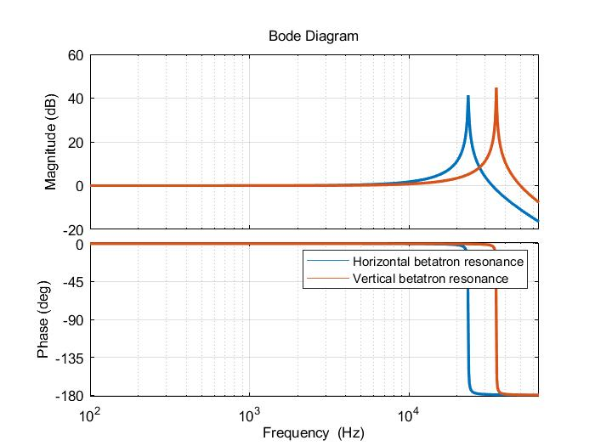

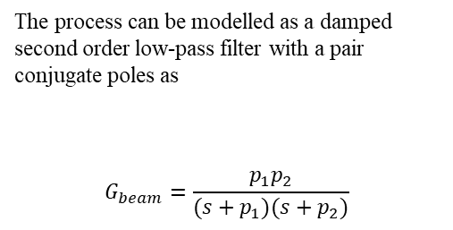
Betatron Oscillation and FOFB system
Relevant for PETRA IV, being the largest in circumference?
Betatron frequency = non-integer tune $×$ revolution frequency
$$ω_{t,x}=2π (0.18 ×130.208333 kHz)=2π(23.4375 kHz)$$
Resonant phenomenon i.e. once excited it remains in oscillations?
$$ω_{t,y}=2π \left(0.27 ×130.208333 kHz\right)=2π \left(35. 15625 kHz\right)$$
That’s not true, we have damping in the synchrotron and damping time ~ 10 ms for PETRA IV
The process can be modelled as a damped second order low-pass filter with a pair conjugate poles as
$$G_{beam}=\frac{p_{1}p_{2}}{(s+p_{1})(s+p_{2})}$$
Resonant poles of Betatron oscillations
$$p_{i}=\left(−\frac{2π}{τ}±jω_{t}\right)$$
Ref: Yao Cheng, Dynamic Closed orbit correction

Slide 14
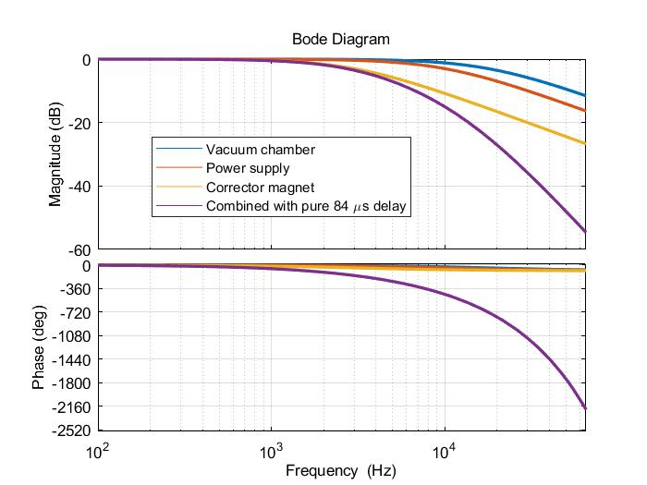
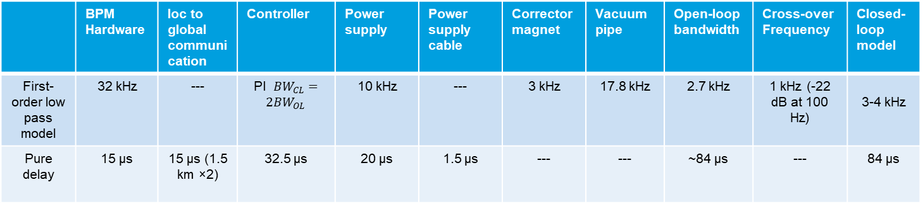
PETRA IV FOFB SISO analytical modeling
Open-loop dynamics
 | BPM Hardware | loc to global communication | Controller | Power supply | Power supply cable | Corrector magnet | Vacuum pipe | Open-loop bandwidth | Cross-over Frequency | Closed-loop model
First-order low pass model | 32 kHz | --- | PI ${BW}_{CL}={2BW}_{OL}$ | 10 kHz | --- | 3 kHz | 17.8 kHz | 2.7 kHz | 1 kHz (-22 dB at 100 Hz) | 3-4 kHz
Pure delay | 15 µs | 15 µs (1.5 km ×2) | 32.5 µs | 20 µs | 1.5 µs | --- | --- | ~84 µs | --- | 84 µs
First estimate, should reduce

Slide 15
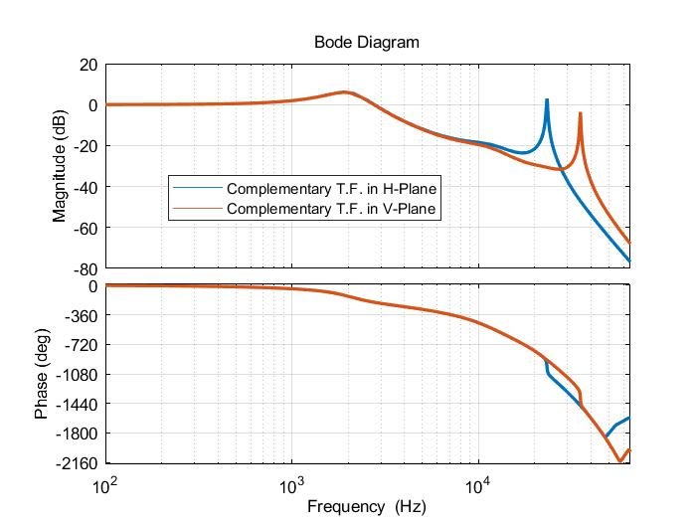
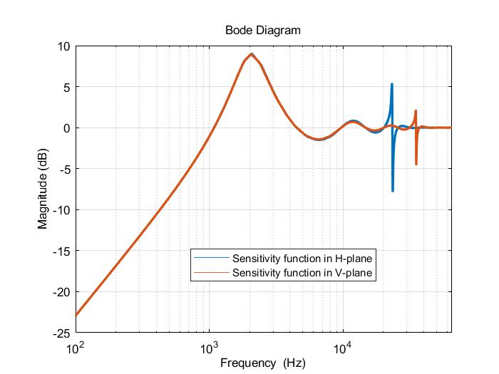
PETRA IV FOFB SISO analytical modeling
Closed-loop dynamics
APS case
Special for PETRA IV:
Betatron frequencies (23. 43 kHz/35.15 kHz) shall be relevant for PETRA IV FOBS system.
Synchrotron frequency of ~ 600 Hz (within the bandwidth of FOFB system)
APS reported such effect at 1.8 kHz during tests for APS-U.

Slide 16
Stability criteria and experiments

Slide 17
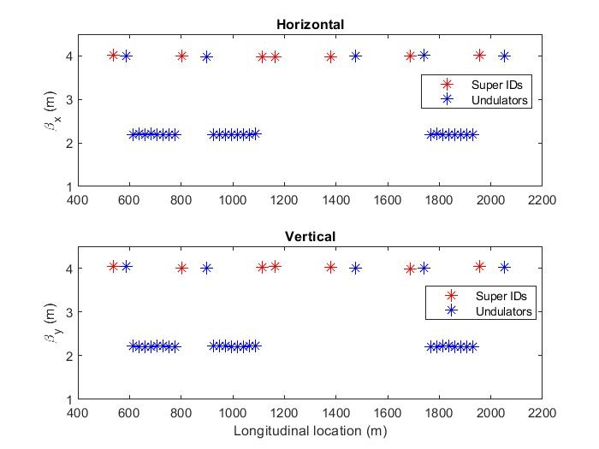
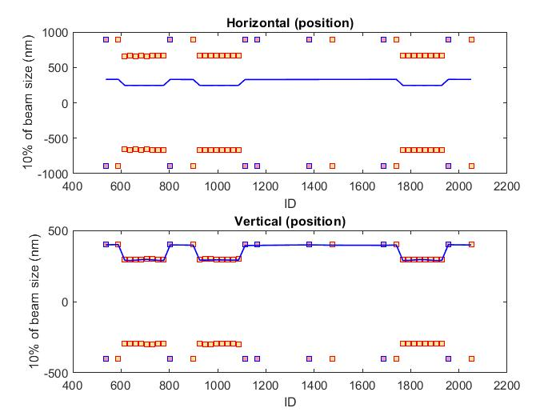
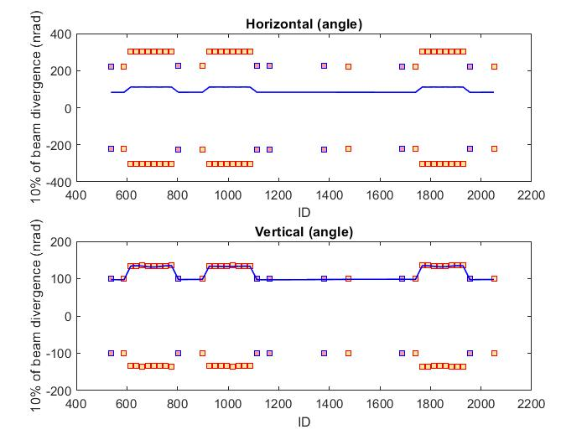



Stability criteria and P.S. ripple (simulation)
The RMS orbit at Undulators (29) and Super IDs (7)
RMS variation of electron beam (and pointing angle) to 10% of the beam size (and divergence).
Beta function at IDs
$$σ_{e}= \sqrt{βε+ σ_{E}^{2}η^{2}}$$
$$σ_{e}^{/}=\sqrt{\frac{ε}{β}}$$
$ε$ is the beam emittance. (20 pm.rad (H) and 4 pm.rad (V)) .
  Y-plane: 300 nm / 134 nrad (RMS) →
  X-plane: 660 nm/ 300 nrad (RMS)
$9 nrad$ → ${10}^{−5} PS noise$
$$900 μrad (full scale)$$
±10% of beam size in both planes
±10% of beam divergence in both planes
RMS orbit position ripple
RMS orbit angle ripple

Slide 18
Integration with Experiments
FOFB local / global integration of X-ray diagnostics and users
Sorting of magnets / BPMs for local (closed bump) and global FOFB integration and error handling
Communication with experiments
Share common timing system – time stamped signals
Integration of new detectors and users
Mechanical movement often BW limited < 100Hz
  monochromator crystals, mirrors etc
Piezo crystals might push BW in sub-kHz regime
Electron based feedback with increased bandwidth (~kHz) and low latency

Slide 19
Interaction with other facilities
Benefitting from community
SIRIUS Brazil
Corrector magnet and P.S specs ……
ALBA Spain
Inclusion of XBPMs in the fast orbit feedback system……(Laura Torino)
Advanced Photon Source
Magnet design
John Carwardine (FOFB system)
I-tech Slovenia for BPMs
White-box models for the beam position calculation…..
BESSY Berlin
Collaboration and periodic discussion with experts (Guenther Rehm)
Looking forward to other facilities learn more and collaborate
Special thanks to all groups at DESY contributing to the project.

Slide 20
Summary and Outlook
Including some open points
Conceptual design is unfolded
  Simulation framework (MADX/AT)
Requirements for FOFB system are not fully defined yet (progressing)
There are some special features of FOFB system for PIV
  Betatron and synchrotron frequencies
  One turn closed orbit
  Latency uncertainty depending on relation location of correctors/BPMs
  Long cables (adding capacitance and inductance to corrector magnet)
  Combined function magnets with much larger DC kick
Outlook: Open points:
  Finalizing specifications for corrector magnets and their power supplies.
  Cables selection between power supply (supply building) and corrector magnets (inside tunnel)
  BPM processing mode for latency optimization and noise (pros and cons)
  Integration of experiments (new detectors)
  Optical fiber communication in tunnel (radiation hardness)
  Injection scheme and its effect on global orbit
  …………

Slide 21
Thank you
Sajjad H. Mirza
MSK
sajjad.hussain.mirza@desy.de
+49 40 8998 1991

