Slide 1
ELI Beamlines
Overview of a control system of a high-power laser facility
Karel Majer
DEELS ’22, Berlin, 07/06/22

Slide 2
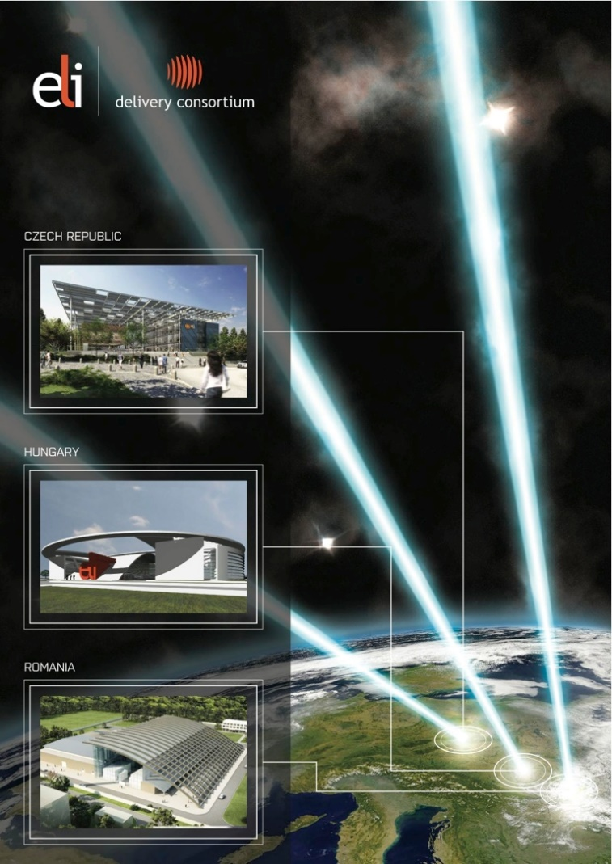
ELI (Extreme Light Infrastructure)
World's largest and most advanced high-power laser infrastructure and a global technology and innovation leader in high-power, high-intensity, and short-pulsed laser systems.
First ESFRI Landmark constructed in the Central Eastern European Member States. Three world-class high-power, high-repetition-rate laser facilities have been established in Czech Republic (ELI Beamlines), Hungary (ELI-ALPS) and Romania (ELI-NP).
The commissioning of the facilities is foreseen to be completed in 2022-2023.

Slide 3
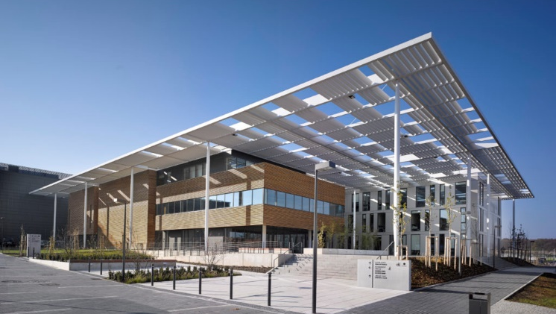
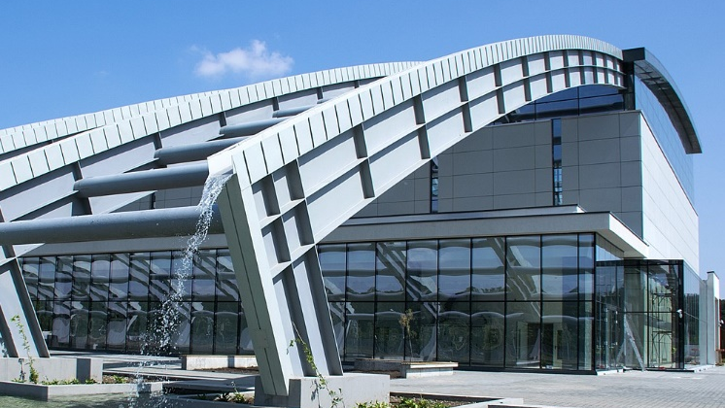
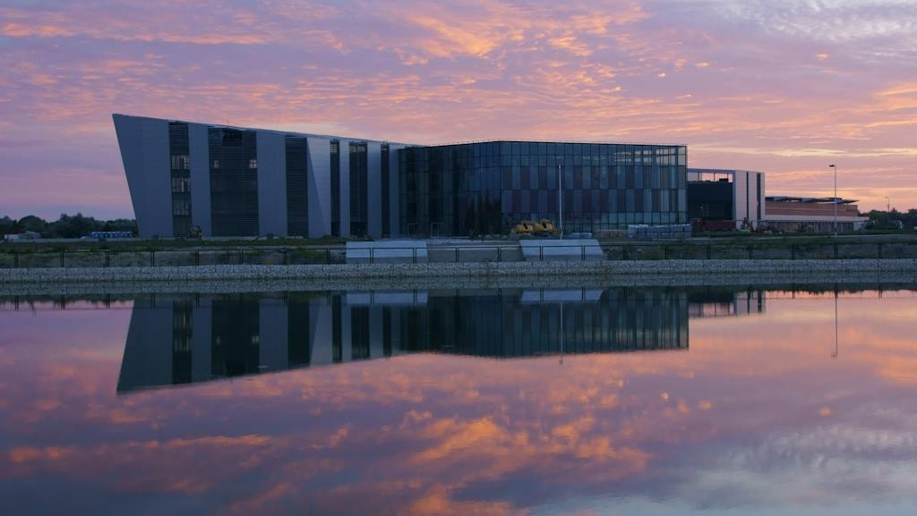
ELI facilities
ELI-ALPS (Szeged, HU)
Ultra-short pulses from THz to X-rays
Attosecond science (electron processes, chemical reactions)
ELI Beamlines (Prague, CZ)
4 high-power fs laser systems
Particle acceleration, X-ray generation, plasma science
ELI-NP (Magurele, RO)
2x10 PW laser
Gamma beam source (to 19 MeV)
Nuclear physics

Slide 4
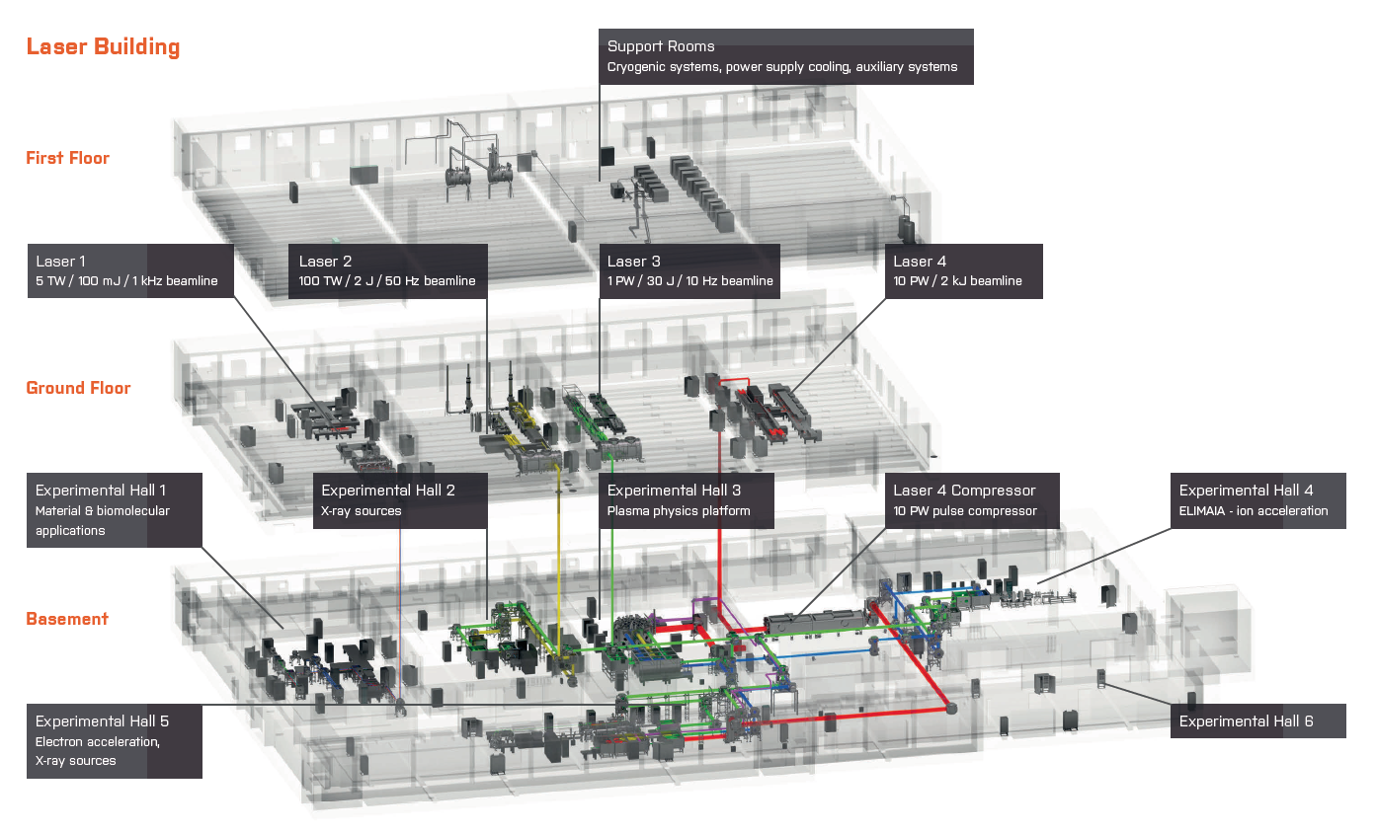
ELI Beamlines facility

Slide 5
ELI Beamlines lasers
Beamline | L1 | L2 | L3 | L4
Peak power | 5 TW | 100 TW | 1 PW | 10 PW
Pulse energy | 100 mJ | 2 J | 30 J | 1,5 kJ
Pulse length | 20 fs | 15 fs | 30 fs | 150 fs
Re. rate | 1 kHz | 50 Hz | 10 Hz | 0,1 Hz
Developer | ELI Team | ELI Team + Rutherford Appleton Laboratory | Lawrence Livermore National Laboratory + ELI Team | National Energetics + Ekspla + ELI Team
Technology | Diode pumping, OPCPA | Diode pumping, OPCPA | Square beam 214 mm x 214 mm, Ti:Sapphire amps and diode and Nd:glass pump lasers | Square beam 625 mm x 625 mm, Discharge lamp pumped Nd:glass amps + OPCPA pre-amps

Slide 6
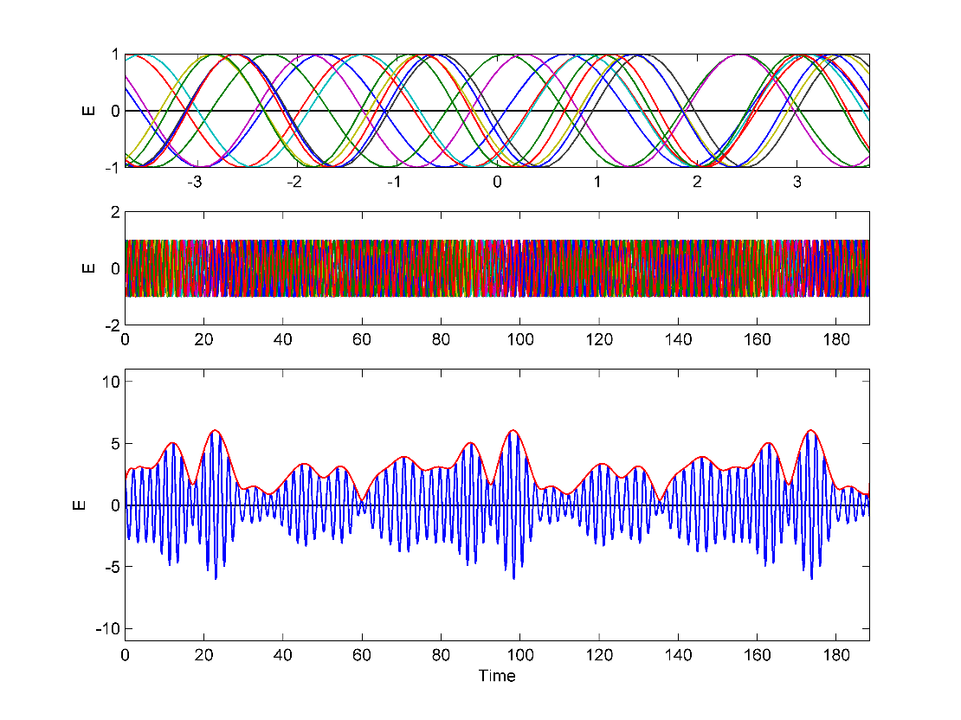
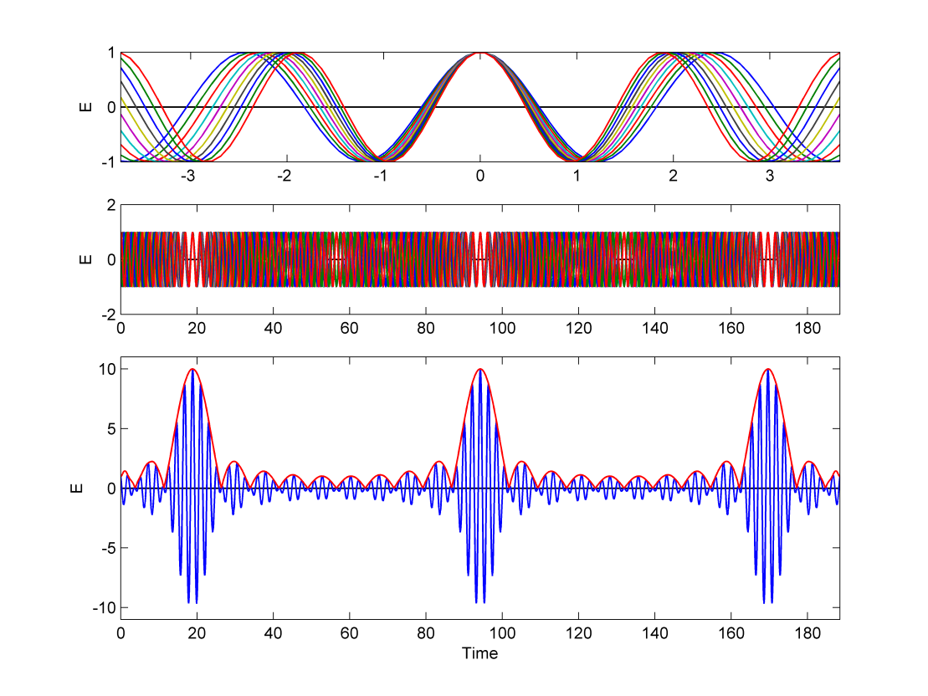
Mode locking

Slide 7
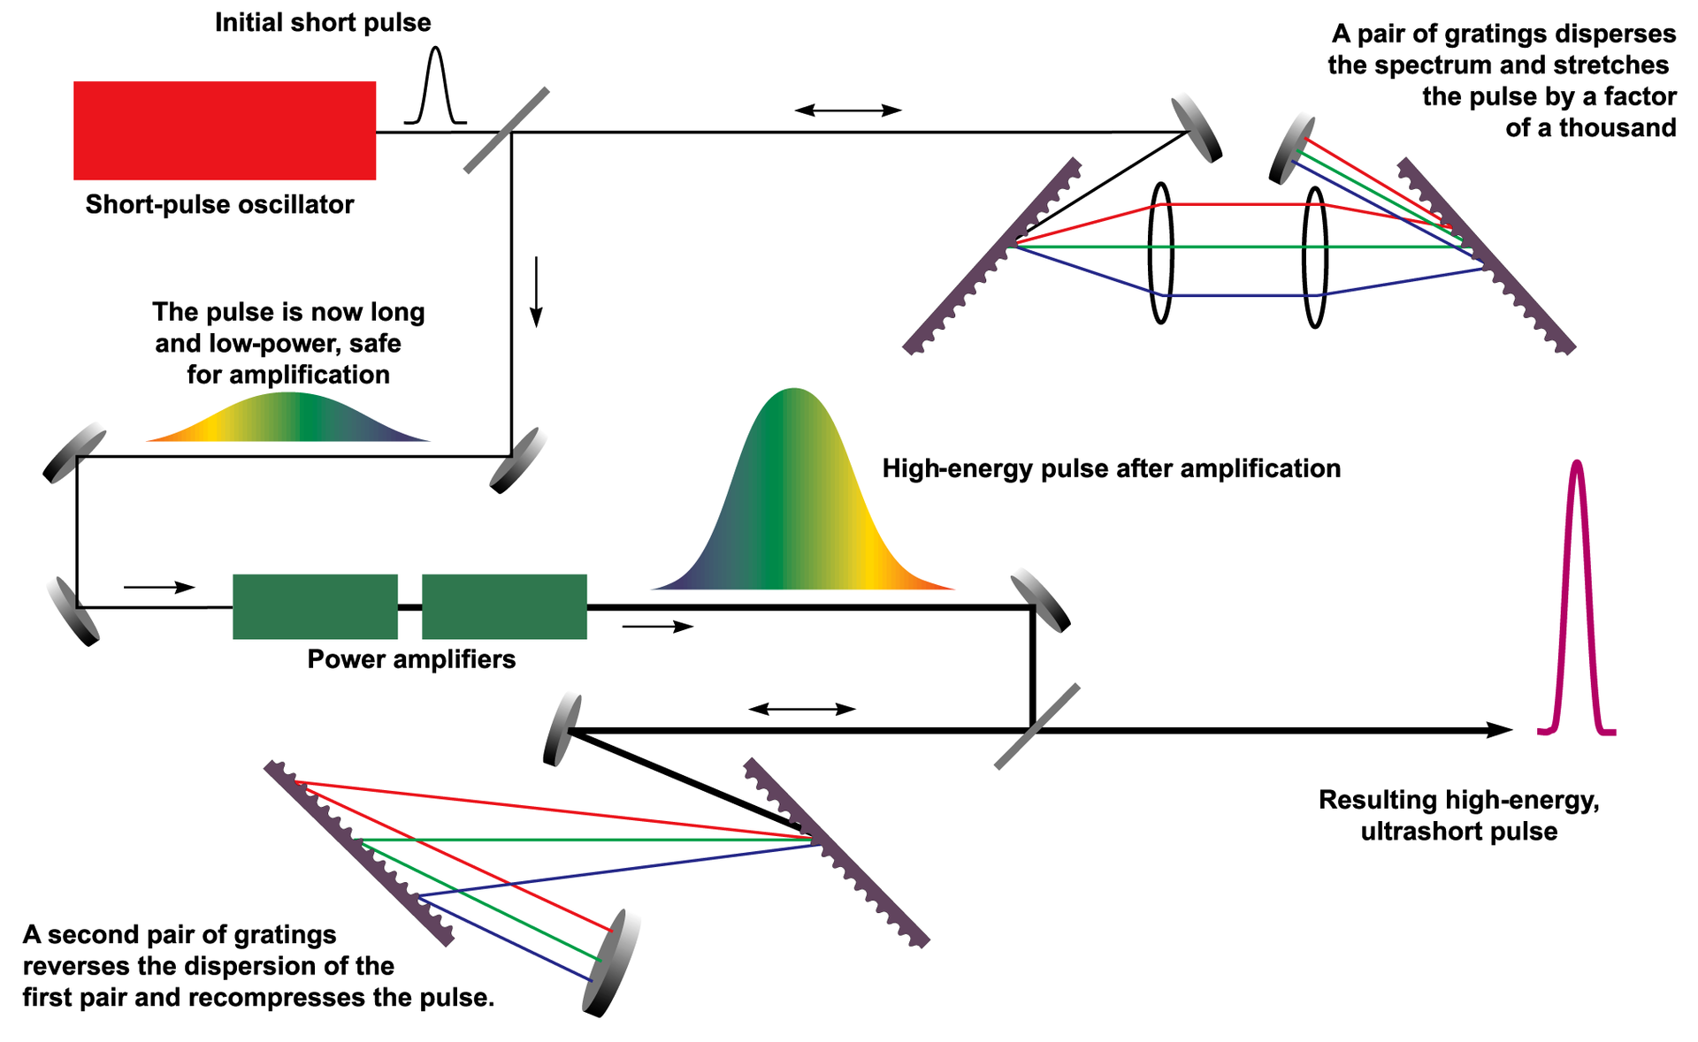
Chirped pulse amplification

Slide 8
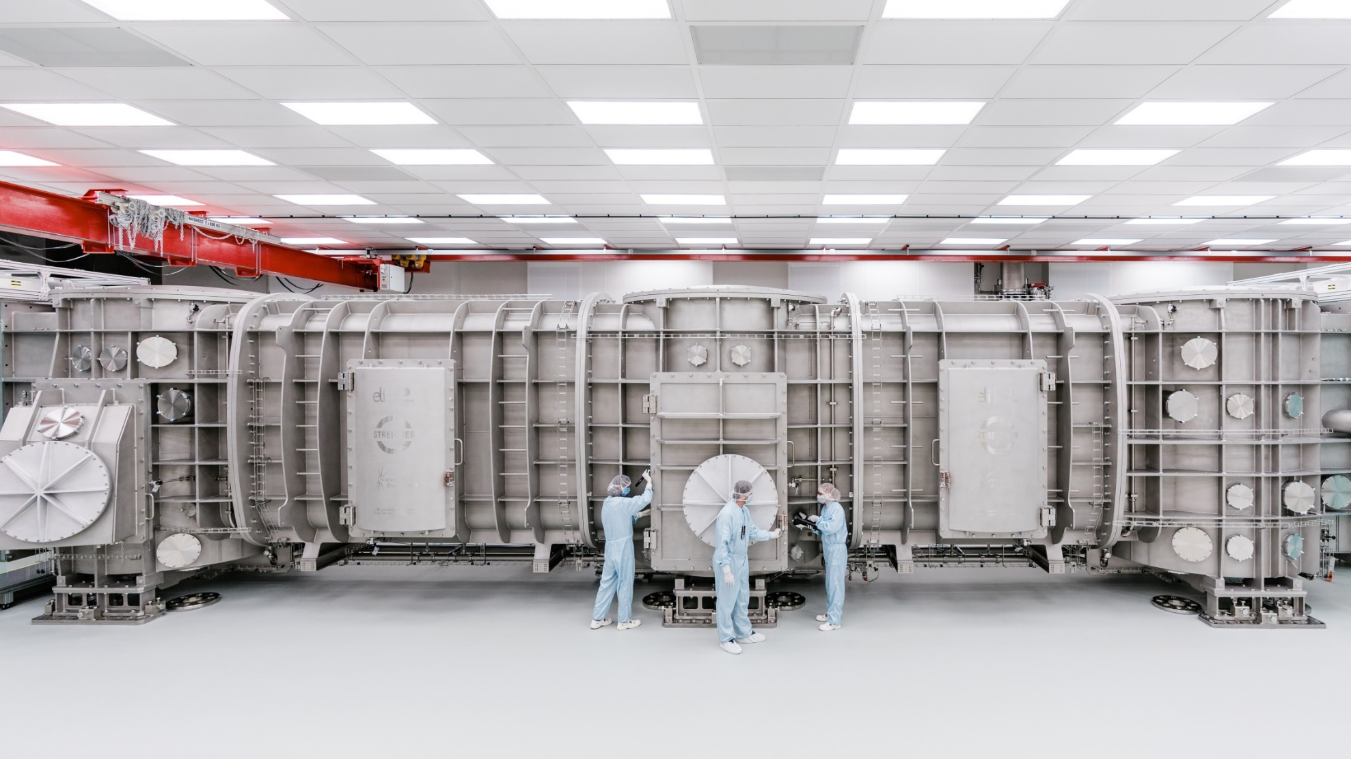
L4 compressor chamber

Slide 9
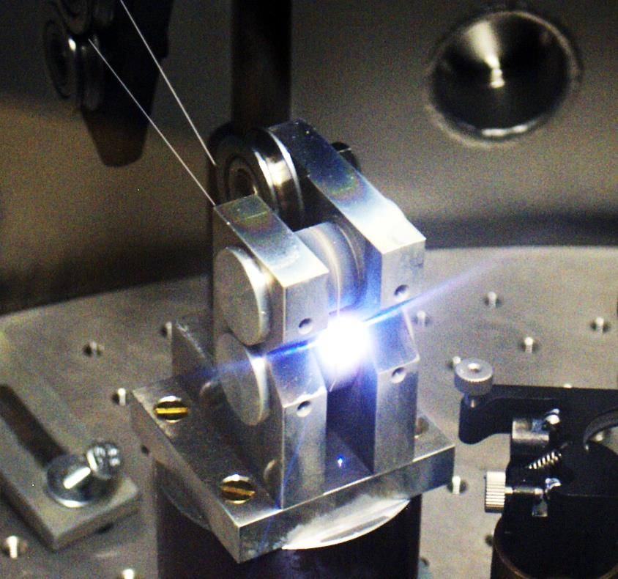
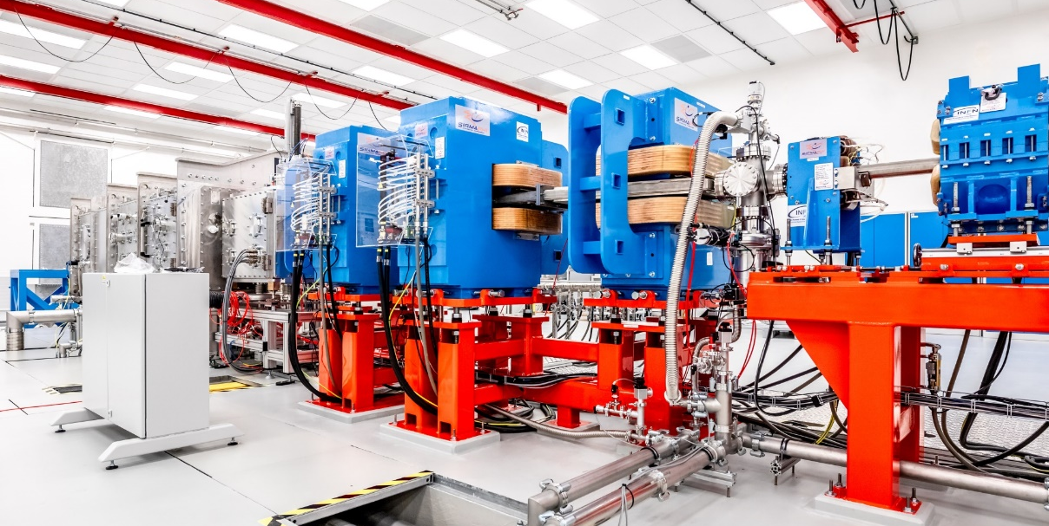
ELI Beamlines experiments
Laser as X-ray source:
Laser beam -> plasma -> electrons accelerated by EM field -> X-ray beam
Bio/molecular research
Plasma physics
Particle acceleration
X-ray sources
Exotic physics
ELIMAIA – ion acceleration

Slide 10
ELI Beamlines laser control system

Slide 11
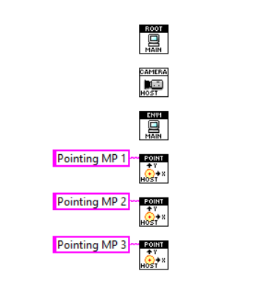
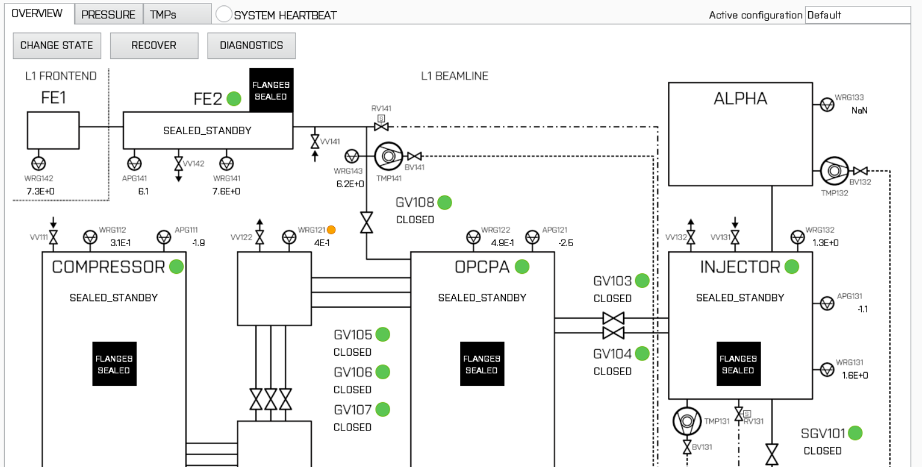
Software architecture
Device monitoring & EPICS
Cameras
Environment monitor
Mostly programmed in LabVIEW – many parallel processes on each controller
LabVIEW-native EPICS implementation (Obsevatory Sciences, modified by ELI)
Easy setup of PVs in MySQL configuration database
LabVIEW framework for creating EPICS-based GUIs
3x pointing

Slide 12
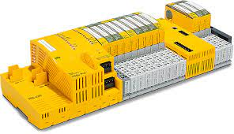
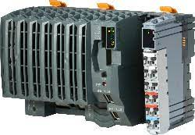
Safety systems
Personnel safety
Pilz PLCs (SIL rating)
Controls when laser may be turned on and propagated
State machine paradigm for each area
  No emission
  Low power
  High power
Radiation confined to experimental halls, separate monitoring system (contractor)
Machine safety
Pilz or B&R PLCs
Guarantees valid laser beampath
Beamline divided into zones
  No emission, low power, high power
Vacuum control
NI RIO (with FPGA) or B&R PLCs
Big volumes, separate roughing and forevacuum primary pumps
Abstraction to a set of state machines

Slide 13
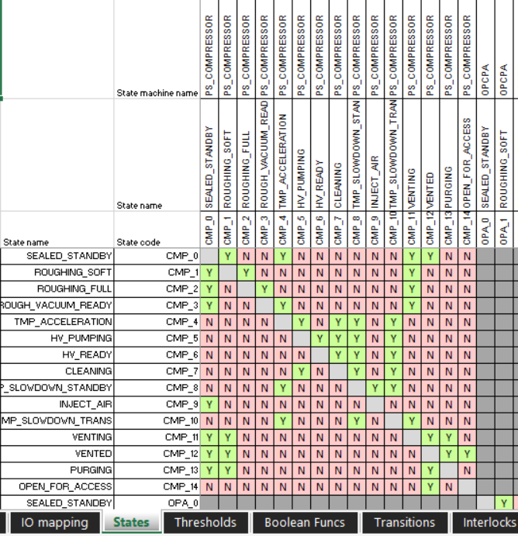
Common system description
We can abstract many systems to a set of Mealy state machines:
Personnel safety (6)
Machine safety (7)
Vacuum control (10+)
Pneumatics control (2)
Environment monitors
Fast interlock for 1 kHz laser
Unified description format for all of them
Systems fully described in Excel spreadsheets

Slide 14
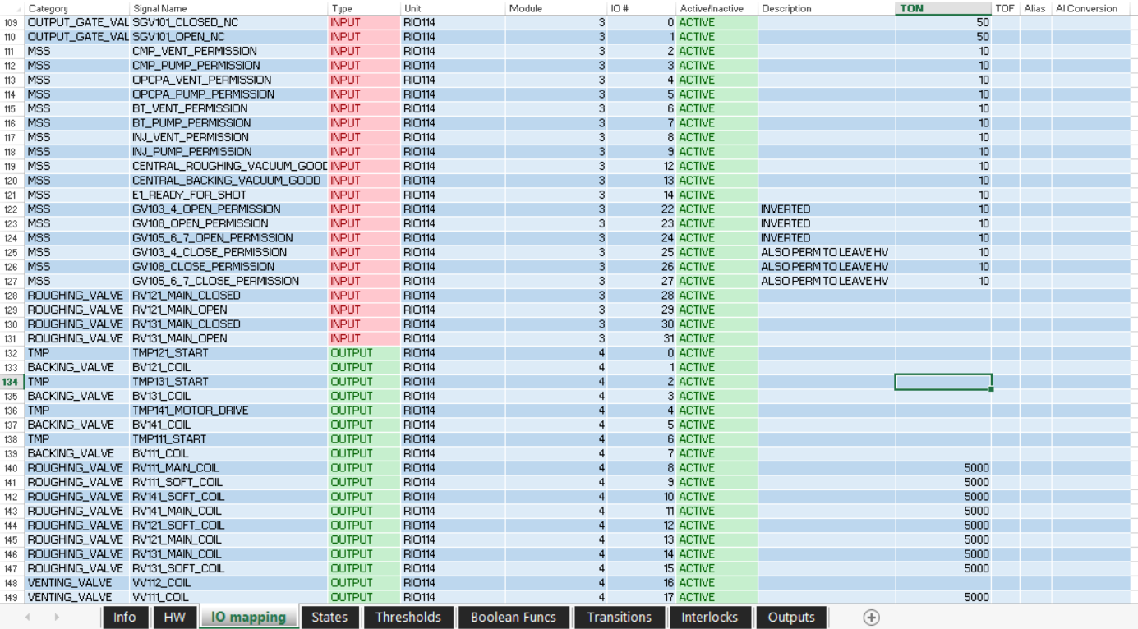
Description in a spreadsheet
IO declaration

Slide 15
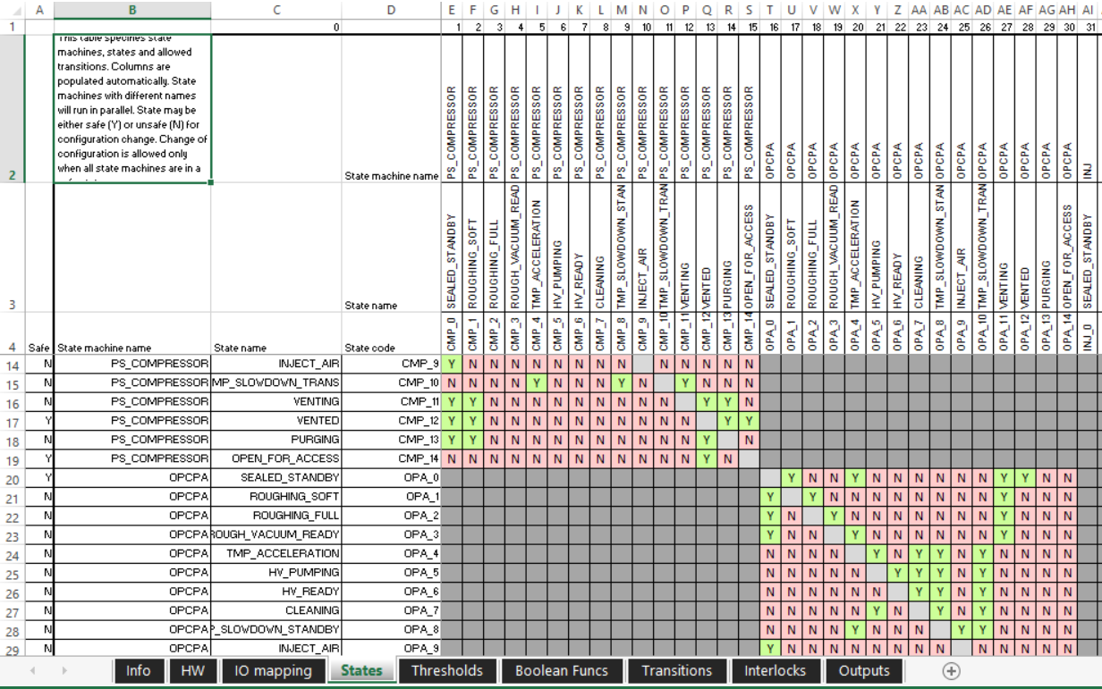
Description in a spreadsheet
Transition matrix

Slide 16
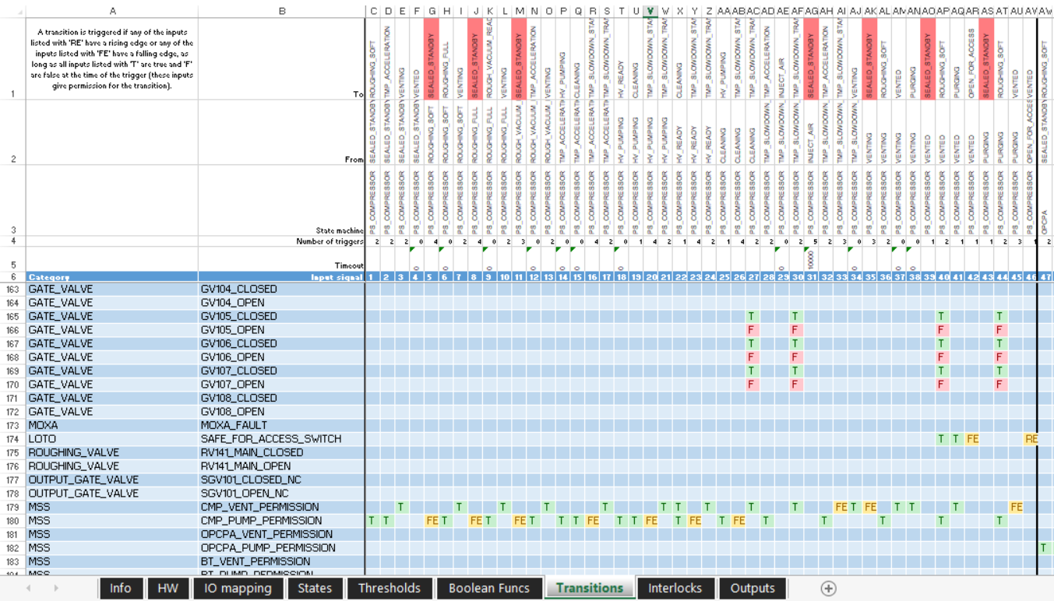
Description in a spreadsheet
Triggers & permissions

Slide 17
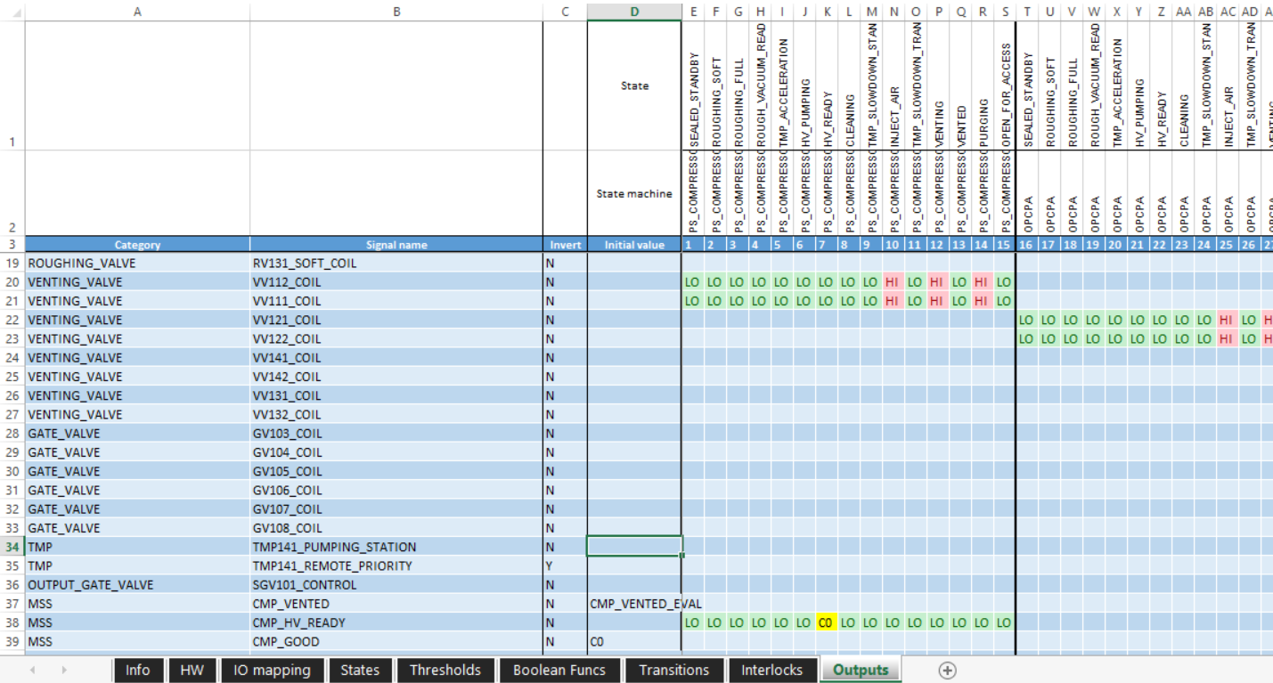
Description in a spreadsheet
Outputs

Slide 18
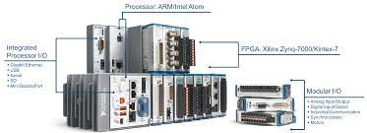
Code generators
Full description in spreadsheet – can we program systems only by changes in Excel?
Yes, we can! (although some people don’t believe that)
LabVIEW parser to extract data from Excel to LabVIEW dictionary or JSON
System description passed to scripters developed for each application type
Unified simulation and diagnostics tools

Slide 19
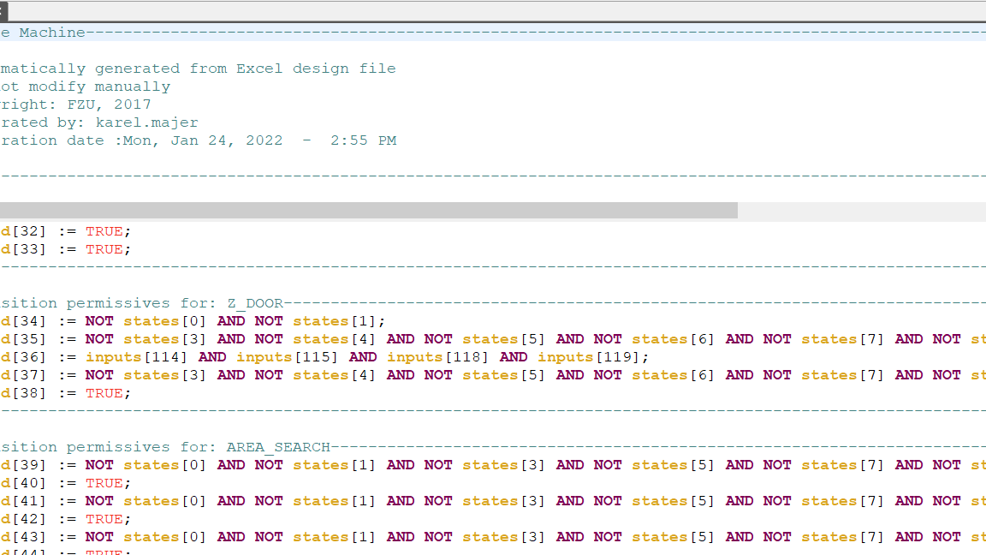
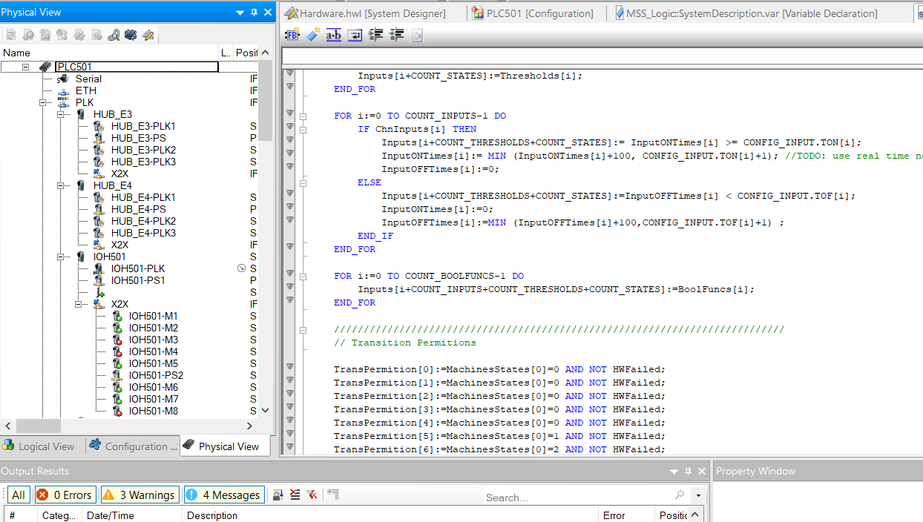
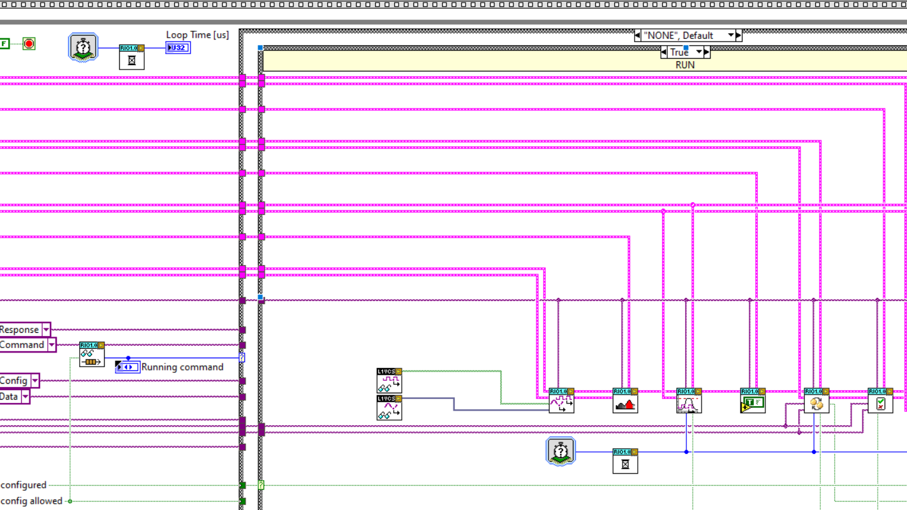
Code generators
LabVIEW FPGA scripter
FPGA runs spreadsheet interpreter
System description stored in RAMs
Generated RAM and IO definitions
Configuration changes – only RAM contents -> no recompilation
Pilz scripter
Generates “hardcoded” ST code
PAS4000 API used to create ready-to-build project
Verified for safety-rated applications
B&R scipter
Generates XML files to create ready-to-build project
Partially “hardcoded” ST code
Dynamic version under development

Slide 20
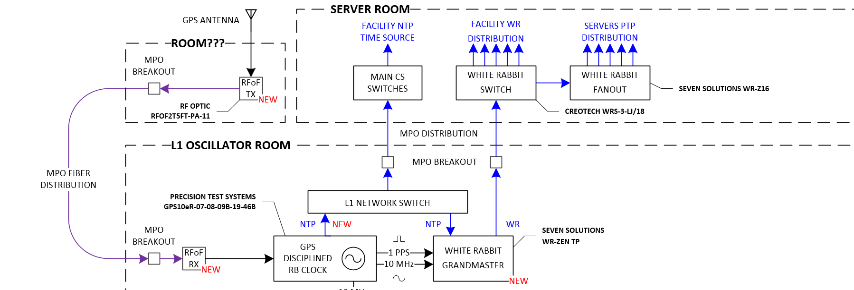
Timing system
GPS – timestamp + 1 pulse per second
Rb clock as GPS receiver
-> 1 PPS, 10 MHz, NTP timestamp to White Rabbit grandmaster
White Rabbit distributed through facility to synchronize all lasers and experiments
Timestamping not too difficult, we know when an event (shot) occurs, highest rep rate 1 kHz

Slide 21
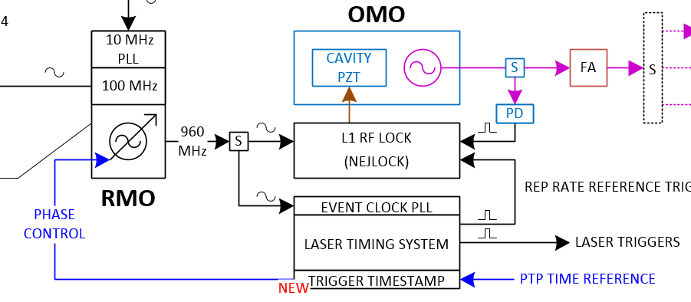
Timing system
Seed laser – usually 80 MHz Ti:Sapphire optical oscillator
RF oscillator + feedback loop to compensate for frequency drift in optical cavity
ETS generates 1 kHz trigger signals -> pulse picking in Pockels cells -> 1 kHz laser
1 kHz trigger distributed through beamline

Slide 22
Data presentation
LCS team gather data, but do not operate lasers nor run experiments
Direct access to controls confined to integration layers – only in control rooms
Operators require data even in offices or remotely

Slide 23
Thank you
Karel Majer
karel.majer@eli-beams.eu
Acknowledgement: Birgit Plötzeneder, Jack Alexander Naylon

