Slide 1
Notes:
Slide 1: Company Logo Full Page
Before you start editing the slides of your talk change to the Master Slide view:
Microsoft Office :Menu: View > Slide Master;
Macintosh – View > Master > Slide Master
Edit the following items:
On the Slide Master (first master slide) – lower area
a) On the left Delete the text and write the title of the event/Conference, Location
b) On the right delete the text and write the name and surname of the speaker and the date (day, month , year)
Close Master View

Slide 2
Beam position interlock for Elettra 2.0 storage ring R. De Monte G. Brajnik Elettra - Sincrotrone Trieste
Notes:
Slide 2: Title of the Presentation
Before you start editing the slides of your talk change to the Master Slide view:
Microsoft Office :Menu: View > Slide Master;
Macintosh – View > Master > Slide Master
Edit the following items:
On the Slide Master (first master slide) – lower area
a) On the left Delete the text and write the title of the event/Conference, Location
b) On the right delete the text and write the name and surname of the speaker and the date (day, month , year)
Close Master View
To start adding slides insert a new slide and select a Layout:
For Title & Subtitle
For text with bullet points
For Text
For Picture, graphs, visuals
Two columns
Blank

Slide 3
Elettra1 beam position interlock overview
Elettra1 storage ring has 11 Insertion Devices on straight sections.
The light generated by some of these IDs can have up to 7 KW per mm² of power
If the light is in the wrong position it could damage some components, up to the breaking of the vacuum chamber.
When IDs are closed, the beam trajectory on these straight sections must be monitored to avoid dangerous light trajectories.
If a wrong/dangerous position is detected, the stored beam must be “killed”.

Slide 4
Elettra1 beam position interlock requirements
The beam position monitoring system must be :
Capable to monitor TWO BPMs to calculate the angle and the displacement of the trajectory
Failsafe: in case of failure of any part, the beam must to be killed
With as few hardware components as possible (as Ford taught us)
With software as simple as possible in a deterministic environment

Slide 5
Elettra1 beam position interlock overview
In Elettra 1, the trajectory on the ID is affected by the presence of two correctors between the two BPM’s.
H & V
Corr.
Insertion Device
H & V
Corr.
Bending Magnet
BPM
IN
BPM
OUT

Slide 6
Elettra1 beam position interlock strategy
Due to the presence of two correctors between the BPMs (before and after the ID), the trajectory interlock strategy is based on “relative position”.
That means in case of users dedicated run:
Injection of full current in the ring
Correct the whole machine orbit
Check the trajectory on every ID section for correct values
Close the ID’s, only if the c) point is passed
Zeroing the relative angle/position computation of the trajectory interlock
Continuously monitor these constraints:
Xmax < | 1.42 Xout - 0.42 Xin | (4mm)
Ymax < | 1.52 Yout - 0.52 Yin | (2mm)
if any of these two conditions aren't met “kill” the stored beam

Slide 7
Diode BPM
A Beam Position Monitor system based on an envelope detector has been developed for ELETTRA1. It is a four-channel system based on a broadband Schottky diode that reads the four voltages from button pickups, in parallel of a Libera Electron.
The analog bandwidth of the detector is less than 1 kHz, while the computation unit have a refresh rate of 10Hz.
With this system we add some redundancy on the fast position interlock in order to protect the vacuum chamber from incorrect positions / angles of the beam, making it easier to supervise the position of two BPMs at the same time.

Slide 8
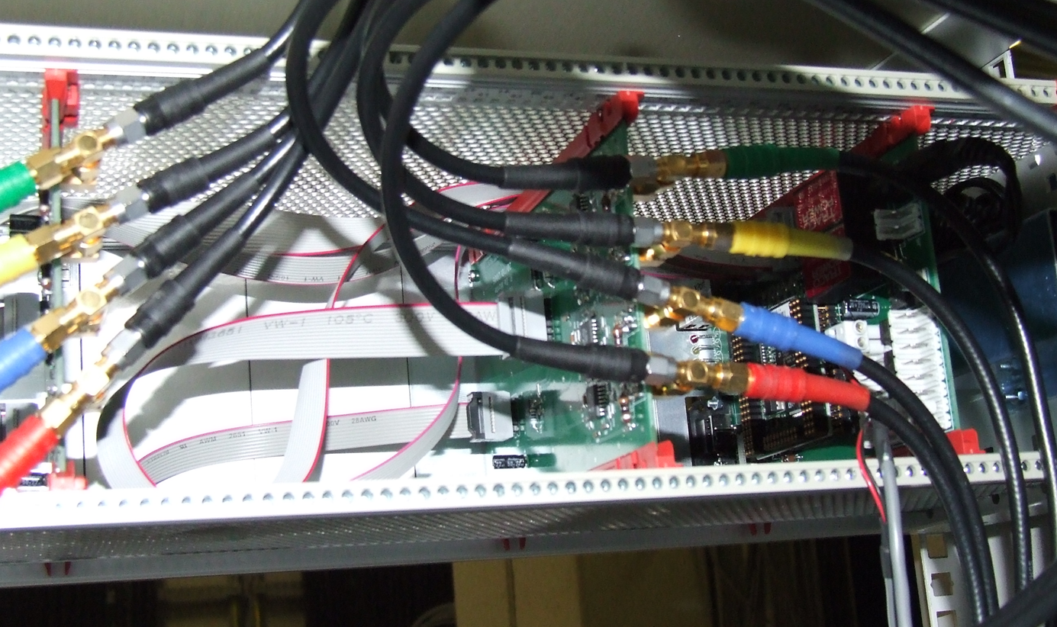
Elettra1 beam position interlock implementation diagram
a
b
a
b
PRE-ID
BPM
BPM n.3
BPM n.4
POST-ID
BPM
c
d
c
d
DIODEBPM A
ADC &
position Meas.
Offset control
System
Position Interlock
computation
DIODEBPM A
DIODEBPM C
DIODEBPM C
DIODEBPM D
DIODEBPM D
DIODEBPM B
DIODEBPM B
Digital BPM
Libera Electron
Digital BPM
Libera Electron
Elettra control system
PLC FailSafe
ILK enable
PLC FailSafe
Beam kill signal
Elettra global
feedback system
Elettra MPS PLC

Slide 9
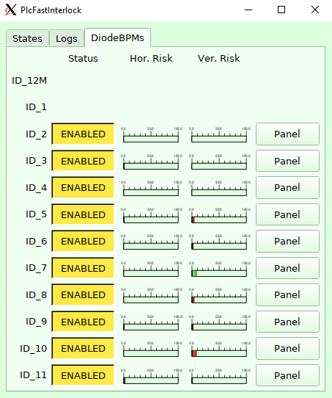
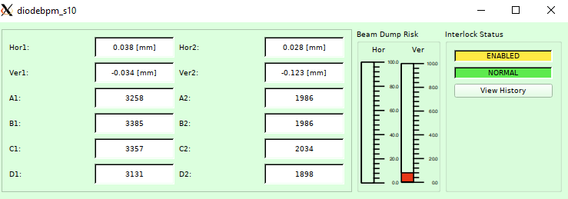
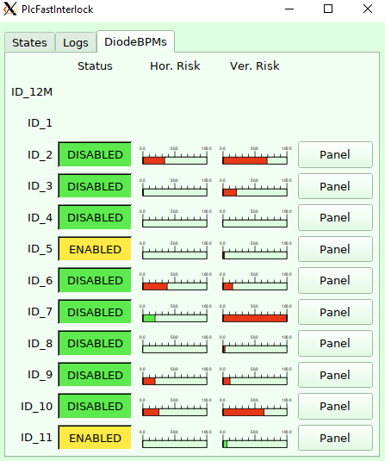
Control room panels
Normal operations
After beam loss for thuderstorm

Slide 10
Who killed the beam?
This question was asked very often when the interlock sources were not monitored fast enough.
The problem arises when the single BPM unit has to decide that the beam is in a dangerous position and therefore must be quickly interrupted. Since the software has to be simplest as possible, and the intervention time is few milliseconds, the beam kill signal is generated from any single device also if the wrong position computation is caused by a loss of beam.
That means that multiple beam kill signals are generated from the DiodeBPM devices nearly at the same time.
Actually the PLC is able to discriminate which was the first DiodeBPM, but it cannot discriminate if the beam has been lost for other reasons (power supply failure, RF failure or spurious kicker shoot).
For this discrimination a fast beam loss detector system has been developed. It consists in a series (4) of digitizer boards that acquire multiple signals @ 4x revolution clock frequency. The signal are : fast DCCT, RF power level from cavities, the PLC interlock OUT, the injections signals, and in general all the signals that can cause a beam dump. In case of beam dump a snapshot of all of these signals Is taken and the operator can check for the real (first) source.
Hopefully until now the system reacted properly and in time to protect the Elettra1 from any damage.

Slide 11
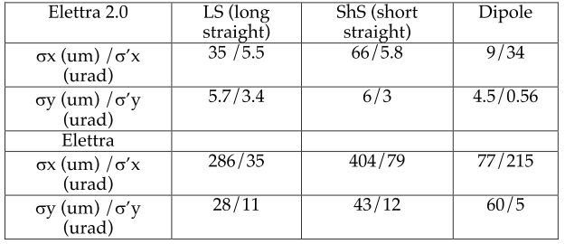
Elettra2 main parameters
Notes:
Slide 3 – (..) : Content of the presentation
Insert a new slide: Home > “New Slide” and choose a slide Layout:
For Title & Subtitle
For text with bullet points
For Text
For Picture, graphs, visuals
Two columns
Blank
If you want Copy & paste an element from the Clip Board to the particular slide: 1. Click on a box to mark it.
2. Position the mouse pointer on the box frame: Copy! 3. Click on the particular slide: Paste!
How you intend to use the elements is your choice. You can combine the text block style with the background colour in different manner.

Slide 12
Elettra 2.0 light sources
Ten long straight sections are occupied by IDs, while one straight is reserved for the crab cavities. Additionally, in four short straight sections two mini-wigglers of 1.8 T will be installed and two low field (< 1T) undulators
LONG Insertion Devices / Wigglers (10 items)
Two BPMs are required to control the light trajectory safety
SHORT Insertion Devices (6 or 7 items)
Due to magnets type between the two BPMs and the machine layout, it seems that more than two BPMs are required to control the light trajectory safety
super-bends of 6 T (2 or 3 items in BM4 position)
These magnets will be installed after two years from Elettra 2 upgrade. Dedicated study on light trajectory safety aren't completed yet.

Slide 13
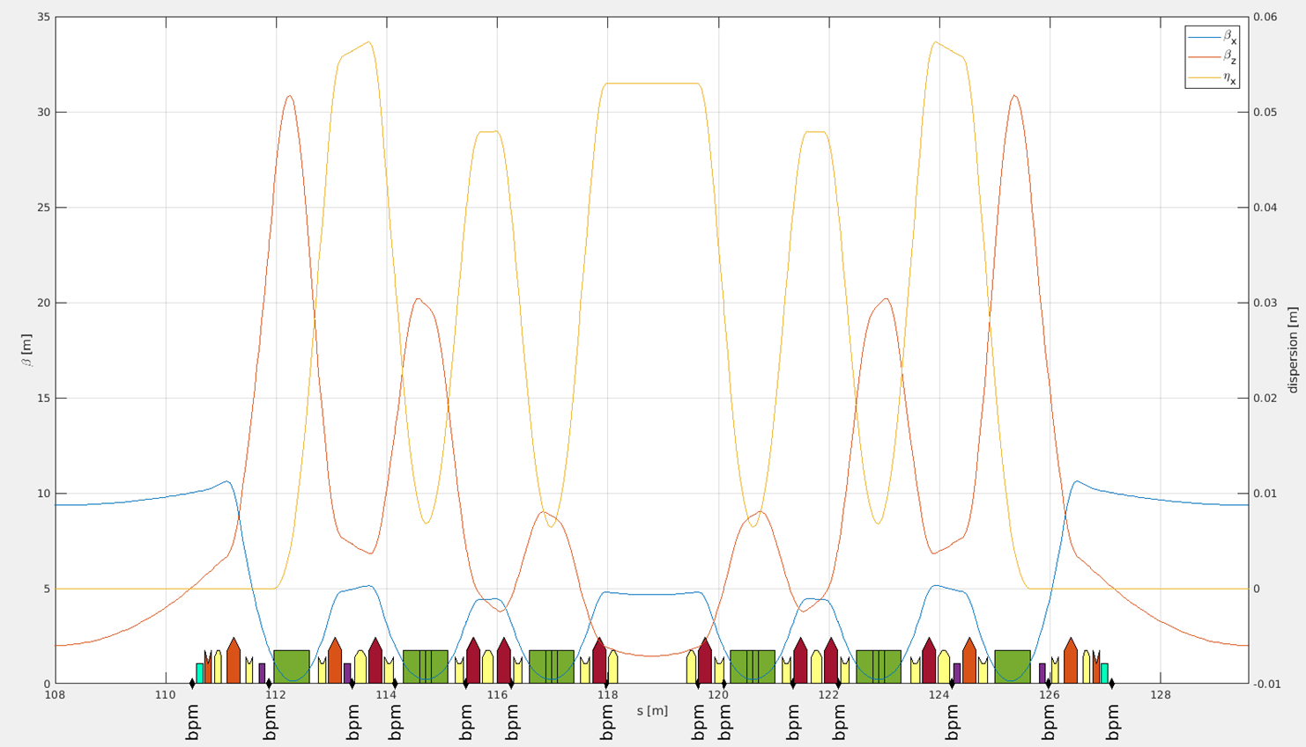
Elettra2.0 achromat layout and position for the interlocks
SHORT
ID
SUPER
BEND
LONG ID
LONG ID

Slide 14
Beam Trajectory interlock for Elettra 2.0
In Elettra2.0 the risks are similar to Elettra, although there are important differences requiring specific attention due to the peculiarity of the new generation machine.
A specific high-performance PLC is in charge of the Fast Interlock System, which monitors the electron beam trajectory inside undulators and wigglers and superbend, and kills the beam in case of mis-steering
Elettra 2.0 poses new challenges that are summarized below:
• Increased energy and stored current: Elettra2.0 will be operating with 400 mA at 2.4
GeV, about three times higher than Elettra;
• Reduced emittance, which means more power density of the electron and photon beams;
• Reduced cross section of the vacuum chamber;
• Reduced undulator gaps and in vacuum undulators (IVU);
• Super-bends and crab cavities.

Slide 15
eBPM for Elettra2.0
A partnership with Instrumentation Technologies for the production of 200 units of BPMs for Elettra 2.0, based on pilot tone compensation is currently running
The Elettra 2.0 ring require 168 (14 per 12 sections) BPM readings
Specifications:
Sub-micron resolution @ 10 kHz
Long-term stability better than 2 µm in 24 hours
Compensation of thermal drifts, channel variations, cables response
Modular approach:
analog front end in the machine tunnel
digitizer in service area
Each digitizer box serve two BPM’s with PilotToneRFFrontEnd

Slide 16
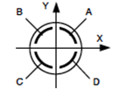
Elettra 2.0 eBPM electronics
PTFE
FPGA carrier
4x coax
FMC 1
timing (MC)
control system (tango)
orbit feedback
eth 10 Gb/s
PoE switch
eth
opto link
PTFE
FMC 2
4x coax
Interlocks OUT
Interlocks IN
machine tunnel
service area

Slide 17
Trajectory Interlock FPGA logic diagram
BPM
#1
4 x ADC
160MS/S
FMC
BPM #1
POSITION
PROCESS
TBT
X and Y
data
Decimation filter/ glitch suppressor
Trajectory angle and displacement computation Failsafe logics
Interlock
activation
PLC
supervisor
ACQ running flag
Beam
dump req.
BPM
#2
4 x ADC
160MS/S
FMC
BPM #2
POSITION
PROCESS
TBT
X and Y
data
Decimation filter/ glitch suppressor
ACQ running flag
Internal Bus
Internal Bus
Tango Control System
Position limits and intervention time parameters loaded @ boot
SOC Arm
CPU
Ethernet
The goal is to have a system
more reliable as possible
Internal
Bus

Slide 18
Questions for diagnostics experts
All of the signals to/from BPM readings electronics, will be managed by a fast PLC system that is super visioning the ID status, the current stored current and all the useful signals like beam shutter status, valves, pressure etc.
Currently we have defined how to manage the short and long ID’s, since they can follow the logic as the actual system.
The part that is still to be under study is the one about protection from light produced by super-bend. The Super-Bend are superconductive bending magnets, which allow a 6T field in very little space.
The problem arises from the fact that the generated light is always present, so that the interlock must always be active, with all the consequences of the case, that is, by limiting some machine operations.
Does other machines have similar issues?
And if yes how they manage it?
Will your fast orbit interlock be based on the reading of dedicated BPMs before and after the radiation sources and on the determination of the angle, or only on the position of a greater number of BPMs in various positions of the machine?
How fast will the reaction time be? (as far as we are concerned, we still have to be generic and cautious, but let's talk about times from 100us to 10 ms).
100us reaction time can generate some spurious beam dumps?

Slide 19
Many thanks to:
Silvano Bassanese , head of diagnostics for Elettra & Elettra2
Marco Lonza, Elettra 2 Control Systems, Elettra 2 MPS design
Alessandro Carniel, for Fast Beam Losses detector
All the Elettra diagnostics team.

Slide 21
Notes:
Last Slide 2: Aerial Photo of Elettra

Slide 22
SPARE SLIDES

Slide 23
Fast Beam Loss Detection
Spurious beam losses can be caused by beam dynamics reasons (tune resonances, instabilities, …) or by faults/mishandling of magnet power supplies and RF plants; during the loss of stored current the beam can have unpredictable trajectory and size, and lost electrons can be distributed along the ring or concentrated in one point.
Given the high peak power of the electron beam, the latter case can produce quenches, electronics faults, demagnetization of permanent magnets or damages of vacuum components.
To avoid these disruptive events a “fast beam loss detector” based on a fast-current transformer will recognize the beginning of the current loss and generate a trigger used to abort the rest of the beam in a fast and controlled way.

Slide 24
Beam Dump System
Various systems may require a beam dump in order to be protected. Presently in Elettra this is achieved by interrupting the RF-drive signal for a duration of 4 ms, in this way the beam loses energy and after some hundreds of turns it is lost at some position in the inward-facing center part of the vacuum chamber.
It has been observed that although this technique is rather robust, it may create problems at the point of loss especially if it occurs at locations of vacuum seals or ion pumps.
The possibility of having such a dedicated beam dump system for Elettra 2.0, consisting of a fast-vertical kicker installed in a short straight section and a beam dump, is being considered.

Slide 25
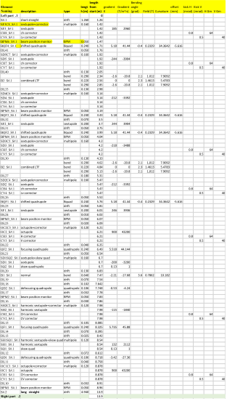
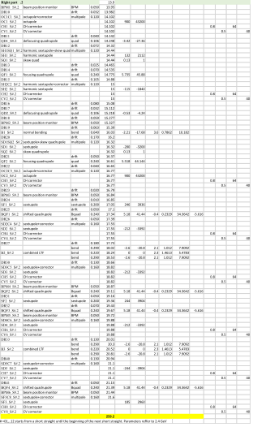

Slide 26
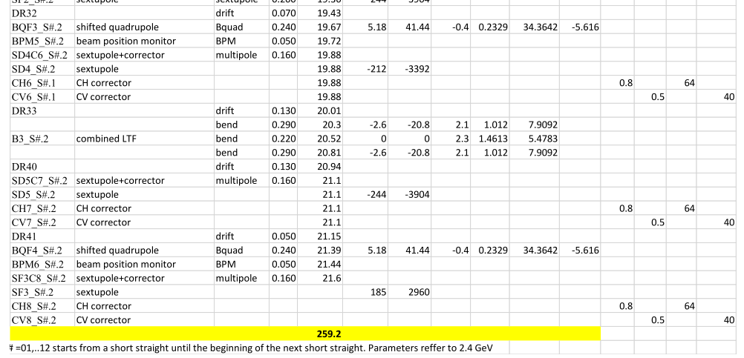

Slide 27
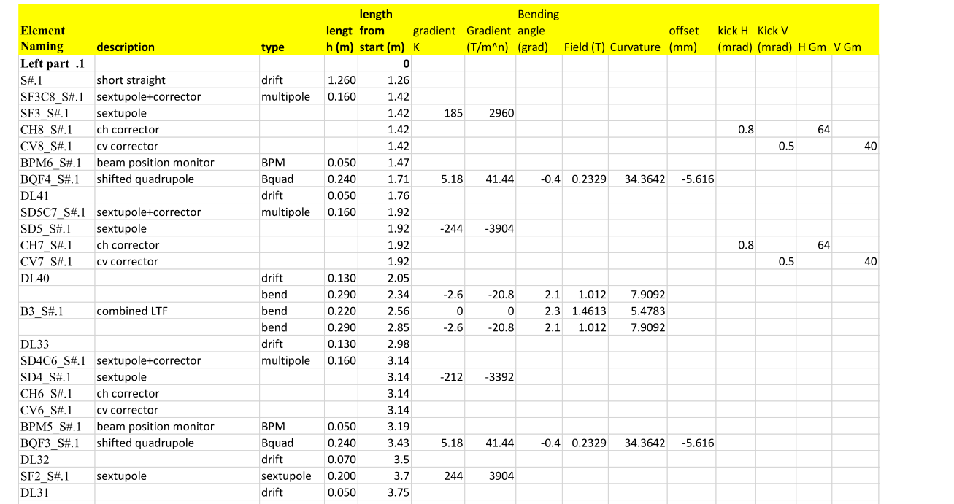

Slide 28
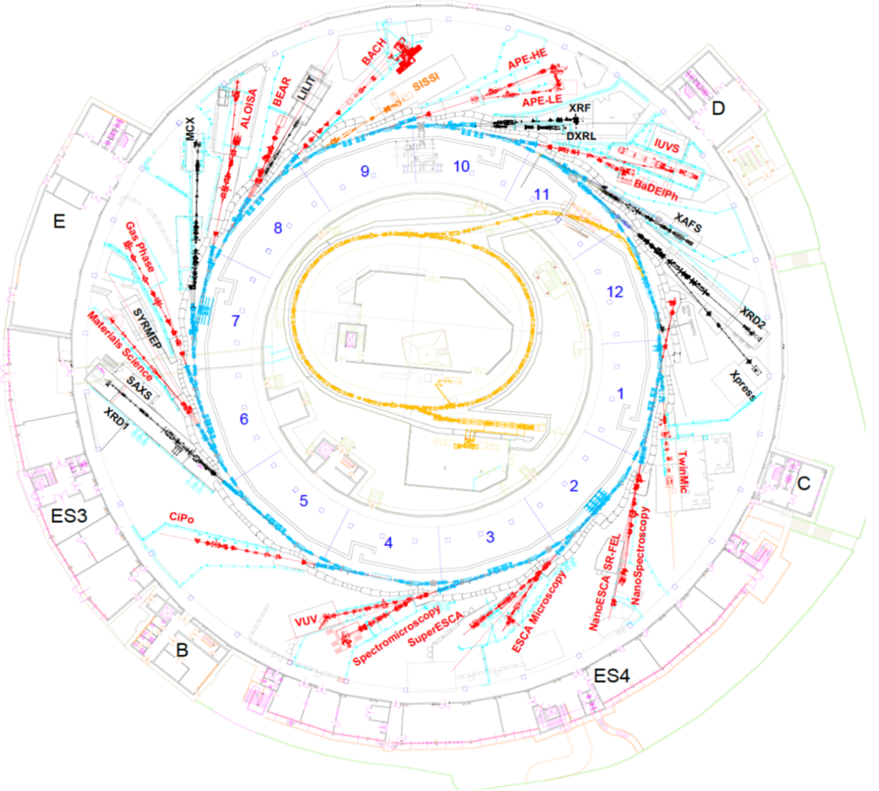
ELETTRA1 Layout

Slide 29
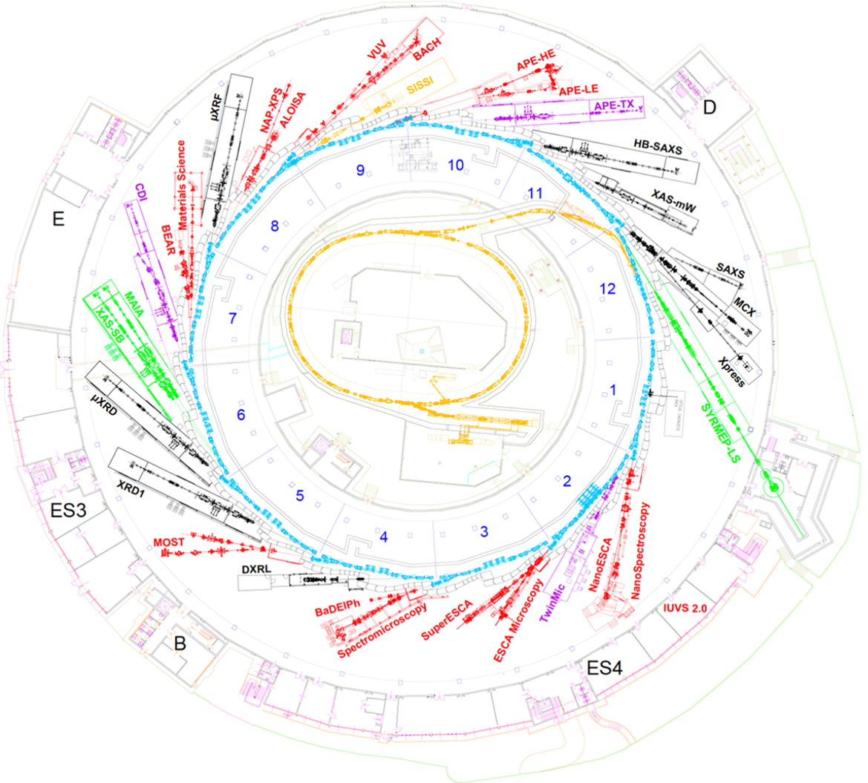
ELETTRA2 Layout

Slide 30
model to formula
(from G. Scrimali internal note)
Expliciting and grouping, one obtains the quadri-dimensional acceptance law:
$${\left({L_{PA}x}_{2}−x_{1}\left(L_{PA}−L_{1}\right)\right)}^{2}+{\left({L_{PA}y}_{2}−y_{1}\left(L_{PA}−L_{1}\right)\right)}^{2}≤{\left(L_{1}R_{PA}\right)}^{2}$$
$${\left({L_{PA}x}_{2}−L_{1PA}x_{1}\right)}^{2} +{\left({L_{PA}y}_{2}−L_{1PA}y_{1}\right)}^{2}≤{\left(L_{1}R_{PA}\right)}^{2}$$
$$y_{1}$$
$$y_{2}$$
$$y_{PA}$$
$$L_{1}$$
$$L_{PA}$$

Slide 31
Clipboard – for copy and paste
Text Box
Text Text Text
Text Text Text
Text Text Text
Text Box
Text Text Text
Text Text Text
Text Text Text
Text Box
Text Text Text
Text Text Text
Text Text Text
Text Box
Text Text Text
Text Text Text
Text Text Text
Rectangle
Text Text Text
Text Text Text
Text Text Text
Text Text Text
Rectangle
Text Text Text
Text Text Text
Text Text Text
Notes:
Clipboard Slide: working slide to be kept at the end of the presentation
Copy & paste an element from the Clip Board to the particular slide: 1. Click on a box to mark it.
2. Position the mouse pointer on the box frame: Copy! 3. Click on the particular slide: Paste!
How you intend to use the elements is your choice. You can combine the text block style with the background colour in different manner.

