Slide 1
Bunch by Bunch BPM measure at SOLEIL
Nicolas HUBERT on behalf of Romain BROUCQUART
DEELS 2022

Slide 2
Origin of this measure
Introduction
Using a fast camera, we captured the turn-by-turn emittance during injection
The beam size was increasing → not physical
"painting" of the spot of the camera by intra-turn position evolution ?
Quick answer → yes. But let's focus on the diagnostic…

Slide 3
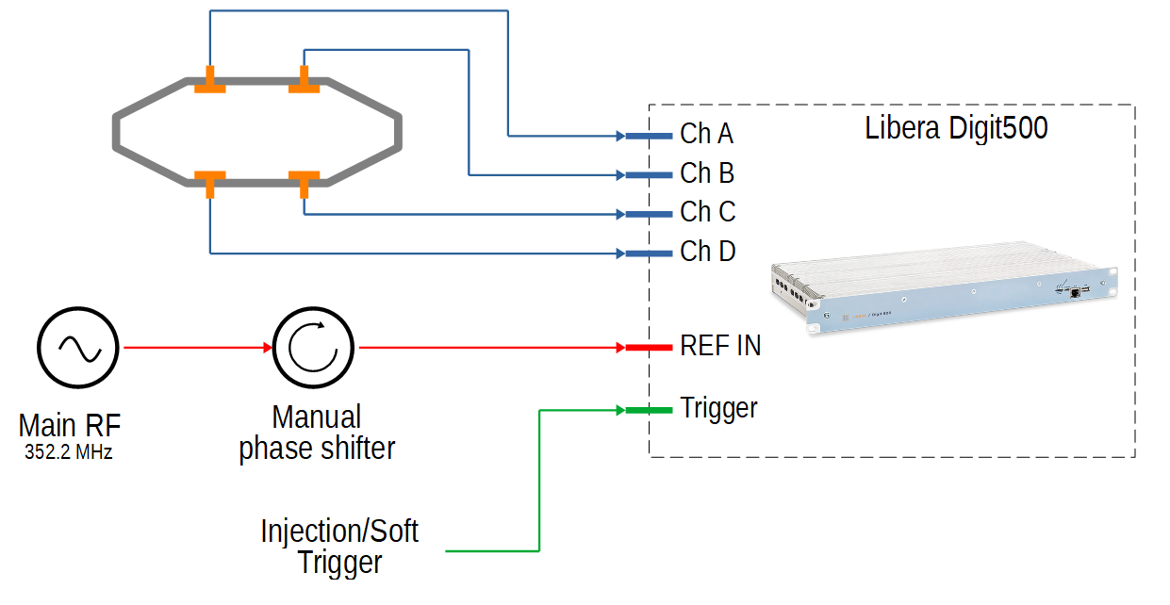
Measure Setup
Introduction
Libera Digit500 connected to BPM Pickups
Sampling rate on the main RF, phase manually adjusted
Capture on request or on injection.

Slide 4
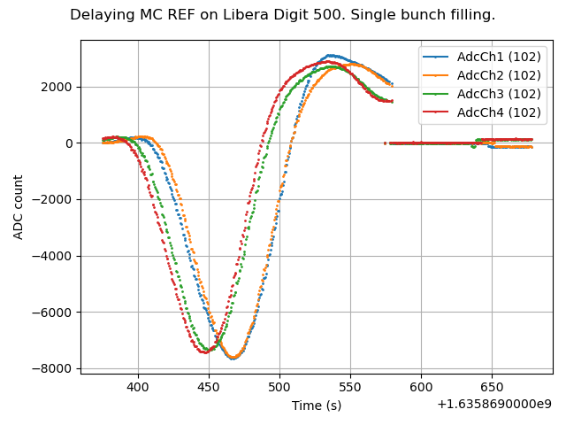
Bunch response
Introduction
Single bunch, 16mA.
Manually scan the sampling phase.
Trigger 3Hz, synchronous to revolution frequency.
Plot the average signal value of the bunch sample over multiple turns.
(!) X-Axis is distorted by the manual scan.
Give an idea of cable phasing and bunch response.
Position the sampling phase at the center point of maximum.

Slide 5
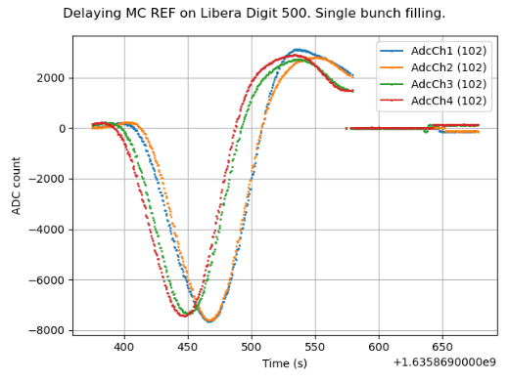
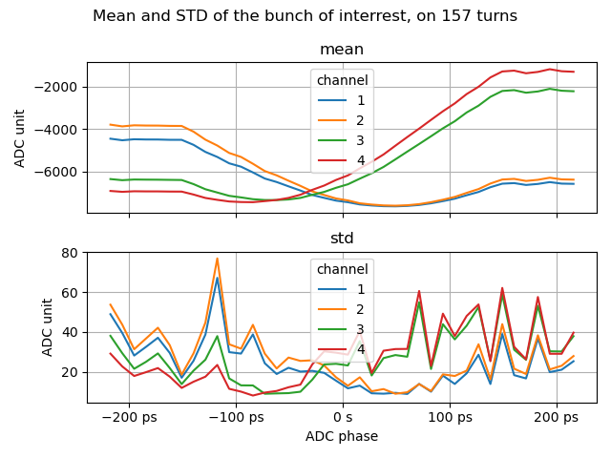
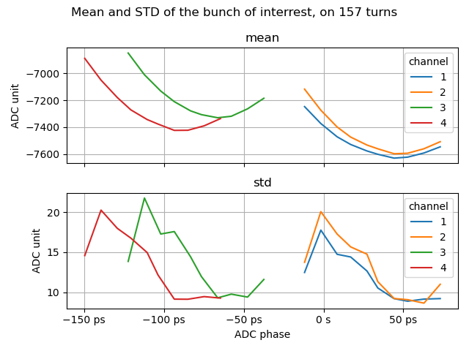
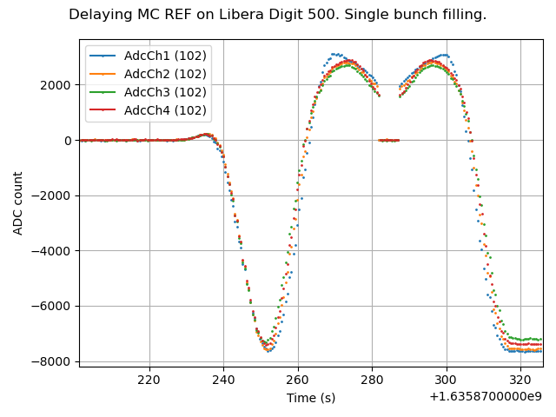
Phase adjustment
Introduction
Sampling phase of each ADC can be programmed independently.
We use that feature to perform gross and fine scan.
Need to be quick to avoid effect of current decay (< 10s).
Fast full scan
Precise local scan

Slide 6
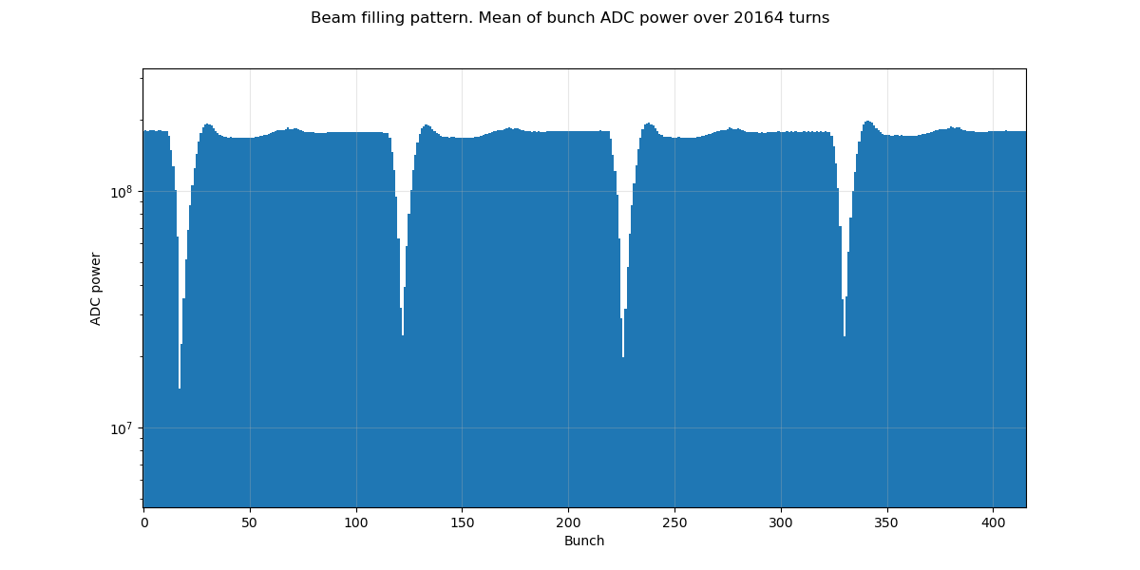
Filling Pattern
Introduction
Wrap data with a periodicity of 416 (number of bunches in SOLEIL).
Observe the sum signal.
Align Trigger and bunch index.
Skip low filled bunches for position processing (high SNR)

Slide 7
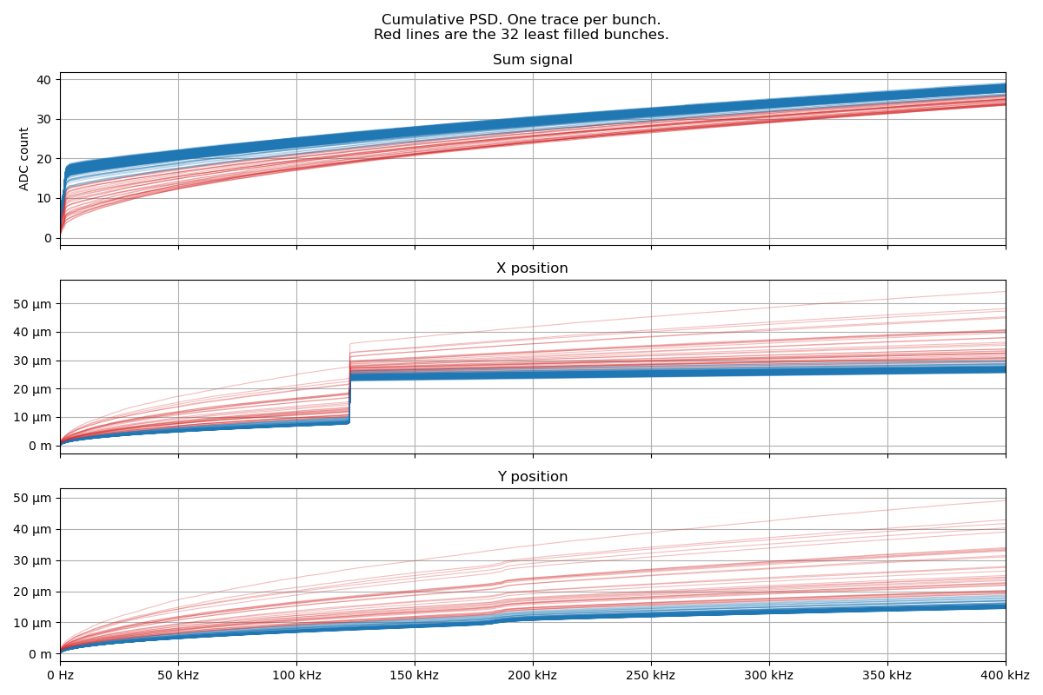
Problem : Betatron Frequency
Introduction
Observation on bunch by bunch sum / position
Signal is decimated by 416
Fsampling = frev (847 kHz)
Spurious at 123 kHz on X position.
Sometimes occurs
Probably betatron frequency

Slide 8
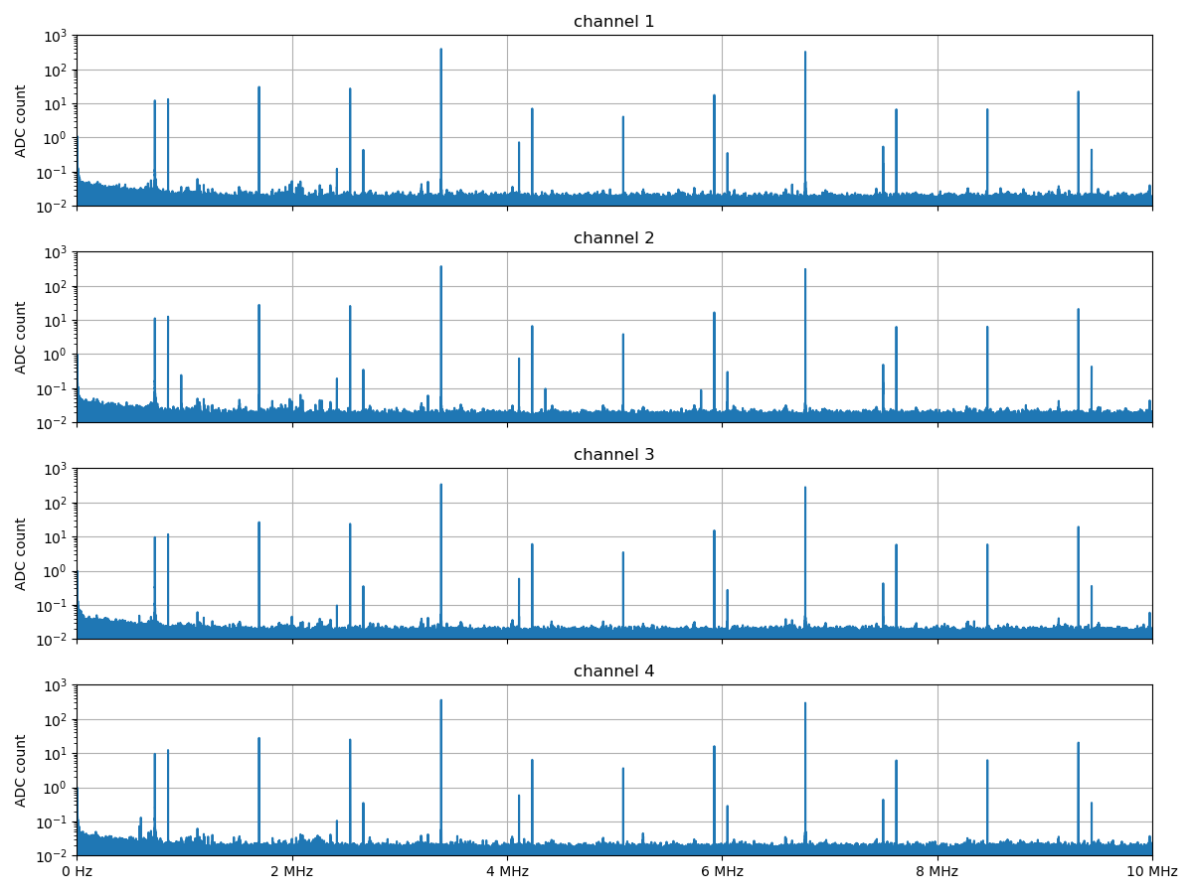
Problem : Betatron Frequency
Introduction
726 kHz
Frev
2*Frev
4*Frev
Observation on raw signal
Fsampling = frf (352 MHz)
726 kHz = frev – 123 kHz

Slide 9
Injection capture
Data visualization
The next captures are performed while kicking the beam for injection.
With or without charges injected.
Data are aligned so that the charge enter the storage ring on turn 0.

Slide 10
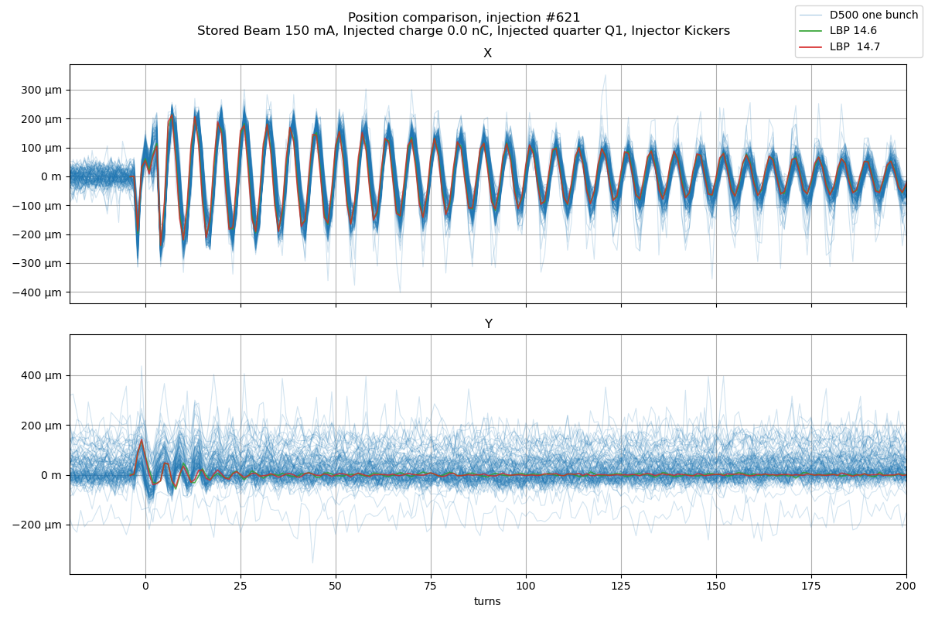
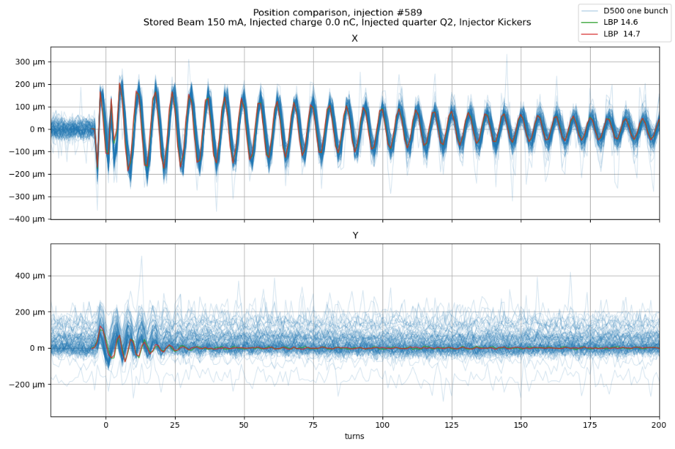
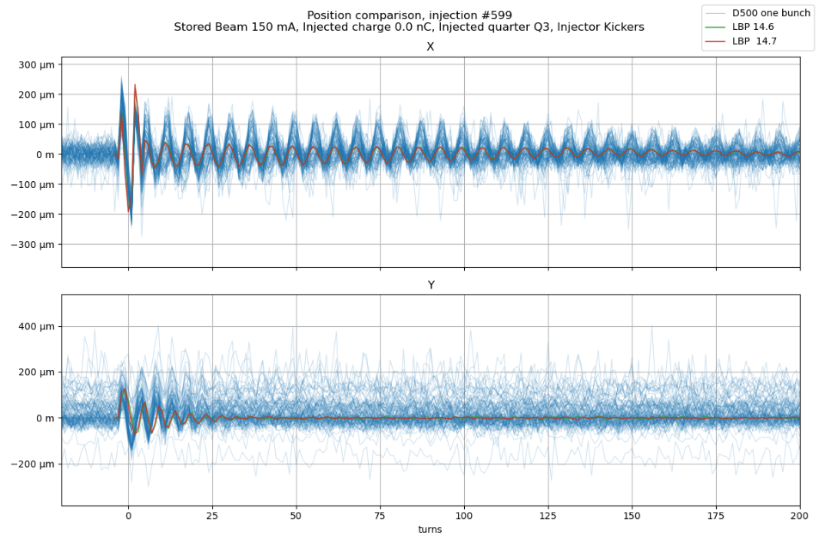
How to visualize the data ?
Data visualization

Slide 11
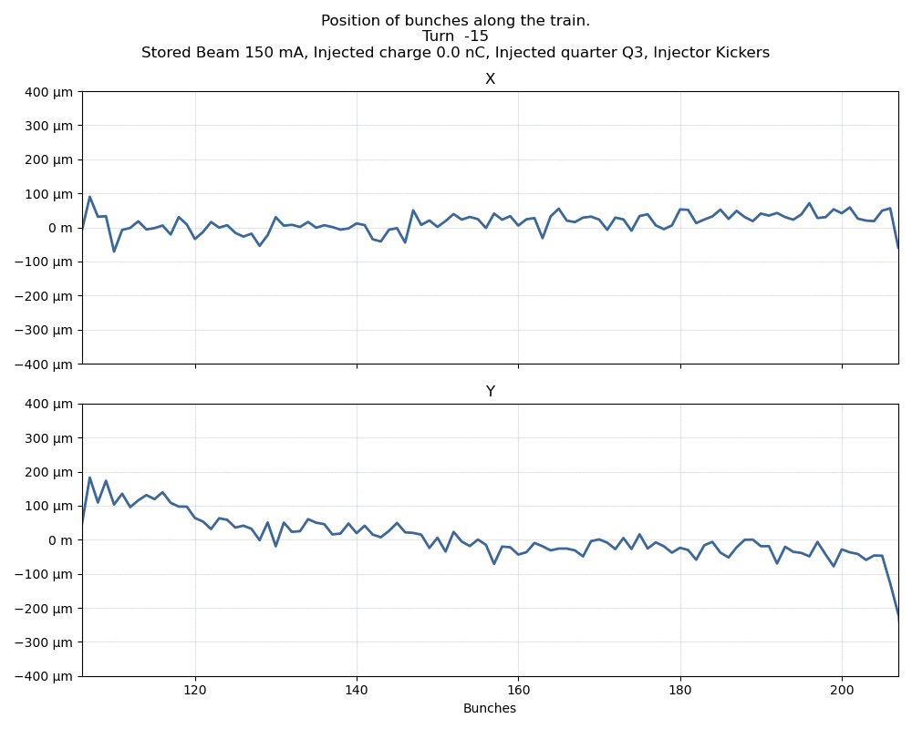
How to visualize the data ?
Data visualization
Animation plot
Each frame is a turn
X-axis is the bunch number (quarter profile)

Slide 12
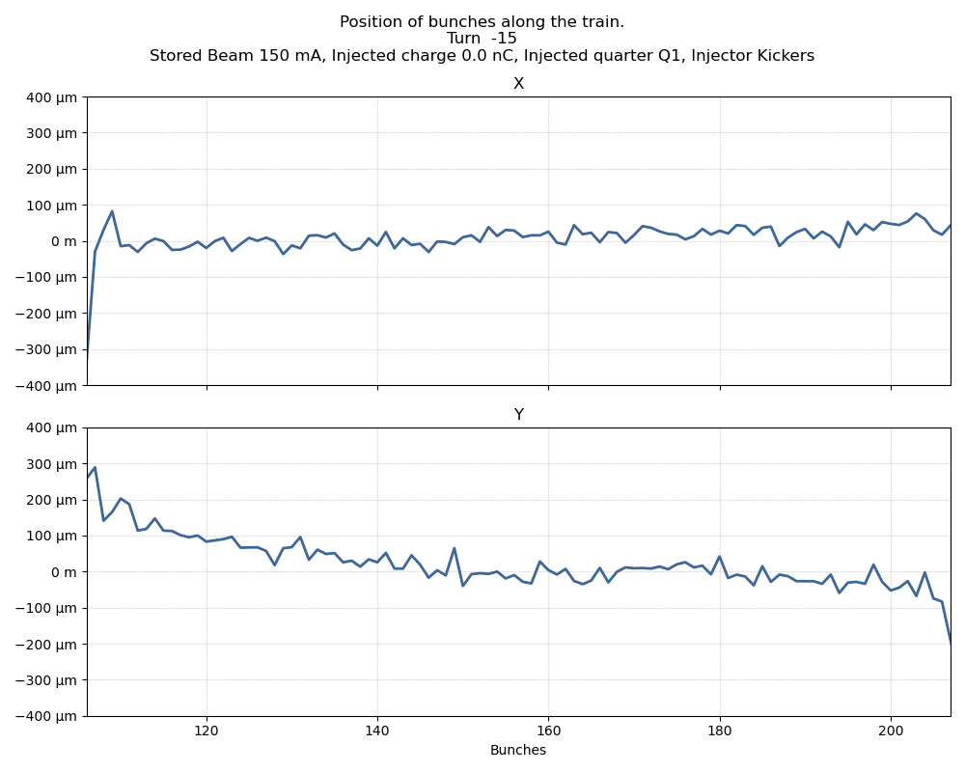
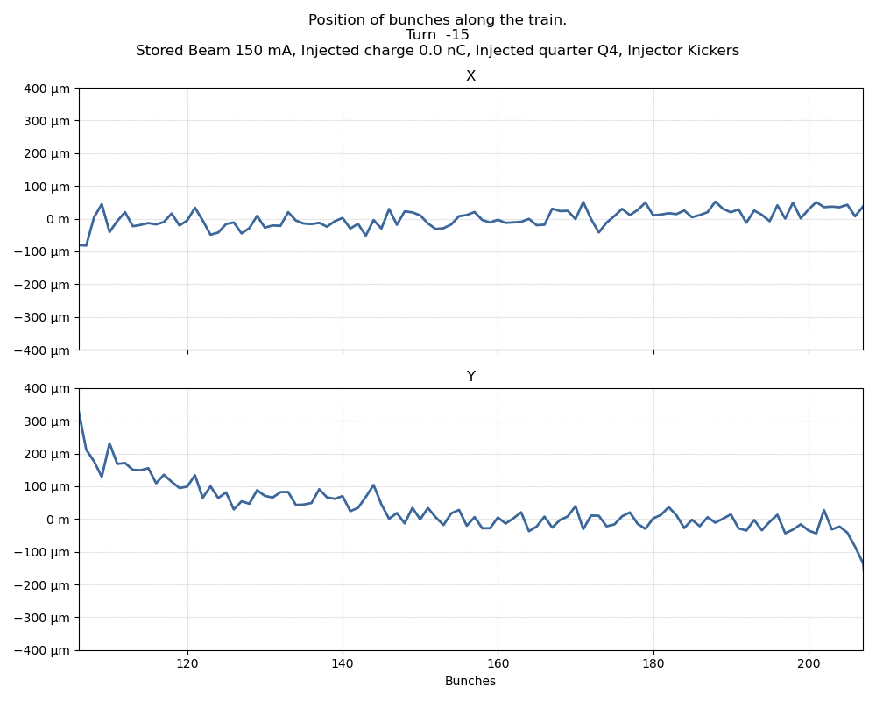
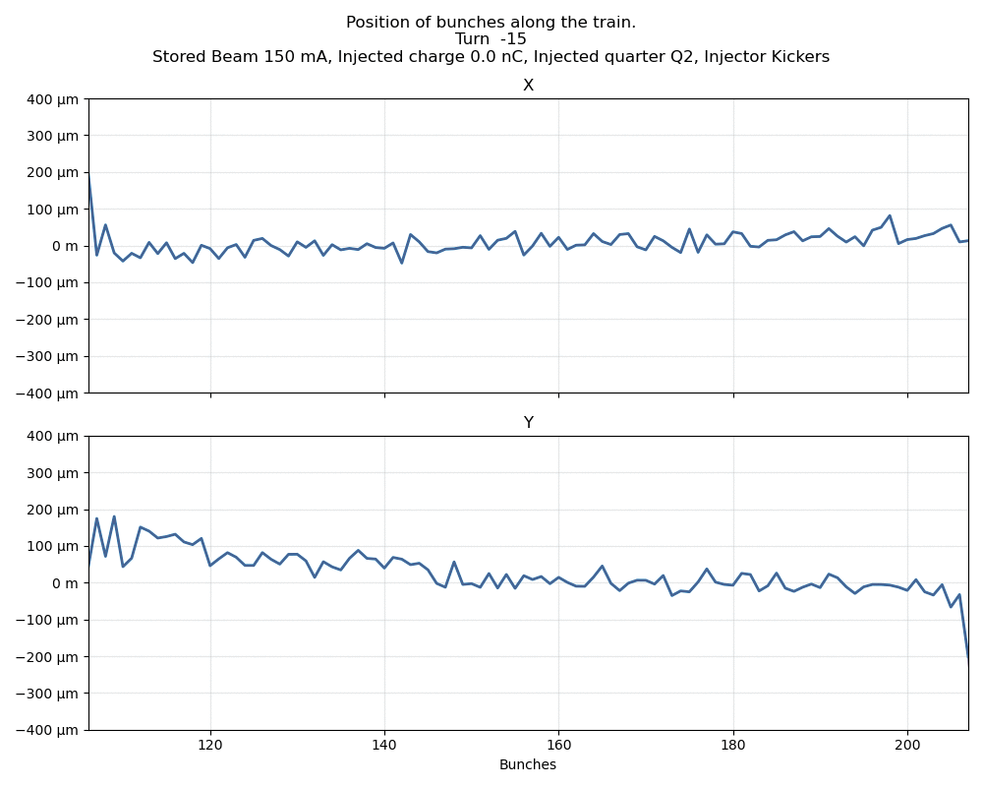
How to visualize the data ?
Data visualization

Slide 13
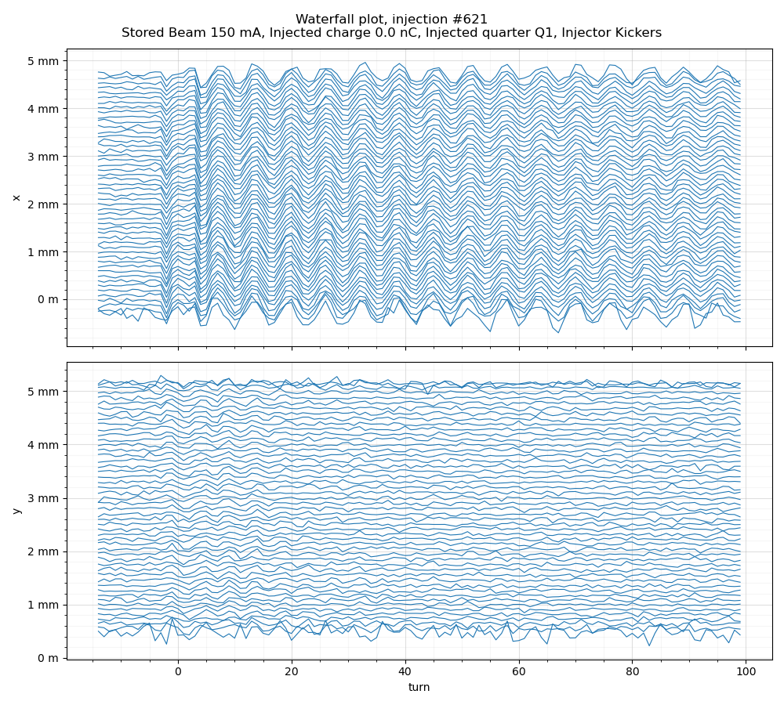
How to visualize the data ?
Data visualization
Waterfall plot
Each line is the position evolution of a bunch (one over two taken).
Each line is offseted by 100 µm

Slide 14
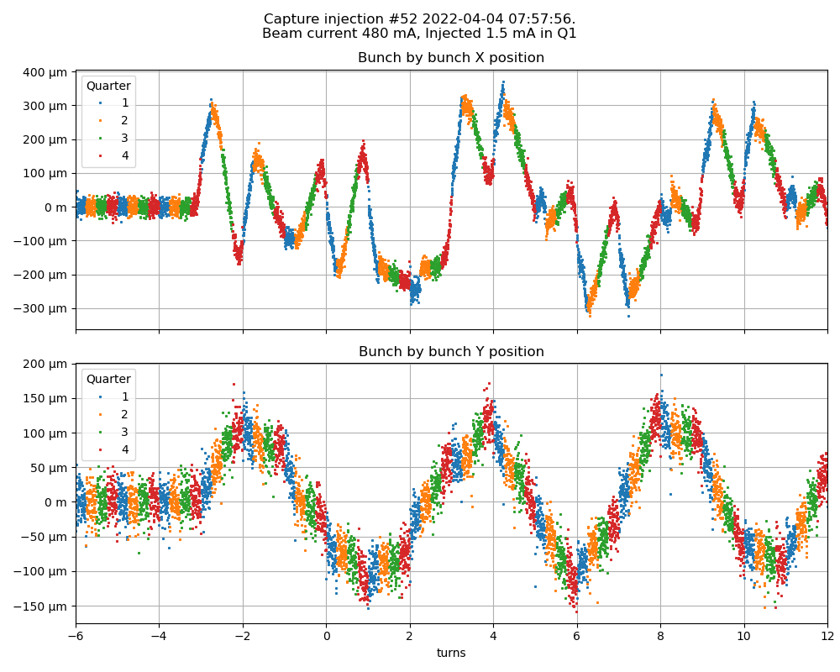
How to visualize the data ?
Data visualization
Colored plot
Quasi direct plot : each point is a sample
Color each point by its quarter

Slide 15
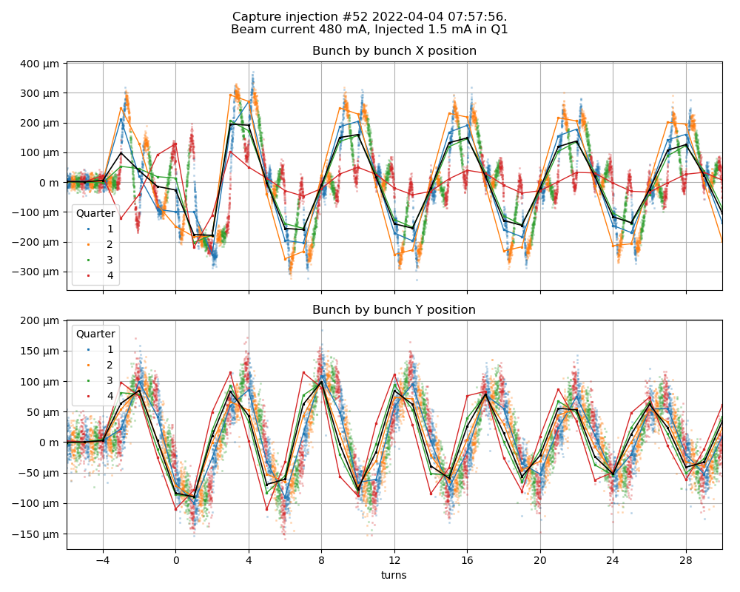
Link to turn by turn from eBPM
Data visualization
Colored line : turn by turn with mask over one quarter.
Black line : total turn by turn data.

Slide 16
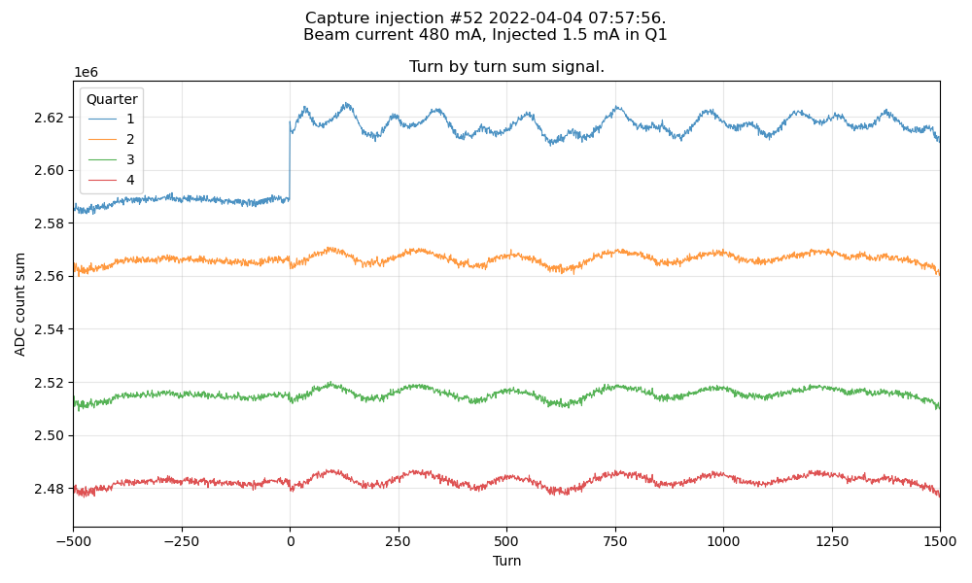
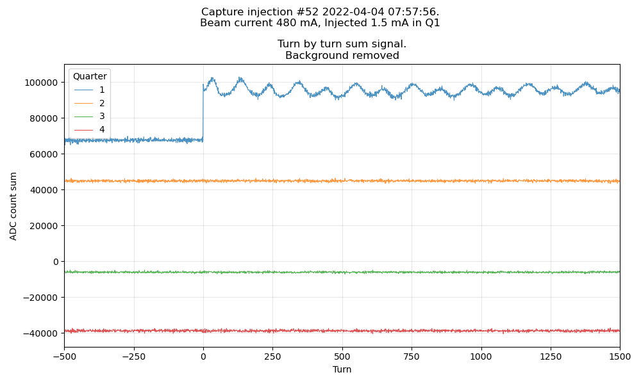
Evolution of sum signal
Sum signal
Evolution of sum signal → effect of bunch phase (stored + injected)
Background removal by estimating common mode on the 3 quarters and removing it on the injected one.
Common mode oscillation = 3920 Hz (Synchrotron Frequency)
Injected quarter oscillation = 8466 Hz (?)

Slide 17
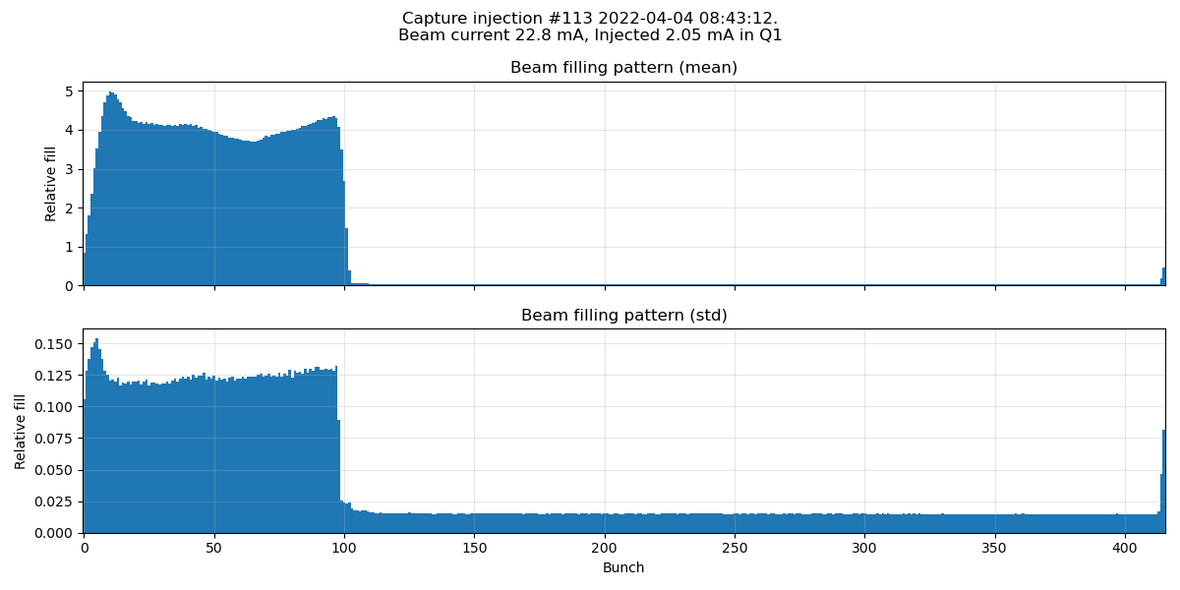
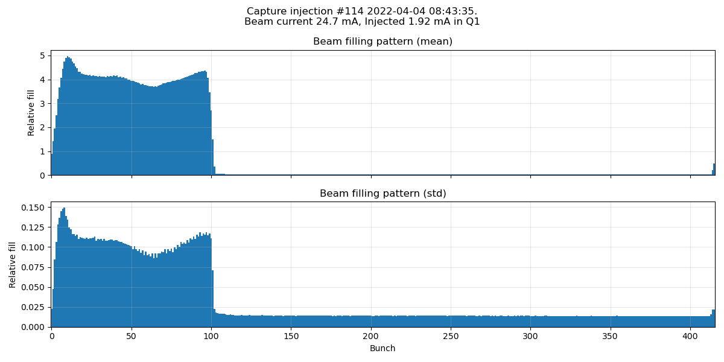
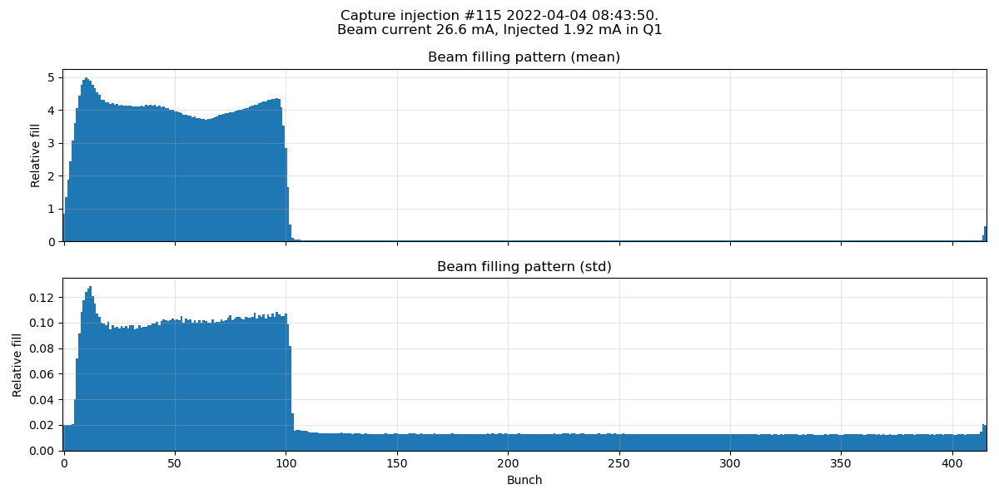
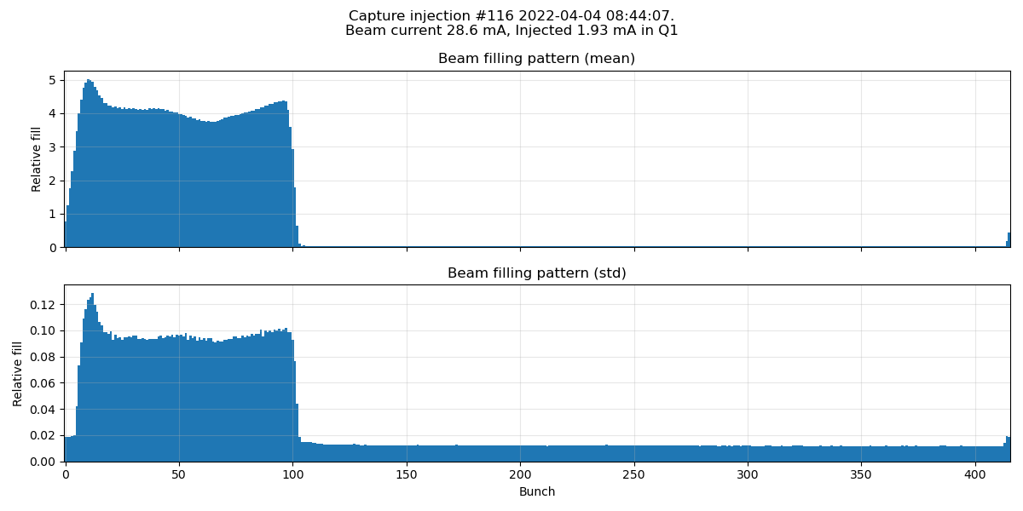
Evolution of sum signal
Sum signal
Mean and std of sum signal, bunch by bunch, over the whole capture
Mean
"Filling pattern"
Std
Proportional to charge injected to the bunch
Sometimes seems not aligned with stored beam → ?
Shape of injection → ?

Slide 18
Position evolution, w/wo charge
Charge injection
For the injected buckets, position picked-up is the barycenter of the stored bunch and the injected charge
500 mA Stored
1,5 mA Injected
For this plot : averaging by grouping bunch 13 by 13.

Slide 19
Consecutive injections
Charge injection
Only one quarter filled (pink)
Consecutive injections in the opposite quarter
Each measure is a mix of the stored (increasing) charge and the injected charge.
For this plot : averaging bunches 8 by 8

Slide 20
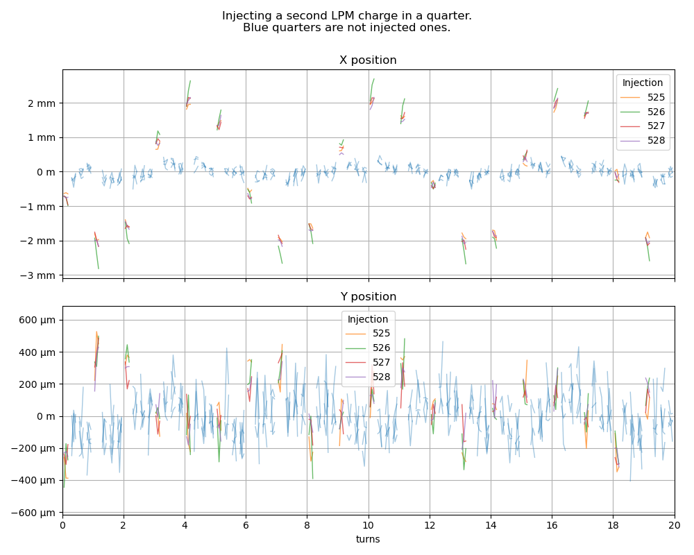
Focus on injected electrons
Charge injection
Second injection in a quarter : the position is halfway between stored and injected charge.
Data aligned so that the injected quarter is always at the same x-axis phase.
6 turns periodic oscillations around the main trajectory, decreased after 70 turns

Slide 21
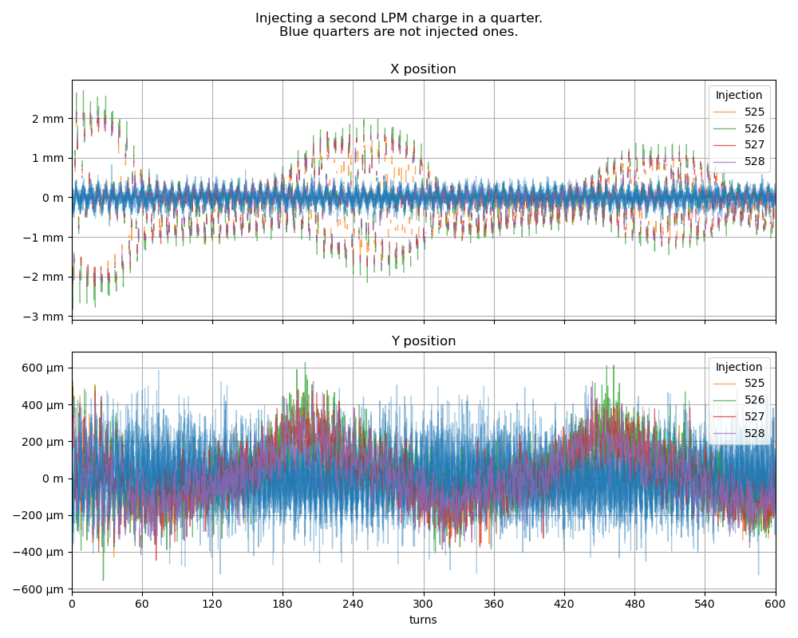
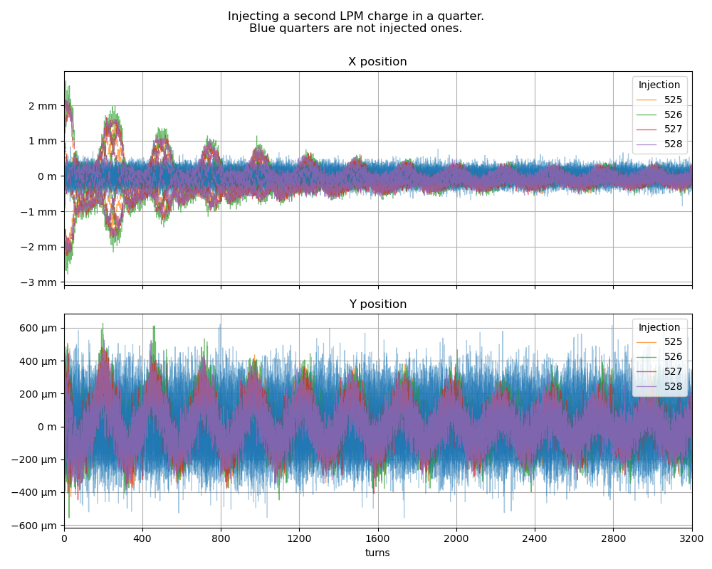
Focus on injected electrons
Charge injection
Periodic damping of oscillation (250 turns) → phase oscillation of injected bunch

Slide 22
Application idea
Let it run on several injection during operation
Automatically compute (and archive) some metrics
Link what is observed with the injection efficiency ?

Slide 23
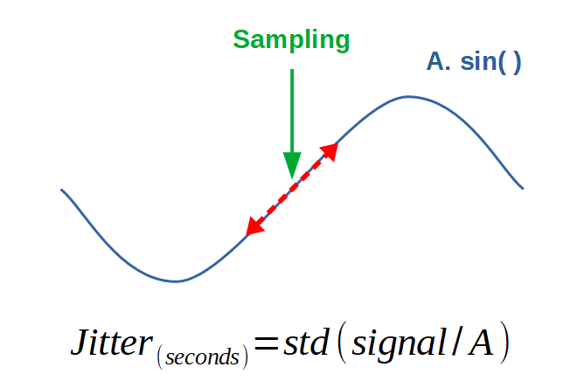
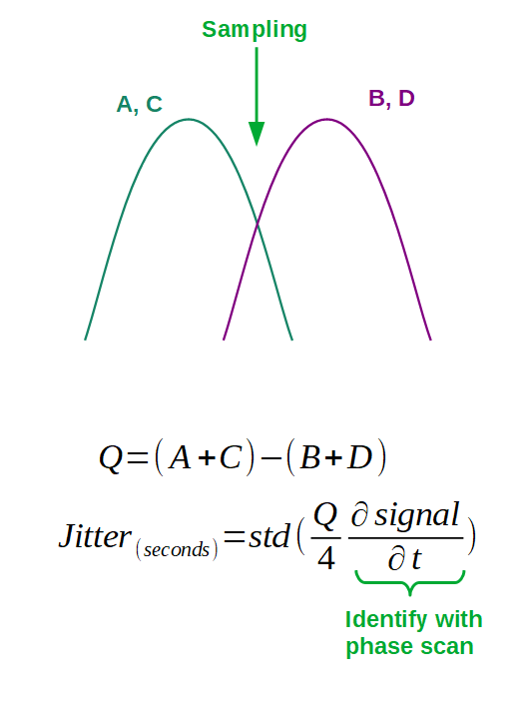
(TODO) Jitter sensitivity
Introduction
Lab measure
Source channels and REF with identical source
Identify jitter with amplitude noise
On beam measure (idea)
Shift the phase so the jitter effect predominant over Q
From Instrumentation Technologies
Jitter : 1,4 ps rms

Slide 24
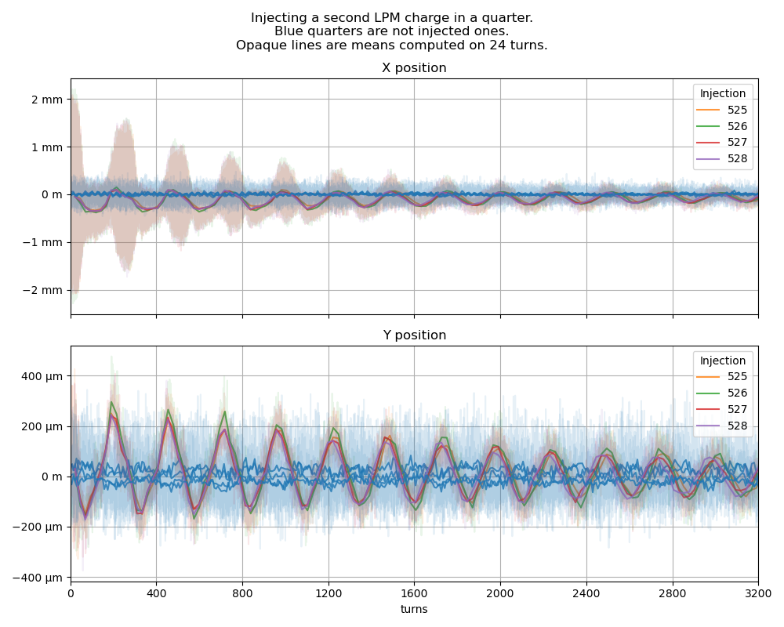
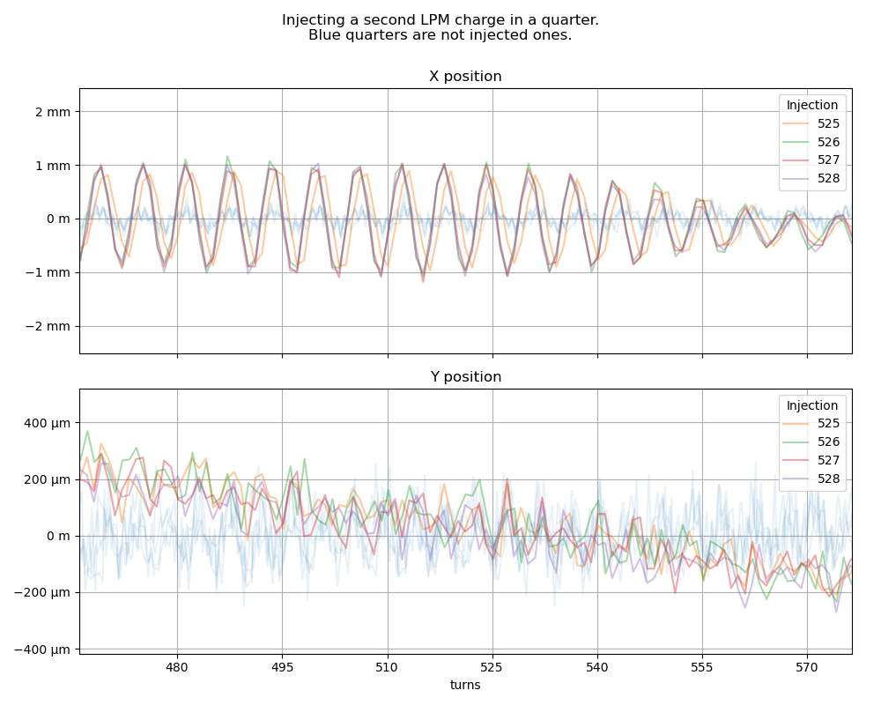
Focus on injected electrons
Charge injection
Offset of injected charge ?
One injected without the same phase (after a few hundred of turns)

Slide 25
