Slide 1
Booster optical beamline
Terry Atkinson, Ji-G. Hwang, S. Wiese
DEELS
2022

Slide 2
Design Criteria
Transport line as short as possible:
move output port from sector 5 to sector 16
extend working area for optical platform
Use only plain mirrors
Simple telescope for slight convergence/collimation
Vacuum window at booster – not beamline
Wedged window to reduce the transmission of reflections
No down-time regarding source point imaging – high level diagnostic in control room
Installation over 4 stages:
SD20 sector swap in booster!
SD21 labyrinth, transport line, IVP, optical table
SD22 telescope, mechanical upgrades, streak camera
SD22/23 THz detector, 2. wedged window, mechanical upgrades
Motivation:
Measure the Bunch length over the ramp

Slide 3
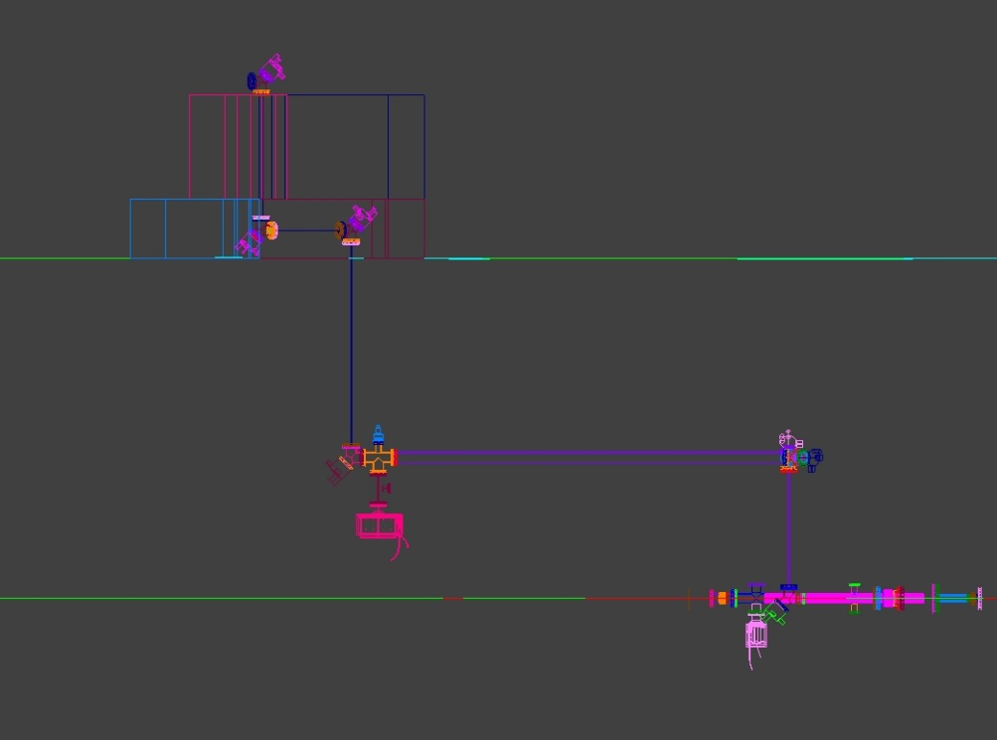
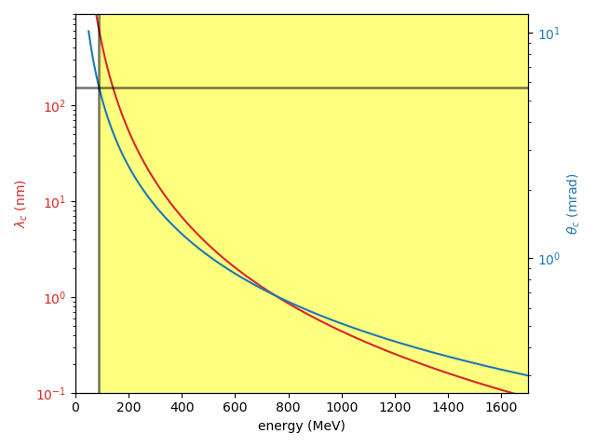
Design consideration 2020
Ji-G. Hwang
Critical wavelength
shorter than 600 nm
θ_{c} ~ 6 mrad
θ ~ 1 mrad
Refractive
optics
1001.2 mm
E_{c} ~ 90 MeV
2034.71 mm
Spot size without optical components:
σ_{x,y} ~ 1 mrad (natural angle) x 11 m (distance from source to last mirror) ~ 11 mm
with the window (Ø 28.7 mm), high losses during transport of the light from low energy beam…

Slide 4
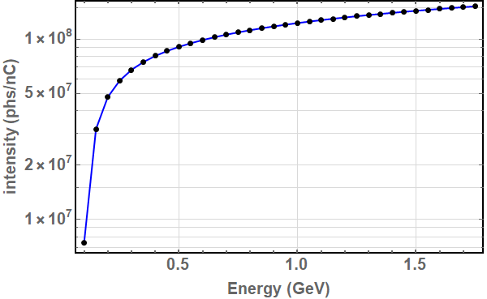
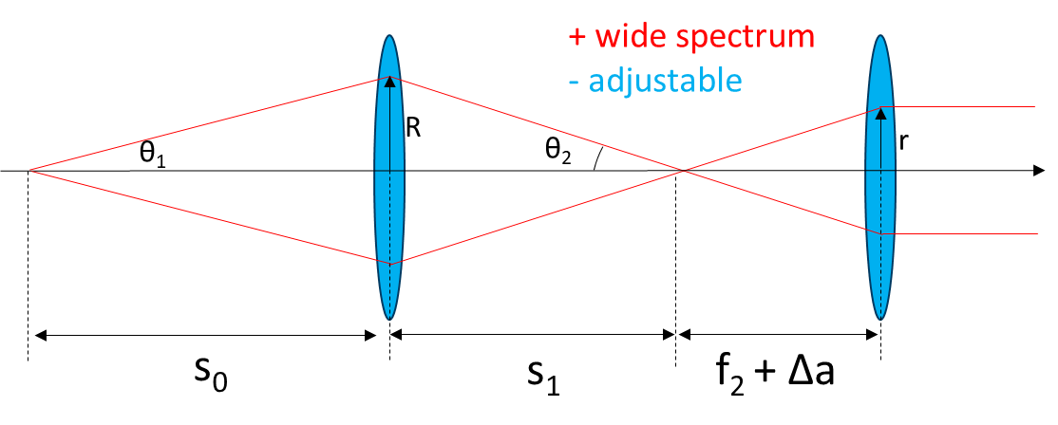
light intensity 2020
Ji-G. Hwang
Integrated photons over 400 – 800 nm wavelength
@ 2.2 m downstream from source point (first lens)
Numerical simulation by SPECTRA
with opening angle: 11 mrad (r=25 mm)
ε_{x} = 100 nm-rad
σ_{t} = 50 ps
σ_{E}/E₀ = 0.1%
Single Bunch charge in booster is <0.4 nC
With a transport line of
1) 7 mirrors (98% reflectivity)
2) 2 lens (97% transmission)
3) 2 windows (99% transmission)
Transmission would be approx. 80 %...

Slide 5
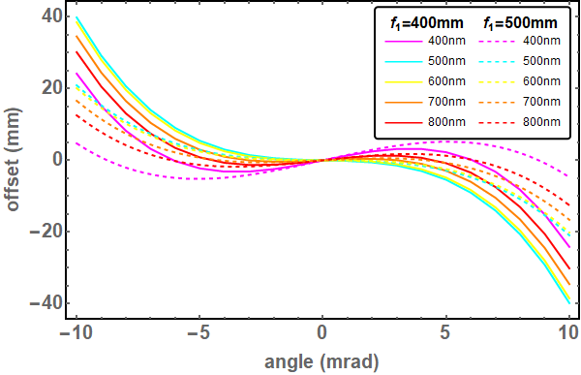
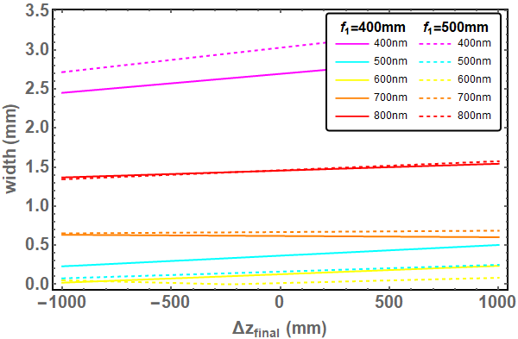
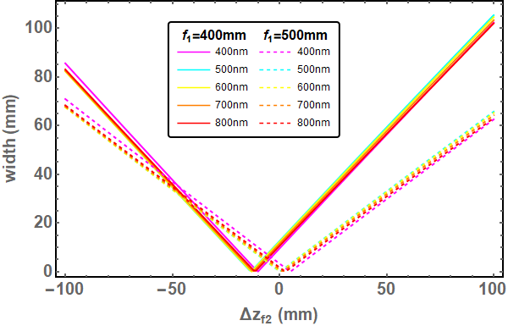
Ji-G. Hwang
Geometrical and chromatic aberrations 2021
Due to the space limitation, two options are feasible:
1. f₁ = 500 mm, Δz_{f1lens} = 100mm, z_{f2opt} = 741.5 mm
2. f₁ = 400 mm, Δz_{f1lens} = 200mm, z_{f2opt} = 578 mm
z_{f2opt}
1001.2 mm
f₁ = 400 mm is more sensitive on angular divergence and f₂ position, but it is better in terms of chromatic aberrations.
Δz_{f1lens}
Source to mirror
2034.71 mm

Slide 6
CAD DESIGN – start to end
Optical table
Labyrinth
Booster ceiling
Booster
Bending
Magnet
IMP
Telescope
Mirrors
S. Wiese

Slide 7
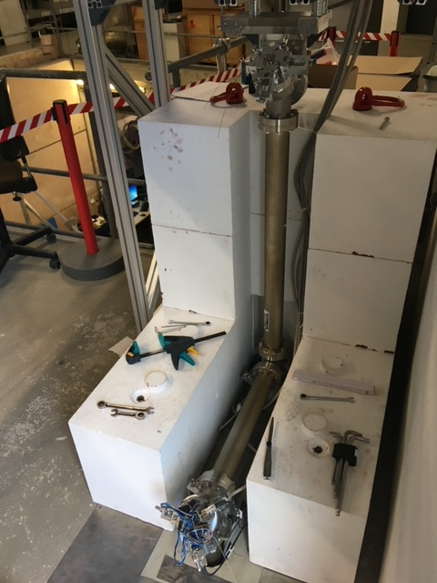
CAD DESIGN – Labyrinth problem
SD 2021
To drill the hole in the floor it took 6 diamond drill sets and 3 days!
Massive labyrinth requirements from Rad. Safety (block height represents ceiling thickness!)
+20-degree angle to align to optical table (internal wall and fire door in the way!)
Motorized mirrors in labyrinth (can only be opened in shutdown)
Platform floor extended, new safety railing
7

Slide 8
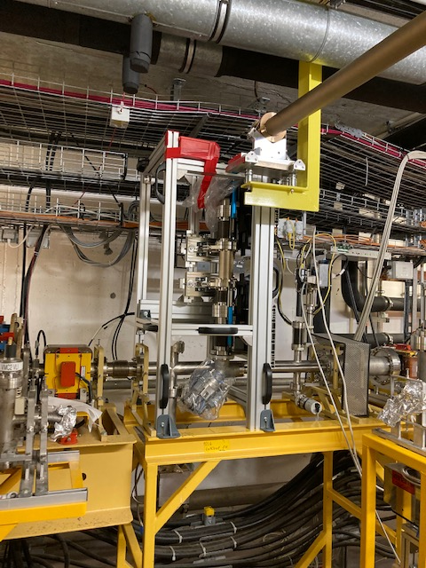
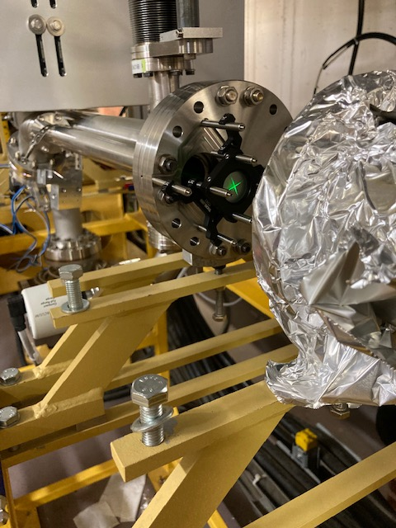
Mechanical Installation
SD 2021
Cable racks cut
Old Ccd camera, mirror and objective lens removed
1st and 2nd Mirror mounted on a frame
Laser aligned from dipole
Old camera box 15 years great service!
8

Slide 9
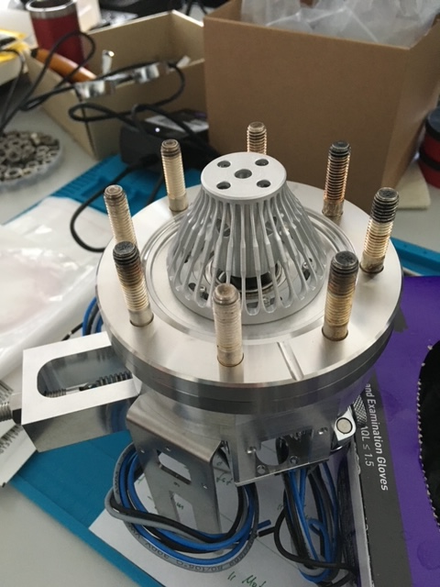
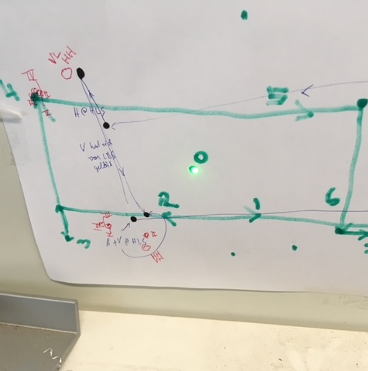
Mirrors
Mirror test lab ongoing…
Standard HZb flat mirror design with 2-point spring axis
Bench tested for alignment
“home” issues, new design under development
9

Slide 10
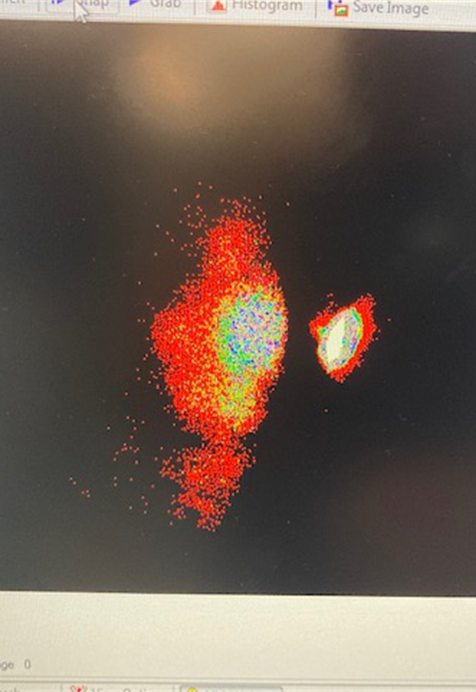
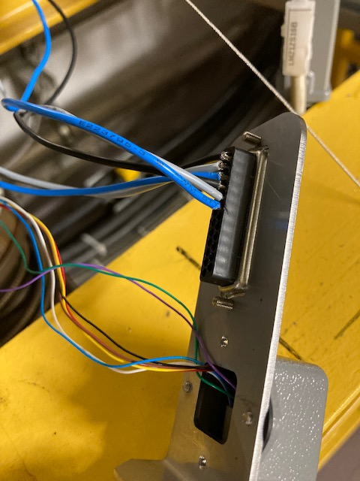
First Beam Sept 2021
sss
Laser alignment beam from table and photon beam from booster observed at the intermediate viewing port
Motor control wires too thick to be safely connected to the control box!
controllers/motors got too hot – changed max amp allowance in software
Webcam and laptop used to find first beam at platform
Zero hours of dark-time!
10

Slide 11
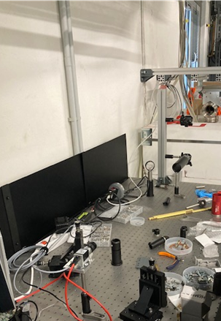
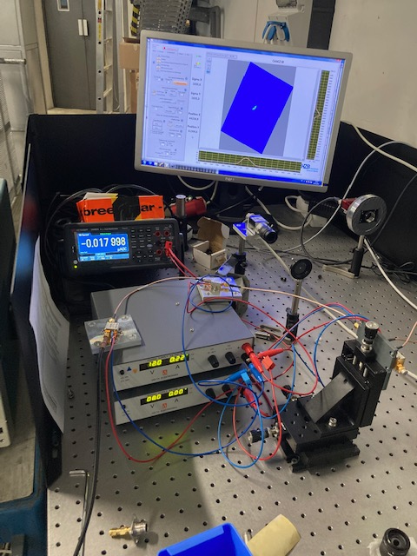
Optical table 2021/22
Translation mirrors to bring the light onto the table
16.5cm working height (streak camera relevant)
Basler ccd camera used to align translation mirrors to the working height
FAST DIODE (HamaMAtsu)
Then the fun starts!
11

Slide 12
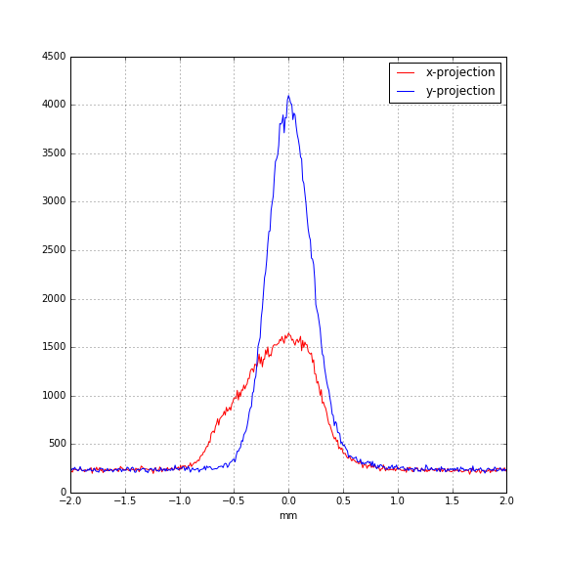
Source point imaging
Setup: (without telescope)
Source point to lens ~ 13m
Lens to camera ~ 1m
standard camera + system at BESSY II
Measured:
SigX – 400um, SigY – 250um
12

Slide 13
Notes: simple cross-check
Abbe limit @600nm
Without optics (only plane mirrors)
Source -> focusing lens 13m
Spot size at focusing lens 20mm (2-inch lens)
Half the angular acceptance 10mm / 13m = 0.77mrad
Limit:
lambda / 2n sin(theta) = 600e-9 / 2*1*sin(0.77) = 243um

Slide 14
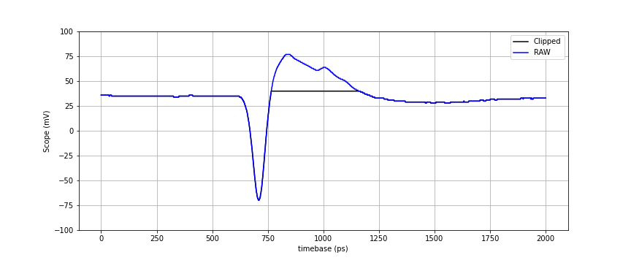
Fast Diode (rise time ~ 50ps)
Setup:
diode -> Bias-T -> two Amps -> scope
trigger FCT5
Bunch length ~ 1/sqrt(V')
0.7mA SB current, @20ms in ramp
604kV, avg. St = 26.35ps
714kV, avg. St = 24.22ps
14
Multi-Gigabit Transmission over multimode optical fibre: Stefano Sottacchi p105/106

Slide 15
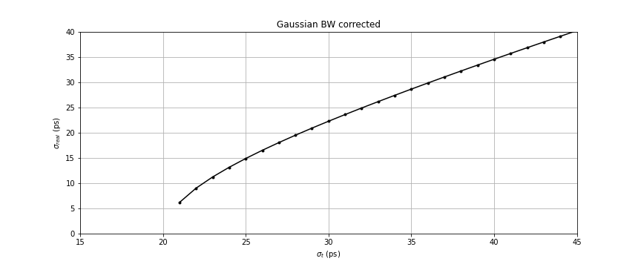
Gaussian Bandwith notes
$$\frac{1}{{\left({BW}_{sys}\right)}^{2}}=\frac{1}{{\left({BW}_{photo}\right)}^{2}}+\frac{2}{{\left({BW}_{amp}\right)}^{2}}+\frac{1}{{\left({BW}_{scope}\right)}^{2}}+…$$
12GHz
12GHz
$$σ_{t}=\text{2}\text{6 }\text{ps}\text{ \# }\text{measured} \text{on} \text{scope}$$
$${BW}_{−3dB}=\frac{1}{2πσ_{t}}\sqrt{2\text{ln}2}\text{ = 7.21 }\text{GHz}$$
rise time = 50 ps # Hamamatsu
$${BW}_{photo}=\frac{\text{0.32}}{\text{rise} \text{time}}=6.4 GHz$$
$${∆t}_{10−90}=\left(\sqrt{2\text{ln}\frac{1}{0.1}}−\sqrt{2\text{ln}\frac{1}{0.9}}\right)σ_{t} \text{= 1.69}σ_{t} \text{= 43 }\text{ps}$$
$${BW}_{sys}=9.4 GHz$$
$${BW}_{−3dB} ∗{∆t}_{10−90}\text{ = 0.32}$$
$$σ_{real}=\frac{1}{1.69}\sqrt{{\left(1.69σ_{t}\right)}^{2}−{\left(\frac{0.32}{{BW}_{sys}}\right)}^{2}}$$

Slide 16
Optical table 2022/23
PC + Monitor
Streak Camera
Fast diode
Scope
90%
Camera
source
Research and development

Slide 17
Thanks to
Installation over 4 stages:
SD20 sector swap
SD21 labyrinth, transport line, IVP, optical table
SD22 telescope, mechanical upgrades –> finished last month!
BSc or Master Student
Test telescope with beam
Install Streak Camera:
Injection/Ramp/Extraction studies…
SD23 THz detector, 2nd wedged window, mechanical upgrades
G. Schiwietz, M. Ries, G. Klemz, G. Rehm+Jens K.
D. Schüler, H. Glass, B. Kuner

