Slide 1
Difficulties in Modifications of Front-end X-ray Beam Position Monitors to Cope with Increase Power Loads from Source Point Upgrades
Claire Houghton, Chris Bloomer and Lorraine Bobb
Diamond Light Source
DEELS’22: 7-8 June 2022
Notes:
XBPM designed to withstand the full power of the X-ray beam.
In Diamond-II this isn’t the case, discussed with FMB they said 47 W.
Q1: Has anyone modified the blades of their XBPM?
Q2: Is 47 W too pessimistic?

Slide 2
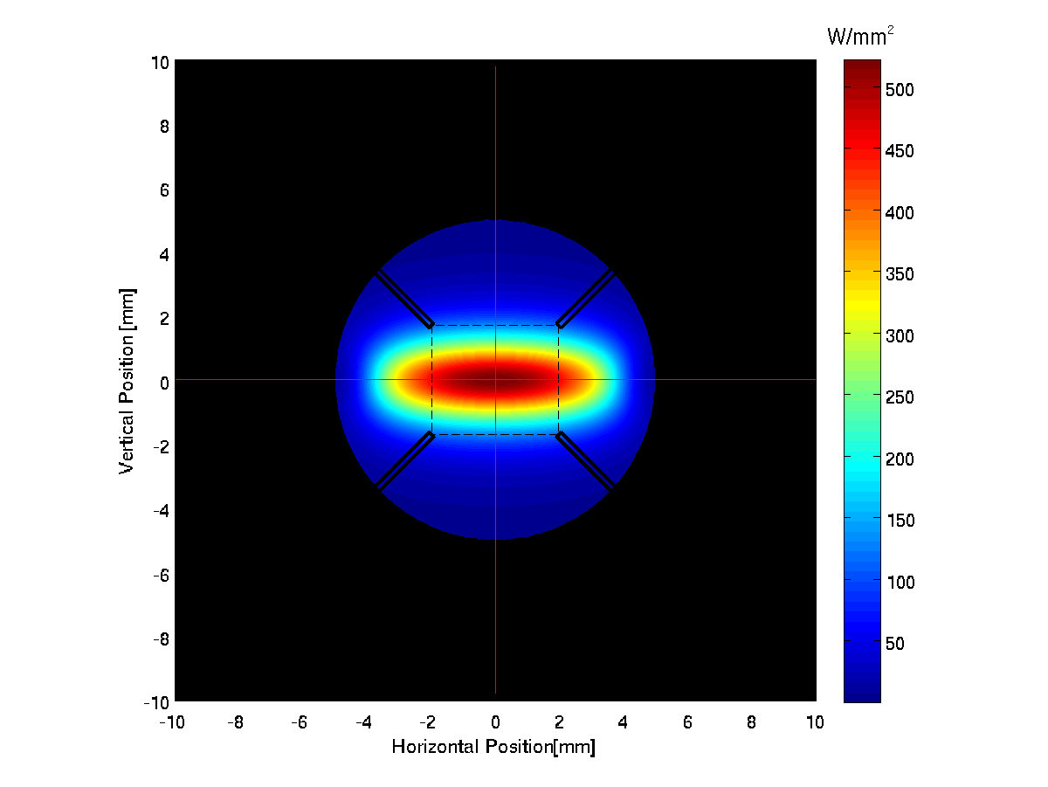
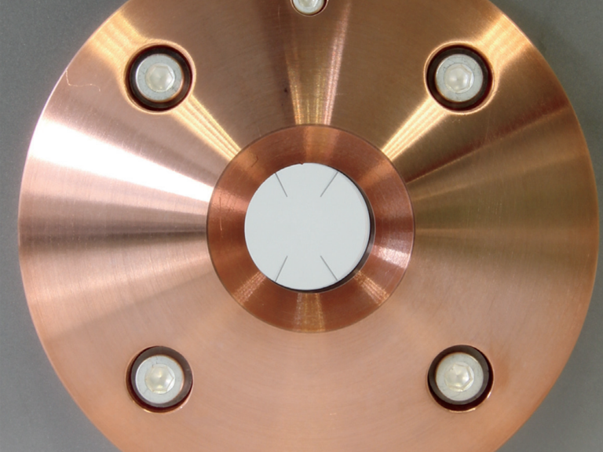
Background
Front End XBPMs use 4 tungsten blades
Manufacturer specifies maximum absorbed power is 47 W per blade.
Modelling indicated with upgrades of ID and storage ring energy for Diamond-II this would be exceeded.
For example, XBPM-01 of I03 CPMU-1 has maximum power of 115 W
Simulations were conducted to find a ‘safe’ location for the blades by retracting them further from the beam.
In-house modifications were undertaken for 6 XBPMs.

Slide 3
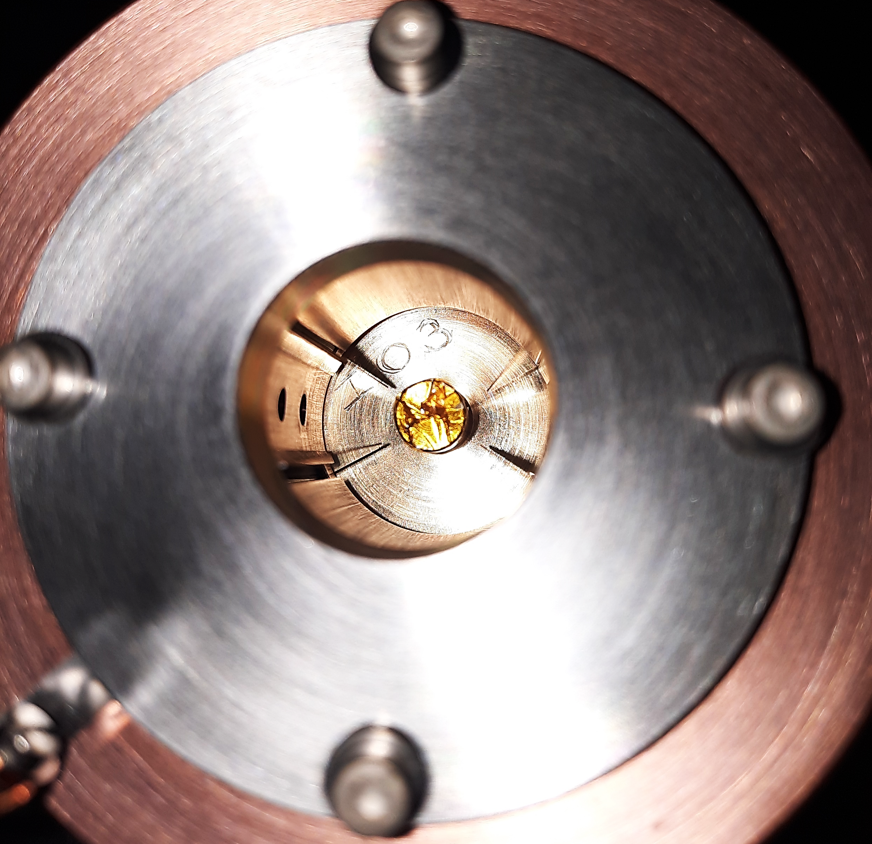
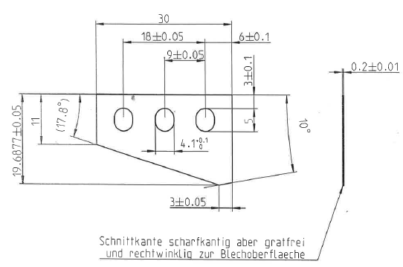
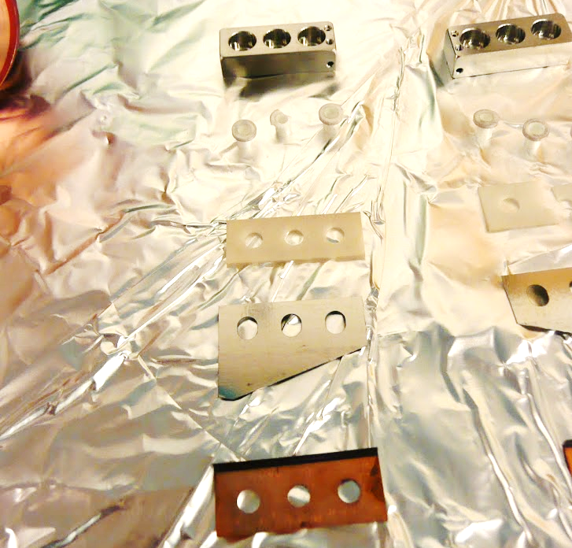
In-house Modifications
Small amount of wiggle room in the blade assembly allows for the new blade separation to be set.
Simulation calculated blade separations used to determine the diameter of a ‘spacer’.
Problems Encountered
Removing the XBPM from vacuum, working in a non-clean area. → Easily resolved but time consuming
Limited by the ‘wiggle room’ of the blade assembly, sometimes this is not enough. → Need to specify and check retraction range of blades in future procurement.
Risk of the blades not being secured correctly, or damage to the ceramic. → Consideration of human error and quality control.
Notes:
Time limited so work done in a non-clean area.
Slotted hole is 8/9 mm. Should get 3mm in each direction, if starting in the centre. This was not the case so did not have the expected wiggle room.
We have modified 6 XBPMs
2 had poor vacuum
1 dead blades
2 wiggle room not enough

Slide 4
Expected increase on all blades.
Expected to balance signals, with amplitudes below saturation level.
Saturation
Expected reduction on all blades
Nominal
Operation
Blades adjusted to take new CPMU power load
New CPMU installed
Manual alignment
(stepper motor failure)
Stepper motor replaced, alignment
Final mitigation; After remote alignment:
Use 3 blades only in XBPM position calculation until next hardware intervention.
Notes:
Modified blades November 2020
I03 New ID April 2021
Manual adjustment made March 2022

Slide 5
Questions Q1: Has anyone modified the blades of their XBPM? Q2: Has anyone done FEAs on how much power these blades can handle? Q3: Is 47W per blade too pessimistic?
Notes:
In nominal Diamond-I conditions a missteer could result in 100 W on the blades, we have not seen any failures.

Slide 6
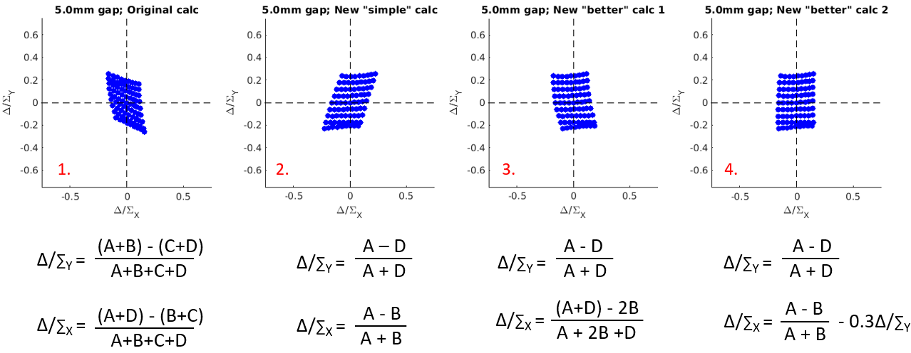

Slide 7
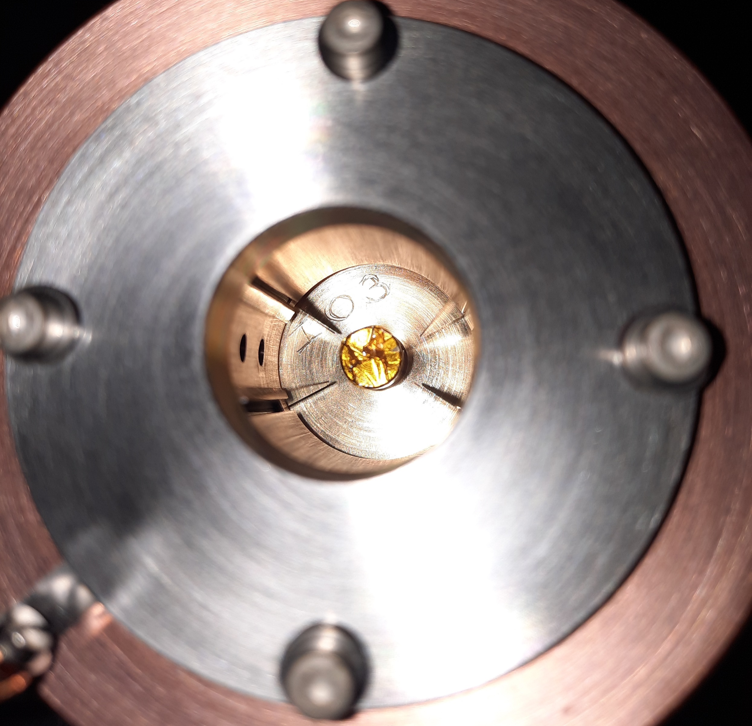

Slide 8
