Slide 1
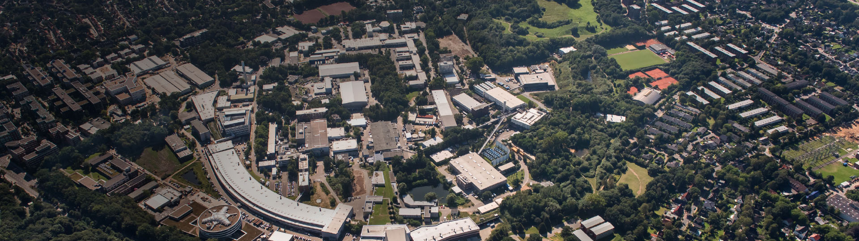
Dump Button BPMs at the European XFEL
D. Lipka, DEELS Workshop, HZB, Berlin
June 2022

Slide 2
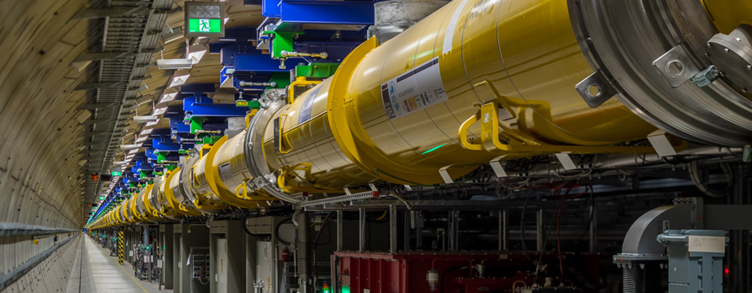
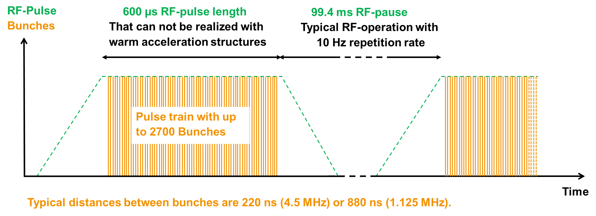
Overview
The European XFEL
Electron beam with momentum up to 17.5 GeV/c and default charge 250 pC produced in trains with minimum time distance of 222 ns
Photo: Dirk Nölle †
Parts of train distributed to SASE 1 and 3, other part to SASE 2: parallel operation of all undulator beamlines
Realized with flat-top-kickers
Measurement of single bunch properties necessary
SASE2
A25
SASE1
SASE3
Courtesy Matthias Scholz, DESY

Slide 3
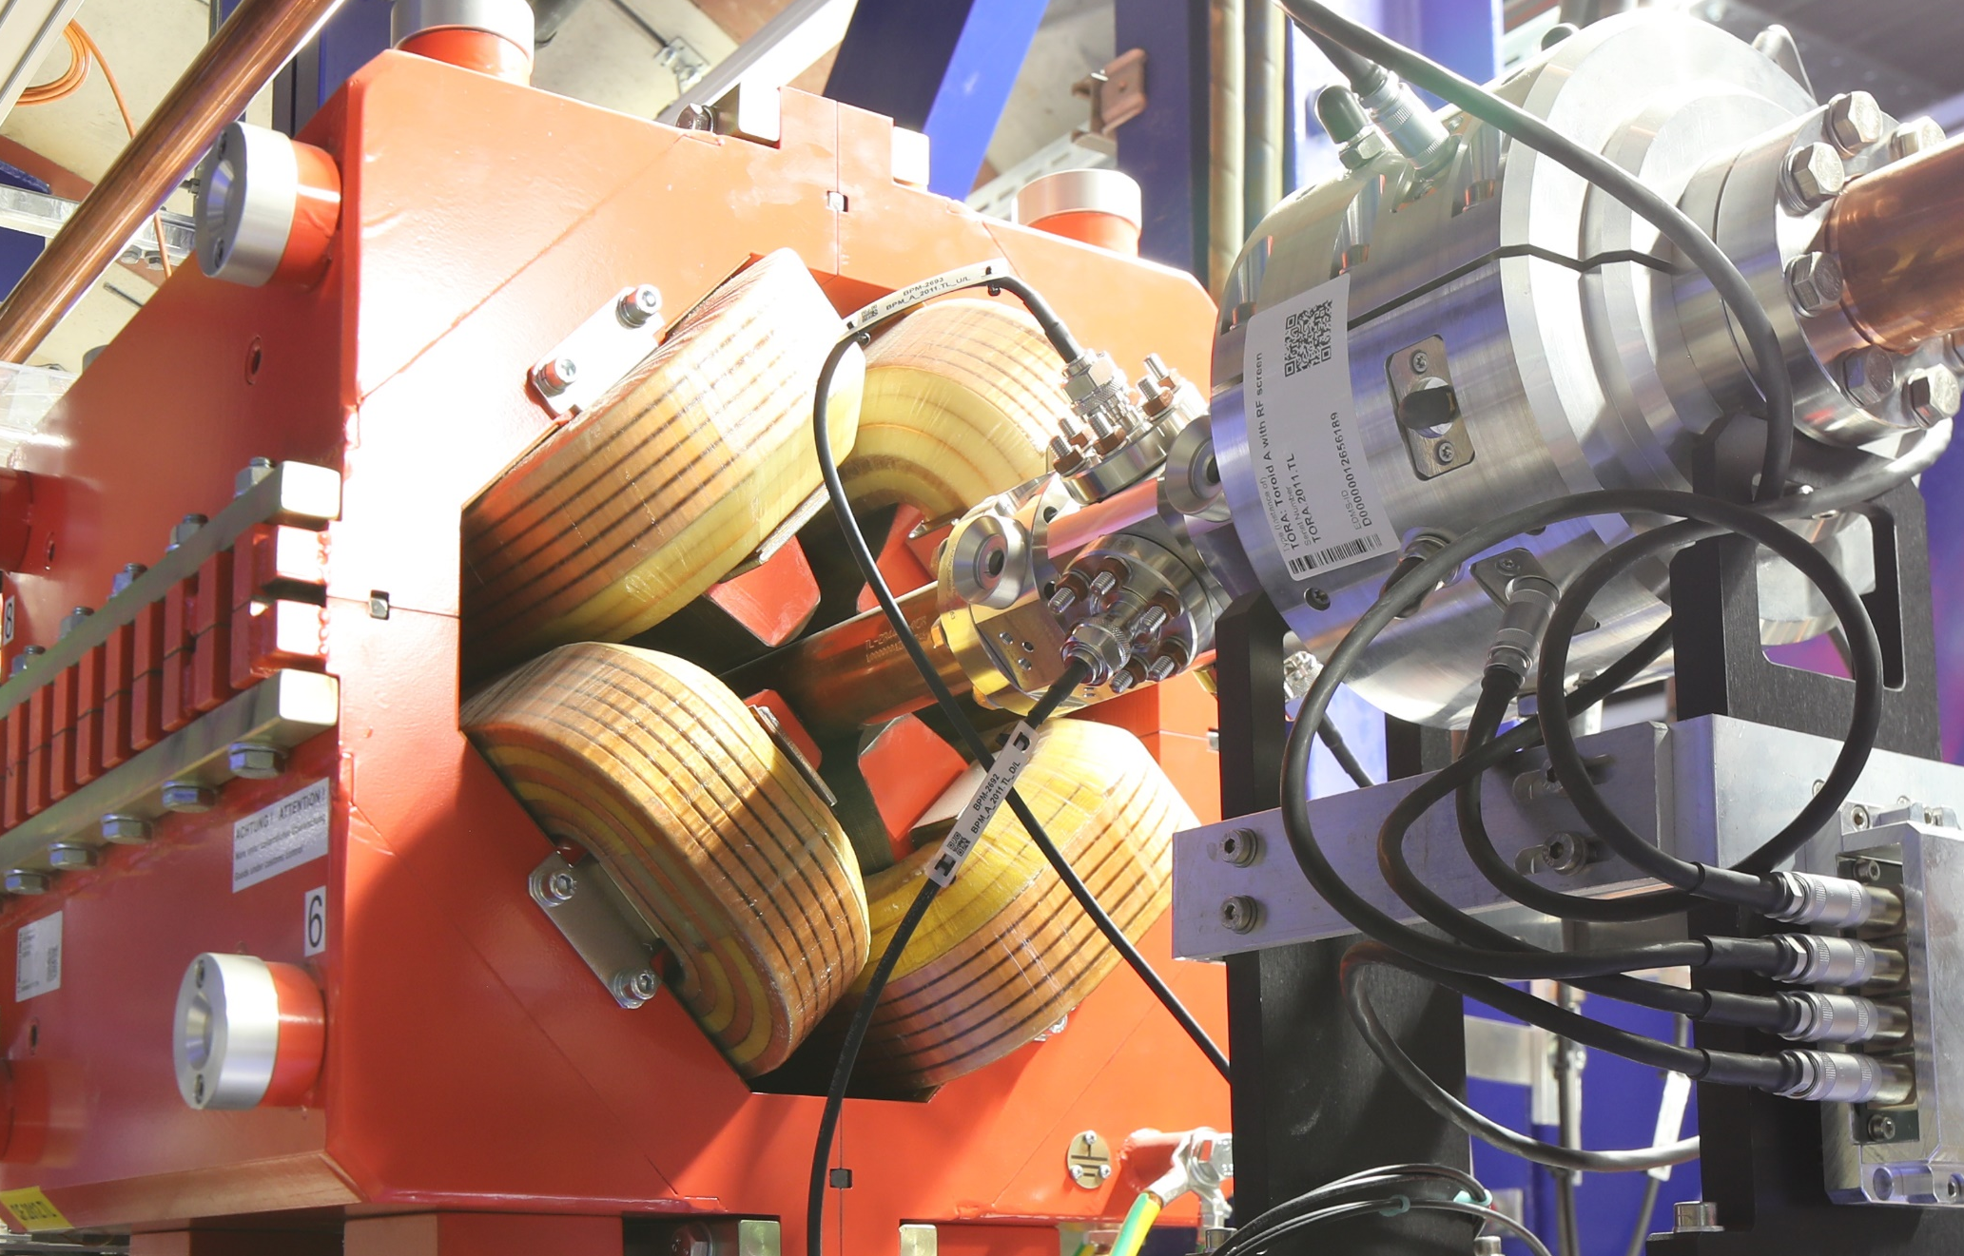
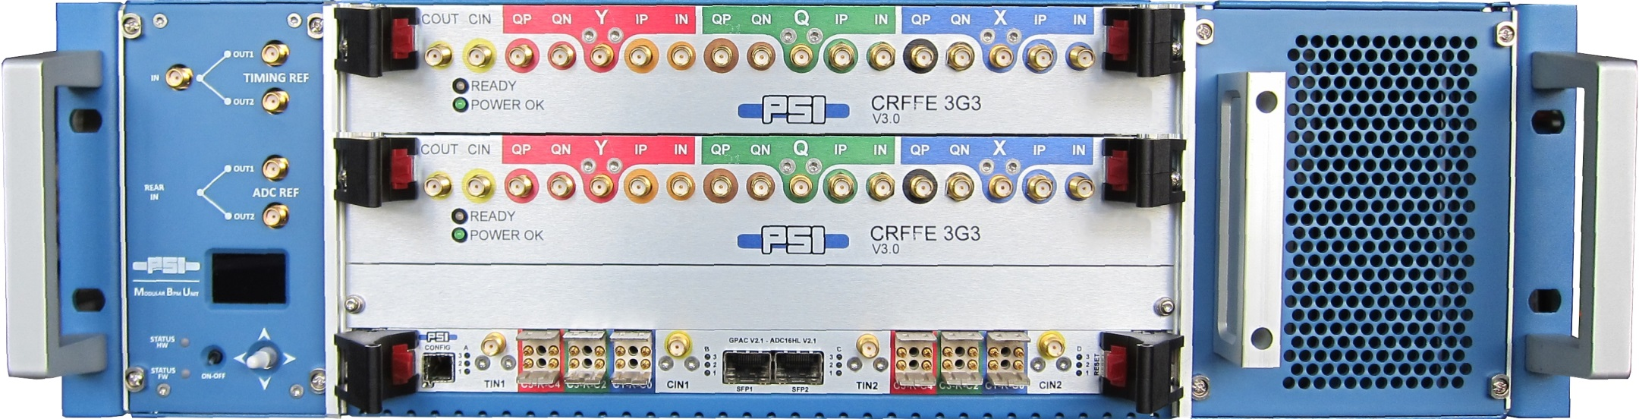
Overview
The BPM system in Eu-XFEL
Cavity, Re-entrant and Button BPMs installed: in summary about 500 monitors
Mainly button BPMs (~300) with different inner diameters: in warm beamline button diameter 16 mm with gap 1.5 mm
Electronic RFFEs for button and cavity BPMs provided by PSI
Button RFFE include notch filter to exclude 1.3 GHz acceleration frequency and include signals up to 2.5 GHz in frequency domain
This results in almost constant amplitude in time domain for several nanoseconds for the analysis
Photo: Dirk Nölle †

Slide 4
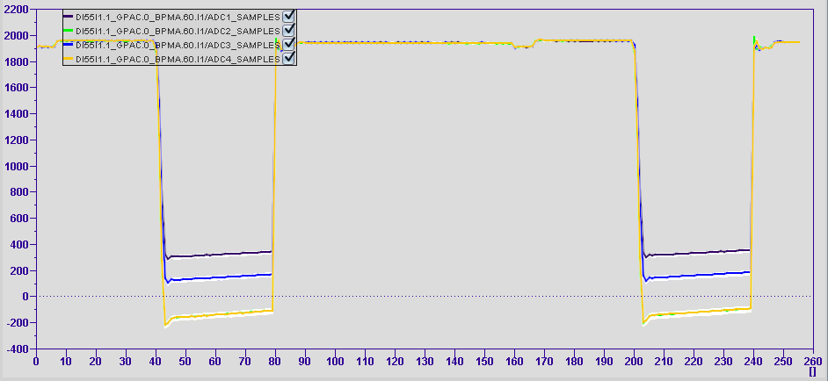
Signal from the BPM in ideal case
After the RFFE with ADCs
The constant amplitude is visible for one bunch, here two bunches with 2.2 MHz repetition rate visible for all 4 channels
Several data points are taken to calculate a mean of the amplitude
The same is done for the background amplitude
After the beam signal a discharging is applied
ADC amplitude
t / samples
Standard warm button BPM with 40.5 mm inner pipe diameter
Sample points with 433.3 MHz ADC repetition rate, corresponds 2.3 ns for each point

Slide 5
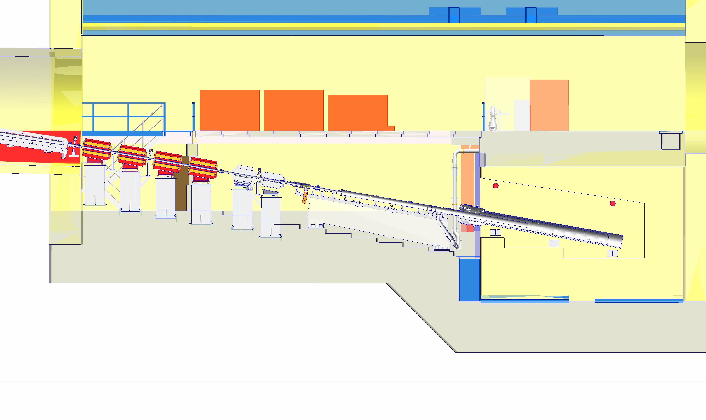
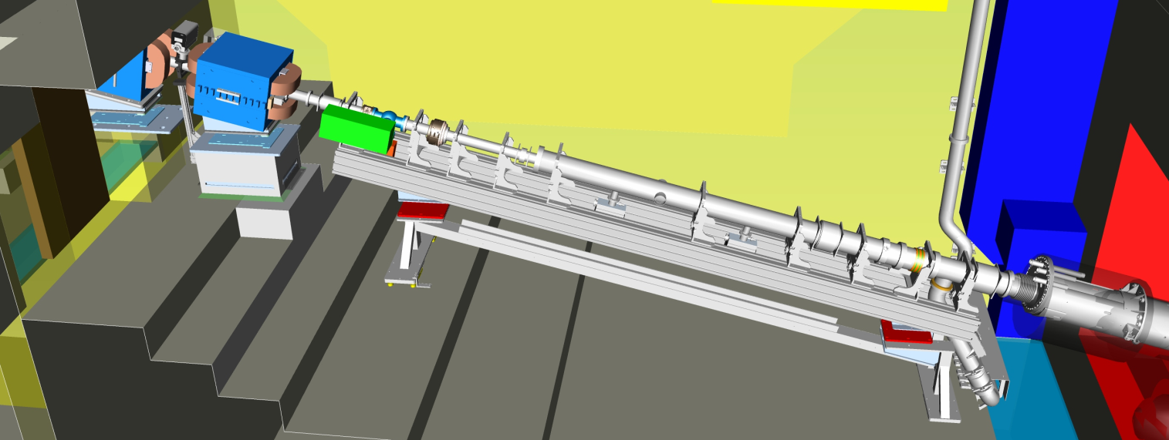
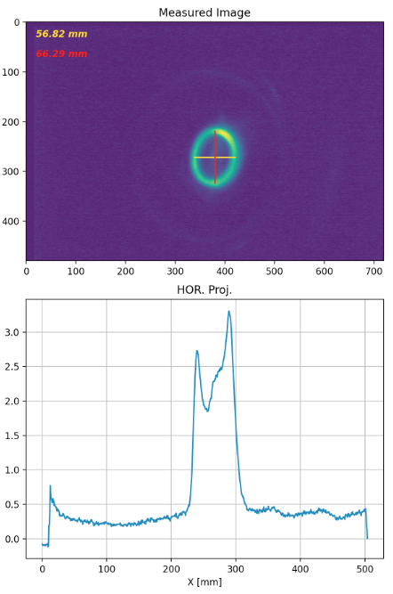
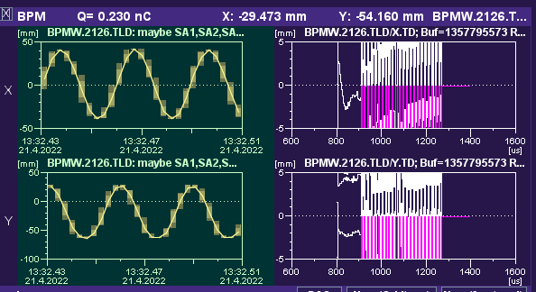
Eu-XFEL Dump-Beamline
Bunches are dumped at three dumps
Each dump contains dipole sweepers to move beam in a circle
Beam pipe increased to 100 mm and the last part has 200 mm inner diameter
BPMs are equipped with the same buttons
screen
Viewport for
Dump window
Last BPM
Courtesy Michael Schmitz, DESY

Slide 6
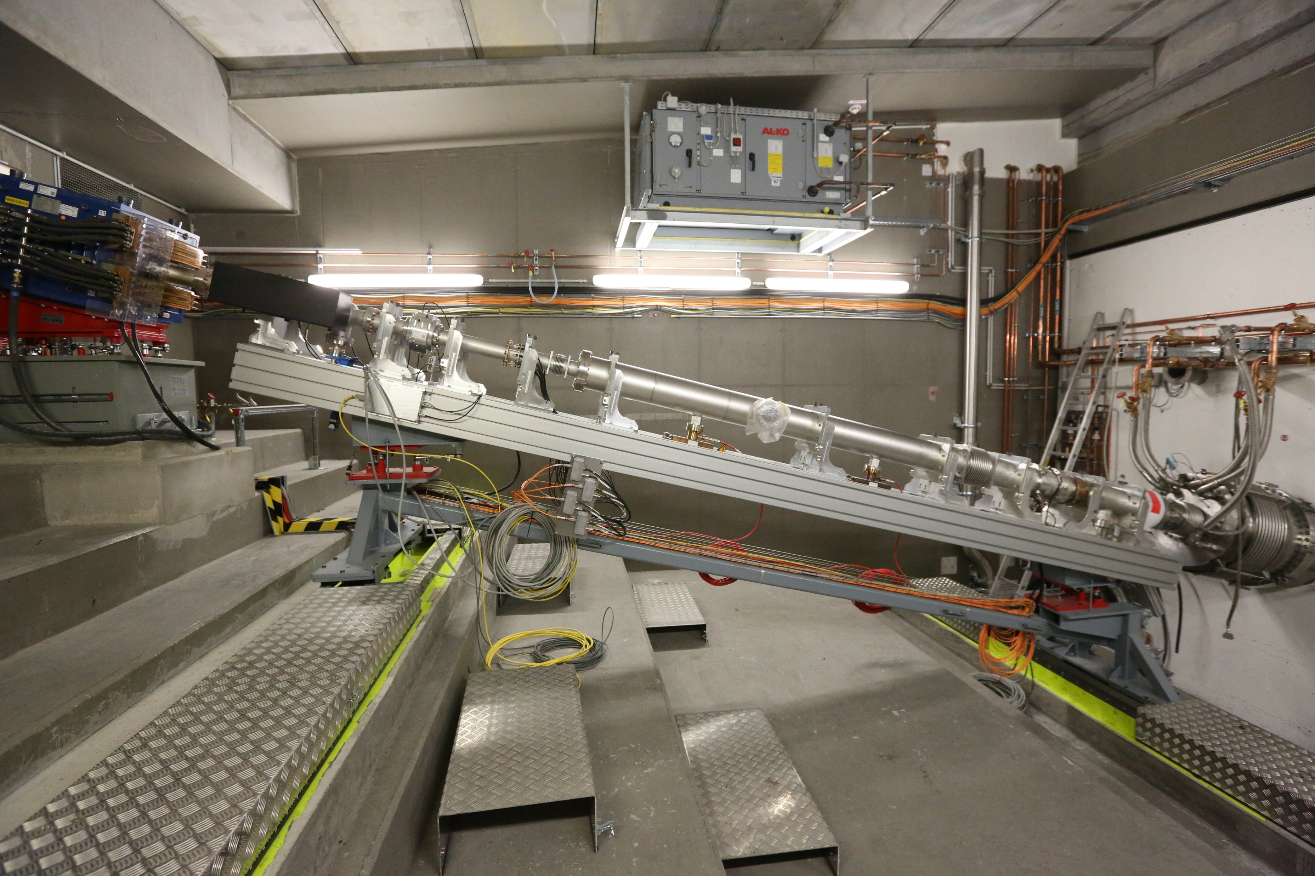
Eu-XFEL Dump-Beamline
Photo: Dirk Nölle †

Slide 7
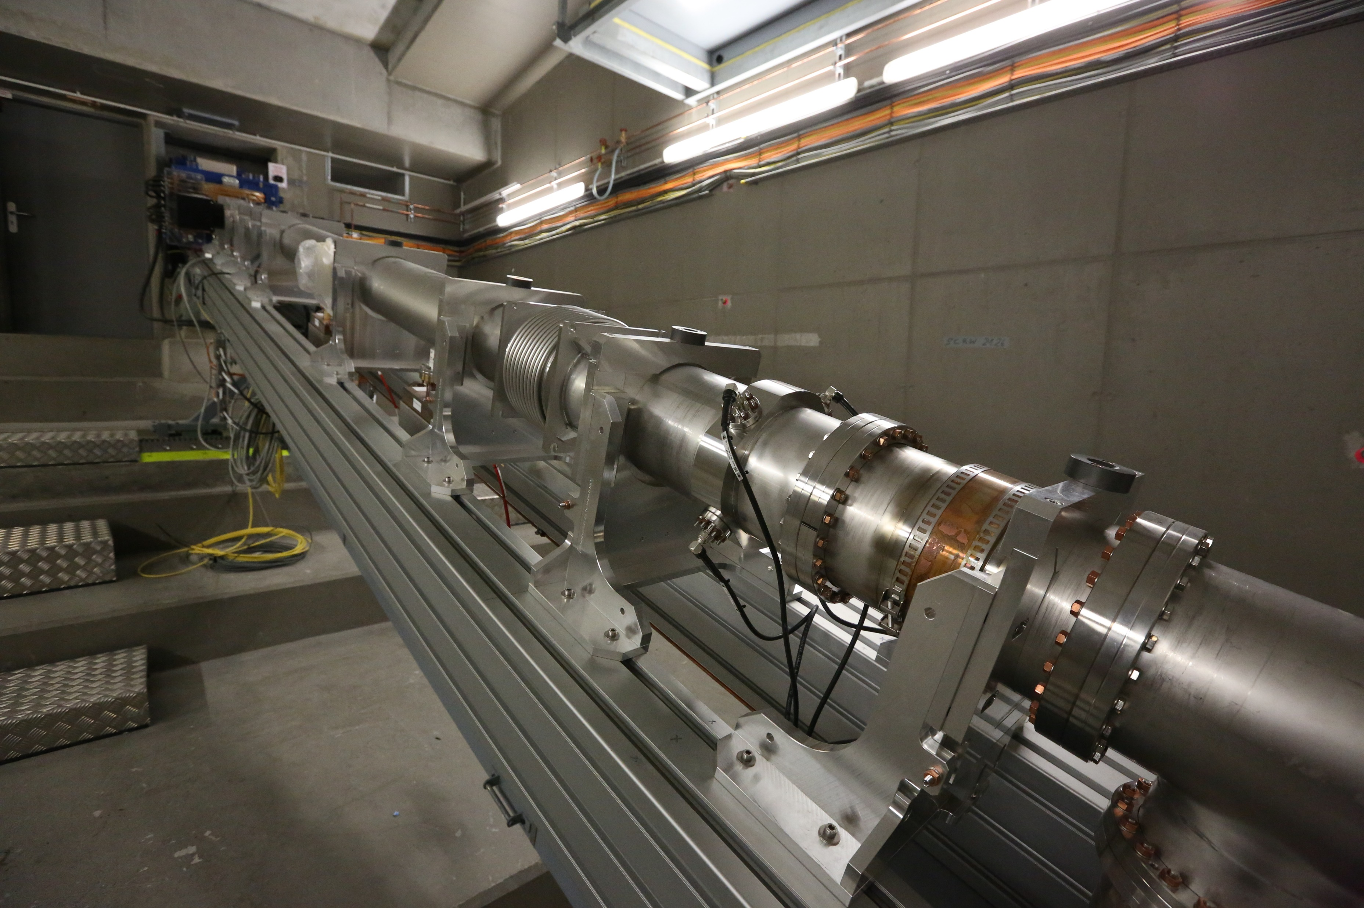
Eu-XFEL Dump-Beamline
Photo: Dirk Nölle †

Slide 8
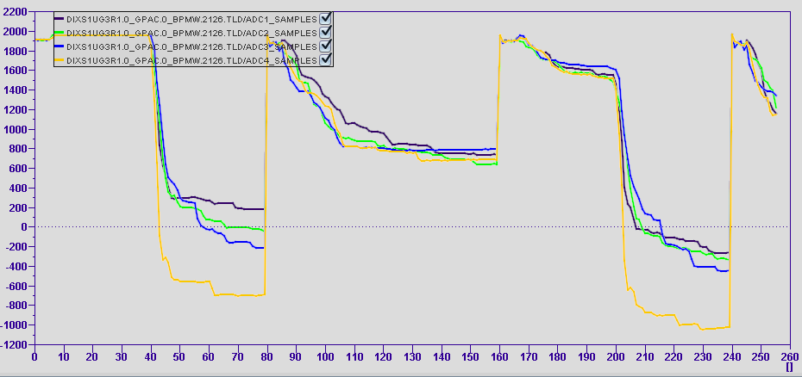

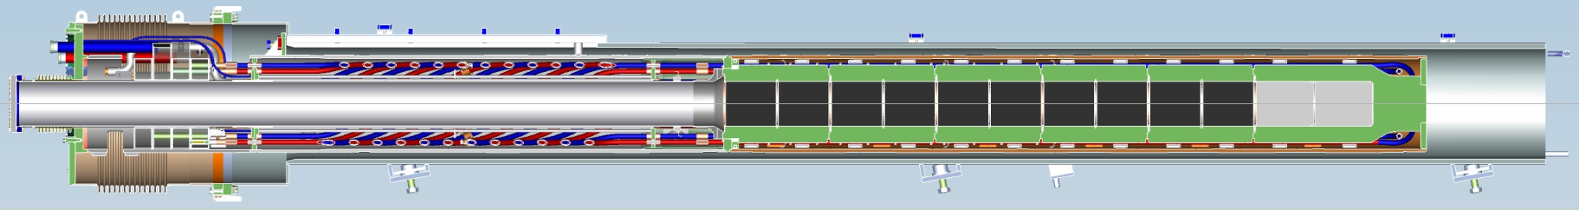
Dump BPM Signal
ADC amplitude
From ADC after RFFE
Observation:
  With standard settings (ADC sample points between 56 and 63) beam position factor k’ about 10 smaller compared to screen extrapolated positions
  Adjusting samples between 44 and 47 (up to 16 ns after beam passing; about max. 5 m free space) factor becomes smaller: k’ about 5
After first bunch an increasing background visible: at background and signal range
Before first bunch no signal visible
BPMs near to dump are more affected
Assumption: charged particles generated from beam in dump
τ ~ 45 +/- 7 ns
1. Bunch empty bucket 2. bunch
BPM before dump
t / samples
899mm
CONCRETE
2189mm
3052mm
0m
1m
Graphit
2m
Al
Cu
3m
4m
5m
Courtesy Michael Schmitz, DESY

Slide 9
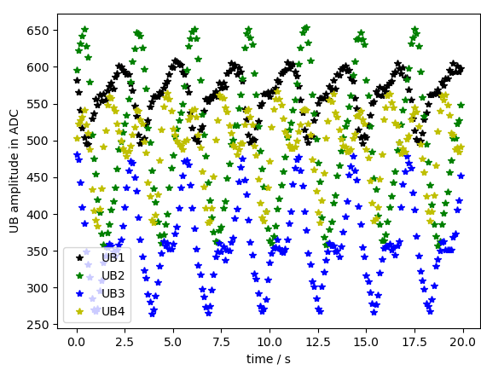
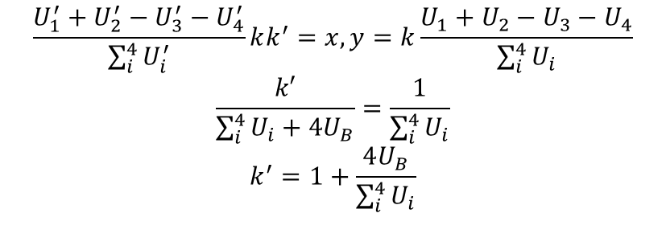
Dump BPM Signal
ADC amplitude
U_{B}
Data Analysis
Assume background charge is equally distributed in space
Each voltage get this contribution U_{B} to amplitude independent of beam position: U’_{i} = U_{i} + U_{B}
Since we have 45° tilted BPM the position is calculated with all 4 buttons:
BPM before dump
U_{B} along bunch train
t / samples
U_{B} for first empty bucket vs. time
$$\frac{U_{1}^{′}+U_{2}^{′}−U_{3}^{′}−U_{4}^{′}}{\sum_{i}^{4}{U_{i}^{′}}}kk^{′}=x,y=k\frac{U_{1}+U_{2}−U_{3}−U_{4}}{\sum_{i}^{4}{U_{i}}}$$
$$\frac{k′}{\sum_{i}^{4}{U_{i}+{4U}_{B}}}=\frac{1}{\sum_{i}^{4}{U_{i}}}$$
$$k^{′}=1+\frac{4U_{B}}{\sum_{i}^{4}{U_{i}}}$$
To become k’ = 5: U_{B} should be 4 times U_{i}
To become k’ = 10: U_{B} should be 9 times U_{i}

Slide 10
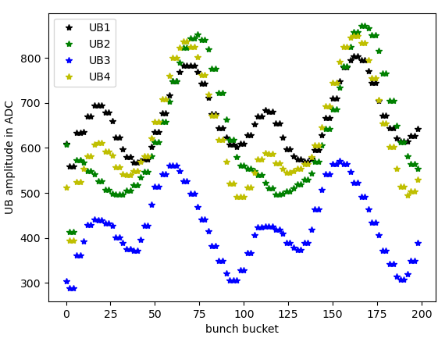
Dump BPM Signal
Data Analysis
U_{B} for first 100 bunches for BPM at dump entrance where every second bucket is not filled
Includes rotation

Slide 11
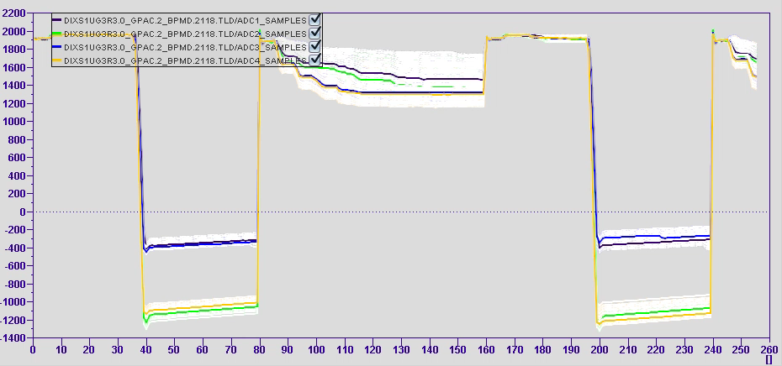
Dump BPM Signal
ADC amplitude
Data Analysis
BPM before sweeper: signal of first bunch almost not affected but amplitude between two bunches show variation of voltage
In general: U_{B} with beam is not known (only at empty buckets but could behave differently) and not constant and depends on beam position
BPM before sweeper
t / samples

Slide 12
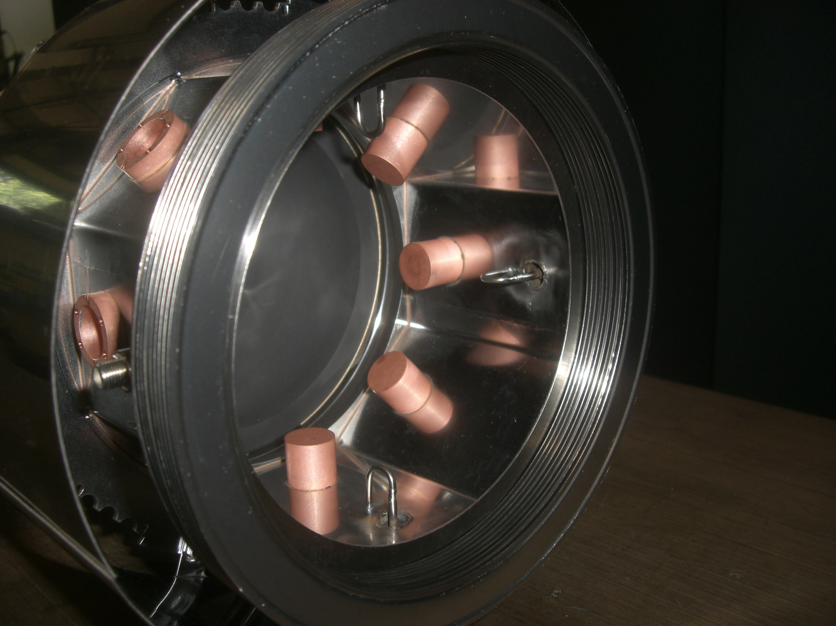
Avoid additional signal
Install magnetic coupled BPM, but motivation is low because
  No guaranty that no fast charged particles generate additional signals
  Exchange of component in vicinity of dump!
Other experience or ideas without changing hardware?
Photo: Dirk Nölle †
In-Air BPM installed at FLASH Dump-Beamline
Dirk Lipka
Machine Diagnostics Instrumentation (MDI)
Dirk.Lipka@desy.de

