Slide 1
Tango Introduction
pyAML Community Meeting 2025.09.04
B. Bertrand (MAX IV)

Slide 2
What is Tango 1/2
“Tango Controls is a free open-source device-oriented controls toolkit for controlling any kind of hardware or software and building SCADA (supervisory control and data acquisition) systems. Tango Controls is operating system independent and supports C++, Java and Python for all the components”

Slide 3
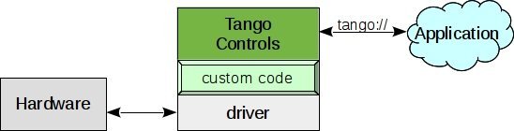
What is Tango 2/2
Started in 1999 @ESRF Synchrotron in Grenoble, France
Used by Synchrotrons, lasers, telescopes…
Rich ecosystem (Archiving, GUI, Tools)
Based on CORBA and ZeroMQ
Built around the concept of devices and device classes

Slide 4
Tango Key Concepts

Slide 5
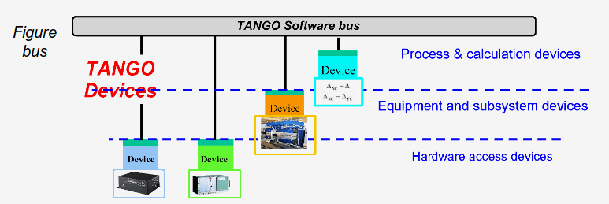
Device
A device is an object providing access to commands, attributes and properties
A device can represent:
A piece of equipment
Multiple pieces of equipment
A set of software functions
A group of devices representing
a subsystem
Notes:
A device is a key concept

Slide 6
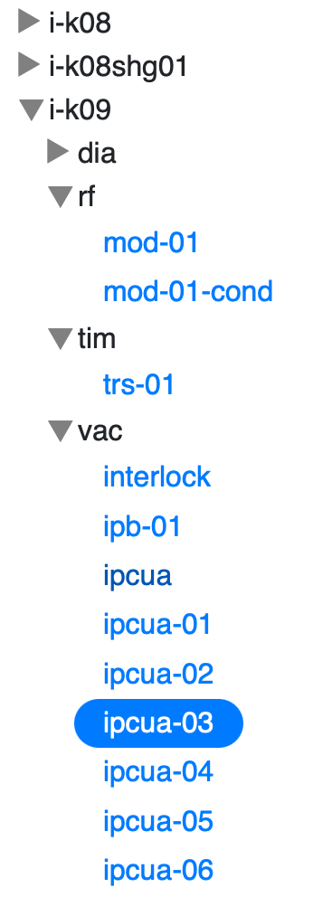
Device name
Every device has a 3 fields name, following a hierarchical
notation: domain/family/member
sys/database/2
sys/tg_test/1
i-c080008cab02/vac/ipcua-04 (Ion Pump)

Slide 7
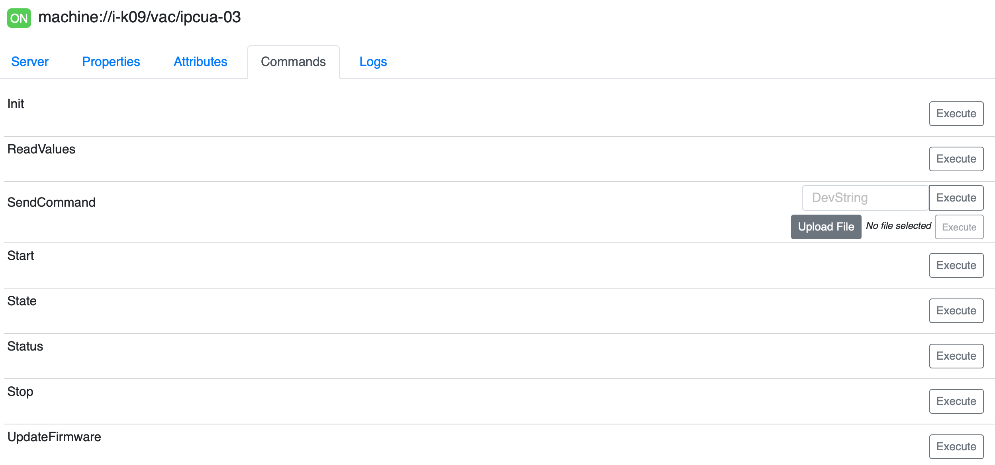
Device Commands
Operation to invoke on a device: SwitchOn, SwitchOff
Every device has at least 3 commands:
  Init
  State
  Status

Slide 8
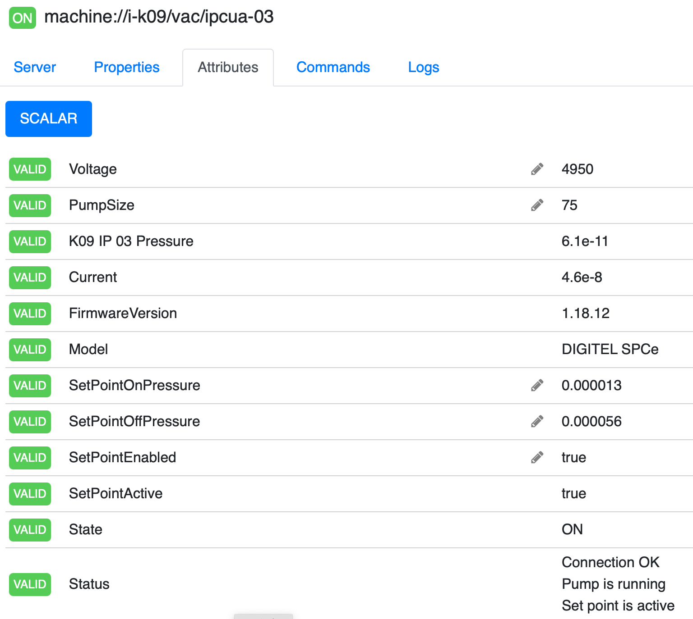
Device Attributes
An attribute represents a typed variable
with a value
Data format: Scalar (0D), Spectrum (1D)
or Image (2D)
Data type (boolean, short, ulong64…)
Read and/or Write
Metadata: quality, timestamp
State and Status

Slide 9
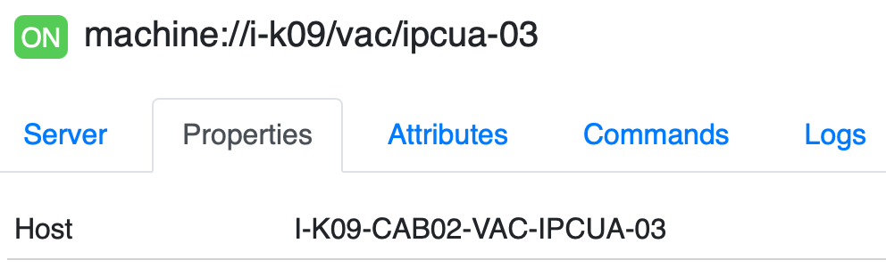
Device Properties
Configuration parameter stored in the Tango Database
Represented as key-value pairs

Slide 10
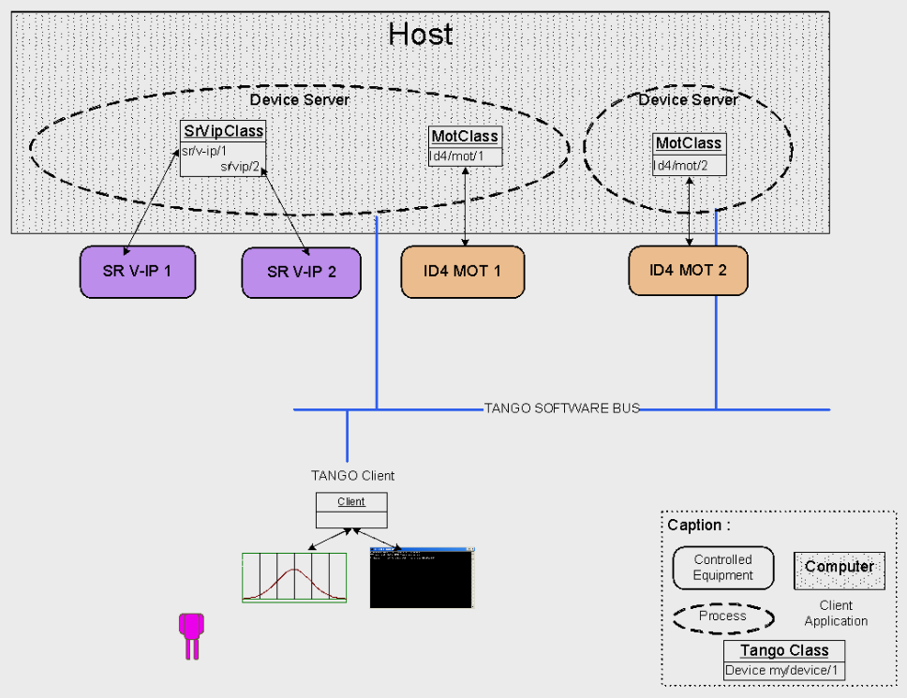
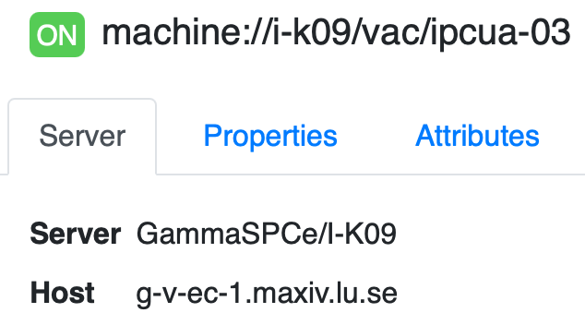
Device Server
A Device Server is the process that will
create devices of a Device Class
(an abstraction of a device’s interface)
{DeviceServerName}/{instanceName}

Slide 11





Tango Database
Each Tango Controls system has a centralised Tango Database
  Maintains a catalog of the Tango device servers and devices configured to run in the sytem
  Stores configuration data (properties) used at initialization of a device
  Acts as name server
  Stores dynamic settings (memorized attributes)
Databaseds
device server
PyDatabaseds
device server
Not production ready - Testing only

Slide 12
TANGO_HOST
Variable that specifies on which host and port the Databaseds is running: localhost:10000
Can be set using:
  environment variable
  /etc/tangorc on unix-like OS
  ${TANGO_ROOT}/tangorc on Windows
  ~/.tangorc on unix-like OS

Slide 13
Tango Controls System Communication
Server
PowerSupply
device server
1. Device Server tells Databaseds about its connection details (IP, hostname, port)
test/power_supply/1
3. Connect to Device Server
TANGO_HOST
Databaseds
device server
Client
DeviceProxy(’test/power_supply/1’)
2. Lookup device & connection string

Slide 14
PyTango

Slide 15
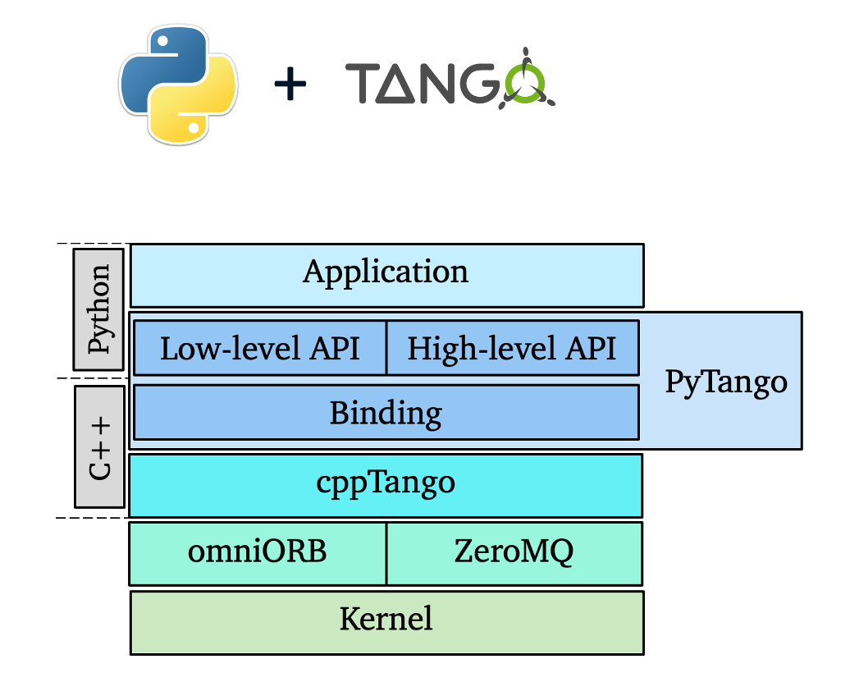
PyTango
Module that exposes to Python the Tango C++ API
Write Tango Device Server
Access the Tango Database
Write Tango client (script, CLI, GUI)

Slide 16
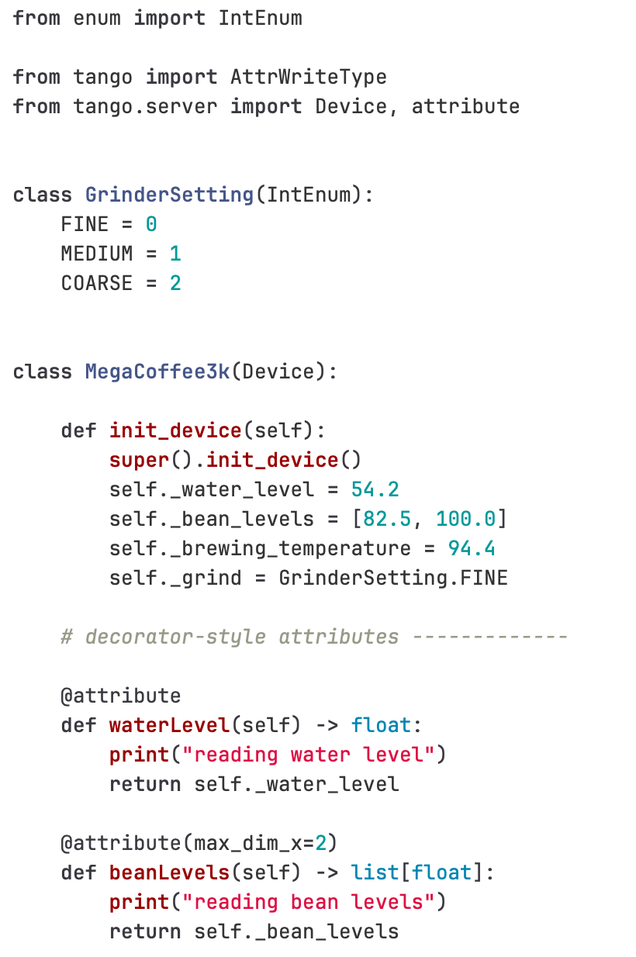
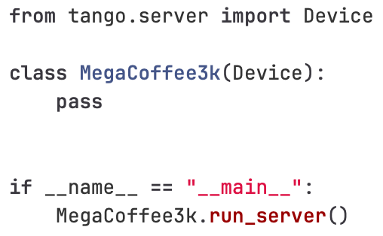
PyTango Device Server

Slide 17
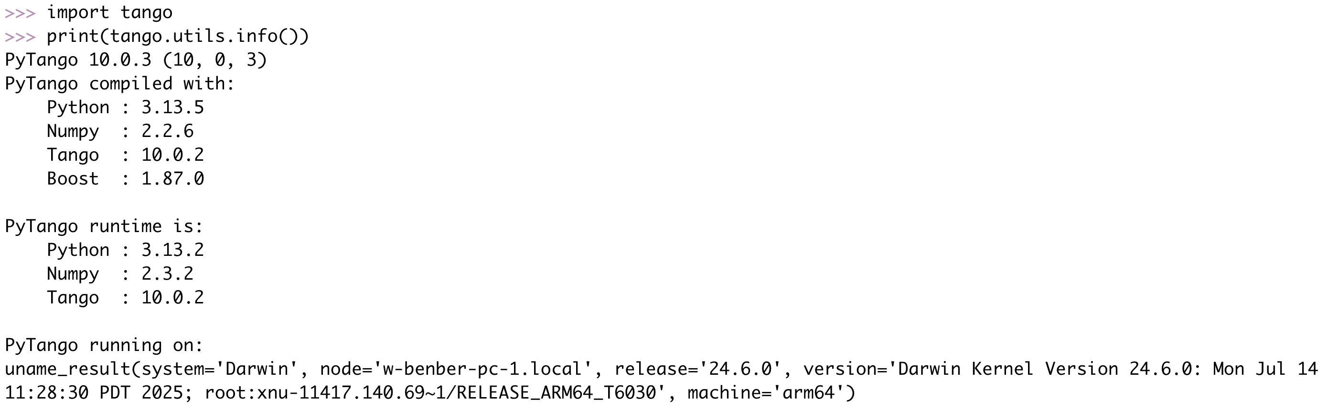
PyTango Client 1/3

Slide 18
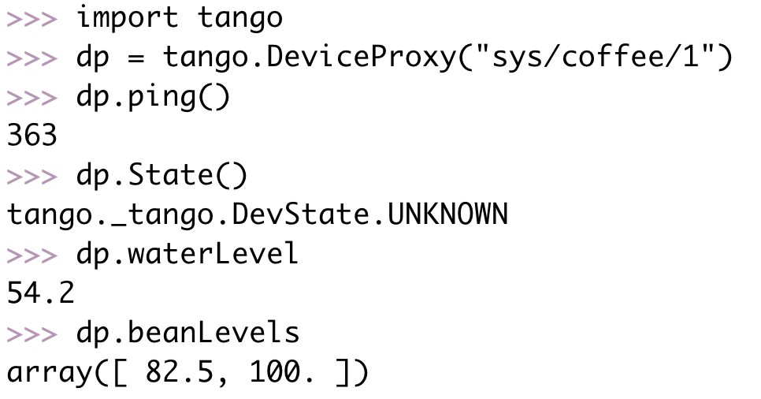
PyTango Client 2/3

Slide 19
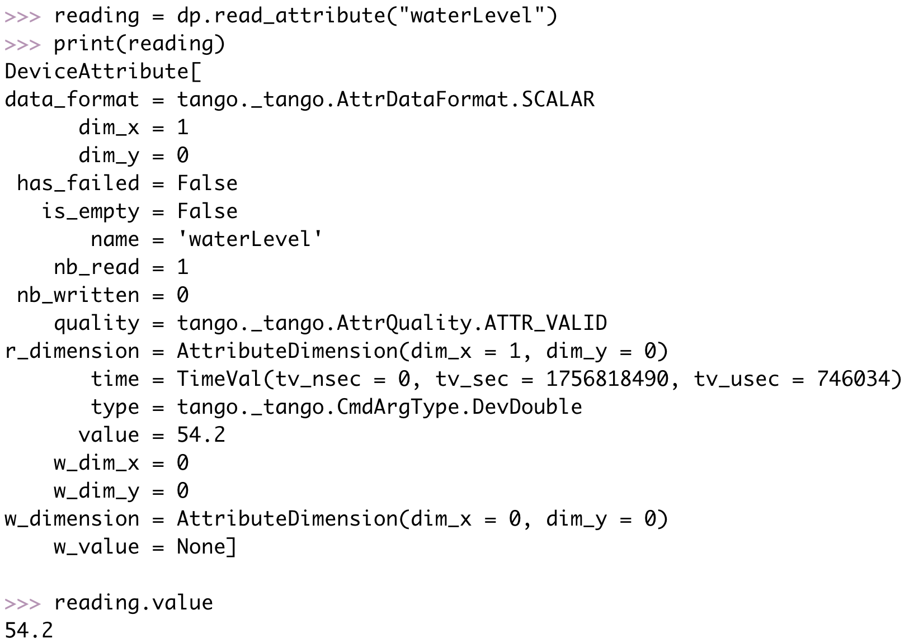
PyTango Client 3/3

Slide 20
Useful Links
https://www.tango-controls.org
https://tango-controls.readthedocs.io
https://pytango.readthedocs.io
https://tango-controls.readthedocs.io/en/latest/Tutorials/getting-started/00--tutorial.html

