Slide 1
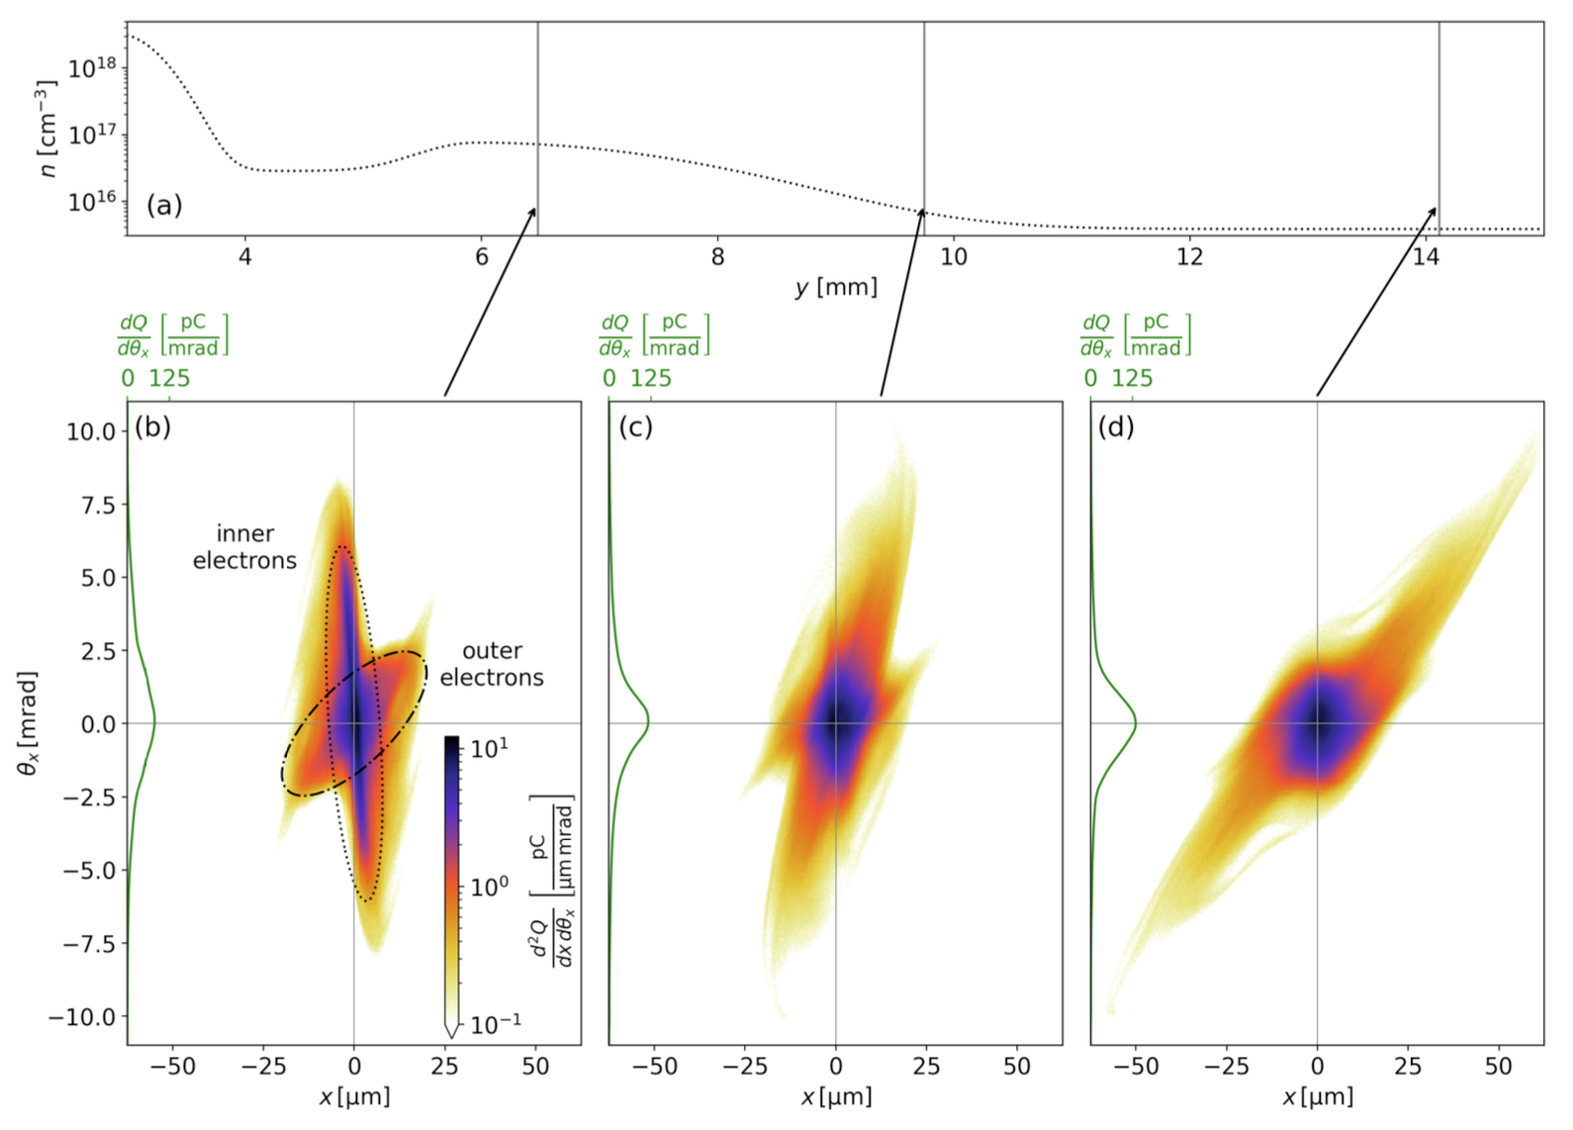
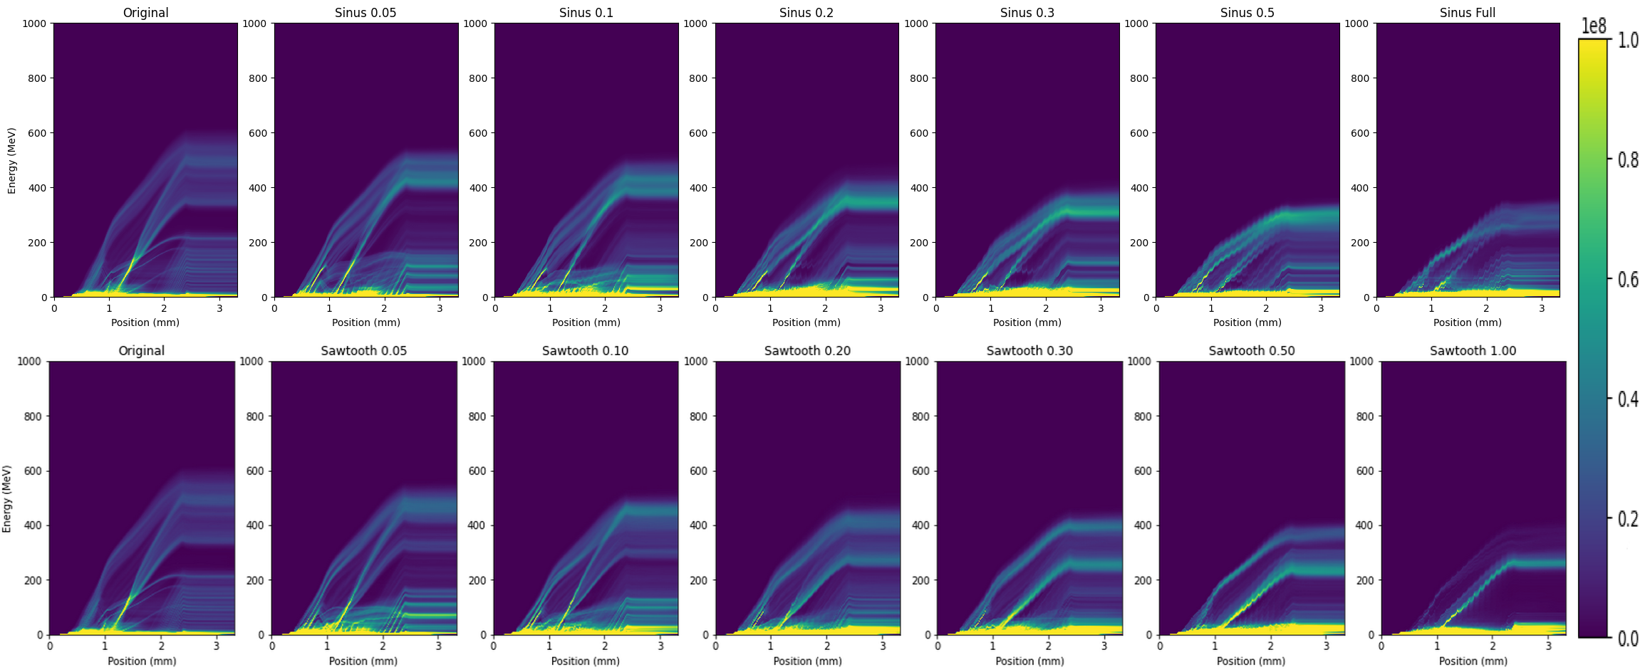
Students’ projects regarding LWFA e⁻ beam quality
How do different plasma profiles change the electron beam parameters?
Yurii Perets
(Taras Shevchenko National University of Kyiv)
Study electron beam property changes due to density fluctuations in plateau region of LWFA
Konrad Schlicke
(Technische Universität Dresden / HZDR)
Study electron beam property changes after various downramps
as expected, density fluctuations reduce effective acceleration force
but also, can reduce energy spread
observed divergence reduction as in experiment
significant influence on spatial distribution and also emittance

Slide 2
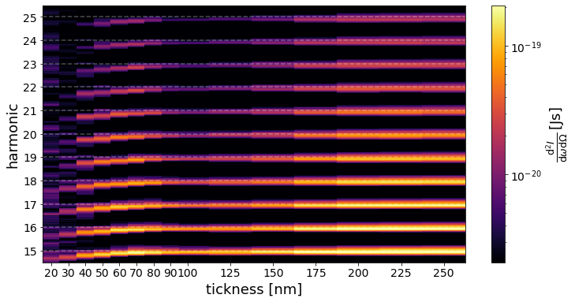
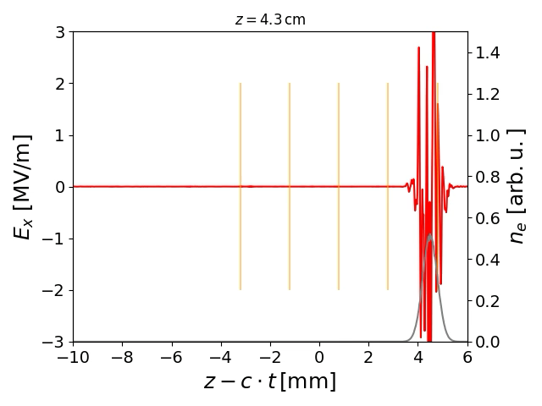
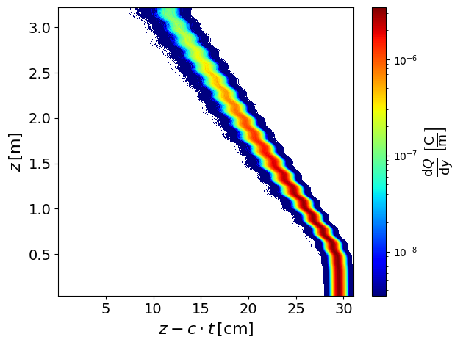
Using PIConGPU for modeling radiation emission
Far-field radiation for diagnostic in foil irradiation (HHG) and as light source in undulators like DALI
High Harmonics Generation (HHG)
(in collaboration with Milenko, etc.)
What do we learn from the reflected light about the proton acceleration during foil irradiation?
DALI-like undulators/wigglers
(in collaboration with Ulf Lehnert, etc.)
Can PIConGPU used to model FELs when the slowly varying envelope approximation of FELS codes fails?
reproduce similar HHGs like experiment for various GDD or foil-thicknesses
still need to solve numerical issues when having complex ion distributions
so far just initial test: observe correct fall back and radiation wavelength
still need to include correct electron beam focusing

