Slide 1
Data management
FWKT group retreat 2025
Institute of Radiation Physics· Laser-Particle Acceleration · Dr. Hans-Peter Schlenvoigt · hp.schlenvoigt@hzdr.de · www.hzdr.de

Slide 2

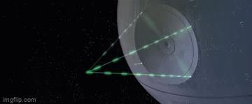

Data and Knowledge are our products

Slide 3







Why data management?
Data
Electronic Lab Documentation
Simulations
Experiments
Metadata
Knowledge

Slide 4



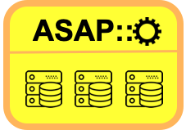


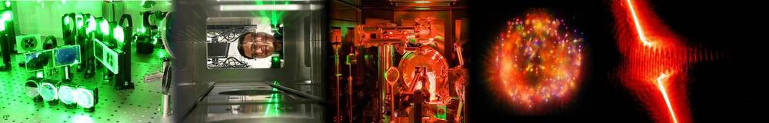




Data management pieces
Data
Tools
and
automation
Electronic Lab Documentation
Simulations
Experiments
Metadata
Knowledge

Slide 5

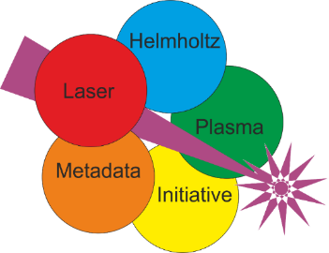


Long-term dream
Data
Tools
and
automation
Domain-specific standard
Data repository
Electronic Lab Documentation
Simulations
Experiments
Metadata
Metadata catalogue
Knowledge

Slide 6
Acknowledgements
    The HELPMI project (ZT-I-PF-3-066) was funded by the Initiative and Networking Fund of the Helmholtz Association in the framework of the Helmholtz Metadata Collaboration project call
      Franz Pöschel, Alex Debus, Alex Kessler, Matt Schwab, Johannes Hornung, Malte Kaluza, Vincent Bagnoud
    Parts of this work are supported by the consortium DAPHNE4NFDI in the context of the work of the NFDI e.V. The consortium is funded by the Deutsche Forschungsgemeinschaft (DFG, German Research Foundation) - project number 460248799.
      Kristin Tippey
    FWK-IT: Paul Schwanse, Willian Rochadel, Paul Petring (ex)
    FWCC/DMS: Oliver Knodel, David Pape, Thomas Gruber, Stefan Müller, Guido Juckeland, Uwe Konrad
    Lasers4EU is funded by the European Union under HE-GA 101131771 “Lasers4EU”
    LAPIS has been submitted to DFG (LIS)
    Michael Bussmann, Jeffrey Kelling, Nicole Wagner and their respective teams

