Slide 1
Pathfinder Instrumentation for SPRING
TauSoL Imaging SpectroPolarimeter
Hemanth Pruthvi ● Hans-Peter Doerr ● Michael Sigwarth ● Markus Roth
Spanish‐German WE-Heraeus-Seminar
Bad-Honnef, Germany
03.07.2025
Optical Instrumentation Group
Thüringer Landessternwarte (TLS)
Tautenburg, Germany

Slide 2
SPRING
Solar Physics Research Integrated Network Group
For synoptic observations of the Sun

Slide 3
Synoptic Observations
Full disk recordings
Spanning decades
Ground or space-based
Ideally, uninterrupted
Cadence of a minute or less

Slide 4
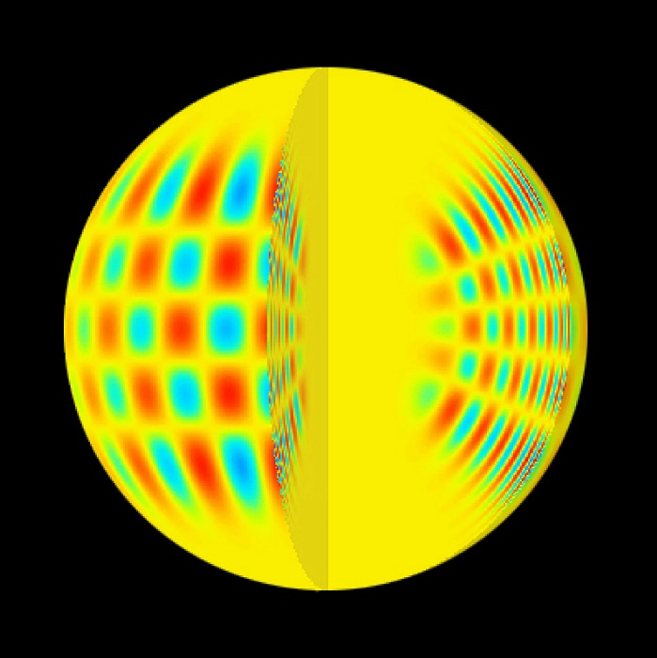
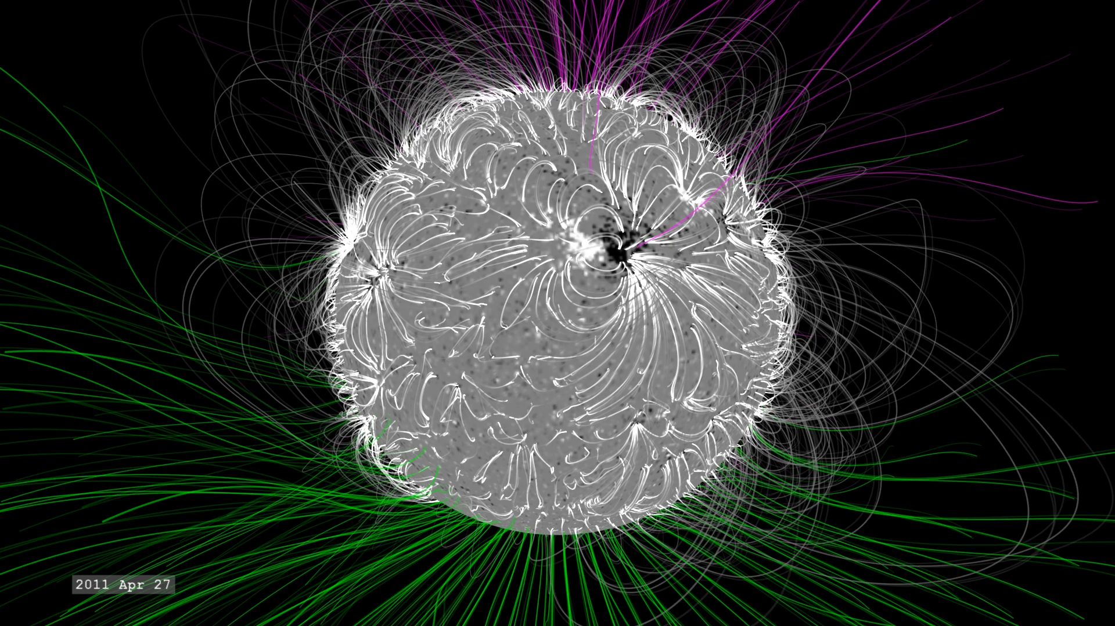
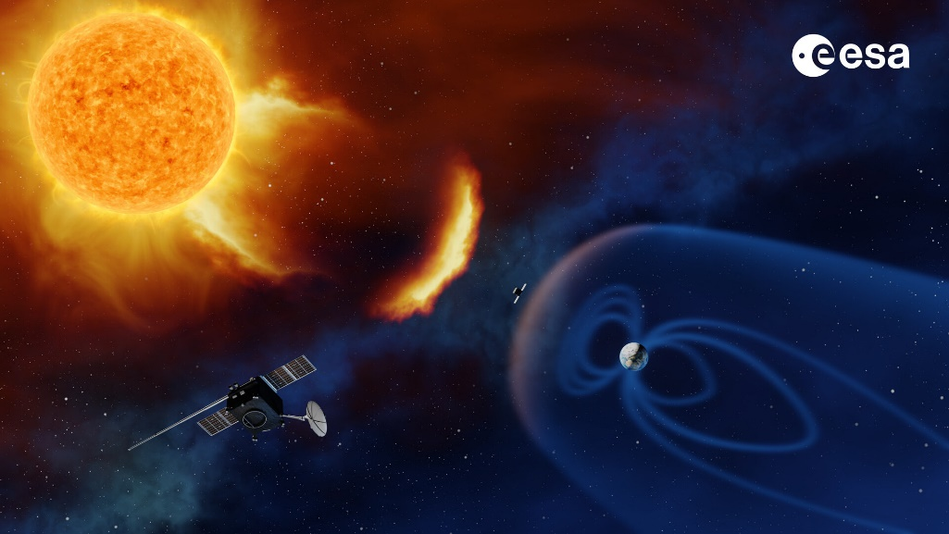
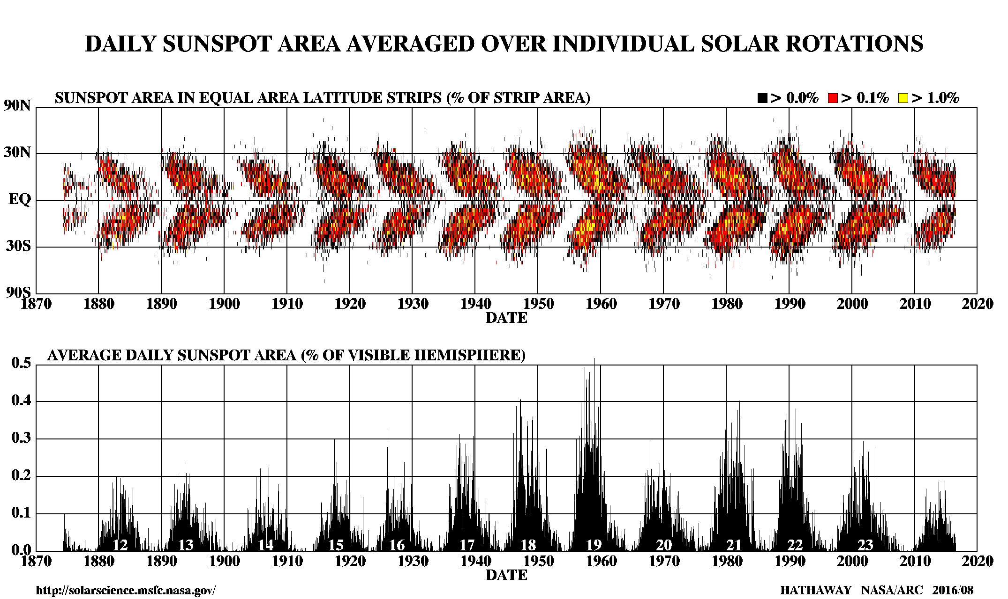
SPRING Motivation
Helioseismology
Solar Activity
ESA
NASA
Space Weather
Long-term Variability
ESA
NASA

Slide 5
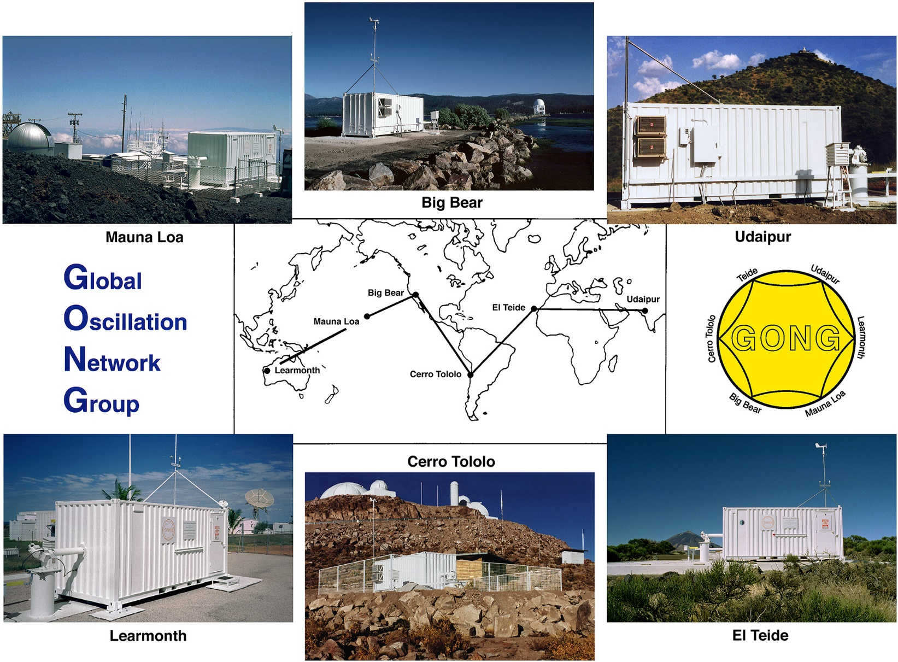
SPRING and GONG
Operational since 1995
Solar interior
Solar activity forecast
End of Life (SDO too!)
What’s next?

Slide 6
SPRING Science Requirements
Instruments
  Filtergraph(s)
  Imaging SpectroPolarimeter(s)
  Scanning SpectroPolarimeter(s)
  Integrated Spectrometer(s)
Region of interest
Full disk; arcsecond resolution
Observables
Intensity, velocity, magnetic field …
Spectral lines
Photosphere to upper chromosphere
Cadence
Few seconds to few minutes

Slide 7
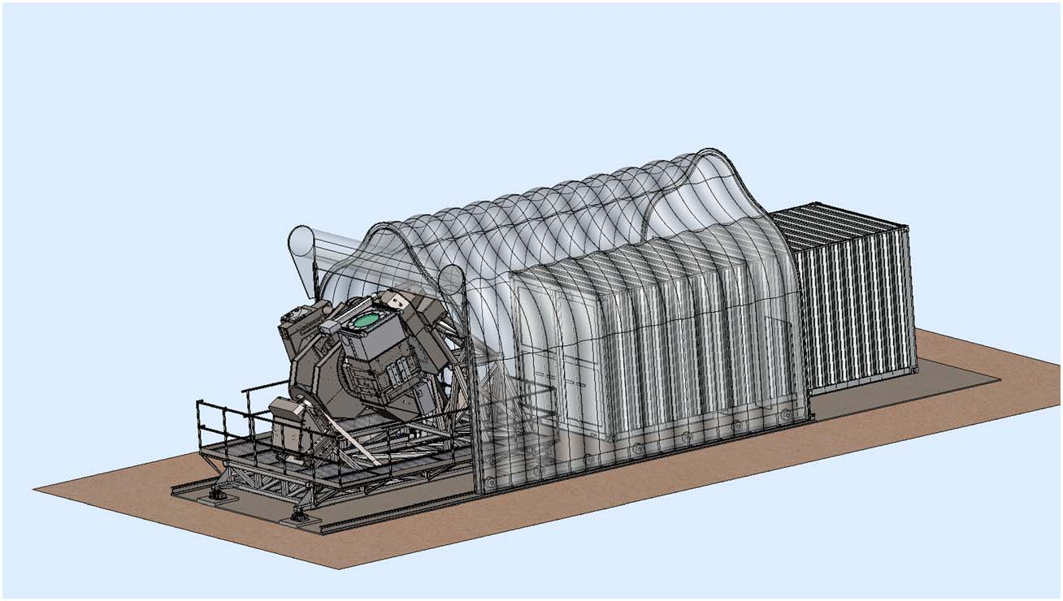
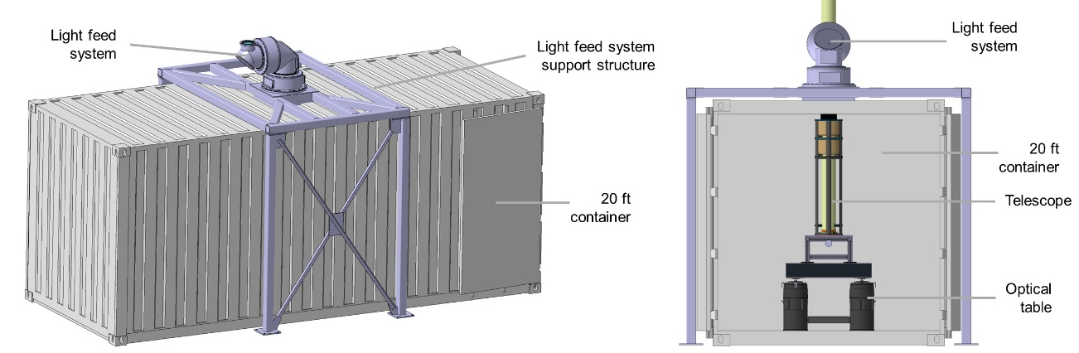
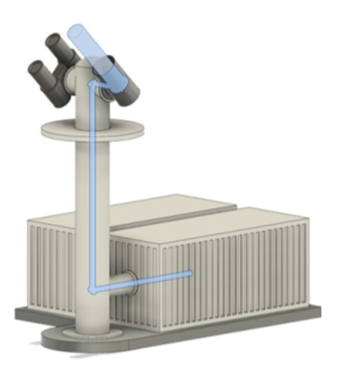
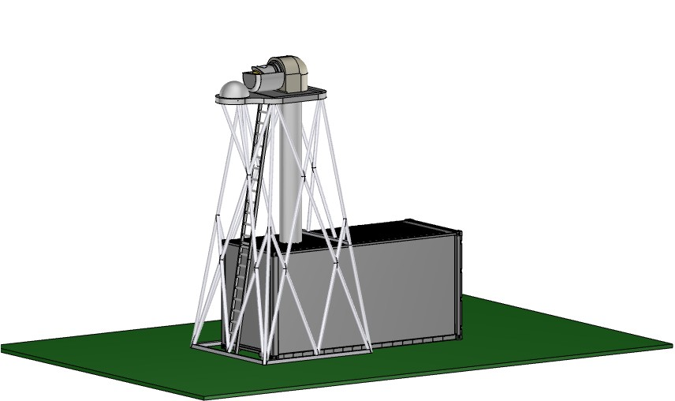
SPRING Concept Studies

Slide 8
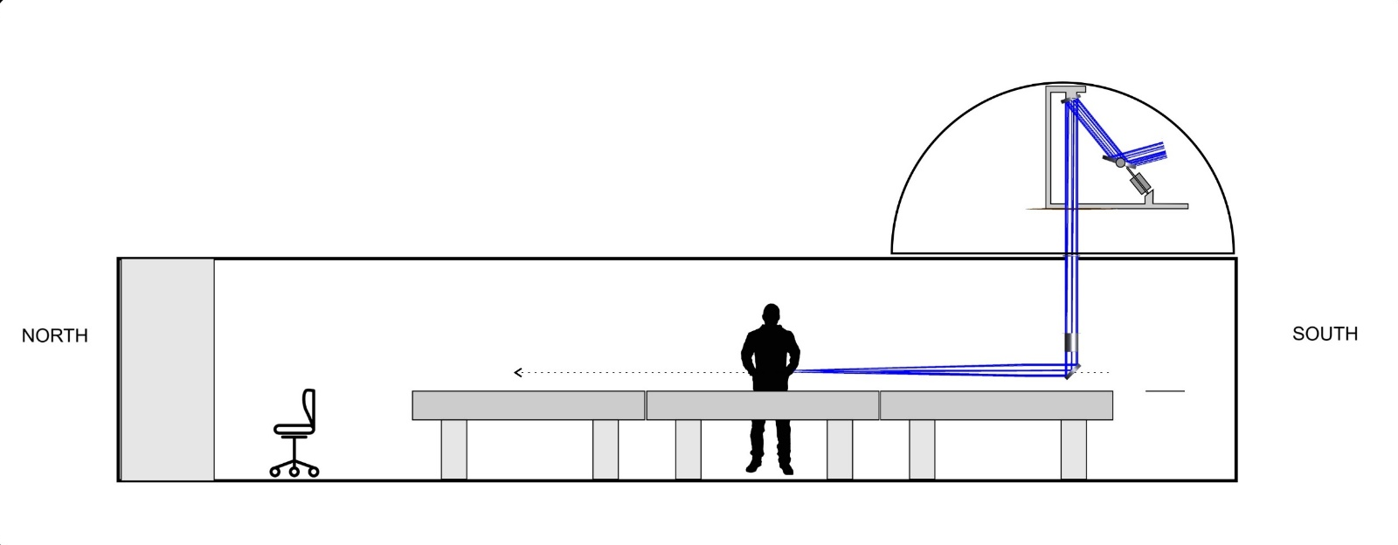
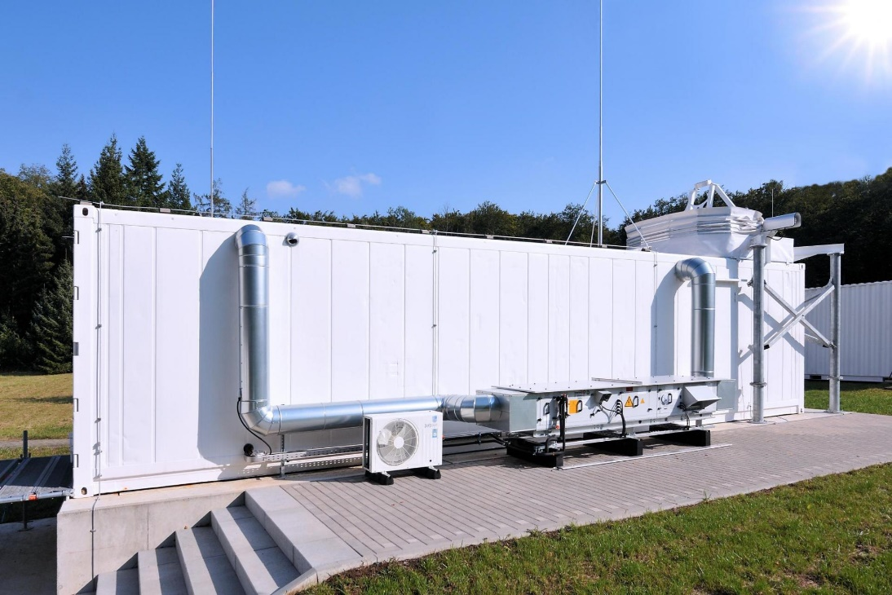
TauSoL Towards SPRING Node-0
Light-feed system
Depressed polar siderostat
Optical benches
For experimentation
40 ft container
Tautenburg Solar Laboratory

Slide 9
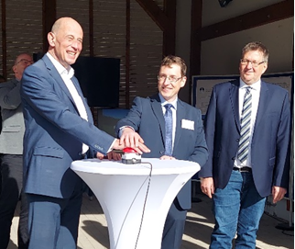
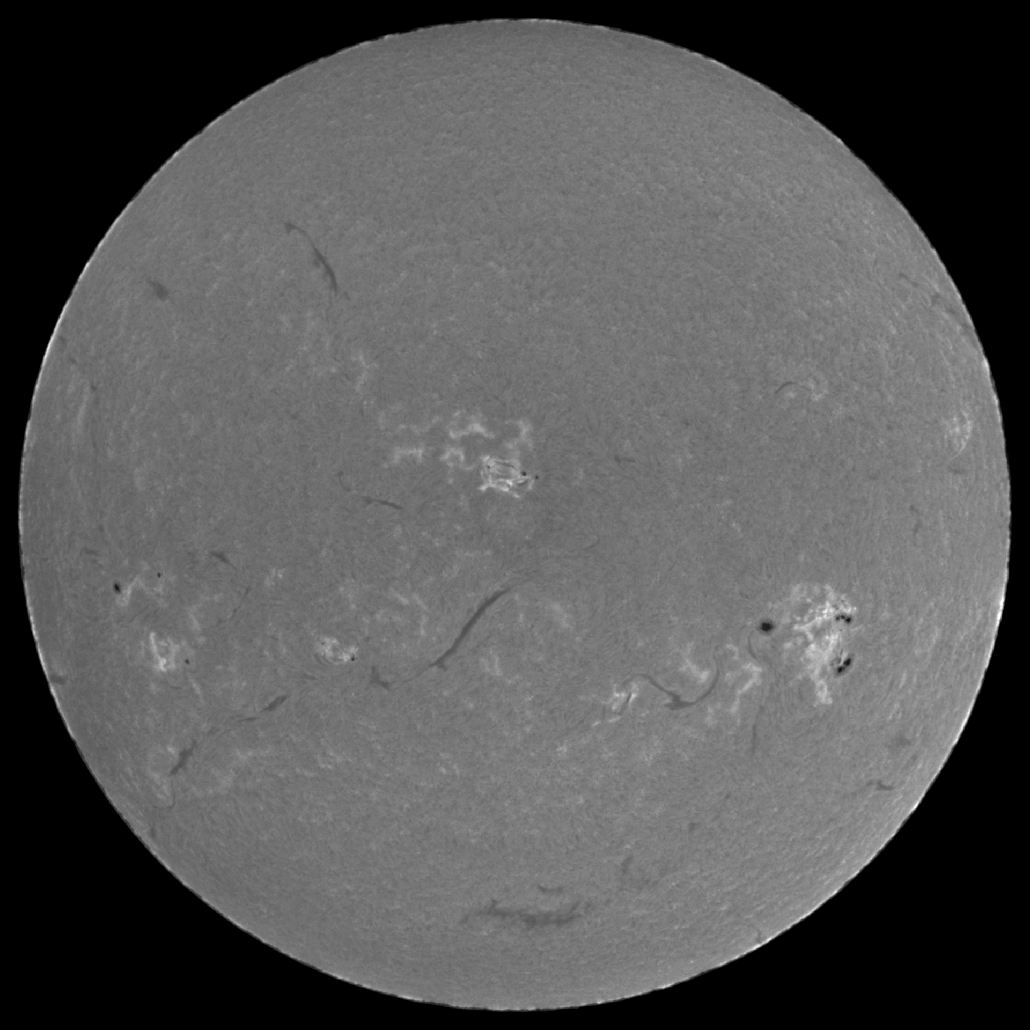
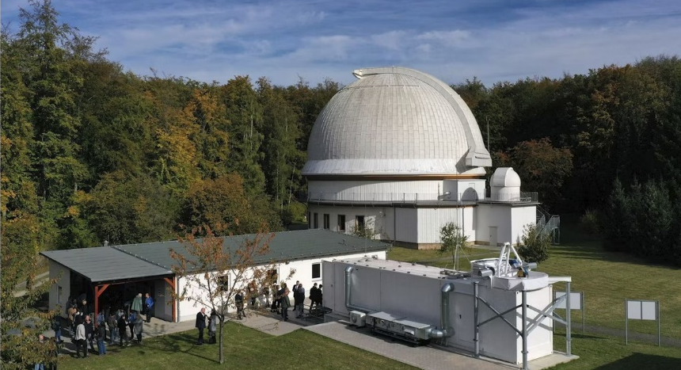
TauSoL First Light & Inauguration

Slide 10
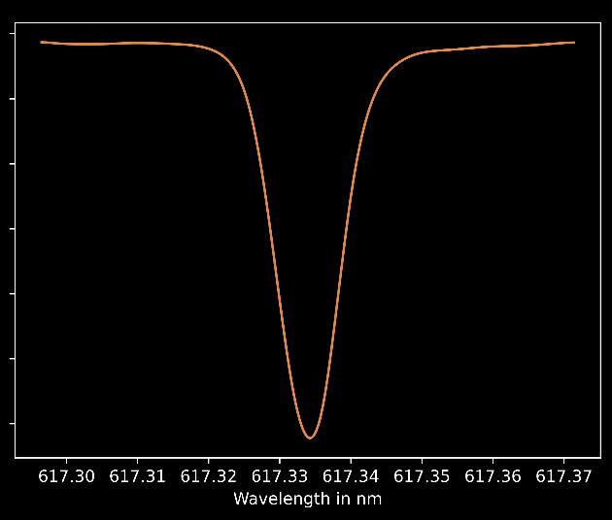
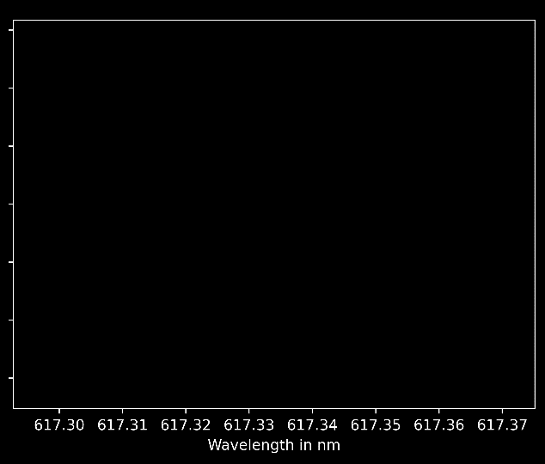
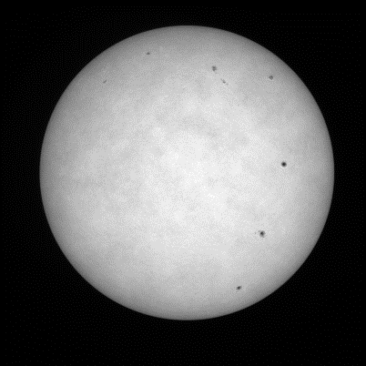
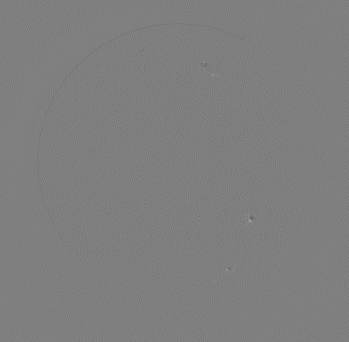
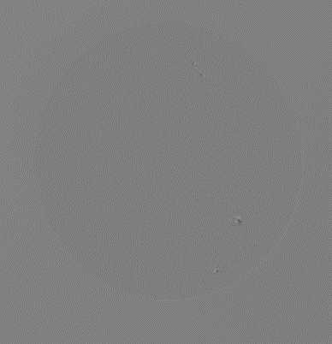
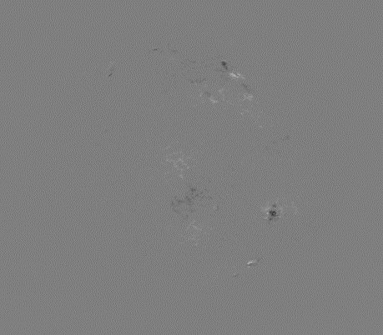

Instrumentation Imaging SpectroPolarimetry
Intensity (Stokes-I)
Linear Polarization (Stokes-Q/I)
Linear Polarization (Stokes-U/I)
Circular Polarization (Stokes-V/I)
SO/PHI

Slide 11
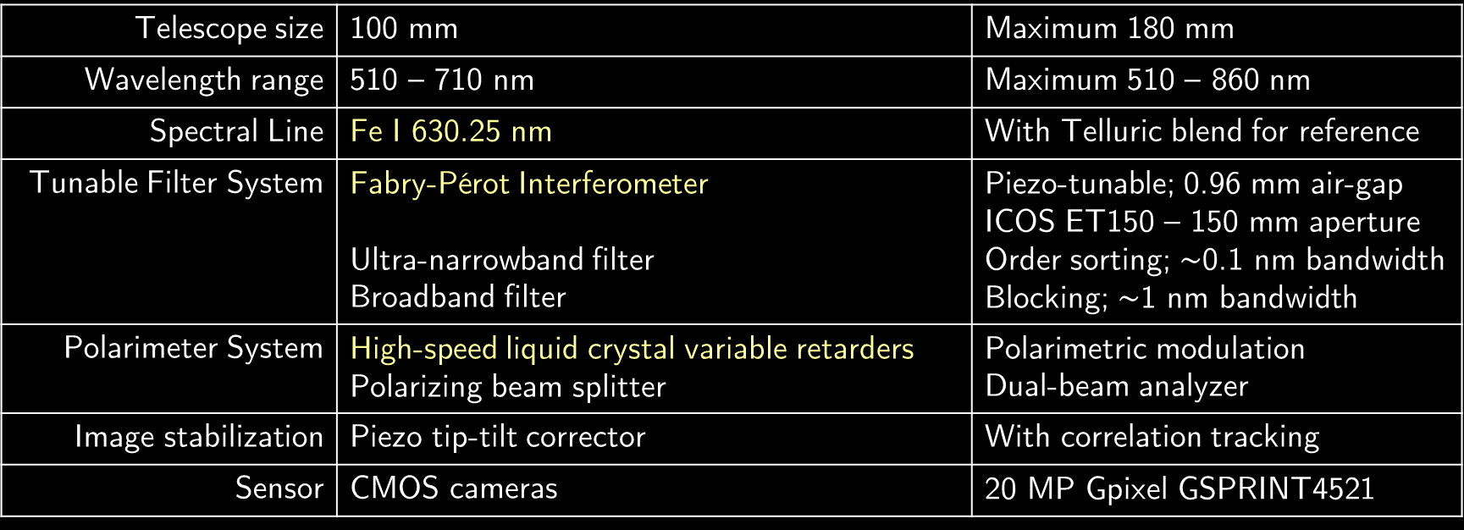
Instrumentation Specifications
Telescope size | 100 mm | Maximum 180 mm
Wavelength range | 510 – 710 nm | Maximum 510 – 860 nm
Spectral Line | Fe I 630.25 nm | With Telluric blend for reference
Tunable Filter System | Fabry-Pérot Interferometer Ultra-narrowband filter Broadband filter | Piezo-tunable; 0.96 mm air-gap ICOS ET150 – 150 mm aperture Order sorting; $\sim$0.1 nm bandwidth Blocking; $\sim$1 nm bandwidth
Polarimeter System | High-speed liquid crystal variable retarders Polarizing beam splitter | Polarimetric modulation Dual-beam analyzer
Image stabilization | Piezo tip-tilt corrector | With correlation tracking
Sensor | CMOS cameras | 20 MP Gpixel GSPRINT4521

Slide 12
Instrumentation Design
Telecentric
Configuration
Collimated
Configuration

Slide 13
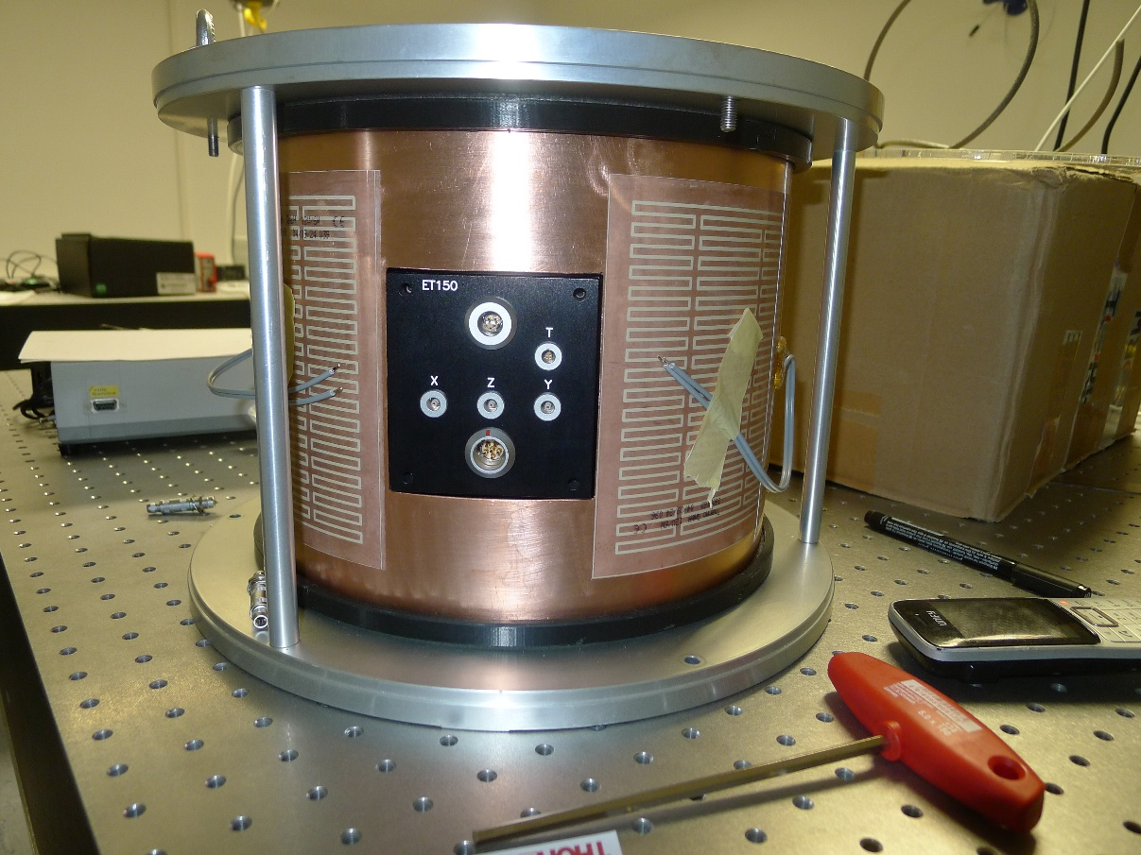
Instrumentation Status
Early stages of Assembly
Prepared for data acquisition
Exploring alternative technologies
Lithium Niobate FPI

Slide 14
SPRING Path Forward
Research and Development
  Infrastructure design
  Next-gen instrumentation
  (viz., high-cadence multi-line spectropolarimeters)
International SPRING Consortium
  GONG site partners
  Solar science community
  Space weather community

Slide 15
In Short …
Synoptic solar observations have become indispensable
Furthering the fundamental knowledge
Preserving the technological modernity
SPRING is the Next-Gen
Several facilities approaching EOL
Interdisciplinary solar science consortium
TauSoL is a Pathfinder
Already operational, instrumentation in-development
Visitors are welcome!

Slide 16
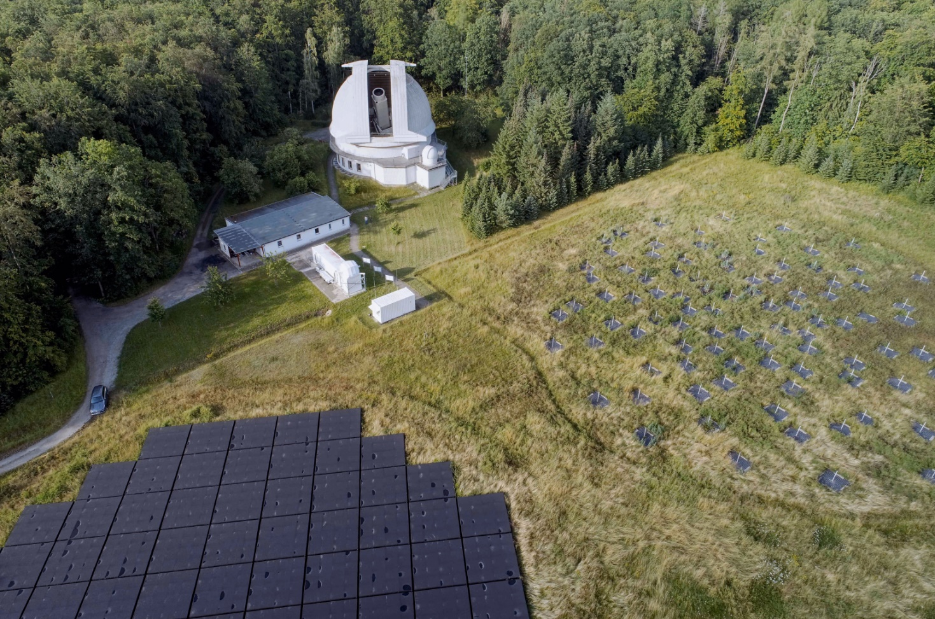
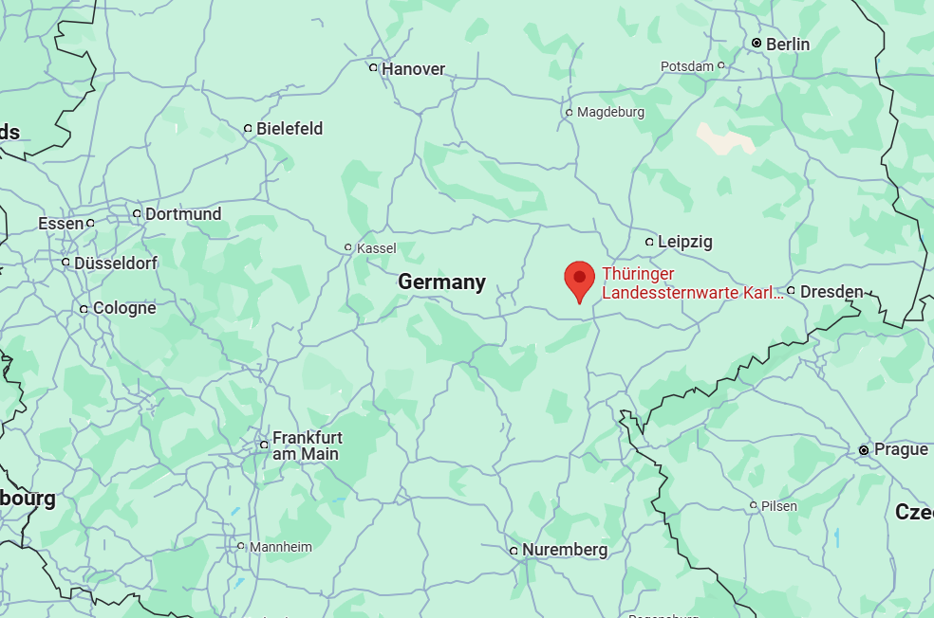
Thank you and questions?

Slide 17
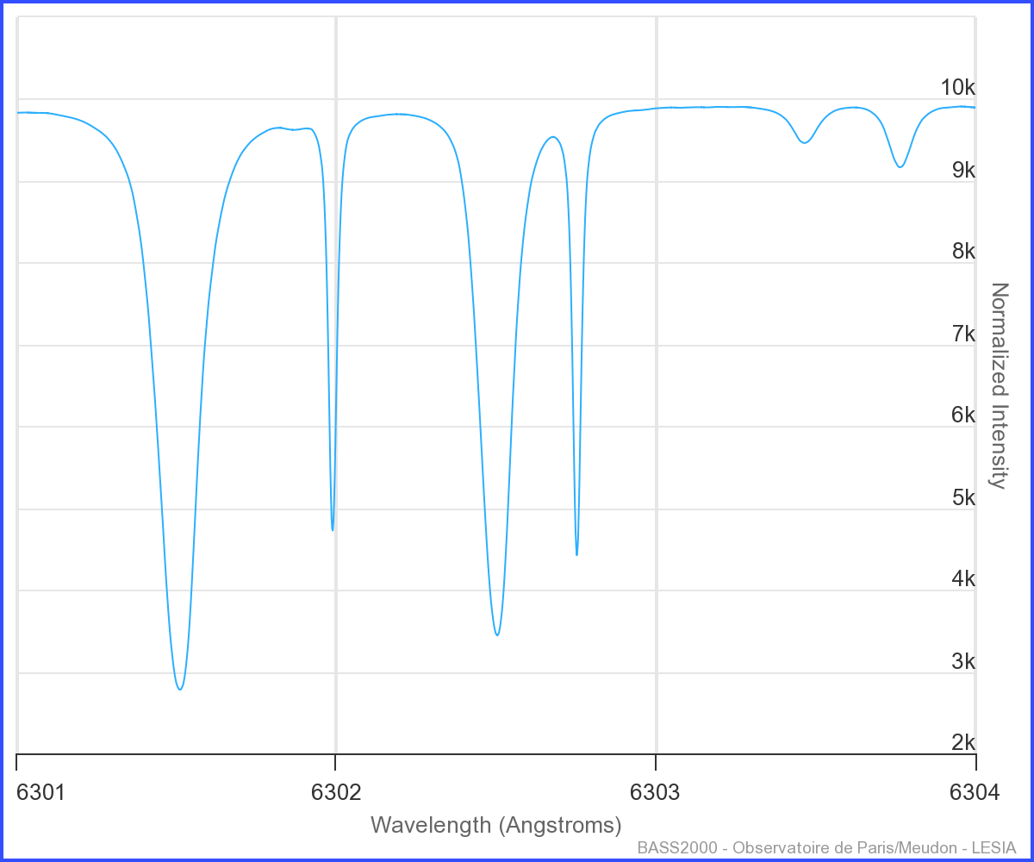
Calibration Spectral line
Fe I 630.25 nm
The “technical line”
High sensitivity to magnetic field
Landé-g = 2.5
Telluric line blend
For wavelength calibration

Slide 18
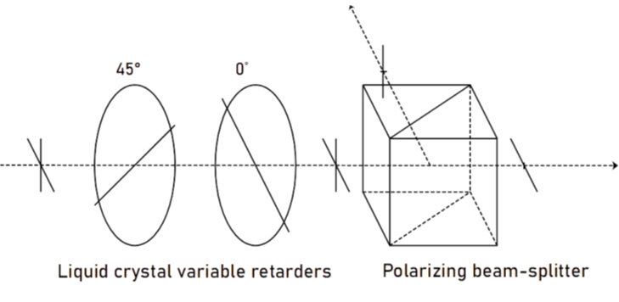
Polarimeter
Dual-beam polarimetry
Two liquid crystal variable retarders
as modulator system
Polarizing beam splitter as analyzer

Slide 19
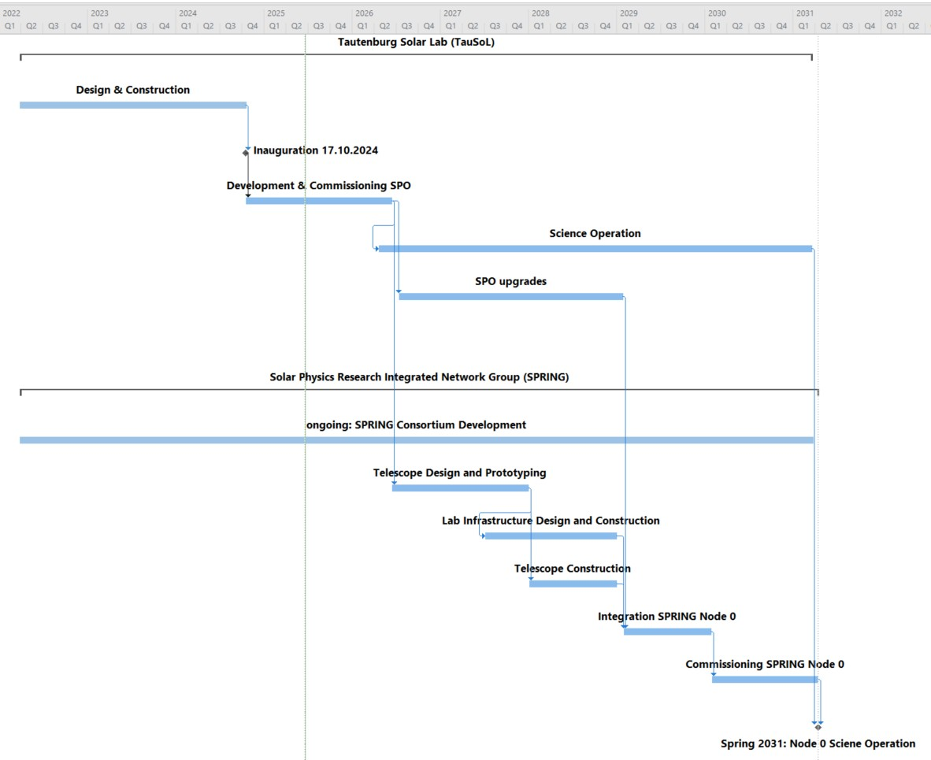
Outlook

Slide 20
Spectrometry
Tunable filtergraph
2-D spectrograph
A single Fabry-Pérot interferometer (FPI)
Ultra narrow passband interference filter

Slide 21
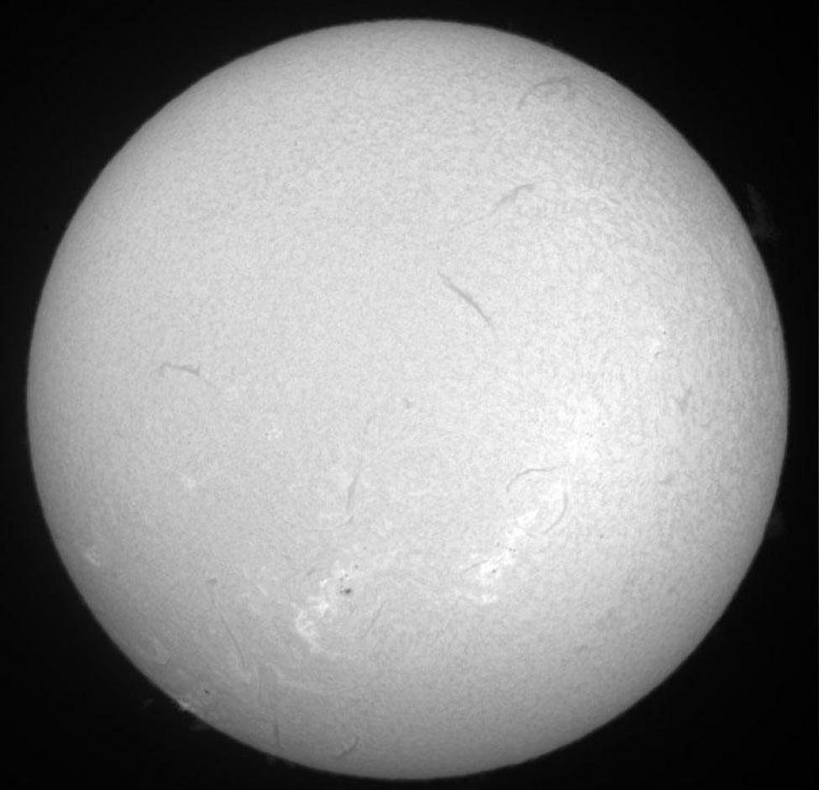
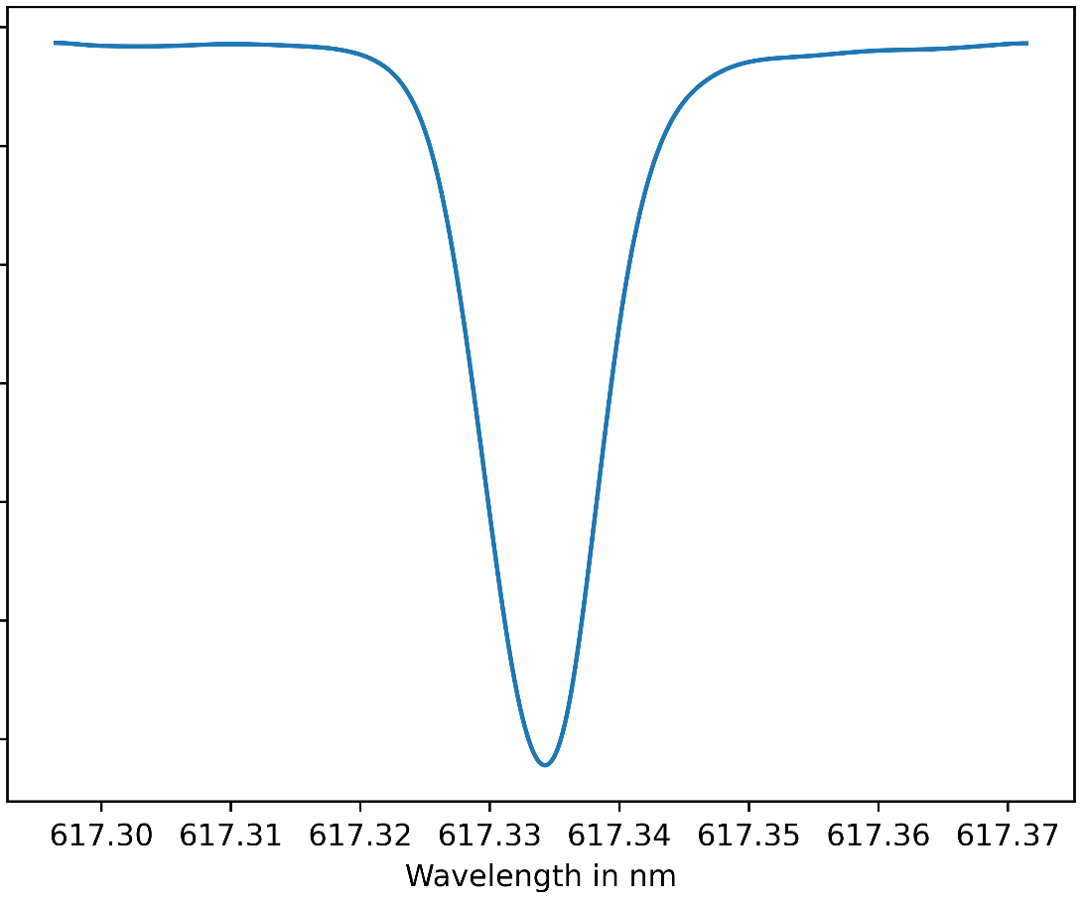
How? Solar Observations
BASS2000

Slide 22

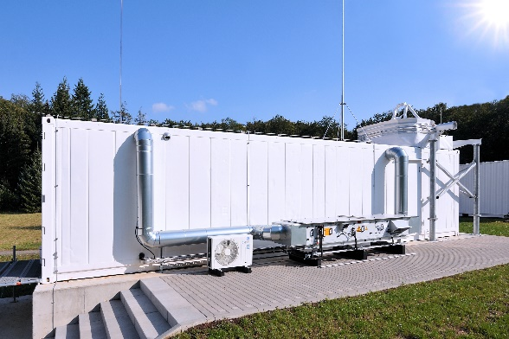
ngGONG – SPRING update meeting Feb. 21, 2025
Outline:
TauSoL 1st light and inauguration / next steps
Start of LiNbO3 wafer development
Outcome of Heliophysics Decadal survey – next steps
Planning's at TLS for SPRING
Formation of a SPRING community: gathering interest and partners
Notes:
Will give a brief overview to the main instrumentation projects and tasks of the new group
Which is a new solar telescope and lab on site here,
Introduce plans for upgrading the 2m Alfred Jensch telescope
and very short motivate “networking activities”
There are also posters to motivate the scientific background of these instrumentation projects and on SolarLab itself.

Slide 23
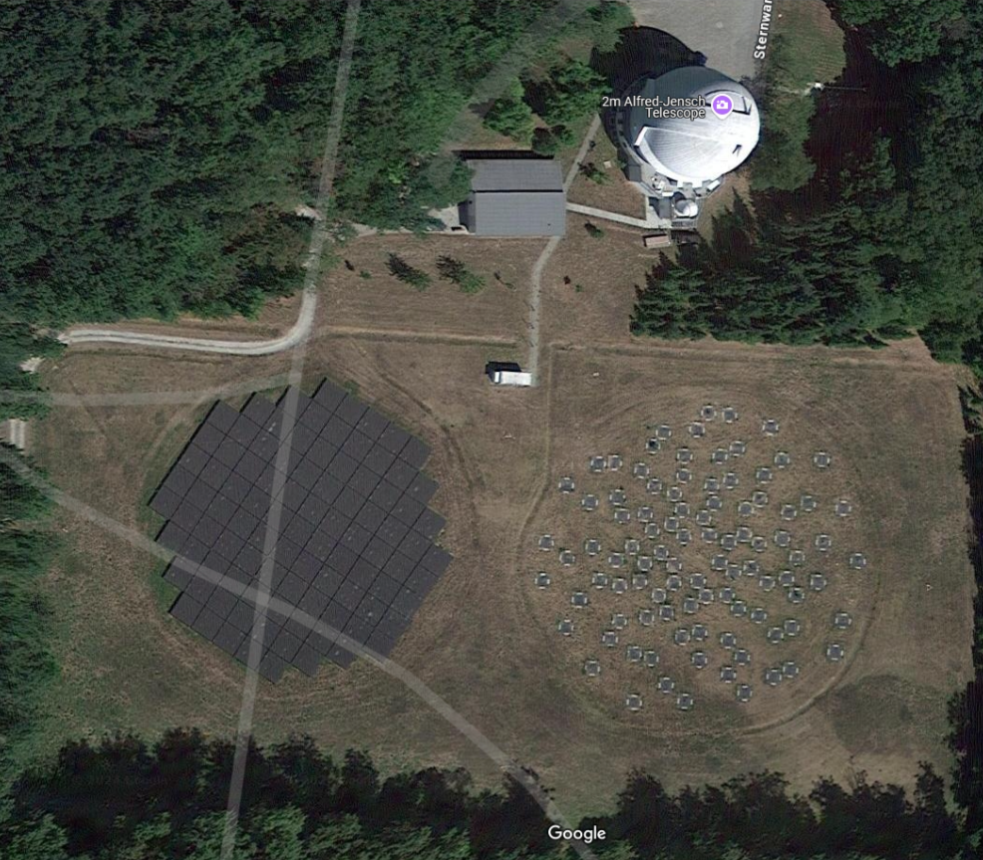
TauSoL
Tautenburg
Solar
Laboratory
At TLS Tautenburg

Slide 24
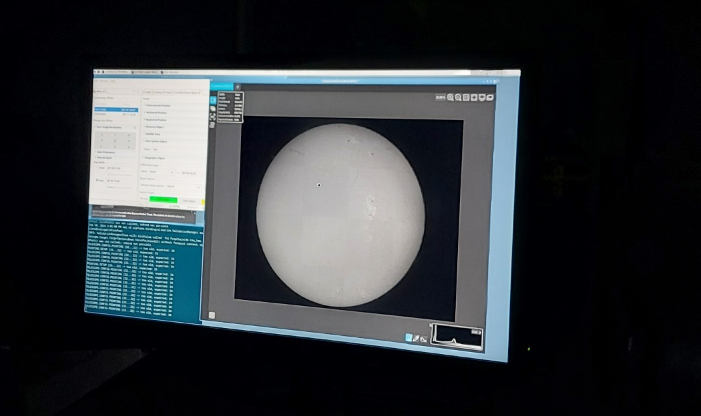
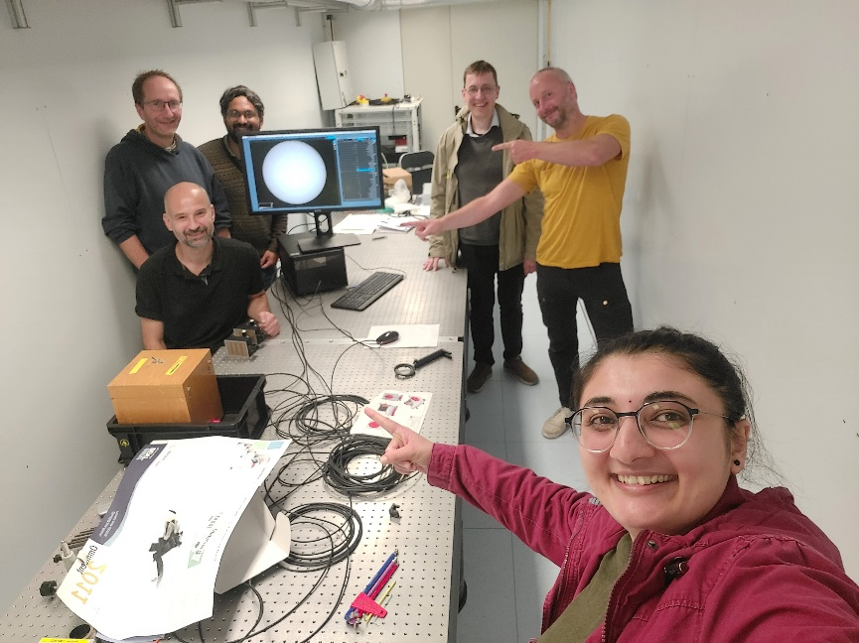

TauSol first light and inauguration Sept-Oct 2024
1st light 18. Sept. 2024
Notes:
Container based concept was not only chosen because of cost and time.
Very likely the next synoptic network instrument will also need to be container based.
So the container based design is part of the “prove of concept”

