Slide 1
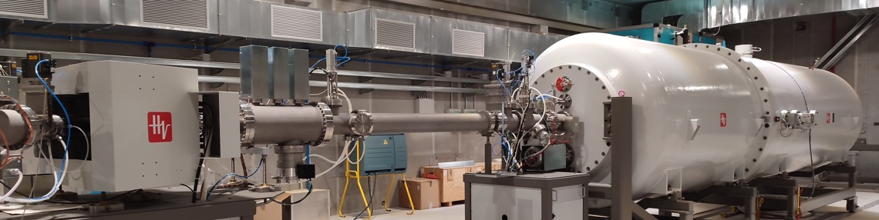
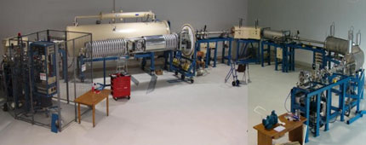
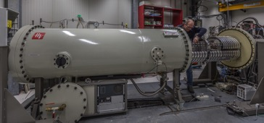



Present knowledge of ⁷Be(p,γ)⁸B and ³He(⁴He,γ)⁷Be
Bad-Hoffen 01-07-2025
Gianluca Imbriani
Physics Department of University of Naples Federico II,
Italian National Institute of Nuclear Physics (INFN)

Slide 2
H-burning in the Sun
pp chain
CNO cycle
Energy generation for pp chain and CNO cycle
versus core Temperature
4p → He + 2ν_{e} + 2e⁺
T Sun
CNO/pp in the Sun about about 0.01

Slide 3
pp Chain
p + p → ²H + e⁺ + ν [0.27 MeV] p + e⁻ + p → ²H + ν [1.44 MeV]
²H + p → ³He + g
³He + ³He → ⁴He + 2p ³He + ⁴He → ⁷Be + γ ³He + p → ⁴He + e⁺ + ν [8 MeV]
⁷Be + e⁻ → ⁷Li + ν [0.81 MeV] ⁷Be + p → ⁸B + γ
⁷Li + p → ⁸Be ⁸B → ⁸Be + e⁺ + ν [6.80 MeV]
⁸Be → 2 ⁴He ⁸Be → 2 ⁴He
99.75%
0.25%
86%
14%
2·10⁻⁵%
99.89%
0.11%
CHAIN I
Q_{eff} = 26.20 MeV
CHAIN II
Q_{eff}= 25.66 MeV
CHAIN III
Q_{eff}= 19.67 MeV
CHAIN IV
Q_{eff}= 16.84 MeV
4p → He + 2ν_{e} + 2e⁺

Slide 4
Before a bit of history….

Slide 5
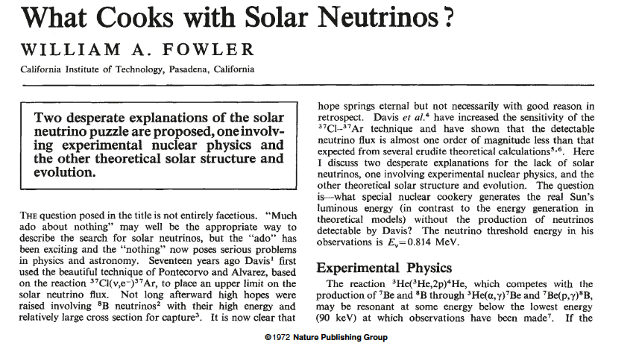
A few years ago before SNO and Borexino experiments
Solar Neutrino Problem
1. MISSING NEUTRINO:
in Ga experiments
(68 ± 3) SNU measured
vs (128 ) SNU expected
2. ⁷Be/⁸B anomaly:
incompatibility
Kamiokande/Homestake
experiments
3. MISSING ⁷Be NEUTRINO:
Using data from Ga and
SK experiments
73^{pp} + 5^{8B} > 75
Nuclear Desperate Explanation
inside the Standard Model
Experiment not feasible due to cosmic rays

Slide 6
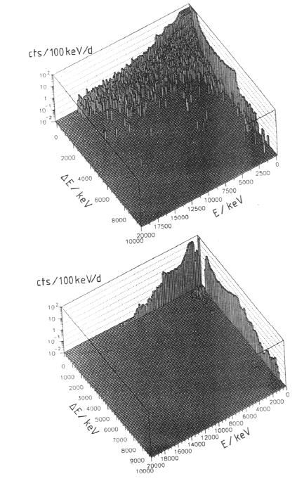
³He(³He,2p)⁴He @ LUNA
Background due to Muons in cosmic rays -> @ LNGS 10-⁶ mouns
Background in particle detectors induced by cosmic-rays was reduced from
10 events/day at the Earth’s surface
to less than
1 event/month in the underground laboratory

Slide 7
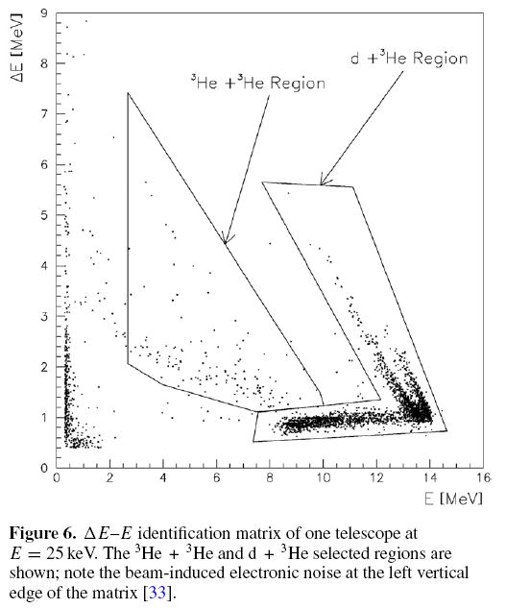
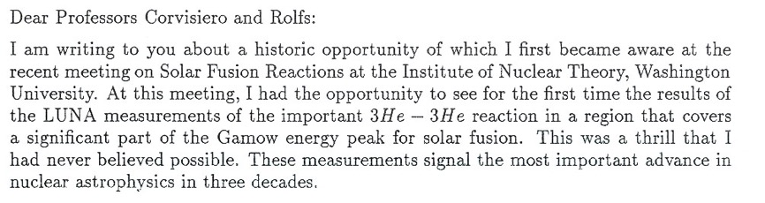
No desperate solution inside the Standard Model
J. Bachall Institute for Advanced Study School of Natural Sciences Princeton, NJ, USA
Background induced by cosmic-rays:
10 events/day at the Earth’s surface
1 event/month at LNGS
S-factor of ³He(³He,2p)⁴He
Gamow peak
First LUNA result
σ_{min=} 0.02 pb
2 events/month !

Slide 8
pp Chain
p + p → ²H + e⁺ + ν [0.27 MeV] p + e⁻ + p → ²H + ν [1.44 MeV]
²H + p → ³He + g
³He + ³He → ⁴He + 2p ³He + ⁴He → ⁷Be + γ ³He + p → ⁴He + e⁺ + ν [8 MeV]
⁷Be + e⁻ → ⁷Li + ν [0.81 MeV] ⁷Be + p → ⁸B + γ
⁷Li + p → ⁸Be ⁸B → ⁸Be + e⁺ + ν [6.80 MeV]
⁸Be → 2 ⁴He ⁸Be → 2 ⁴He
99.75%
0.25%
86%
14%
2·10⁻⁵%
99.89%
0.11%
CHAIN I
Q_{eff} = 26.20 MeV
CHAIN II
Q_{eff}= 25.66 MeV
CHAIN III
Q_{eff}= 19.67 MeV
CHAIN IV
Q_{eff}= 16.84 MeV
4p → He + 2ν_{e} + 2e⁺

Slide 9
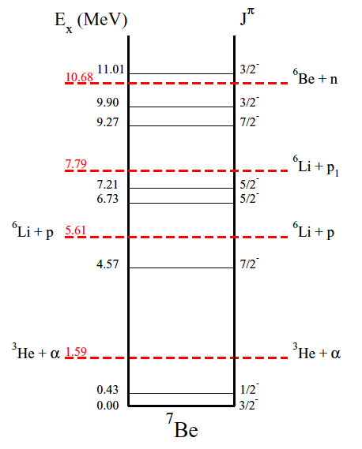
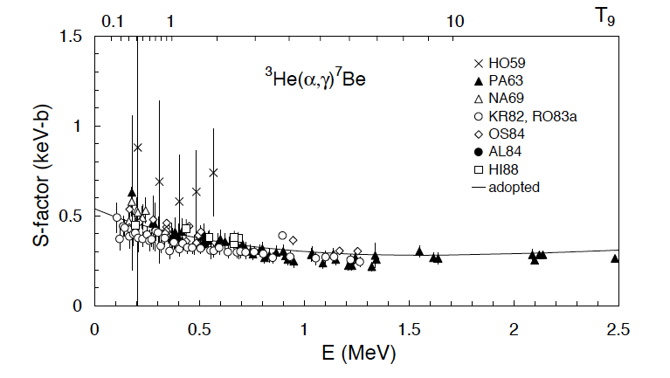
Status of ³He(⁴He,γ)⁷Be

Slide 10
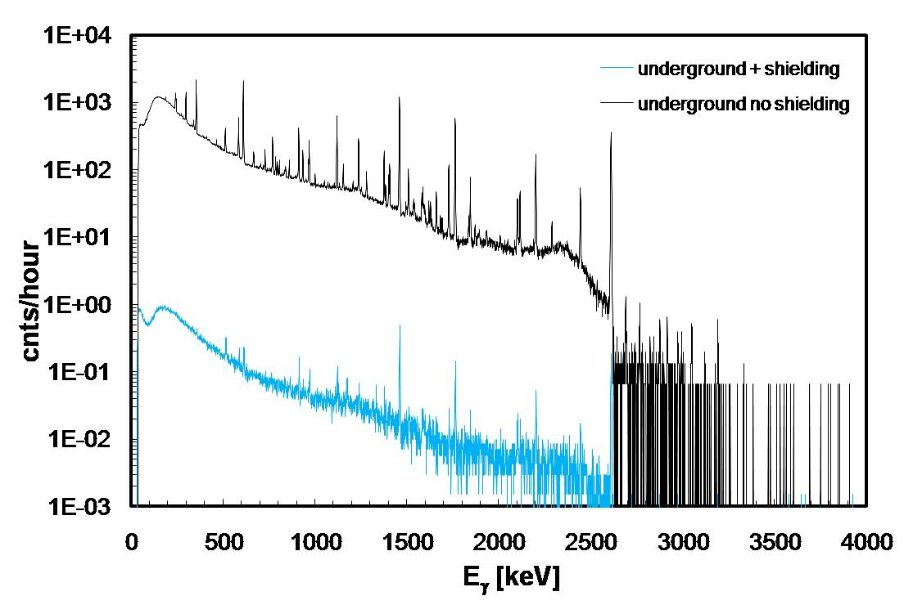
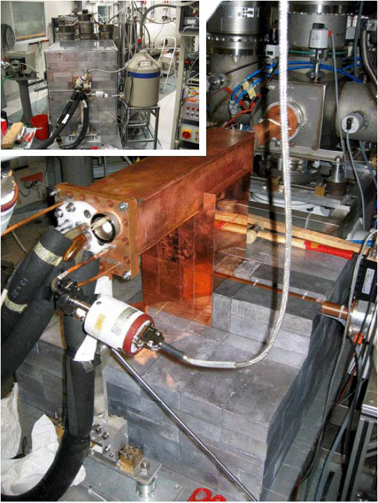
³He(⁴He,γ)⁷Be @LUNA
3 orders of
magnitude!!!!
In a surface laboratory passive shielding such as lead can be placed around the detectors but it is limited to a certain thickness. One cannot add further shielding material since cosmic-ray muons interact always with the material and create energetic neutrons which, in turn, create γ-rays in the lead.
A separate treatment is needed for ²²²Rn, which diffuses out of the rocks and permeates through the detector shielding. The decaying radon and its daughters produce α and β particles that produce again secondary γ radiation by bremsstrahlung and nuclear reactions. A popular solution of this problem is to house the detector in a box with a small overpressure of flushing nitrogen.

Slide 11
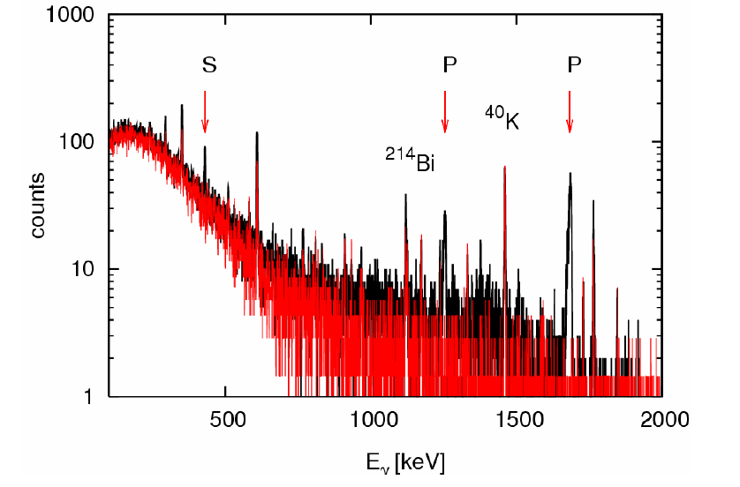
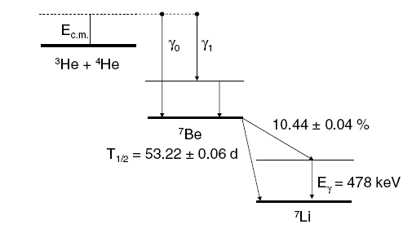
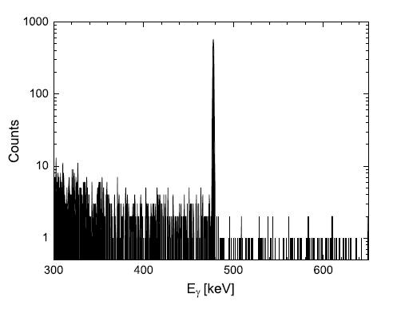
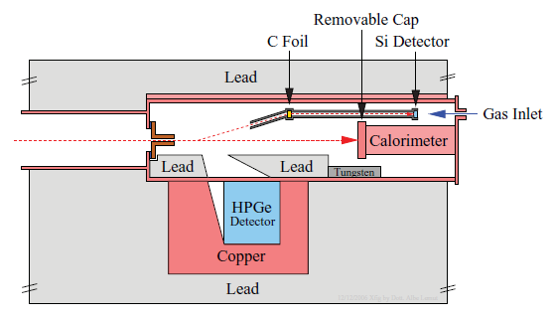

γ-spectrum of ³He(⁴He,γ)⁷Be @ LUNA
Q-value = 1.586MeV
Confortola et al. PHYSICAL REVIEW C 75, 065803 (2007)
E =93 keV
Q= 637 C
31 days of beam

Slide 12
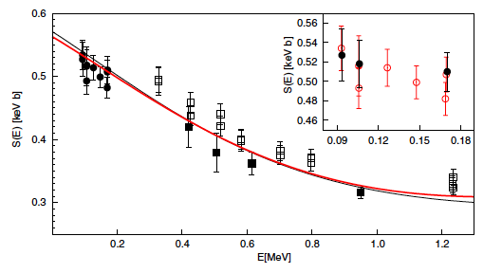
³He(⁴He,γ)⁷Be LUNa and γ-prompt results
Activation
Prompt
Seattle university
LUNA
BIG BANG Energy Range
Weizmann institute
Solar Gamow Energy

Slide 13
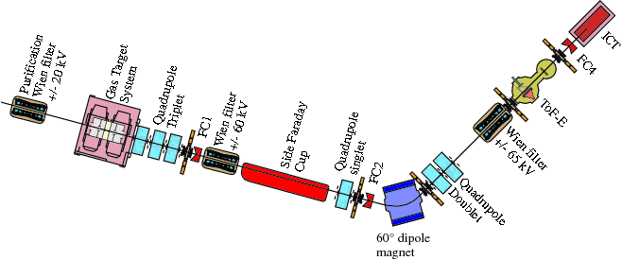
An alternative approach: Recoil Mass Separator
A+α→C+γ
A/C>10¹⁵
for ¹²C(α,γ)¹⁶O
basic principles
γ-rays
Projectiles
TARGET
FILTER
DETECTOR
LENS
Recoils
Projectiles
p_{rec} = p_{proj} momentum conservation!
coincidence
γ-rays
detector
γ-ray emission
-> recoil cone
Why Recoil Separators?
High efficiency
(mostly) background free
Excellent background reduction for γ-spectroscopy
Disadvantages
Very difficult to do!!

Slide 14
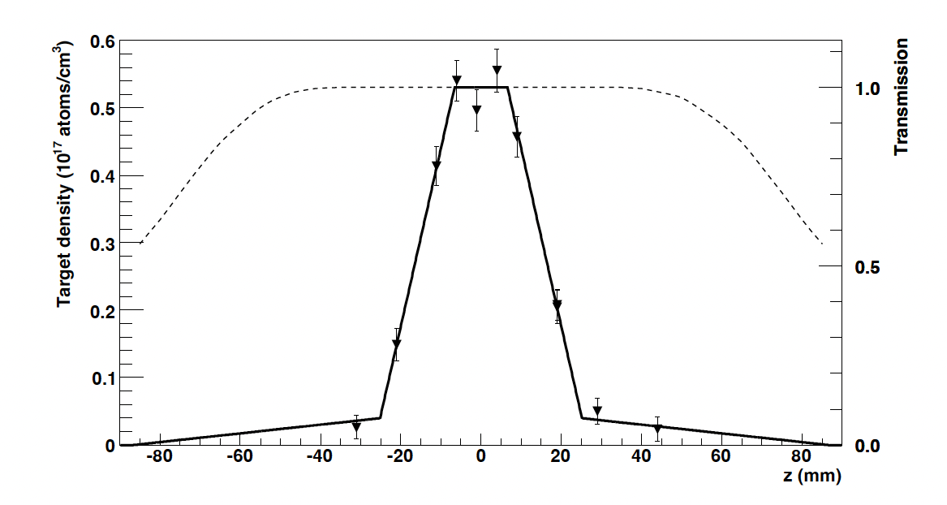
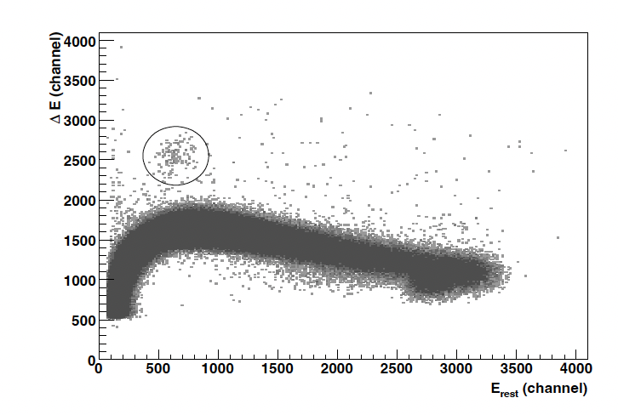
Recoil collection and identification @ERNA
Angular broadening by γ-ray emission
E₀
ϑ_{recoil}
γ
³He(α,γ)⁷Be @ 1.2 MeV
Density profile of the 3He gas target.
The dashed line represents the expected transmission of 7Be recoils.

Slide 15
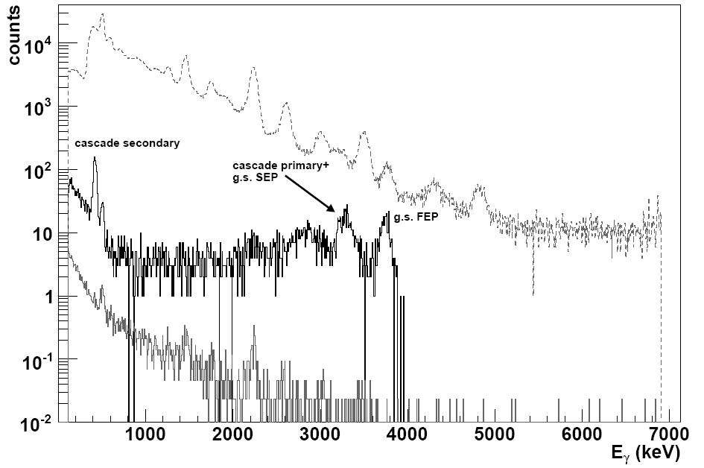
γ-rays coincidence @ ERNA
Singles γ-spectrum
³He(α,γ)⁷Be
E_{cm}=2.15MeV
Background suppression about 4 orders of magnitude!!!
Coincidence
γ-spectrum
Background random coincidence
ERNA RMS Bochum - Di Leva PhD thesis

Slide 16
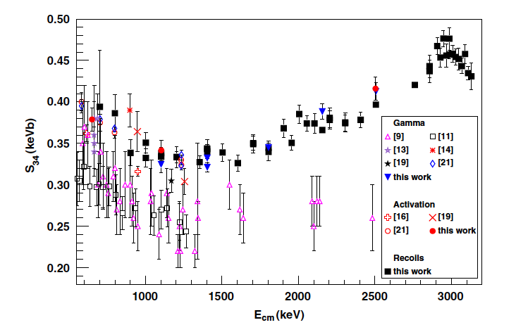
Status of ³He(⁴He,γ)⁷Be after ERNA
Di Leva et al.

Slide 17
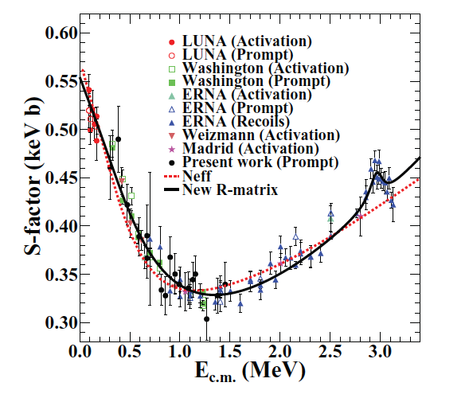
³He(⁴He,γ)⁷Be @ Notre Dame
Agreement with ERNA and LUNA

Slide 18
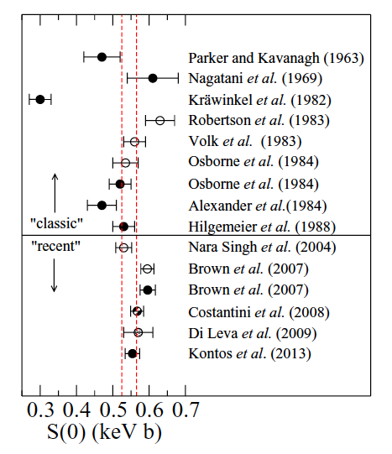
Present status of ³He(⁴He,γ)⁷Be

Slide 19
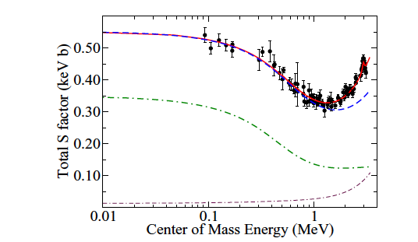
³He(⁴He,γ)⁷Be R-matrix fit
Importance of interference term between external capture and external pole
s-wave E1 external capture +
background pole (J^{π} = 1/2⁺) + interference ≈
s-wave E1 external capture
background pole (J^{π} = 1/2⁺)

Slide 20
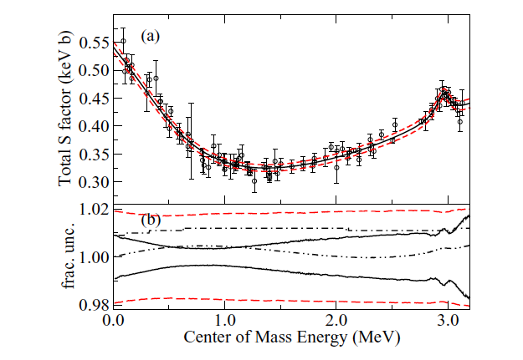
³He(⁴He,γ)⁷Be Montecarlo uncertanties

Slide 21
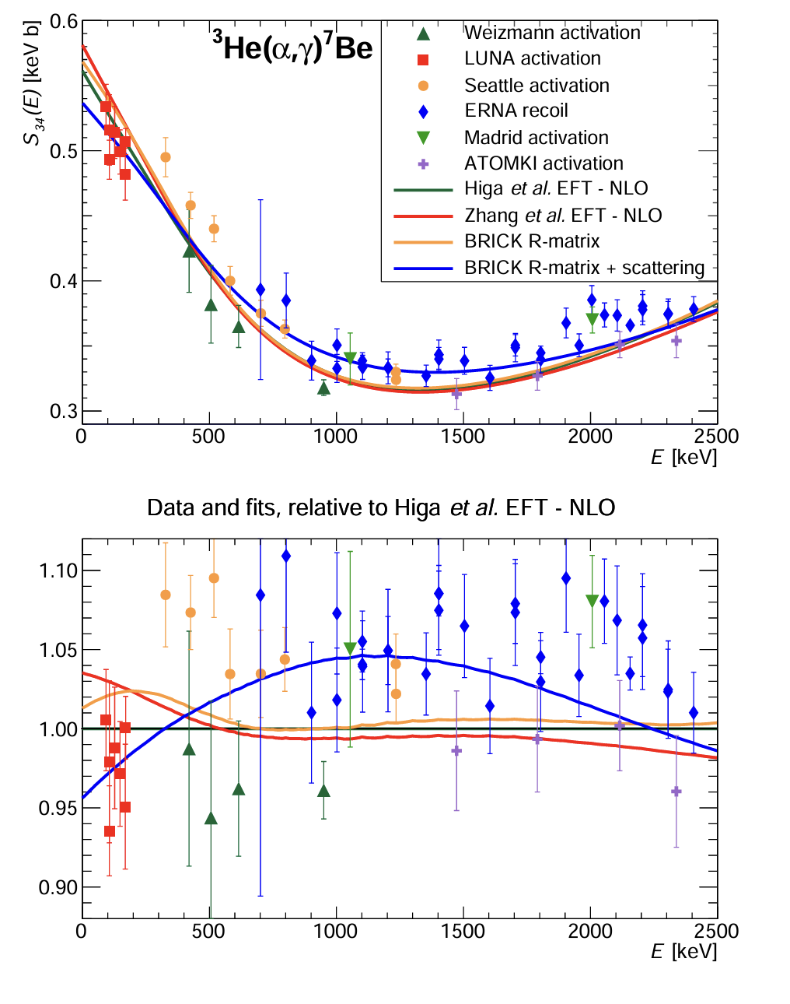
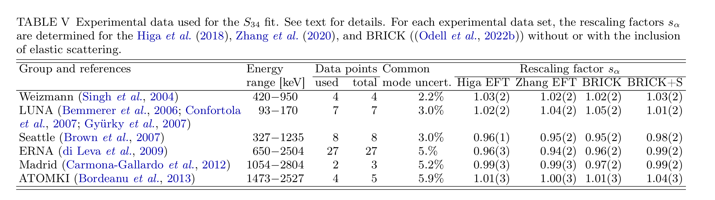
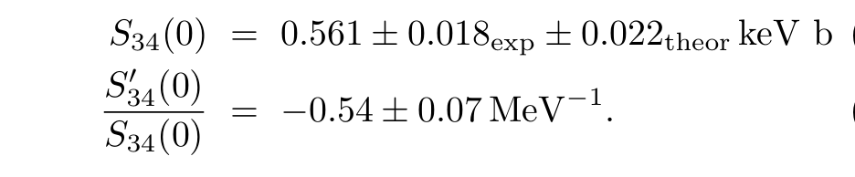
³He(⁴He,γ)⁷Be @SFIII 2025

Slide 22
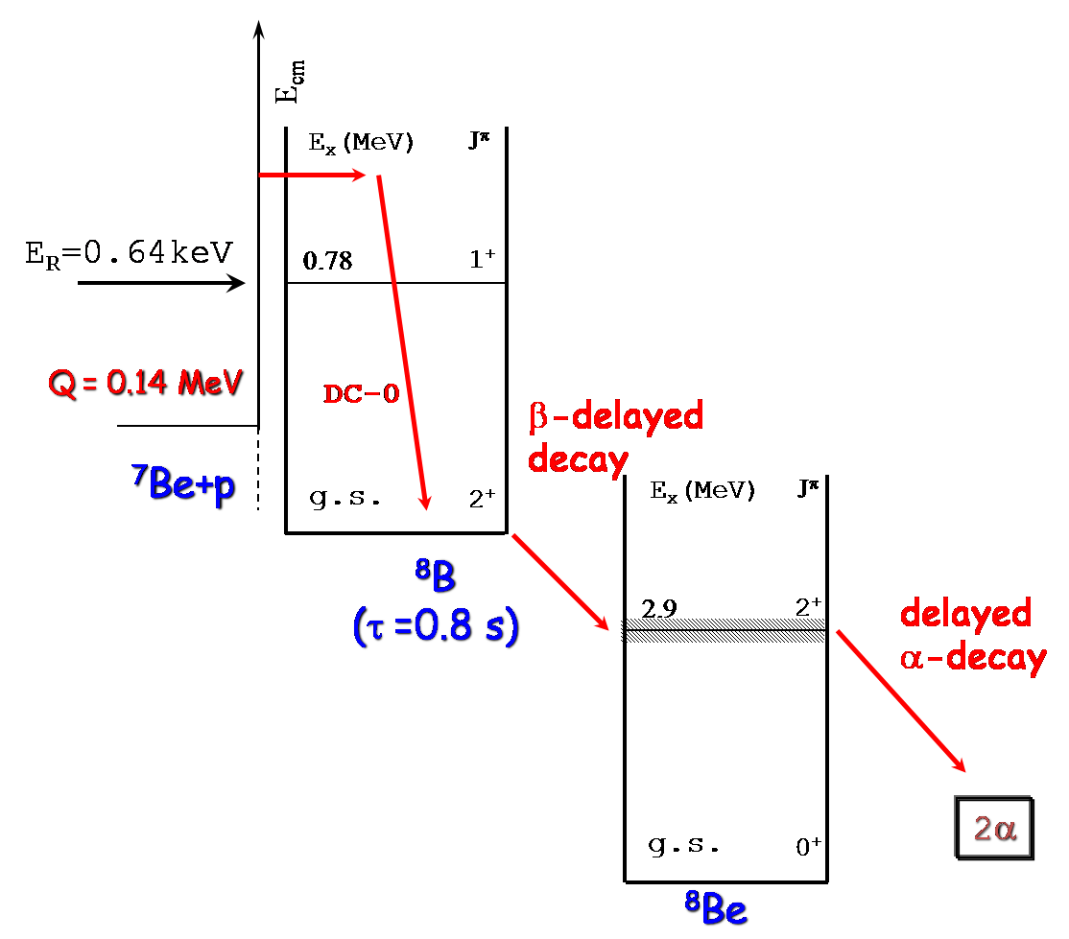
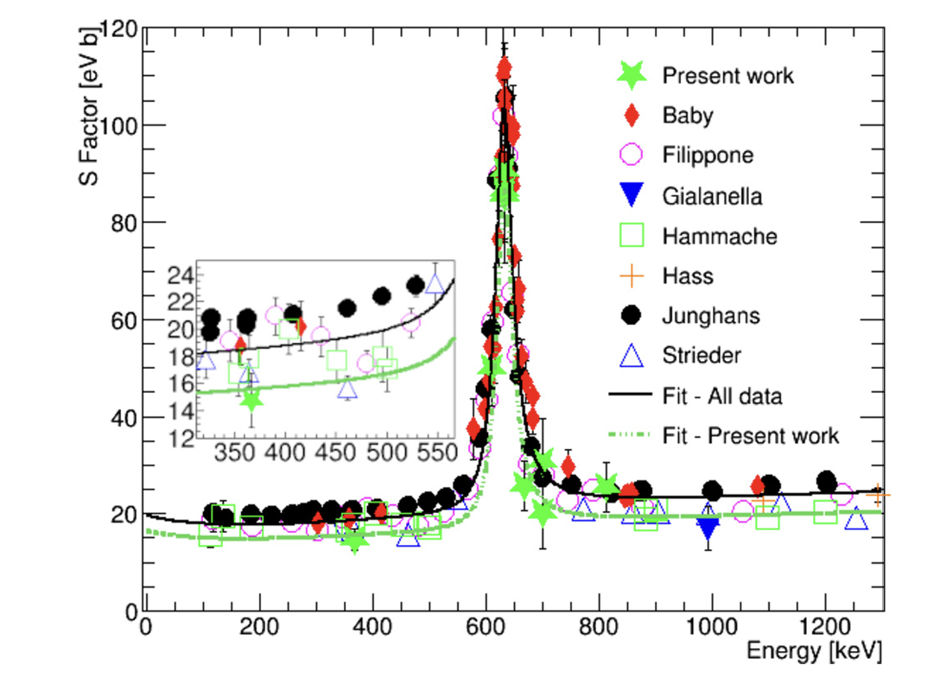
⁷Be(p,γ)⁸B experiments

Slide 23
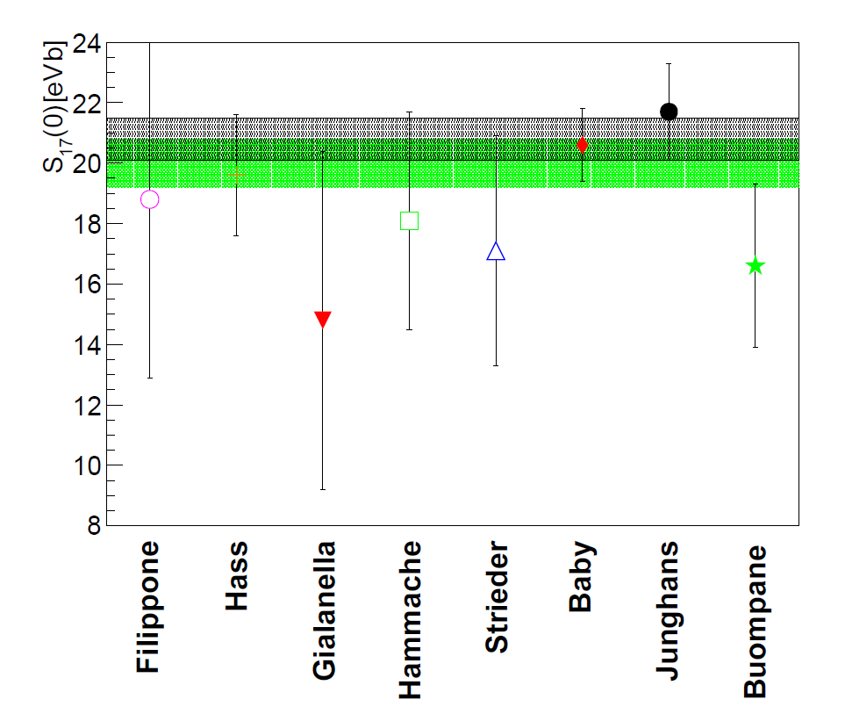
⁷Be(p,γ)⁸B experiments

Slide 24
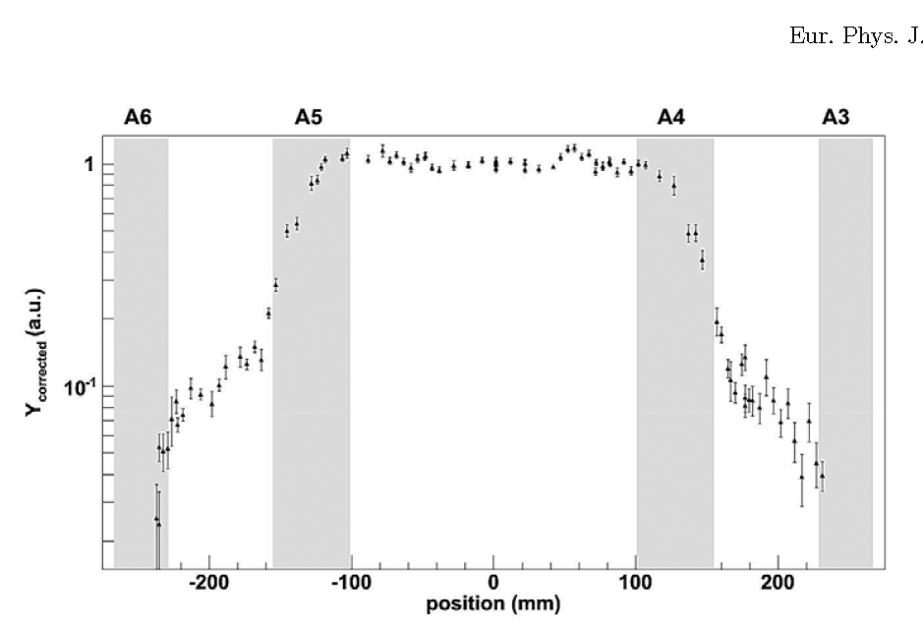
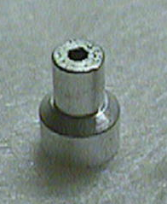
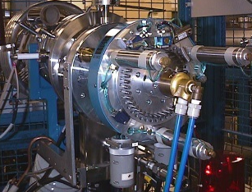
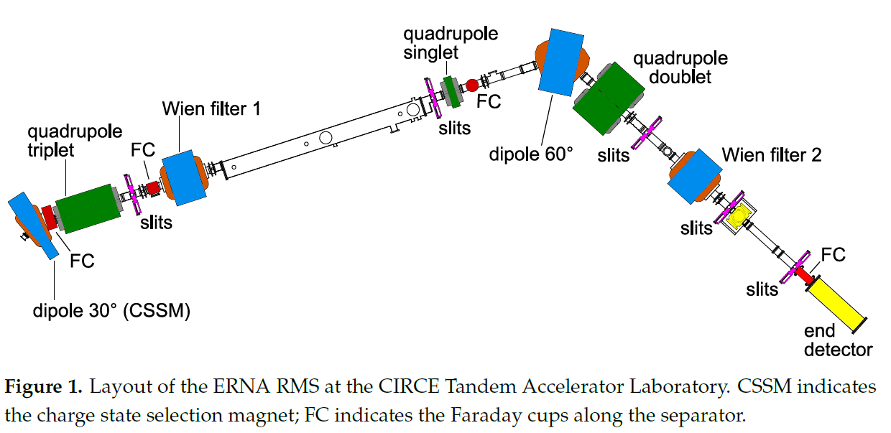

⁷Be(p,γ)⁸B @ERNA using a radioactive beam
H2 extended gas target
⁷Be beam
CIRCE laboratory
SNICS-40 ions source.
Source
2mm cathodes
⁷Li + ⁷Be
pills
Intensity up to 10⁹ pps.
≈10GBq
Radiochemical
separation
Test and
mounting
⁷Be BEAM
3x≈3GBq
Density profile of the gas target as seen in the yield of the 478 keV g-ray line from the ⁷Li(p, p’)⁷Li*
Target density n = 7.22 ± 0.15 · 10¹⁸ at/cm² at 4.9 mbar.

Slide 25
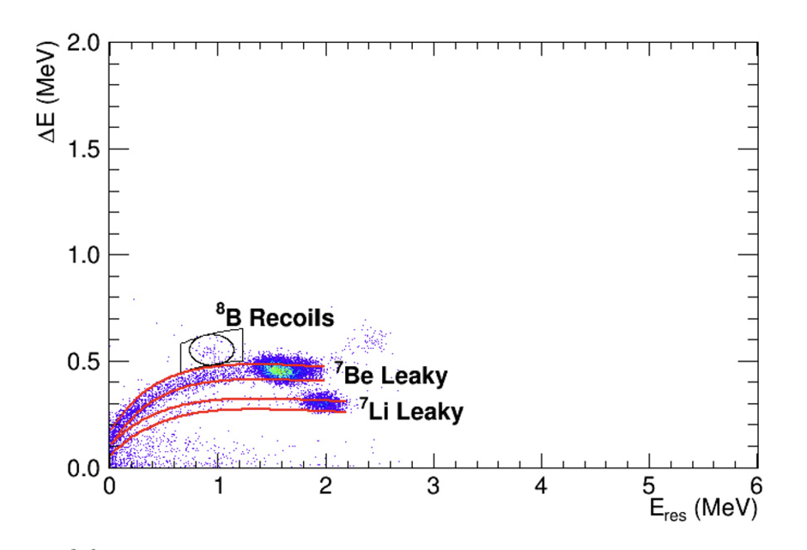
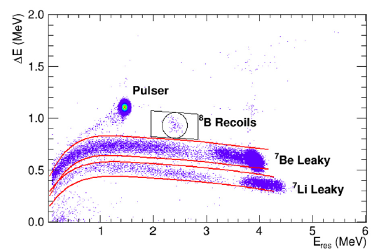
⁷Be(p,γ)⁸B @ERNA using a radioactive beam

Slide 26
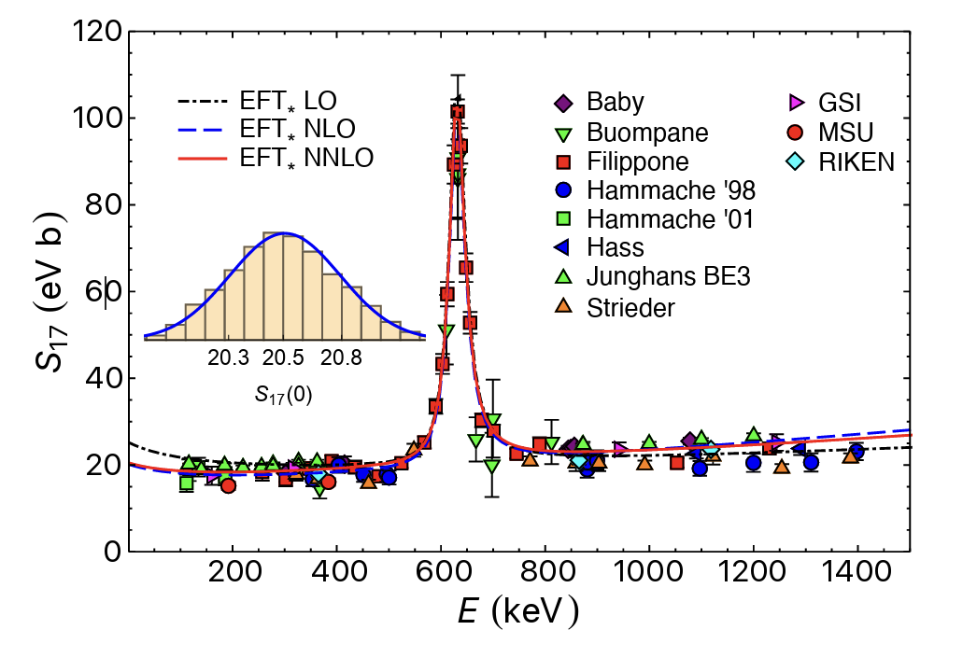
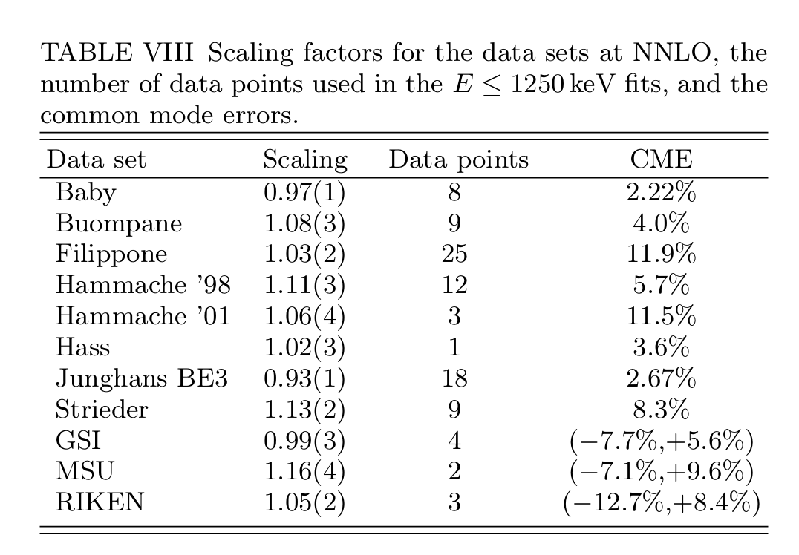
⁷Be(p,γ)⁸B @SFIII

Slide 27
Conclusions and outlooks
³He(α,γ)⁷Be measuring underground from high energy towards very low with the same setup, considering also angular distribution.
⁷Be(p,γ)⁸B a more extensive inverse kinematic experiment will reduce the systematic uncertainty.

