Slide 1






Solar fusion cross sections III: a nuclear physics perspective
Alessandra Guglielmetti
Università degli Studi di Milano and INFN Milano, ITALY
alessandra.guglielmetti@unimi.it

Slide 2
Outline
Why solar fusion cross section meetings and papers?
Basic ingredients of nuclear astrophysics (reaction rate, cross section, Gamow energy, resonance strength, …)
A selection of cases from Solar Fusion III
Conclusions and perspective

Slide 3
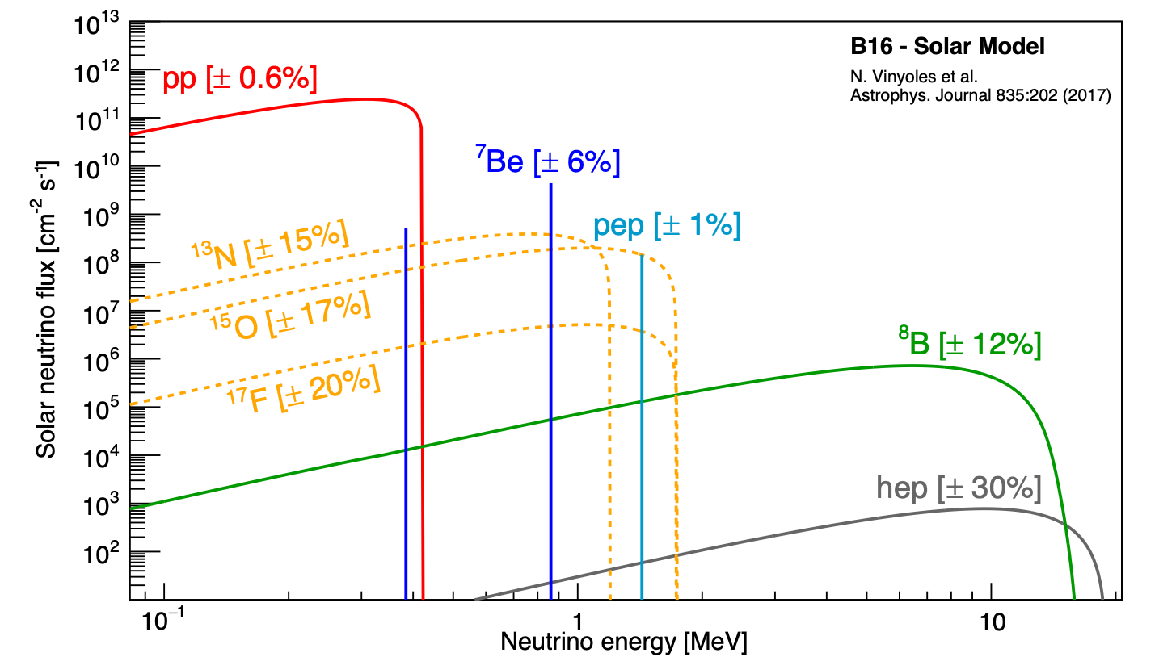
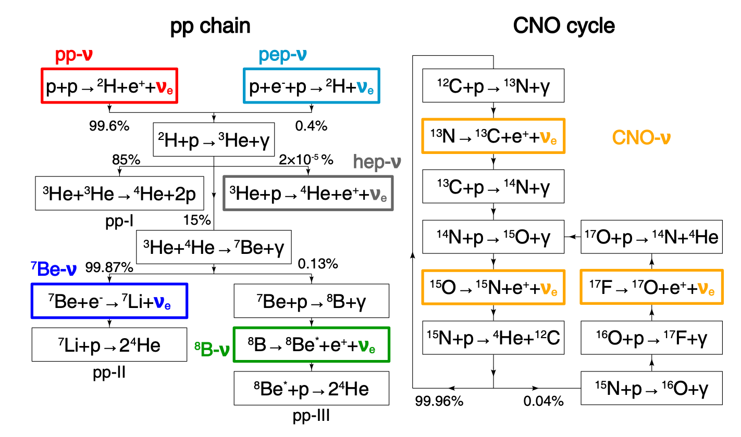
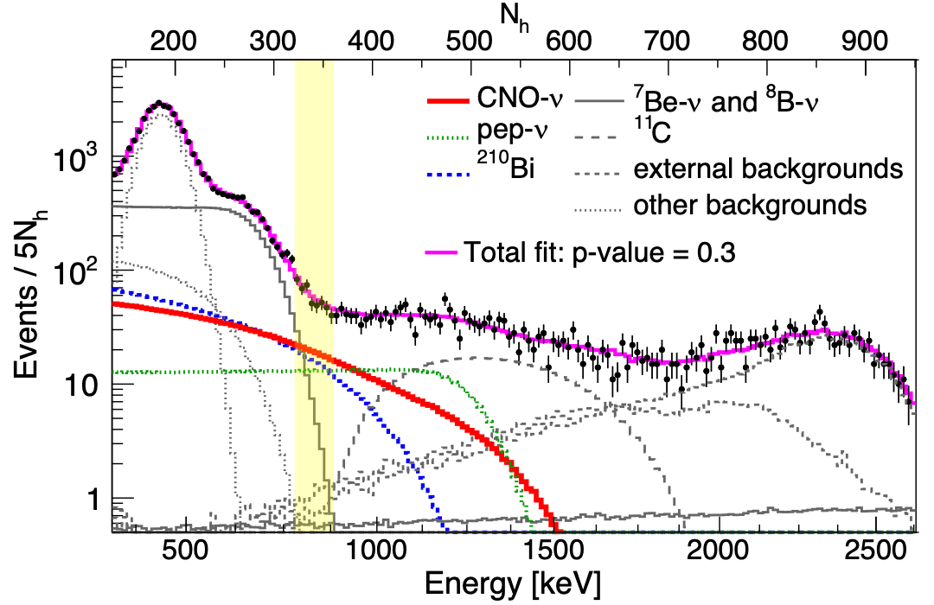
Fusion reactions and neutrino production in the Sun
pp chain: ~ 99% E_{sun}
CNO cycle: ~ 1% E_{sun}
CNO OPTIMIZED ROI
Neutrino flux from the Sun can be used to study:
Solar interior composition→ metallicity
Neutrino properties
only if the cross sections of the involved reactions are known with enough accuracy

Slide 4
Solar Fusion Cross Sections I, II and III- Why?
Solar neutrino experiments use the neutrinos ‘‘to see into the interior of a star and thus verify directly the hypothesis of nuclear energy generation in stars’’
Pioneering experiments (Homestake, Kamiokande, GALLEX, SAGE, …) provided direct evidence that the stars shine and evolve as the result of nuclear fusion reactions among light elements in their interiors
Sun, and solar models, can be probed with unprecedented precision through neutrino-flux measurements and helioseismology.
Important to assess how uncertainties in our understanding of the underlying nuclear physics might affect our interpretation of such precise measurements.

Slide 5
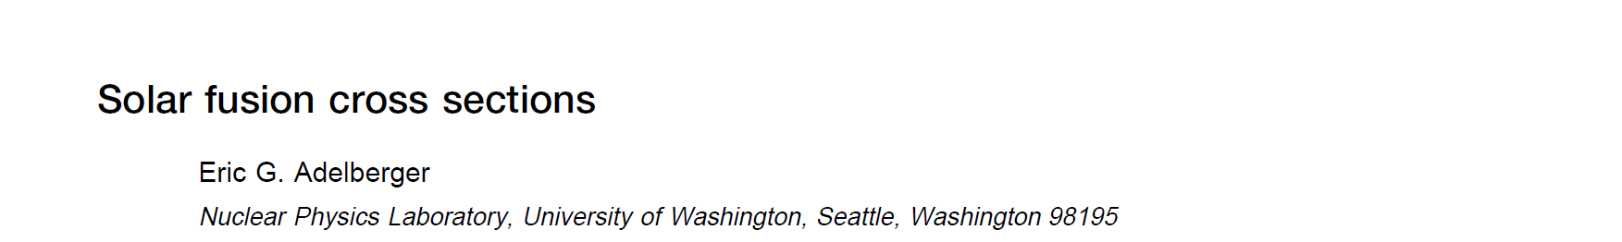
Solar Fusion Cross Sections I
Solar Fusion Cross Section (I)- Workshop held at the Institute for Nuclear Theory, University of Washington, 17-20 February 1997
A group of international experts in the nuclear physics and astrophysics of hydrogen-burning stars met to begin critical discussions of the existing data on relevant nuclear reactions, with the aim of determining ‘‘best values’’ and uncertainties for the contributing low-energy S factors. The group also considered opportunities for further improvements in both measurements and theory.
Adelberger et al., Solar Fusion Cross Sections, Rev. Mod. Phys. 70 (1998), 1265

Slide 6
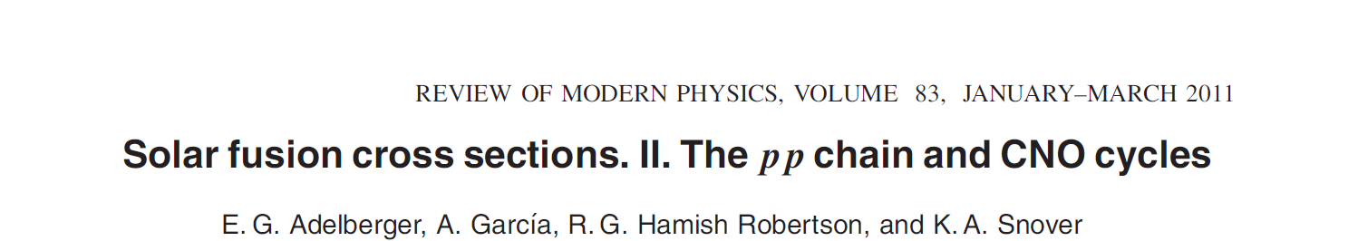
Solar Fusion Cross Sections II
Ten years after publication of Solar Fusion I, a proposal was made to the Institute for Nuclear Theory (INT) to revisit this process, in order to produce a new evaluation that would reflect the considerable progress made in the past decade, as well as new motivations for further constraining the SSM.
Solar Fusion Cross Section II- Workshop held at the Institute for NuclearTheory, Seattle, January 2009
→Adelberger et al., Solar Fusion Cross Sections II. The pp chain and CNO cycle , Rev. Mod. Phys. 83 (2011),195

Slide 7
Solar Fusion Cross Sections III
Initially scheduled for 2020, ten years after the previous SF-II workshop, SF-III brought together experimentalists and theoreticians working on hydrogen burning nuclear reactions with the final goal of defining a new set of consensus reaction rates appropriate for solar and stellar evolution models.
The Solar fusion III workshop (SF-III) took place from July 26-29, 2022, at Berkeley (USA) under the sponsorship of ChETEC-INFRA, the NSF network N3AS and the Institute for Nuclear Theory (USA)
SCIENTIFIC ORGANIZERS
D. Bemmerer, A. Guglielmetti, W. Haxton, A. Serenelli
PROGRAM COORDINATOR
Megan Baunsgard Institute for Nuclear Theory & Laura Fantone N3AS
https://www.int.washington.edu/programs-and-workshops/22-82w
https://indico.ice.csic.es/event/30/overview

Slide 8
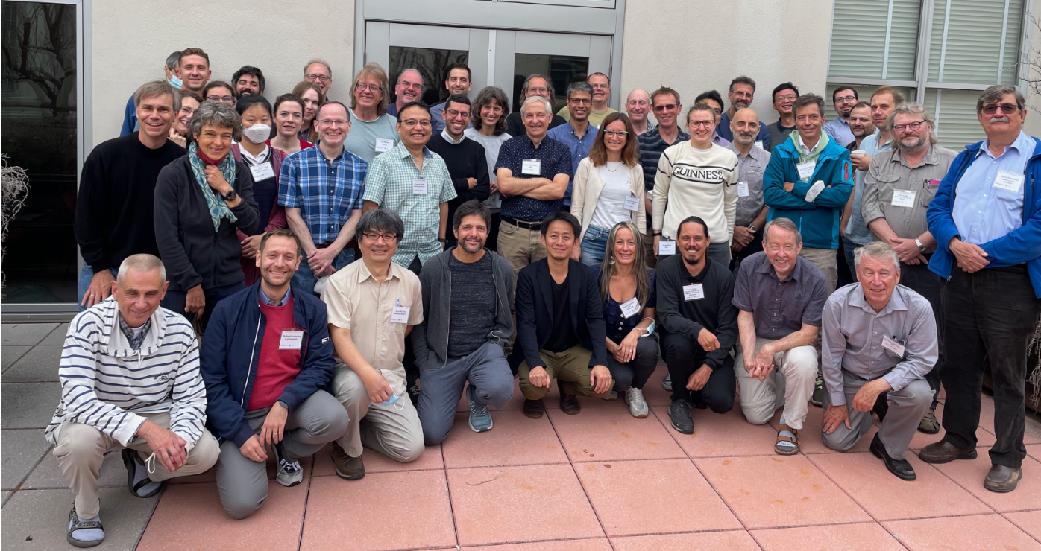
SFIII: 47 scientists from 12 countries!

Slide 9
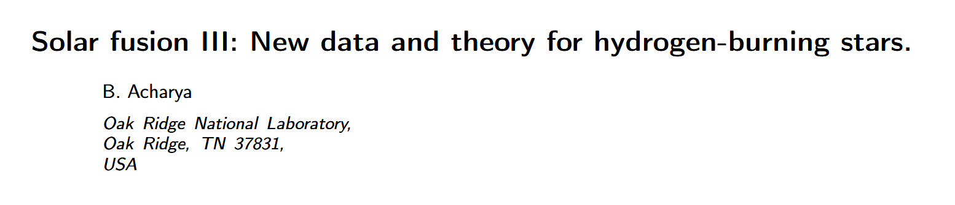
Solar Fusion Cross Sections III
9 Working Groups (WGs), focusing on specific nuclear reactions (or groups of nuclear reactions) or other relevant topics (neutrinos, new facilities, …)
each participant could join up to 3 different WGs
WGs presented the state-of-the-art of the field in plenary talks at the very beginning of the workshop and then followed their activities by individual meetings.
Final summaries were presented on the last day
final goal is to provide the community with a new generation of nuclear cross sections that take into consideration the advancements in the field since SF-II in 2010

Slide 10
Working groups and conveners (I)
* WG1 - S₁₁ [¹H(p, e⁺ ν)²H] and theory, extrapolations, radiative corrections, electron capture, neutrino spectra
Conveners: L. Marcucci (Univ. Pisa), J.-W. Chen (Natl. Univ. Taiwan)
* WG2 - Solar neutrino observations, helioseismology, asteroseismology
Conveners: F. Villante (Univ. L'Aquila), A. Serenelli (ICE), H. Robertson (Univ. Washington)
* WG3 - S₁₁₄ [¹⁴N(p, γ)¹⁵O]
Conveners: R. James deBoer (Notre Dame U.), Tamás Szücs (ATOMKI)
* WG4 - S₁₂ [²H(p, γ)³He]
Conveners: F. Cavanna (INFN Torino) A. Walker-Loud (Lawrence Berkeley National Lab)
* WG5 - S₁₇ [⁷Be(p, γ)⁸B]
Conveners: L. Gialanella (Univ. Studi Campania)

Slide 11
Working groups and conveners (II)
* WG6 - S₁₁₂ [¹²C(p, γ)¹³N], other CNO, NeNa
Conveners: R. Depalo (Univ. Milano), Ch. Iliadis (Univ. North Carolina)
* WG7 - S₃₄ [³He(⁴He, γ)⁷Be] and S₃₃ [³He(³He, 2p)⁴He]
Conveners: D. Bemmerer (HZDR), K. Nollett (San Diego State)
* WG8 - New facilities: LUNA-MV, JUNA, NIF, etc
Conveners: M. Aliotta (Univ. Edinburgh), M. Wiescher (Notre Dame Univ.)
* WG9 - Opacity, screening
Conveners: T. Nagayama (Sandia), J. Colgan (Los Alamos), B. Balantekin (UW-Madison)

Slide 12
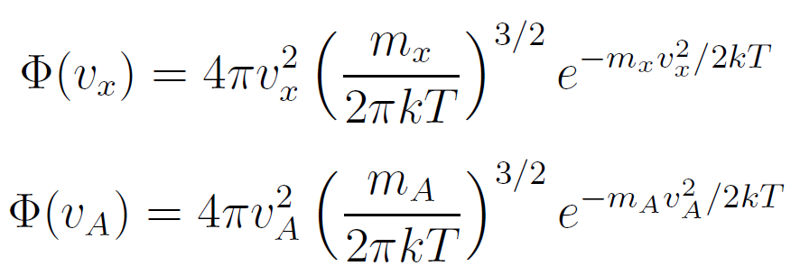
Fusion reactions inside the stars
The total energy produced by thermonuclear reactions depends on the energy released by the single reaction (Q-value) and on the number of reactions occurring in the star per unit time and unit volume (stellar reaction rate)
The stellar reaction rate r of the reaction A+x→ B+w with N_{A} , N_{x} atoms/vol is given by:
$r=N_{A}N_{x}\int_{0}^{∞}{\int_{0}^{∞}{Ф\left(v_{A}\right)Ф(v_{x}) σ\left(v\right)v{ dv}_{A}{dv}_{x}}}$ $=N_{A}N_{x}\left\langle σv\right\rangle$
where the velocities of the interacting nuclei follow the Maxwell Boltzmann distribution
and the cross section depends on the relative velocity $v{=v}_{A}− v_{x}$

Slide 13
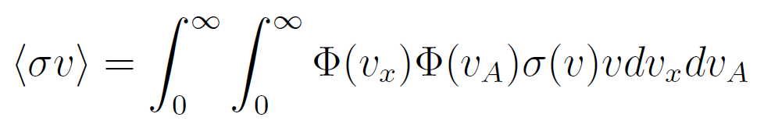
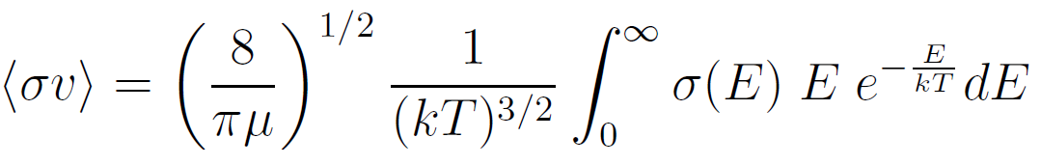

Fusion reactions inside the stars
The reaction rate per particle pair
can be expressed in terms of the energy in the centre of mass system E and the reduced mass μ
$$E=\frac{1}{2}μν^{2}$$

Slide 14
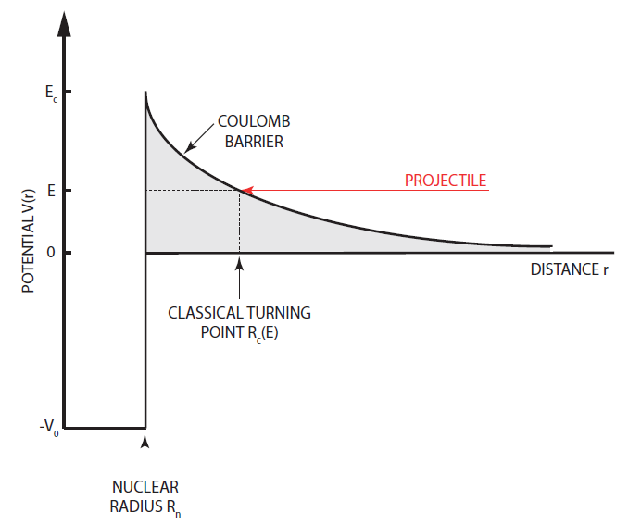
Charged particles induced non resonant reactions
The interacting nuclei inside the stellar plasma are positively charged and follow the Maxwell Boltzmann distribution that has a maximum at E=kT
In our Sun T ≈ 10⁷ K→ kT ≈ keV
Coulomb barriers E_{C} between light charged nuclei are of the order of MeV
→E<<E_{C}→ Tunneling effect

Slide 15
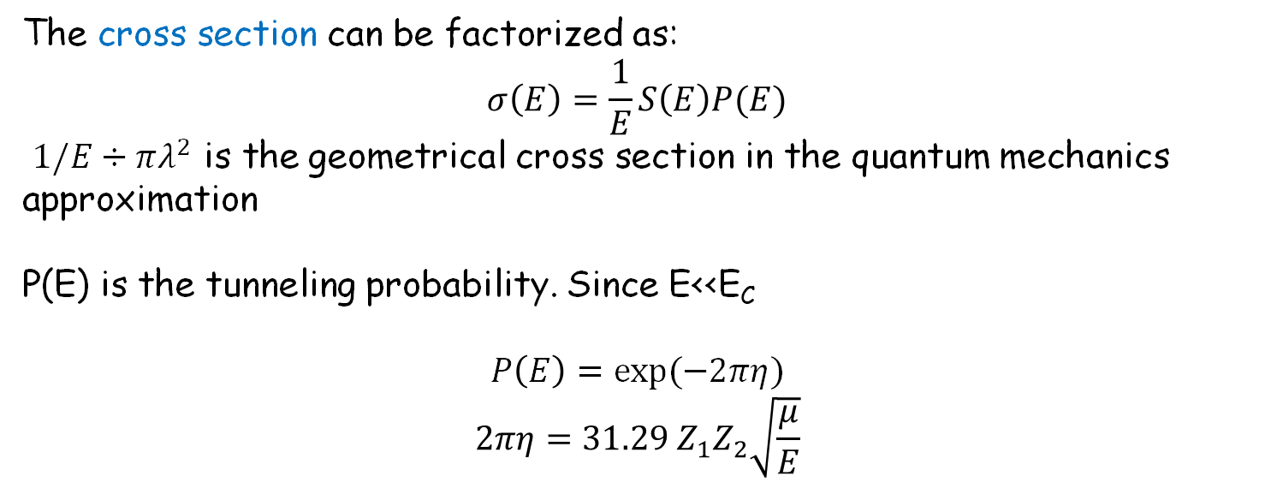
Cross section
The cross section can be factorized as:
$$σ\left(E\right)=\frac{1}{E}S\left(E\right)P(E)$$
$1/E÷πλ^{2}$ is the geometrical cross section in the quantum mechanics approximation
P(E) is the tunneling probability. Since E<<E_{C}
$$P\left(E\right)=exp⁡(−2πη)$$
$$2πη=31.29 Z_{1}Z_{2}\sqrt{\frac{μ}{E}}$$
S(E) is the astrophysical S factor slowly varying with energy
In most cases S(E) can be expanded as a power series around E = 0
S(E) ≃ S(0) + S′(0) E + S′′(0) E²
with the leading term being S(0)

Slide 16
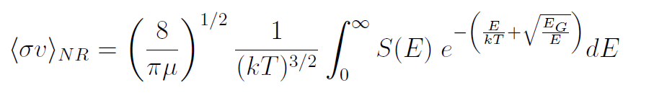
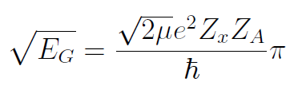
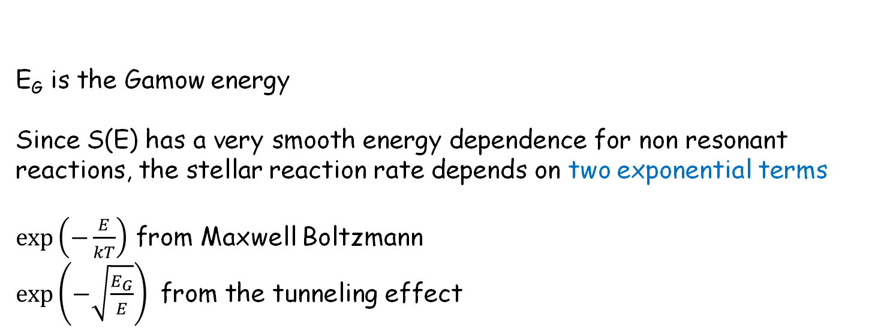
Stellar reaction rate
Introducing the cross section into the reaction rate:
E_{G} is the Gamow energy
Since S(E) has a very smooth energy dependence for non resonant reactions, the stellar reaction rate depends on two exponential terms
$\exp\left(−\frac{E}{kT}\right)$ from Maxwell Boltzmann
$\exp\left(−\sqrt{\frac{E_{G}}{E}}\right)$ from the tunneling effect
The Gamow peak is given by the product of the two terms in the integrand

Slide 18
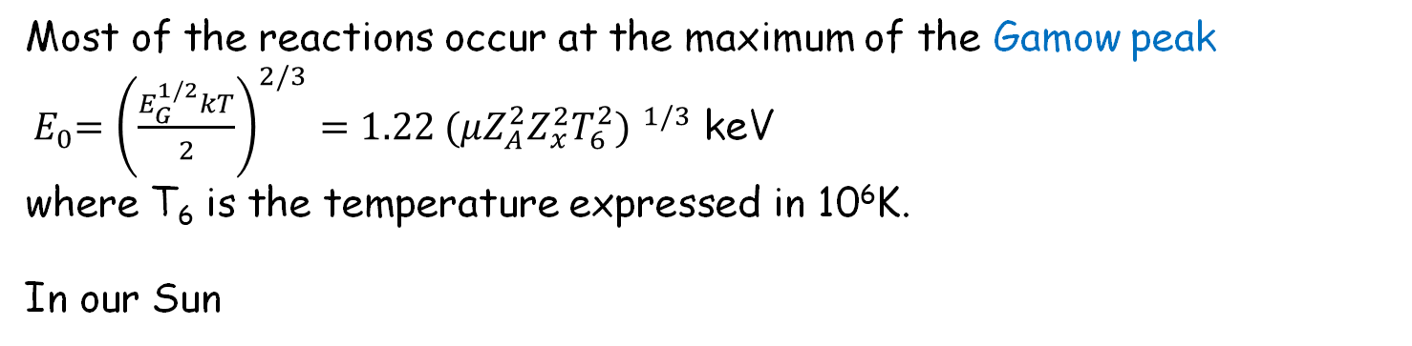
Gamow energy
Most of the reactions occur at the maximum of the Gamow peak
${ E}_{0}={\left(\frac{E_{G}^{1/2}kT}{2}\right)}^{2/3}=1.22 {(μZ_{A}^{2}Z_{x}^{2}T_{6}^{2}) }^{1/3}$ keV
where T₆ is the temperature expressed in 10⁶K.
In our Sun
³He(³He,2p)⁴He E₀=21 keV
d(p,γ)³He E₀=6 keV
¹⁴N(p,γ)¹⁵O E₀=27 keV
³He(⁴He,γ)⁷Be E₀=22 keV
The Gamow Peak energies are much smaller than the height of the Coulomb barrier → very small cross sections (exponential dependence of σ(E) through the term P(E))

Slide 19
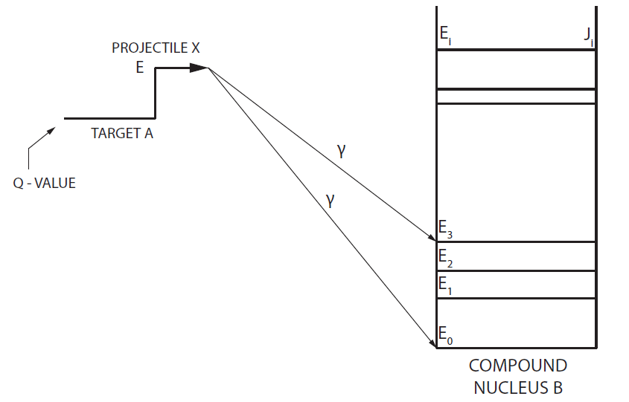
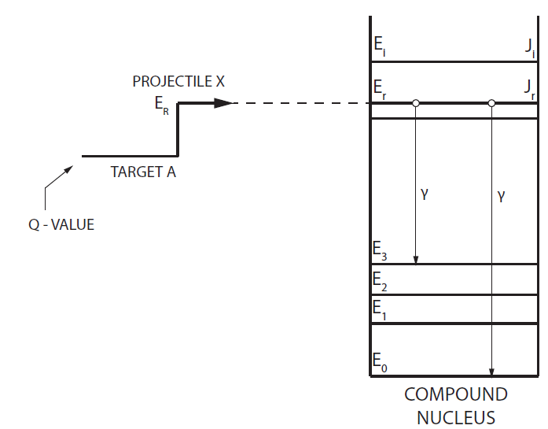

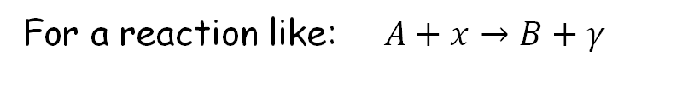
Non resonant vs resonant reactions
For a reaction like:$A+x→B+γ$
Resonant Reactions
Non Resonant Reactions
CM system

Slide 20





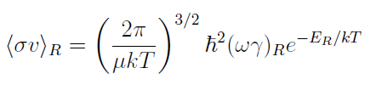
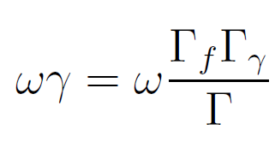
Resonant reactions
A resonant state can be formed if the angular momentum and parity conservation laws are respected:
The cross section is derived in the Breit Wigner approximation as
Γ_{f} and Γ_{γ} are the partial width for the formation and decay of the compound nucleus (Γ≪ E_{R})
The stellar reaction rate is given by:
Resonance strength

Slide 21
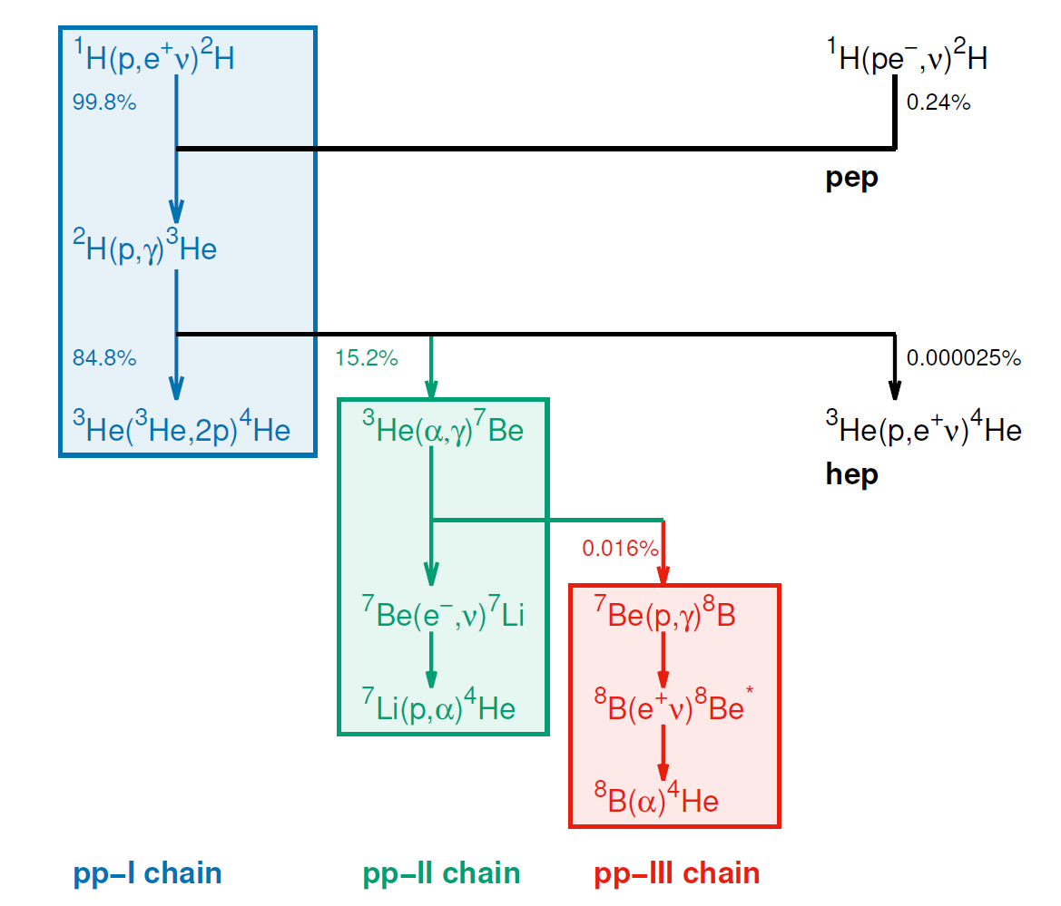
The nuclear physics of Solar Fusion III: p-p chain

Slide 22
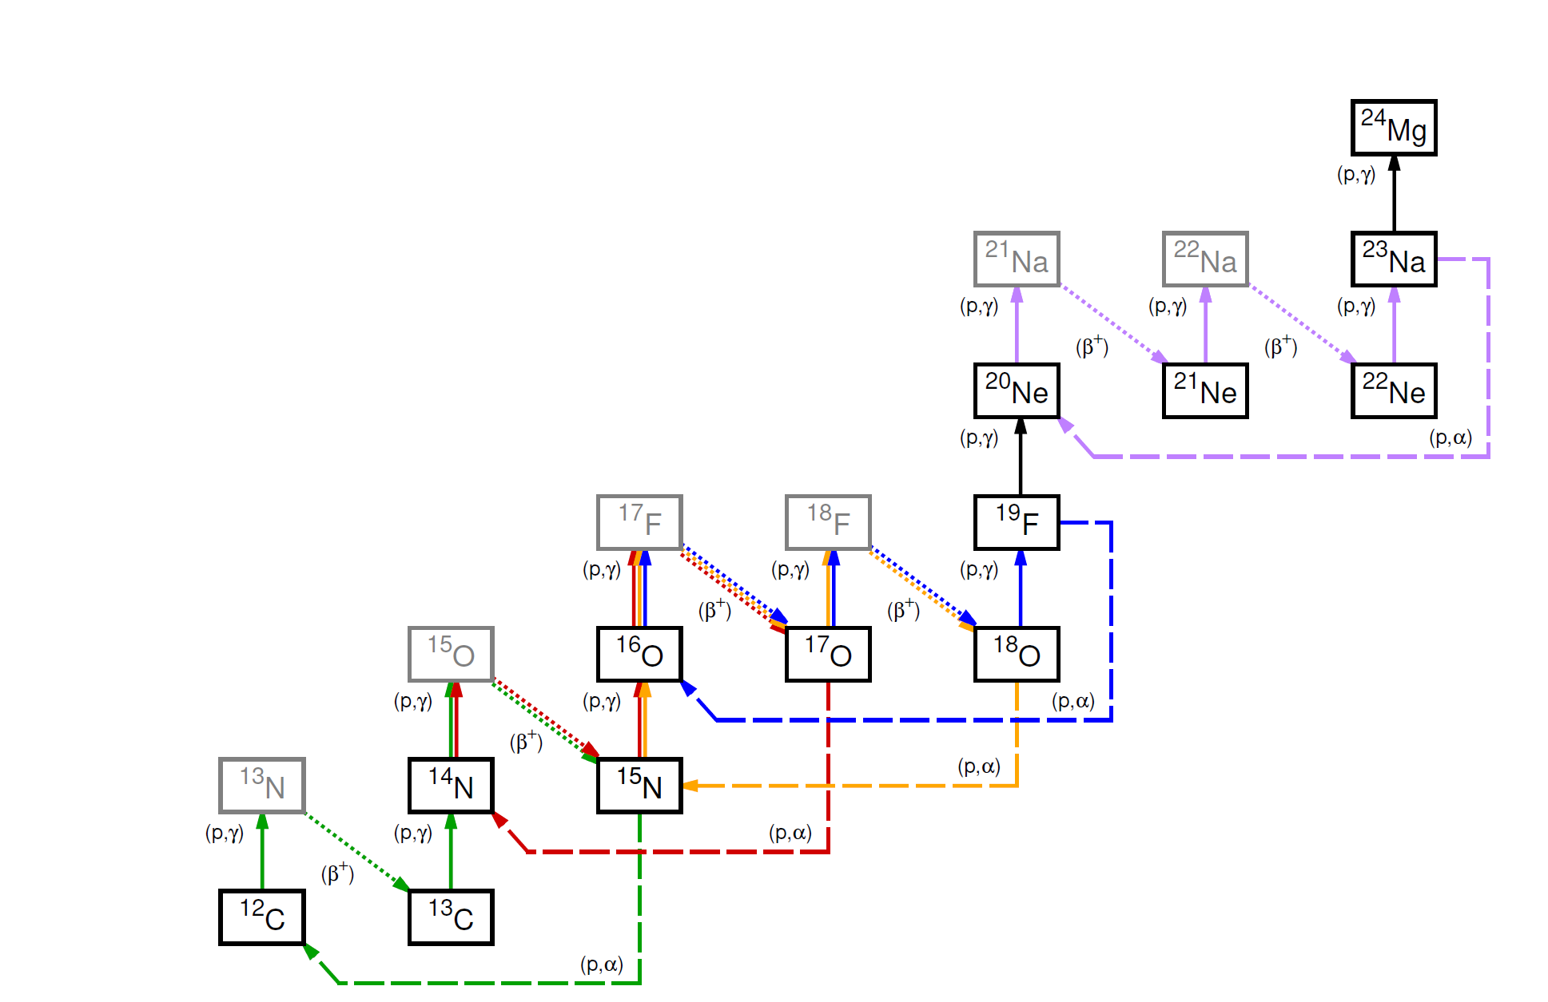
The nuclear physics of Solar Fusion III: CNO and NeNa cycles

Slide 23
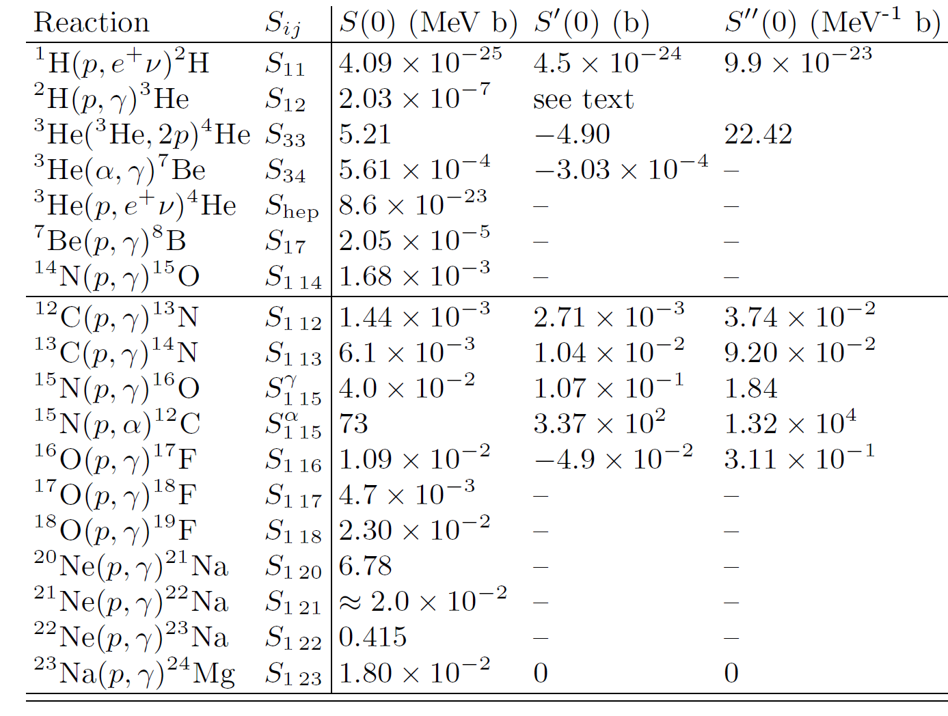
The nuclear physics of Solar Fusion III

Slide 24
The ²H(p,γ)³He reaction
The ²H(p,γ)³He reaction is the second step in the pp chain of solar fusion.
It's important for protostar evolution and Big Bang Nucleosynthesis (BBN).
Recent advances include new experimental measurements and theoretical/phenomenological analyses.

Slide 25
The ²H(p,γ)³He reaction
New Experimental Data:
Accelerator-based measurements by Tišma et al. (2019), LUNA Collaboration (Mossa et al., 2020b), and Turkat et al. (2021).
Inertial confinement fusion plasma-based measurements by Zylstra et al. (2020) and Mohamed et al. (2022).
Theoretical Studies:
Ab initio calculations by Marcucci et al. (2016) using realistic nuclear interaction models.
Results were about 10% higher than experimental data.
Recommendations for future work include using chiral effective field theory and studying angular distributions.

Slide 26
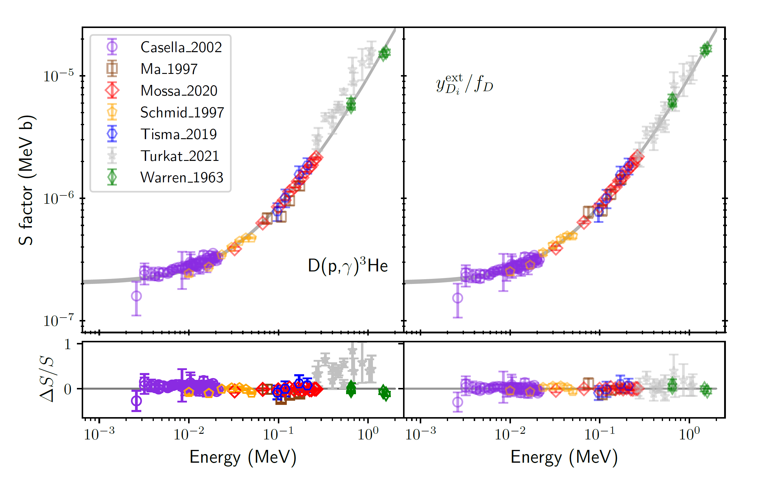
The ²H(p,γ)³He reaction
Phenomenological and Bayesian Analyses:
S-factor modeled by low-order polynomials in energy.
Bayesian analysis methods adopted to evaluate reaction rates and provide uncertainty estimates.
Both ab initio predictions and polynomial models used to constrain the data.
Bayesian analysis favored phenomenological models over polynomial approximations.

Slide 27
The ³He(³He,2p)⁴He reaction
  Terminates the pp-I chain
  Ratio of its rate to ³He(α, γ)⁷Be controls branching to pp-II and pp-III chains
  No new absolute measurement of S33 since SFII

Slide 28
The ³He(³He,2p)⁴He reaction
Possible reaction mechanism: p + ⁵Li, di-proton + α, and direct three-body decay
New information on proton energy spectrum:
  Measured using Inertial Confinement Fusion (ICF) plasmas at 165 keV Gamow peak energy
  Shows significant structure, indicating a sequential reaction mechanism through ⁵Li ground state. Differs from simple elliptical spectrum used in previous analysis.
  Impact on the results since cross section is measured detecting protons above a threshold.

Slide 29
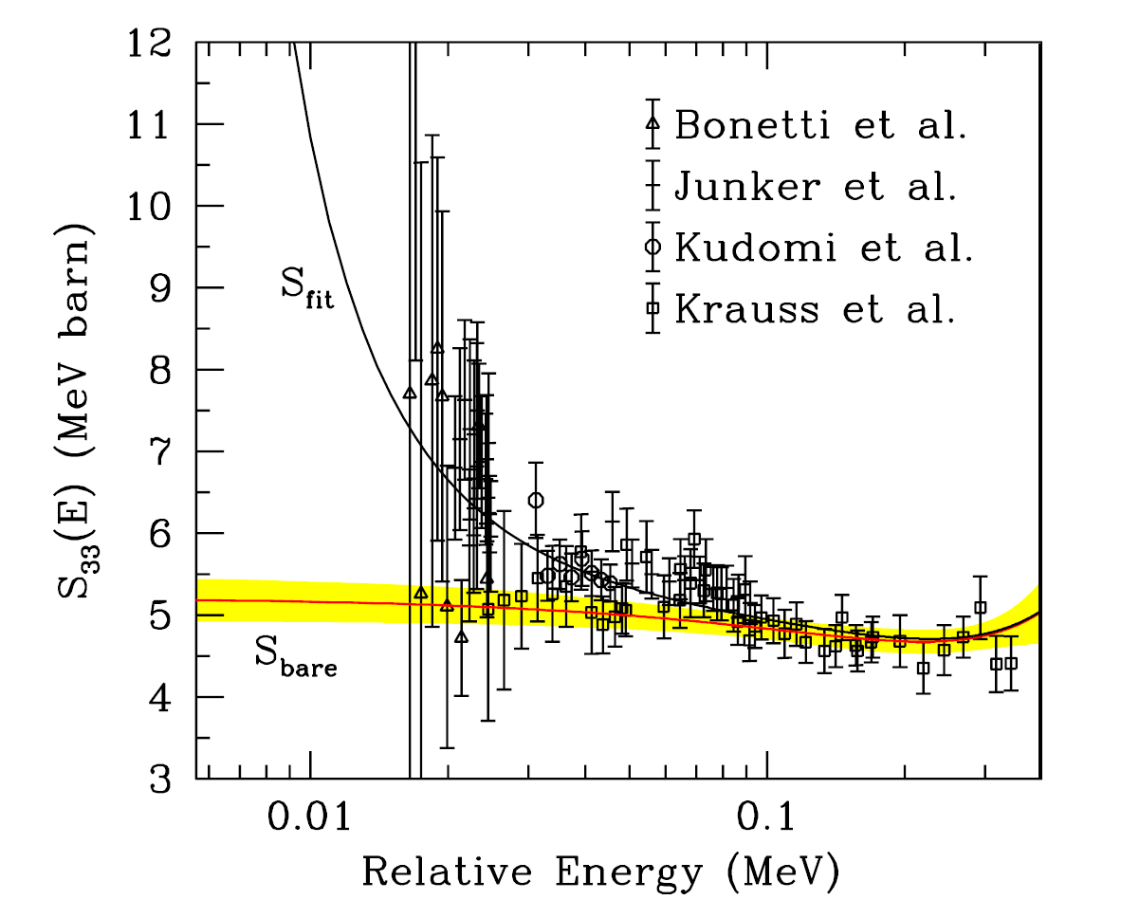
The ³He(³He,2p)⁴He reaction
Recommendation:
  S33 fit from SF II retained, but with additional 4% systematic uncertainty to take the uncertain spectral shape into account
Future work:
  New measurements could provide more accurate cross sections and improve understanding of proton spectra and angular correlations

Slide 30
The ³He(α,γ)⁷Be reaction
  Proceeds via non resonant capture to g.s. and 1st excited state of ⁷Be
  Prompt-γ, activation, and recoil methods have been used
  Recent studies have focused on activation and recoil methods due to concerns about γ-ray angular distribution uncertainties

Slide 31
The ³He(α,γ)⁷Be reaction
New experimental data:
Five new experiments since Solar Fusion II, mostly at higher energies
Experiments performed with activation and recoil methods selected due to concerns about γ-ray angular distribution uncertainties
Theoretical progress:
  Ab initio calculations (in good agreement with data)
  Halo effective field theory (EFT) methods
  R-matrix analyses with Bayesian parameter estimation
Data fitting:
  Halo EFT and R-matrix parameterizations used
  Bayesian analysis methods applied to handle parameter degeneracies
  Fits performed with and without elastic scattering constraints

Slide 32
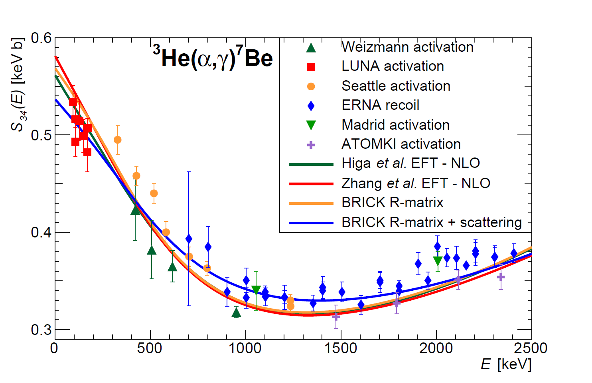
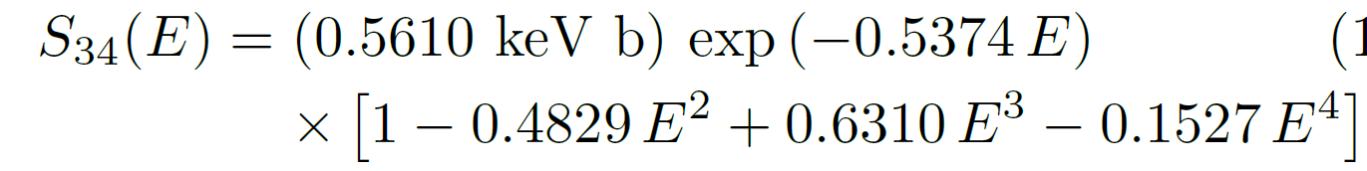
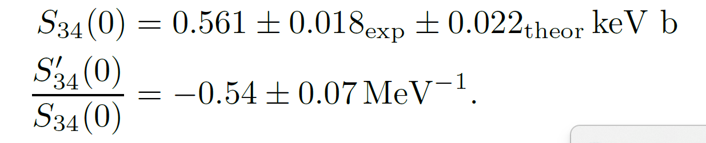
The ³He(α,γ)⁷Be reaction
Recommended S(E) from the Higa et al. EFT-NLO fit

Slide 33
The ³He(α,γ)⁷Be reaction
Recommendation is essentially the same as in SF II, but derived from completely different theoretical approaches much more directly connected to the data and much less dependent on model assumptions.
Based on data over a wider energy range.
Future work recommendations:
  New elastic ³He+⁴He scattering experiments needed
  Measurements of γ-ray angular distribution required
  Wide-range S-factor study with small point-to-point errors recommended
  Further development of ab initio calculations and inclusion of γ-ray angular distributions in theoretical work

Slide 34
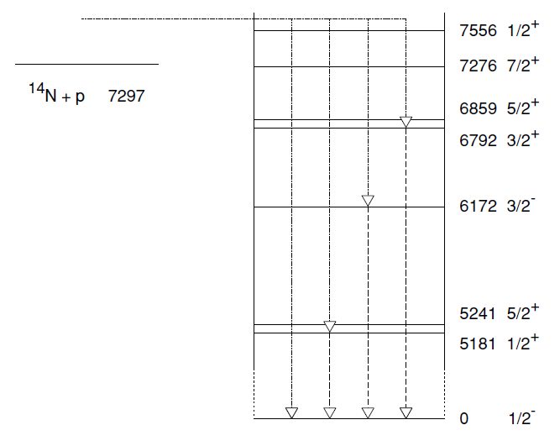
The ¹⁴N(p,γ)¹⁵O reaction
Proceeds through a number of bound-state transitions
The total capture cross section is dominated by capture to the 6.79 MeV state of ¹⁵O (71-78% of total cross section)
The second strongest transition is the capture to the ground state (16 − 17% )
The capture to the 6.18 MeV state (3/2⁻) is responsible for about 7 − 8% of the total cross section.

Slide 35
The ¹⁴N(p,γ)¹⁵O reaction
Recent developments:
  New measurements of capture reaction cross section and indirect studies on 6.79 MeV state lifetime, proton ANCs, and low-energy scattering
  Several new R-matrix fits performed
259 keV resonance:
  narrow resonance with precisely known strength and with γ-ray transitions that span a wide energy range→used for normalization in many experiments
  New recommended strength: ωγ₂₅₉ = 12.86 ± 0.45 meV, consistent with previous value but with higher precision.

Slide 36
The ¹⁴N(p,γ)¹⁵O reaction
Ground state transition cross section very challenging to measure accurately and to high precision because the cross section is very low and most experiments perform measurements with high efficiency γ-ray detectors in very close geometry→ summing corrections needed
The new data and accompanying R-matrix fits have repeatedly confirmed a discrepancy between the R-matrix fit and the experimental data→ a larger uncertainty (37% vs 19%) has been attributed to this transition compared to SF II
Repeated measurements of the 6.79 MeV transition continue to produce consistent results, especially at very low energies→ uncertainty (2.9% vs 4.0%) has been further reduced from that of SF II.
For the three weaker transitions, no new experimental data. Values of S(0) determined by scaling those from SF II by the ratio of the 259 keV resonance strengths adopted here and from SF II.
a larger uncertainty of 8.4% has been estimated for S1 14(0), compared to the 7% uncertainty recommended in SF II.

Slide 37
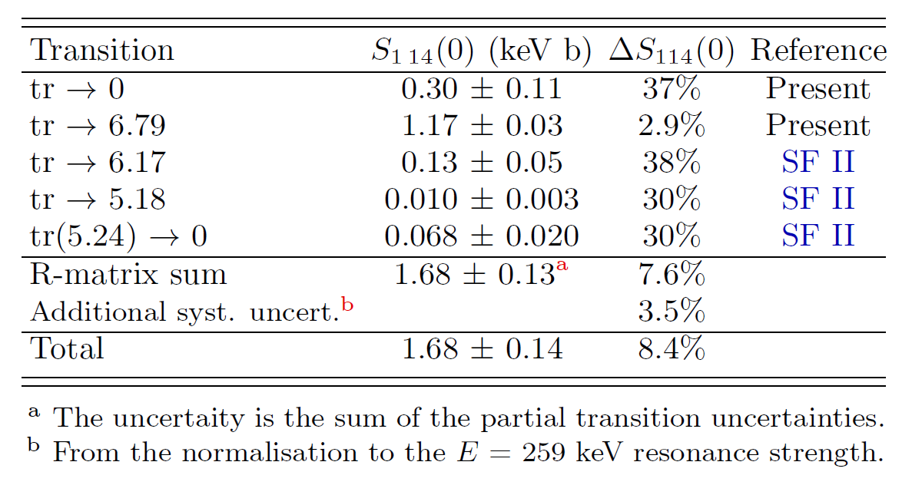
The ¹⁴N(p,γ)¹⁵O reaction
Recommendations for future work (see also Alba Formicola’s talk)
  Far geometry angular distribution measurements for ground state transition
  New measurements to replace Schröder et al. (1987) data
  Additional low-energy measurements of ground state transition
  Precise measurement of 6.79 MeV state lifetime
  High-energy measurements of 6.18 MeV and 7.56 MeV final state cross sections

Slide 38
Other CNO cycle and NeNa cycle reactions
  Proton-induced reactions on ^{12,13}C, ¹⁵N, ^{16,17,18}O, ¹⁹F, ^{20,21,22}Ne, and ²³Na analyzed. Interest for solar neutrinos (up to ¹⁶O) and to H- burning in AGB stars (higher temperatures)
  Focus on low-energy region (below 150 keV in center of mass)
  Updated S-factors, Gamow peak locations, and resonance strengths provided

Slide 39
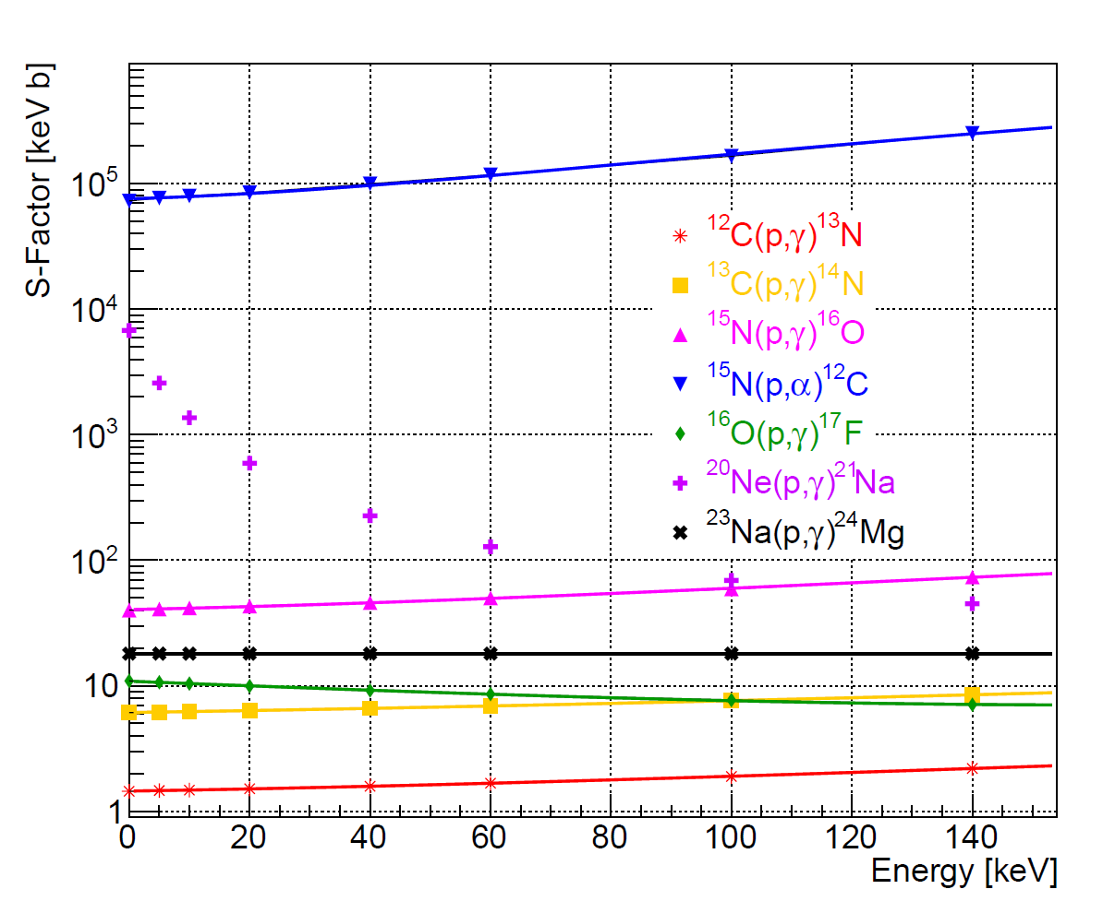
Other CNO cycle and NeNa cycle reactions

Slide 40
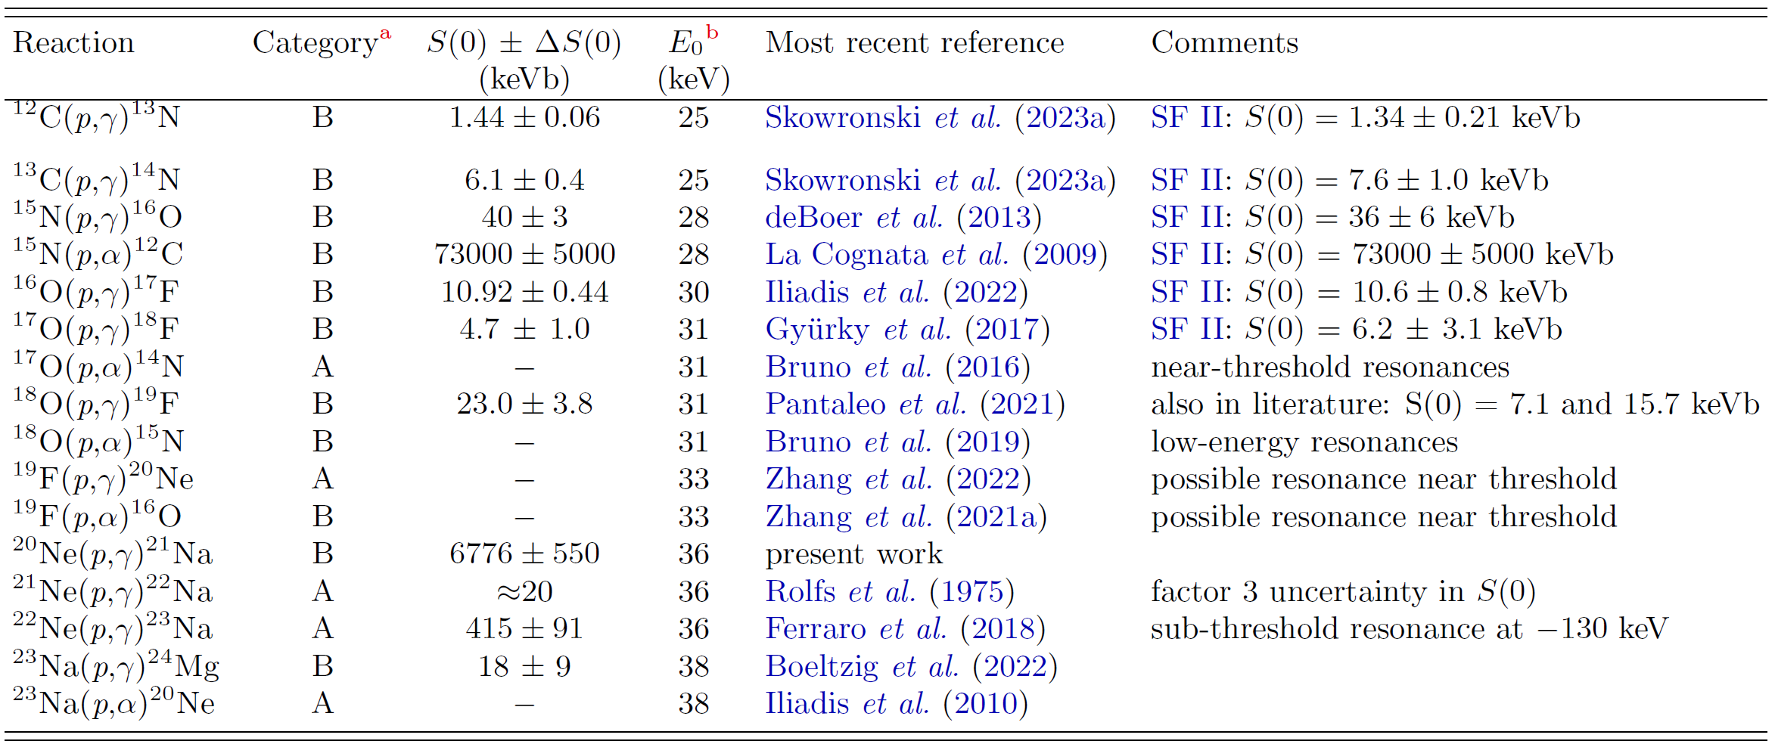
Other CNO cycle and NeNa cycle reactions
(“A”) Narrow resonances. (“B”) Broad resonant/non-resonant contributions

Slide 41
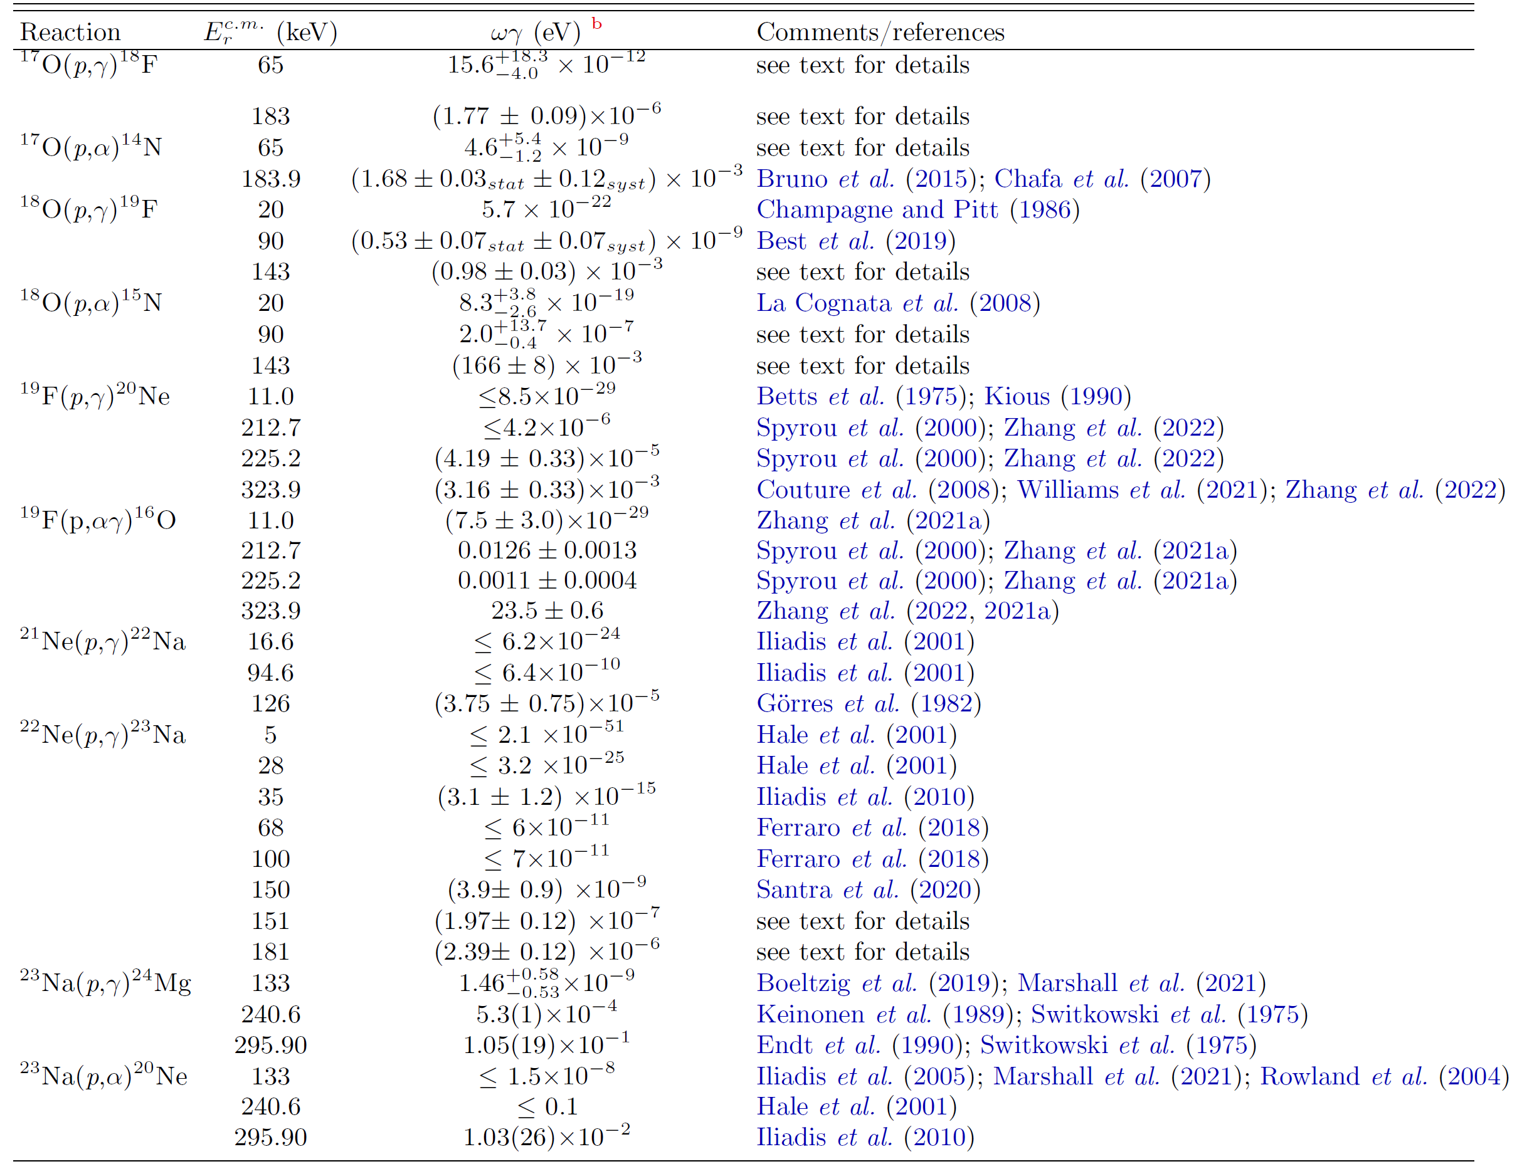
Other CNO cycle and NeNa cycle reactions

Slide 42
¹²⁻¹³ C(p,γ) ¹³⁻¹⁴ N reactions

Slide 43
¹²C(p,γ)¹³ N reaction
Influenced by the tail of a broad resonance and the non-resonant capture to the ground state of ¹³N
The results of six new direct measurements have been published since SF II
Thanks to the high consistency of all recent datasets, the extrapolation of the cross section to solar energies has now improved uncertainty.
Owing to the self-consistency between the used methods (activation and in beam gamma spectroscopy) and the precise data covering the lowest energies to date (Ep =80-140 keV) the S-factor recommended by Skowronski et al. (LUNA collaboration) is adopted

Slide 44
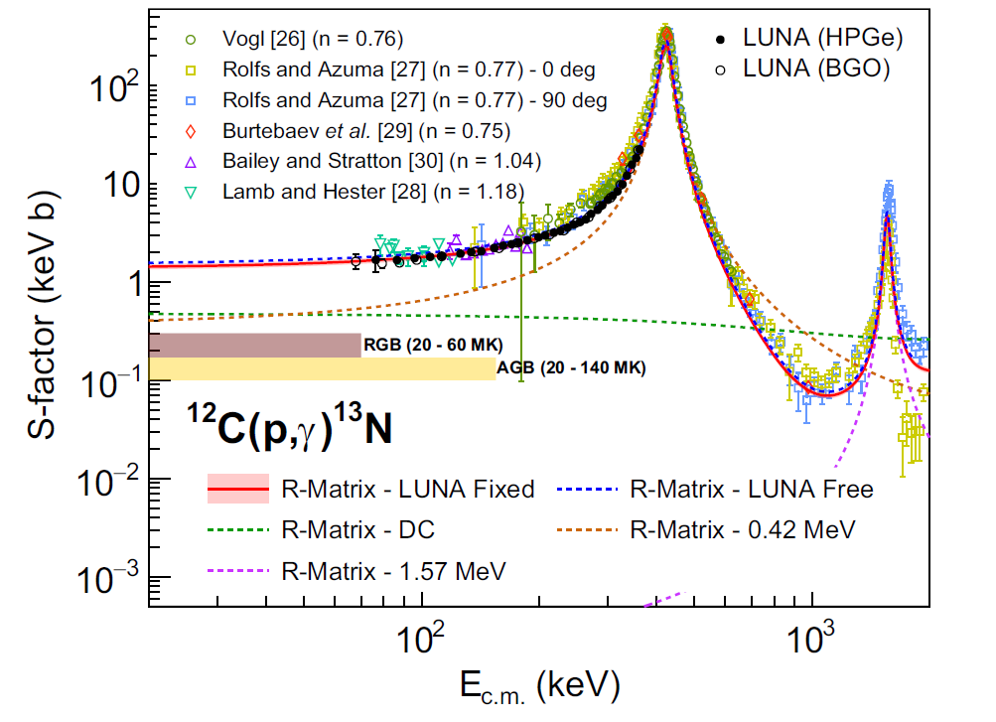
¹²C(p,γ)¹³ N reaction

Slide 45
¹³C(p,γ)¹⁴ N reaction
Proceeds to the ground state and five excited states in ¹⁴N. The low-energy cross section is influenced by the tail of a broad resonance at laboratory bombarding energy of E_{lab} ≈ 558 keV.
Previously, only a single work (King et al 1994) reported cross sections for all transitions which was the basis of the S-factor recommendations in both SF I and SF II.
New comprehensive experiment by the LUNA collaboration provided data in the energy range of E_{lab} = 80 − 400 keV with two different techniques to measure both partial cross sections and total cross sections.
The adopted S-factor is based on the new LUNA result owing to its self-consistency between the different methods for measuring the cross sections, and the higher precision of the dataset compared to (King et al 1994)

Slide 46
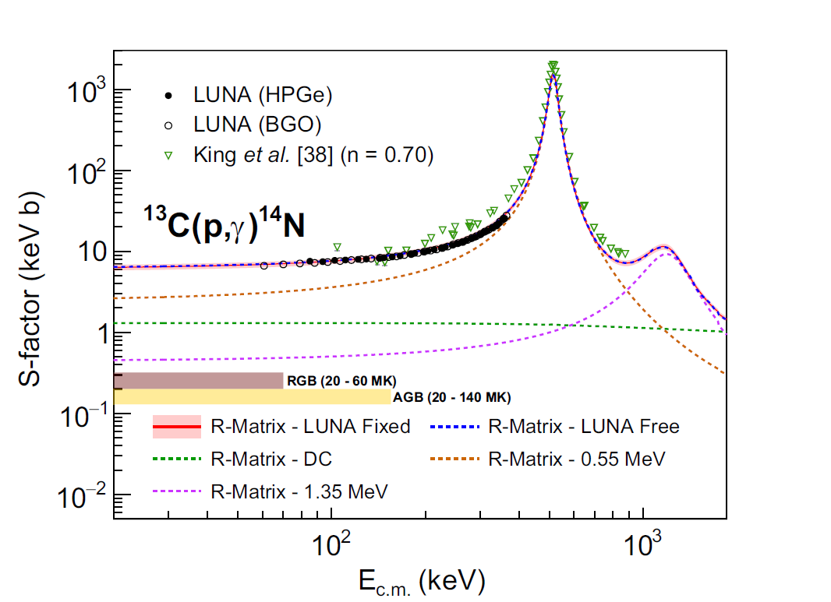
¹³C(p,γ)¹⁴ N reaction

Slide 47
Conclusions
Solar Fusion cross section III paper summarizes the significant progress that has been made over the last decade in understanding the nuclear reactions that govern energy production in solar and stellar hydrogen burning
The nuclear physics of the pp chain remains a significant uncertainty in SSM predictions of the individual neutrino fluxes - pp, pep, hep, ⁷Be, ⁸B, and CNO. Ambitious goal would be to reduce such uncertainties to a factor of 2 below current SSM “environmental” uncertainties
For several reactions the SF III recommended values are less precise than those of SF II.This is indicative of a more cautious treatment of uncertainties
For all of the experimentally accessible pp-chain reactions and for S1 14 which determines the CNO cycle rate, there is a need for at least one experimental data set spanning the entire energy range. Stay tuned!
The effort should go on!

