Slide 1


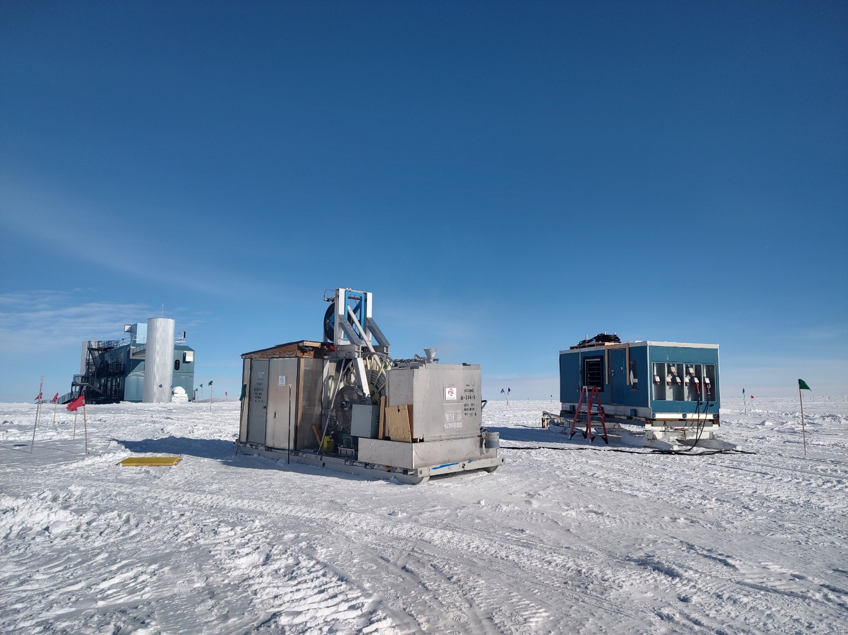
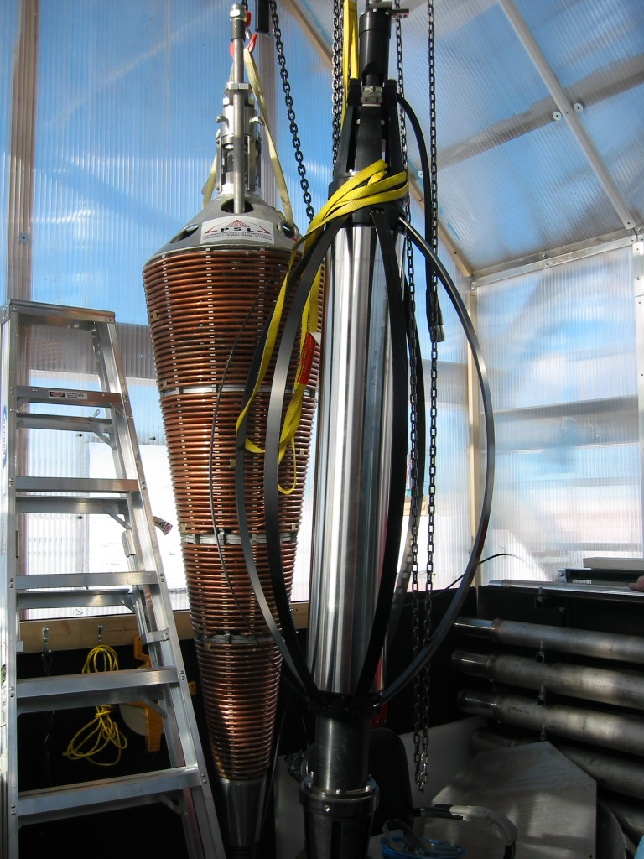
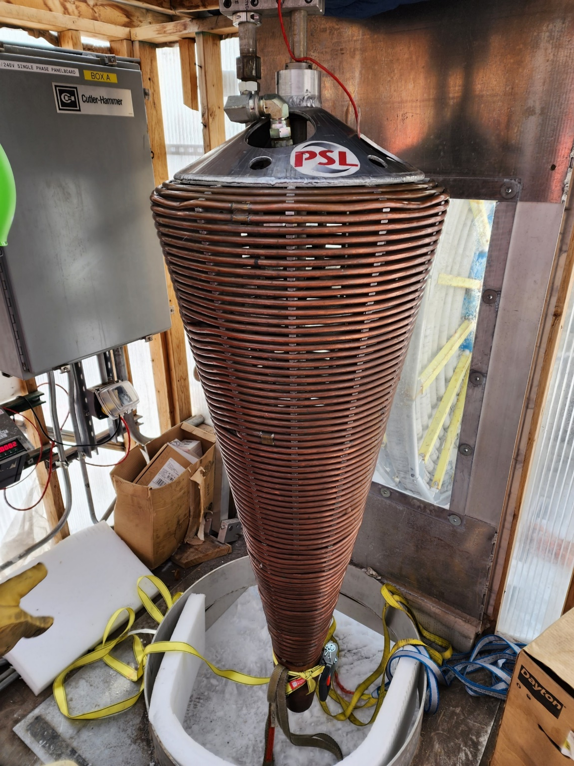
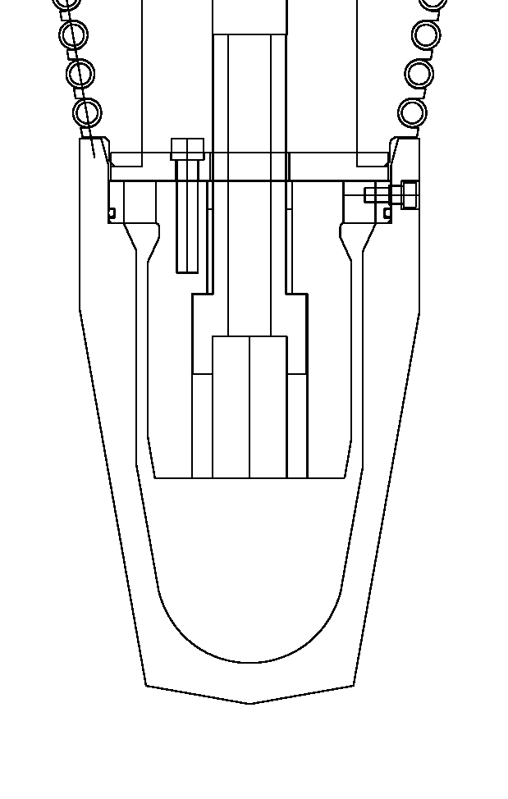
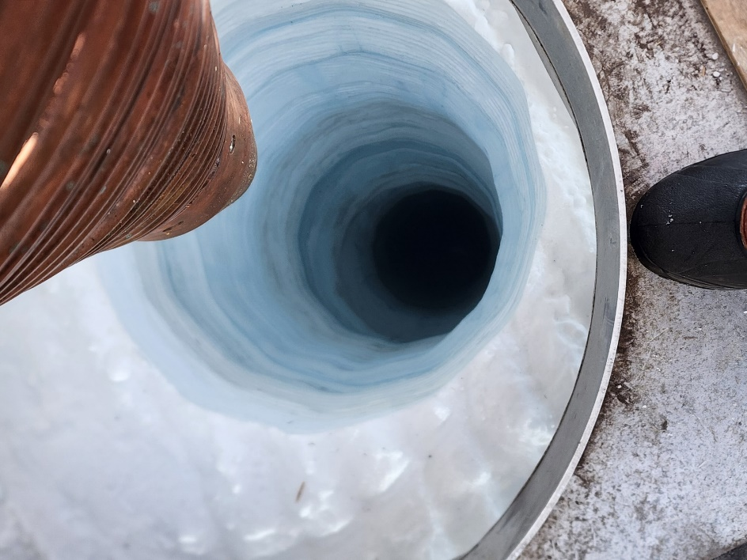
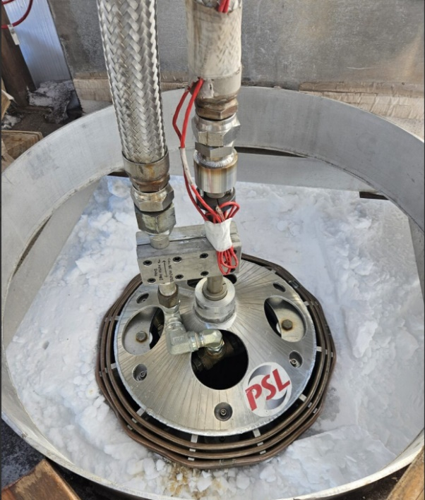
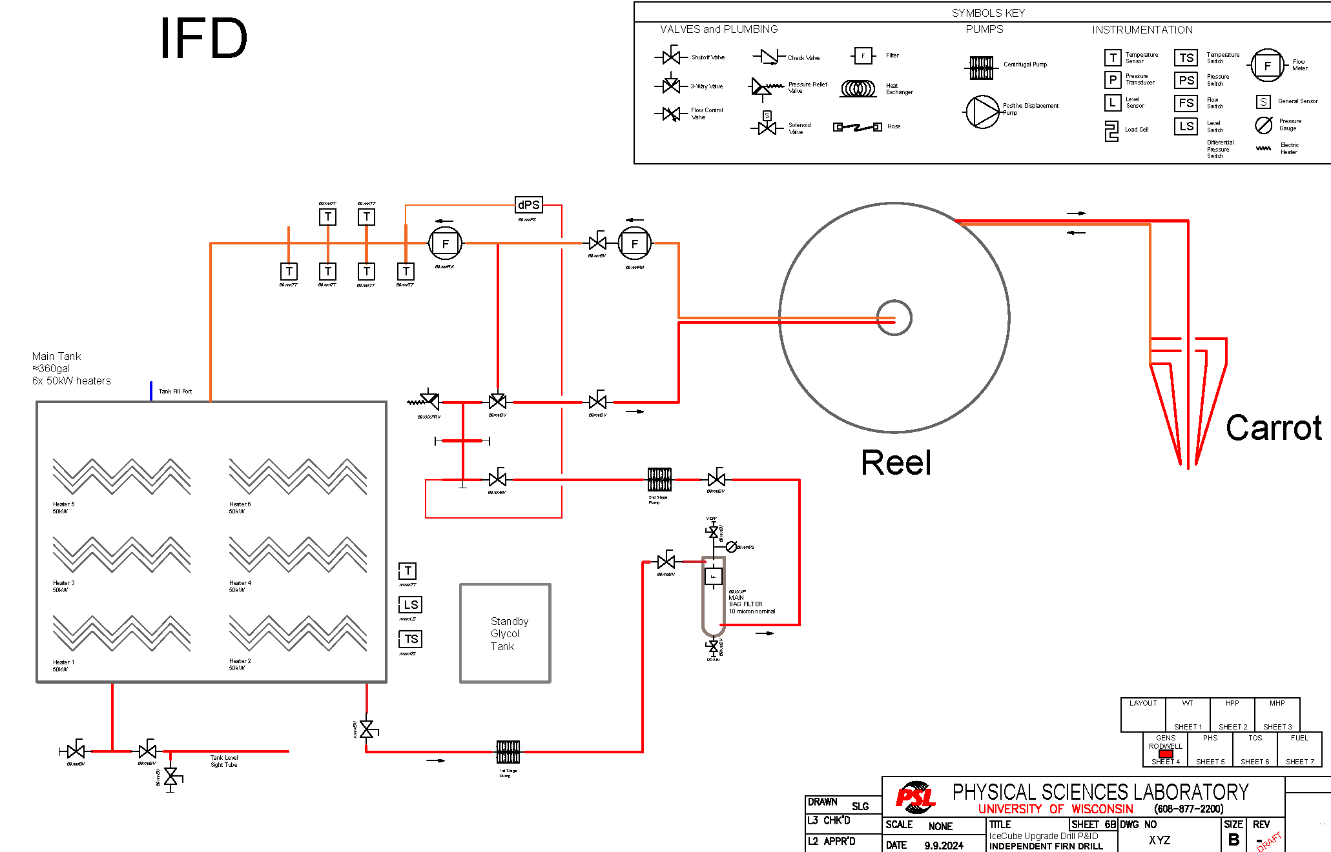
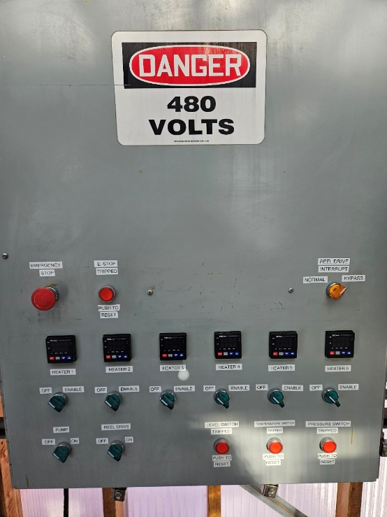
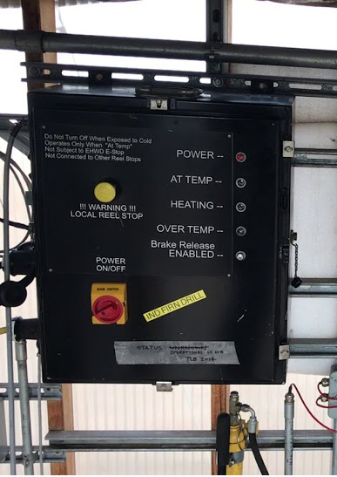


Large-Diameter Firn Drilling with the IceCube Independent Firn Drill
T. Benson¹, J. Nesbit¹, L. Oxborough¹, The University of Wisconsin-Madison Physical Sciences Laboratory Team¹
¹ University of Wisconsin-Madison Physical Sciences Laboratory, Madison, WI, USA
The Independent Firn Drill (IFD) was developed to improve firn hole quality and operational efficiency of the drilling campaign for the IceCube Project. The IFD is used to create an initial 60 cm borehole through the firn layer at the South Pole to a depth of approximately 40 m, where melt water begins to pool in the borehole. At that point, the deep hot water drill (Enhanced Hot Water Drill, now the IceCube Upgrade Drill) is used to continue drilling the borehole to the required total depth of 2500-2600 m. The top 40 m of firn is permeable to water and using lost-water hot water drill techniques for this section is highly inefficient, and therefore a hot point technique is preferred. The IFD uses a closed-loop water-glycol system that electrically heats the fluid in a local reservoir and circulates it through a coiled copper tube cone-shaped hot point. Drill rates are slow, however designing the system to be independent from the main hot water drill operations allows the IFD to begin making firn holes well ahead of main drilling activities, in some cases a year or more ahead of time. Coupled with a mobile generator, the IFD system is completely standalone and highly mobile. It requires 1 person to operate during drilling, but can also be left unattended for extended periods because the system is fully electric. A functional description of the IFD system will be presented.
SPECS
Hole Depth | 137.8 ft (42 m)
Hole Size | 24 inch (60 cm)
Immersion Heaters | 6
Pumps | 1
Required Operators | 1
Thermal Power | 240 kW
Electrical Service | 480VAC 3-ph, 2x 100A
Sled Weight | 11968 lb (5428 kg)
Footprint | 20 ft x 12 ft (6.1 m x 3.6 m)
Reservoir Capacity | 360 gal (1362.75 liter)
Flow Rate | 18 GPM (68.1 LPM)
Pressure | 40 PSI (276 kPa)
The IFD operates as a closed-loop system, with the basic components of a hot water drill: heaters, a pump, a tank, hose, and a drillhead. It can be positioned with a 953 loader over the hole location. There are six immersion heaters, four primary and two spare, to heat a 360-gallon volume of 60/40 water/glycol solution. A single pump circulates the solution through 1-1/2" diameter stainless steel braided hose into the drillhead. Two braided hoses, a supply hose and a return hose, are bundled together on the reel and thus structurally coupled to support the load of the drillhead. A single Allen Bradley drive controls the reel motion logic. The IFD requires two feeds of 480 VAC 3-phase 100A power; typically this power is supplied with the CRREL generator at the South Pole station. The system can be operated in an idle mode with a single power feed but requires two feeds for full system operation.
Early Design: Integrated Drill
The first iteration of the firn drill (left) was utilized for two Antarctic field seasons with the Enhanced Hot Water Drill (EHWD). Hot water was circulated through four parallel circuits of copper tubing on the outside of the drill to melt snow through direct contact. Additionally, through small holes added to the plumbing and a central down-spraying nozzle, water escaped to quickly melt the snow. This method was inefficient resulting in lost water and lost time due to the operation being directly tied to the EHWD, delaying any deep drill activities.
New Design: Independent Recirculating Drill
The second iteration of the firn drill (right) was introduced in 2007 and expedited the drilling process. The new system was entirely independent of the EHWD, allowing for new firn holes to be drilled outside of deep drilling operations. A new drillhead, nicknamed “carrot”, featured circulation of hot water-glycol solution through the copper tip (diagram below) before splitting off to four parallel copper coil circuits and then recombining at a return manifold. The solution then recirculates back into the tank to be reheated. The new design successfully drilled the firn holes for the remainder of IceCube as well as 9 firn holes for IceCube Upgrade in the 2024-2025 Antarctic season.
During drilling, the operator monitors the temperature delta and the load cell readout to determine drilling speed. A large temperature delta indicates melting at the tip, however a very large delta indicates pooling in the hole which occurs during slow drilling or in the transition region. Melting at the leading tip is the limiting factor of drilling speed. A load plot (below, right) indicates field data of the target load versus drill depth. Gravity keeps the carrot straight in the hole, with the carrot resting slightly on the surrounding, softened firn. This is where the load cell readout comes in: if the load begins to drop, the payout is too fast which risks the carrot tilting and creating a crooked hole. If the load begins to rise, the carrot is hanging freely in the hole, indicating the payout speed can be increased.
The firn drill reel motion is operated manually by pendant and an operator. The gray box controls the heaters via digital thermostats, pump power, and reel motion. It also has temperature, pressure, and fluid level alarms. The black box contains the Allen Bradley motor drive with speed control and features indicator lights for heating status. The black box also directs the brake operation via the failsafe disc brake.

