Slide 1
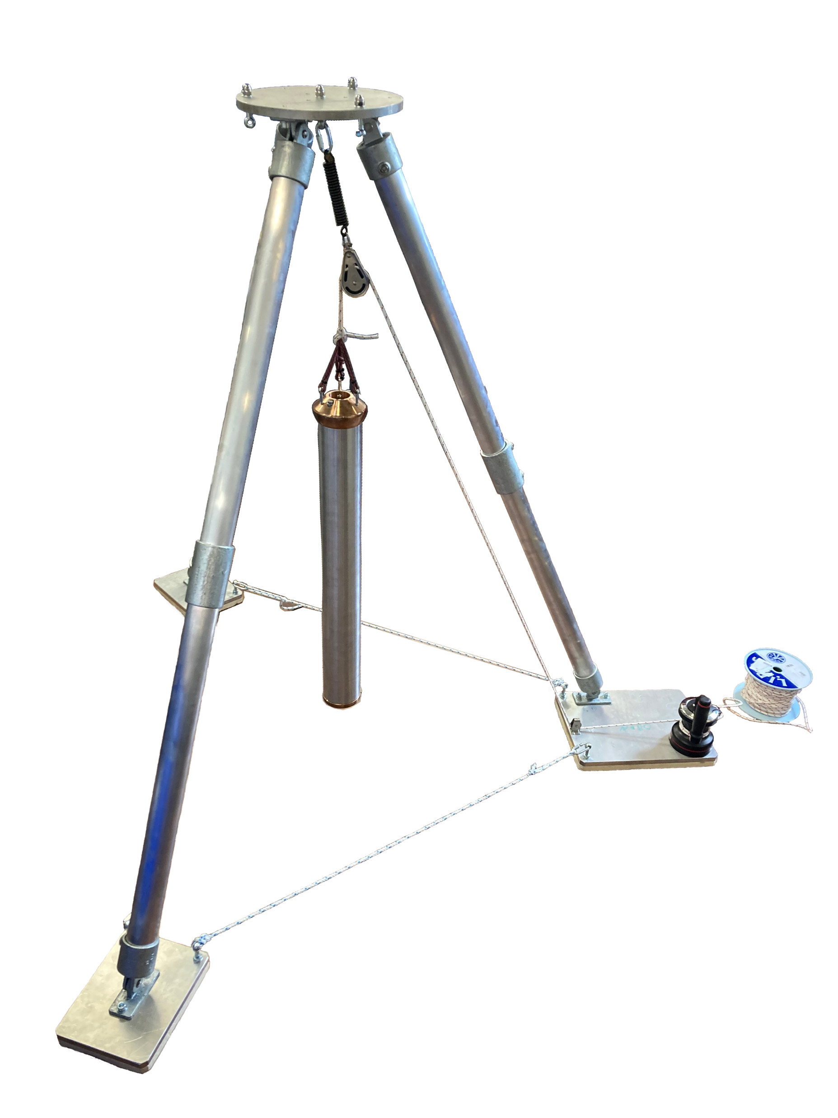
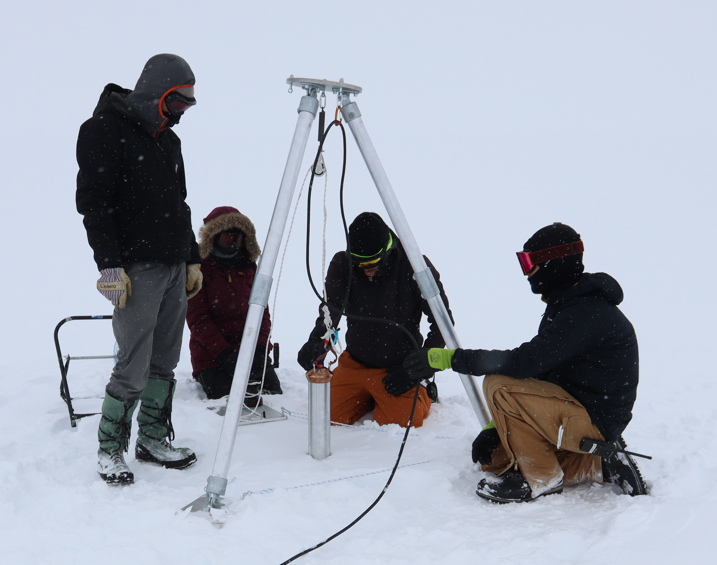
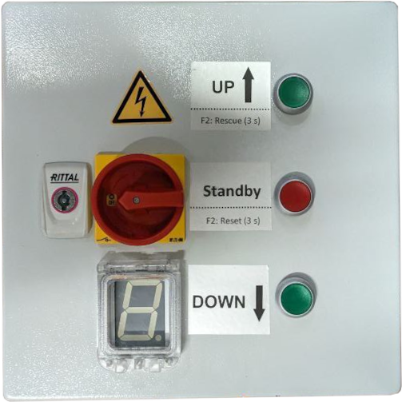

A Compact Autonomous Melting Probe
for Subsurface Sensor Deployment
Depth up to 100m
Lightweight
Small Footprint
Simple Usage
Autonomous Operation
Single Operator

