Slide 1





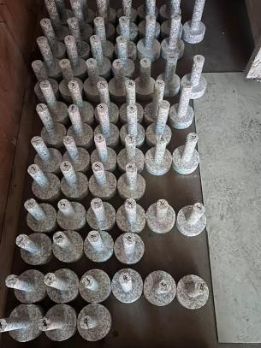
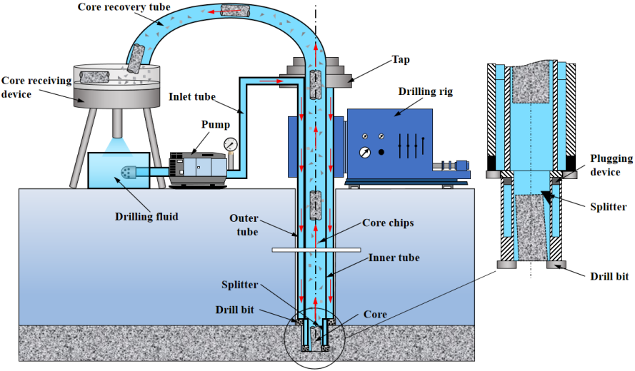
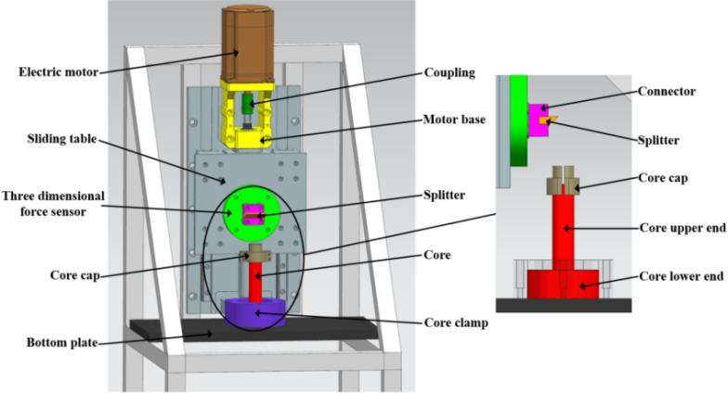
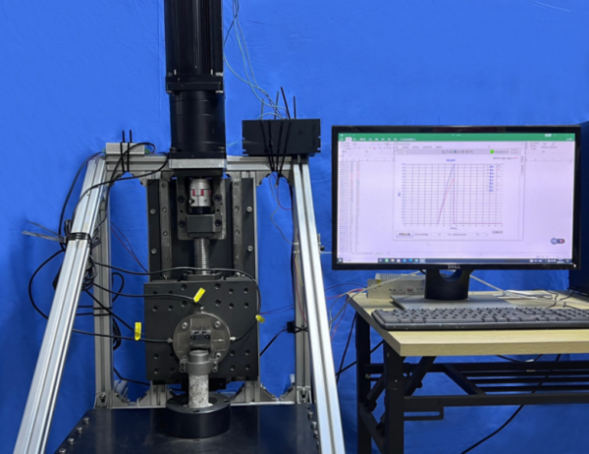
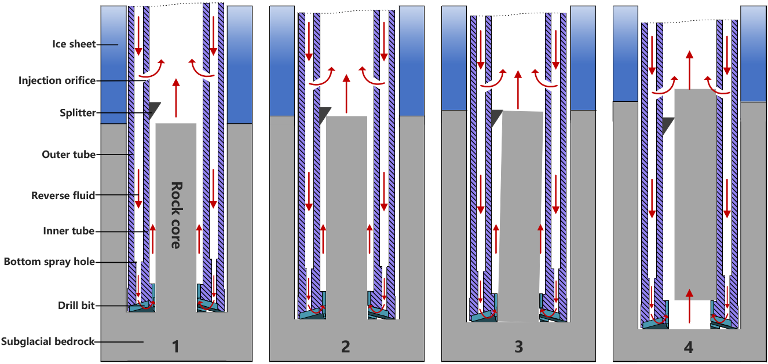
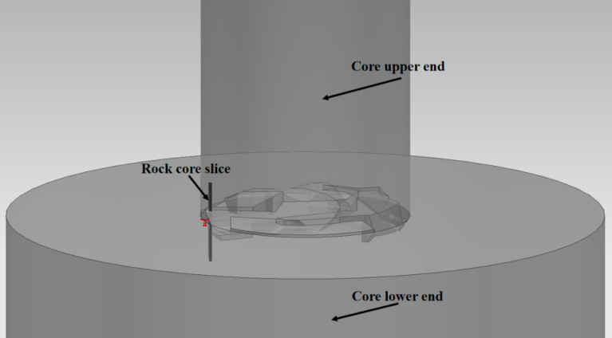
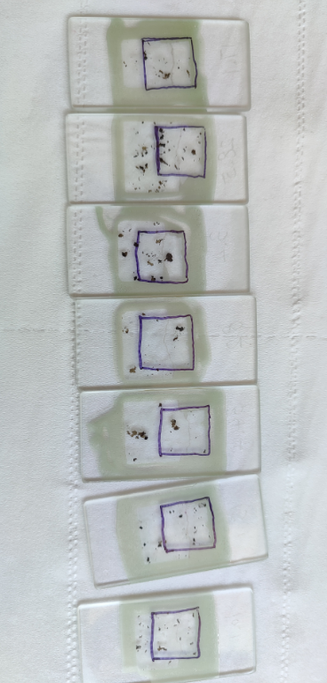
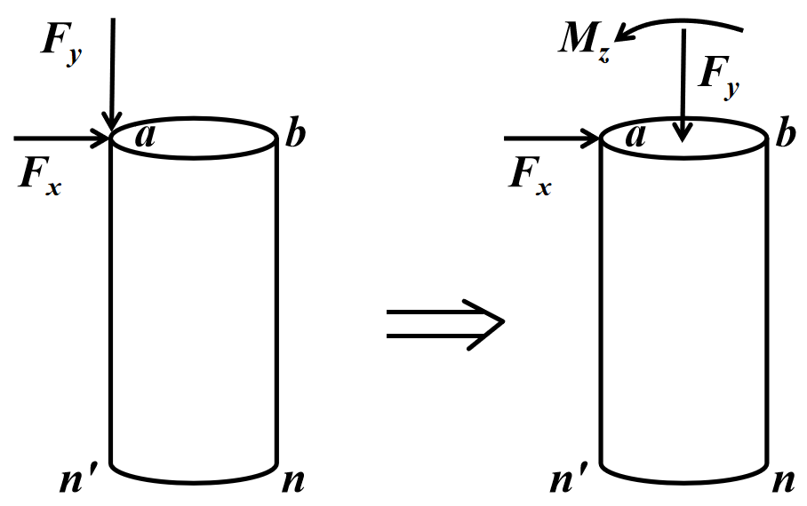
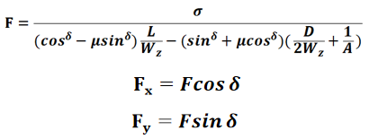
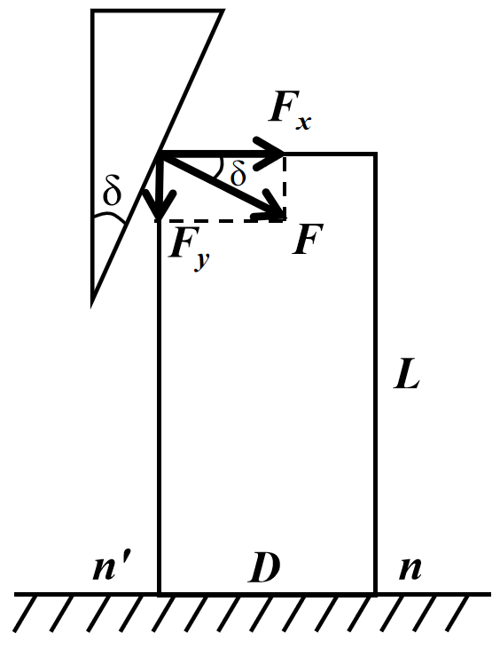
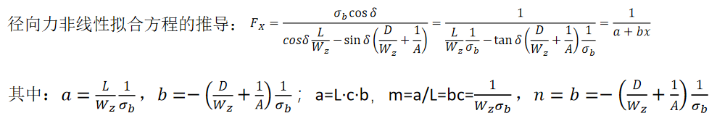
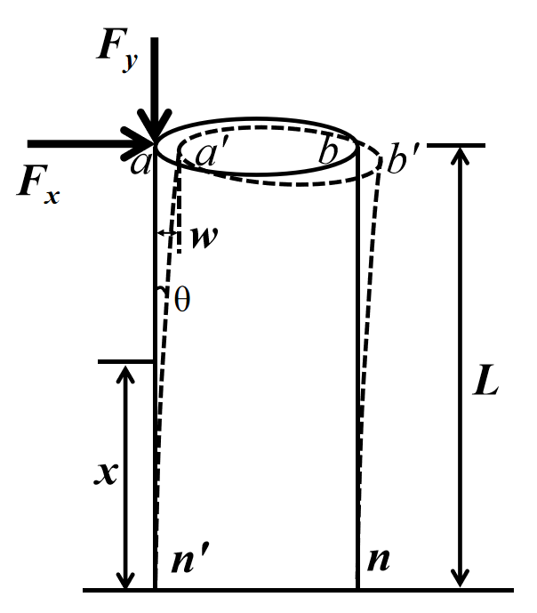
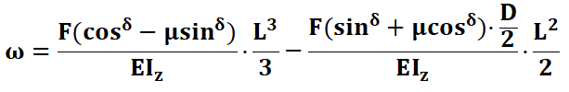
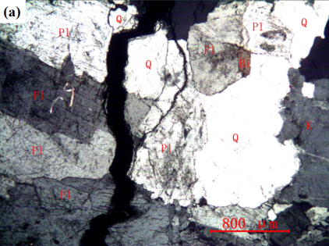
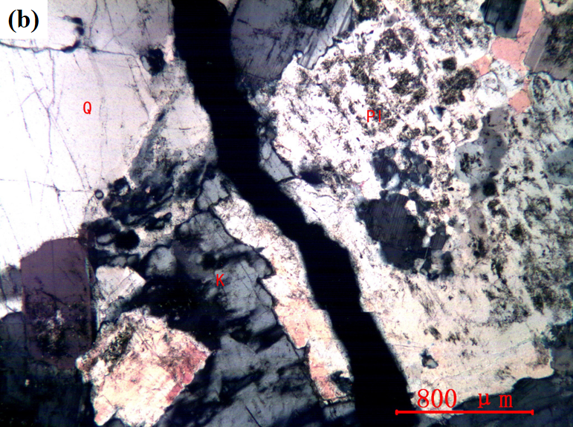
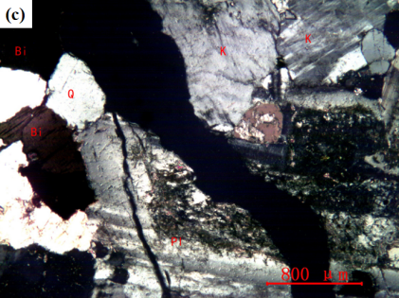
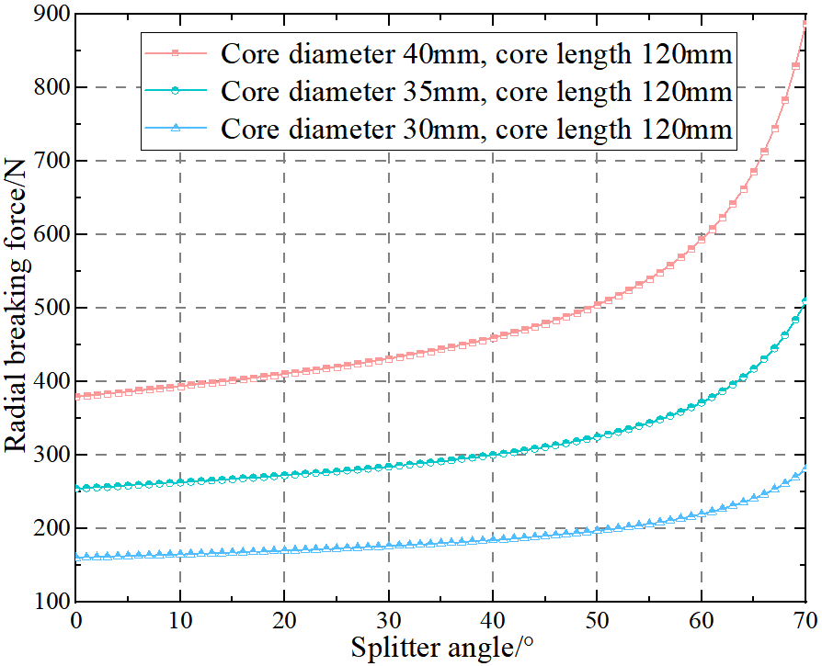
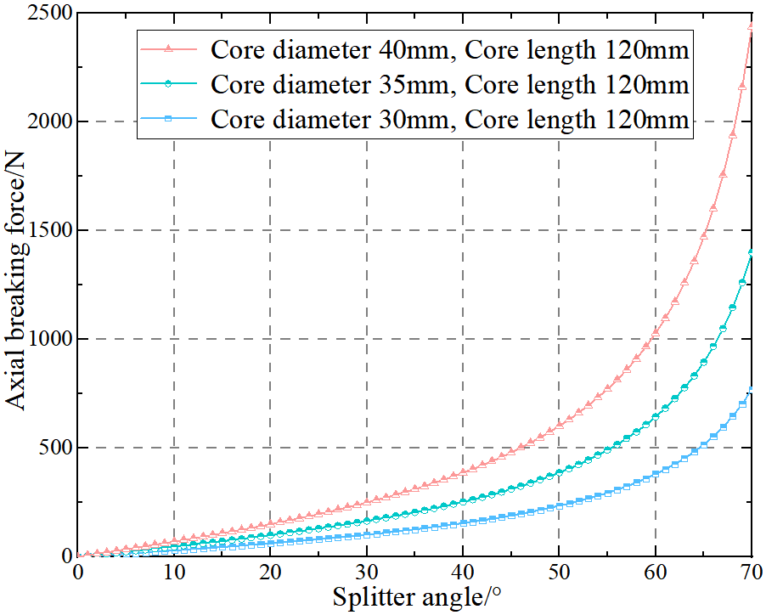
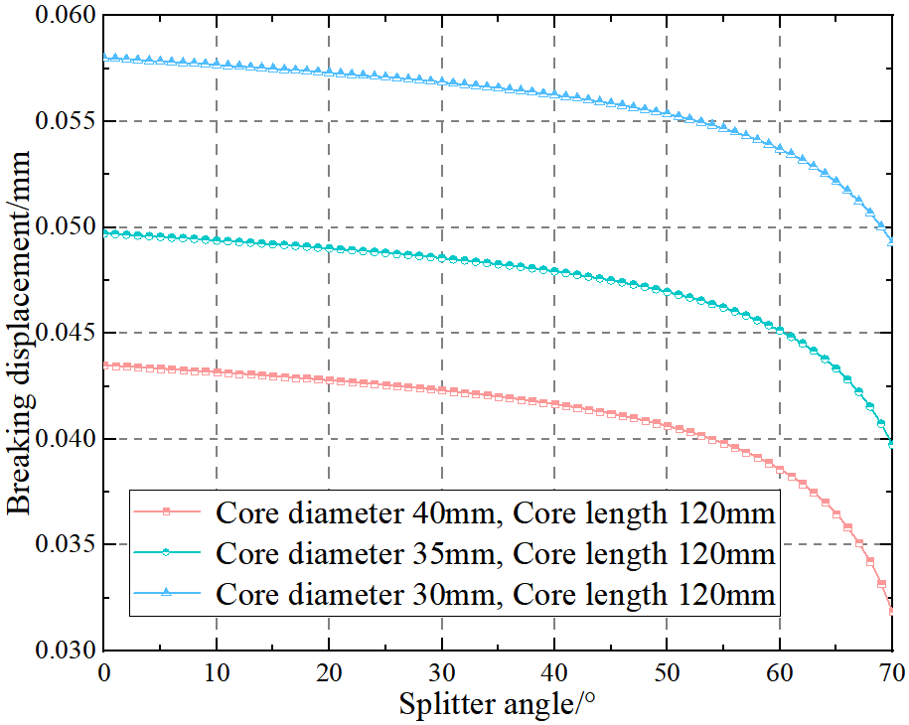
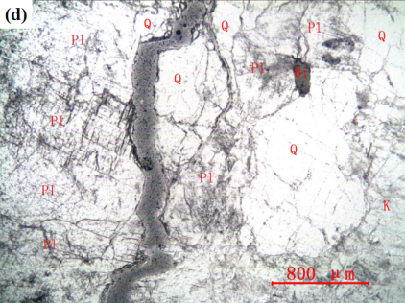
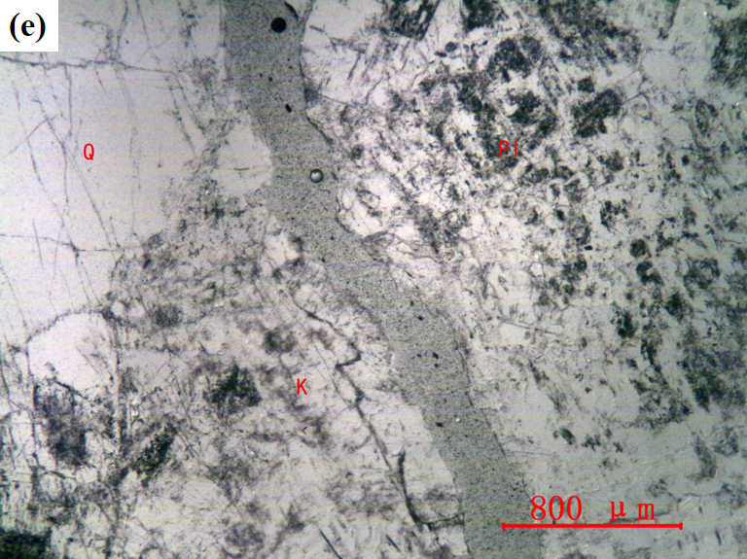
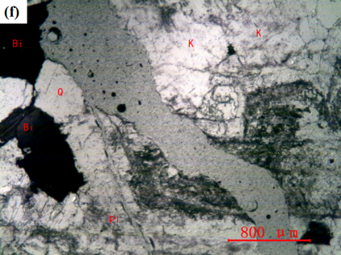
Model construction and research of synergistic-effect mechanism on subglacial bedrock core breaking
Zhihao Cui, Rusheng Wang*, Guigang Tu, Xiaopeng Fan, Da Gong, Xinyu Lv, Siqi Hong
Polar Research Center, Jilin University, Changchun, China
1.Introduction
3. Multi-factor analysis experiment of rock core breaking
In the field of polar research, acquiring bedrock samples from beneath polar ice sheets is of great significance for frontier research in basic science, such as reconstructing ancient climates, exploring ancient life, and studying subglacial geological structures, among other related applications. However, subglacial bedrock core drilling is extremely challenging, and to date, there have been few successful cases, with insufficient subglacial bedrock samples obtained.
Rock core samples are produced through a mechanical turning process in an integrated double-cylinder form. The diameter at the lower end of the rock cores is significantly larger than that at the upper end, simulating the bedrock layer during the rock core breaking process. The upper end of the rock cores is the section that contacts the splitter and is broken.
To eliminate the influence of the crushing conditions at the contact between the rock cores and the splitter during the breaking experiment on the analysis of the breaking mechanism, specialized metallic rock core caps are assembled at the top of the rock cores.
Technology | Location | Depth | Rock core length | Year | Country
CRREL | Greenland | 1391m | 3.55m | 1966 | America
KEMS-112 | Vavilov | 461.61m | 2.28m | 1988 | Russia
PICO-5.2" | Summit | 3055m | 1.55m | 1993 | America
PICO-5.2" | Taylor Dome | 554.1m | 0.1m | 1994 | America
RAID | Minna Bluff | 682m | 2m | 2015 | America
ASIG | Pirrit Hills | 157.8m | 8m | 2017 | America
IBED | Gamburtsev | 199m | 0.06m | 2019 | China
IBED | Lazarev Hills | 545m | 0.5m | 2024 | China
In comparison with conventional rock core drilling methods, hydraulic reverse circulation continuous coring offers significant advantages. To ensure its successful implementation, rock core breaking is a critical issue.
Fig.7. Rock core samples
After the experiment begins, the top motor drives the lead screw of the vertical slide to rotate. The rotation of lead screw moves the working platform of the slide up and down, allowing the splitter to follow the slide's working surface and uniformly approach or move away from the rock core cap. When the splitter first makes contact with it, the three-dimensional force sensor generates a reading. As the splitter continues to move downward, the reading steadily increases. When the downward movement of the splitter causes the bottom of the rock core to break, the reading from the sensor drops sharply. The peak value of the reading represents the radial and axial breaking forces of the rock core.
Fig.1. Principle diagram of hydraulic reverse circulation continuous coring
Fig.8. Schematic diagram and actual image of test rig
Since the initial areas of rock failure typically occur sequentially at microcracks, mineral grain interfaces, and in mineral particles themselves with lower strength (Whittles et al. 2006), this experiment uses a polarizing microscope to characterize and analyze the breaking modes and mineral species at the initial breaking locations of each group of rock core samples. The aim is to investigate the variation patterns in the ultimate stress of each group of rock core materials from a microscopic perspective
Fig.2. Principle diagram of the automatic isometric rock core breaking
Fig.9. Schematic diagram of the slicing position for characterization on the breaking surface
2. Multi-factor coupling modeling of rock core breaking
In the process of rock core breaking, a certain amount of lateral displacement takes place. The inner diameter of the drill tool's inner tube must accommodate the spatial requirements for this displacement at the top of the rock core. Additionally, the rock core must be subjected to a sufficiently large breaking force to generate the required lateral displacement in order to be broken. Therefore, the necessary conditions for achieving automatic isometric rock core breaking include either an adequate breaking force or sufficient lateral displacement. A multi-factor coupling model was established based on elastic mechanics and the maximum tensile stress theory, decomposing the breaking force into radial and axial components. The model accounts for the combined effects of bending moment and eccentric compression at the critical cross-section of the rock core, where tensile stress from Fx and compressive/bending stress from Fy determine failure initiation.
The initial fracture where the rock core is broken passes through the imaging region. The green area in the figure represents the rock core slice, and the purple area indicates the imaging region.
Fig.10. Schematic diagram of the imaging area for characterization on the breaking surface of rock cores
4. Mechanism analysis of rock core breaking
Through fitting analysis, it is found that the experimental data closely match the theoretical model of rock core breaking force. This result not only supports the correctness and rationality of the multi-factor coupling model but also derives the hypothesis on the mechanisms influencing rock core breaking. To further validate the model, microstructural characterization and analysis of the broken rock cores after the rock core breaking experiment are necessary.
Fig. 4. Breaking force analysis diagram
Derivation of the Radial Force
Nonlinear Fitting Equation:
In which:
Fig.3. Force state diagram
of the rock core
Fig. 5. Breaking displacement analysis diagram
The factor values are substituted into equations for the breaking force and displacement to obtain the curves of radial breaking force, axial breaking force and breaking displacement, which vary with changes in the splitter angle across different core diameter ranges. Through a comprehensive analysis, the optimal value ranges for each parameter were determined: splitter angle (15°–55°), core diameter (25–45 mm), and core length (80–200 mm). These ranges balance breaking force and displacement, optimizing both the hydraulic reverse circulation continuous coring performance and core transportation efficiency.
(a) Core length: 110 mm (b) Core length: 140 mm (c) Core length: 170 mm
Fig.11 Dependence of radial breaking force on the splitter angle
(a)Splitter angle and radial breaking force (b) Splitter angle and axial breaking force
(c) Splitter angle and breaking displacement
Fig.6. Influence of splitter angle on rock core breaking across different core diameter ranges
Fig.12 Orthogonal (a、b、c) and single (d、e、f) polarization microscopy imaging results
Q. Quartz；K. K-feldspar；Pl. Plagioclase；Bi. Biotite

