Slide 1
A new dynamometer for testing ice core drill motors and gears.
Matthias Hüther¹, Frank Wilhelms¹²
¹Alfred Wegener Institute, Helmholtz Centre for Polar and Marine Research, Bremerhaven, Germany ²Georg August University of Göttingen, Department of Isotope Geology, Göttingen, Germany

Slide 2
Motivation
Failed to provide working motor with sufficient torque for BEIO drilling
Failure not detected early:
Ambitious goals and
Missing full system testing capabilities

Slide 3
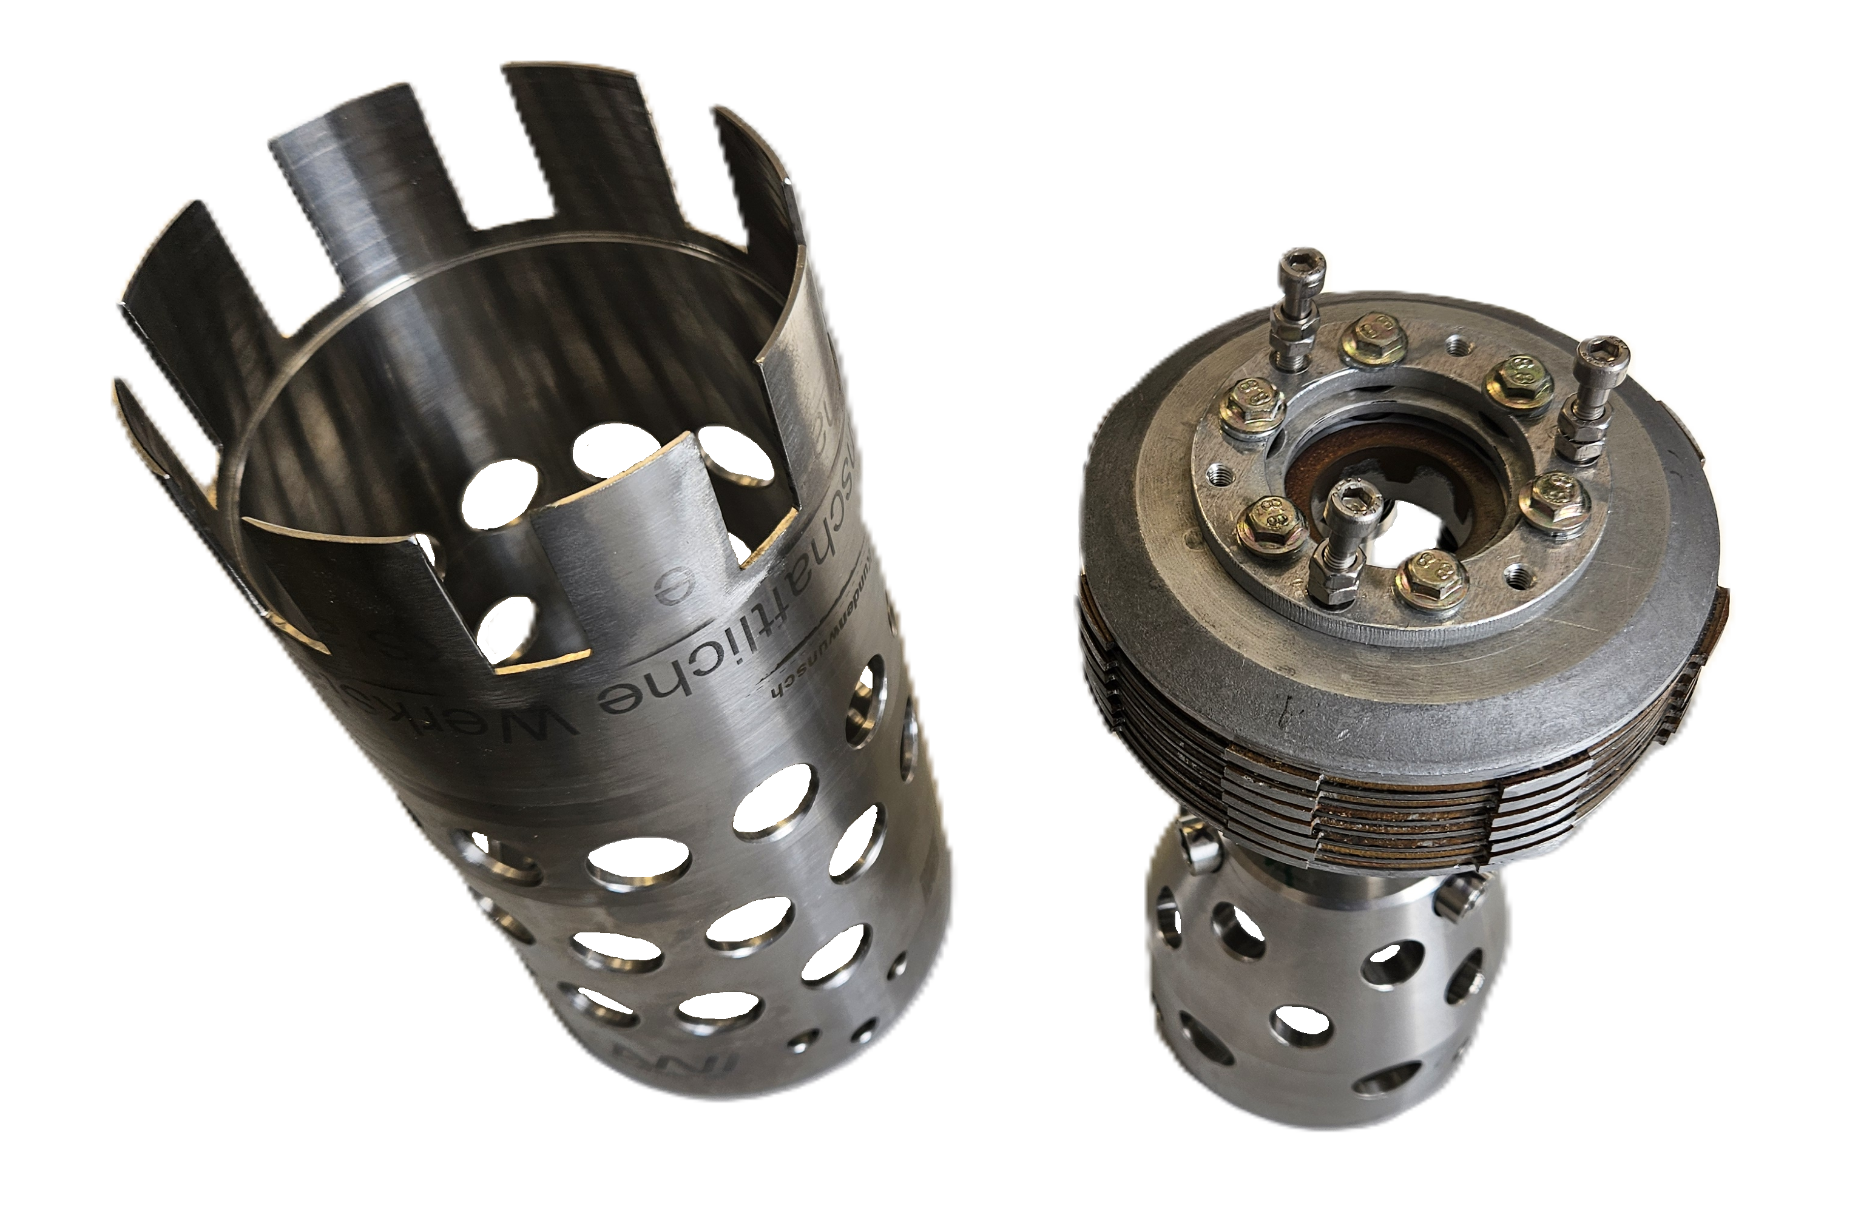
Existing Test Stands
Testing Motor on drill cable:
Without mechanical load
Peak torque, blocking
Break module
Testing in the Field
Break module was build for testing in EDML Borehole

Slide 4
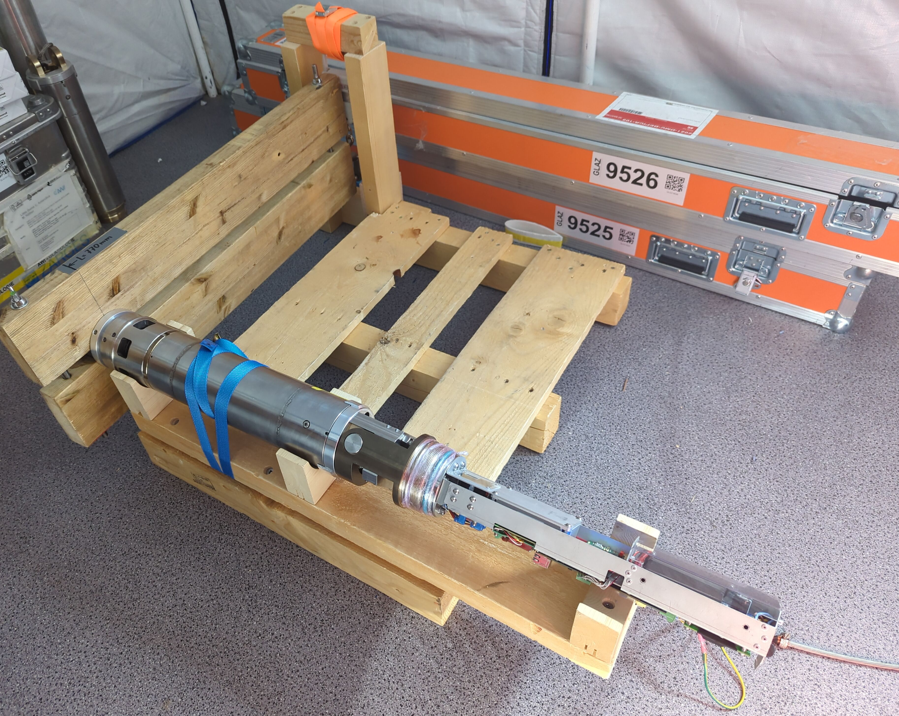
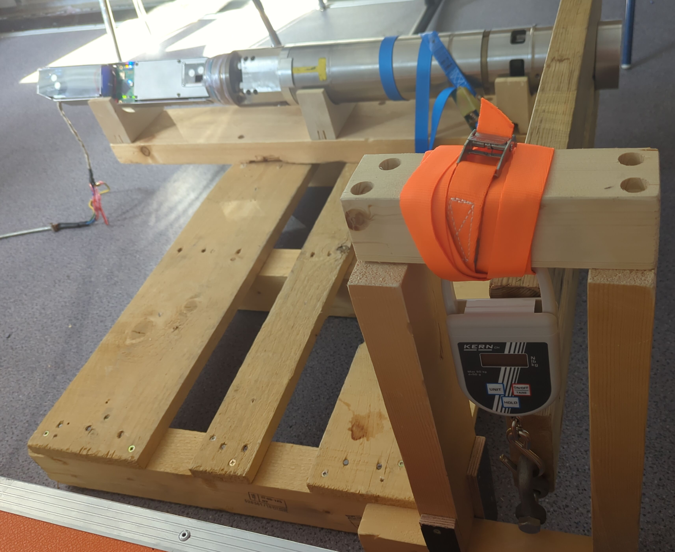
Makeshift Test stands

Slide 5
Envisioned Use cases
Evaluation of current drill motor limitations
Testing current motor with new gear
Potential new motor designs
Comparison testing between ice core drill motors

Slide 6
Design Goals
Dynamometer for workshop at AWI
Simulating of full coring run duration
Break Torque ~ 0 – 100 Nm
RPM ~ 0 – 200 1/min
Measuring torque and RPM
If possible simulate different torque path:
Internal: Pump / Chip transport
External: Drill head / Ice cutting

Slide 7
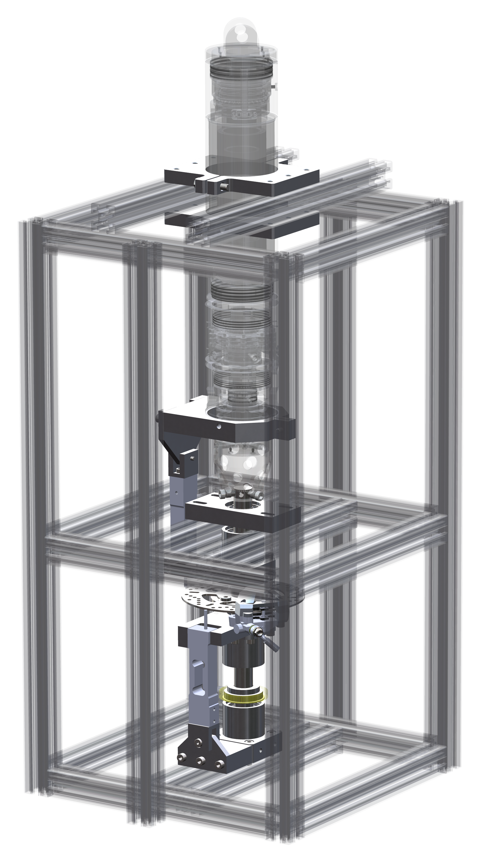
Mechanical Setup
Off-the-shelf disk break
Existing incremental encoder
Cheap load cells
Reuse drill parts
Aluminum extrusion frame
Manual hydraulic breaks
Optional Break control

Slide 8
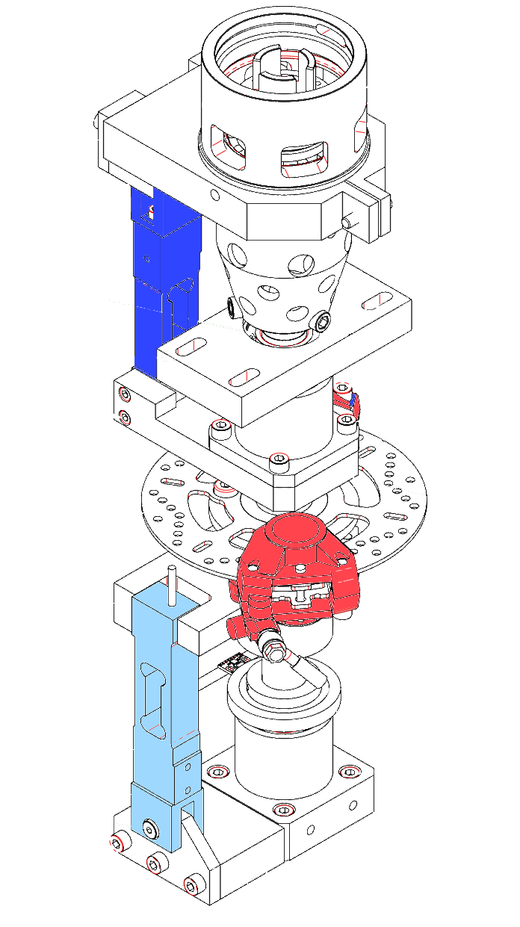
Internal / External Break
Internal
Single Disk
Two Breaks
Two Load Cells
External

Slide 9
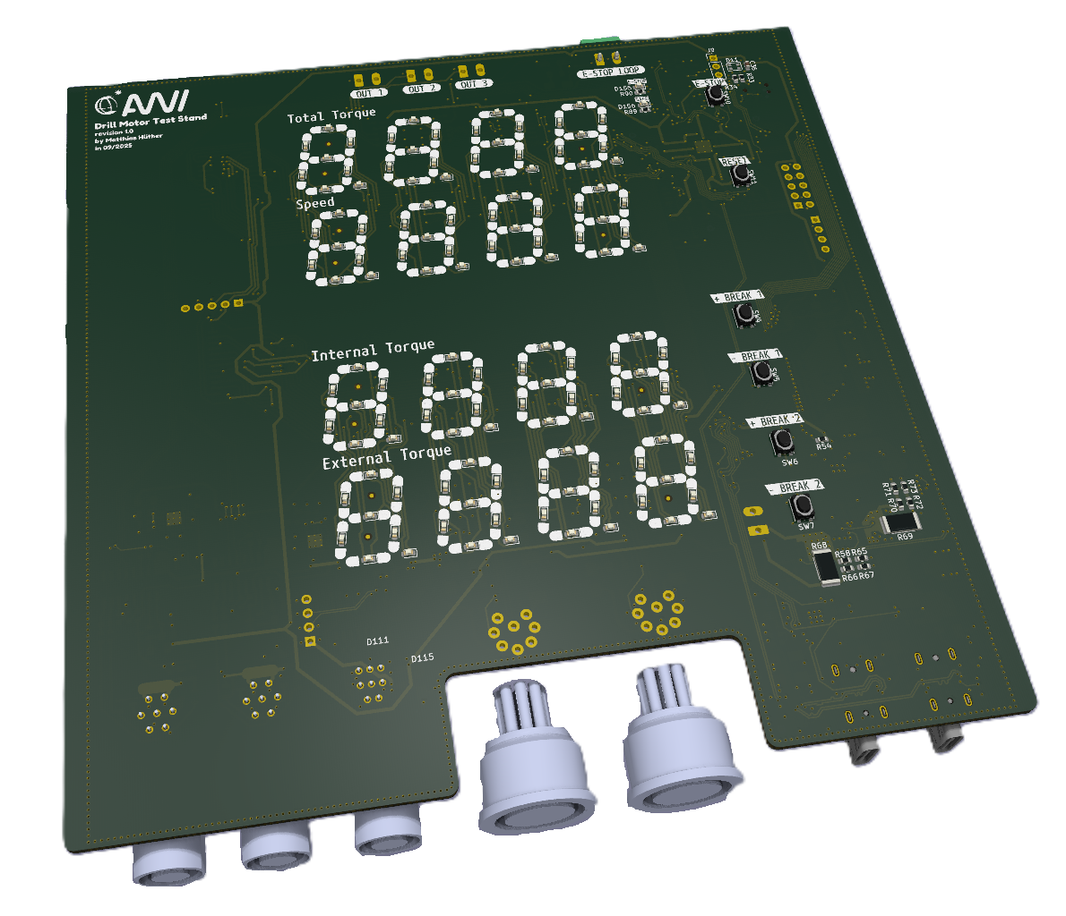
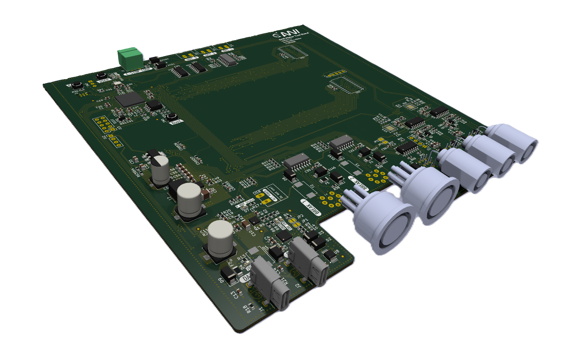
Electronic
Single PCB
Support for two load-cells
Encoder interface
Standalone displays
USB Serial for “fast” live Data
USB DP as power supply
Two stepper motor interfaces
Buttons and E-stop

Slide 10
Current State
Mechanics mostly assembled
PCB v1.0 in production
Firmware feasibility studied
Next step:
Testing electronics
Firmware implementation of sensors

Slide 11
Missing Capabilities
Motor / gear not submerged
Limited temperature and pressure simulation
Unknown dynamic behavior / drill characteristics

Slide 12
Questions
Thanks for your attention.
Any questions?

Slide 13
Abstract
Specialised test equipment is frequently required during the design and verification phases of a project. However, this equipment is often expensive, not always readily available at the time, or just time-consuming to use. This can result in reliance on systems that have not been adequately tested prior to field campaigns. This may lead to system failures or substandard designs.
This newly designed dynamometer is intended for use in testing motors and gears of ice core drills. The aim is to resolve the issue of a missing test facility by using off-the-shelf components in its construction, with a relatively small and user-friendly form factor.
This presentation will introduce the design concept and its intended use cases.

