Slide 1
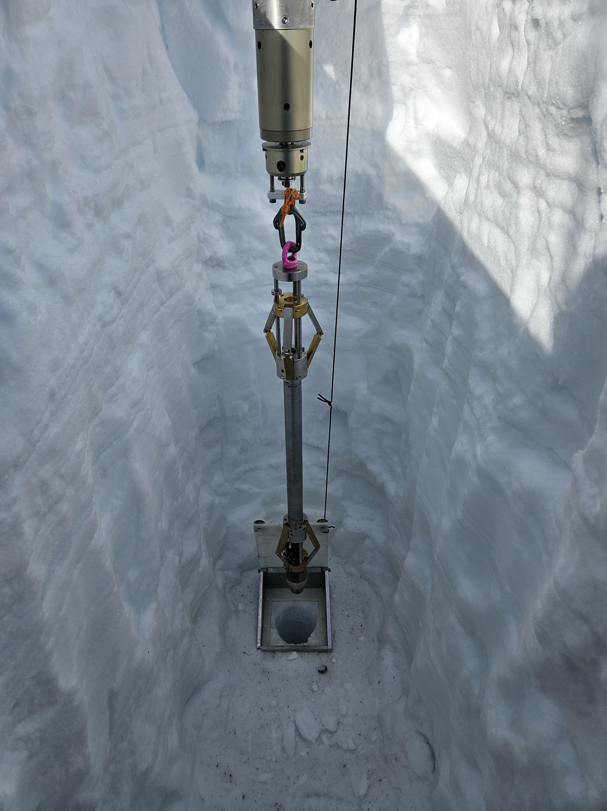
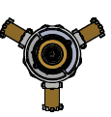
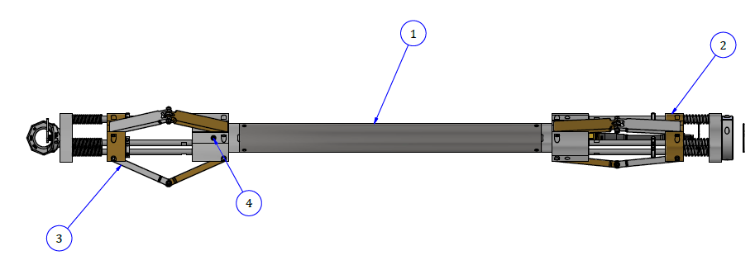
The MiniLogger System
Presented by:
Kevin Nikolaus
Notes:
##-AccessibilityAssistant: Skip layout check-##

Slide 2
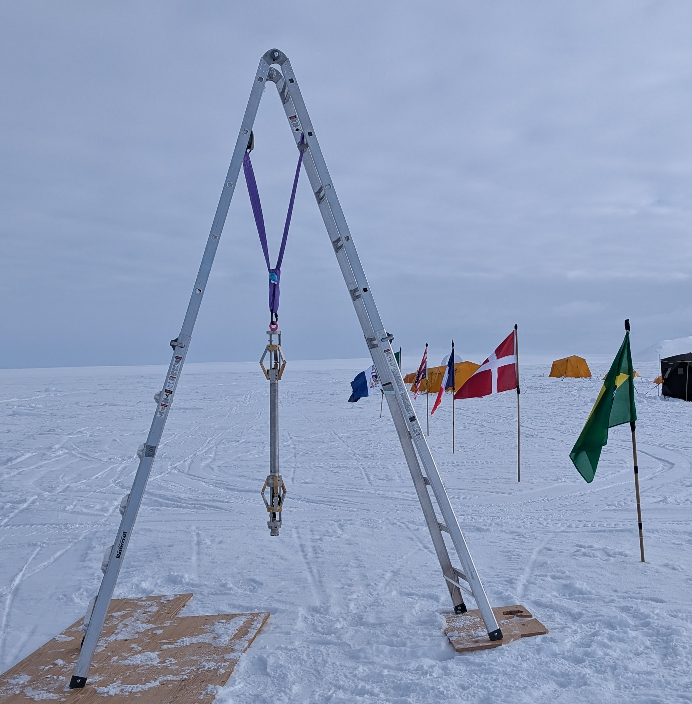
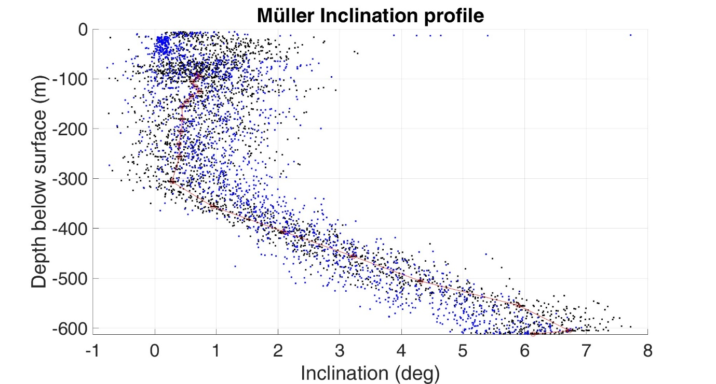
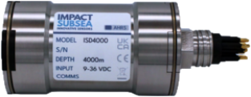
Overview
Motivation
Focus: Standalone, low-weight borehole logging tool
The ISD4000, a sensor borrowed from the oceanographic world, provides high quality temperature, pressure, and orientation measurements. We designed a simple self-powered logging device to record this data, no special winch or cable required.
ISD4000
Impact Subsea
Depth, Temperature
& Orientation Sensor

Slide 3
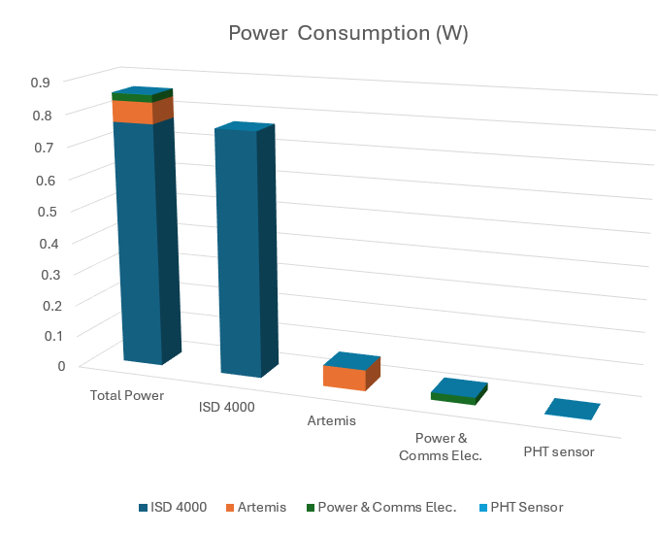

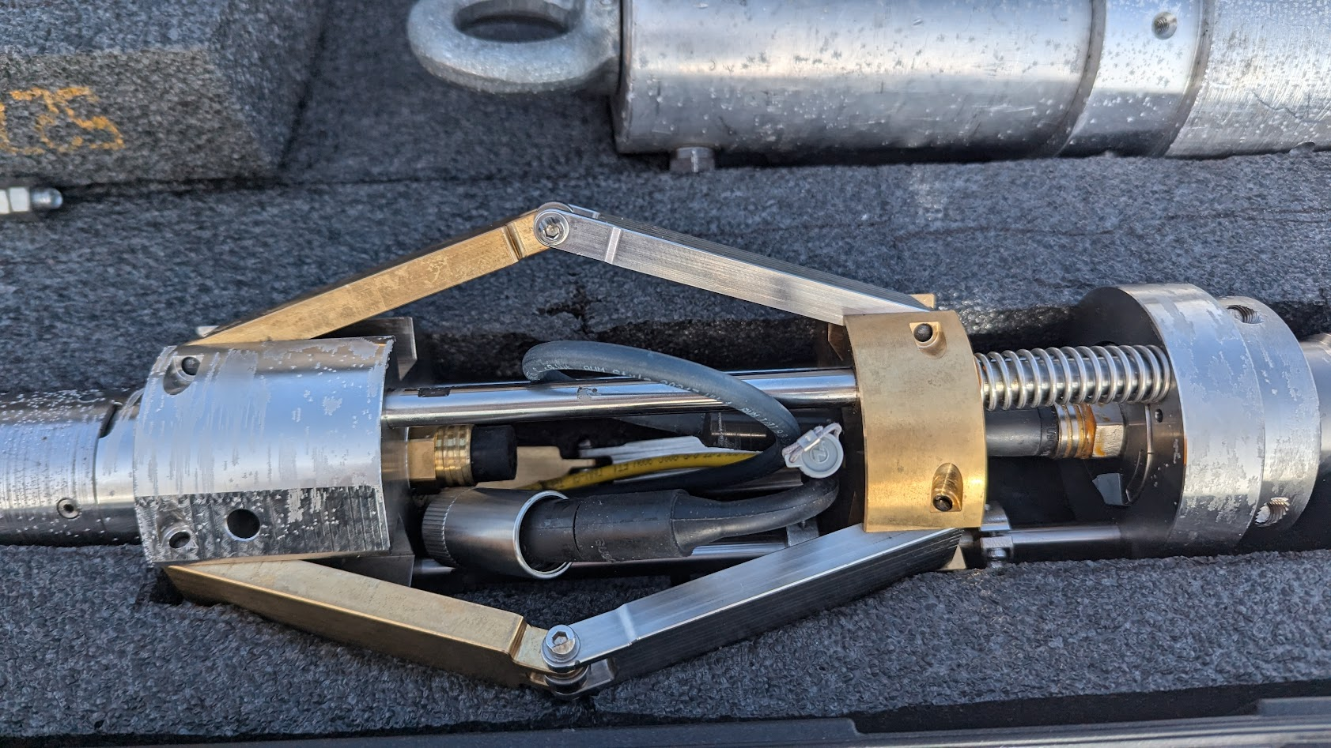
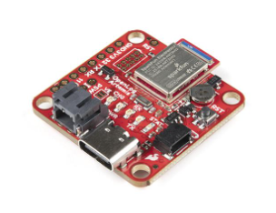
Overview of the Electrical Design
3
8 Pin Subconn
RS232 to TTL
Converter
Comms
Features
On board data logging
Robust single cable connection between sensor and logger
Power System
Shorting plug in wet cable automatically starts system upon connection
Low power electronics allow for long endurance
Misc.
Pressure relief value to seal under vacuum to ensure good seal prior to use (using internal PHT sensor)
OpenLog Artemis
PHT Qwicc Sénsor
3.3V
Bluetooth
Data Transfer
Power
Linear
Regulator
3.6 V C Cell Battery
3.6 V C Cell Battery
14.4V
3.6 V C Cell Battery
3.6 V C Cell Battery
Openlog Artemis
Pressure
Relief Port

