Slide 1
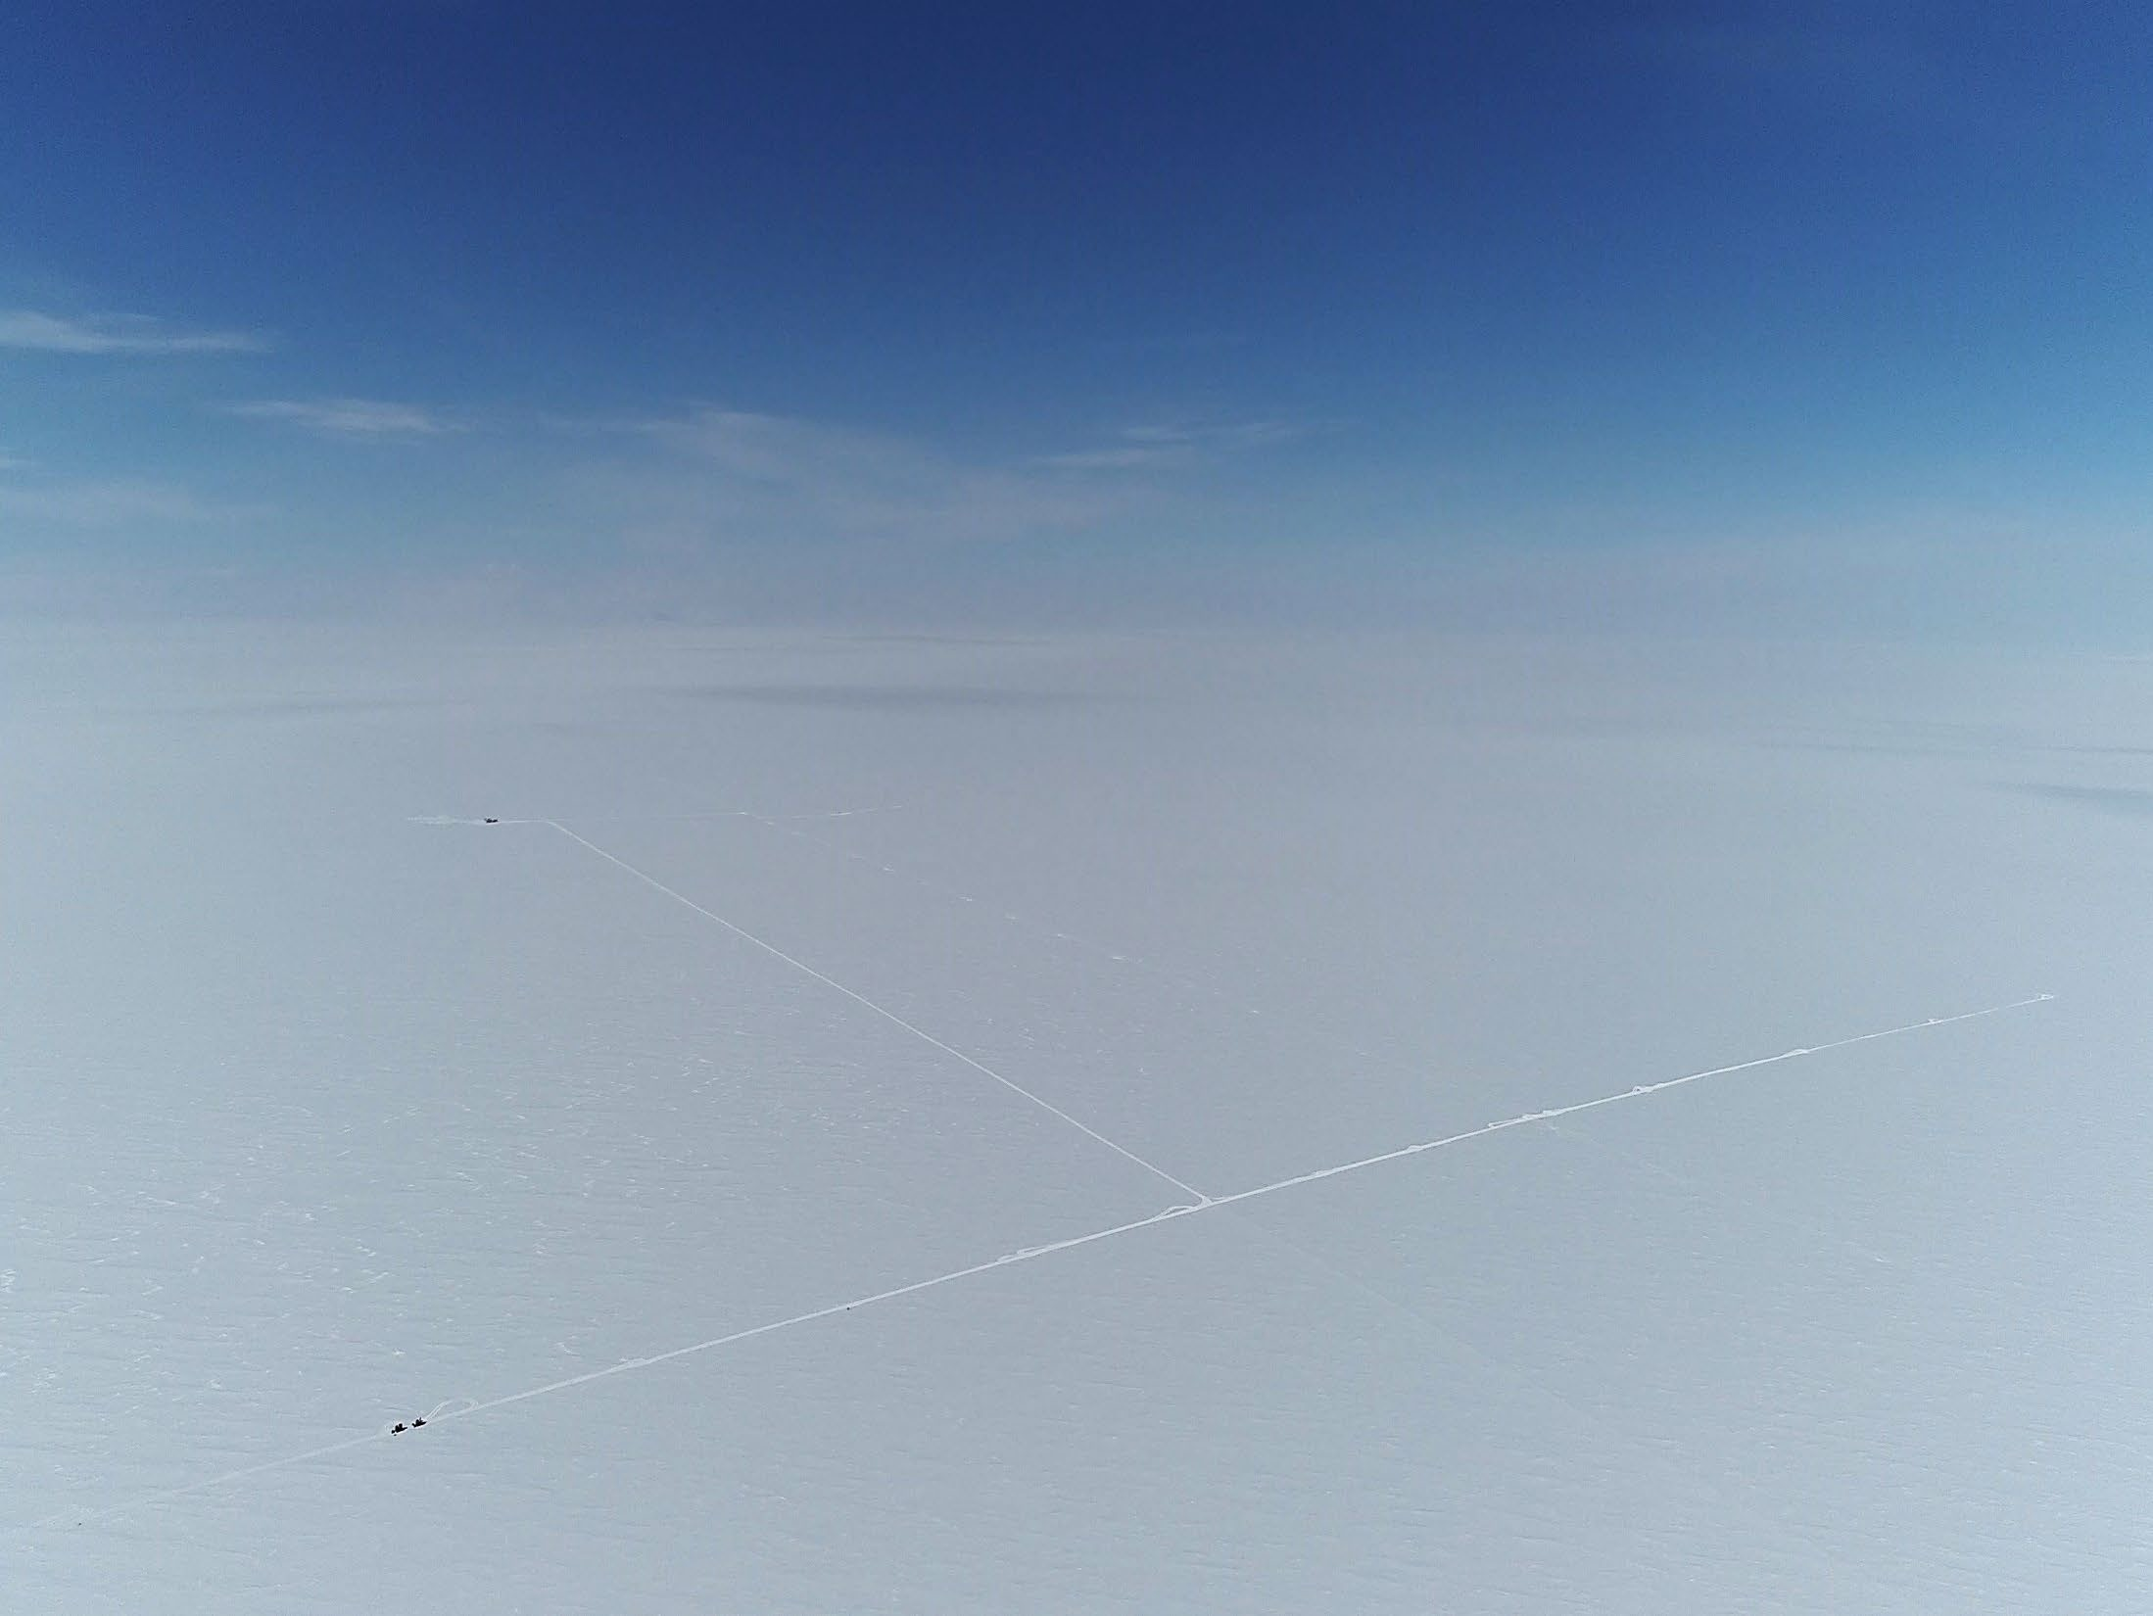
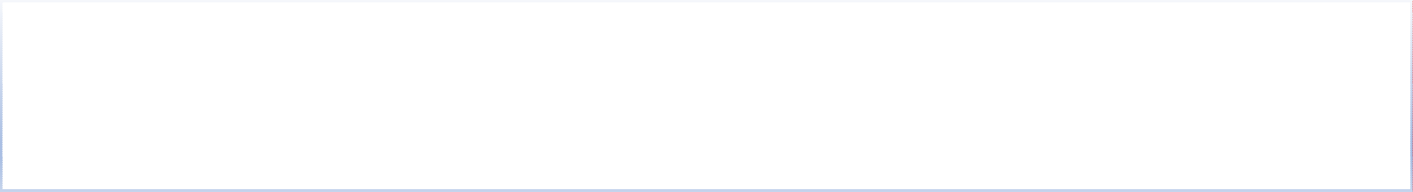













































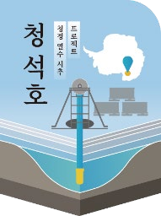



9th International Symposium on Ice Drilling Technology
Mincheol Kim
2021.12. Seismic survey at D2

Slide 2

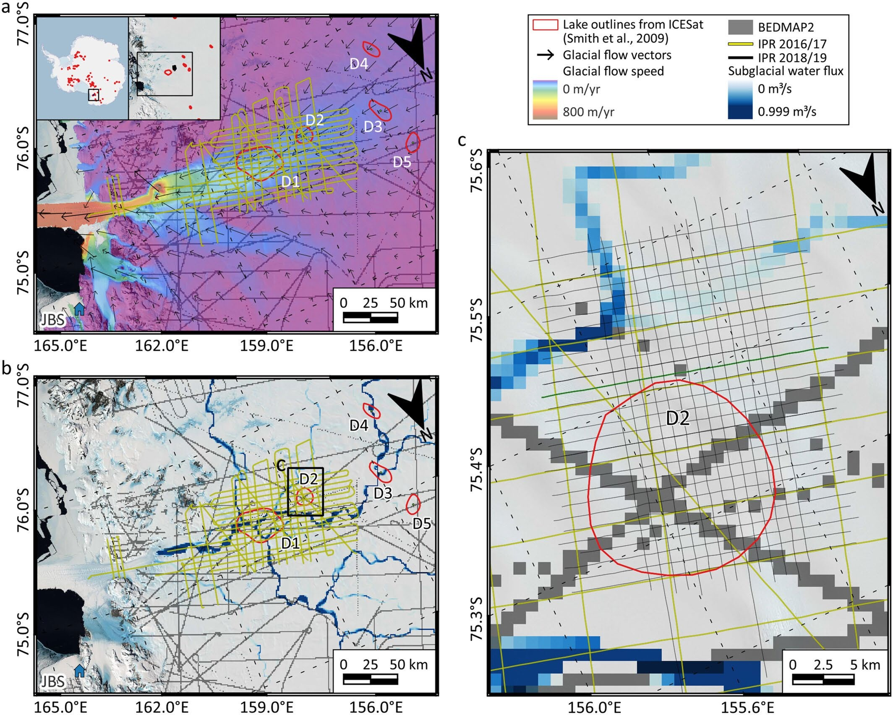
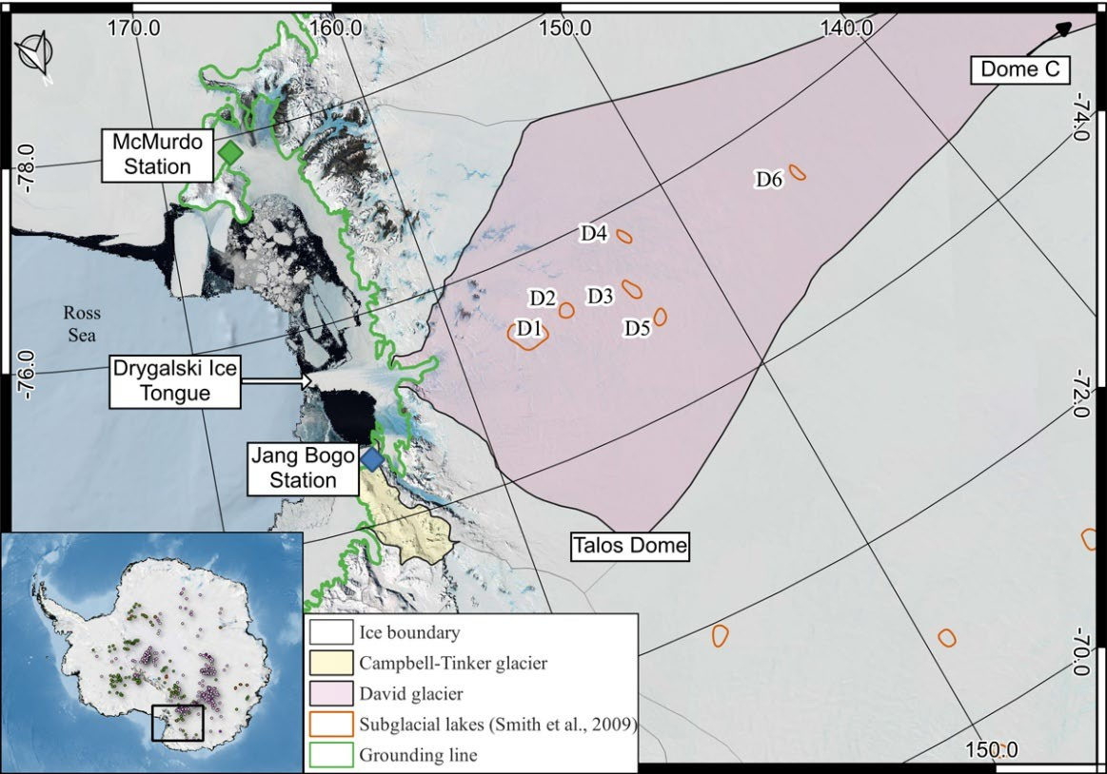

Locations of candidate subglacial lakes under David Glacier
Ju et al.(2025) JGR Earth Science
Airborne IPR coverage of the D1 and D2 areas

Slide 3
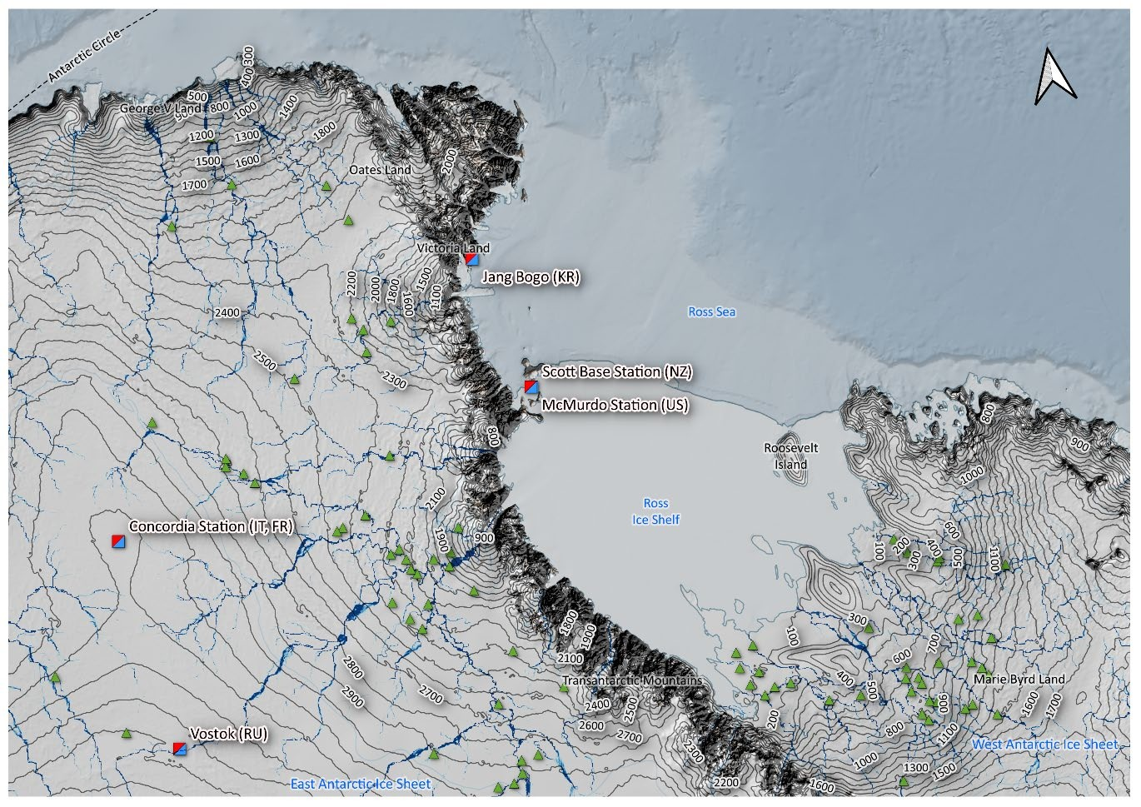
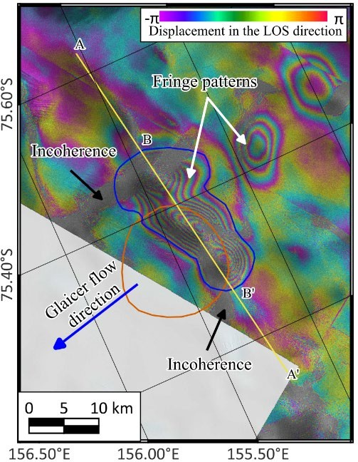
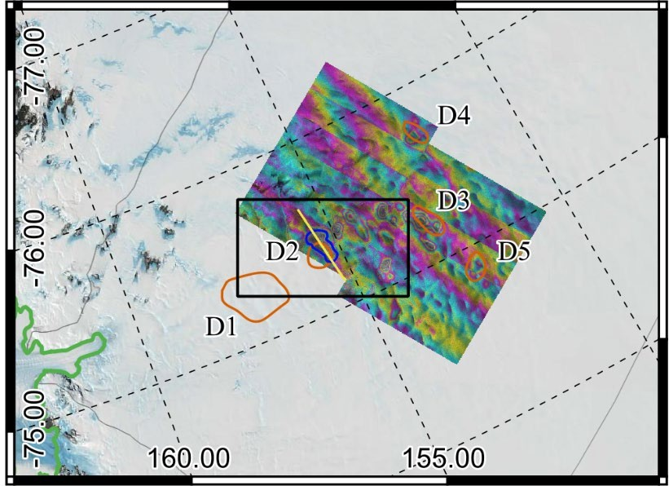

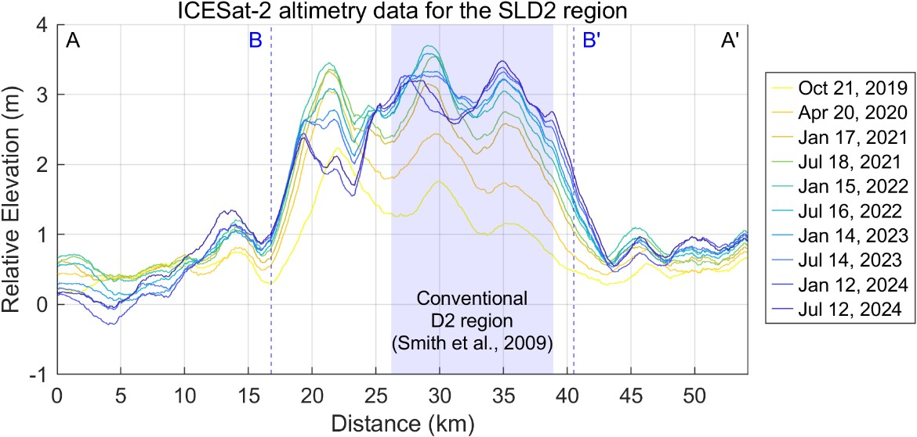
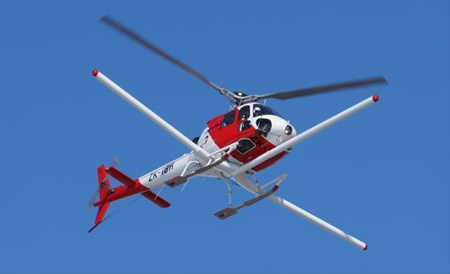
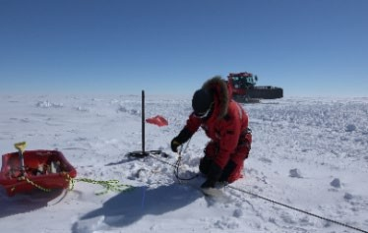

4
267 km from JBS
Altitude: 2,000m
Lake Cheongsuk
2016/17, 2018/19 season
2019/20, 2021/22 season
<Airborne IPR and 96-channel seismic survey>
Ju et al.(2025) JGR Earth Science

Slide 4
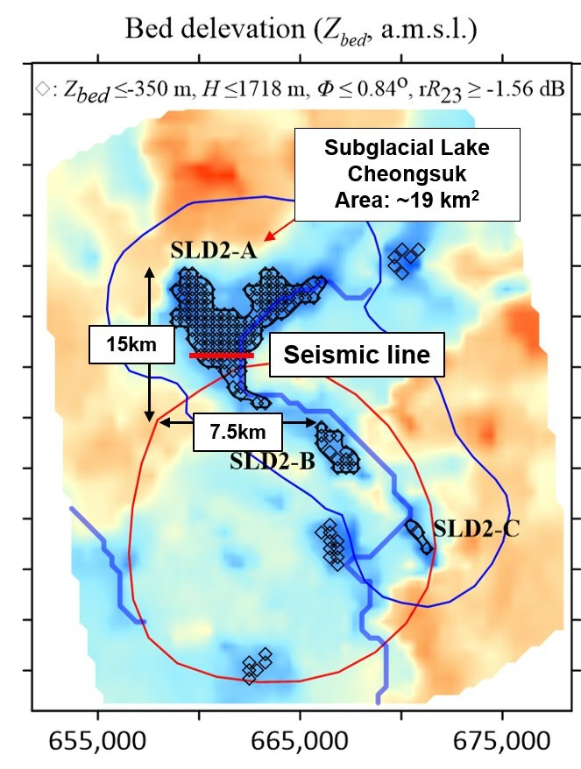
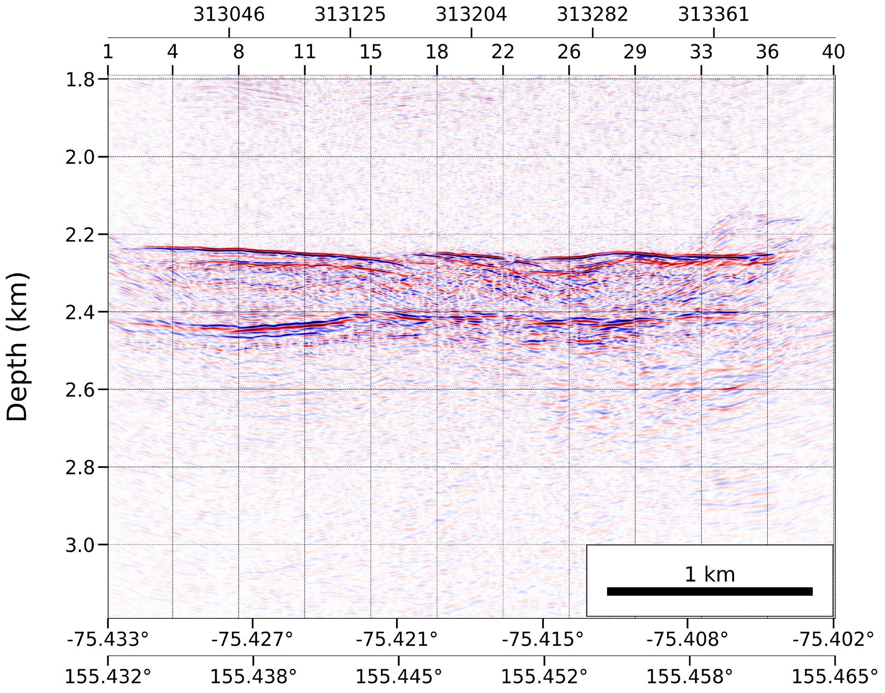

Ice-water interface
Ice thickness (2.2~2.3 km)
Water column depth (48~77 m)
Lake bed
Ju et al.(2025) JGR Earth Science
Ju et al.(2025) EGUsphere (under review)

Slide 5
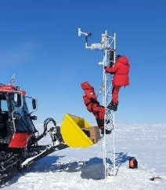
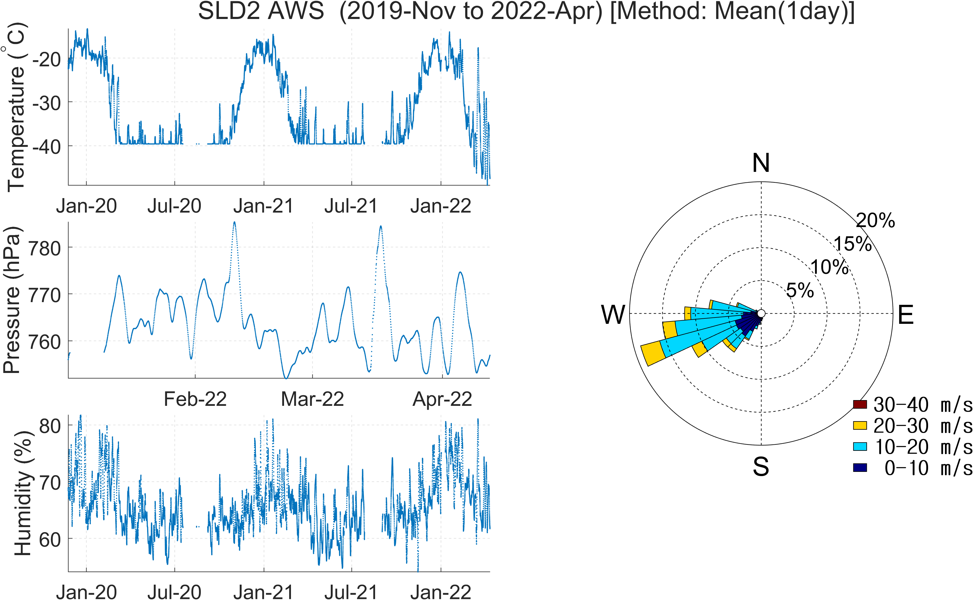

AWS installed at D2 (4 m height)
Temperature: -11°C and -56°C
Wind: prevailing wind direction from WSW, with a maximum speed of 30.3 m/s and an average of 12.3 m/s
Snow accumulation rate: 0.25 m/yr

Slide 6
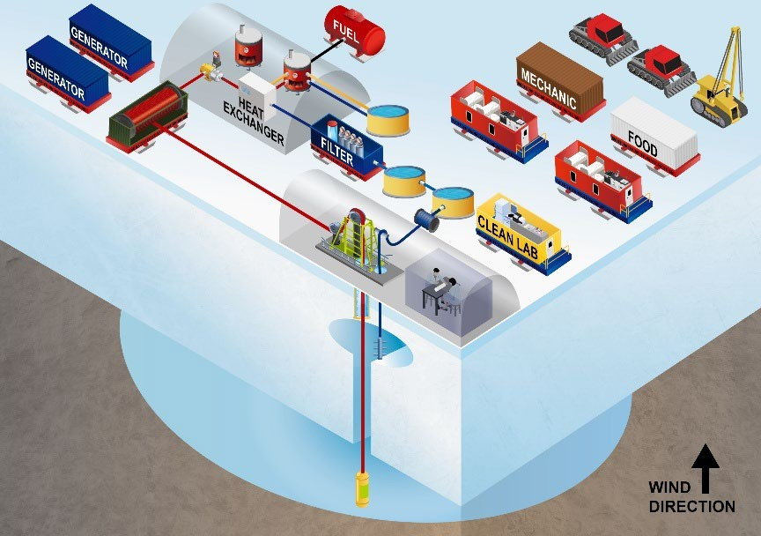
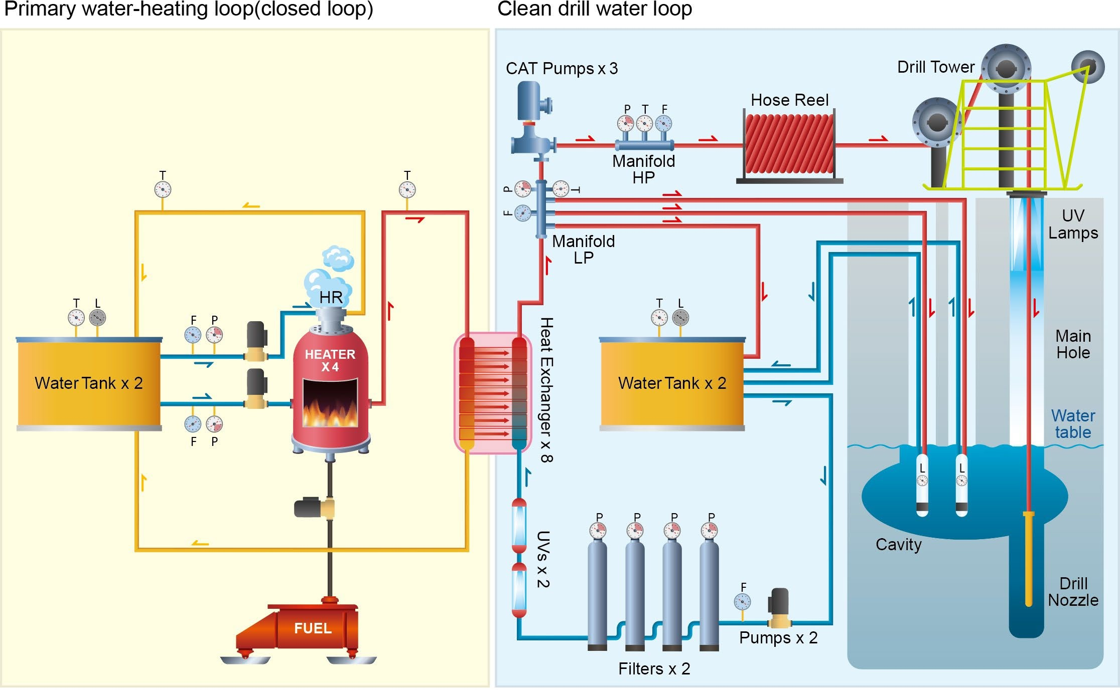

CASCA Clean Hot Water Drilling (CHWD) project
Field camp layout
Modified schematic of the BAS SLCECs CHWD system (adapted from Makinson et al., 2021)

Slide 7
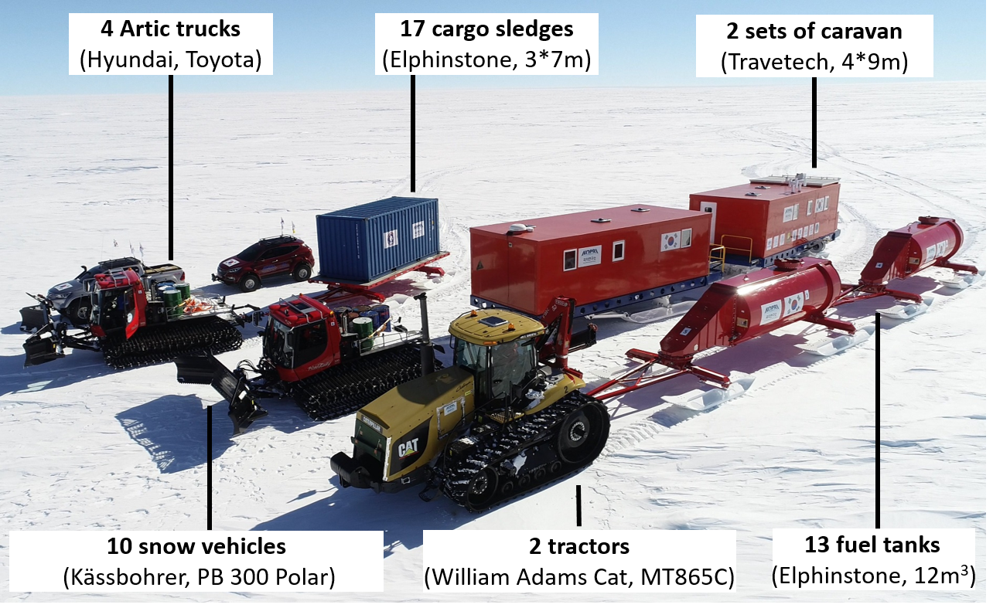
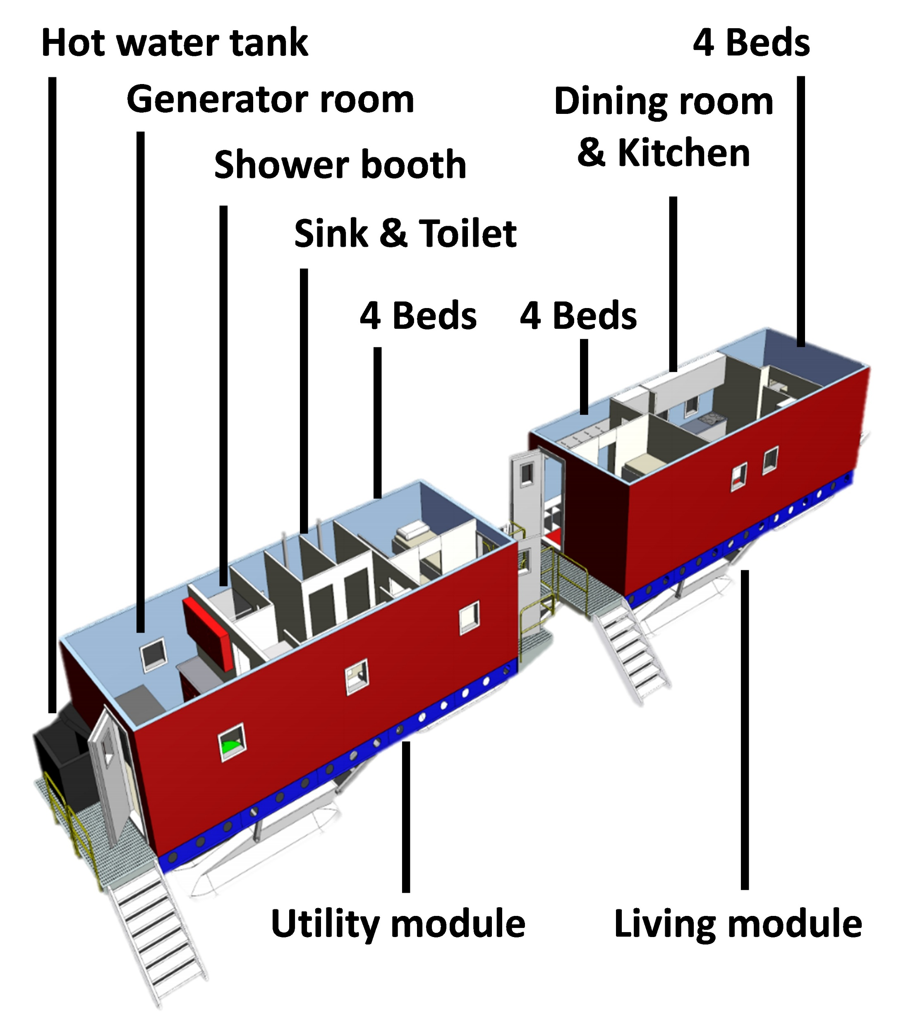

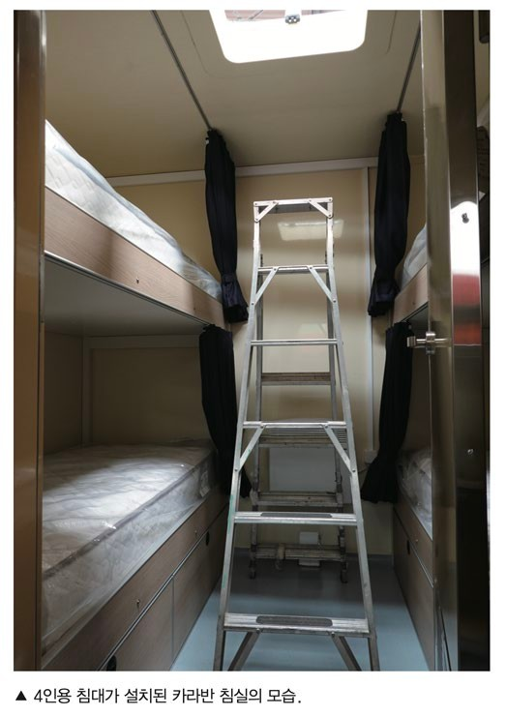

Tractor traverse systems
Poster presentation by Hoje Kwak on 15:30, 16 September
Title: Traverse, modular system, and drill camp operations for CASCA clean hot water drill
Two sets of caravans to accommodate 24 personnel

Slide 8


Slide 9
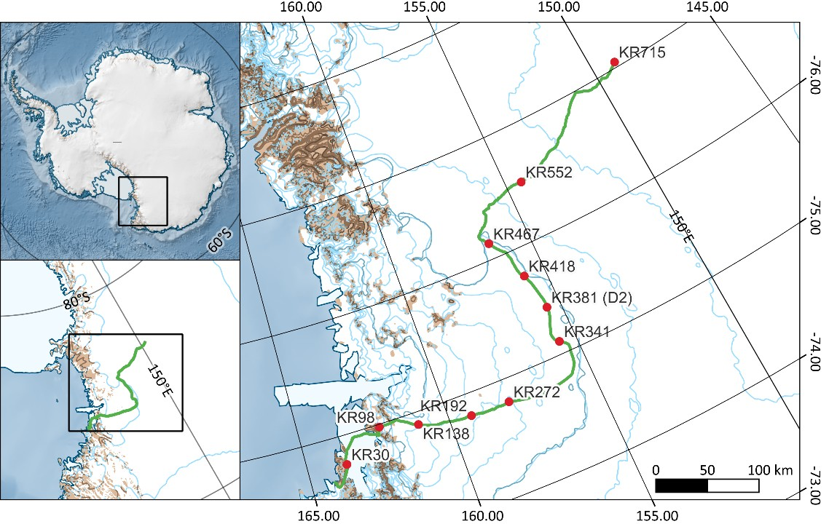
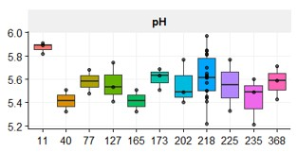
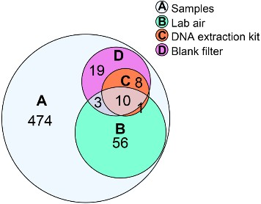
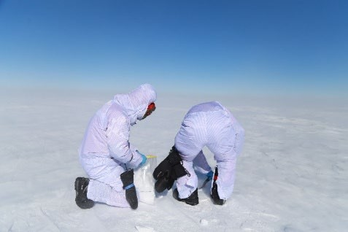
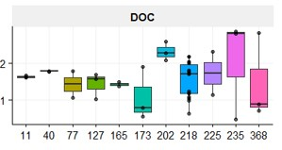
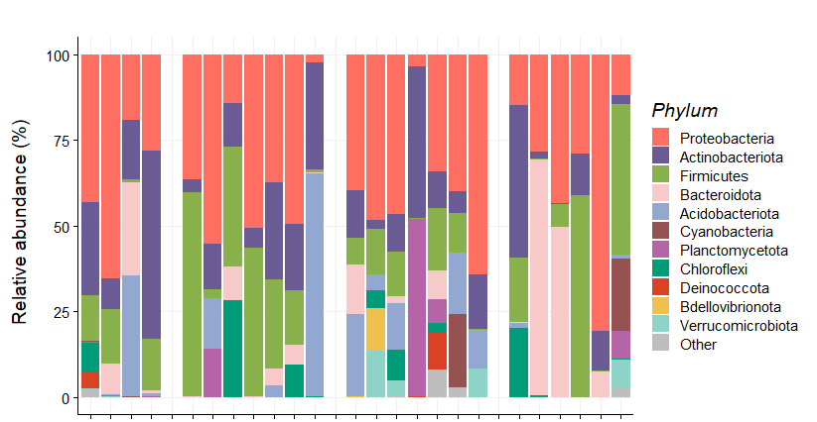
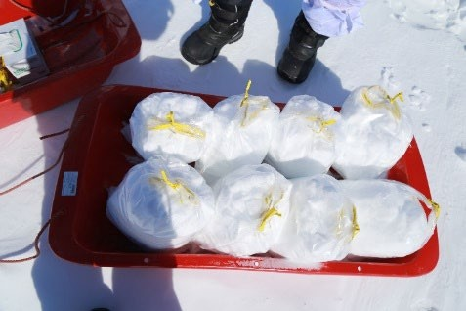

Contaminant control
Snowpack sampling
KOPRI traverse route
Air
10cm
30cm
60cm
Myeong et al. in preparation
Snow depth
Baseline survey of snowpack chemistry and microbiota for contamination control and subglacial-lake comparisons

Slide 10
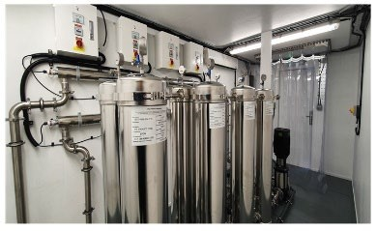

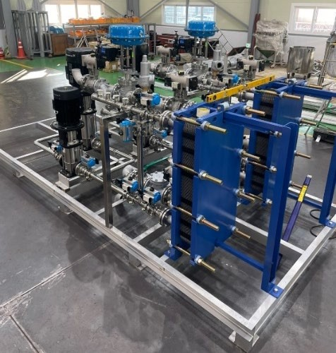
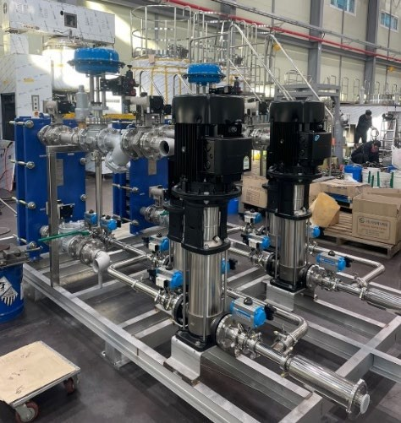
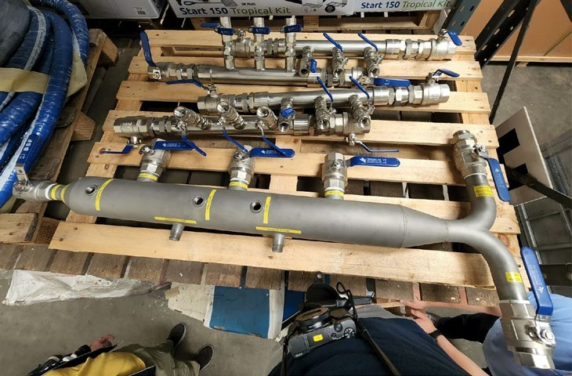

UV & filtration system
Manifolds
Heat exchangers and low-pressure pumps
Hygienic piping across the entire drill-water circuit

Slide 11
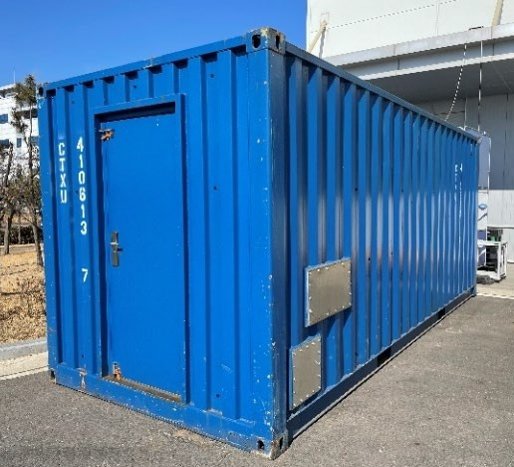
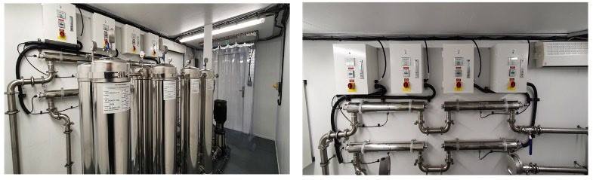
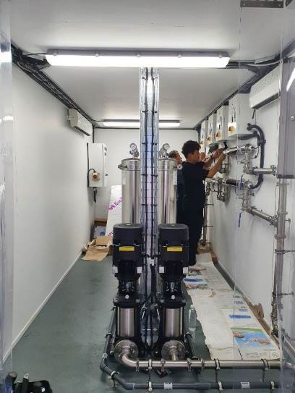
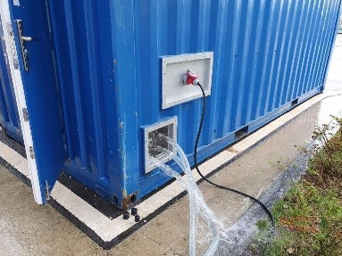
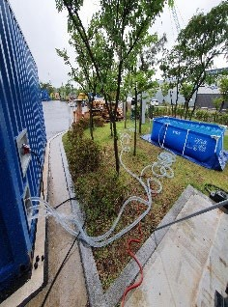
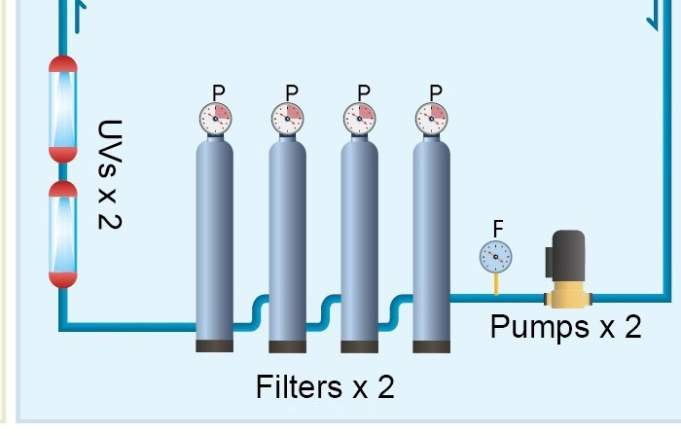


4-stage filtration (20, 5, 1, 0.1 μm)
UV lamps (185 nm and 254 nm with >40 mJ/cm²)
Operation testing
Containerized dual-mode UV & filtration system

Slide 12
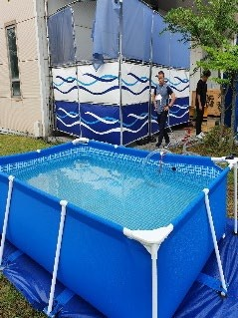
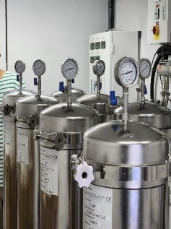
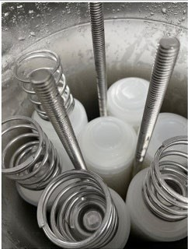
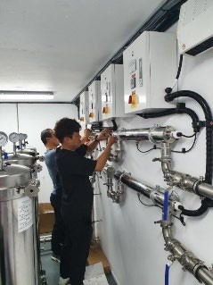

Initial (before filtration)
4-stage filtration (20, 5, 1, 0.1 μm)
UV lamps (185 nm and 254 nm)
 | Initial | 1st-filtration | 2nd-filtration | 3rd-filteration | 4th-filtration | UV
Turbidity (NTU) | 2.12 | 1.07 | 0.50 | 0.44 | 0.42 | 0.41
Total Coliforms/ml | 1,010 | 500 | 180 | 66 | 1 | 0

Slide 13
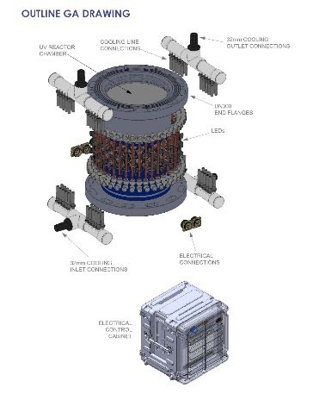
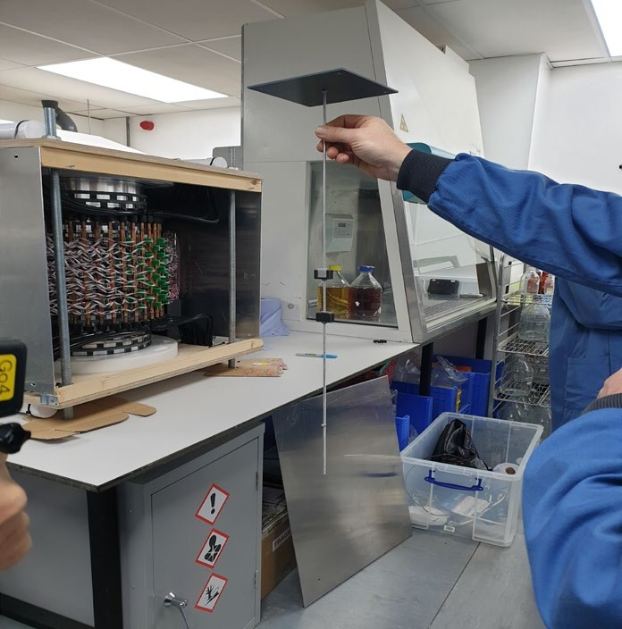
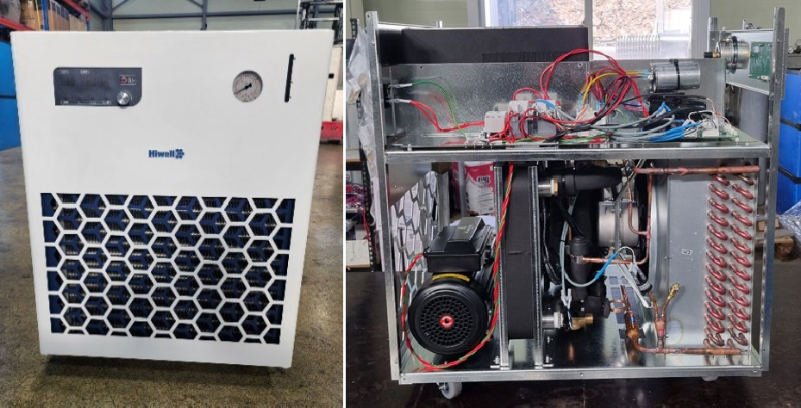
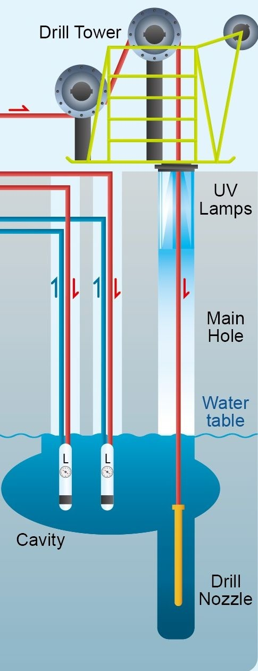

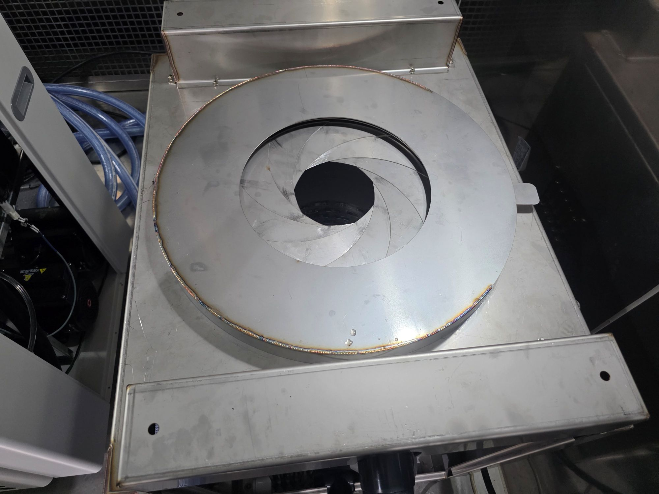
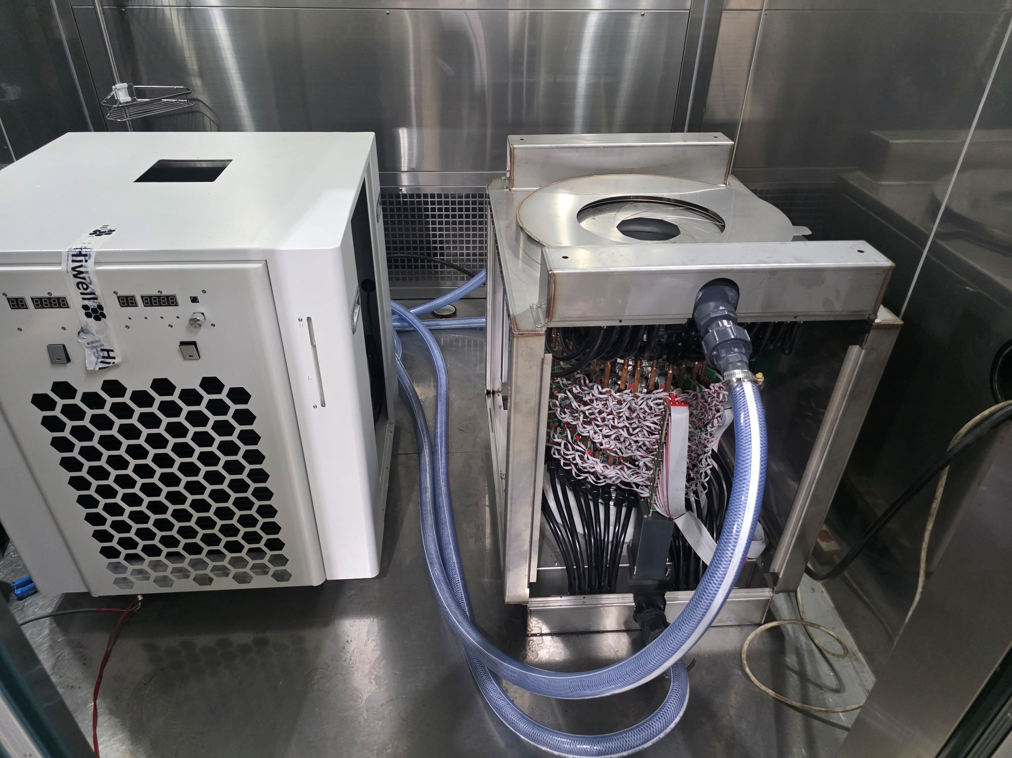
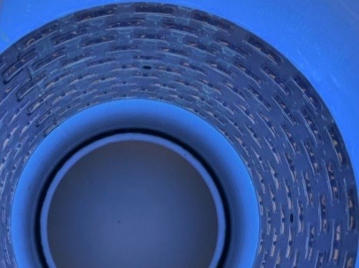
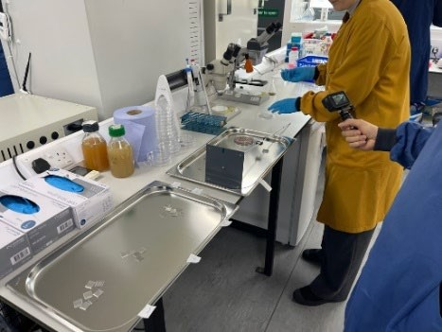

200-UV-LED collar with low- and high-dose modes
Air-cooled chiller for LED-UV collar thermal control

Slide 14


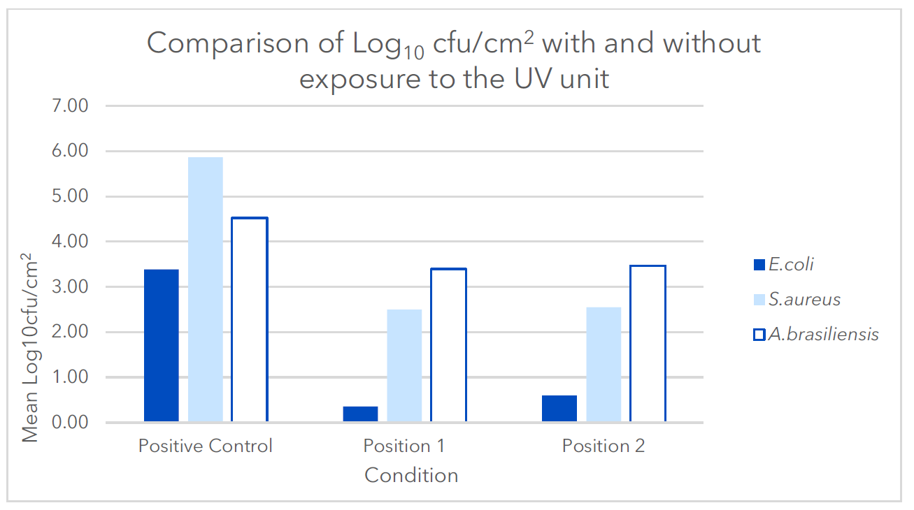

Test conditions:
a 44 mm diameter hose descending at 1 m/min
a 7 mm diameter cable descending at up to 80 m/min
E. coli: 3.03 log CFU/cm² (99.91% removal)
S. aureus: 3.37 log CFU/cm² (99.96%)
A. brasillensis: 1.13 log CFU/cm² (92.59%)
Low UV power: 3-log inactivation of microbes at 7 mm diameter cable descending at up to 20 m/min
High UV power: 3-log inactivation of microbes at 7 mm diameter cable descending at up to 80 m/min
position 1
position 2
disk inoculated with the test microorganisms

Slide 15







Vacuum insulated panel (VIP) system
Sampling
Microscopic observation
DNA-based detection of microbial contaminants
In the field:
Drill water and equipment surface swap sampling periodically
In a portable cleanroom laboratory:
Water filtering and DNA extraction
Fluorescent microscopy (or cell sorting via FACS)
Quantitative PCR (ddPCR)
in situ DNA sequencing via MinION Nanopore system
Metal-free laboratory with an entry air-shower
A portable Class 1,000 cleanroom laboratory with high- temperature insulation

Slide 16







Water sampler
Borehole measurement system
Sediment sampler
Drill hose jet wash cleaner
Nozzle + weight stack
Images were adapted from BAS
Class 100 cleanroom tent

Slide 17


2026/27 season
Operational testing of individual equipment at Jang Bogo Station
2027/28 season (~ 60 days)
Test drilling
2028/29 season (~ 60 days)
Seismic survey to investigate sediment structure (optional)
2,300 m drilling of Lake Cheongsuk

Slide 18


Mincheol Kim
mincheol@kopri.re.kr
2021.12. seismic survey camp at D2

