Slide 1
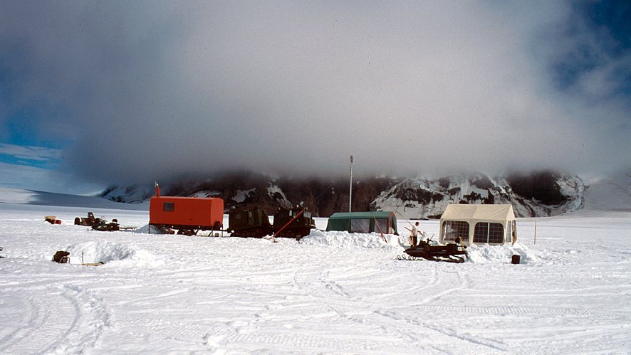
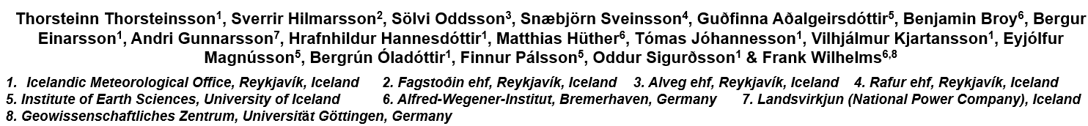
9th International Symposium on Ice Drilling Technology, Potsdam, Germany, September 14-20 2025
Challenges in ice core drilling on temperate ice caps

Slide 2
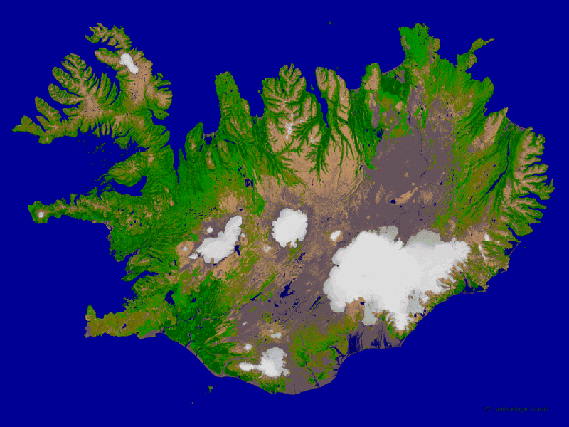
Ice core drilling sites in Iceland 1972-2002
Hofsjökull 2001: 100 m
Langjökull 1997: 70 m
Grímsvötn 2002: 115 m
Bárðarbunga 1972: 415 m

Slide 3
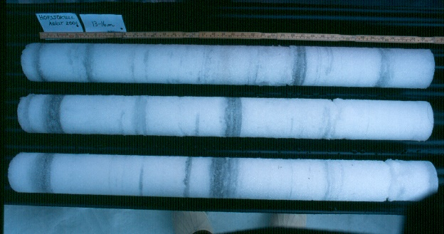
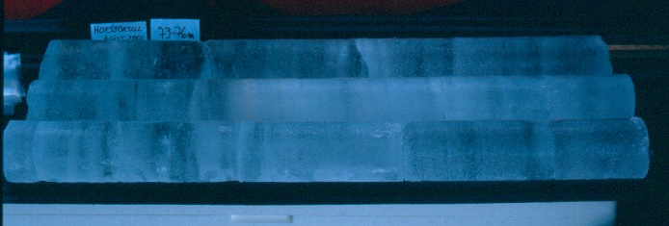
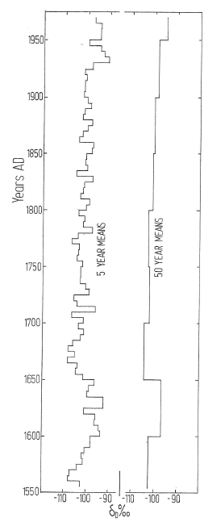
ICELAND – potential studies of ice cores
Core photos
Deuterium profile
from 400 m
Bárðarbunga ice
core, drilled 1972.
Interestingly, the
lowest δD values
are obtained in the
cold 2nd half of
the 17th century.
Full homogeni-
zation of the
record has not
occurred, even
though the ice
is temperate.
B. Árnason (1976)
16-19 m
73-76 m
δ¹⁸O: 0-20 m
δ¹⁸O: 60-80 m
100 m core from Hofsjökull 2001:
Late-summer dust peaks, allowing annual layer count constrained by
Hekla tephra layers 1980 and 1991.

Slide 4
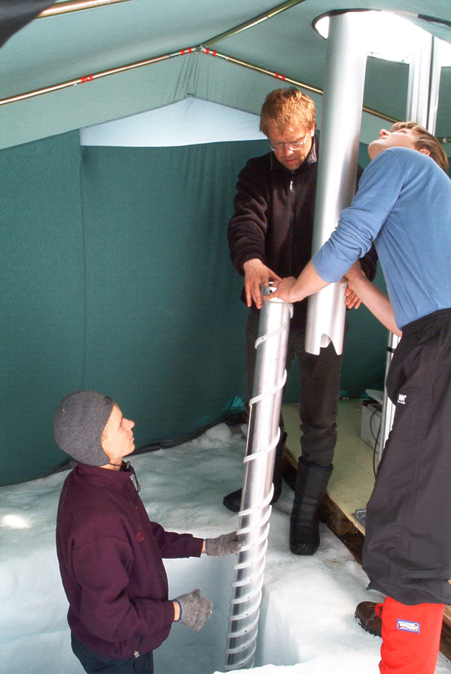
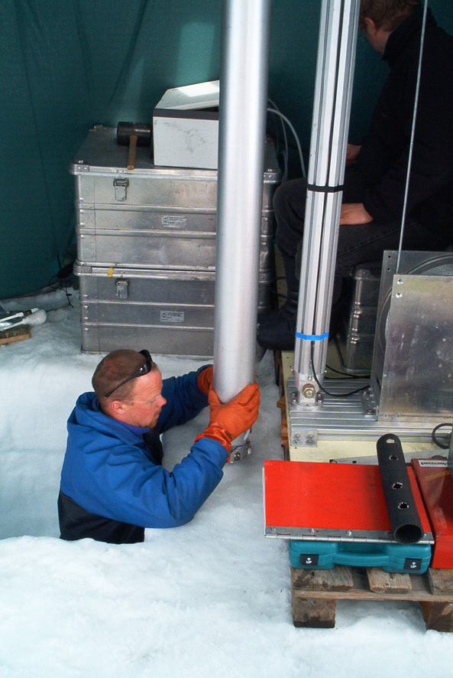
Grímsvötn drilling 2002
Foto: Karen Guldbæk Schmidt
Foto: Karen Guldbæk Schmidt

Slide 5
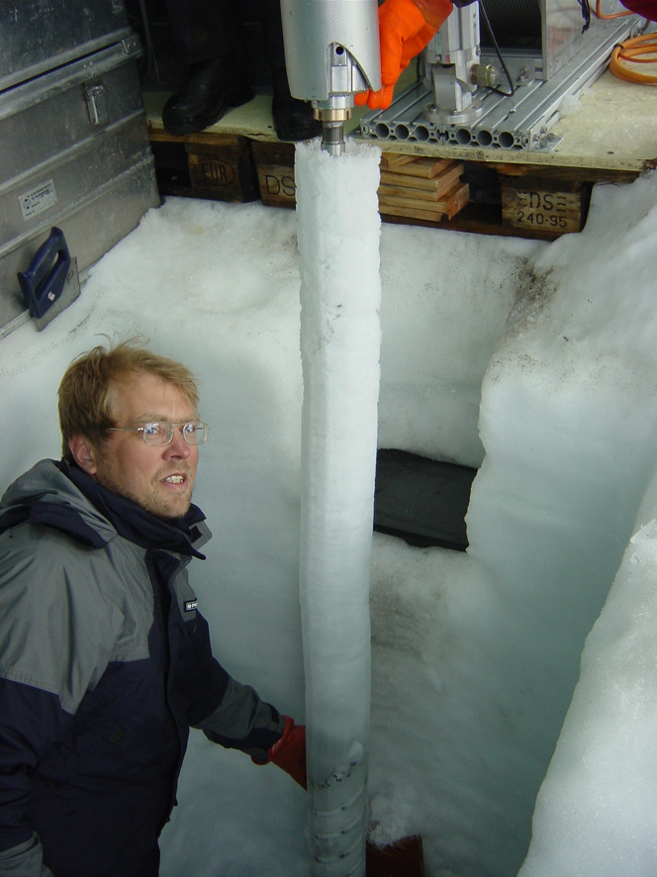
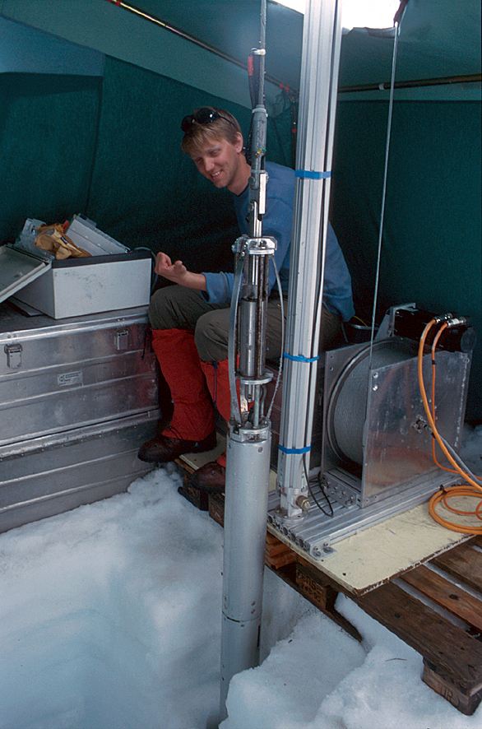
Full chips chamber after a successful run
Foto: Björn Oddsson

Slide 6
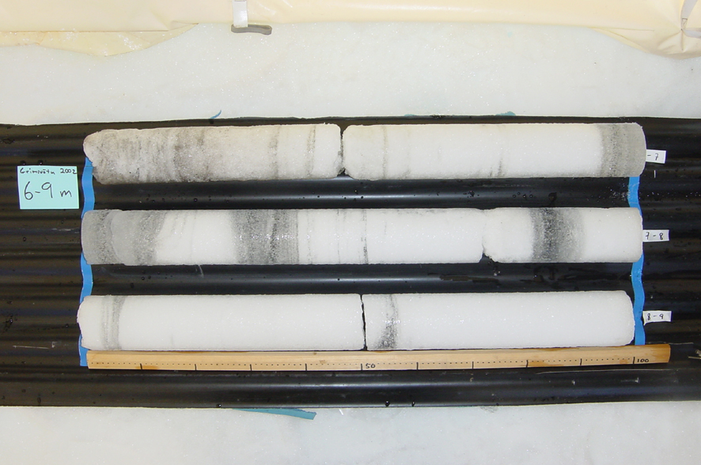
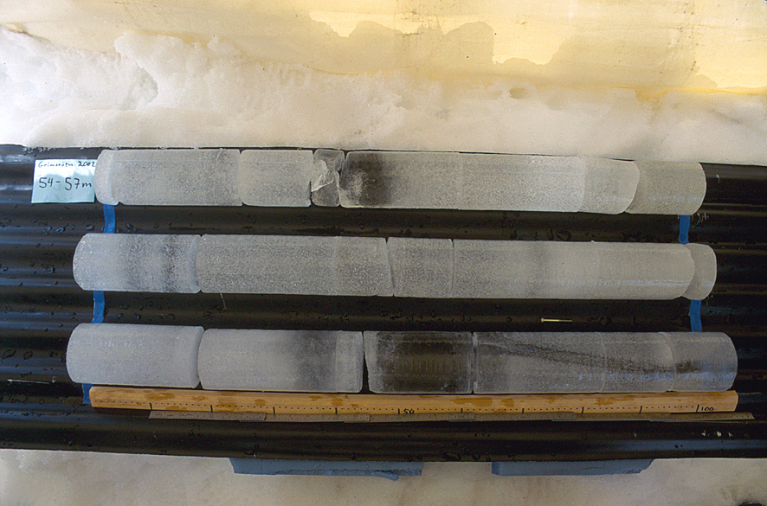
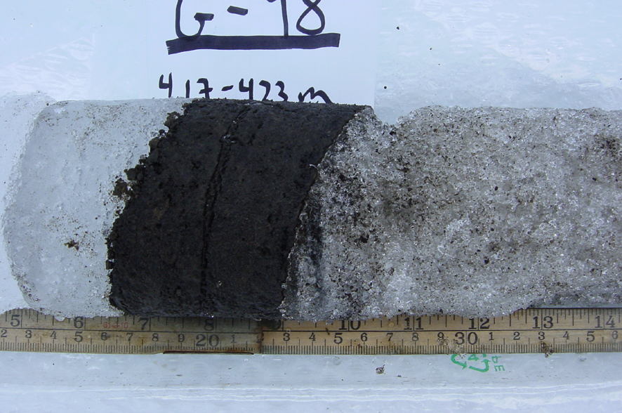
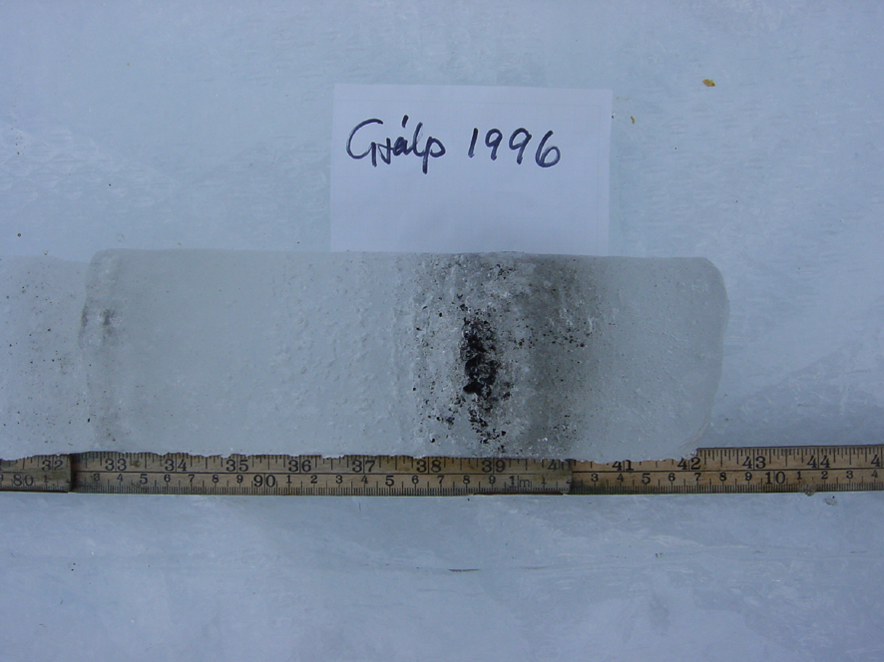
Grímsvötn ice cores
Foto: Björn Oddsson
Foto: Björn Oddsson
Foto: Björn Oddsson

Slide 7
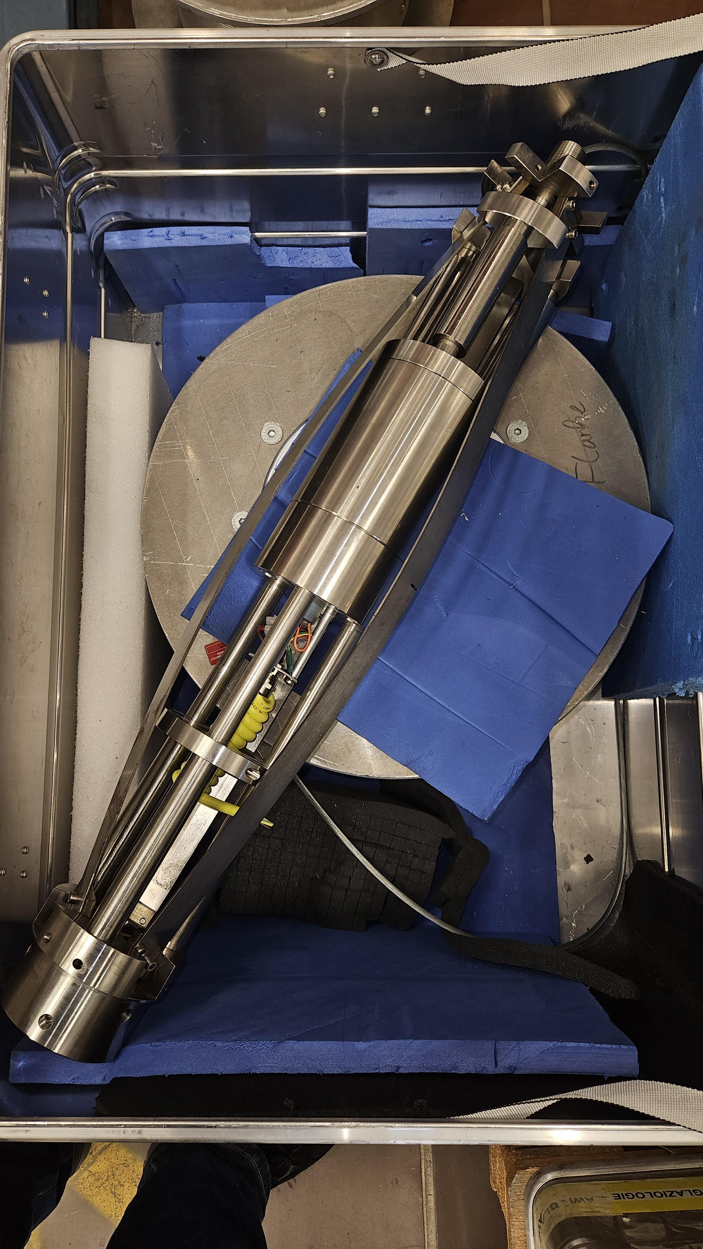
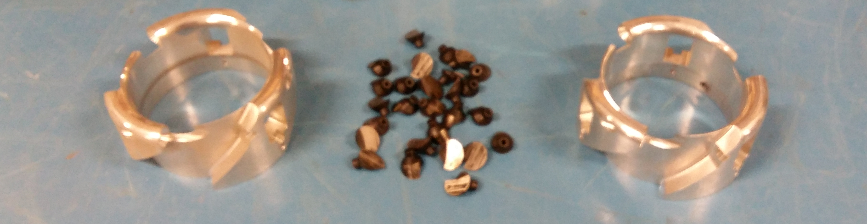
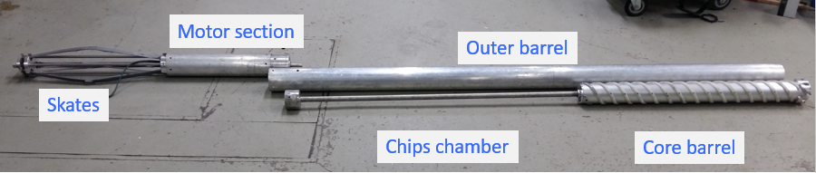
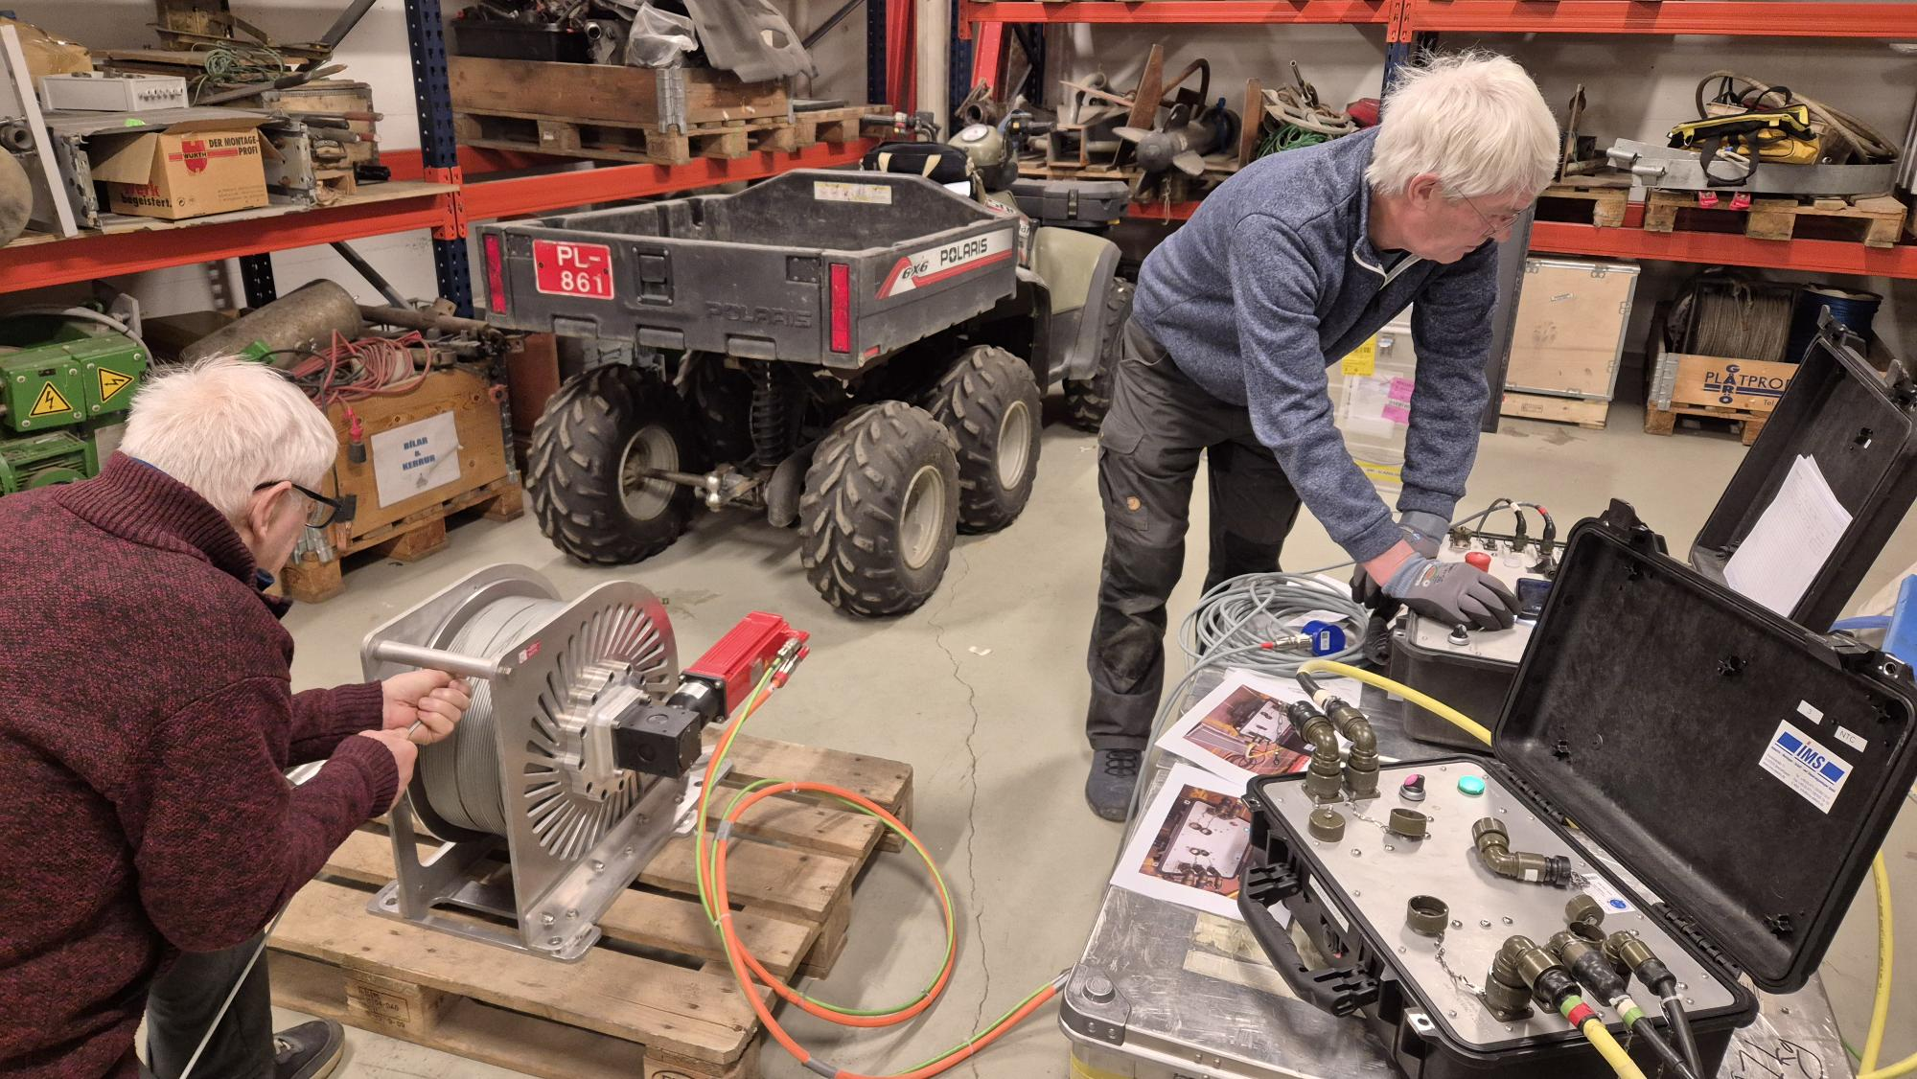
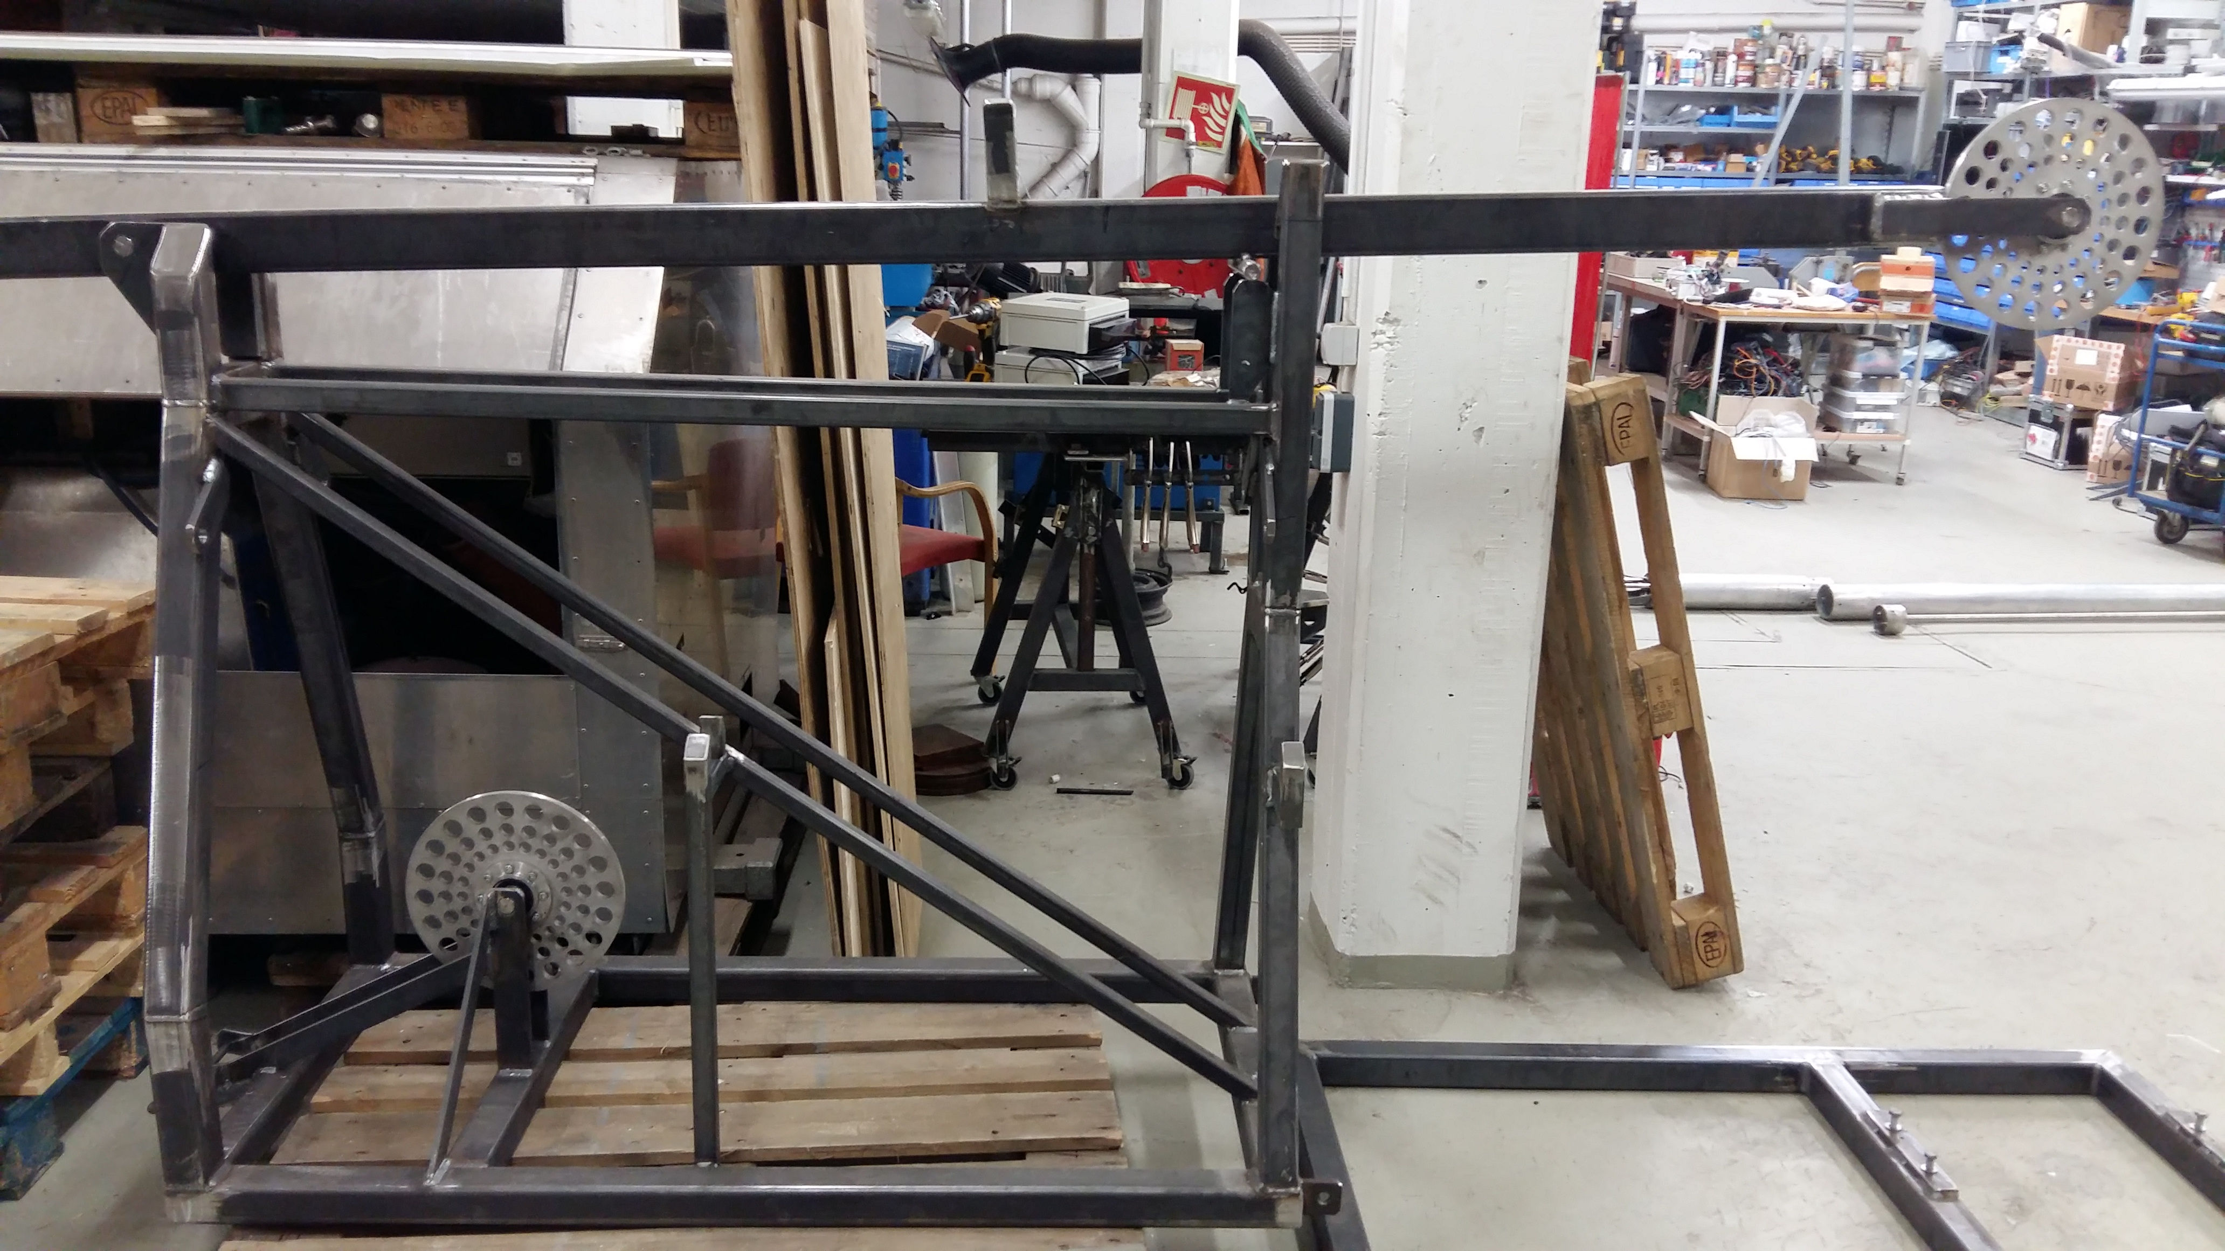
AWI Antitorque
ICELAND – Status of new shallow ice core drilling system
Drill essentially complete, testing ongoing
Drill heads and cutters
Testing the AWI winch
& control units
Replaced with anti-
torque from AWI
Side view of
drill tower
in horizontal
position

Slide 8
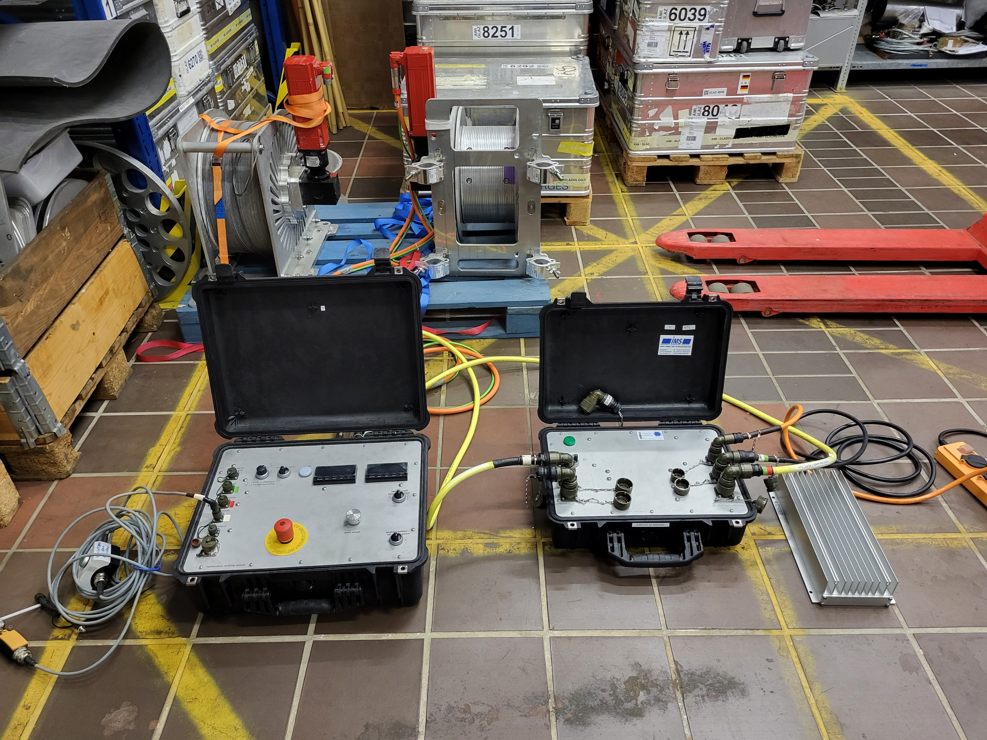

Slide 9
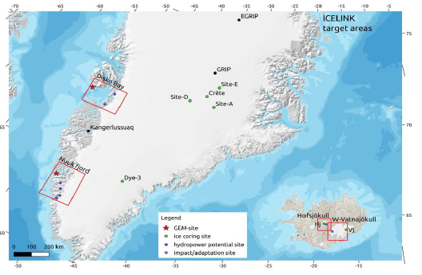
ICELINK
ICELINK WP 3: Historical Data
Firn/ice cores reaching back to the end of
the Little Ice Age:
Four shallow cores (40-60 m ) south of GRIP
Shallow core at Dye 3
~200 m core from Vatnajökull
Accumulation rates (ice equivalent thickness):
GRIP/Crete area: ~0.2 m/a
Dye 3 area: ~0.55 m/a
Central Vatnajökull: ~2.2 m/a
Greenland campaign 2026 (AWI and UCPH): Daily operations out of Kangerlussuaq, drilling and core logging
Additional sampling of uppermost 2m of snowpack
Analysis of Greenland cores: δ¹⁸O, ECM, CFA, density => accumulation rate and variations
Iceland campaign 2026 (VI,UI,collaborators): Annual Vatnajökull expedition (Icelandic Glacological Society)
This assumes that the drilling system will be ready for operations in 2026 (see next slide)
Analysis of Iceland core: Visual inspection, texture, dust measurements for annual layer identification,…

